Slide 1
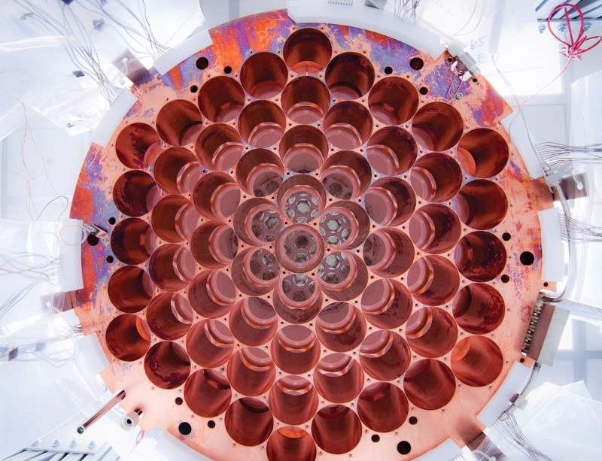
The Large Underground Xenon (LUX) Experiment
An Overview

Slide 2
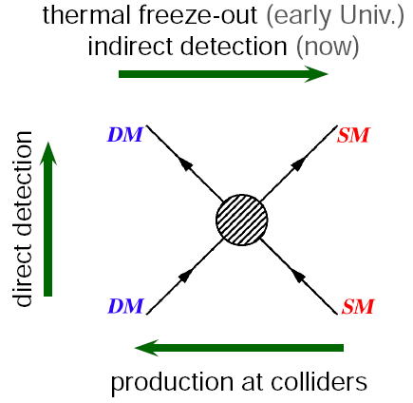
The Goal: Directly Detect Dark Matter
We theorize the existence of dark matter based on its gravitational effects. We currently have no other evidence of its existence, or its nature.
Through direct detection we hope to verify its existence (as opposed to modified gravity theories) as well as learn about its properties (mass, interaction strength, etc).
Direct detection is when a DM particle scatters off of a normal particle.

Slide 3
The candidate: WIMPs
The leading candidate for dark matter is a particle called the WIMP.
WIMP stands for Weakly Interacting Massive Particle, so called because it interacts only via the weak force and via gravity.
This is because in order to get the correct amount of dark matter out of the big bang in the simplest models requires a particle with a self interaction cross section at the weak scale.
WIMPS are expected to have mass in the 100GeV range. This makes Xenon an ideal detection medium, having mass ~120GeV.

Slide 4
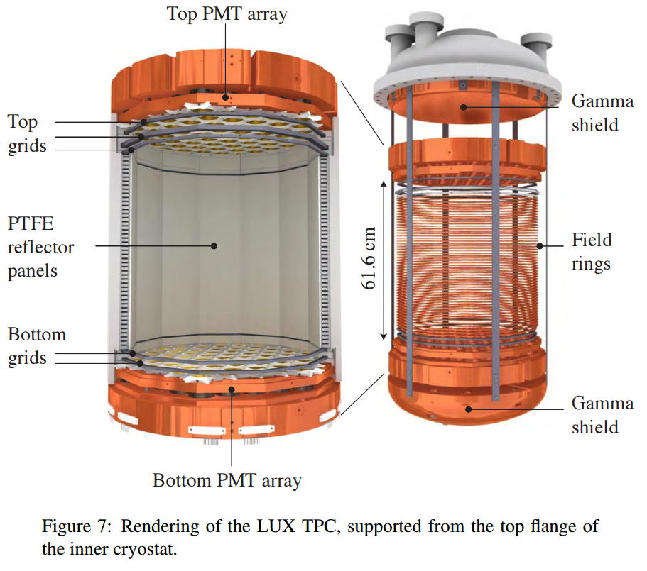
The Detector: LXe TPC
Teflon Vessel containing liquid and gaseous Xenon
PMT arrays at the top and bottom
Biased wire grids provide electric field

Slide 5
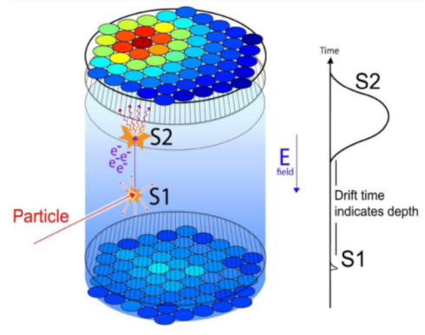
The Signal: Scintillation and Electroluminescence
Interactions produce both excited Xe molecules (Xe₂*), and Xe ions (Xe⁺).
  Xe₂* relaxes to produce scintillation (S1) (175 nm photons).
  e⁻ from ionization can do two things:
    recombine to form Xe₂*, then scintillate
    or drift to the surface and cause electroluminescence (S2) in the gas (the e⁻ further excite Xe gas and that scintillates)
The pattern of light on the PMT arrays along with the delay between the S1 and S2 signals tell us where the event took place.

Slide 6
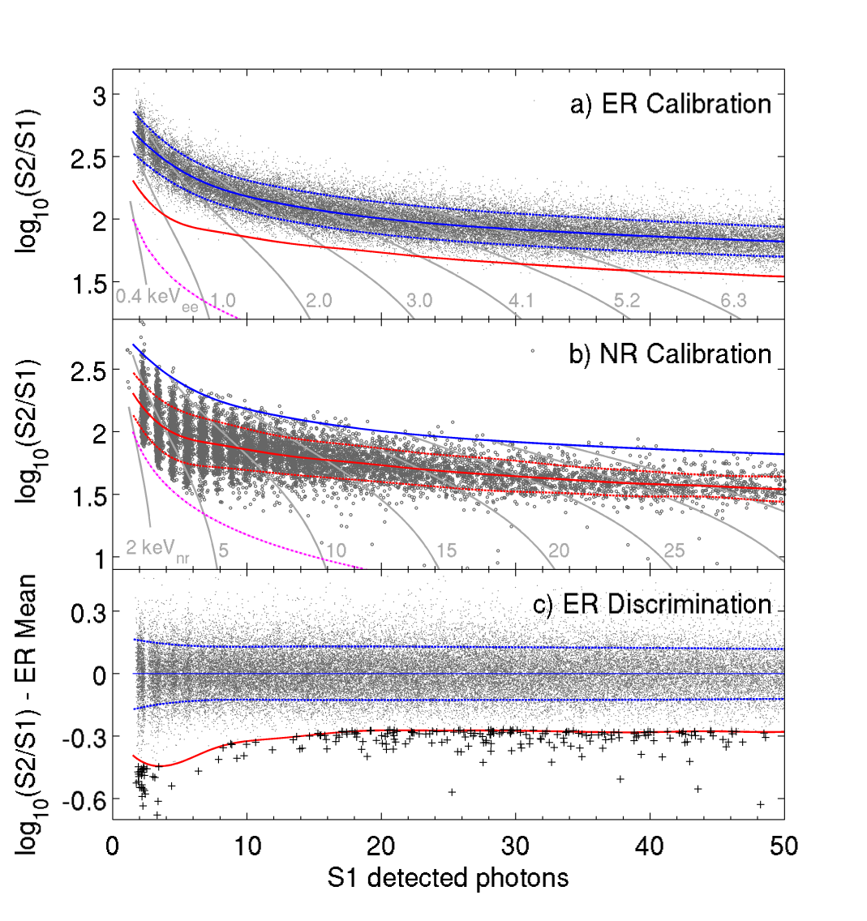
Signal Types: Electron vs Nuclear recoils
Charged particles and photons produce electron recoils.
Non-charged particles (like WIMPS and neutrons) produce nuclear recoils.
Electron recoils result in more ionization than nuclear.
Because of this, their S2/S1 ratio is higher which can be used to distinguish between them.

Slide 7
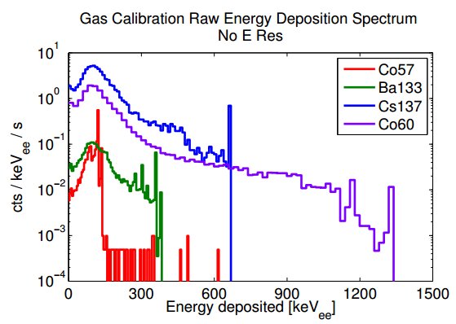
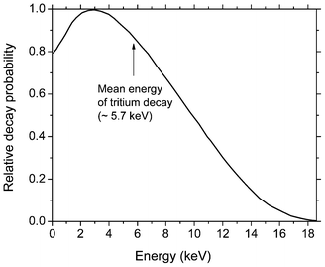
Calibration: Electron Recoil
External Source Spectra
We use a range of γ-ray sources to determine the shape of the ER band. Most of these are deployed externally and only penetrate the outer edge of the detector.
Two sources are injected directly:
  Tritium (³H) in the form of CH₃T - a β source at < 18.6 keV (mean e⁻ energy of 5.7 keV)
  ^{83m}Kr - A metastable excited state of Krypton which emits two γs at 41.6 keV and 9.4 keV.
Tritium β Decay Energy
http://i1.wp.com/physicsopenlab.org/wp-content/uploads/2016/02/trizio.gif

Slide 8
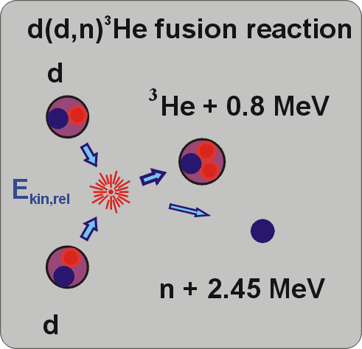
Calibration: Nuclear Recoil
We use a Deuterium-Deuterium (DD) neutron generator to map out the NR band.
The neutrons are monoenergetic with 2.45 MeV kinetic energy.
This creates a energy deposition spectrum out to ~74 keV, covering the expected WIMP region.
http://www2.mpq.mpg.de/lpg/research/neutrons/neutrons.html

Slide 9
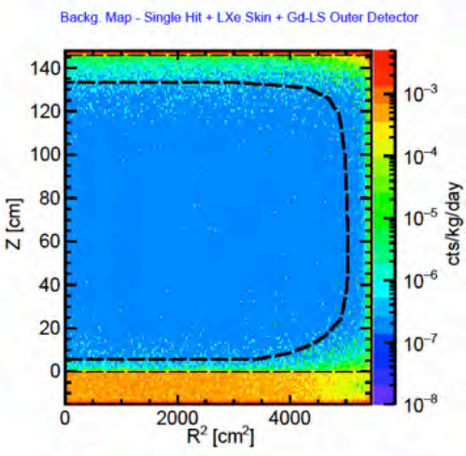
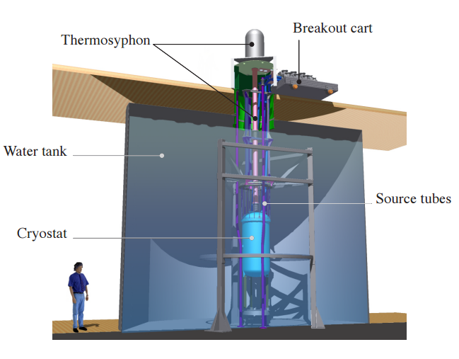


Backgrounds:
We mitigate the background from cosmic rays by retreating underground to the 4850’ level at the Sanford Underground Research Facility in Lead, SD.
The ground is also radioactive, however, so we need a water tank to shield against radiation from the cavern walls.
The detector components themselves also emit radiation so we only use the innermost portion of the Xe to look for WIMPs.

Slide 10
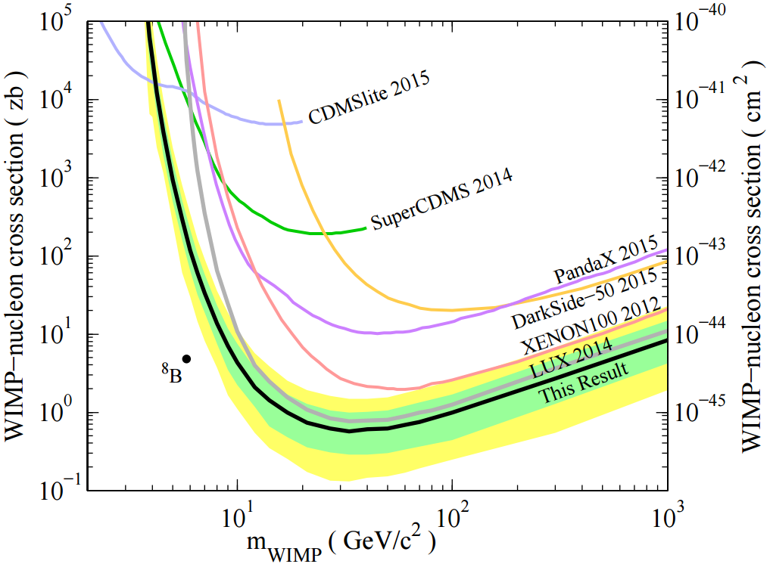
Results & Progress
Our first real search was a 90 day run (called run03). Which produced the best spin independent limit at that time.
After the fact, we refined calibrations and analysis techniques and produced a new limit with the same data from Run03 which we call the “Run03 Reanalysis” which is the current leading spin independent limit.
Run04 is an additional 210 live-day run that just finished earlier this month.
We are in the process of final calibrations and analysis of this data.

