Slide 1
AmBe Neutron Sources
August 9, 2016
1

Slide 2
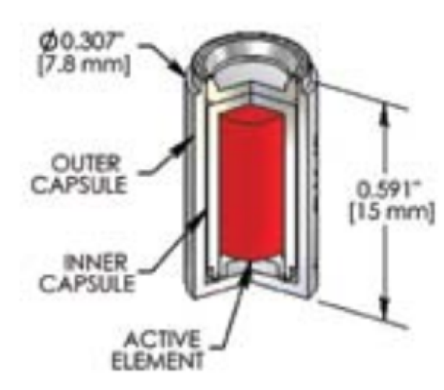
Physical Make-up
Uses the Americium 241 isotope in oxide form mixed with Beryllium which is contained within a double-encapsulated stainless steel canister.
Has an output of 74 MBq’s or about 5000 n/s
Emits neutrons isotropically
Relatively simple/robust design
2

Slide 3
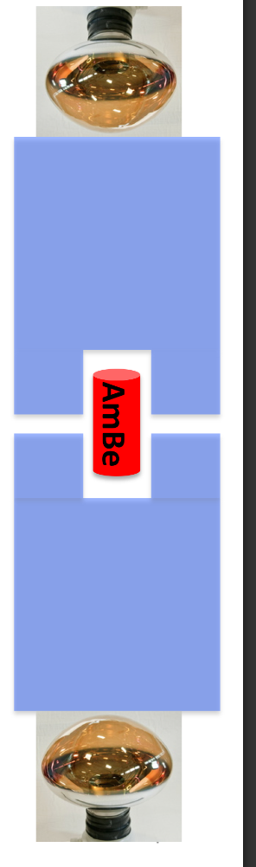
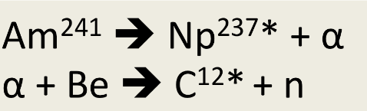
“Tagged” Source
A 4.4 MeV gamma ray is produced from the de-excitation of the carbon atom.
This gamma ray is absorbed by a sodium iodine crystal surrounding the source which then re-emits it as 415 nm light
Photomultiplier tubes then detect this light which is used to “tag” a neutron being emitted.
NaI
NaI
3

Slide 4
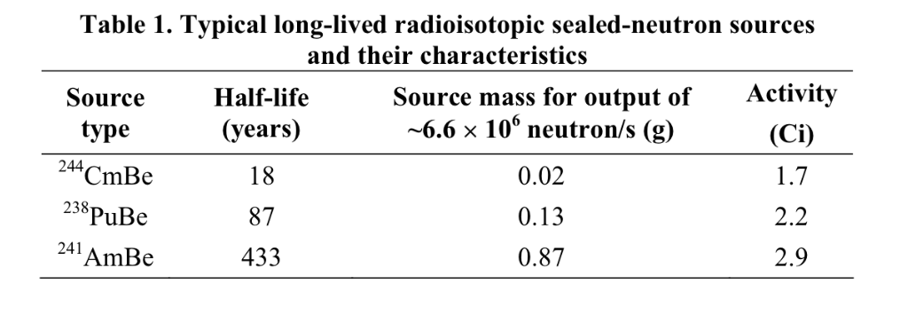
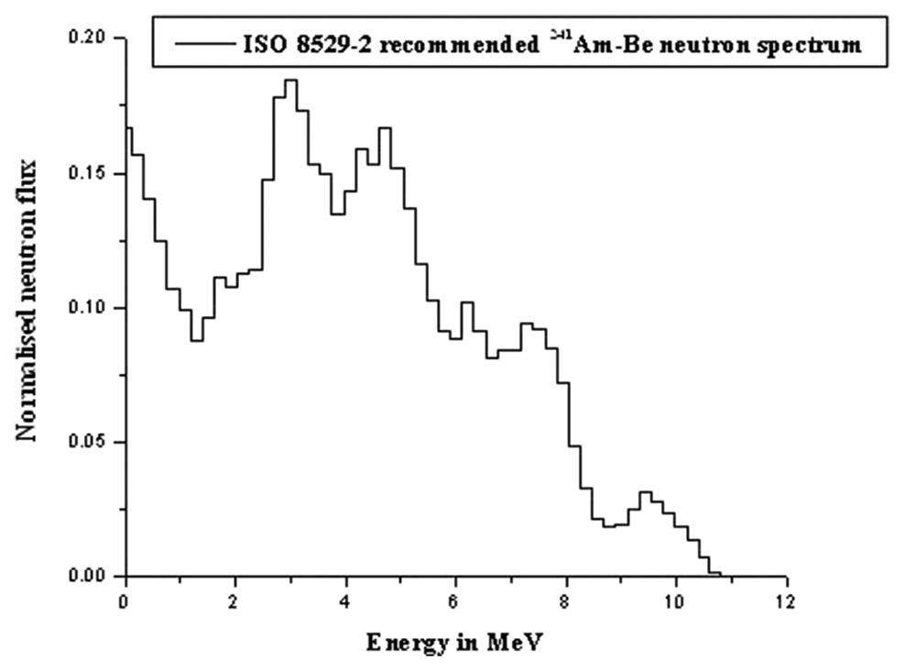
4

Slide 5
Underground update
Hooked up the condenser to the purification system and ran argon through the new piping and condenser.
Connected the output of the condenser to the inlet of the inner vessel.
Plan to start using the condenser on Thursday and hopefully keep it running for the entire week.

