Slide 1
Radiation Driven Inflation
Ilya Gurwich and Aharon Davidson
Physics department
Ben-Gurion University
Aharon Davidson and I.G., JCAP06(2008)01

Slide 2
Outline
Introduction
Brane gravity
Unified brane gravity
Unified Brane cosmology
Inflation
Radiation Driven Inflation
Permanent inflation
Finite inflation
Fluctuations (current and future research)
Summary

Slide 3
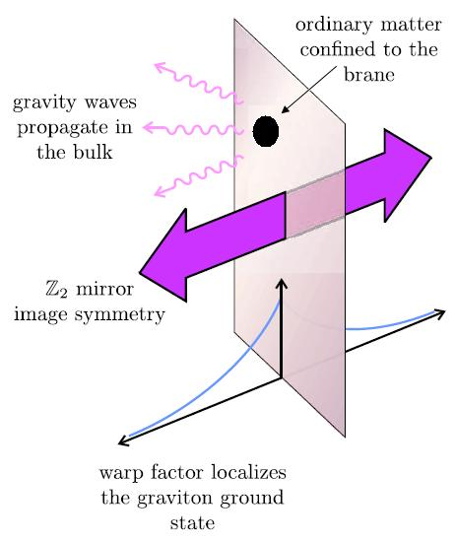
Brane Gravity
Randall-Sundrum II (RS) scenario: GR is recovered at large scales / low energies.
L. Randall and R. Sundrum, Phys.Rev.Lett.83:4690 (1999).
Dvali-Gabadadze-Poratti (DGP) scenario: GR recovered at small scales / high energies + vDVZ anomaly.
G.R. Dvali, G. Gabadadze and M. Porrati, Phys.Lett.B485:208 (2000)
Collins-Holdom (CH) scenario = RS+DGP: GR is recovered at all scales + no vDVZ anomaly.
H. Collins and B. Holdom, Phys.Rev.D62:105009 (2000).
H. Collins and B. Holdom, Phys.Rev.D62:124008 (2000).

Slide 4
Dirac’s Brane Variation
“a tiny deformation of the brane corresponding to the brane being pushed a little to the right will not be minus the variation corresponding to the brane being pushed a little (equally) to the left, on account of the left and right bulk sections not being a smooth continuation of each other”
P.A.M. Dirac, Proc.Roy.Soc.London A268:57 (1962)
Do today’s brane theories respect Dirac’s prescription for consistent brane variation?

Slide 5
Dirac’s Variation: Example
A simple example – Snell’s law.
h
y
D. Karasik and A. Davidson, Class.Quant.Grav.21:1295-1302 (2004)

Slide 6
Geodetic Brane
We can get a clue that there is something wrong with the current formalism by looking at the limit of no bulk gravity.
Under this condition we should get the Regge-Tietelboim / Cordero-Vilenkin (stealth brane) model:
T. Regge and C. Tietelboim, in Proc. Marcel Grossman (Trieste) 77 (1975)
R. Cordero and A. Vilenkin, Phys.Rev.D65:083519 (2002).

Slide 7
Unified Brane Gravity
The Action:

Slide 8
Unified Brane Gravity
The Variation:
Variation with respect to the normal.
Variation with respect to the brane metric.
Variation with respect to the 5-dimensional metric.
Variation with respect to the 5-dimensional metric on the brane.
Dirac’s variation is implemented:

Slide 9
Unified Brane Gravity
The general variation:
In the usual scenario, the general variation has all the 15 degrees of freedom and thus “consumes” the general coordinate transformation degrees of freedom.
However, on the brane, if general variation is permitted, the brane's location is changed during the variation, violating Dirac’s linearity of the variation.
On the brane:

Slide 10
Unified Brane Gravity
Dirac
An effective 5D energy-momentum of the brane that includes both matter and gravity. For CH it is 0, however, in the more general case, it has no components in the acceleration direction (Analogue to the geodesic equation) and is conserved.
A. Davidson and I.G., Phys.Rev.D74:044023 (2006)
CH limit
RS limit
DGP limit
RT/CV limit

Slide 11
Unified Brane Cosmology
General cosmological embedding
General radially symmetric 5-dimensional metric
On the brane
The embedding

Slide 12
Unified Brane Cosmology
Example(RS)
Example(DGP)
embedding
ω is the “embedding energy” of the brane.
If ω is 0, we return to the familiar CH (RS and DGP) brane cosmology.

Slide 13
Example: RS Cosmology from UBC

Slide 14
Example: DGP Cosmology from UBC

Slide 15
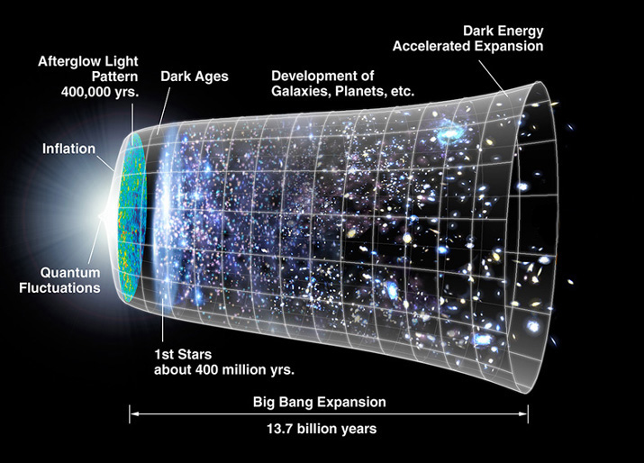
Inflation and Brane Inflation - from a critics view
Inflation is a mandatory element of theoretical cosmology – It resolves multiple problems: horizon, flatness and unwanted relics.
Following the recent precision cosmology measurements of WMAP, inflation is now an essential component of experimental cosmology as well.

Slide 16
Inflation and Brane Inflation - from a critics view
However…
The mechanism for inflation is unknown. Suggested mechanisms often suffer from:
sensitivity to initial conditions (this throws away the purpose of inflation).
No physical basis (solutions that are “engineered” to generate inflation rather than follow from a physical theory).
The scalar fields are non-renormalizable.

Slide 17
Inflation and Brane Inflation - from a critics view
However…
The mechanism for inflation is unknown. Suggested mechanisms often suffer from:
sensitivity to initial conditions (this throws away the purpose of inflation).
No physical basis (solutions that are “engineered” to generate inflation rather than follow from a physical theory).
The scalar fields are non-renormalizable.
The popular scalar field approach is an excellent way to study fluctuations, but is not a viable mechanism. Replacing the arbitrary H(a) in cosmology with the arbitrary V(φ) scalar potential is not giving an answer but rather rephrasing the question.

Slide 18
Inflation and Brane Inflation - from a critics view
Despite its apparent simplicity, inflation is not easy to generate properly. Inflation must provide:
An exit mechanism.
Enough e-folds.
Sufficient reheating (particle creation).
All that without contradicting the known particle physics.
This is very hard to do in the framework of GR.
So, is inflation really generated by an exotic scalar field?
Or, can we find a natural mechanism for inflation outside GR?

Slide 19
Permanent inflation in UBC
Permanent inflation (= de Sitter space) requires ξ=const.
This dictates:

Slide 20
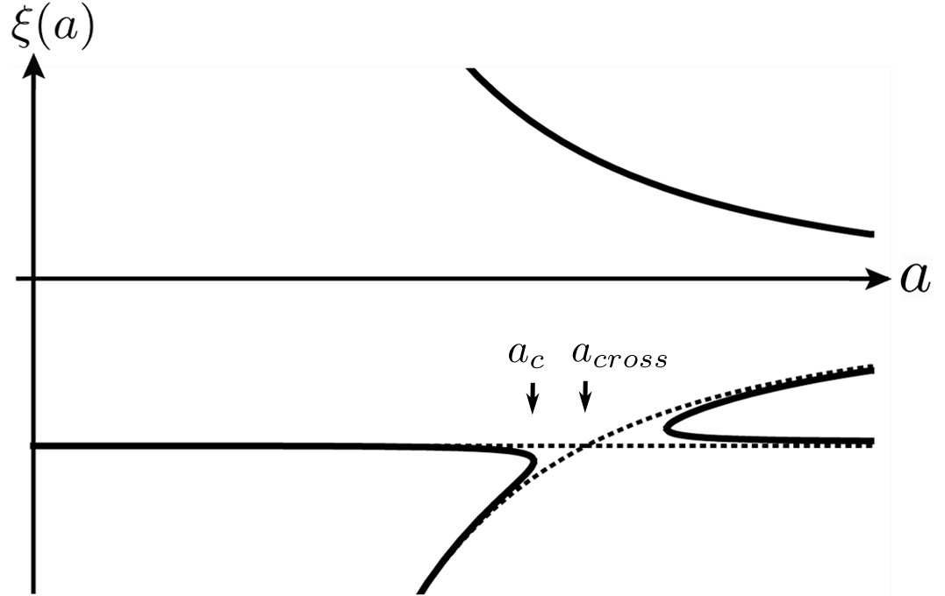
Cosmological Phase Transition
The solution in hand cannot be eternal. The cosmological cubic equation reveals a phase transition.
If , inflation will end at a point, almost independent of the amount of deviation.
We choose
To ensure the exiting universe has a zero cosmological constant (a good approximation for the small cosmological constant in our universe).

Slide 21
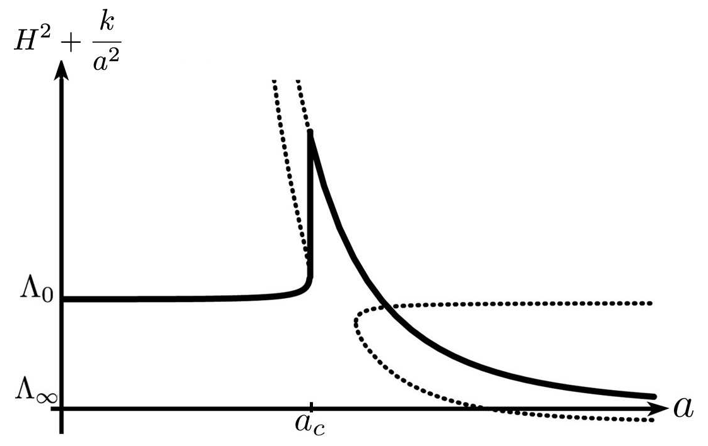
Radiation Driven Inflation
The full solution exhibits a “hysteresis like” behavior.
Exiting to a radiation dominated universe via a phase transition that is accompanied by a finite jump in the Hubble constant.
The behavior is reminiscent of the λ-transition in liquid helium.
Approaching the transition

Slide 22
Radiation Driven Inflation
Defining the dimensionless constant:
We can calculate the number of e-folds:

Slide 23
Radiation Driven Inflation
The apparent singularity is smoothened by the quantum fluctuations.
The RDI model predicts a huge momentary jump in the Hubble constant. This could have an interesting and measurable effect on the CMB fluctuations.
The affect on the CMB could be model independent and thus have a research appeal beyond the specific model.

Slide 24
Fluctuations of RDI
Warning: Preliminary!!!
Warning: Preliminary!!!
In the critical case ( ) and assuming the radiation consists only of photons (so that exactly),
. Any deviation will lead to slightly different values.
The phase transition is smoothened, so that there is no real singularity.
In a simplified model the smoothening can be described as a locally “more advanced” cosmological evolution, so that the phase transition starts earlier when nearing a positive perturbation.

Slide 25
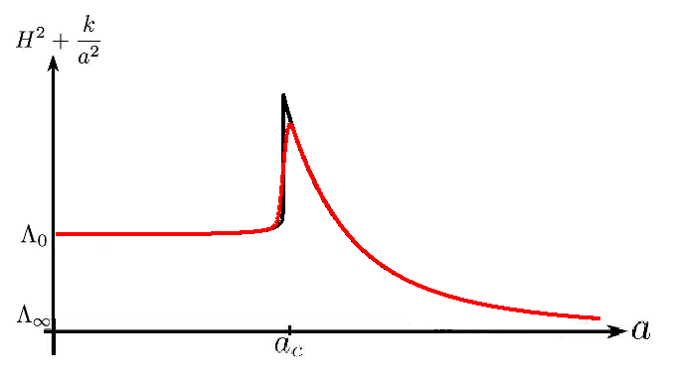
Fluctuations of RDI
Warning: Preliminary!!!
Warning: Preliminary!!!
No fluctuations
With fluctuations
The singularity disappears and we are left with a point in time with very high .

Slide 26
Summary and Future Directions
We present a natural, no fine-tuning, mechanism for cosmic inflation.
Fluctuation are under research.
The radiation driven inflation predicts a finite jump in the Hubble constant, that can have unique affects on the CMB and maybe interesting even model-independently.
Possibly, fluctuations can be studied experimentally, using liquid helium (not without precedent)
D.I. Bradley et al. Nature Phys.4:46 (2008)

Slide 27
Thank You
End

