Slide 1

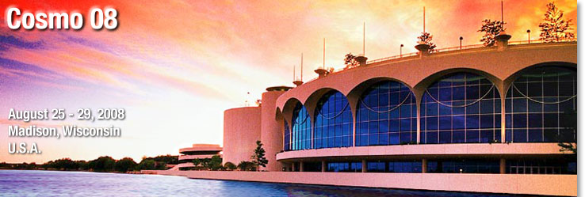
Can dark energy have a color?
Dejan Stojkovic
SUNY at Buffalo

Slide 2
Motivation
Puzzles raised by the recent
observational data:
  Dark Matter Problem
  Dark Energy Problem
Concentrate on the Dark Energy Problem
Many explanations proposed
Still far from the satisfactory solution

Slide 3


Outline
Introduction
Question:
Can Dark Energy carry gauge charges?
Proposal: acceleration is driven by the phase transition is which SU(3)_{c} symmetry is breaking
Dark matter can NOT carry gauge charges!
Dark Energy can!

Slide 4
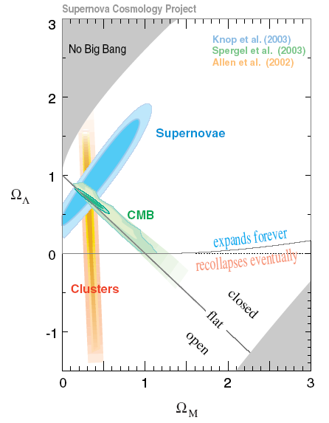
The standard model of cosmology
The Standard Cosmological Model

Slide 5
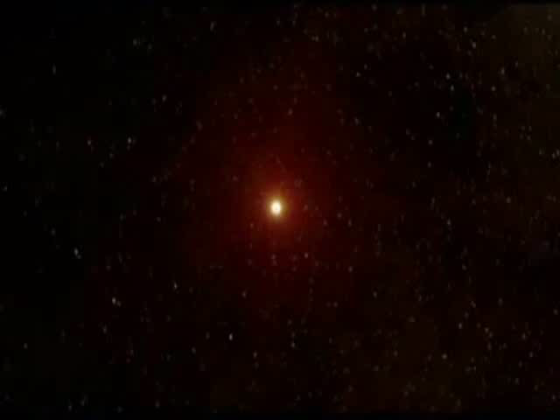
The standard model of cosmology

Slide 6

The bad news!
95-96% of the content of the
Universe seems to be missing

Slide 7
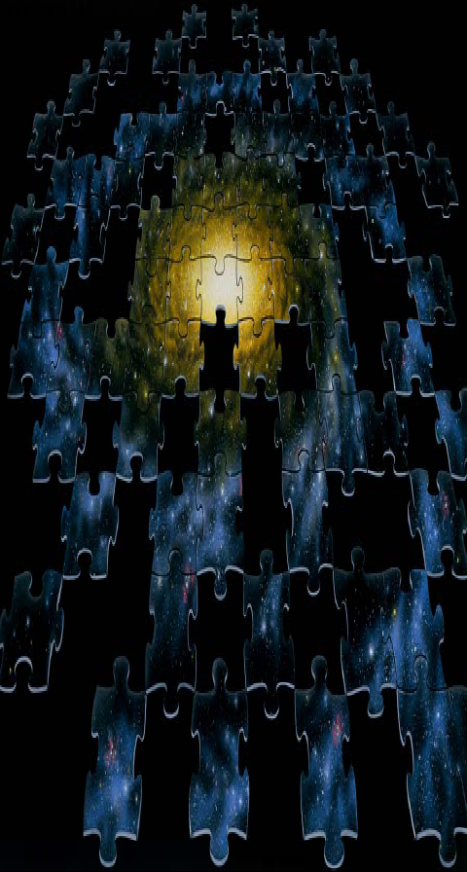
The dark matter puzzle
(credit Rocky Kolb)

Slide 8
Dark Energy Puzzle
Our Universe is accelerating!

Slide 9
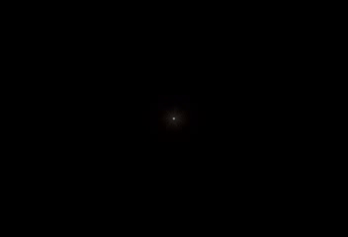

Slide 10

Dark Energy Comprises 72% of Universe
“Normal Matter”
4-5%
Dark Energy
72-73%
Dark Matter
23%

Slide 11
Dark energy -
Cosmological constant?
Something else with the
constant energy density Ω_{Λ}
Minimal solution: vacuum energy density
This energy drives an accelerated expansion

Slide 12
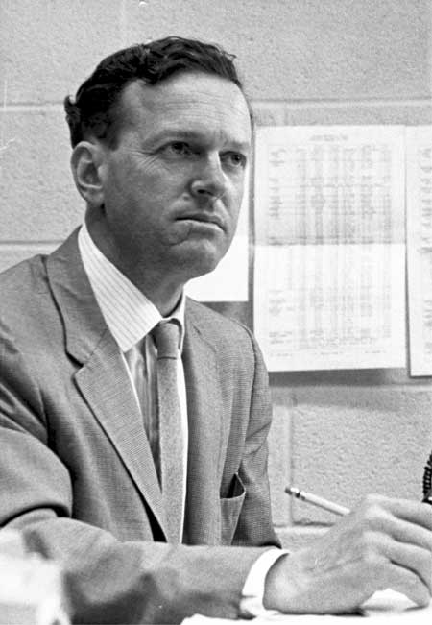
What is cosmological constant?
“For every complex natural phenomenon there is a simple, elegant, compelling, wrong explanation.”
Tommy Gold – astronomer from Cornell
(credit Rocky Kolb)

Slide 13
What is cosmological constant?
Guess #1: Gravitational vacuum energy density
Problems:
Quantum gravity effects not fully understood
Huge discrepancy between the prediction and observation

Slide 14


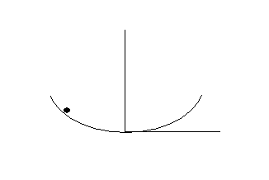
Guess #2: Scalar field vacuum energy density
aka quintessence
ρ

Slide 15
Guess #3: Modified Gravity Models
aka f(R) models
ρ

Slide 16
Guess #4: K-essence
ρ

Slide 17

Guess #5: Brane World Models
In particular: DGP model
ρ

Slide 18
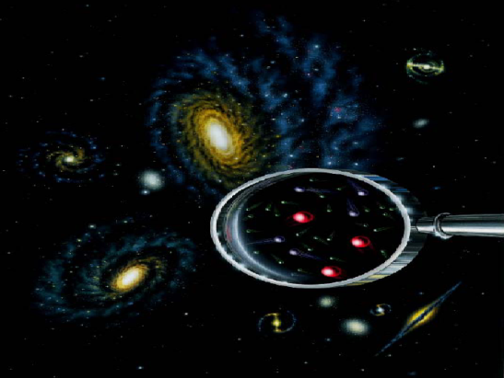
Our proposal
D.S., G. Starkman, R. Matsuo, PRD (2008)
We do not solve the CC problem!
A mechanism that can explain cosmological acceleration
And yet can be tested in future collider experiments
Does not require symmetries and fields
decoupled from the rest of the Universe

Slide 19
Analogy with primordial Inflation
In its history, our Universe already had a period of acceleration:
Primordial Inflation !
Imagine you were living ~ 1 Hubble time after
the onset of primordial inflation, at t ~ 10⁻³⁵ sec
If you were very smart to figure out that M_{GUT} ~ 10¹⁵ GeV
You would conclude that there is a phase transition going on
right now that is driving accelerated expansion of the Universe
Imagine that something similar is happening NOW!
(credit Josh Friemann)

Slide 20
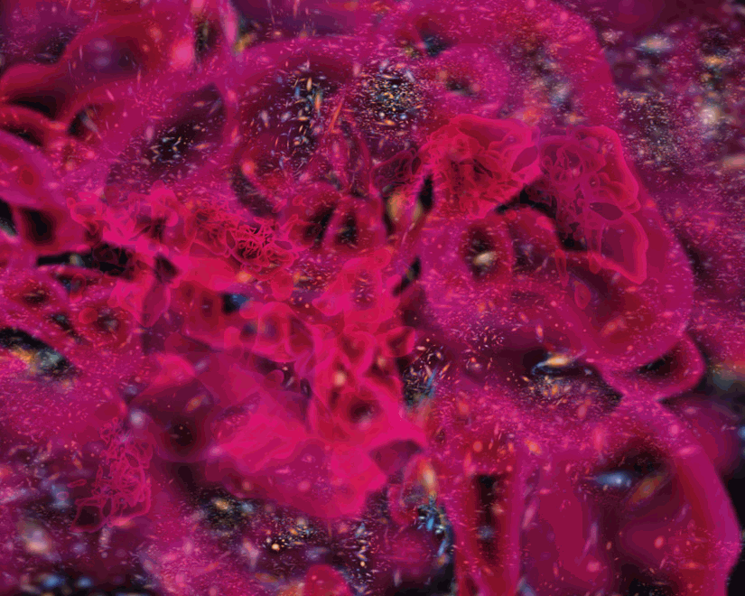
Interesting question: what symmetry is being broken right now
Obviously, one can always invent a new symmetry
decupled from the rest of the Universe
Instead, the most interesting possibility is that one of the only
two remaining gauge symmetries SU(3)c or U(1)EM is breaking
Artistic view of a universe filled by
a turbulent sea of dark energy
Dark energy has a color!

Slide 21
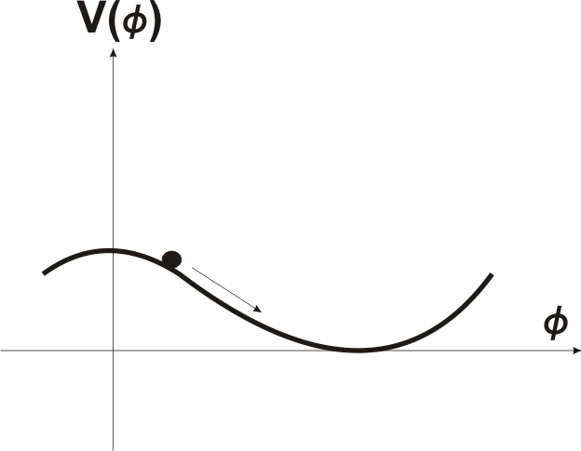
Second order phase transition
in which SU(3)_{c} is breaking
Suffers form all shortcomings of quintessence models
Very light colored scalar field
Rolling down its potential
+
Very difficult to hide the light
colored scalar field

Slide 22
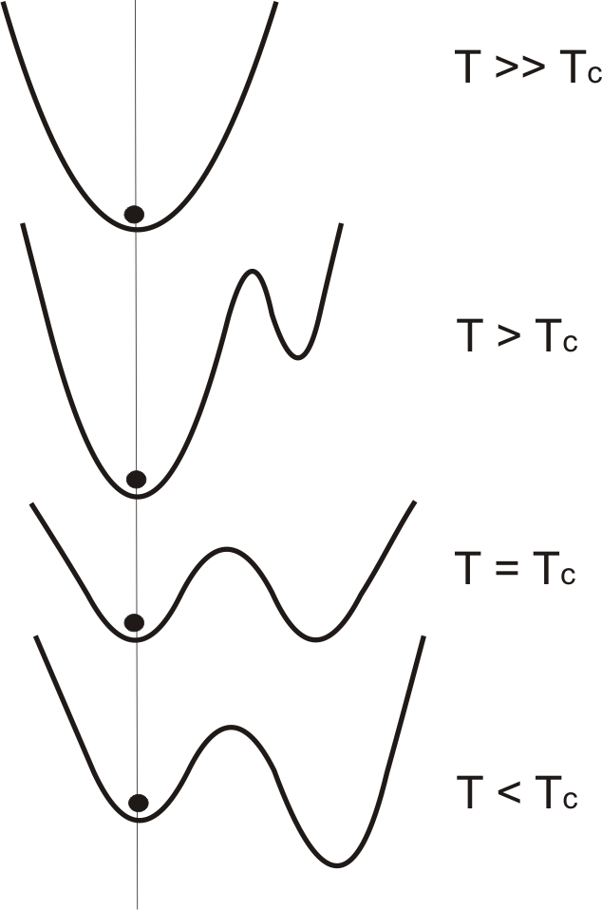
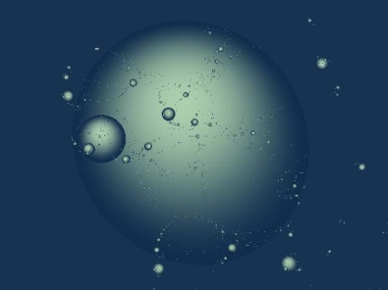
First order phase transition
Much more convenient

Slide 23
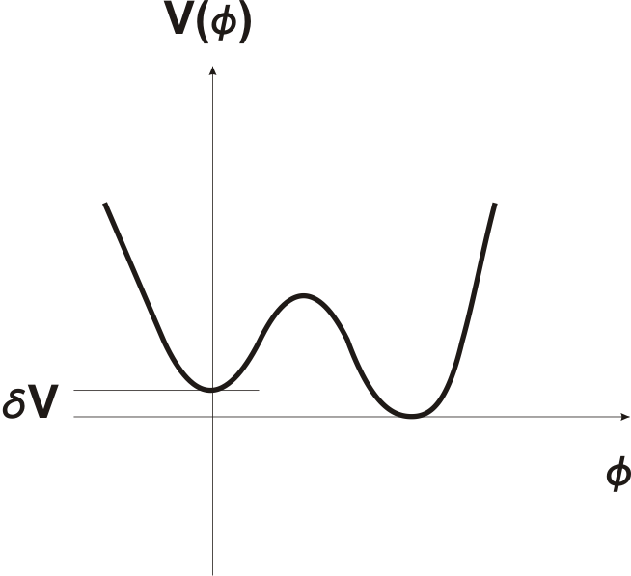

True Vacuum
broken symmetry
False Vacuum
unbroken symmetry
Non-zero vacuum energy density
Cosmological constant
Massive gluons
Quark confinement broken
Protons do not exist
Non-zero scalar field VEV

Slide 24
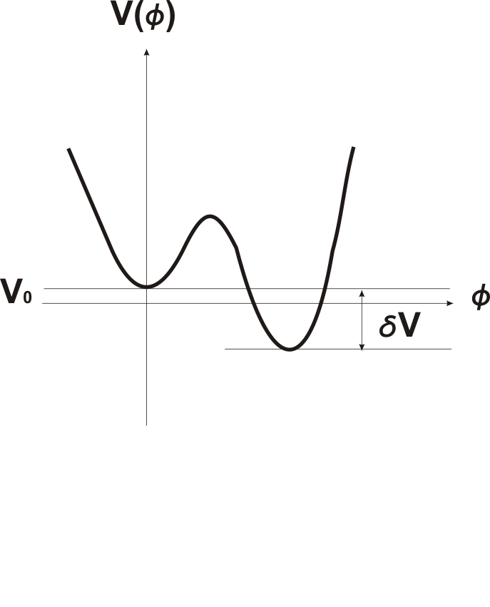
Tuned vs Not-Tuned
The shape of this
potential is tuned
The shape of this potential is NOT tuned.
It is just shifted up by an overall value V_{0.}

Slide 25
MODEL for SU(3)c breaking
Massive colored scalar field φ
Adjoint representation of SU(3)_{c}
In a diagonal traceless representation
V₀ is an overall shift of the potential
ε is the measure of the fine tuning of the shape of the potential

Slide 26
Fixing the parameters
V₀ : vacuum energy density
Cosmological constant
Input from observations
False Vacuum
unbroken symmetry
True Vacuum
broken symmetry
Mass of the colored scalar field:
Difference in energy between the vacua:
Interesting numerology :

Slide 27

Transition Rate
Transition Rate:
Euclidean Action:
Transition time is greater than the life-time of the universe if
Mild fine tuning of the shape
of the potential satisfies all
of the cosmological constraints!
Accelerated expansion
Equation of state w=-1
We still exist

Slide 28

Future of our Universe
First order phase transition proceeds with
nucleation of bubbles of true vacuum
If ε = 0, the transition time is infinite
If ε ≈ 0.1, we are just about to tunnel
to the true vacuum (doomsday!?)
True vacuum is not necessarily an absolute doomsday
e.g. SU(3)_{c} → SU(2)_{c} some gluons remain massless, quark confinement survives (protons survive)
However, if the true vacuum is AdS, after the tunneling the whole universe collapses into a black hole (Coleman-De Luccia)
TRUE DOOMSDAY!

Slide 29
Particle Physics Phenomenology
We live in the False Vacuum
with unbroken symmetry!
Massless gluons
Quarks confined
Protons do exist
Scalar field has zero VEV
Mass of the colored
scalar field ~ TeV:
Low energy QCD
phenomenology unchanged!

Slide 30

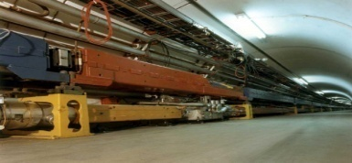
BONUS:
Model can be tested in colliders
Massive colored scalar field
Very interesting near future
accelerator phenomenology
New massive color singlet states:
Bound states of Φ’s
Bound states of Φ’s with quarks
Fractionally charged hadrons!
Adjoint representation is 8-dim in SU(3) classification scheme
and
contain singlets (color free states)
3,6,10,15,21 support color singlets which are fractionally charged, i.e.
FRACTIONALLY CHARGED HADRONS (FCH)!

Slide 31
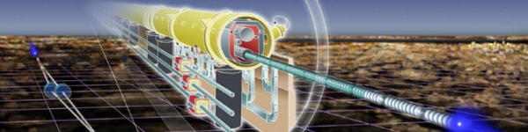

Experimental Signature
ɸ can decay into gluons and quarks
lifetime depends on the couplings and specific
representation of SU(3)_{c}
Fast decay main signature will be gluon and
quark jets in excess of SM prediction
To produce FCH, lifetime of ɸ should be longer than
the characteristic hadronization time ∼ (100MeV)⁻¹
e.g. if ɸ is protected by some symmetry
Production of fractionally charged hadrons
is a very interesting prediction of this model!

Slide 32
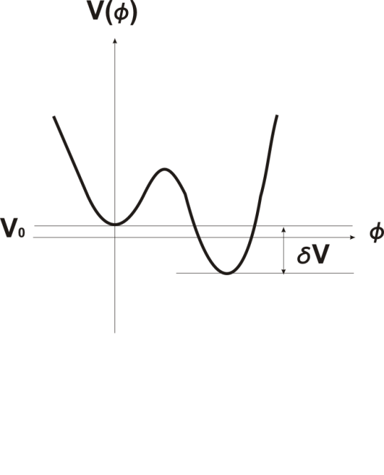

The potential barrier between the vacua is only ~ TeV
V_{max}
Can produce small bubbles of true vacuum (of TeV ⁻¹ size)…
…and watch them decay
Production of a critical bubble (able to expand) is suppressed
(otherwise we could destroy the Universe!)

Slide 33
Vachaspati, PRD, 04: How to reconstruct field theory by studying field excitations
if “kink” solutions are present
If we excite the field locally
we can learn only about the
local structure of the potential
To learn about the global shape of the potential we need to excite the solution that extrapolates between the vacua
Need to excite a kink solution,
(closed domain wall)
i.e. a small bubble of true vacuum
Can reconstruct the scalar field potential in future accelerators!

Slide 34
Reconstructing the field theory by studying kink excitations
Inverse Scattering method
Theory given by:
Equation of motion:
Φ₀ → kink solution
Zero mode (ω = 0):
Bogomolnyi equation
where
Solve for Z₀ and find

Slide 35
Conclusions
First order phase transition in which SU(3)_{c} breaks
can explain accelerated expansion of the universe
Low energy QCD phenomenology remains the same
New signature for the future collider experiments
Can reconstruct the potential in colliders!

Slide 36
YES!
Dark Energy CAN have a color!

Slide 37
THANK YOU

