Slide 1
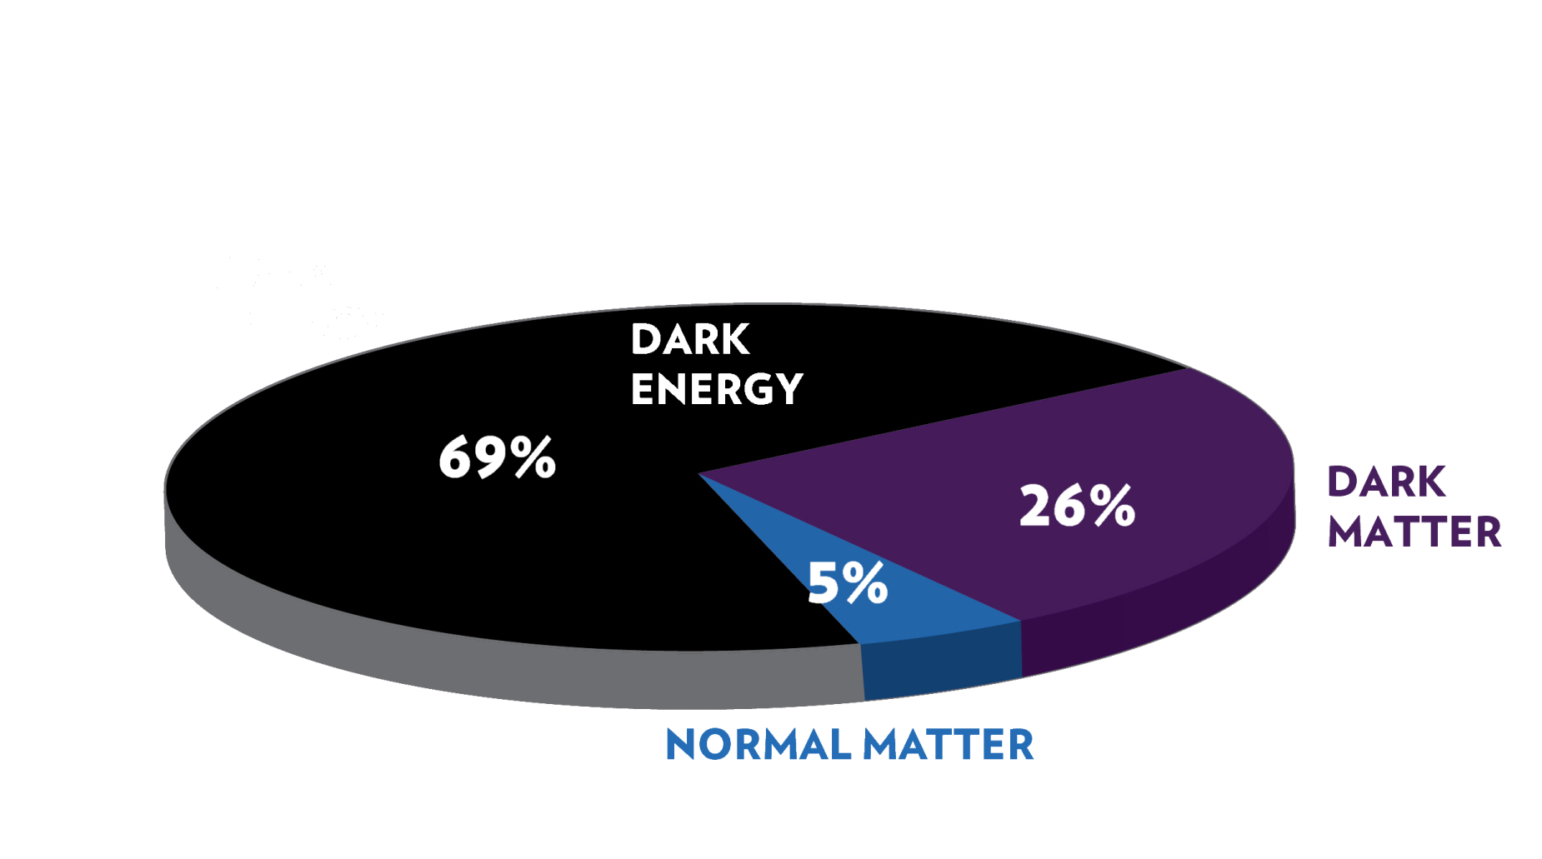
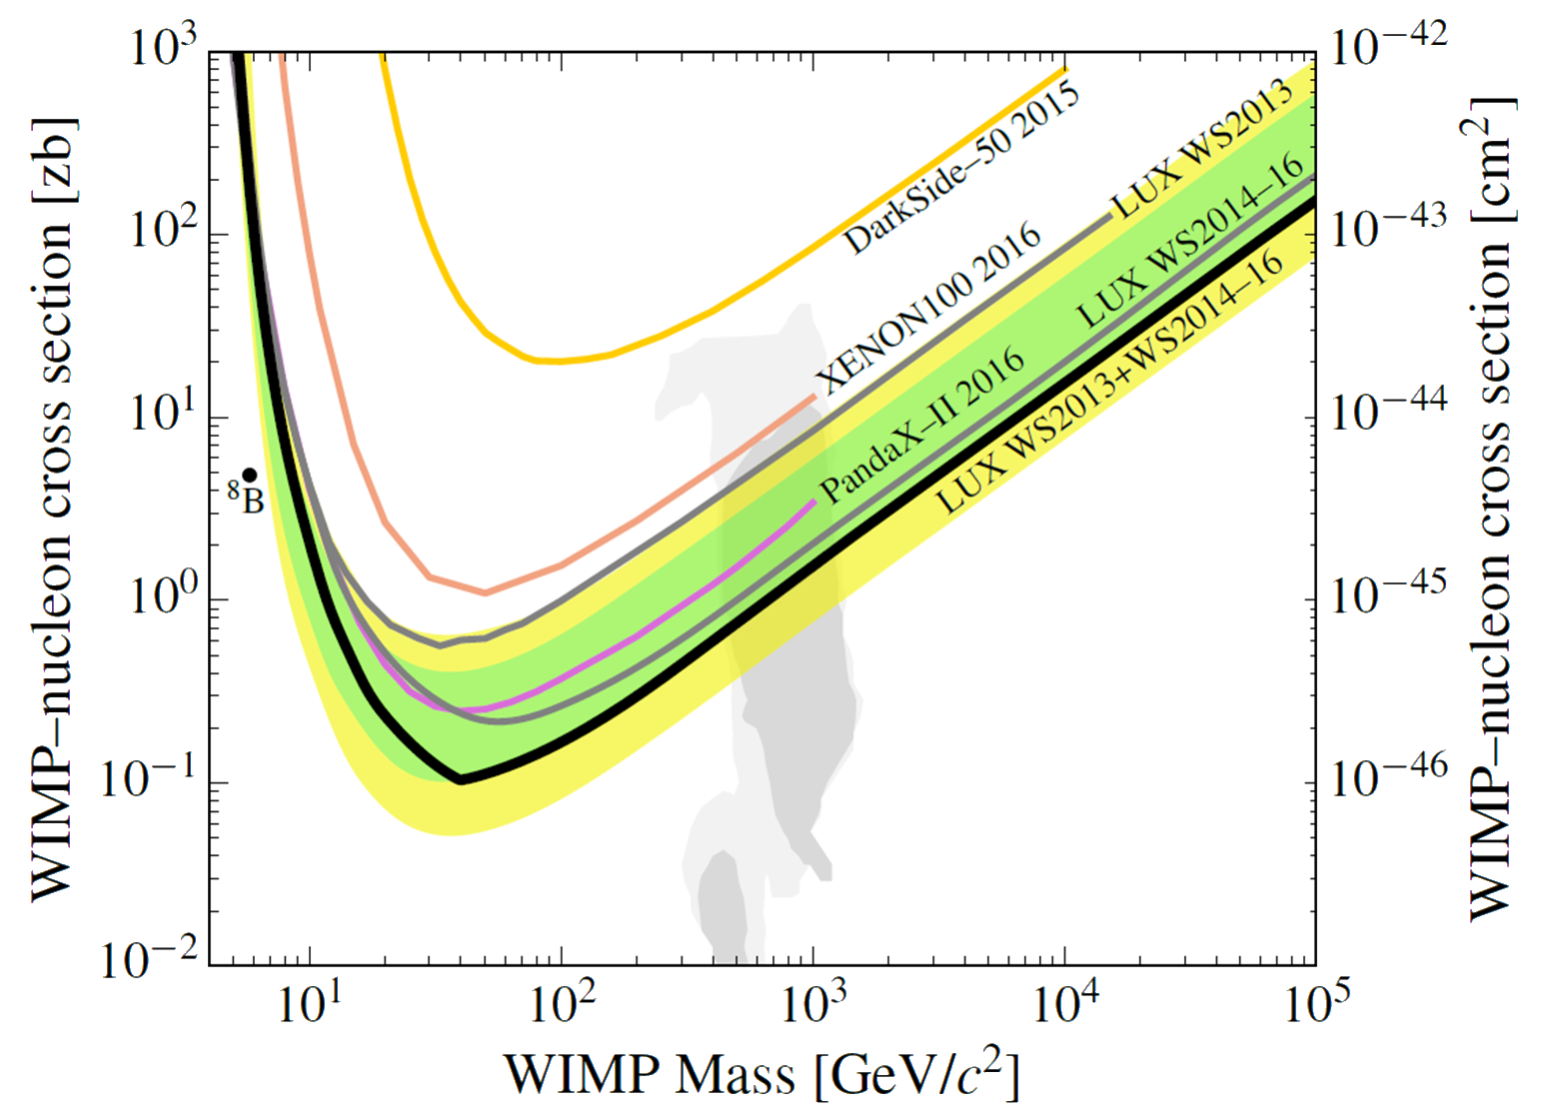
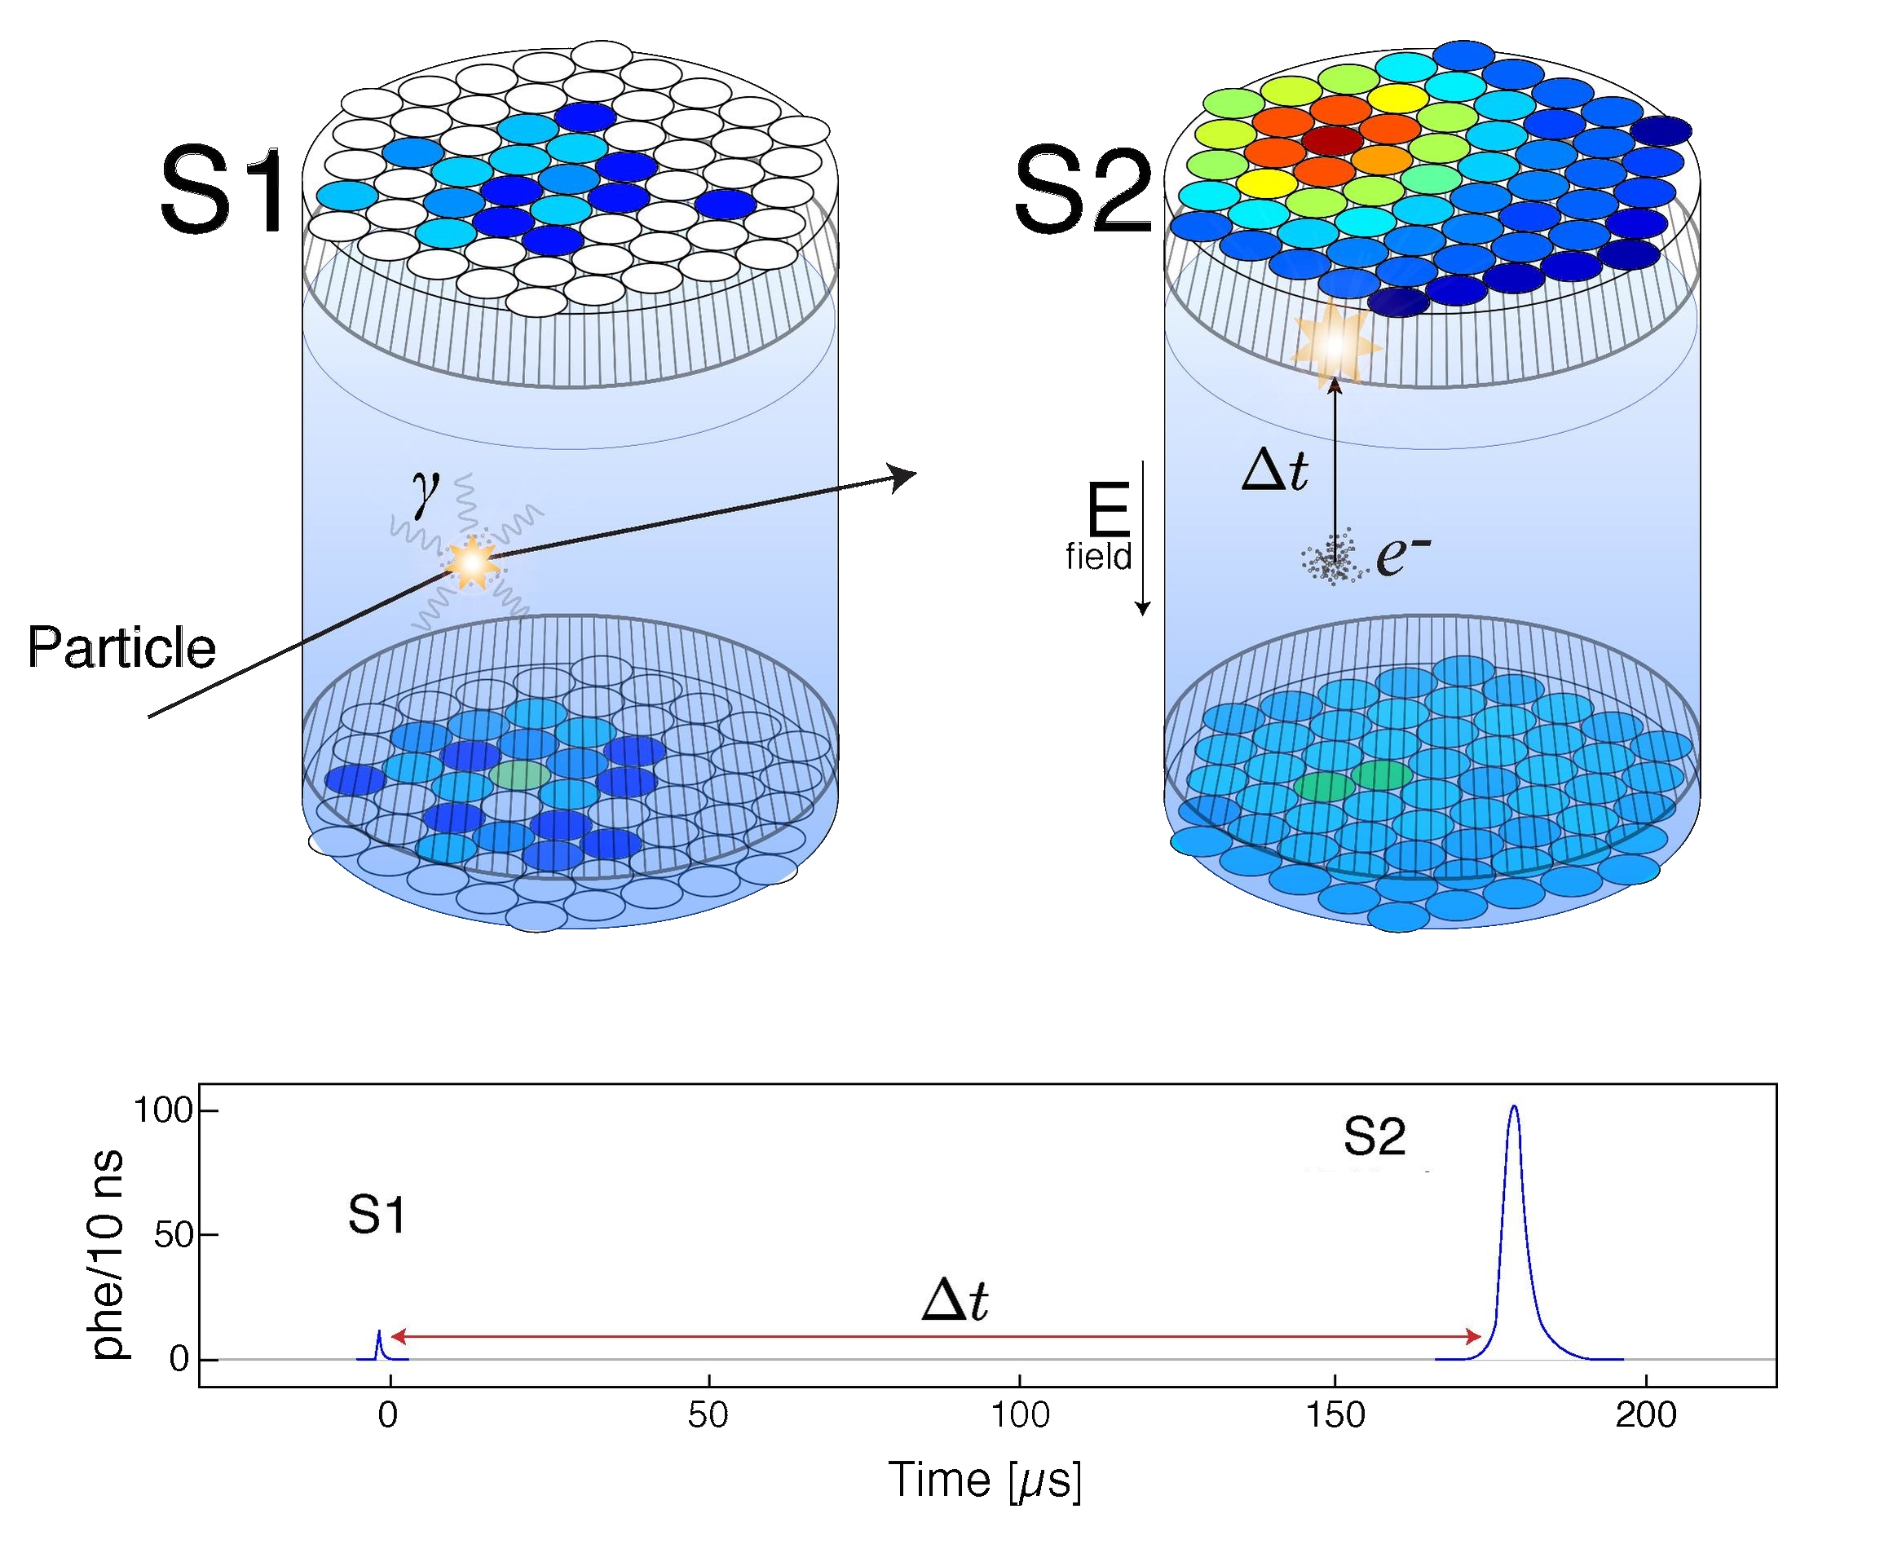
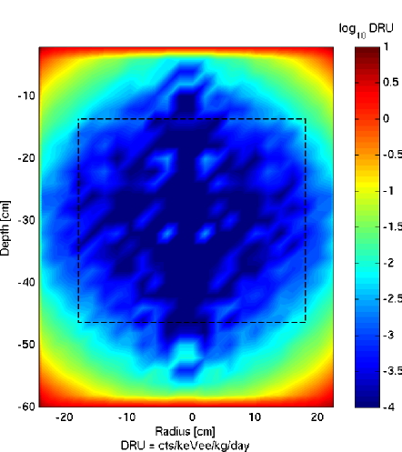
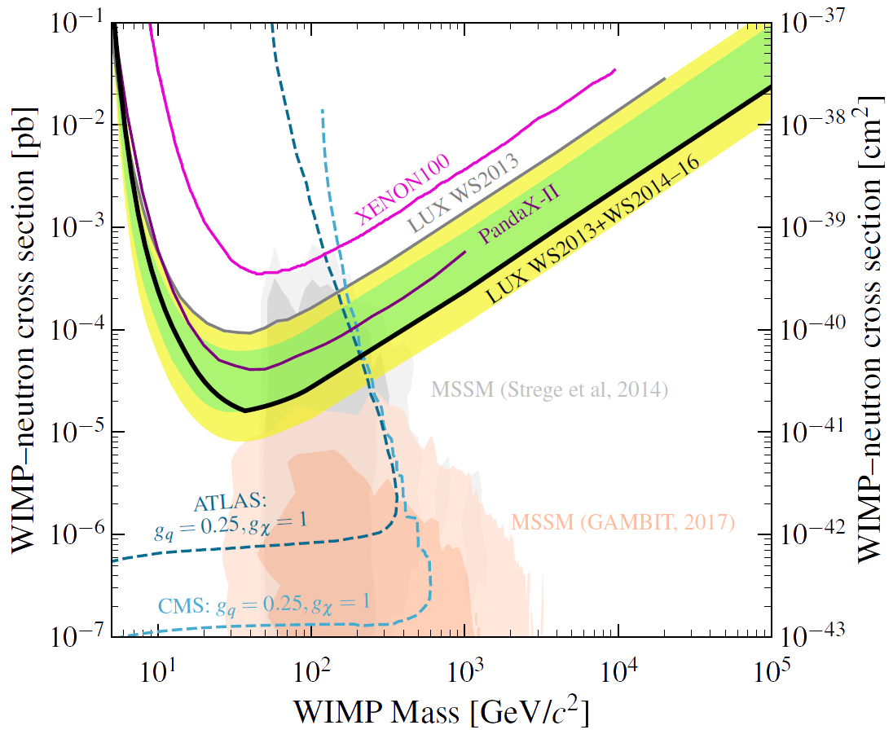
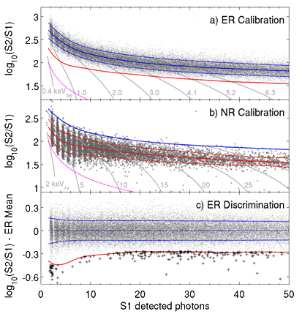
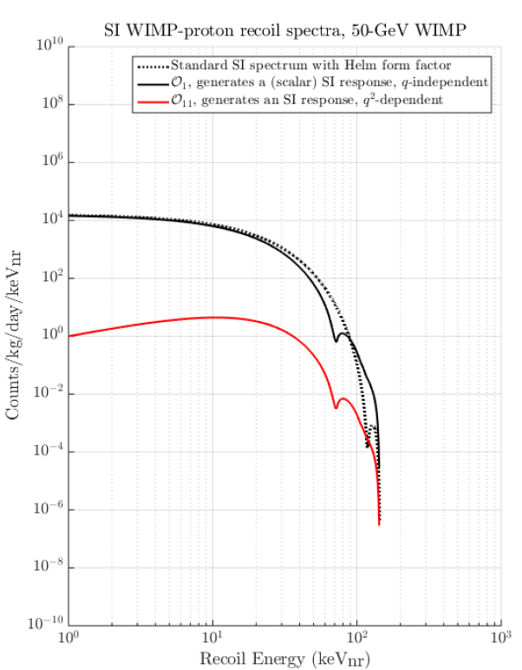
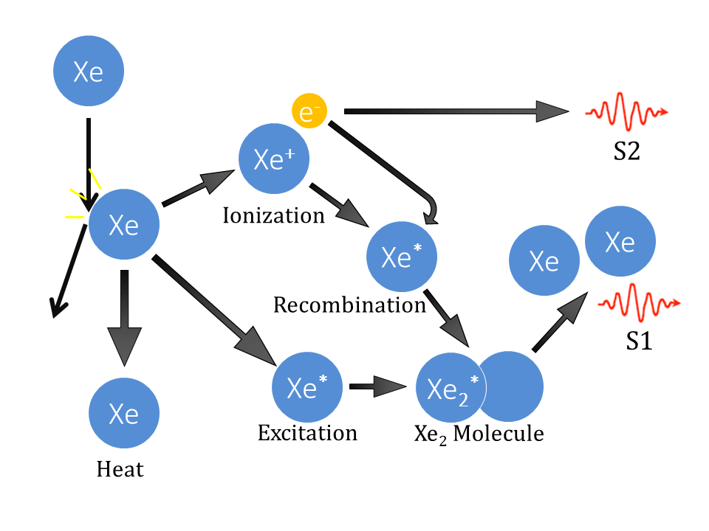
The Large Underground Xenon Experiment
Motivation
The particle nature of dark matter remains unknown. LUX was designed to look specifically for
weakly interacting massive
particles (WIMPs), one
proposed particle
candidate for dark matter.
Signal vs Background
WIMPs are expected to
Results
Lux placed a world-leading limit on the WIMP-nucleon spin-independent cross section (Xenon 1T has recently announced –but has not yet published- a better result).
Location
The LUX detector was located at SURF in Lead, SD USA. The same cavern used by Ray Davis in his discovery of solar neutrinos.
Detector
LUX is a dual-phase time projection chamber (TPC).
Signal vs Background
WIMPs are expected to interact uniformly throughout.
Most backgrounds cannot penetrate deeply into the liquid.
Signal can be distinguished based on interaction location.
An interaction can happen one of two ways.
Nuclear recoil (NR): particle recoils off a Xe nucleus. WIMPs and neutrons interact this way.
Electron recoil (ER): particle recoils off an electron. The vast majority of backgrounds (Photons, electrons, alphas, etc.) interact this way.
Future: Spin Dependent
LUX is also sensitive to the spin-dependent WIMP-neutron cross section. LUX is currently in the process of updating this limit.
The bulk is liquid xenon. A thin gas layer resides at the top.
An Electric field is applied to drift electrons to the surface.
Particle interactions create two signals:
Scintillation (S1) directly measured by PMTs
Charge (S2) measured via scintillation from feed electrons extracted from the liquid
Interaction positions are determined by the S2 PMT hit-pattern and the delay between S1 and S2.
ERs have a higher S2/S1 ratio than NRs.
ER S1 and S2 response is calibrated primarily using γs from ^{83m}Kr and βs from CH₃T.
The NR response is calibrated primarily using neutrons from D-D fusion.
Future: Effective Field Theory
The two couplings mentioned above assume that the dominant interaction is not momentum or velocity dependent. Relaxing this assumption yields a more general set of couplings. LUX is in the process of setting constraints on each of these couplings.
Xenon Physics
Recoiling xenon nuclei (or recoiling electrons) can either ionize or excite xenon atoms.
Freed electrons can either escape or recombine.
Contact
Name: Shaun Alsum
Email: SAlsum@wisc.edu
Phone: (616)-272-6460
Address: wouldn’t you like to know?

