Slide 1
Research Presentation
John Campbell

Slide 2
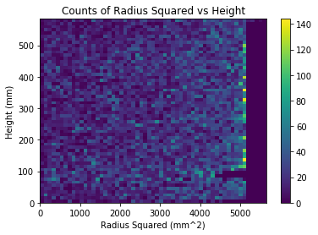
Plots!
Concerns
Time threshold?
Does not line up exactly with parameters (especially height)
Gap at 100mm height

Slide 3
Still To Do
Fix Current Issues
Use Energy Values Instead of Counts
Try Simulating Decays from Bottom
Possibly other Materials?

