Slide 1
What I Am Doing
Simulating Background Decays in the Phase 1 Detector
Today’s Slide is Here

Slide 2
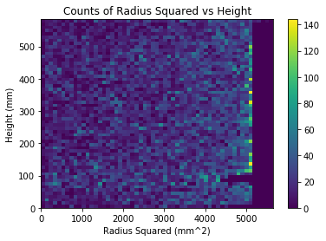
Plots!
Concerns
Time threshold?
Does not line up exactly with parameters (especially height)
Gap at 100mm height

Slide 3
Still To Do
Fix Current Issues
Use Energy Values Instead of Counts
Try Simulating Decays from Bottom
Possibly other Materials?

Slide 4
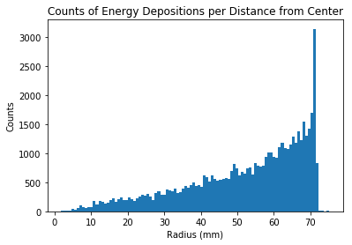
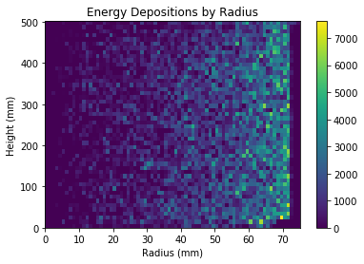
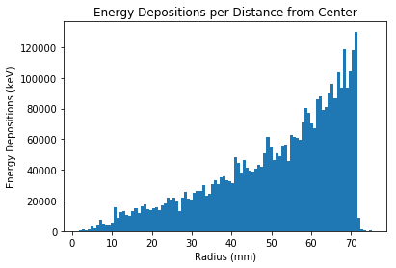
Energy Depositions and Correct Dimensions

Slide 5
Still To Do
Find decay rates in area
Fix geometry problems
Other materials?

