Slide 1
What I Am Doing
Simulating Decays of Elements in the Forward Field Region
Today’s Slide is Here

Slide 2
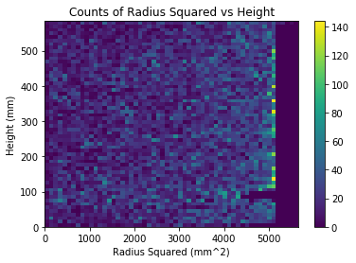
Plots!
Concerns
Time threshold?
Does not line up exactly with parameters (especially height)
Gap at 100mm height

Slide 3
Still To Do
Fix Current Issues
Use Energy Values Instead of Counts
Try Simulating Decays from Bottom
Possibly other Materials?

Slide 4
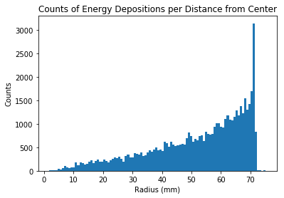
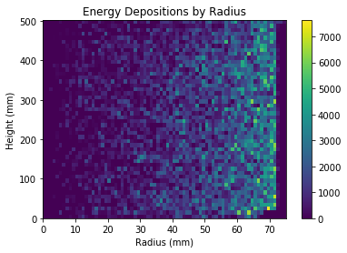
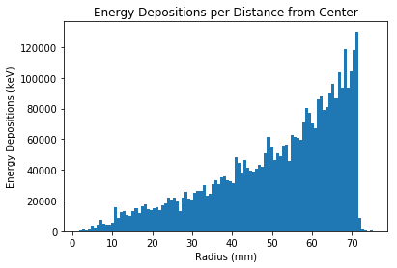
Energy Depositions and Correct Dimensions

Slide 5
Still To Do
Find decay rates in area
Fix geometry problems
Other materials?

Slide 6
Thermal Neutron Scattering
https://indico.cern.ch/event/245281/contributions/1564676/attachments/420136/583408/thermal_physics_validation_argarcia.pdf
http://pubs.cnl.ca/doi/pdf/10.12943/CNR.2017.00002

Slide 7
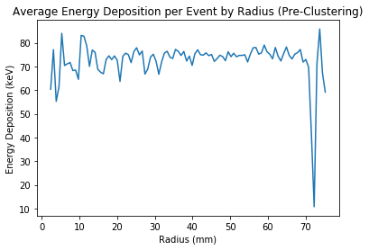
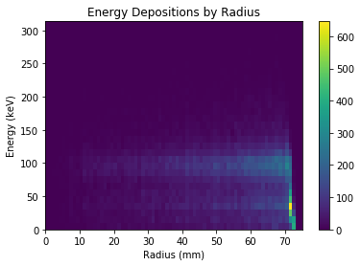
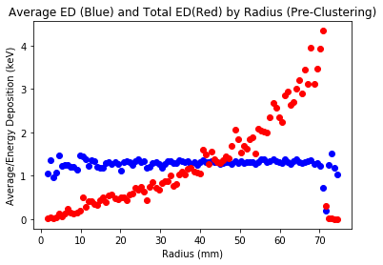
Average Energy Deposition
Why is there so little energy degradation until it is close to the center?
Why is there a sudden drop at the edge, but regular events past it?
Why are there so many small-energy events at the edge, but fewer later on?

Slide 8
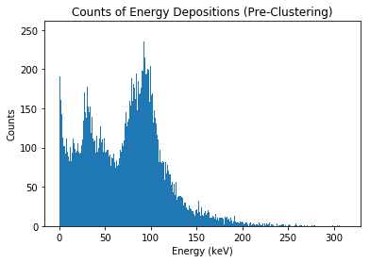
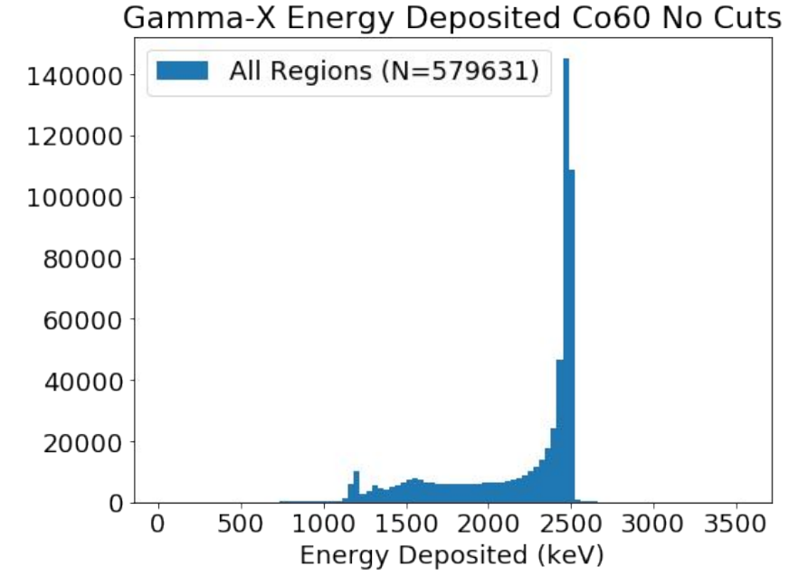
Energy Histogram Very Far Off
Mine
Jonathan’s

Slide 9
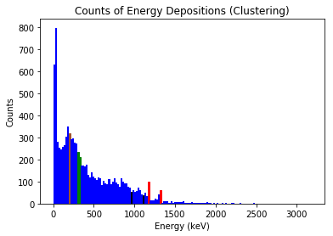
Now With Clustering
Post-Clustering
Expected Values (keV)
Brown=E’ (204, 208)
Green=β^{− max} (316)
Black=E_{e} (966,1112)
Red=Photopeak (1173,1333)

Slide 10
Still to Do/Answer
Read
Do
*Why I am getting so many events well above 1333 keV?
*What types of events are causing the very small, but numerous energy deposits?
Why are there relatively few events at photopeak (compared to other measurements)?
What other energy values do I want to look at?
Understand equations that I am using
Find values of other energy factors (escape peaks, detector efficiency, etc.)
Create rough model of what I should be seeing (ideally)
Keep reading

Slide 11
Summer Overview
Got Submission Script/Macro running
Plotted by position
Plotted by energy/histograms of energy
Included Clustering
Included Accurate Values
Other elements
Measured rate above energy threshold
Cable Making (Minor)
More components w/ More Decays (In Progress)

Slide 12
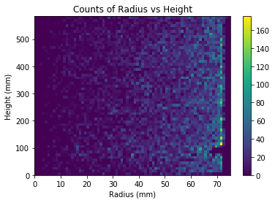
Plotting By Position/Energy/Clustering

Slide 13
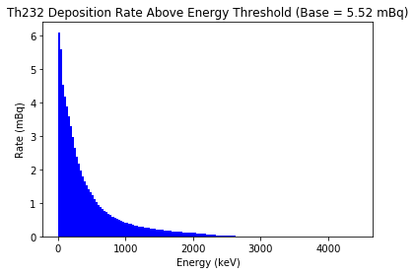
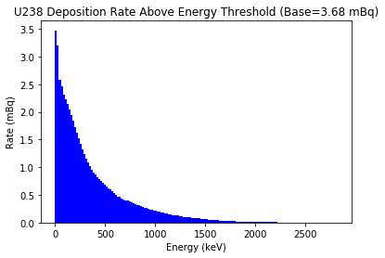
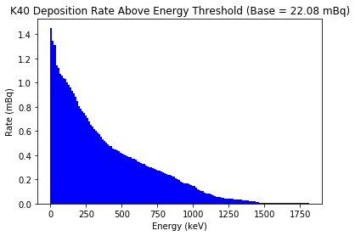
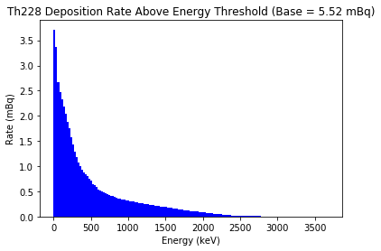
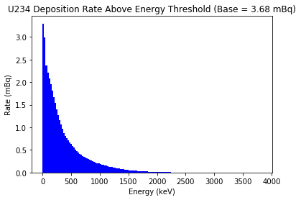
Accurate Values/Rate/More Elements

Slide 14
Goals For Fall 2017 Semester
Research Tasks
More Components
Give LZ-value estimate range
Errors (And More Events)
Thorium Alpha Energies
Conceptual Knowledge
What Specific Impact Do Decays Have on Experiment
Technical Knowledge
Learn More C++; be able to write code in C++ instead of Python
Getting Better at ROOT

Slide 15
K40 Background Sources
Volume Name | Mass (g) | Other masses | K | %
VacuumSpaceOuterCryoVessel | 1.22E-20 |  | 8.52E-29 | 0.7
InnerCryoVessel | 78576.8 |  | 2.81E-03 | 3.572002652
LiquidXenonInnerCryoVessel | 48918.7 | 96588.6 | 1.29E-03 | 2.64
GasXeInnerCryoVessel | 243.699 | 257.436 | 2.39E-06 | 0.98
TPCptfeInLiquid | 13548.2 |  | 8.91E-04 | 6.58
TPCptfeConeInLiquid | 1531.61 |  | 5.05E-06 | 0.33
gridRingInLiquid | 108.655 |  | 4.93E-06 | 4.54
PeekSpacerArc1 | 7.09061 | 7.09144 | 2.67E-07 | 3.77
PeekSpacerArc2 | 2.57045 | 2.56987 | 9.77E-08 | 3.8
PeekSpacerArc3 | 2.57033 | 2.57025 | 1.00E-07 | 3.89
PeekSpacerArc4 | 2.57021 |  | 6.84E-07 | 26.63056824
PeekSpacerArc5 | 2.57049 | 2.57035 | 6.84E-07 | 26.62766741
peekSpacersInGas | 47.5447 |  | 1.73E-06 | 3.64
gridRingInGas | 108.664 |  | 4.93E-06 | 4.54
activeLXeRFRegion | 3643.83 |  | 9.66E-05 | 2.65
activeLXeFFRegion | 23253.3 |  | 1.52E-02 | 65.23999991
activeGXeFFRegion | 2.10509 |  | 2.33E-07 | 11.09
AnodeGridHolder | 0.05311 |  | 5.53E-09 | 10.42
CathodeGridHolder | 7.8301 |  | 9.22E-07 | 11.77
GateGridHolder | 7.86043 |  | 1.04E-06 | 13.19000004
BottomGridHolder | 8.14317 |  | 7.08E-08 | 0.87
anodeGridRingSupportInGas | 1114.76 |  | 2.93E-05 | 2.63
TPCptfeConeInGas | 871.769 |  | 2.62E-05 | 3
top_pmtR9288_adapter | 162.704 |  | 3.11E-06 | 1.91
top_pmtR9288_quartzWindow | 10.6158 | 10.6159 (ad) | 3.07E-07 | 2.89
top_pmtR9288_realVacuum | 5.76E-24 | 5.76301e-24 (ad) | 1.23E-31 | 2.128739756
topR9288_PMT_Photocathode_1 | 4.21468 |  | 1.11E-07 | 2.63
top_pmtR9288_flashing | 1.11387 | 1.11377 (ad) | 2.97E-08 | 2.67
top_pmtR9288_aluminumBody | 51.4667 | 51.4608( ad) | 1.03E-06 | 2.01
TopPMT | 0.33035 |  | 1.48E-08 | 4.49
bottom_pmtR9288_adapter | 162.726 |  | 3.25E-07 | 0.2
bottom_pmtR9288_quartzWindow | 10.6158 |  | 2.34E-08 | 0.22
bottom_pmtR9288_realVacuum | 5.76E-24 |  | 1.09E-32 | 0.189900764
bottomR9288_PMT_Photocathode_1 | 4.21483 |  | 7.17E-09 | 0.17
bottom_pmtR9288_flashing | 1.11391 |  | 1.89E-09 | 0.17
bottom_pmtR9288_aluminumBody | 51.463 |  | 2.11E-07 | 0.41
BottomPMT | 63.5921 |  | 3.12E-07 | 0.49
Total | 1.73E+05 |  | 2.03E-02 | 11.78823734
Each source @ 1mBq/kg
Rate is for > 0 keV
Issues

Slide 16
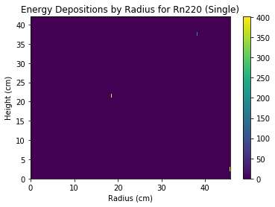
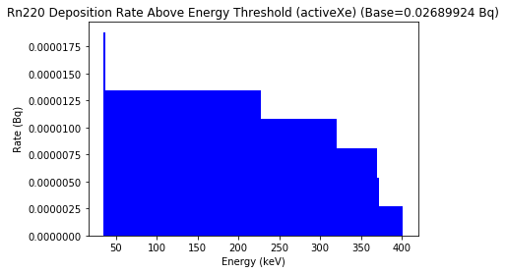
Thoron Calibration

Slide 17
To Work On
Backgrounds for other elements
Give energy threshold histograms
Better statistics for Thoron calibration source

