Slide 1
Emergent Cyclic universe & Tolman's Entropy Problem
Tirthabir Biswas
IGC, Penn State University, USA

Slide 2
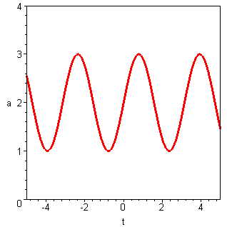
Challenges & Virtues of Cyclic Universes
Singularity Resolution:
Inflation cannot be past eternal, geodesically incomplete [Guth,Vilenkin,Borde,Linde]
“Effective” 4D metric + BKL conjecture => FLRW, ok to start
Consistent (ghostfree) Bounce
p-adic/SFT inspired Non-local modifications
of gravity [Seigel, Mazumdar, TB]
Ghost condensation [Arkani-Hamed et.al., Khoury et.al.]
Casimir Energies
BCS Gap energy: [Alexander, TB]
Einstein,Freedman,Tolman,Lemaitre, 30’s
Bondi,Gold,Narlekar,Hoyle (steady state) 50’s
(pre-big bang) ’97
Steinhardt & Turok (ekpyrotic),
Freese et.al.,Frampton et. al. (phantom)

Slide 3
Challenges/Virtues Cont.
Turn-around
Spatial curvature
Scalars
Classic puzzles:
Horizon: All
Flatness & Largeness: Emergent cyclic model
Homogeneity: “no new ideas”, Ekpyrotic models can address it
IV. Black hole over-production & Dark energy
Quintessence (ekpyrotic) makes BH’s dilute
Phantom makes BH’s disintegrate
V. Generating Scale-invariant Perturbations
Scalar field fluctuations [Steinhardt et.al]
Stringy fluctuations [Brandenberger et. al]
“New idea”?
VI. Tolman’s Entropy Problem = Geodesic incompleteness

Slide 4
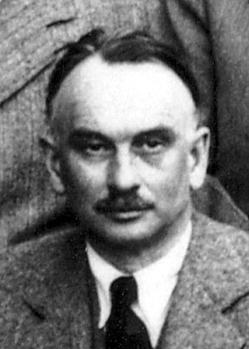
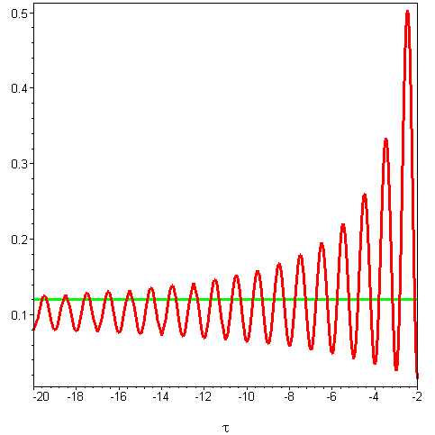
Emergent Cyclic Universe
Tolman’s Entropy Problem
Entropy is monotonically increasing
Universe atmost quasi-periodic
Entropy (Energy, period) vanishes
in a finite time in the past
Beginning of time – back to square 1
Thermal Hagedorn Phase, T=T_{H} ~ M_{S}
All string states in thermal equilibrium
entropy constant
As cycles shrink, universe is hotter
less time in entropy producing non-Hagedornic phase
more time in Hagedorn phase
Cycles assymptote to a constant entropy periodic evolution

Slide 5
Stringy Toy Model
Hagedorn half
Eternally periodic universe
Non-Hagedorn half
Hagedorn matter = massless (r)+massive (m)‏
&
Gluing the two halves ( )‏
Entropy is conserved
Matter and radiation was in equilibrium till the transition
Phenomenological Input:

Slide 6
Energy Exchange & Entropy Production
Matter coverted to radiation [Tolman,Barrow]
Conserves total stress-energy tensor
Consistent with 1st & 2nd law of thermodynamics
Breaks time-reversal symmetry – arrow of time
Exchange function, s(a,Ω)‏
Small cycle limit, s ~ const.
Crucial Difference
Singular bounce Γ interaction cannot keep up with H → ∞
Thermal equil. Cannot be mantiened entropy production during the bounce
Nonsingular bounce H is finite, a thermal Hagedorn phase may exist.

Slide 7
How are doing?
I. Can Casimir Energy work? (work in prog. Roiban)
Include all stringy degrees
Can thermal equilibrium be mantained?
II. & IV. Introduce scalars
III. Still have to address homogeneity problem
V. “Disguised Inflation” (conjecture, work in prog. Mazumdar)
Can entropy generation lead to inflation on an average?
If cycle time scale << Hubble time scale
A massless scalar may get a scale-invariant spectrum
Instead of a flat inflaton potential we want

Slide 8
Thermodynamic Fluctuations during Hagedorn Phase
Energy to Power Spectrum
Energy to density fluctuations:
Energy fluctuations from Heat Capacity
Matter fluctuations to metric perturbations
Power Spectrum

Slide 9
CMB Spectrum: Minimal Requirements
Fluctuations should come from massive modes and not massless (radiation)‏
Amplitude:
Spectral tilt:
typically one obtains almost perfect scale-invariance!

Slide 10
Assessment
Resolving the singularity?
Emerging possibilities, we can move ahead
Resolving cosmological puzzles?
Bouncing Universe: horizon, flatness (?)‏
Cyclic Universe: much better chance (homogeniety ?)‏
Generating scale-invariant Perturbations
Ekpyrotic:2-field case works, Integrate with backgrounds
BVN mechanism: Open strings (radiation)+Closed strings (winding) + Quantum Gravity works!
Better understanding of Hagedorn phase?
New Mechanism
What about the Dark Energy?
Ekpyrotic has built-in accelerated phase
Presence of Λ ends cyclicity, we are living in the last cycle!
Predictions/Tests
Gravity Waves, Non-gaussianity…

Slide 11
Hagedorn Phase
Qualitative Behaviour
Close to T=T_{H} ~ M_{S} massive (winding) string states are excited. Pumping energy doesn’t increase temperature, produces new states.
Thermodynamics no longer determined by massless modes:
Cosmological Evolution: Entropy is constant
Energy, Temperature remains approximately constant
Transition to radiation occur when S ~ VT_{H}^{d}

