Slide 1
Nflation:
observational predictions from the random matrix mass spectrum
Soo A Kim
Kyung Hee University
SAK and Andrew R. Liddle (Sussex)
Phys. Rev. D 76, 063515, 2007, arXiv:0707 .1982.
28th August 2008
COSMO08

Slide 2
Outline
Introduction
Nflation
Basic set-up
Multi-field dynamics
Observational predictions
Numerical results
The spectral index
Summary
COSMO08

Slide 3
Introduction
Single field (large)
Chaotic inflation
P. Kanti and K. A. Olive,
Phys. Rev. D60, 043502 (1999),
Phys. Lett. B464, 192 (1999).
N. Kaloper and A. R. Liddle,
Phys, Rev, D61, 123513, (2000).
Initial condition
problem
Multiple fields
Assisted inflation
Large number of fields(N_{f})
R. Liddle, A. Mazumdar, and F. E. Schunck, Phys. Rev. D58, 061310 (R).
Nflation
from particle physics
in inflation models
S.Dimopoulos et al, hep-th/0507205.
Random initial
conditions
Different mass
spectrum
Adiabatic perturbations
Density perturbations
The tensor-to-scalar ratio
COSMO08

Slide 4
NflationⅠ
The basic set-up
A set of massive uncoupled scalar fields with a particular mass spectrum
Potentials
Periodic potentials (cosine ones)
quadratic ones
Near to the minima of their own potentials
Mass spectrum by the random matrix
Random initial conditions
With the field initial conditions φ_{i}/M_{Pl}
chosen uniformly in the range [0,1]
⇔ Symmetry to [-1,1]
S. Dimopoulos et al, hep-th/050205.
R. Easther and L. McAllister, JCAP 0605, 018 (2006).
SAK and Andrew R. Liddle, Phys. Rev. D74, 023513 (2006).
COSMO08

Slide 5
Nflation Ⅱ
Multi-field dynamics
The total potential
Field equations
The number of e-foldings
COSMO08

Slide 6
Nflation Ⅱ
Multi-field dynamics
The total potential
Field equations
Slow-roll
approximations
The number of e-foldings
COSMO08

Slide 7
Observational predictions Ⅰ
See also the talk by Laila Alabidi
The perturbation spectrum of the curvature perturbations
The tensor-to-scalar ratio
independent of N_{f} , of their masses, and of their initial conditions
M. Sasaki and E. D. Stewart, Prog.Theor.Phys. 95, 71 (1996).
D. H. Lyth and A. Riotto, Phys. Rep. 314, 1 (1999), R. Easther and L. McAllister, JCAP 0605, 018 (2006).
~0.16
(N=50)
L. Alabidi and D.H. Lyth, JCAP 0605, 016 (2006).
COSMO08

Slide 8
Observational predictions Ⅱ
See talks by Ben Wandelt and by Shuntaro Mizuno
The non-gaussianity parameter
also independent of model parameters
D. Seery and J. E. Lidsey, JCAP 0509, 011 (2005),
D.H. Lyth and Y. Rodriguez, Phys. Rev. D.71, 123508 (2005).
SAK and Andrew R. Liddle, Phys. Rev. D74, 063522 (2006).
~O(0.01)
(N=50)
COSMO08

Slide 9
Observational predictions Ⅲ
The spectral index
always less than n_{S}=0.96, the single field case
M. Sasaki and E. D. Stewart, Prog. Theor. Phys. 95, 71 (1995).
Y-S. Piao, Phys. Rev. D74, 047302 (2006).
COSMO08

Slide 10
Numerical results
SAK and Andrew R. Liddle, Phys. Rev. D74, 023513 (2006).
The relations between the total number of e-foldings N_{total} and the number of fields N_{f}
N_{total} ≈ N_{f} /12
indicate more than 600 fields needed to get enough e-foldings, i.e. more than 50 e-foldings
COSMO08

Slide 11
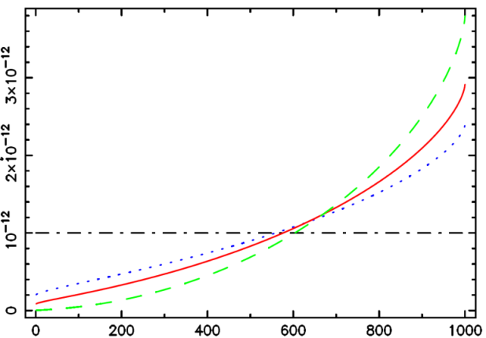
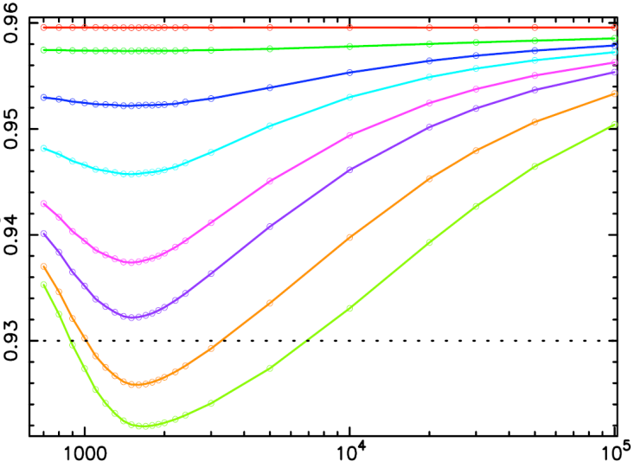
The spectral index
The mass spectrum by the random matrix ⇒ m_{i}² (β)
The average mass term
m=10⁻⁶M_{pl}
β=0, 0.3, 0.5, 0.9
The spectral index
β=0, 0.1, 0.3, 0.5,
0.7, 0.8, 0.9, 0.95
R. Easther and L. McAllister,
JCAP 0605, 018 (2006).
m_{i}²/M_{Pl}²
i
SAK and Andrew R. Liddle, Phys. Rev. D 76, 0635156 (2007).
Observational
Lower Limit
(WMAP5)
n_{S}
Observational
Lower Limit
(WMAP3)
N_{f}
COSMO08

Slide 12
Summary Ⅰ
At least 600 fields needed
The tensor-to-scalar ratio &
the non-gaussianity parameter
Completely independent of the model parameters
N_{f} and the mass spectrum
Also independent of the field initial conditions
COSMO08

Slide 13
Summary Ⅱ
The spectral index
Depends on the model parameters;
n_{S}(N_{f}, m_{i})
Also depends on the initial conditions
Existence of the independent regime for the initial conditions
called ‘thermodynamic’ regime
Provided β < 0.3, becomes independent
[With a large N_{f}, n_{S} also becomes independent]
Thank you!
COSMO08

