Slide 1
Probabilistic Simulation of Knee Contact and Ligament Loading using HTCondor
Joshua D Roth, Darryl G Thelen
UW Neuromuscular Biomechanics Lab
Department of Mechanical Engineering, UW-Madison

Slide 2
Outline
Overview of UW Neuromuscular Biomechanics Lab (NMBL)
Ongoing orthopedic research in UW NMBL
Modeling approach in UW NMBL to simulate human movement using HTCondor
Application of UW NMBL modeling approach with HTCondor to address anterior knee pain after total knee replacement

Slide 3
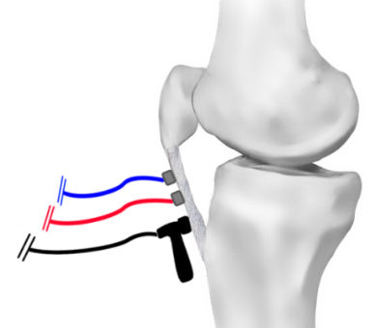
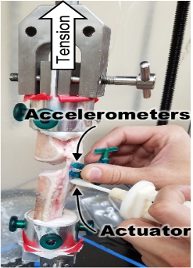
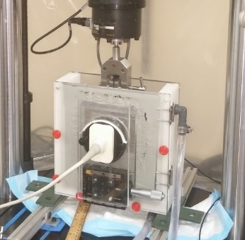
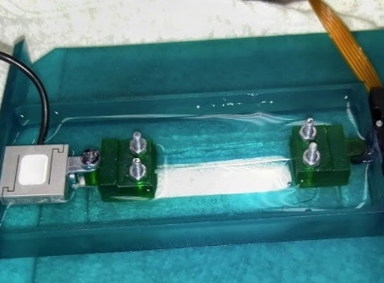
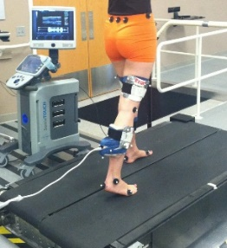
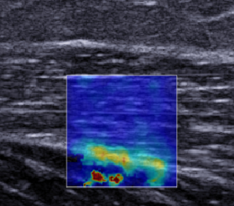
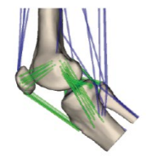
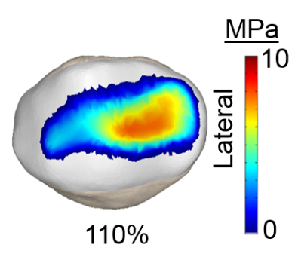
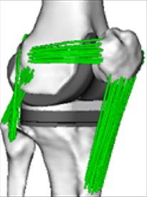
Overview of UW Neuromuscular Biomechanics Lab
Tissue Mechanics
Imaging
Biomechanics
Clinical Applications Using HTC Condor
Anterior cruciate ligament (ACL) reconstruction
Pediatric gait disorders
Total knee replacement
Modeling &
Simulation
http://opensim.stanford.edu/support/event_details.html?id=169

Slide 4
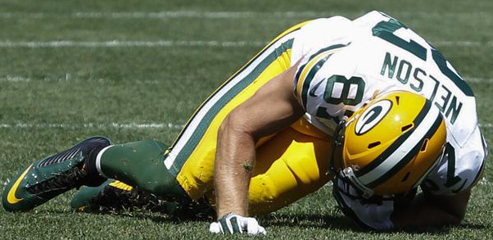
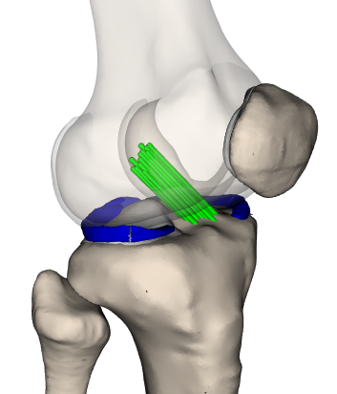
Ongoing Orthopedic Research in UW NMBL
Ligament Reconstruction
Pediatric Orthopedics
Total Knee Replacement
Clinical Challenge: Up to 50% of patients develop osteoarthritis within 10 year of surgery
Clinical Challenge: Functional outcomes after current treatments are inconsistent and too often unsatisfactory.
Clinical Challenge: Up to 20% of patients are not satisfied after surgery

Slide 5
Outline
Overview of UW Neuromuscular Biomechanics Lab (NMBL)
Ongoing of orthopedic research in UW NMBL
Modeling approach in UW NMBL to simulate human movement using HTCondor
Application of UW NMBL modeling approach with HTCondor to address anterior knee pain after total knee replacement

Slide 6
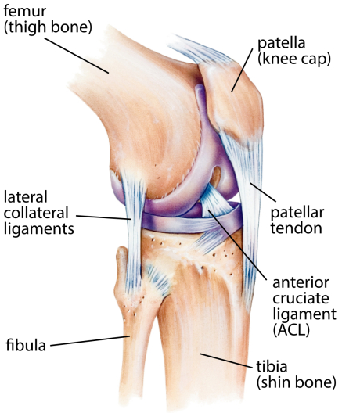
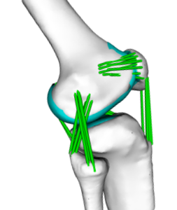
Knee anatomy and UW NMBL knee model
6 Degree-of-Freedom Joints
Custom Surface Contact Model
Non-linear Spring Ligaments
Lenhart et al, Ann Biomed Eng, 2015

Slide 7
Modeling approach to simulate patient-specific movement
Musculoskeletal
Simulation
Gait Analysis
Muscle Forces
Knee Movement
Ligament Forces
12
MPa
6
0
Contact Pressures
Smith et al, J Knee Surg, 2016

Slide 8
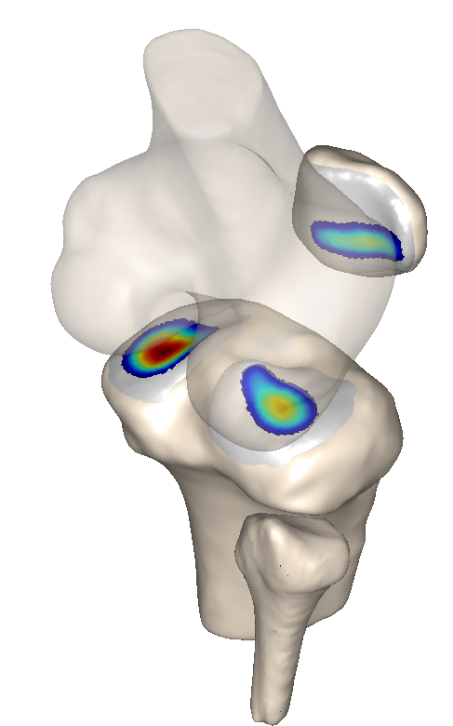
Uncertainty patient-specific simulations
Knee
Geometries
Surface
Contact Model
Ligament
Model
Musculoskeletal
Model
Surface
Material Properties?
Ligament
Properties?
Neuromuscular
Coordination?

Slide 9
Monte Carlo Analysis Useful to Evaluate Uncertainties
P
Parameter 1
HTCondor enables large-scale sensitivity analyses
.
.
.
P
Parameter N
1 simulation ≈ 0.5 hours
3000 simulations in series ≈ 1500 hours
3000 simulations in parallel ≈ 2 hours

Slide 10
Outline
Overview of UW Neuromuscular Biomechanics Lab (NMBL)
Ongoing of orthopedic research in UW NMBL
Modeling approach in UW NMBL to simulate human movement using HTCondor
Application of UW NMBL modeling approach with HTCondor to address anterior knee pain after total knee replacement

Slide 11
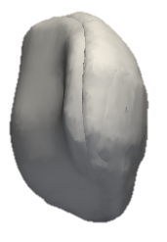
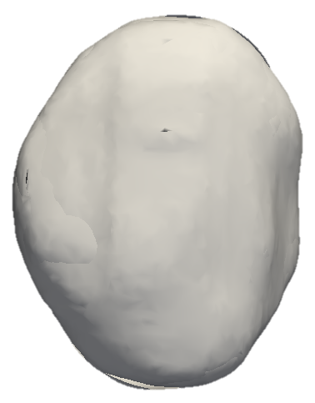
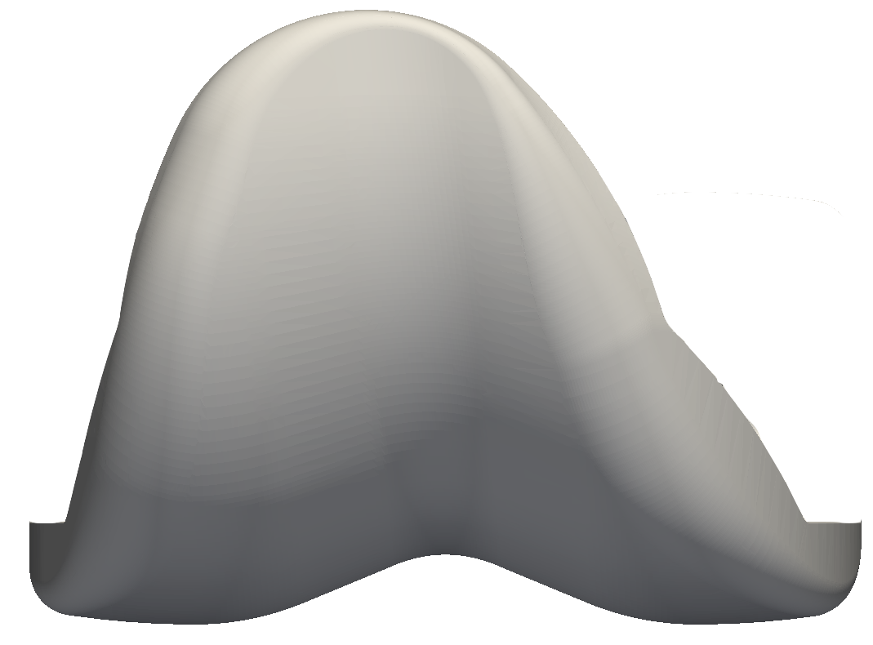
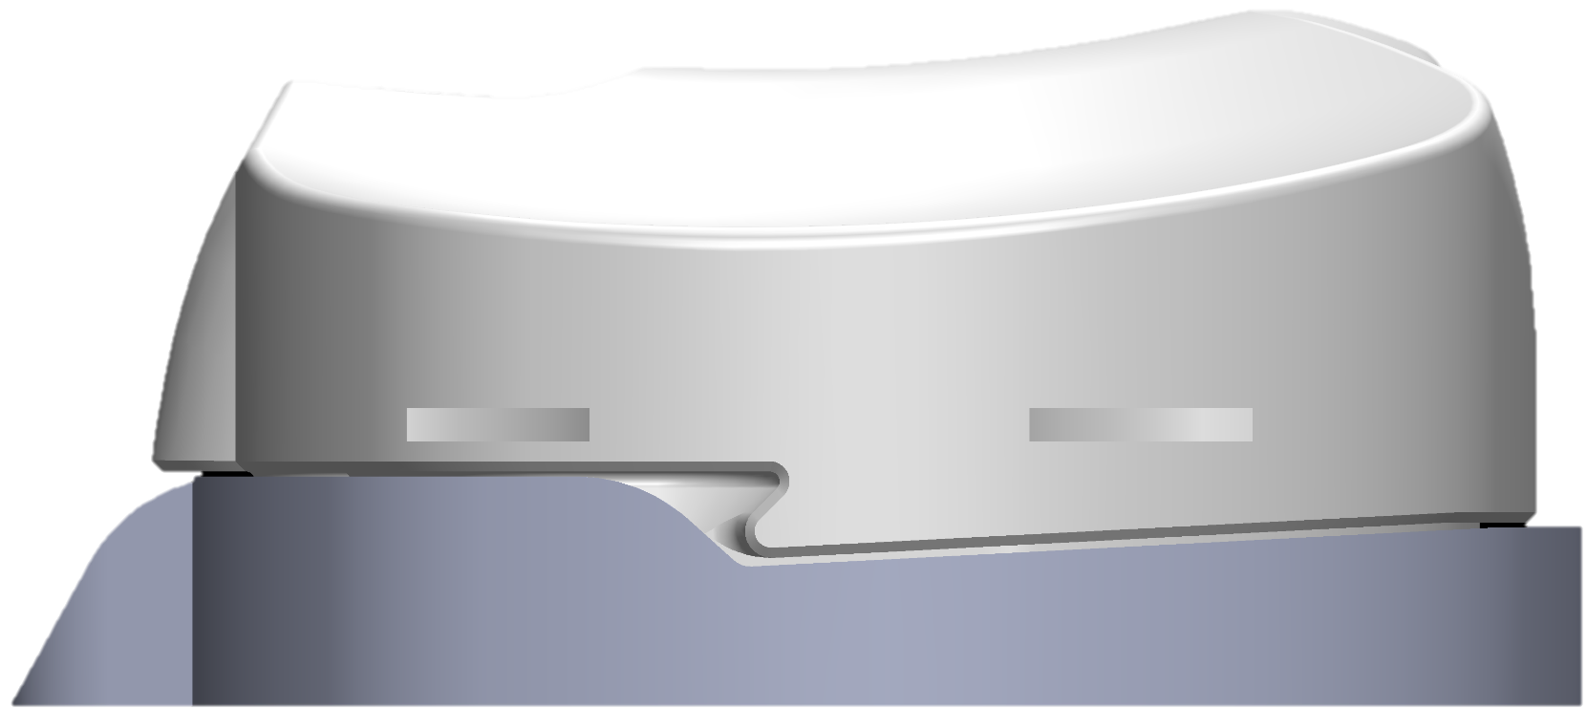
Why is there an 8% incidence of anterior knee pain after total knee replacement (TKR)?

Slide 12
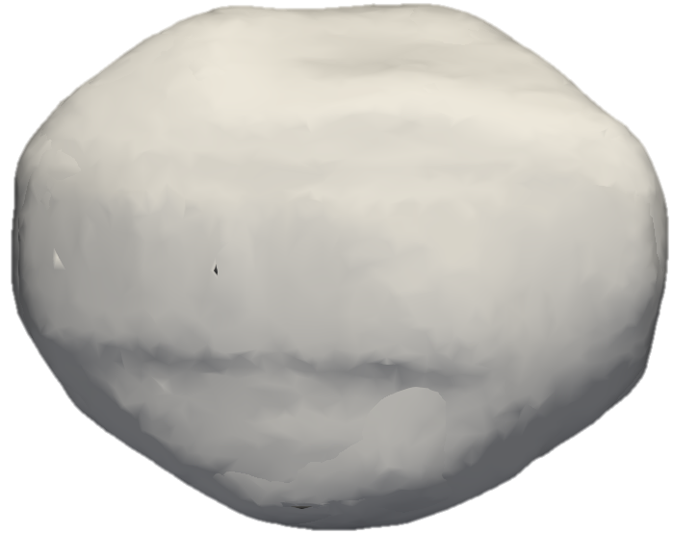
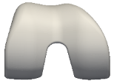
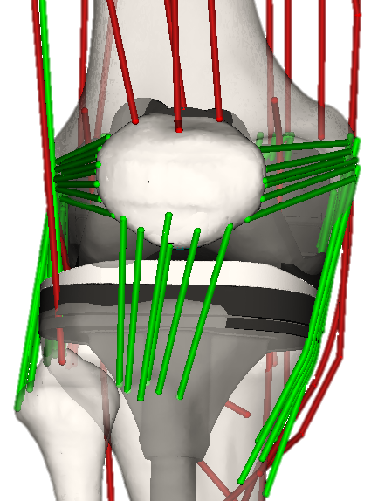
Determined Sensitivity of Knee Mechanics to Femoral Component Malrotation Using Monte Carlo Sensitivity Analysis
F_{lPFL}
F_{mPFL}
-16°
P
16°
F_{M-L}
I-E Malrotation
P
n=1000
P
Stiffness
Resting Length

Slide 13
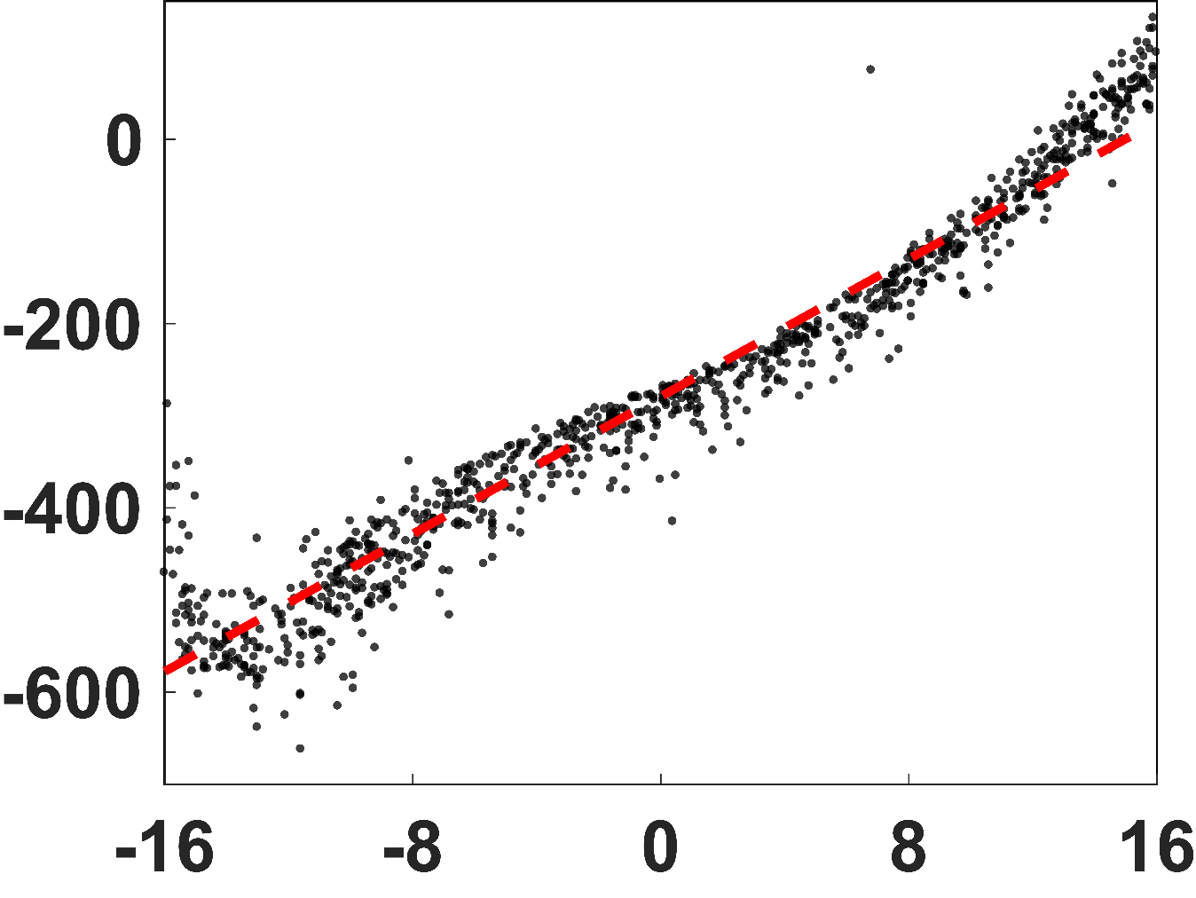
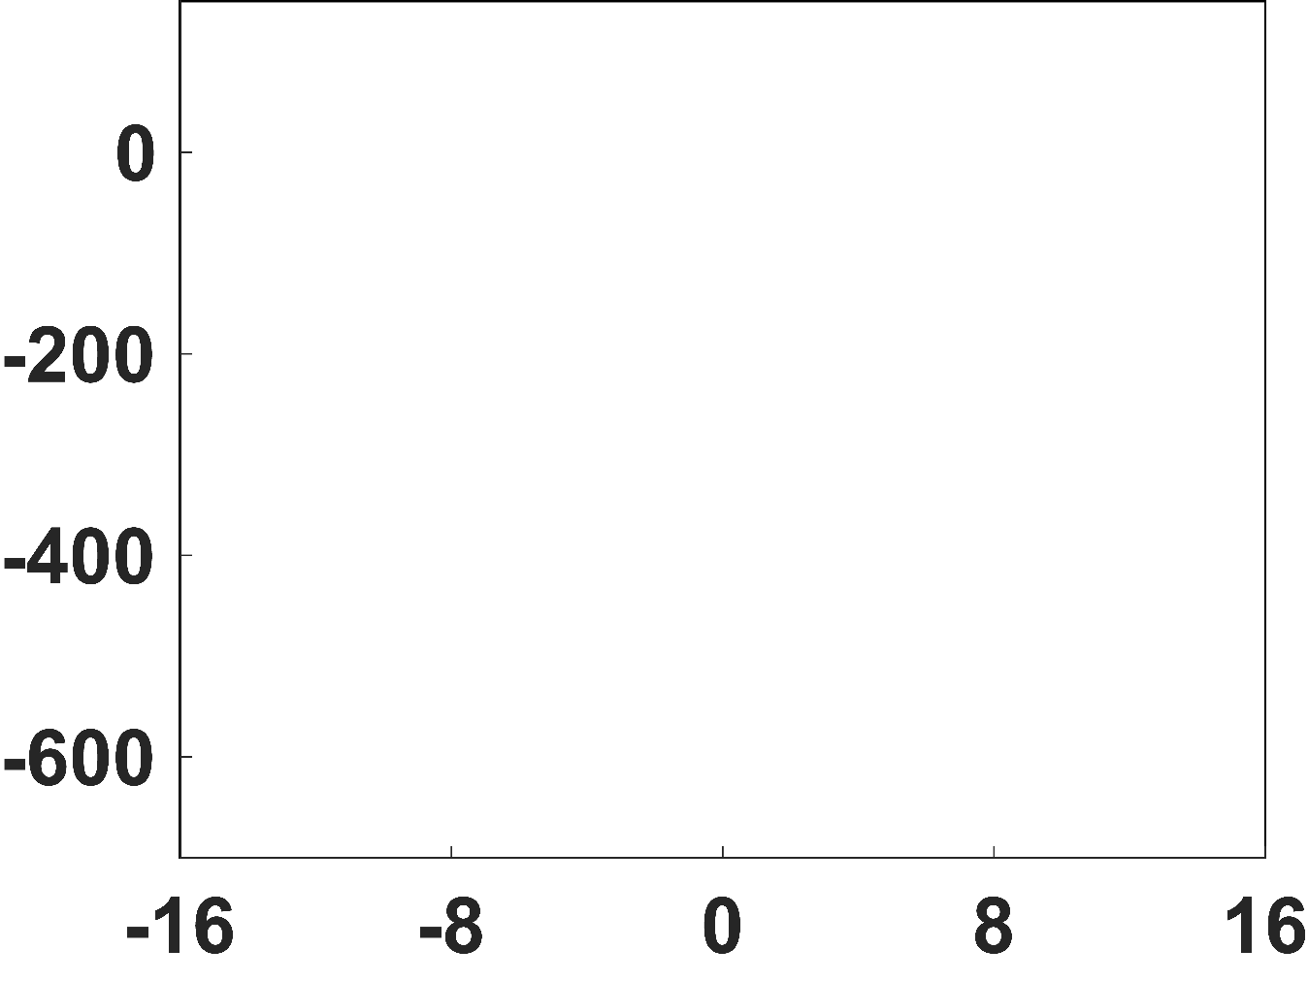
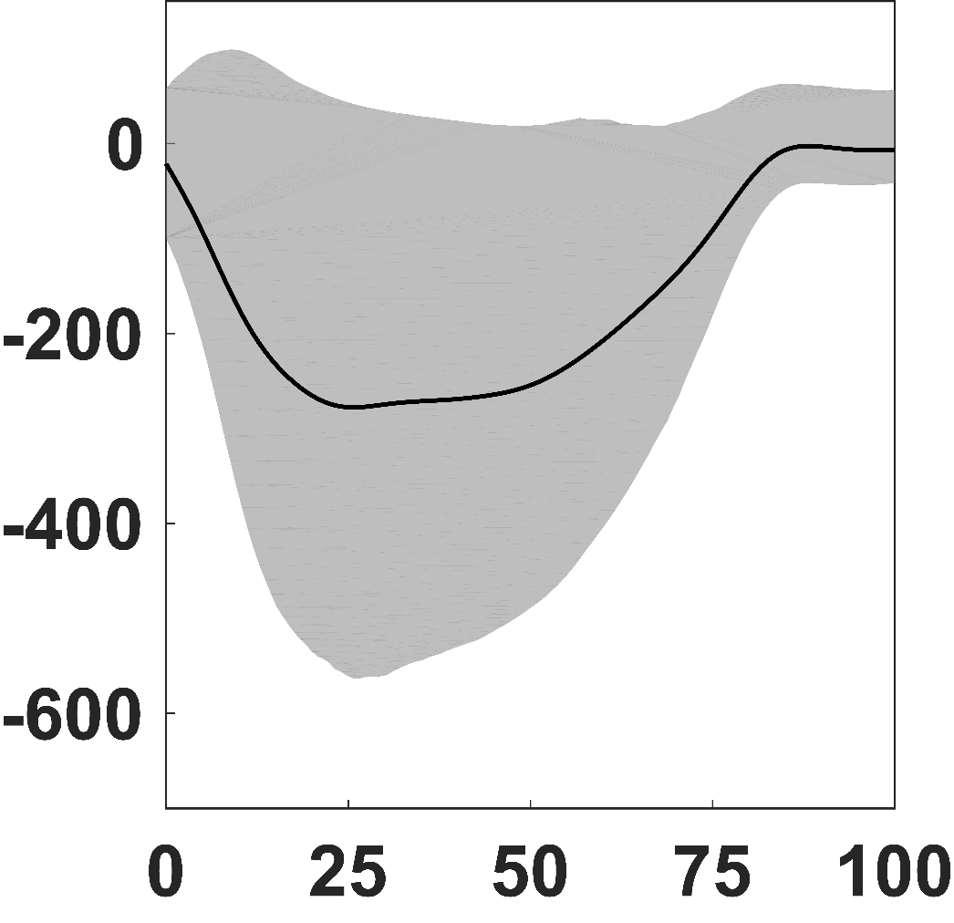
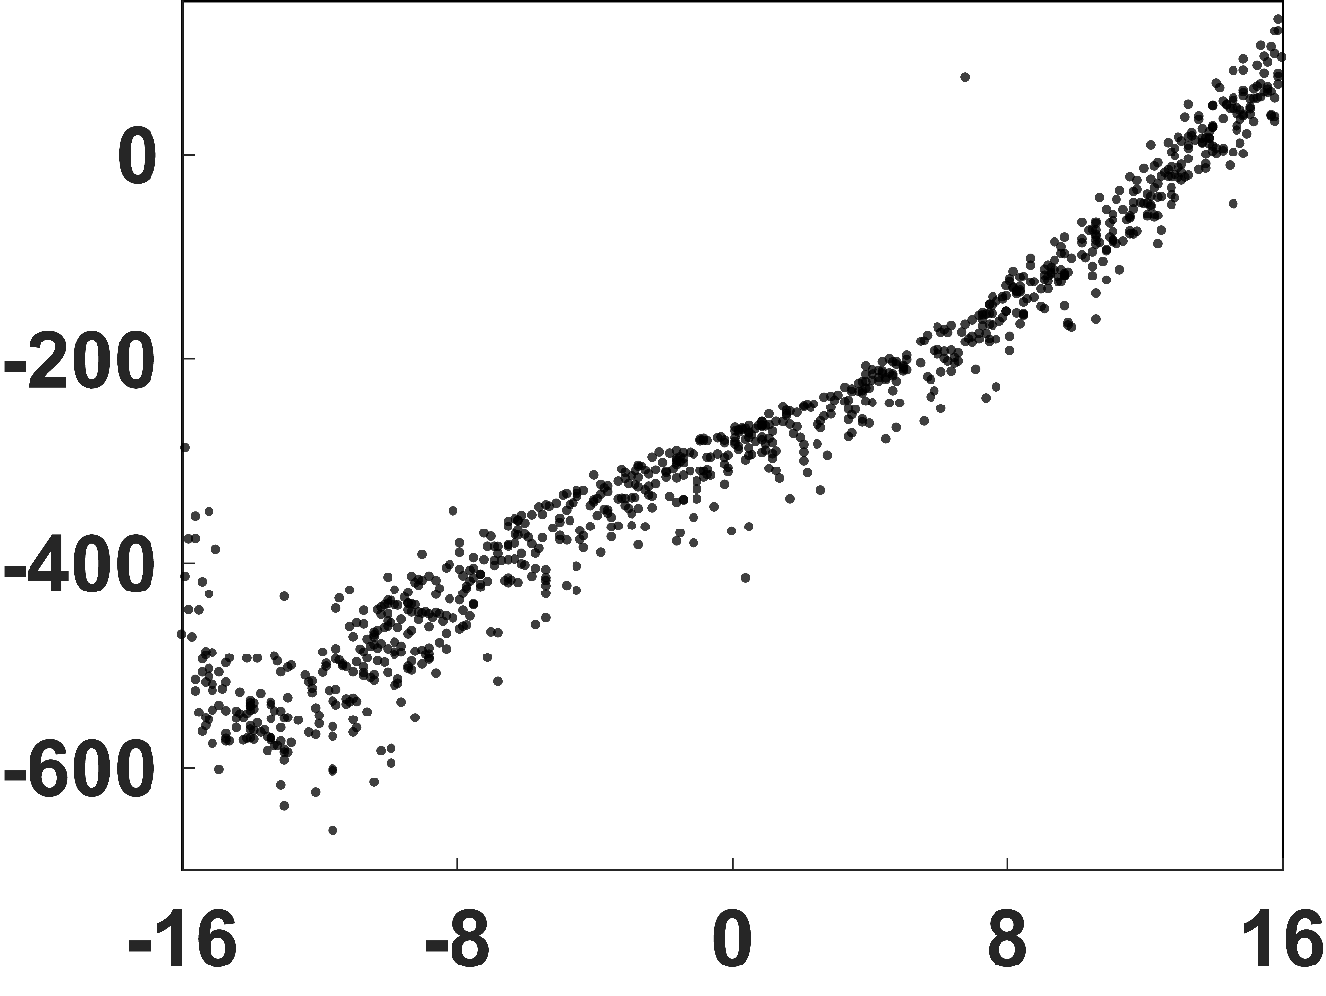
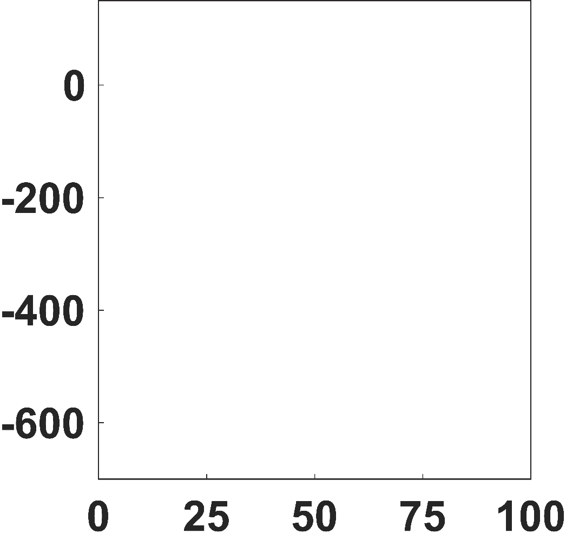
Contact Forces Highly Sensitive to Component Malrotation
M-L PF Contact Force [N]
19 N/deg
r² = 0.8
45°
F_{M-L}
medial
% Stance
I-E Malrotation
[deg] (+external)

Slide 14
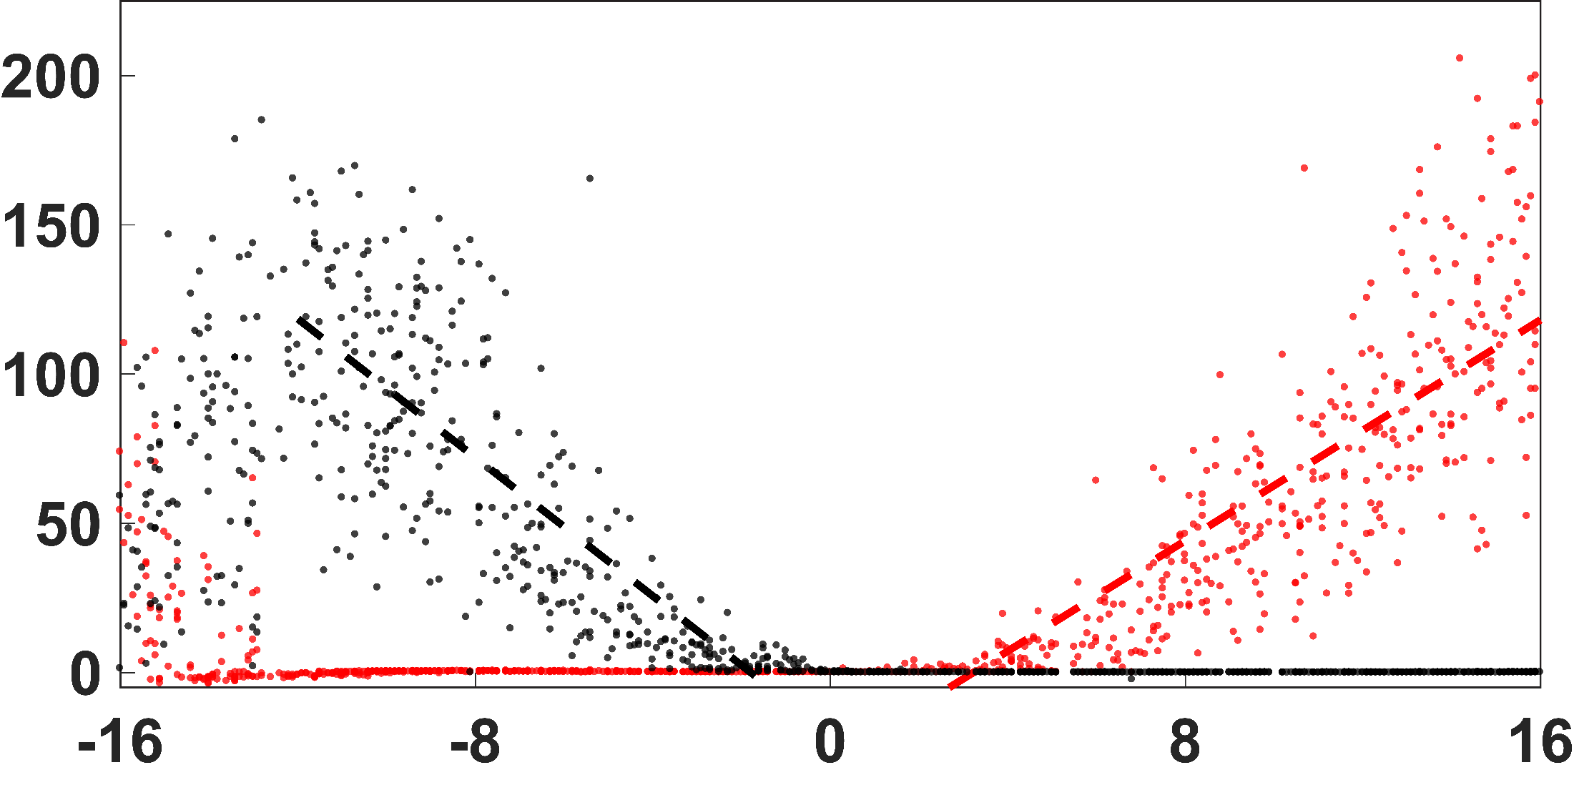
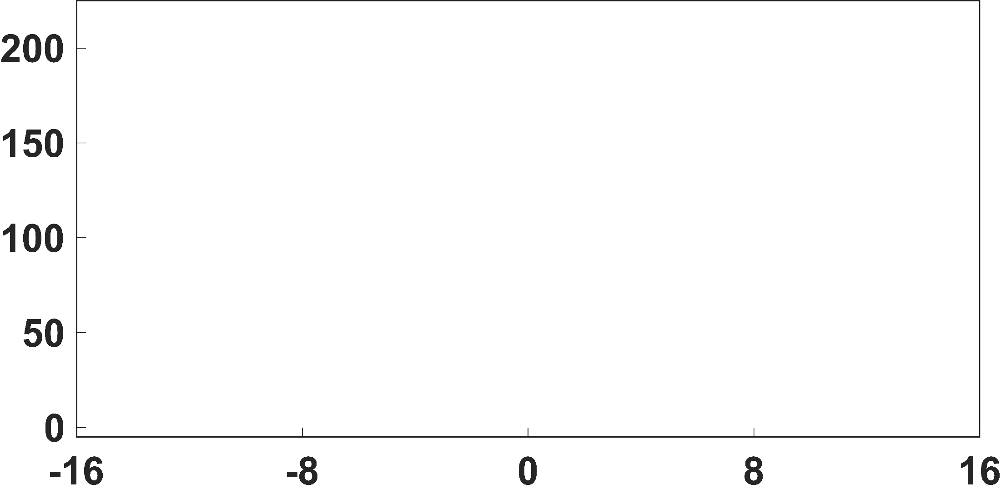
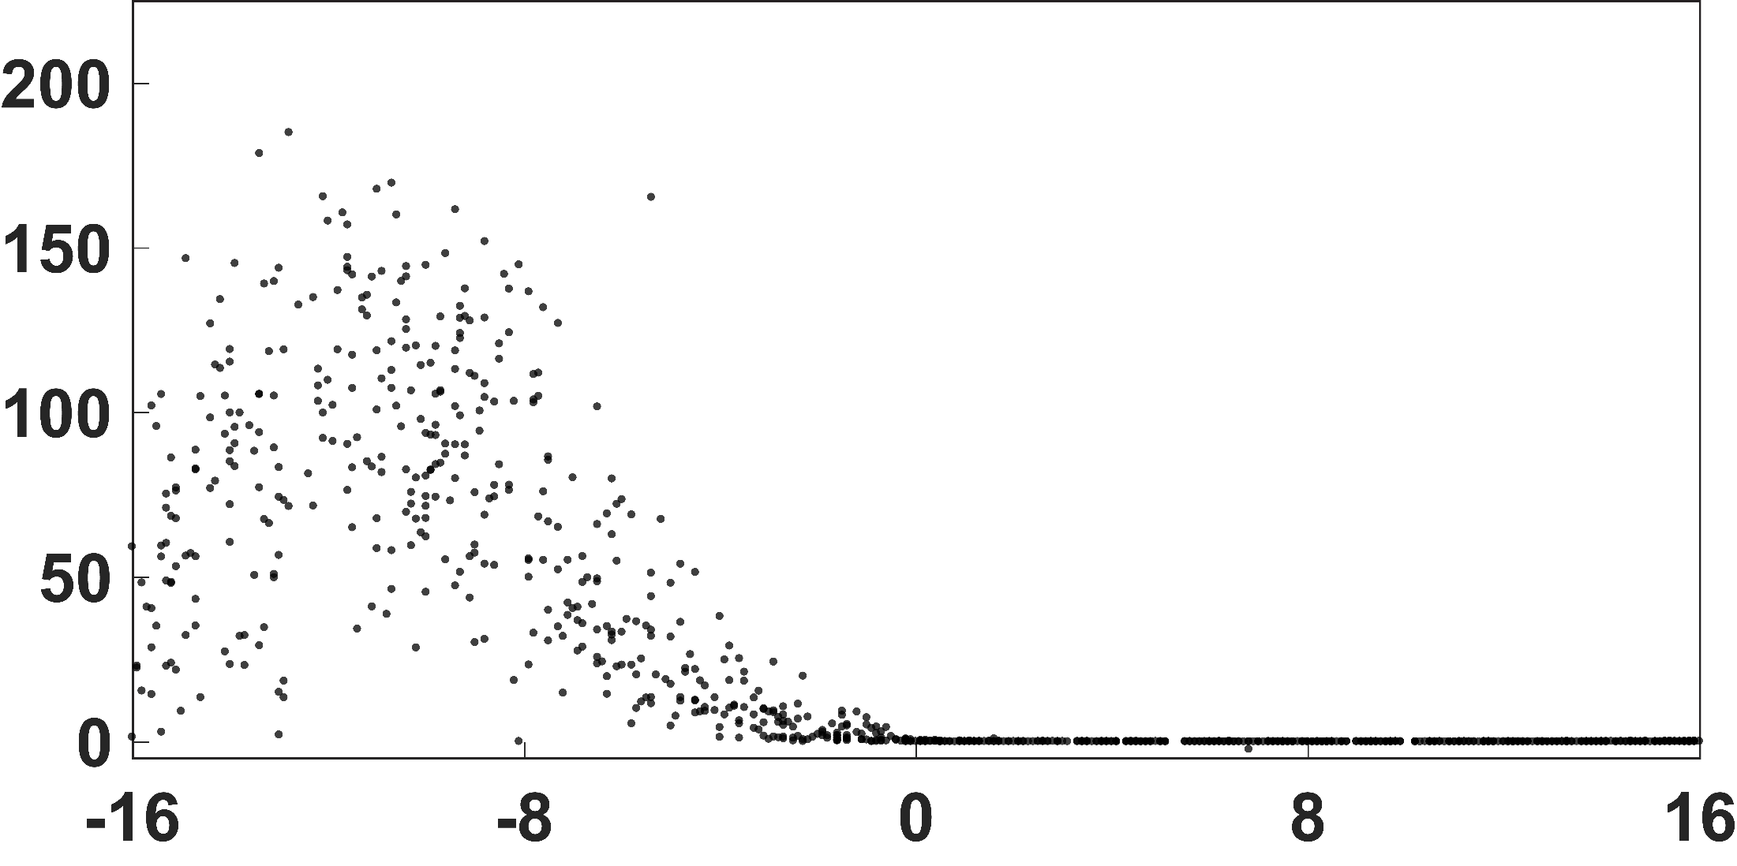
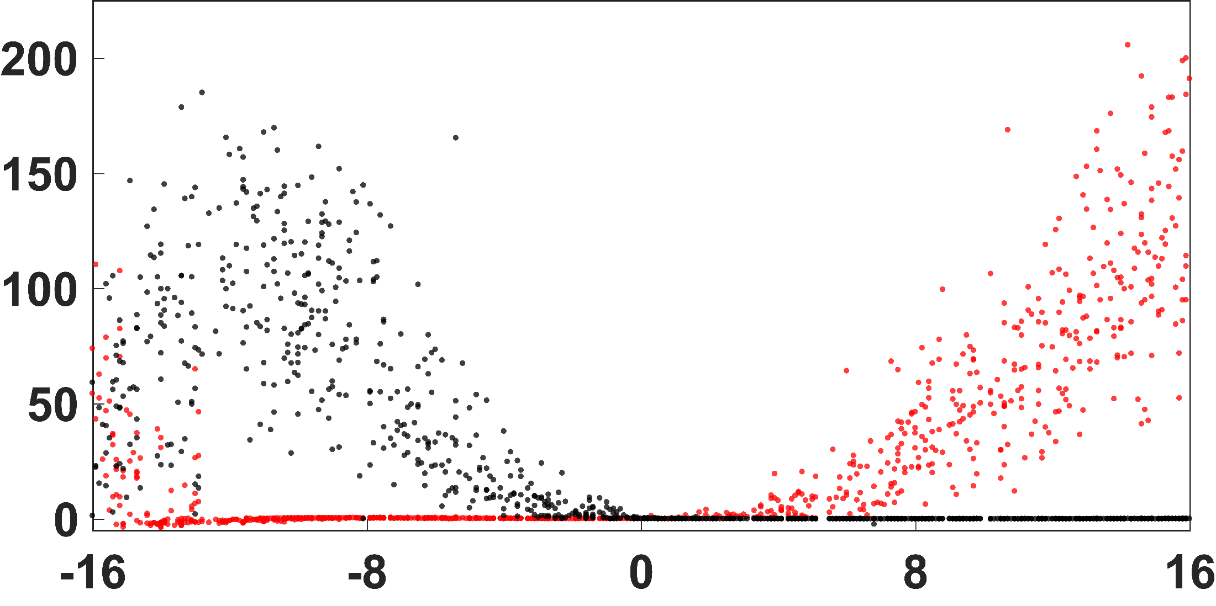
Ligament Tension Highly Sensitive to Component Malrotation
-12°
F_{lPFL}
F_{mPFL}
9 N/deg
r² = 0.8
Ligament Tension [N]
12 N/deg
r² = 0.7
-2°
3°
I-E Malrotation [deg] (+external)

Slide 15
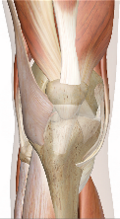
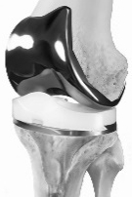
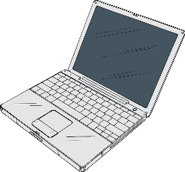
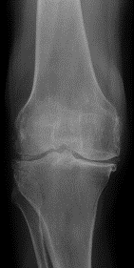
Envisioned Translation of Computational Models to Improve Patient Satisfaction
Intraoperative Biomechanics
Biomechanical
Metrics
Postoperative Biomechanics
Treatment
Specifics
Medical Images

Slide 16
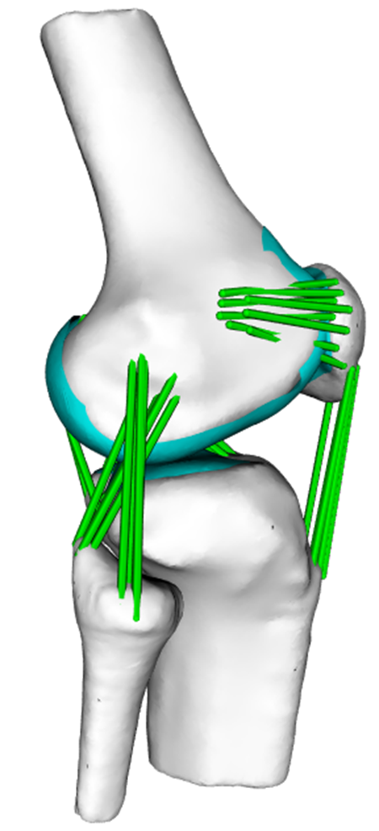
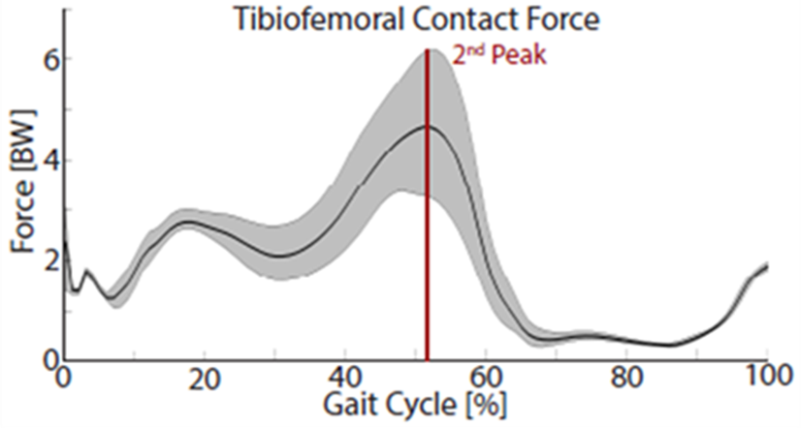
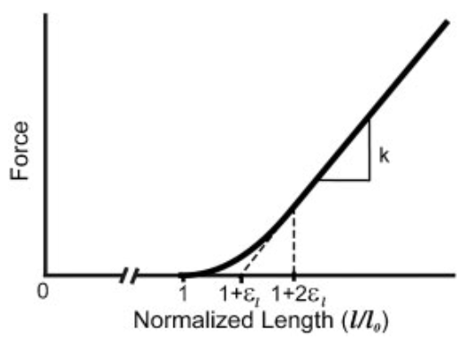
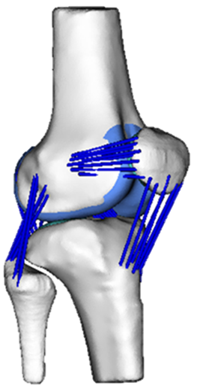
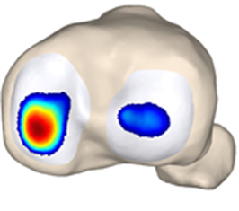
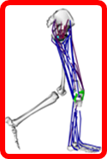
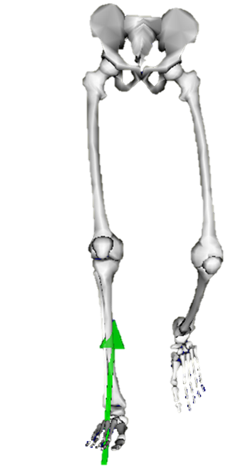
Future work aims to parameterize all model inputs
Probabilistic Knee Contact and Ligament Loading
Parameterized Inputs
Stochastic Simulation
Anthropometrics
Constitutive
Properties
Knee
Geometry
Neuromuscular Coordination
High Throughput Computing
…
Gait Dynamics

Slide 17
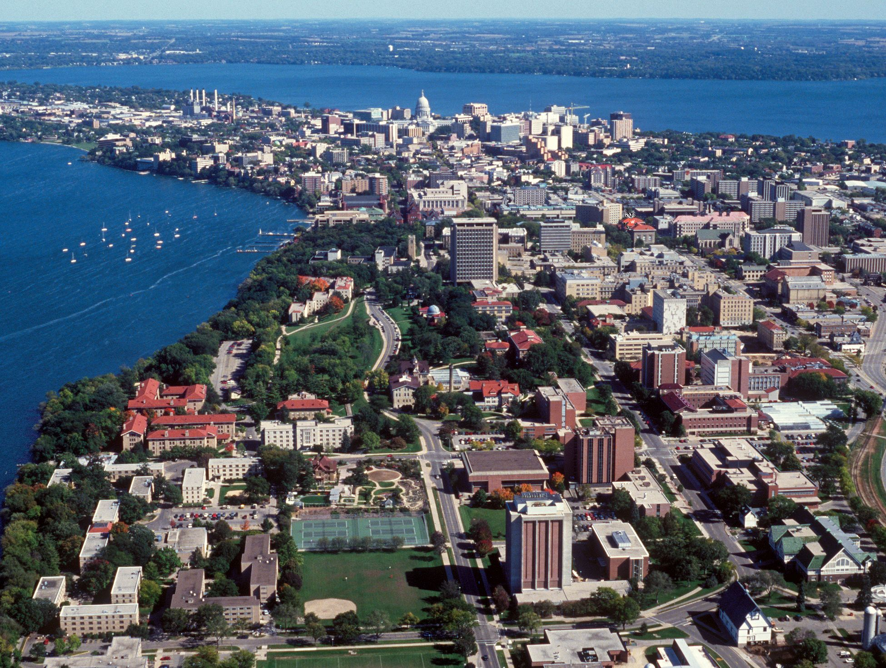
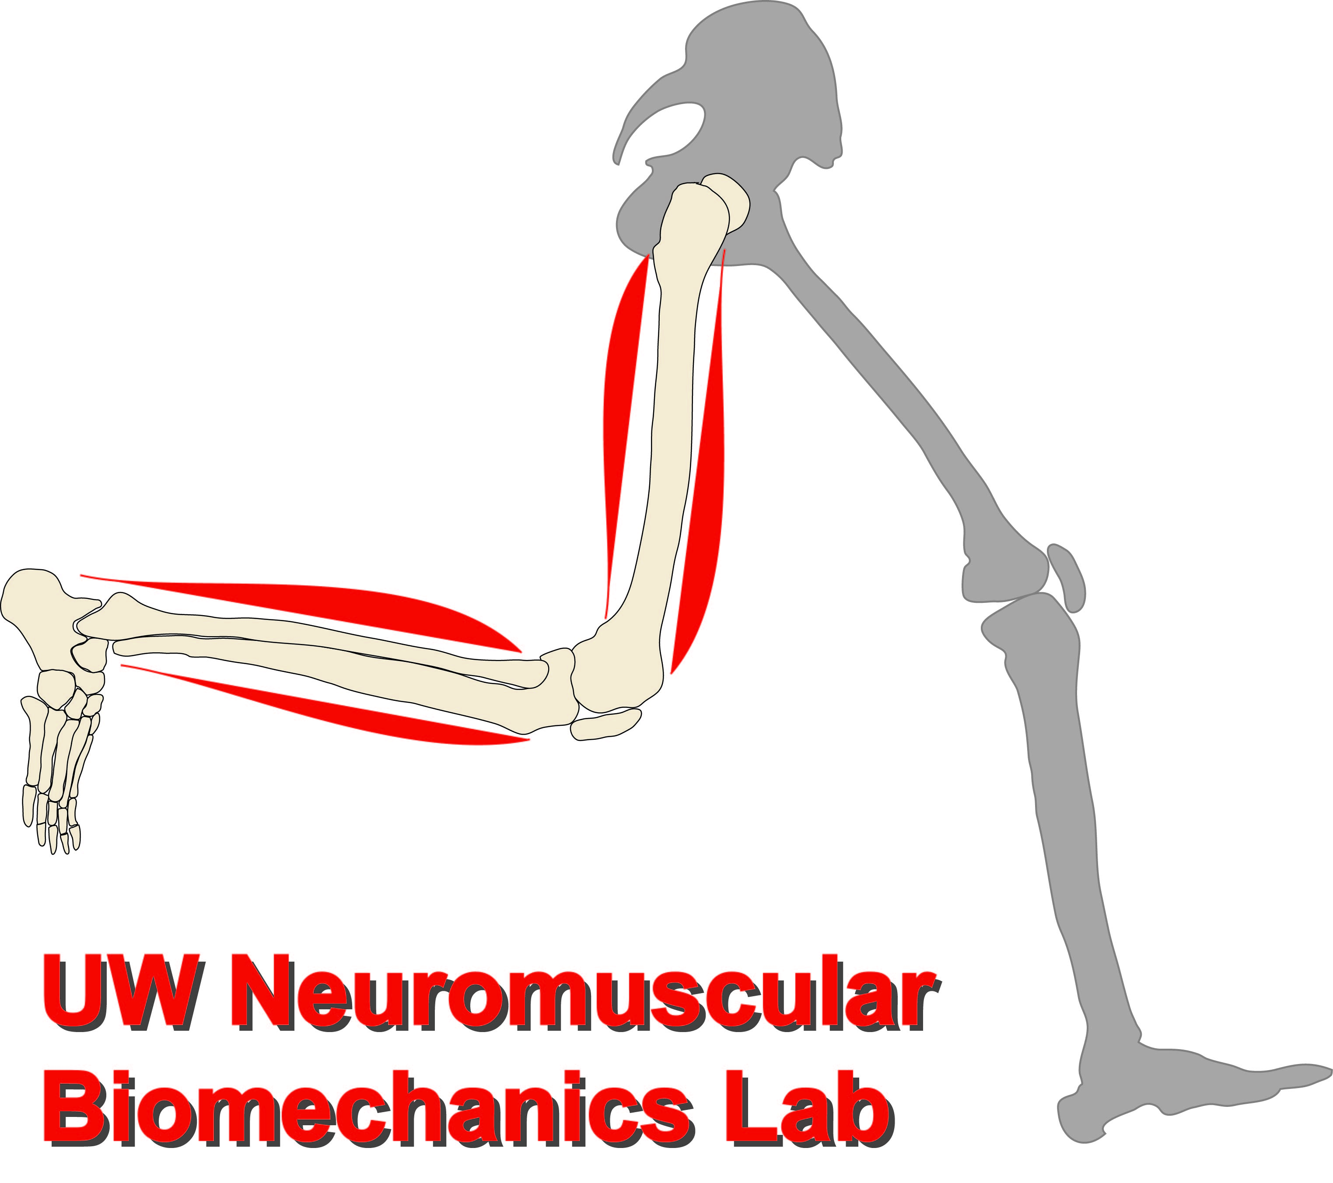
Acknowledgements
Colin R. Smith, PhD
Whitaker Post-doctoral Fellow
ETH Zürich
http://uwnmbl.engr.wisc.edu/
jdroth2@wisc.edu
dgthelen@wisc.edu
Christina Koch
EB015410, HD084213, AR062733, HD065690, 5 T32 AG 213-26

Slide 18
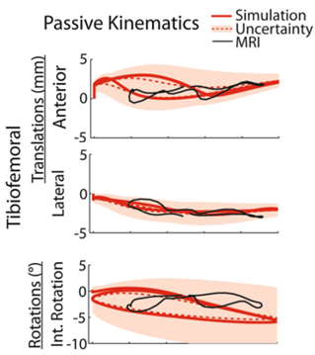
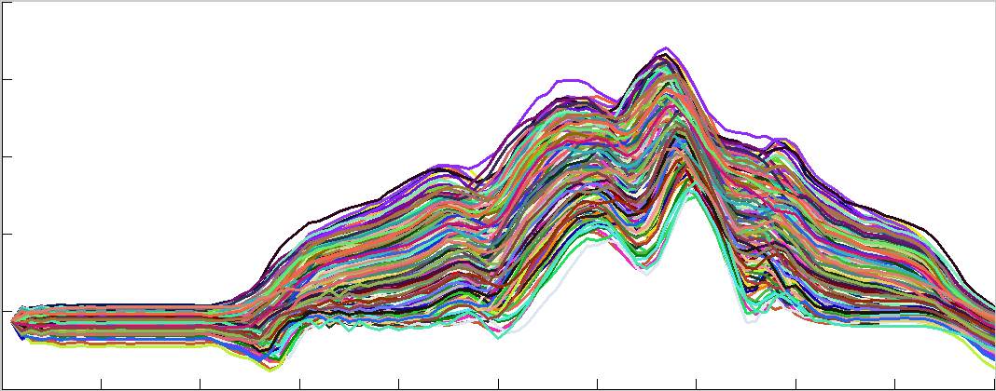
Propagation of ligament property uncertainty to kinematics
0
3000 Simulations
-1
Adduction [º]
-2
Time
Lenhart et al, Ann Biomed Eng, 2015

Slide 19
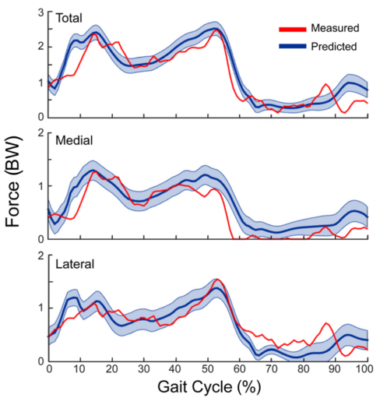
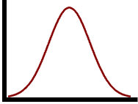
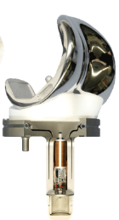
Propagation of ligament property uncertainty to joint contact forces
ITB
Stiffness
LCL
Stiffness
PFL
Stiffness
MCL
Stiffness

