Slide 1
The SciTokens Authorization Model: JSON Web Tokens & OAuth
Jim Basney <jbasney@ncsa.Illinois.edu>
Brian Bockelman <bbockelm@cse.unl.edu>
This material is based upon work supported by the National Science Foundation under Grant No. 1738962. Any opinions, findings, and conclusions or recommendations expressed in this material are those of the author(s) and do not necessarily reflect the views of the National Science Foundation.
Notes:
The SciTokens project (https://scitokens.org), in collaboration with the HTCondor team, is helping to bring capability-based authorization for least-privilege access to scientific computing infrastructures using the JSON Web Token (JWT) and OAuth standards, which are already used by services like Box, Dropbox, and Google Drive. This talk will give an introduction to the SciTokens model, including an introduction to JWTs and OAuth, and will discuss motivating use cases including PyCBC workflows using HTCondor in LIGO.

Slide 2
SciTokens Project
The SciTokens project, starting July 2017, aims to:
Introduce a capabilities-based authorization infrastructure for distributed scientific computing,
Provide a reference platform, combining CILogon, HTCondor, CVMFS, and XRootD, and
Implement specific use cases to help our science stakeholders (LIGO and LSST) better achieve their scientific aims.

Slide 3
Identity-based Authorization
At the core of today’s grid security infrastructure is the concept of identity and impersonation.
A grid certificate provides you with a globally-recognized identification.
The grid proxy allows a third party to impersonate you, (ideally) on your behalf.
The remote service maps your identity to some set of locally-defined authorizations.
We believe this approach is fundamentally wrong because it exposes too much global state: identity and policy should be kept locally!

Slide 4
Capability-based Authorization
We want to change the infrastructure to focus on capabilities!
The tokens passed to the remote service describe what authorizations the bearer has.
For traceability purposes, there may be an identifier that allows tracing of the token bearer back to an identity.
Identifier != identity. It may be privacy-preserving, requiring the issuer (VO) to provide help in mapping.
Example: “The bearer of this piece of paper is entitled to write into /castor/cern.ch/cms".

Slide 5
Capabilities versus Impersonation
If GSI took over the world, an attacker could use a stolen grid proxy to make withdrawals from your bank account.
With capabilities, a stolen token only gets you access to a specific authorization (“stageout to /store/user at Nebraska”).
SciTokens is following the principle of least privilege for distributed scientific computing.

Slide 6
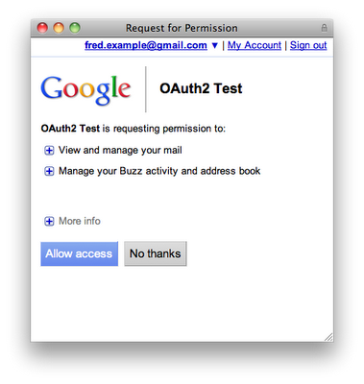
The World Uses Capabilities!
The rest of the world uses capabilities for distributed services.
The authorization service creates a token that describes a certain capability or authorization.
Any bearer of that token may present it to a resource service and utilize the authorization.
The primary way this is implemented is through OAuth2.
When you click “allow access” on the right, the client at “OAuth2 Test” will receive a token. This token will permit it to access the listed subset of Google services for your account.
OAuth2 is used by Microsoft, Facebook, Google, Dropbox, Box, Twitter, Amazon, GitHub, Salesforce (and more) to allow distributed access to their identity services.

Slide 7
Three-Legged Authorization
In OAuth2, there are three abstract entities involved in the authorization workflow:
Authorization server issues capabilities (tokens).
The resource owner (end-user) approves authorizations.
The client receives tokens. Often, this is the third-party website or smartphone app.
Once the token is issued, it can be used at the resource server to access some protected resource.
In the Google example, Google runs both the authorization and resource servers.
Resource Owner
Authorization Server
Client

Slide 8
SciTokens Model
T
= token
Integrating an OAuth2 client on the HTCondor submit host
Enhancing CILogon to support OAuth2 with VO-defined scopes
Enhancing HTCondor to manage token refresh, attenuation, and delivery to jobs
Enhancing data services (CVMFS, Xrootd) to allow read/writes using tokens instead of grid proxies
Submit
Execute
Data
Scheduler
Launcher
Data Server
T
T
token
T
T
User
Token Manager
Job
Token Server
T

Slide 9
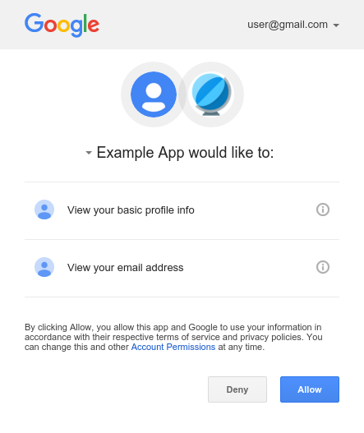
End-Goal
CERN
CMS user @ cern.ch
The end-goal is this
The first time you use HTCondor, you navigate to a web interface and setup your desired permissions.
On every subsequent condor_submit, HTCondor will transparently create the access token for you. User sees nothing.
Replace CERN, usernames, and authorization as desired.
Goal: our first use of OAuth2 will be to stageout from payload jobs to Box.
HTCondor
Stage Output

Slide 10
PASSWORD IN TERMINAL
USER MANAGEMENT OF FILES
SCITOKENS-PROXY-INIT
COPY/PASTE

Slide 11
Architecture
R
= refresh tokens
A
= access tokens
Policy DB
Token Server
Job Submission
Job Execution
condor_submit
condor_startd
User
Identity Provider
condor_schedd
condor_starter
Data Access
condor_credd
User’s job
Data Server
A
A
A
(CVMFS / XRootD)
condor_shadow
A
R

Slide 12
OAuth2 Authorization Framework
User (Resource Owner)
Client
Authorization Server
Resource Server
Authorization Request
Authorization Request
Authentication & Consent
Authorization Grant
Authorization Grant
Authorization Grant
Access + Refresh Tokens
Access Token
Protected Resource
Validate Token
Refresh Token
Access + Refresh Tokens

Slide 13
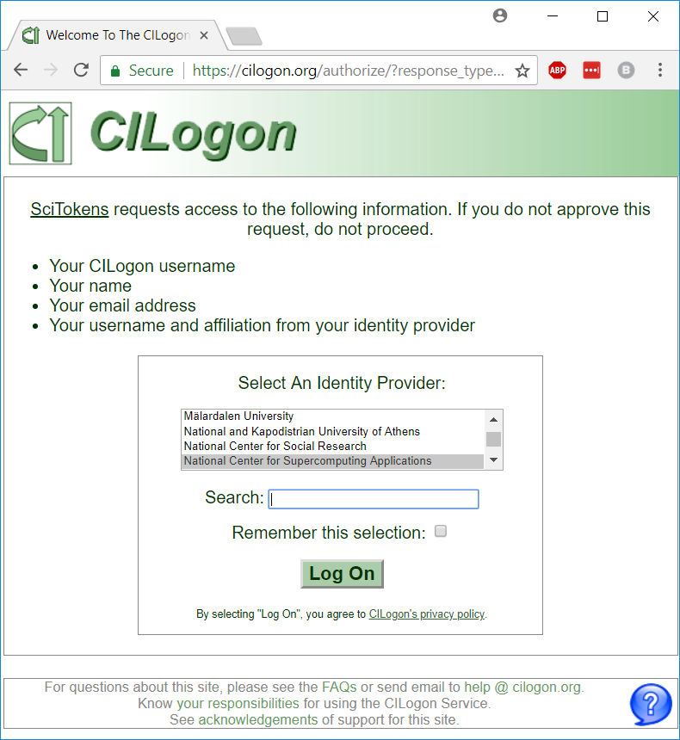
CILogon and SciTokens
CILogon
Federated Identity Management
OpenID Connect
ID Tokens
SciTokens
Federated Authorization
OAuth 2.0
Access Tokens
InCommon IdP
User ID Name Email
CILogon
User Info VO Info Groups
SciTokens
Access Rights
Resource

Slide 14
Tokens for Distributed Science Infrastructures
Distributed science infrastructures are distinct from a “resource server” like Google because they are not run by a single central entity.
Hence, unlike Google, we can’t use opaque random strings for the token. We need something that allows for distributed verification.
Given a token, a storage service can determine it is valid.
Analogously, given a proxy chain and a set of trust roots, you can determine the GSI proxy is valid.
Goal: Sites set aside some area for each VO; VOs manage the authorizations within these “VO home” areas.

Slide 15
JWT in action!
Free tokens! Navigate to https://demo.scitokens.org to get your free tokens!
This demo illustrates the access token format we’re working on.
Utilizes JSON Web Tokens (JWT) as the access token format.
Various RFCs provide clear guidance on how to verify token integrity.
Adds a few domain-specific claims for receiving access to storage.
The tokens are base64-encoded and can be used as part of a curl command to use protected resources.

Slide 16
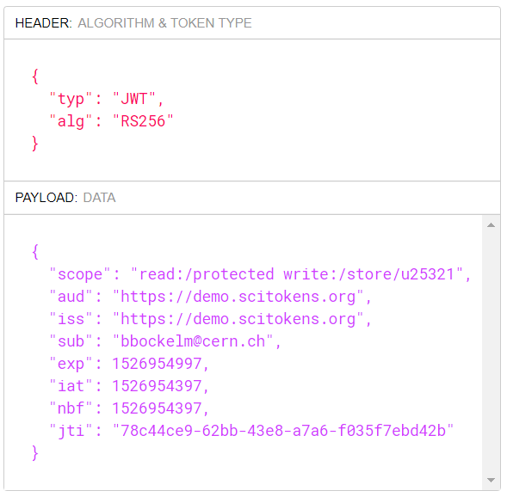
Example Token, Decoded
The decoded token contains multiple scopes - basically filesystem authorizations.
The audience narrows who the token is intended for.
The issuer identifies who created the token; value used to locate the public keys needed to validate signature.
The subject is an opaque identifier for the resource owner. In this case, it also happens to be the identity.
The expiration is a Unix timestamp when the token expires. A typical lifetime is 10 minutes.

Slide 17
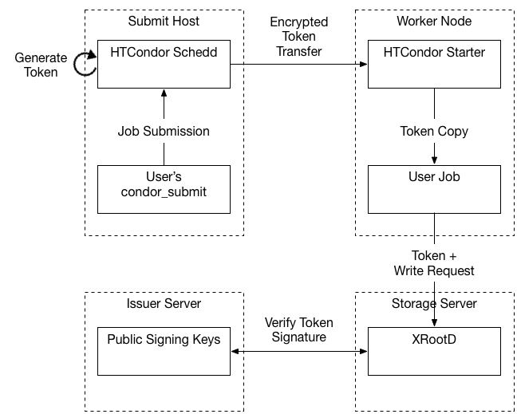
Early results on OSG
We have been able to get a basic end-to-end token-based auth{z,n} workflow working for the OSG VO submit service.
This includes patches to Xrootd to validate tokens presented via HTTP and to write files out with the correct Unix user permissions.
Cheats:
instead of using OAuth2 to generate the token, we keep a signing key on the submit host.
only one token needed.
submit host and storage server owned by OSG.

Slide 18
Wait, I’ve seen this before!
If you’re from ALICE and getting a sense of déjà vu — you’re right!
The capability-based infrastructure is precisely the authorization infrastructure used by ALICE for the past decade.
SciTokens takes this successful model, recasts it using modern web protocols, and utilizes OAuth2 workflows to issue the tokens.
The use of common protocols and workflows means that we have a large number of battle-tested libraries we can leverage (spend our time doing other stuff besides writing the basics!).
Using JWT-formatted access tokens is somewhat-commonplace among web companies.
We think SciTokens is unique in using JWT access tokens for distributed verification in a federated infrastructure.

Slide 19
Status & Next Steps
So far we have:
Version 1.0 of Python and Java libraries
Simple HTCondor OAuth client implementation
XRootD token validation plugins
Token-based CVMFS access
X509-to-SciToken translation service
3rd-party HTTPS FTS transfers authorized with SciTokens
Next steps:
Use Java library for a dCache authorization plugin
Release plugin for CVMFS support
More fine-grained token management in HTCondor
Integration with LIGO LDAP
Enhancing HTCondor token support with OAuth flows

Slide 20
Thanks!
Visit
https://scitokens.org/
for more info.
Any questions?

