Slide 1
Python: Swiss-Army Glue
Josh Karpel <karpel@wisc.edu>
Graduate Student, Yavuz Group
UW-Madison Physics Department

Slide 2
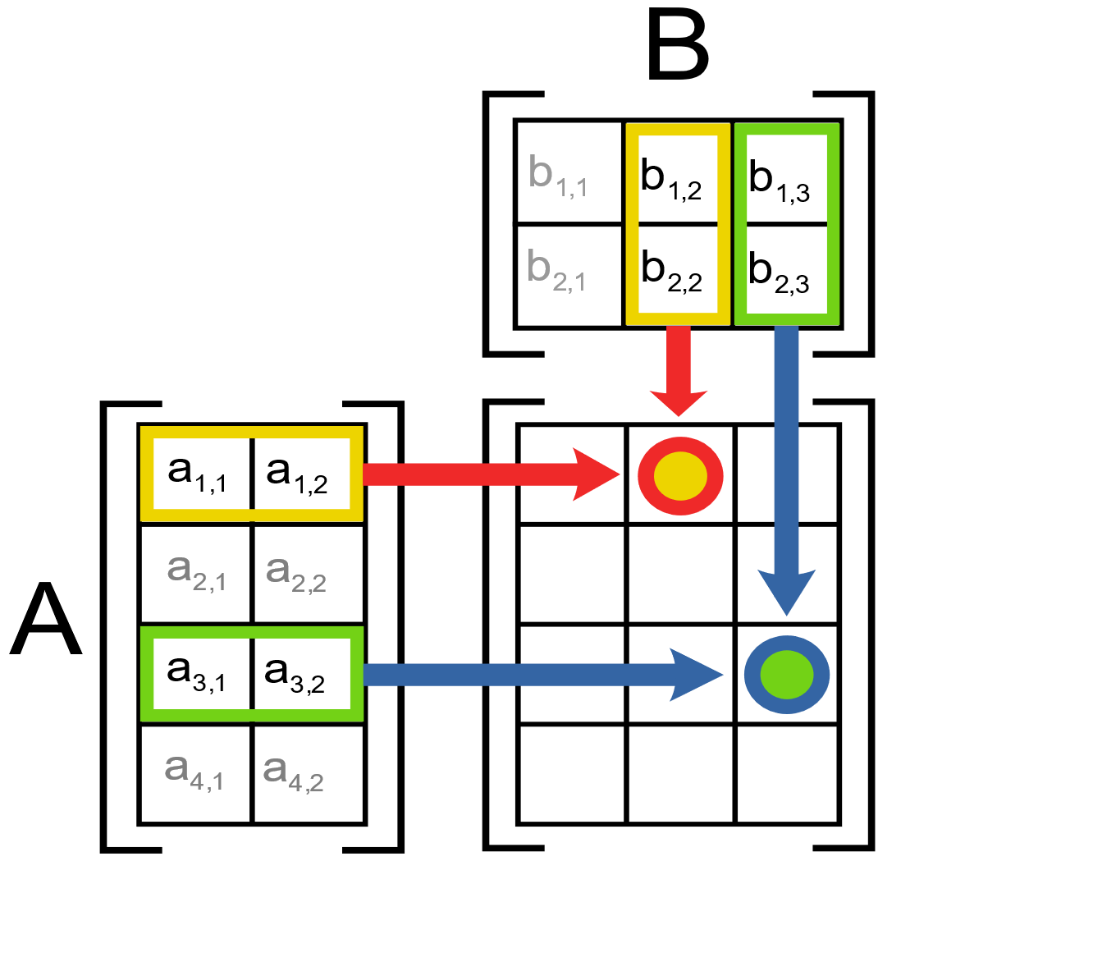
My Research: Matrix Multiplication

Slide 3
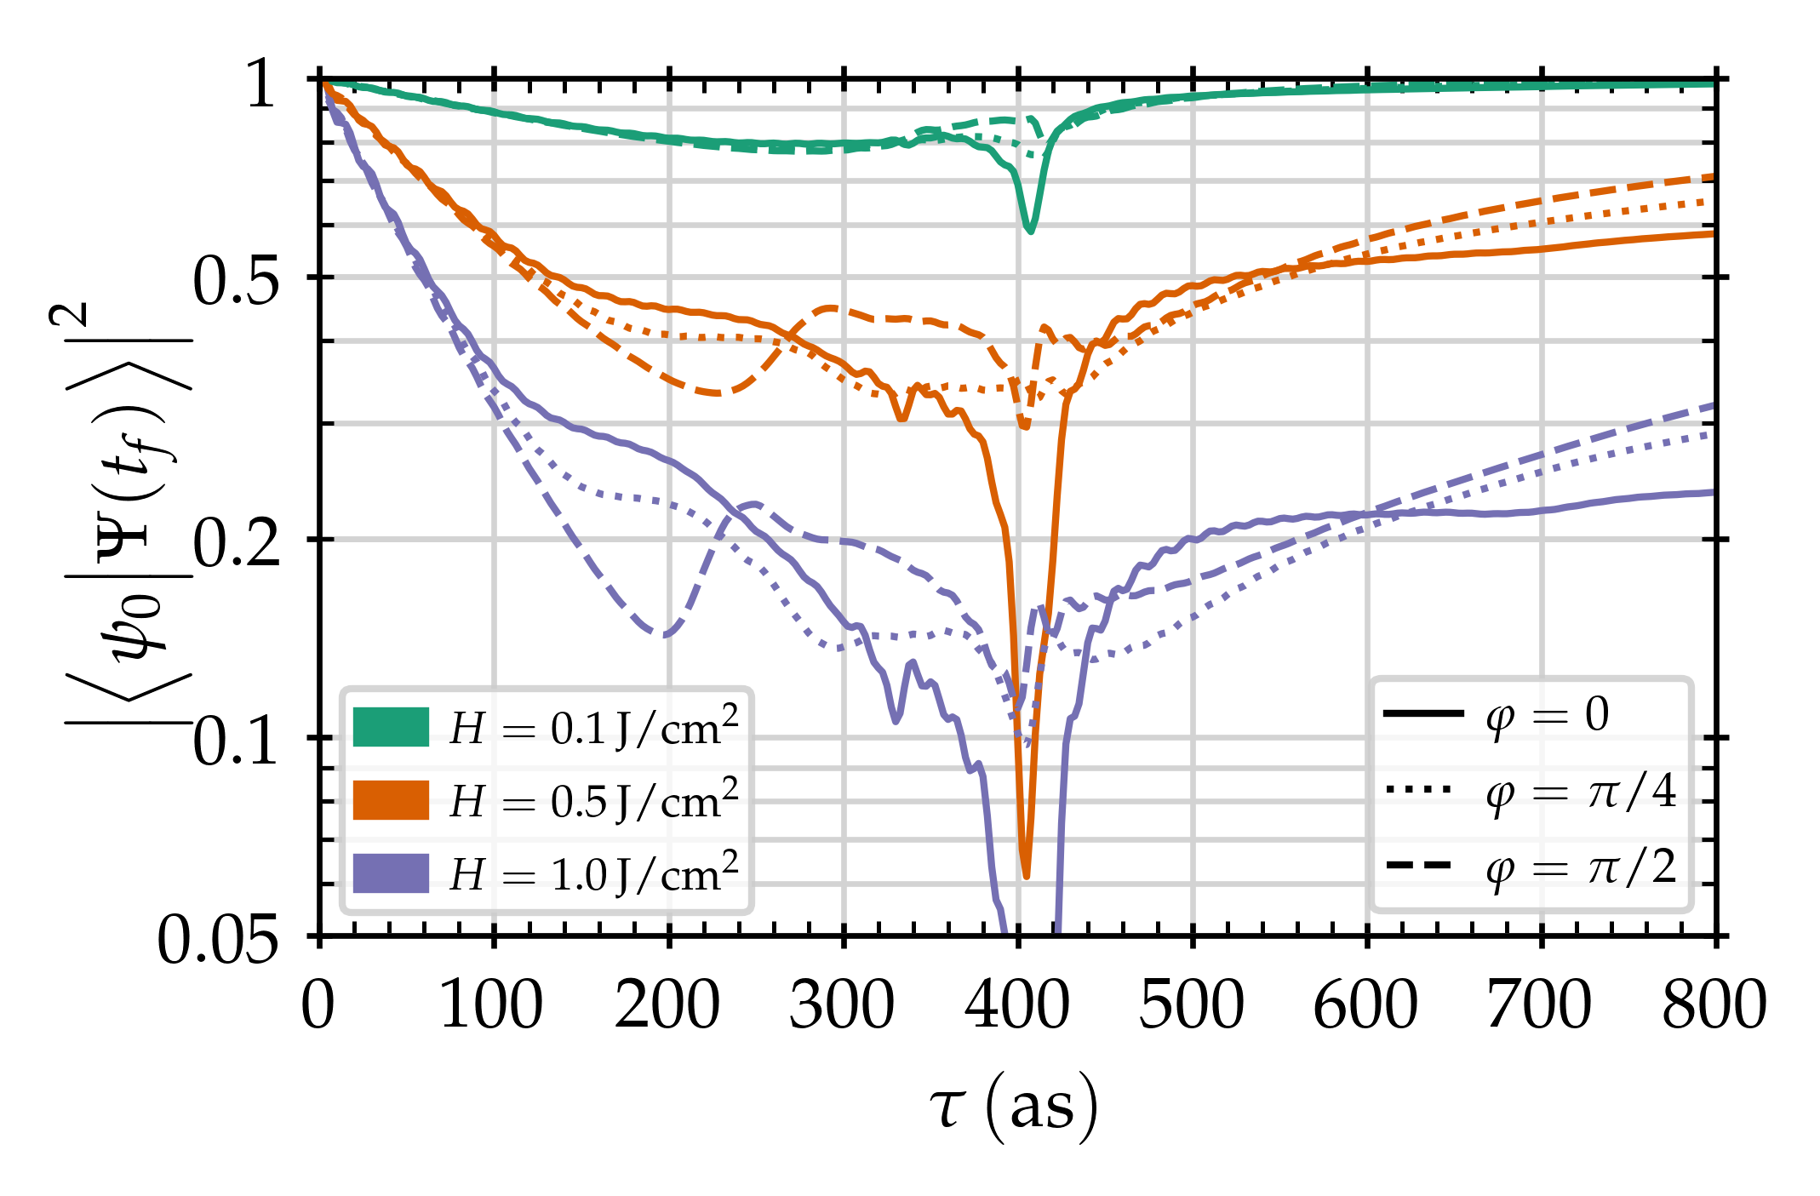
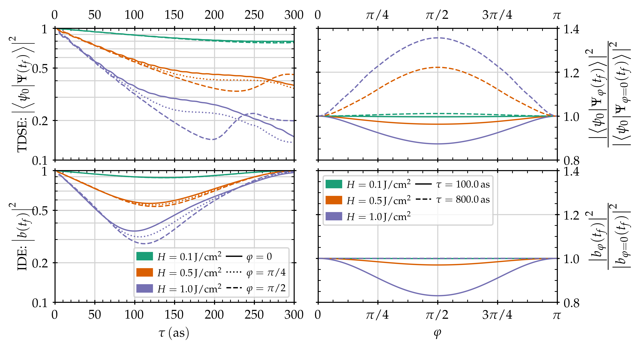
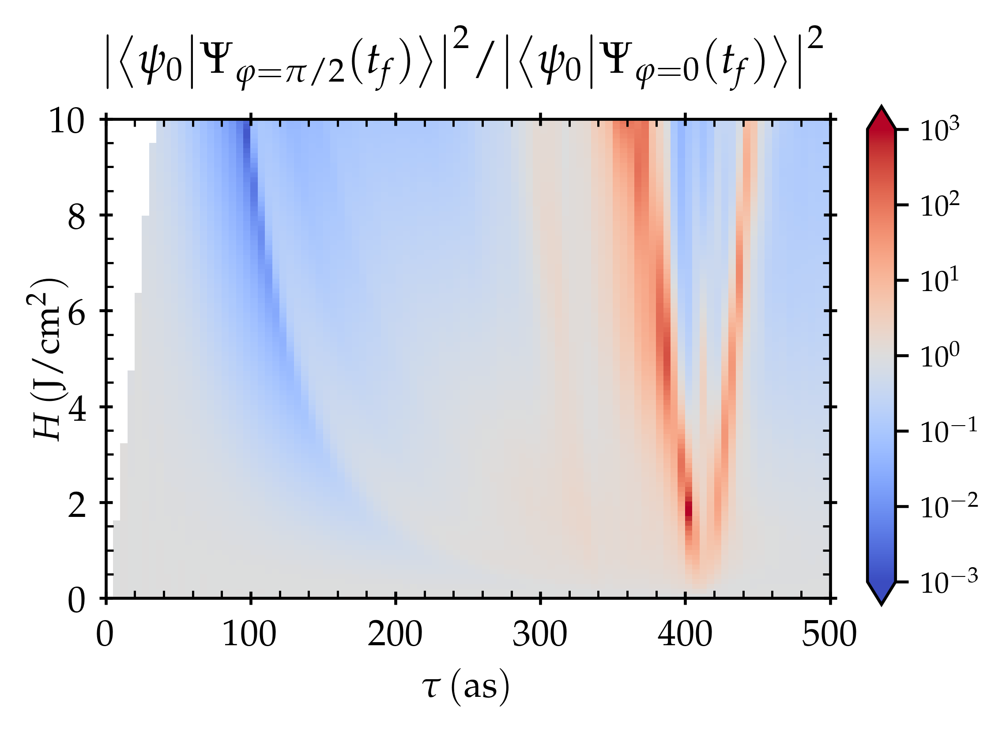
My Research: Computational Quantum Mechanics
Why HTC?
HUGE PARAMETER SCANS
How HTC?
Manage jobs w/o big infrastructure
https://doi.org/10.1364/OL.43.002583

Slide 4
Using Python for Cluster Tooling
Create
Create jobs programmatically: “questionnaires”
Run
Store rich data: pickle
Analyze
Automate file transfer: paramiko
Processing: pandas sqlite matplotlib ...
Computation: numpy scipy cython
...
Notes:
Should already be familiar to sysadmins, who might write their own quick Python scripts

Slide 5
Using compiled C/Fortran code
>>> import numpy as np
>>> x = np.array(list(range(10)))
>>> x
array([0, 1, 2, 3, 4, 5, 6, 7, 8, 9])
>>> x * 2
array([ 0, 2, 4, 6, 8, 10, 12, 14, 16, 18])
>>> x ** 2
array([ 0, 1, 4, 9, 16, 25, 36, 49, 64, 81])
>>> np.dot(x, x)
285
Also see: Cython, Numba, F2PY, etc.

Slide 6
Scientific Python stack is full-featured
Other Things People Like | Python Equivalents
Mathematica’s symbolic mathematics | sympy
Mathematica Notebooks / MATLAB’s command window | IPython Notebooks
MATLAB’s multidimensional arrays | numpy
MATLAB’s plotting tools | matplotlib
Pre-implemented numerical routines | scipy
Plus all the power of Python as a general-purpose language!

Slide 7
Generate jobs programmatically via “questionnaires”
$ ./create_job__tdse_scan.py demo --dry
Mesh Type [cyl | sph | harm] [Default: harm] >
R Bound (Bohr radii) [Default: 200] > 100
R Points per Bohr Radii [Default: 10] > 20
l points [Default: 500] >
[WARNING] ~ Predicted memory usage per Simulation is >15.3 MB
Mask Inner Radius (in Bohr radii)? [Default: 80.0] >
Mask Outer Radius (in Bohr radii)? [Default: 100.0] >
<MORE QUESTIONS>
Generated 75 Specifications
Job batch name? [Default: demo] >
Flock and Glide? [Default: y] > n
Memory (in GB)? [Default: 1] > .8
Disk (in GB)? [Default: 5] > 3
Creating job directory and subdirectories...
Saving Specifications...
Writing Specification info to file...
Writing submit file...

Slide 8
Use input and eval (carefully!)
choices = { 'a': 'hello', 'b': 'goodbye', } choice = choices[input('Choice? ')] # Choice? <a> print(choice) # hello
import numpy as np array = eval('np.linspace(0, 10, 11)') print(type(array)) # <class 'numpy.ndarray'> print(array) # [0. 1. 2. 3. 4. 5. 6. 7. 8. 9. 10.]
array = eval(input('Enter your array!'))

Slide 9
Generate jobs programmatically via questionnaires
[09:18 PM | karpel@submit-5 | ~/jobs/demo] $ ls -lh
total 236K
-rw-rw-r-- 1 karpel karpel 257 Apr 9 21:09 info.pkl
drwxrwxr-x 2 karpel karpel 4.0K Apr 9 21:09 inputs
drwxrwxr-x 2 karpel karpel 4.0K Apr 9 21:09 logs
drwxrwxr-x 2 karpel karpel 4.0K Apr 9 21:09 outputs
-rw-rw-r-- 1 karpel karpel 22K Apr 9 21:09 parameters.txt
-rw-rw-r-- 1 karpel karpel 186K Apr 9 21:09 specifications.txt
-rw-rw-r-- 1 karpel karpel 972 Apr 9 21:09 submit_job.sub
Advantages
Avoids copy-paste issues
Provide feedback during job creation to catch errors early
Flexible enough to define new “types” of jobs without writing entirely new scripts
Easy to generate metadata about job
Notes:
Avoids copy-paste issues like forgetting to change something, or changing something you shouldn’t have
Easy to generate metadata about job because you have access to the inputs while they’re still in Python

Slide 10
Store rich data using pickle
Advantages
Works straight out of the box
Avoid transforming to/from other data formats (CSV, JSON, HDF5, etc.)
Implement self-checkpointing jobs easily
Gotchas
Certain types of objects can’t be serialized
Not as compressed as dedicated formats
Can accidently break backwards-compatibility
import pickle class Greeting: def __init__(self, words): self.words = words def yell(self): print(self.words.upper()) greeting = Greeting('hi!') with open('foo.pkl', mode = 'wb') as file: pickle.dump(greeting, file) with open('foo.pkl', mode = 'rb') as file: from_file = pickle.load(file) print(from_file.words) # hi! from_file.yell() # HI!

Slide 11
Automate file transfer using paramiko
import paramiko remote_host = 'submit-5.chtc.wisc.edu' username = 'karpel' key_path = 'wouldnt/you/like/to/know' ssh = paramiko.SSHClient() ssh.set_missing_host_key_policy(paramiko.AutoAddPolicy()) ssh.connect(remote_host, username = username, key_filename = key_path) ftp = ssh.open_sftp() ssh.exec_command('ls -l') # returns stdin, stdout, stderr ftp.put('local/path', 'my/big/fat/input/data') ftp.get('path/to/completed/simulation', 'local/path')
Advantages
Runs on a schedule
Easy to control which files get downloaded
Can hook directly into data processing
Gotchas
Slow
Occasional strange interactions with Dropbox/Box/Google Drive?

Slide 12
Process data using pandas
df = pd.read_excel(...) df = pd.read_csv(...) df = pd.read_hdf(...) df = pd.read_json(...) df = pd.read_pickle(...) df = pd.read_sql(...)
df.to_excel(...)
df.to_csv(...)
df.to_hdf(...)
df.to_json(...)
df.to_pickle(...)
df.to_sql(...)
df.to_html(...)
# and more!
import numpy as np import pandas as pd dates = pd.date_range('2018-01-01', periods = 6) df = pd.DataFrame( np.random.randn(6, 4), index = dates, columns = list('ABCD'), ) print(df)
#####################
A B C D
2018-01-01 -0.165014 0.721058 1.113825 1.778694
2018-01-02 1.774170 0.130640 1.089180 -0.812315
2018-01-03 1.167511 0.121111 -0.766156 1.816411
2018-01-04 0.103793 0.438878 -0.040532 0.238539
2018-01-05 -0.492766 1.466809 -0.384373 2.209309
2018-01-06 -1.304448 0.593538 0.055233 1.930035

Slide 13
Visualize data using matplotlib

Slide 14
Python is Swiss-Army Glue
Run Jobs
Process Jobs
Retrieve Jobs
Generate Jobs
pickle
numpy
scipy
cython
input/eval
Python
pickle
matplotlib
pandas
sqlite
paramiko
pickle

Slide 15
Where to go from here?
My (extremely unstable) framework, Simulacra
The HTCondor Python Bindings
James Bourbeau’s PyCondor
Your own ideas!

