Slide 1
UW-Madison HTCondor InSAR Workflow
Elena C. Reinisch, Ph.D. Student
UW-Madison Department of Geoscience
May 24, 2018

Slide 2
Why monitor Deformation?
Tracking deformation patterns in space and time can lead to a better understanding of geophysical processes
earthquakes
sinkholes
volcanoes
geothermal areas

Slide 3
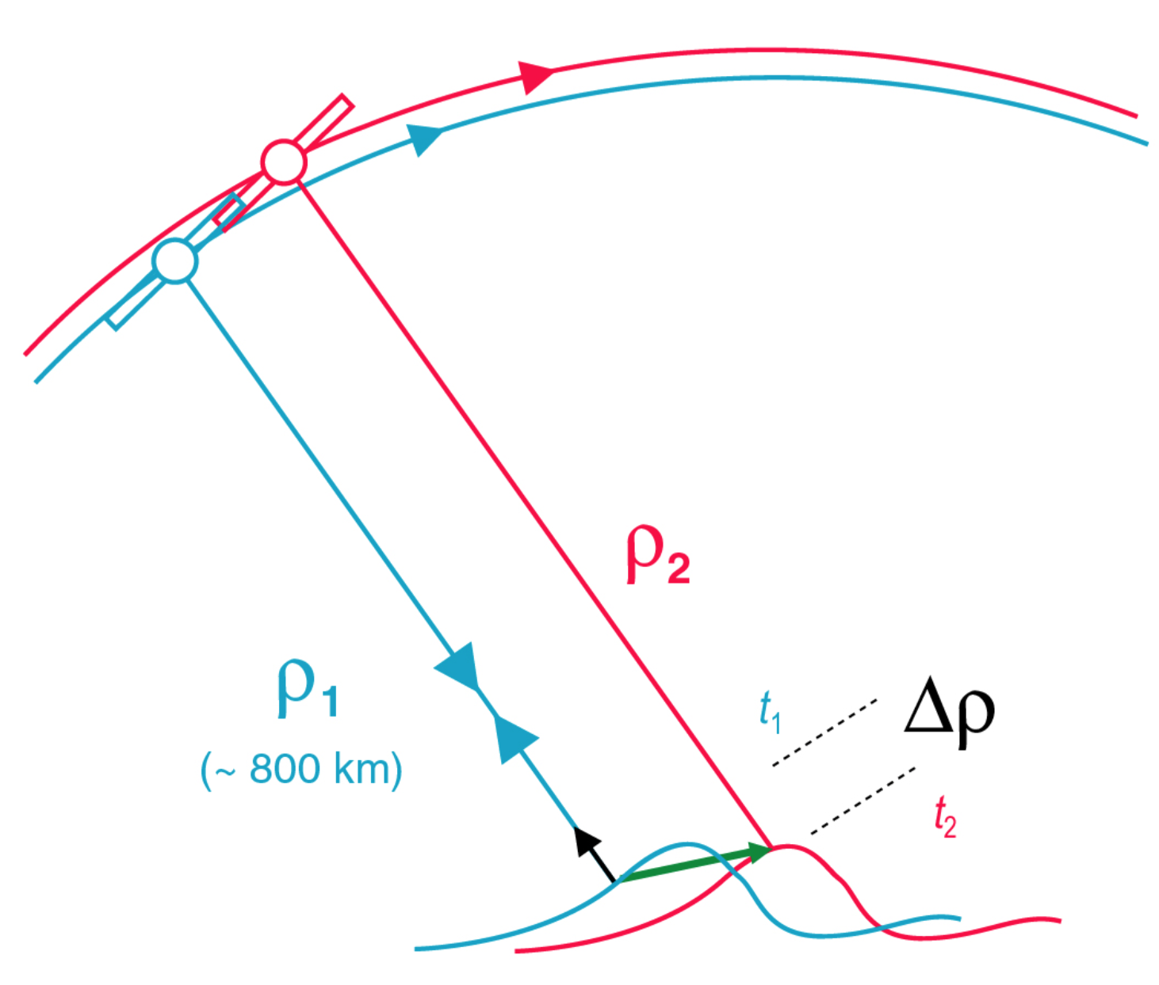
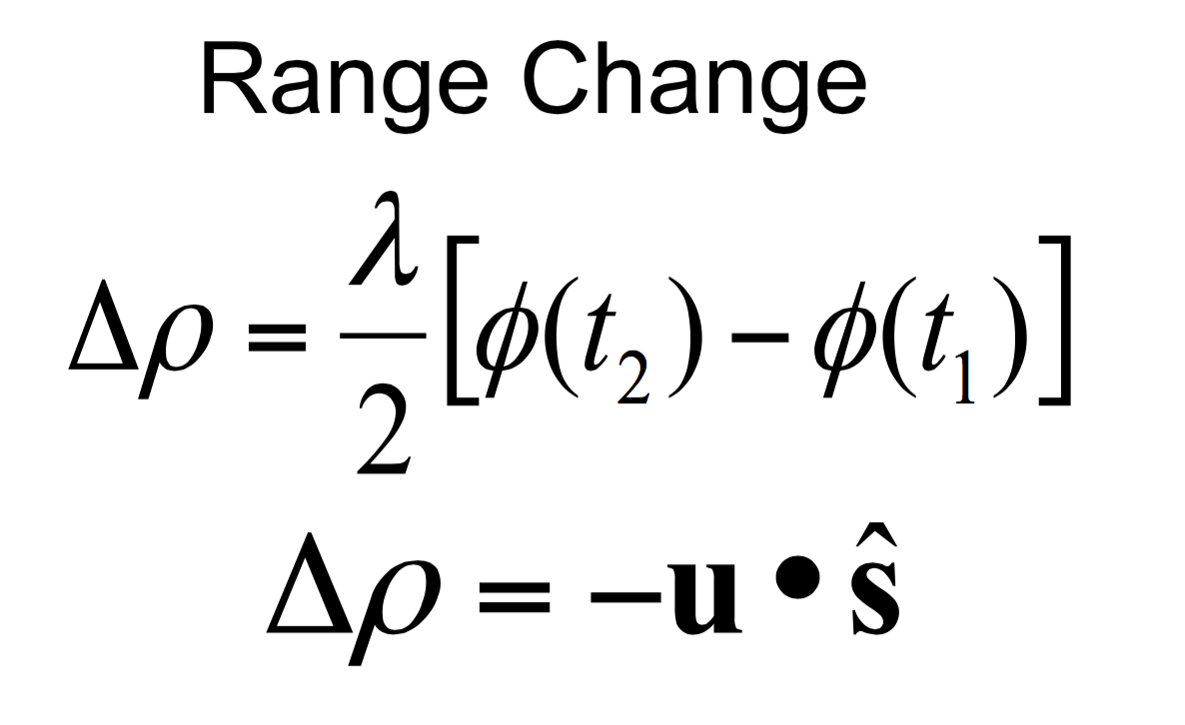
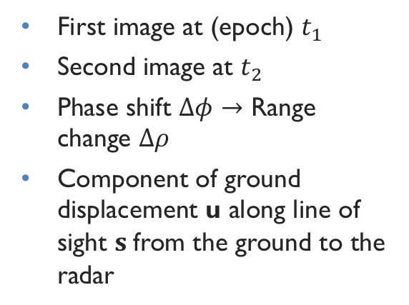
Interferometric Synthetic Aperture Radar (InSAR)
First image at (epoch) $t_{1}$
Second image at $t_{2}$
Phase shift $Δφ→$ Range change $Δρ$
Component of ground displacement u along line of sight $s$ from the ground to the radar

Slide 4
Figure courtesy of Paul Rosen, “Principles and Theory of Radar Interferometry”. UNAVCO Short Course, Aug. 4, 2014
Notes:
ADD pics of phase differencing to get interferogram

Slide 5
Objective
Use high throughput computing resources to independently process many pairs at a time in a consistent and user-friendly manner
GMT5SAR (InSAR processing software)
[Sandwell et al., 2011]
UW-Madison’s Center for High Throughput Computing (CHTC)
Sandwell, D., Mellors, R., Tong, X., Wei, M., & Wessel, P., 2011. GMTSAR: An InSAR Processing System Based on Generic Mapping Tools, UC San Diego: Scripps Institution of Oceanography.

Slide 6
Process at a Glance

Slide 7
Compatibility across servers
Define consistent set of environment variables in setup.sh scripts and login files
Consistent directory scheme across storage and computational servers
(e.g., /[disk]/insar/[sat]/[trk]/raw)
Direct SSH between servers
Notes:
makefiles
job submission on submit-3
post-processing on porotomo

Slide 8
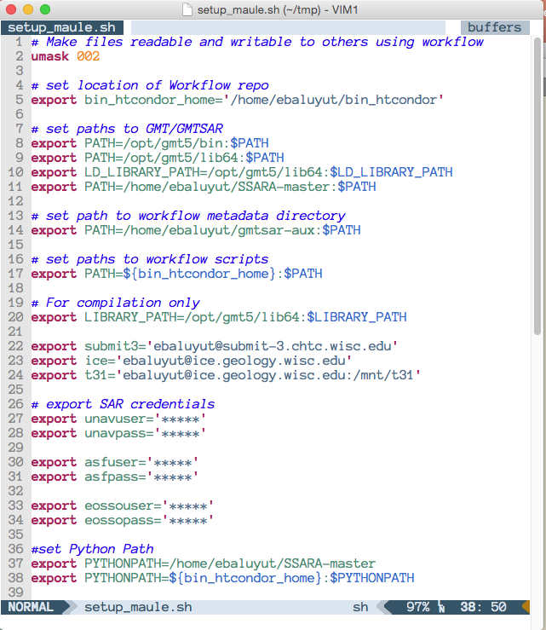
Example setup.sh script
manage permissions
set path to repo
add paths to GMT5, GMT5SAR, and workflow scripts
set variables for server credentials
set variables for SAR database credentials
Notes:
Make note that these variables are stored in .bash_profile on submit-3

Slide 9
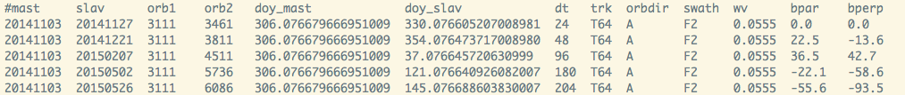
Summary of initial steps (1-2)
Download raw data
Prepare data for jobs
Update databases
Generate sub-list of pairs to process based on input criteria
Copy sub-list of pairs to submit-3 server
Notes:
Run egenerate_pairlist.sh
Generates master list of pairs based on site and satellite/track
Uses master epoch list from maule and information from PRM files (baseline, etc)
If PRM files don’t exist, gives instructions to get temporary PRM files
Run generate_PAIRSmake.sh
Make sublist of pairs to form based on input criteria

Slide 10
3. Submit Job (on submit-3)
For each pair in sub-list of pairs:
  submit job
  with each job, transfer:
    Portable (compressed) versions of software and orbit files
    setup.sh script
    SSH keys
User friendly
  “make run”
Notes:
For each pair in sub-list of pairs:
submit job
With each job, transfer:
Portable (compressed) versions of software and orbit files
setup.sh script with relative paths to portable software to be sourced from job server
SSH keys for direct transfer to/from storage server and job server

Slide 11
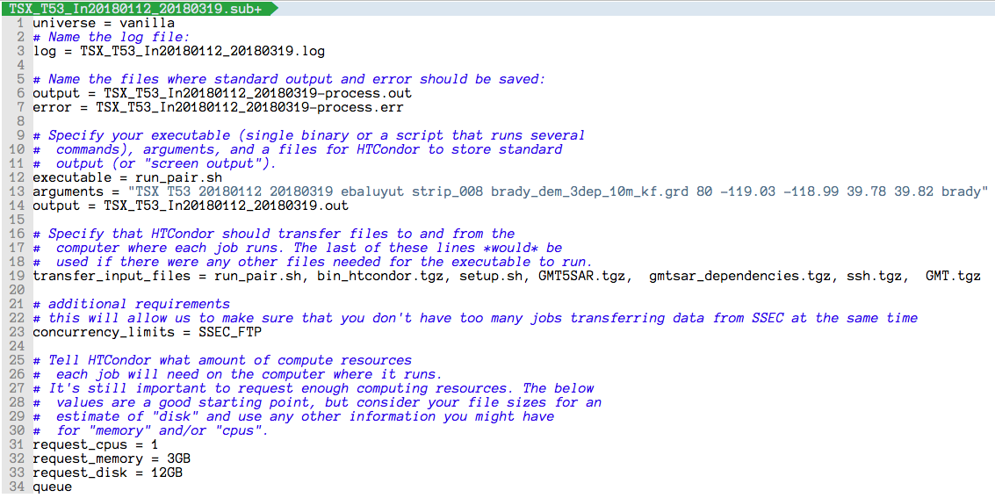
Example submit file

Slide 12
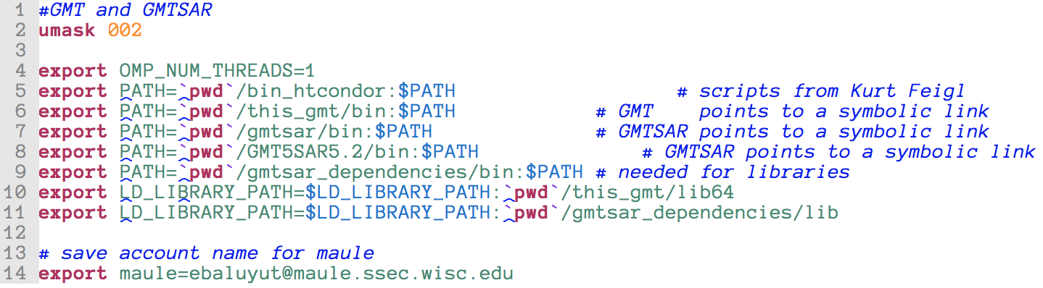
Transferred setup.sh script

Slide 13
4. Process pair (on job server)
On each job server (non-interactive):
  Setup software and SSH directories
  Copy data files from maule
  Process pair
  Transfer tarred result to maule

Slide 14
5. Gather job statistics (on submit-3)
After all pairs have finished, gather statistics on jobs (submit-3)
Transfer files to chosen server
  maule - permanent storage
  porotomo - post-processing
Notes:
After all pairs have finished, gather statistics on jobs (submit-3):
pairs_check.sh
Transfer files to chosen server
pairs2maule.sh – for storage only
pairs2porotomo.sh – for modelling, etc.
Optional analysis (porotomo):
Use makefile commands to set up directory for running GIPhT, GraphTreeTA, etc.
Scripts for rotating to UTM and plotting

Slide 15
Lessons Learned So Far
Handling different levels of computational proficiency
  Makefiles
  Well-documented code
  Comprehensive user manual
Improving workflow efficiency with the help of CHTC
  Portable software
  Direct SSH
Version tracking and software consistency
  Git repository

Slide 16
Success and future work
Many successful runs for a variety of satellites:
  S1-A
  ERS-2
  ALOS
  TSX/TDX
  Envisat
Many successful sites:
  Geothermal fields: Brady Hot Springs, NV; East Mesa, CA; Don Campbell, NV; Dixie Meadows, NV; Tungsten, NV; Coso, CA
  Laguna del Maule Volcanic Field, Chile
Continuing work on automating processes, tutorials, etc.
Software publicly available on GitHub: https://github.com/ecreinisch/bin_htcondor
Workflow manual available at https://elenacreinisch.com/page/software

Slide 17


acknowledgements
Thank you to the following people for giving helpful discussions, and advice, and for testing the workflow:
  Kurt Feigl, Sam Batzli, Hélène Le Mével, Dougal Hansen, Tabrez Ali
Thank you to UW-Madison’s CHTC
and specifically their coordinators,
Lauren Michael and Christina Koch
Thank you to the GMT5SAR community
for all of the collaboration
This material is based upon the work support by the
National Science Foundation Graduate Research Fellowship under
Grant No. DGE-1256259

Slide 18
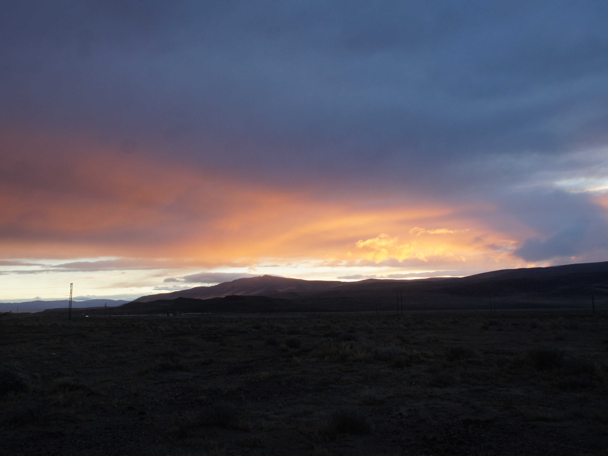
Thank you!
Questions?
Brady Hot Springs Geothermal field, NV

