Slide 1
Jason Kras
Fall 2018 Work
Progress on slide 3

Slide 2
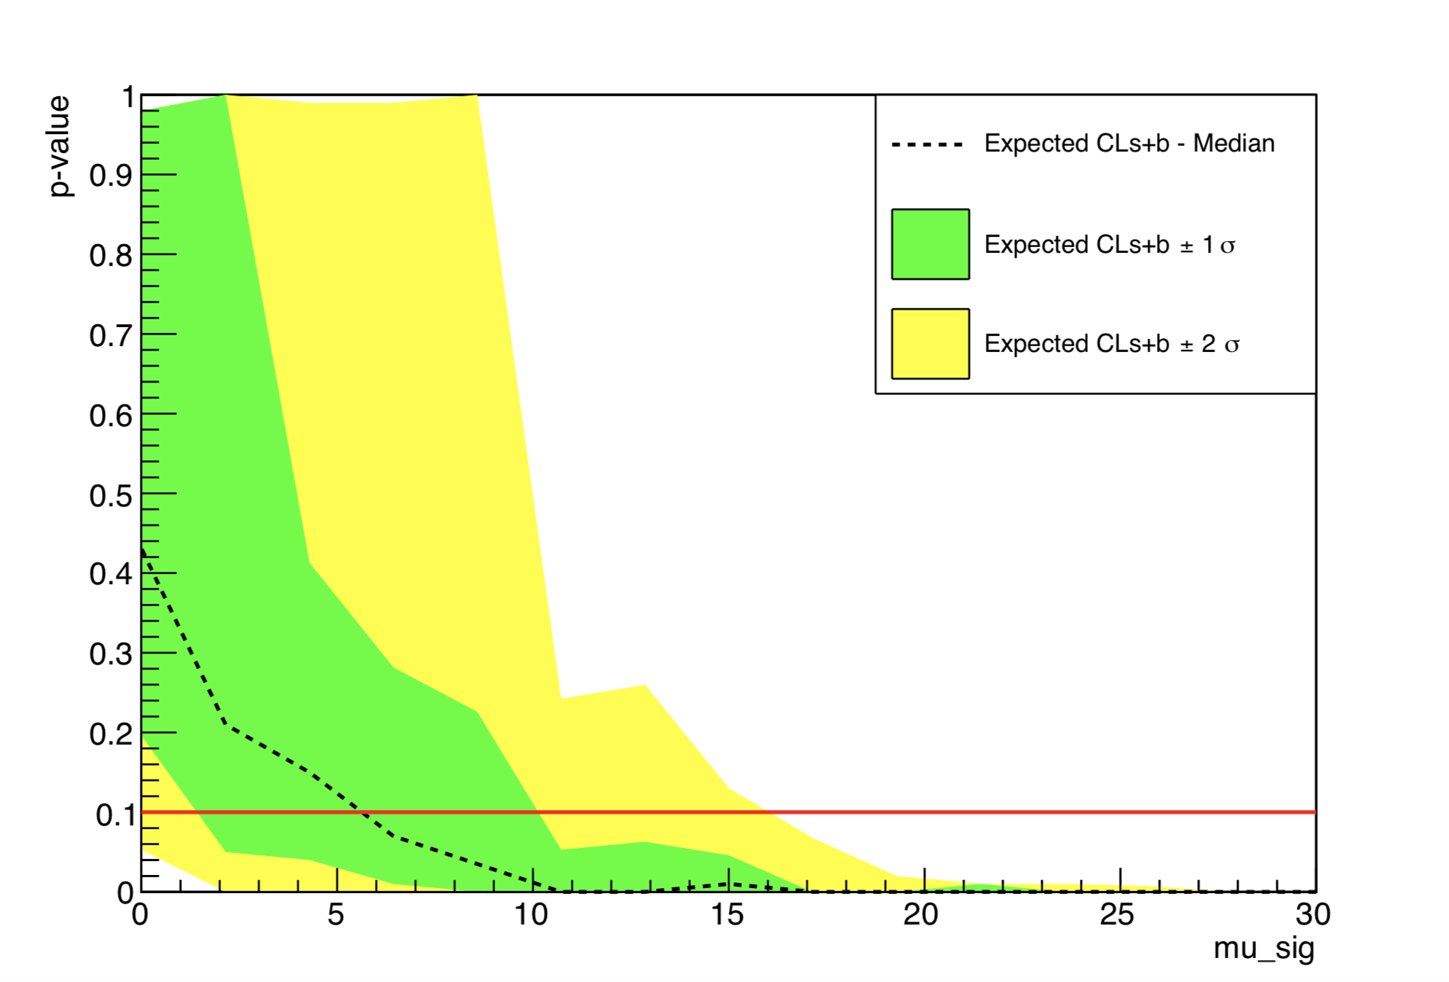
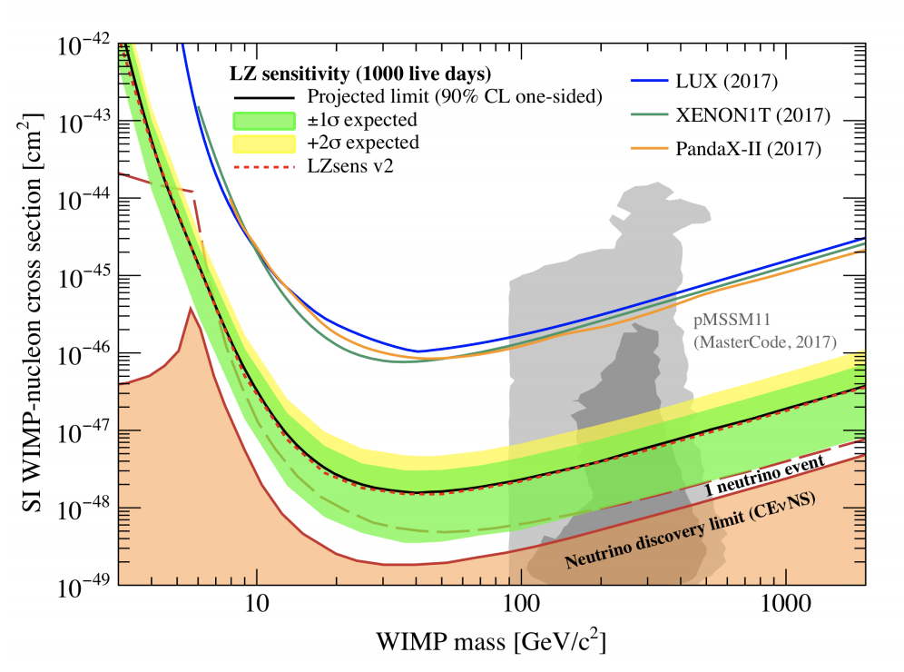
9/27
Current Tasks
Understand the LZ limit setting code
Apply it for different detector parameters
Progress and future
Successfully running code for single WIMP masses
Need to learn how to mesh several mass simulations to create the limit plot

Slide 3
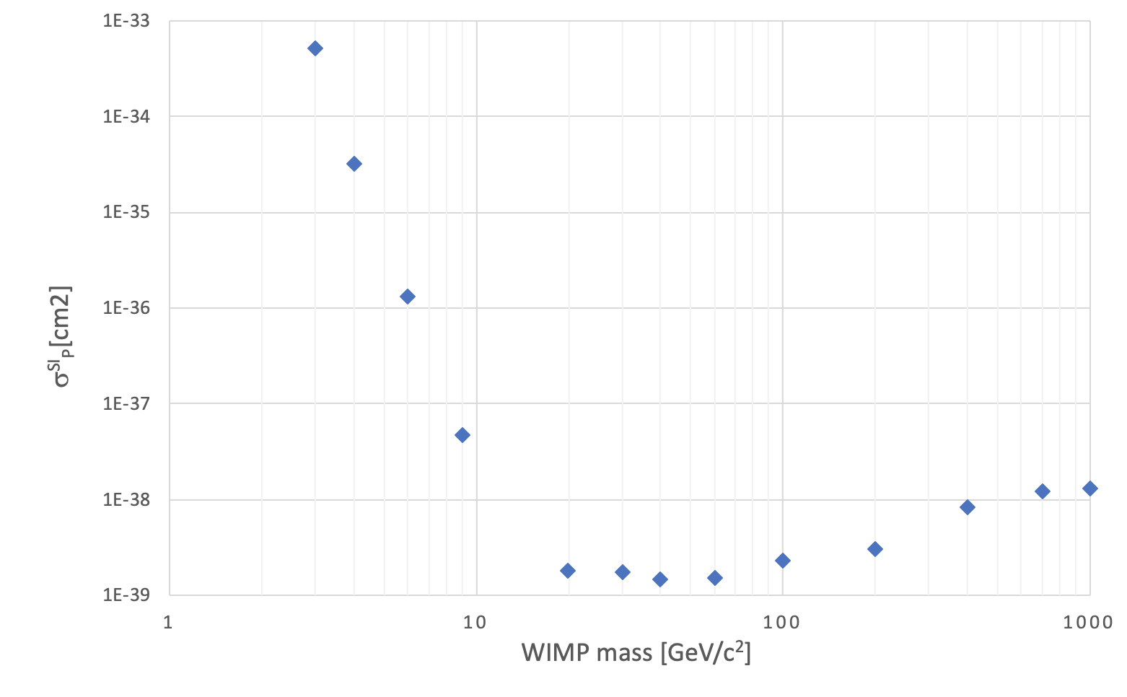
10/11
Progress
Able to create full limit spectrum, however order of magnitude on cross section off by factor of 9
Tasks
Need to verify it is working properly

