Slide 1
Alignment and CNV analysis in cattle
HTCondor week 2019
Presentor: Bet h Lett
Adviosr: Brian Kirkpatrick

Slide 2
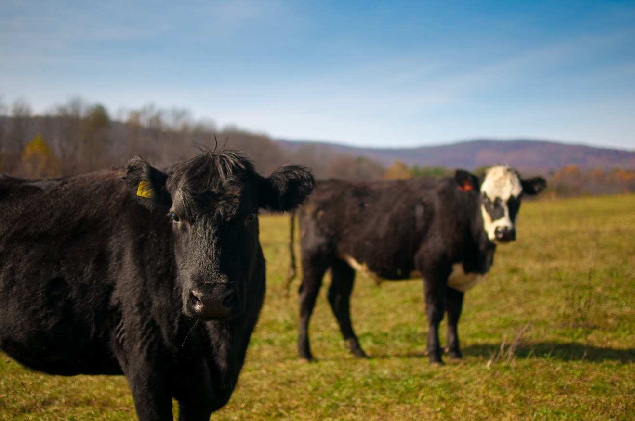
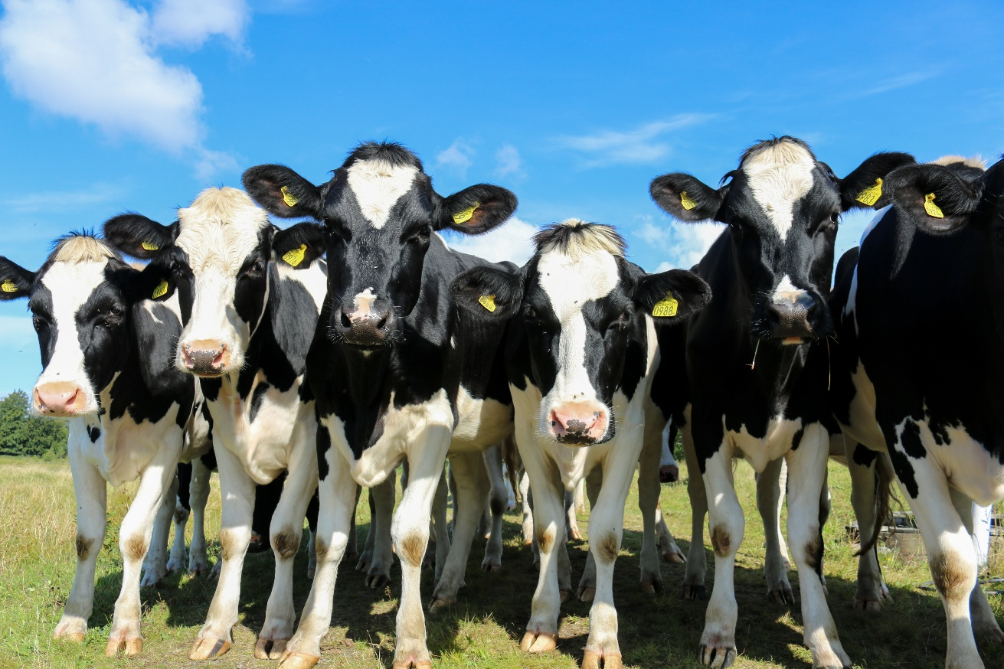
Genetic work in cattle
This Photo by Unknown Author is licensed under CC BY-SA
Notes:
Something about a step back from title to explain that alignment and CNV analysis are studying genetics of cattle with the goal of improving production and health of the animals

Slide 3
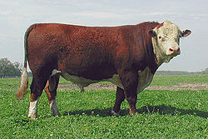
Alignment
This Photo by Unknown Author is licensed under CC BY-SA
Notes:
Alignment is a form of genome assembly
Starting with selected individuals

Slide 4
Alignment
This Photo by Unknown Author is licensed under CC BY-SA
Notes:
Extract dna

Slide 5
Alignment
This Photo by Unknown Author is licensed under CC BY-SA
Notes:
Dna is sequenced in small chunks called short reads

Slide 6
Alignment
Reference Genome
This Photo by Unknown Author is licensed under CC BY-SA
Notes:
These reads in alignment-based assembly are matched to a reference

Slide 7
Alignment
Reference Genome
Aligned Genome
This Photo by Unknown Author is licensed under CC BY-SA
Notes:
These mapped reads from an aligned genome

Slide 8
Copy Number Variant - CNV
Normal
Aligned Genome
Notes:
CNV is a feature that can cause changes in genes and gene expression. They can be desirous or benign. And are detectable in assemblies. Consider this as threshold of normal

Slide 9
Copy Number Variant - CNV
Gains
Normal
Aligned Genome
Notes:
Increase

Slide 10
Copy Number Variant - CNV
Loss
Normal
Aligned Genome
Notes:
Decrease

Slide 11
Alignment and CNV analysis with

Slide 12
Alignment: Example C041
50 x coverage
Notes:
Goal: Here to explain the computation struggle of alignment with C041 –
The one downside to ANY assembly is the computational time.

Slide 13
Alignment: Example C041
50 x coverage
paralyzing
Notes:
These reads were broken into smaller pieces

Slide 14
Alignment: Example C041
50 x coverage
paralyzing
63316347
x2,156 jobs
Notes:
CHTC paralyzing and server capabilities allowed RUNNING over 2,000 jobs to clean and align parts of the reads. paralyzing
Taking probably close to weeks worth of work on lab computer to

Slide 15
Alignment: Example C041
50 x coverage
Inputs:
3.7 GB
Reference Genome
25 MB files
x 2,156 jobs
Notes:
CHTC paralyzing and server capabilities allowed RUNNING over 2,000 jobs to clean and align parts of the reads. paralyzing
Taking probably close to weeks worth of work on lab computer to a few days
However learning each job intakes a 3.7 GB that needs moved around

Slide 16
Alignment: Example C041
50 x coverage
3.7 GB
Reference Genome
25 MB files
x 2,156 Jobs
Outputs:
~50-60 GB
Bam File
Notes:
And each job outputs a file that is roughly
That is needed for a later step

Slide 17
Alignment: Example C041
Bam File
Bam File
Bam File
Bam File
2,156 files
Notes:
100 GB memory
180 GB Disk
8 cpus

Slide 18
Alignment: Example C041
Bam File
Bam File
Bam File
Bam File

Slide 19
Alignment: Example C041
Bam File
Bam File
Bam File
Bam File
Aligned Genome

Slide 20
Alignment: Example C041
Bam File
Bam File
Bam File
Bam File
Aligned Genome
~160 GB
Notes:
Manually needed to run each step (3 total! To get this file)!!!! But that involved a lot of checking and struggle to realize with the amount for this depth it actually needed 3 steps not just two, Potentially an area to explore a work flow!

Slide 21
Aligned Genome
x25 bulls
Aligned Genome
Aligned Genome
~50 GB / genome
Aligned Genome
Aligned Genome
This Photo by Unknown Author is licensed under CC BY-SA

Slide 22
Aligned Genome
Aligned Genome
1.5 TB
Aligned Genome
Aligned Genome
Aligned Genome
This Photo by Unknown Author is licensed under CC BY-SA

Slide 23
CNV analysis challenge
1.5 – 1.8 TB

Slide 24
CNV analysis
Aligned Genome
x25 samples
CNVnator
DELLY
Lumpy
Notes:
Looked at software that allowed individual analysis and then on that would merge results for each indviudal
For

Slide 25
CNV analysis
Aligned Genome
x25 samples
CNVnator
DELLY
Lumpy Single
VCF
VCF
VCF
Notes:
Looked at software that allowed individual analysis and then on that would merge results for each indviudal
For

Slide 26
CNV analysis
Aligned Genome
Lumpy Population
CNVnator
DELLY
Lumpy Single
VCF
VCF
VCF
VCF
x25 samples
Notes:
Looked at software that allowed individual analysis and then on that would merge results for each indviudal
For

Slide 27
CNV analysis
Aligned Genome
Lumpy Population
CNVnator
DELLY
Lumpy Single
VCF
VCF
VCF
VCF
Lumpy Single
VCF

Slide 28
CNV analysis
Aligned Genome
CNVnator
DELLY
Lumpy Single
Lumpy Population
x25
x25
x25
x25 + 1 + 25 = 51 jobs
VCF
VCF
VCF
VCF
List of CNVs
Total Jobs: 126/ individual
Notes:
25+25+25+51 =

Slide 29
CNV analysis
List of CNVs
Individual level CNVs
~294 average
Breed specific CNVs
~ 749 Jersey

Slide 30
Acknowledgements
This Photo by Unknown Author is licensed under CC BY-NC
Advisor:
Brian Kirkpatrick
Committee:
Hasan Kahtib
Kent Weigel
Irene Ong

Slide 31
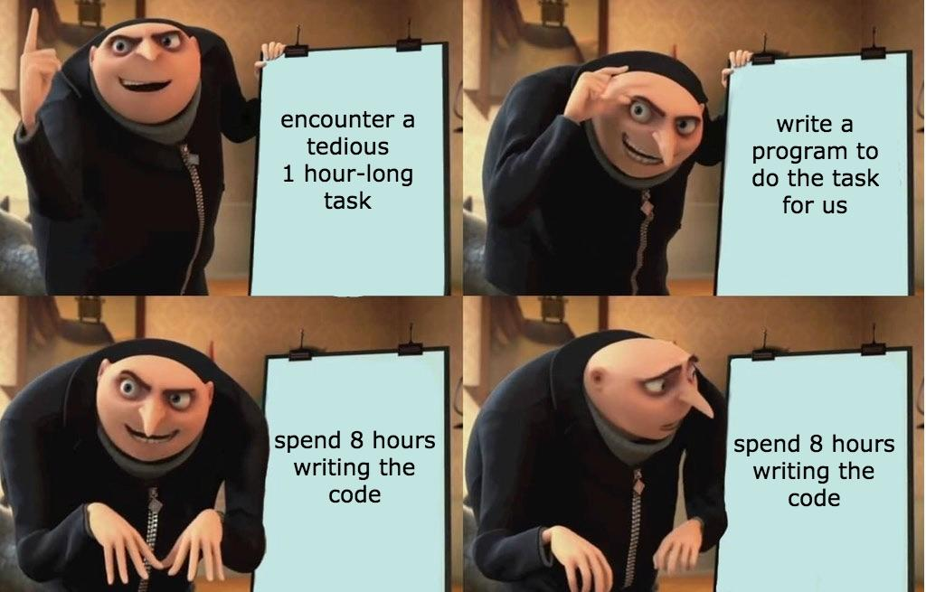
Questions????

