Slide 1
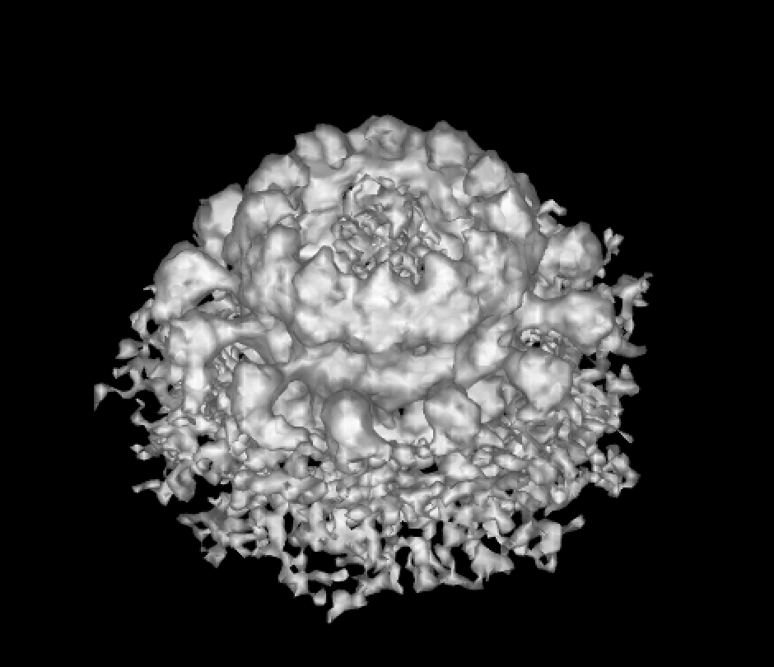
Studying RNA Virus Replication with Cryo-Electron Microscopy on HTC
Hong ZHAN
2019 May 20th

Slide 2
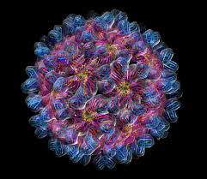
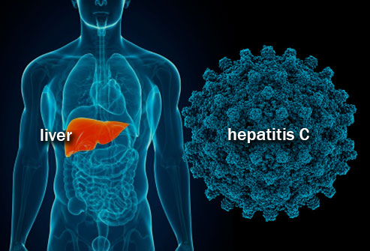
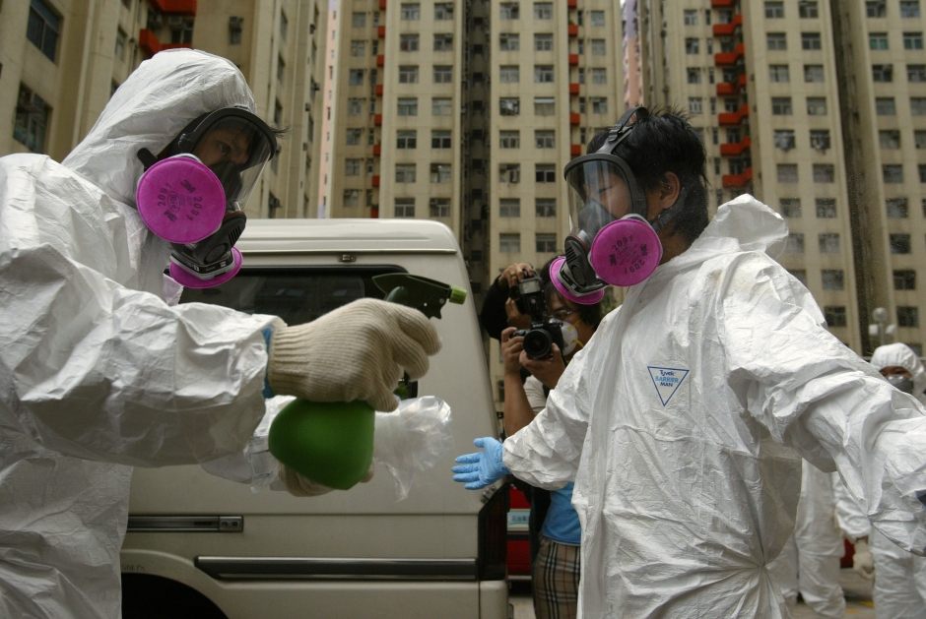
Positive-strand RNA virus: threats to public health
Host
(Plants, microbiomes, animals, humans)
RNA Virus
Interaction
HBV-C & liver cancer
Yellow fever virus
SARS outbreak in Asia

Slide 3
Outlines
Overview of Cryo-EM method in the study of nano-machinery of RNA virus genome replication complex
Data processing with HTC
Using HTC in study RNA viral replication machinery

Slide 4
Outlines
Overview of Cryo-EM method in the study of nano-machinery of RNA virus genome replication complex
Data processing with HTC
Using HTC in study RNA viral replication machinery

Slide 5
Nodavirus: RNA genome replication overview
Flock Horse Virus (model system)
RNA1
RNA2
Protein A
Capsid
Protein B1/B2
Viral particle
Infection
Pass through host membrane
Mitochondria [“Energy Factory” for Cell]
RNA1
RNA3
RNA2
New virus

Slide 6
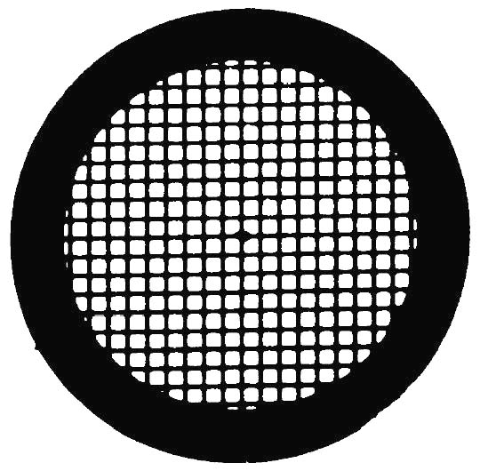
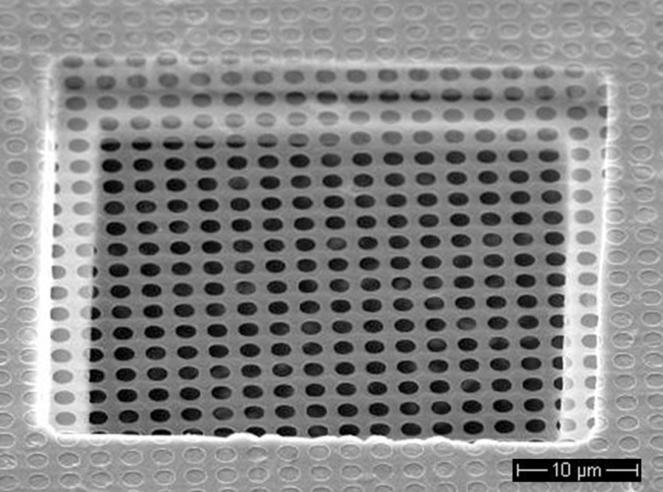
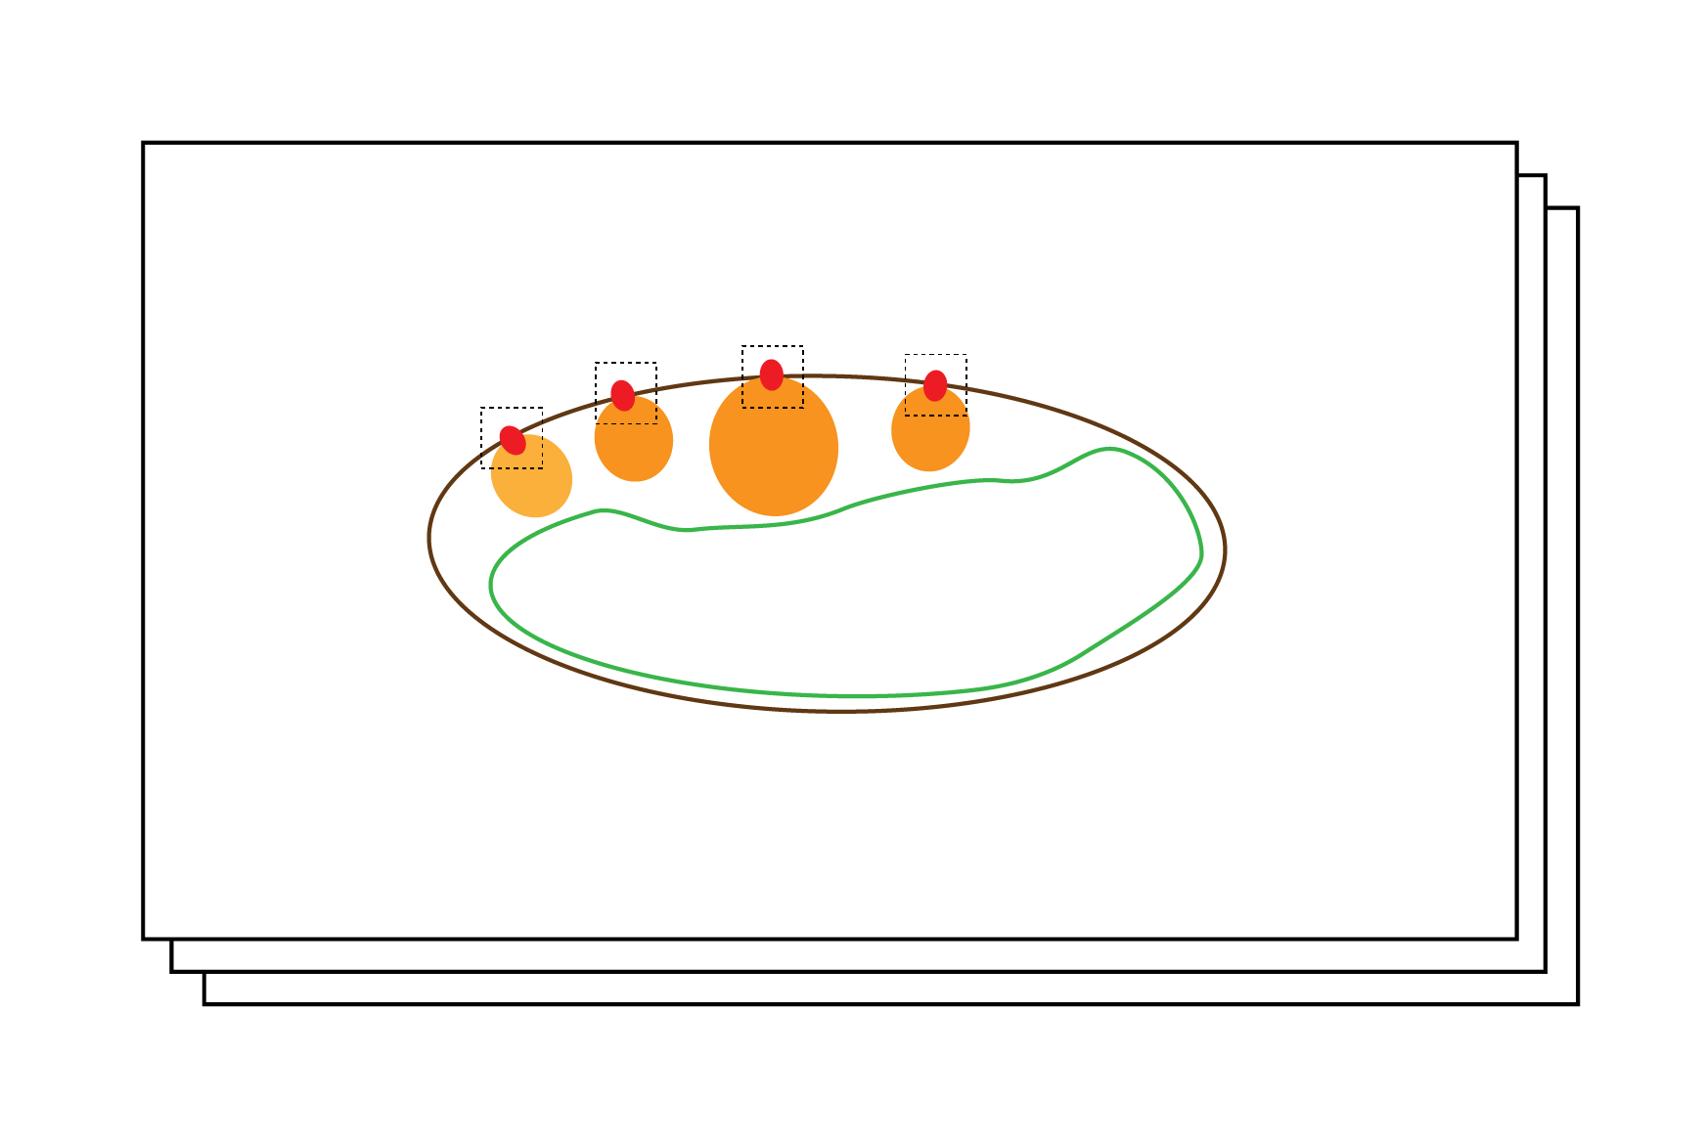
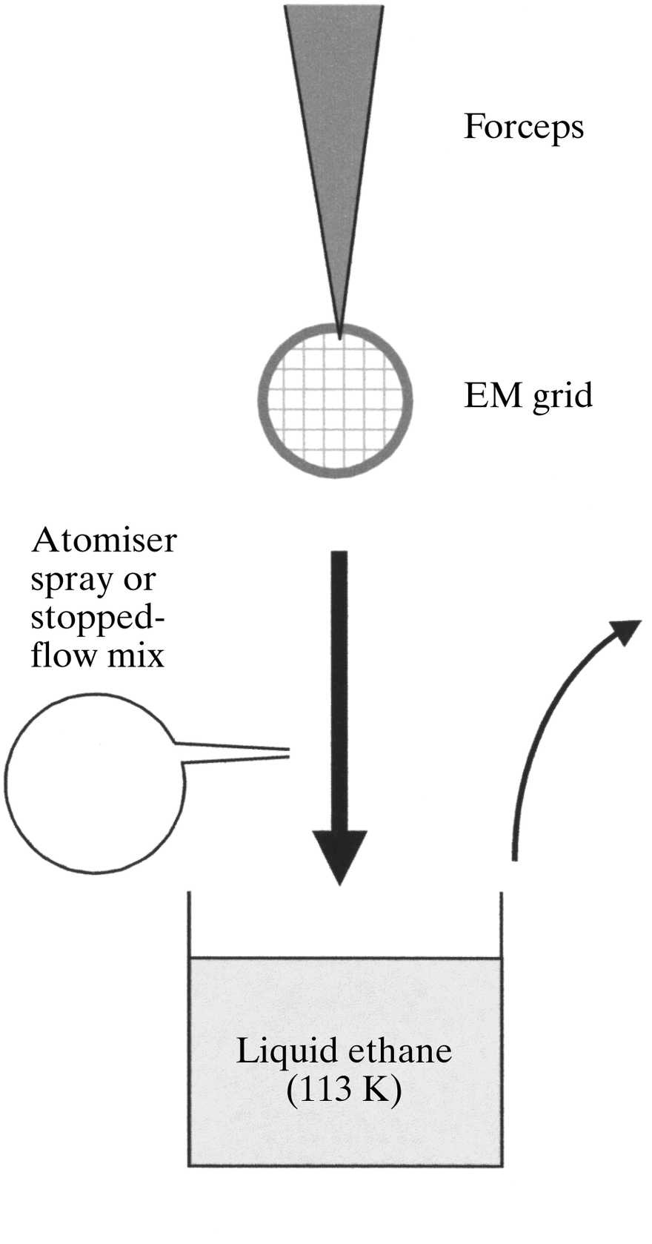
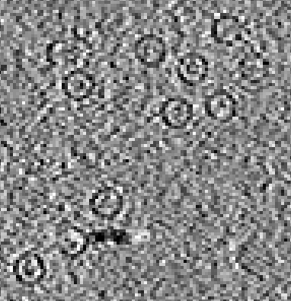
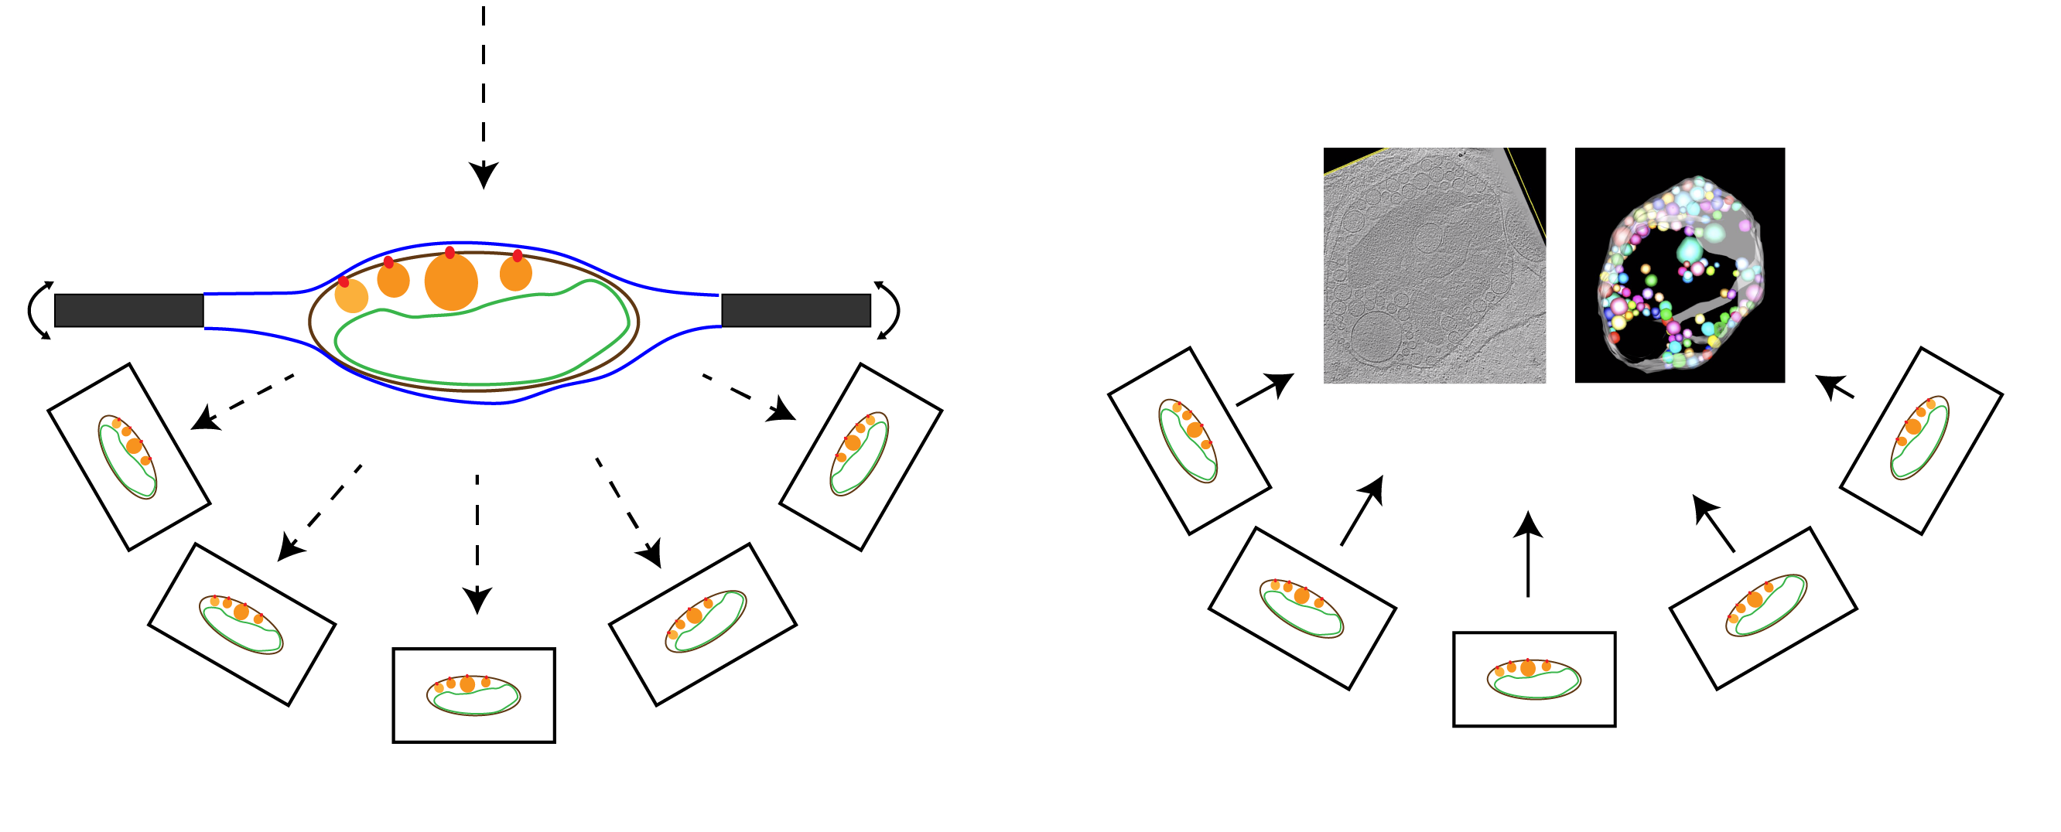
Cryo-electron tomography/subtomogram averaging
High-resolution study of protein structures
Subtomogram averaging
Hole size: 2µm
Hole center distance: 4µm
⌀: 3mm
Plunge freeze
vitrification
…
From: Electron Microscopy Sciences
Top-view
Side-view
Electron beam
3D tomogram reconstruction
Carbon film
“Hole”
Tilt series from -60º to 60º (3º increment)
Back-projection
Averaged 3D crown

Slide 7
Example: Cryo-Tomography of isolated infected mitochondria

Slide 8
Major challenges in Cryo-EM study
Instrument imperfection
Irradiation damage
Sample characteristics

Slide 9
Solutions
Instrument imperfection: Perfect alignment/calibration; computational correction for retrieve degraded information
Sample damage: Dose-symmetric acquisition (from “best” to “worst”)
Thermo-drift due to irradiation: Dose-fractionation or take several frames instead of a single image
Sample characteristics: alternative approach to overcome (single particle)
Increase computational costs exponentially
How to process large cryo-EM data in a reasonable time period?

Slide 10
Outlines
Overview of Cryo-EM method in the study of nano-machinery of RNA virus genome replication complex
Data processing with HTC
Using HTC in study RNA viral replication machinery

Slide 11
Difficulties in HTCondor for Cryo-EM study
Human interaction
Align frames
Pick targets
Lack of graphic visualization ability
Check quality
No GUI
3. Software
Open-source software
Multiple programs for different steps
Align frames
Align tilts (projections)
Picking targets

Slide 12
Difficulties in HTCondor for Cryo-EM study
Solutions
Human interaction
Align frames
Pick targets
2. Lack of graphic visualization ability
Check quality
GUI
3. Software
Open-source software
Multiple programs for different steps
Find optimal parameters
GUI support***
Alternative way to visualize results locally
Divide steps for using different software
Parameter 1
Parameter 2
One sample
Parameter 3
…

Slide 13
Outlines
Overview of Cryo-EM method in the study of nano-machinery of RNA virus genome replication complex
Data processing with HTC
Using HTC in study RNA viral replication machinery

Slide 14
Overview of Cryo-EM work-flow on HTC
Final results
CHTC CPU pools
…
Output
…
Submit node/home directory
…
…
…
…
…
…
Data, programs, other files
“download”
“Mount”
File system (Online)
(Squid [100MB- 1GB])
File system
(Gluster [>1GB])
Local workstation

Slide 15
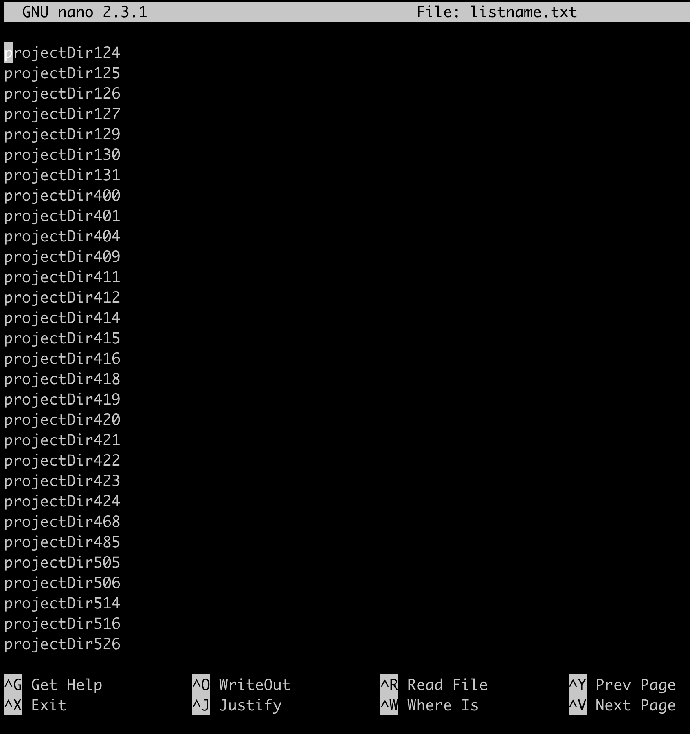
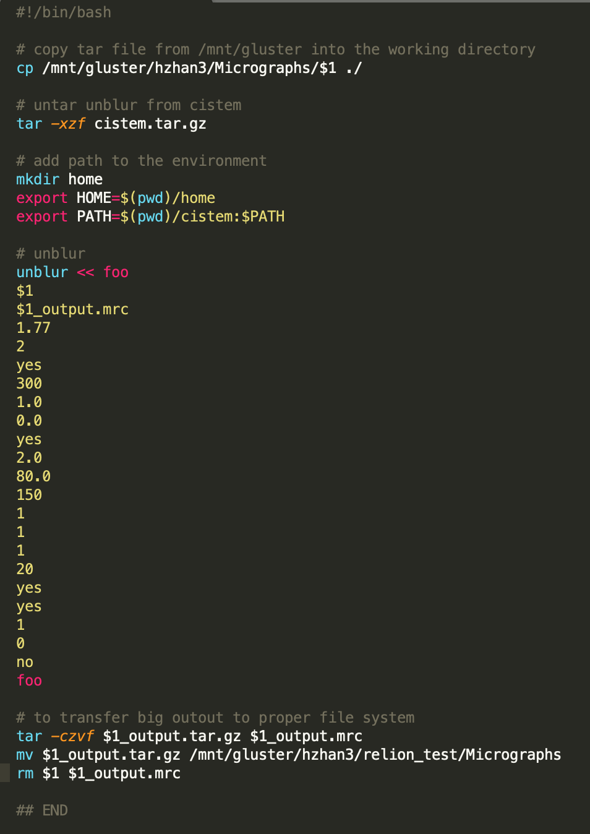
Queue jobs from a list with parameters
List of movies to align independently:
Executable script:
Using $1, $2, $3 … to call different field in a list file as an input
$1
List of 3503

Slide 16
Perform ”alignment” more efficiently
Each movie alignment takes ~ 2-5min on one cpu of a standalone workstation
~5hr to 13hr

Slide 17
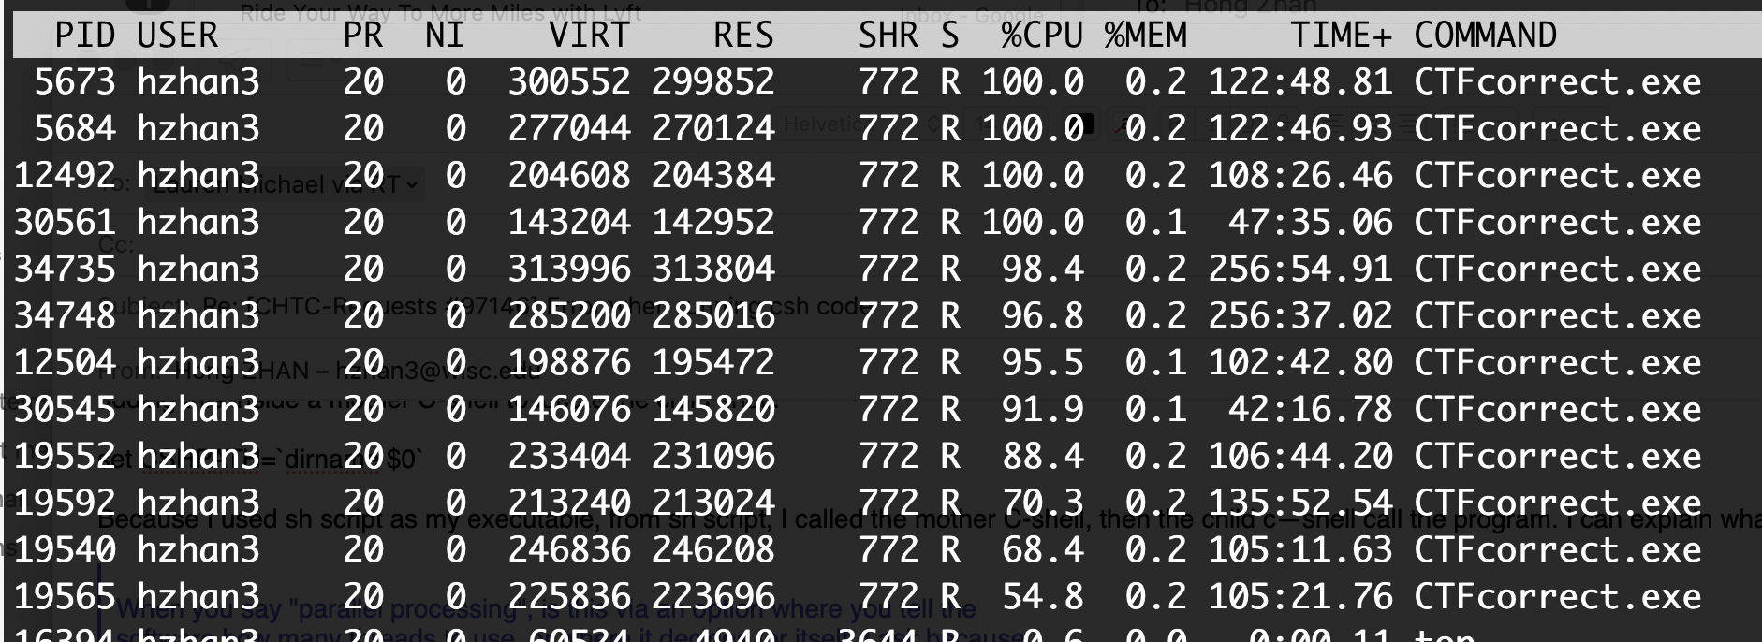
Using multiple CPUs within one job

Slide 18
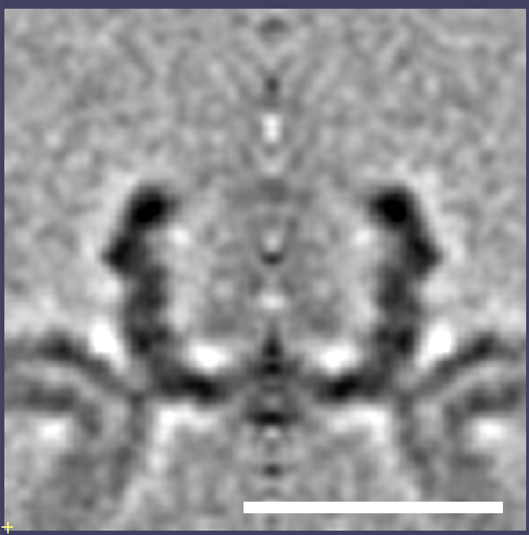
Cryo-tomography/subtomogram averaging using HTC
Align frames
2hrs on HTC
Align tilts (projections)
4hr with GPU for 31 tomograms
HPC system
Picking targets
4 days
Workstation
20nm

Slide 19
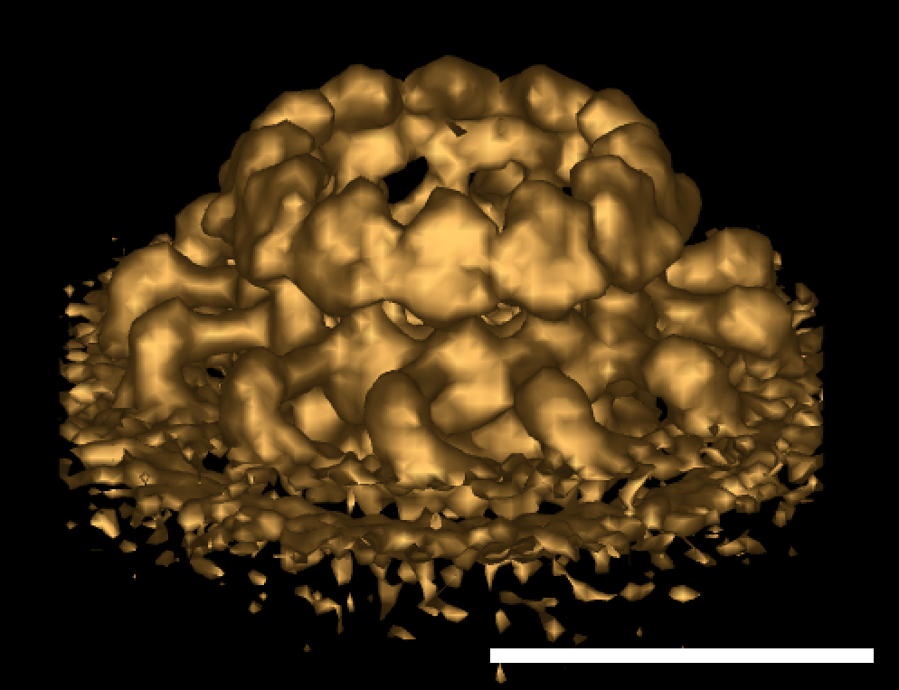
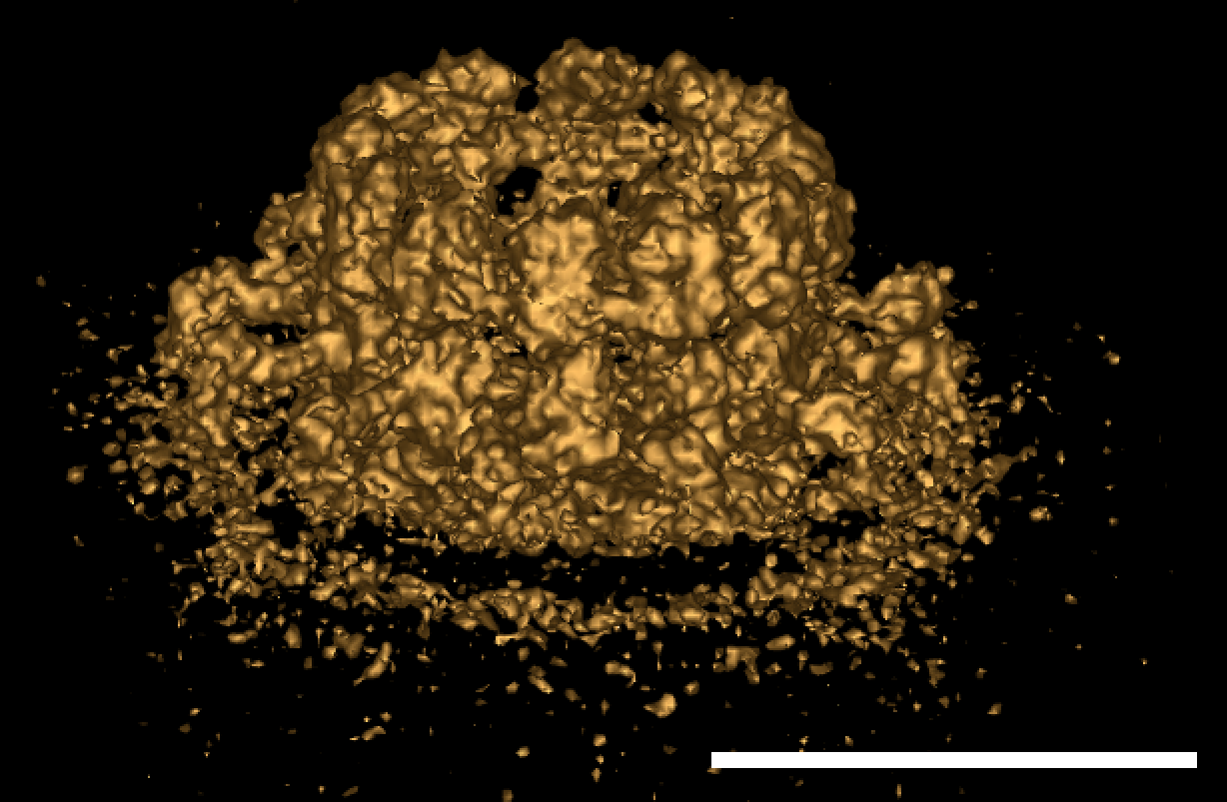
Future direction …
HTC usage: 8,812 total HTC hours
High resolution crown structure: More data, better pre-processing
18Å
12Å
Forward
20nm
20nm

Slide 20
Acknowledgements
Dr. Paul Ahlquist’s lab
Cryo-EM facility at Janelia
Rick Huang
Chuan Hong
Cryo-EM facility Pacific Northwest Cryo-EM center
Claudia Lopez
Craig Yoshioka
Janelia Research Campus
Dr. Nikolaus Gregorieffl’s lab
Tim Grant
Benjamin Himes
UW-Madison Data-hub
Sarah Stevens
Steven Goldstein
Paul Ahlquist
Megan Bracken
James Bruce
Zach Coleman
Johan den Boon
Reza Djavadian
Mark Horswill
Maskaki Nishikiori
Janice Pennington
Nuruddin Unchwaniwala
UW-Madison Center for High Throughput Computing
Lauren Michael
Christian Koch
Morgridge Core Computation
Miron Livny
Brian Bockelman
Morgridge Virology
Anthony Gitter

