Slide 1
Welcome to the 20th Week (year 35 of our project)

Slide 2
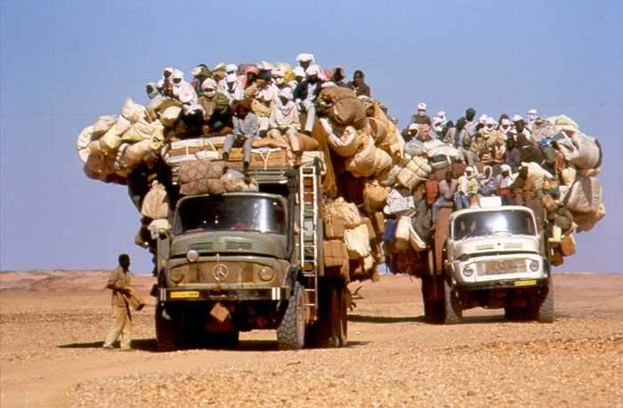
Thank you for building such
a wonderful and thriving
HTC community

