Slide 1


An opportunistic HTCondor pool inside an interactive-friendly Kubernetes cluster
At HTCondor Week 2019
Presented by Igor Sfiligoi, UCSD
for the PRP team

Slide 2


Outline
Where do I come from?
What we did?
How is it working?
Looking head

Slide 3

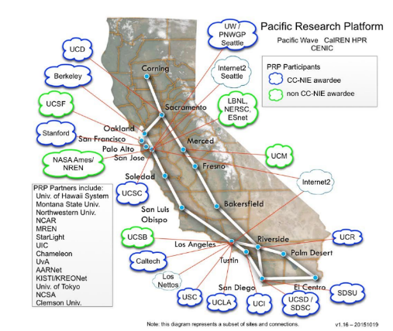

The Pacific Research Platform
The PRP originally created as a
regional networking project
  Establishing end-to-end links
  between 10Gbps and 100Gbps
(GDC)

Slide 4
The Pacific Research Platform
The PRP originally created as a
regional networking project
  Establishing end-to-end links
  between 10Gbps and 100Gbps
Expanded nationally since
  And beyond, too

Slide 5
The Pacific Research Platform
Recently the PRP evolved in a major resource provider, too
  Because scientists really need more than bandwidth tests
  They need to share their data at high speed and compute on it, too
The PRP now also provides
  Extensive compute power – About 330 GPUs and 3.5k CPU cores
  A large distributed storage area - About 2 PBytes
Select user communities now directly use
all the resources PRP has to offer
  Still doing all the network R&D in the same setup, too
  We call it the Nautilus cluster

Slide 6
Kubernetes as a resource manager
Industry standard
Large and active development and support community
Container based
More freedom for users
Flexible scheduling
Allows for easy mixing of service and user workloads

Slide 7
Designed for interactive use
Users expect to get what they need when they need it
Makes for very happy users
Congestion happens only very rarely
And is typically short in duration

Slide 8
Opportunistic use
No congestion
Idle compute resources
Time for opportunistic use

Slide 9
Kubernetes priorities
Priorities natively supported in Kubernetes
Low priority pods only start if no demand
from higher priority ones
Preemption out of the box
Low priority pods killed the moment
a high priority pod needs the resources
Perfect for opportunistic use
Just keep enough low-priority pods in the system
https://kubernetes.io/docs/concepts/configuration/pod-priority-preemption/

Slide 10
HTCondor as the OSG helper
PRP wanted to give opportunistic resources to Open Science Grid (OSG) users
Since they can tolerate preemption
But OSG does not have native support for Kubernetes
Supports only resources provided by batch systems
We thus instantiated an HTCondor pool
As a fully Kubernetes/Containerized deployment

Slide 11
HTCondor in a (set of) container(s)
Putting HTCondor in a set of containers is not hard
Just create an image with HTCondor binaries in it!
Configuration injected through Kubernetes pod config
HTCondor deals nicely with ephemeral IPs
Everything else just works from there
Persistency needed for the Schedd(s)
And potentially for the Negotiator, if long term accounting desired
Everything else can live off ephemeral storage
The Collector must be discoverable – Kubernetes service

Slide 12
Service vs Opportunistic
Collector and Schedd(s) deployed as high priority service pods
Should be running at all times
Few pods, not high CPU or GPU users, so OK
Using Kubernetes Deployment to re-start the pods in case of HW problems and/or maintenance
Kubernetes Service used to get a persistent routing IP to the collector pod
Startds deployed as low priority pods
Hundreds of pods in the Kubernetes queue at all times, many in Pending state
HTCondor Startd configured to accept jobs as soon as it starts and forever after
If pod preempted, HTCondor gets a SIGTERM and has a few seconds to go away
Pure opportunistic

Slide 13
Then came the users
Everything was working nicely, until we let in real users
Well, until we had more than a single user
OSG users got used
to rely on Containers
So they can use any weird software they like
But HTCondor Startd already running inside a container!
Cannot launch a user-provided container
So I need to provide
user-specific execute pods
How many of each kind?
Not without elevated privileges

Slide 14
Then came the users
Everything was working nicely, until we let in real users
Well, until we had more than a single user
OSG users got used
to rely on Containers
So they can use any weird software they like
But HTCondor Startd already running inside a container!
Cannot launch a user-provided container
So I need to provide
user-specific execute pods
How many of each kind?

Slide 15
Dealing with many opportunistic pod types
Having idle Startd pods
not OK anymore
A different kind of pod could use that resource
A glidein-like setup would solve that
Keeping pods without users not OK anymore
They will just terminate without ever running a job
Who should regulate the “glidein pressure”?
How do I manage fair share between different pod types?
Kubernetes scheduling is basically just priority-FIFO
How am I to know what Container images users want?
Ideally, HTCondor should have native Kubernetes support

Slide 16
Dealing with many opportunistic pod types
Having idle Startd pods
not OK anymore
A different kind of pod could use that resource
A glidein-like setup would solve that
Keeping pods without users not OK anymore
They will just terminate without ever running a job
Who should regulate the “glidein pressure”?
How do I manage fair share between different pod types?
Kubernetes scheduling is basically just priority-FIFO
How am I to know what Container images users want?
Ideally, HTCondor should have native Kubernetes support
I know how to implement this.

Slide 17
Dealing with many opportunistic pod types
Having idle Startd pods
not OK anymore
A different kind of pod could use that resource
A glidein-like setup would solve that
Keeping pods without users not OK anymore
They will just terminate without ever running a job
Who should regulate the “glidein pressure”?
How do I manage fair share between different pod types?
Kubernetes scheduling is basically just priority-FIFO
How am I to know what Container images users want?
Ideally, HTCondor should have native Kubernetes support
I was told
this is coming.

Slide 18
Dealing with many opportunistic pod types
Having idle Startd pods
not OK anymore
A different kind of pod could use that resource
A glidein-like setup would solve that
Keeping pods without users not OK anymore
They will just terminate without ever running a job
Who should regulate the “glidein pressure”?
How do I manage fair share between different pod types?
Kubernetes scheduling is basically just priority-FIFO
How am I to know what Container images users want?
Ideally, HTCondor should have native Kubernetes support
In OSG-land, glideinWMS solves this for me.

Slide 19
Dealing with many opportunistic pod types
No concrete plans on how to address these yet.
Having idle Startd pods
not OK anymore
A different kind of pod could use that resource
A glidein-like setup would solve that
Keeping pods without users not OK anymore
They will just terminate without ever running a job
Who should regulate the “glidein pressure”?
How do I manage fair share between different pod types?
Kubernetes scheduling is basically just priority-FIFO
How am I to know what Container images users want?
Ideally, HTCondor should have native Kubernetes support

Slide 20
Dealing with many opportunistic pod types
For now, I just periodically adjust the balance
A completely manual process
Currently supporting only a few, well behaved users
Maybe not optimal, but good enough
But looking forward to a more automated future

Slide 21
Are side-containers an option?
Ideally, I do want to use user-provided, per-job Containers
Running HTCondor and user jobs in separate pods
not an option due to opportunistic nature
But Kubernetes pods are made of several Containers
Could I run HTCondor in a dedicated Container?
Then start the user pod in a side-container?
Pretty sure currently not supported
But, at least in principle, fits the architecture
Would also need HTCondor native support
Pod
HTCondor container
User job container

Slide 22

Will nested Containers be a reality soon?
It has been pointed out to me
that latest CentOS supports unprivileged Singularity
Have not tied it out
Probably I should
Cannot currently assume all of my nodes have a recent-enough kernel
But eventually will get there

Slide 23
Looking ahead
Looking forward to a more automated future
Will do what I have to myself
Would be happier if I could use off-the-shelf solutions

Slide 24
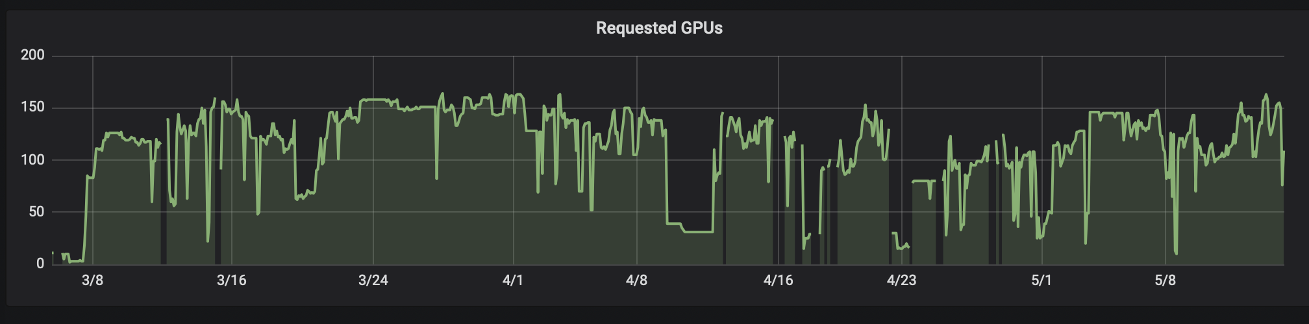
A final picture
Opportunistic GPU usage over the past few months

Slide 25
Summary
We created an opportunistic HTCondor pool in the PRP Kubernetes cluster
  OSG users can now use
  any otherwise-unused cycles
The lack of nested containerization forces us to have
multiple execute pod types
Some micromanagement
currently needed, hoping for
more automation in the future

Slide 26

Acknowledgents
This work was partially funded by
US National Science Foundation (NSF) awards
CNS-1456638, CNS-1730158,
ACI-1540112, ACI-1541349,
OAC-1826967, OAC 1450871,
OAC-1659169 and OAC-1841530.

