Slide 1
What’s new in HTCondor? What’s coming? HTCondor Week 2019 May 21, 2019 – Madison, WI
Todd Tannenbaum
Center for High Throughput Computing
Department of Computer Sciences
University of Wisconsin-Madison

Slide 4
So what year was the first
Condor Week meeting?
There are 2 hard problems in computer science: caching, naming, and off-by-1 bugs!

Slide 5
Release Series
Stable Series (bug fixes only)
HTCondor v8.8.x - introduced Jan 2019
(Currently at v8.8.4)
Development Series (should be 'new features' series)
HTCondor v8.9.x (Currently at v8.9.2)
Since HTCondor Week 2018…
Public Releases: 10
Documented enhancements: ~81
Documented bug fixes: ~78
Detailed Version History in the Manual
http://htcondor.org/manual/latest/VersionHistoryandReleaseNotes.html

Slide 6
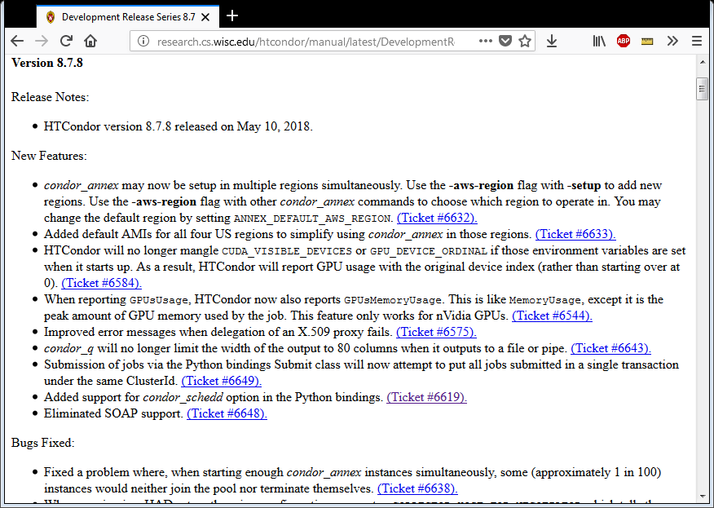

Slide 7
Enhancements in HTCondor v8.4
Scalability and stability
Goal: 200k slots in one pool, 10 schedds managing 400k jobs
Introduced Docker Job Universe
IPv6 support
Tool improvements, esp condor_submit
Encrypted Job Execute Directory
Periodic application-layer checkpoint support in Vanilla Universe
Submit requirements
New RPM / DEB packaging
Systemd / SELinux compatibility

Slide 8
Enhancements in HTCondor v8.6
Enabled and configured by default: use single TCP port, cgroups, mixed IPv6 + IPv4, kernel tuning
Made some common tasks easier
Schedd Job Transforms
Docker Universe enhancements: usage updates, volume mounts, conditionally drop capabilities
Singularity Support

Slide 9
What's new in v8.8 and/or cooking for v8.9 and beyond?

Slide 10
"You know nothing, Job Snow!"

Slide 11
Winter is coming for…
SOAP API
Long live House Python!
RHEL/Centos 6 Support
Quill
"Standard" Universe
Instead self-checkpoint vanilla job support [1]
Non-standard packaging
UW packages and Centos/Debian packages can now be the same
HTCondor Manual
[1] https://htcondor-wiki.cs.wisc.edu/index.cgi/wiki?p=HowToRunSelfCheckpointingJobs

Slide 12
Manual is now a cheat-sheet "Page790.pdf"

Slide 13
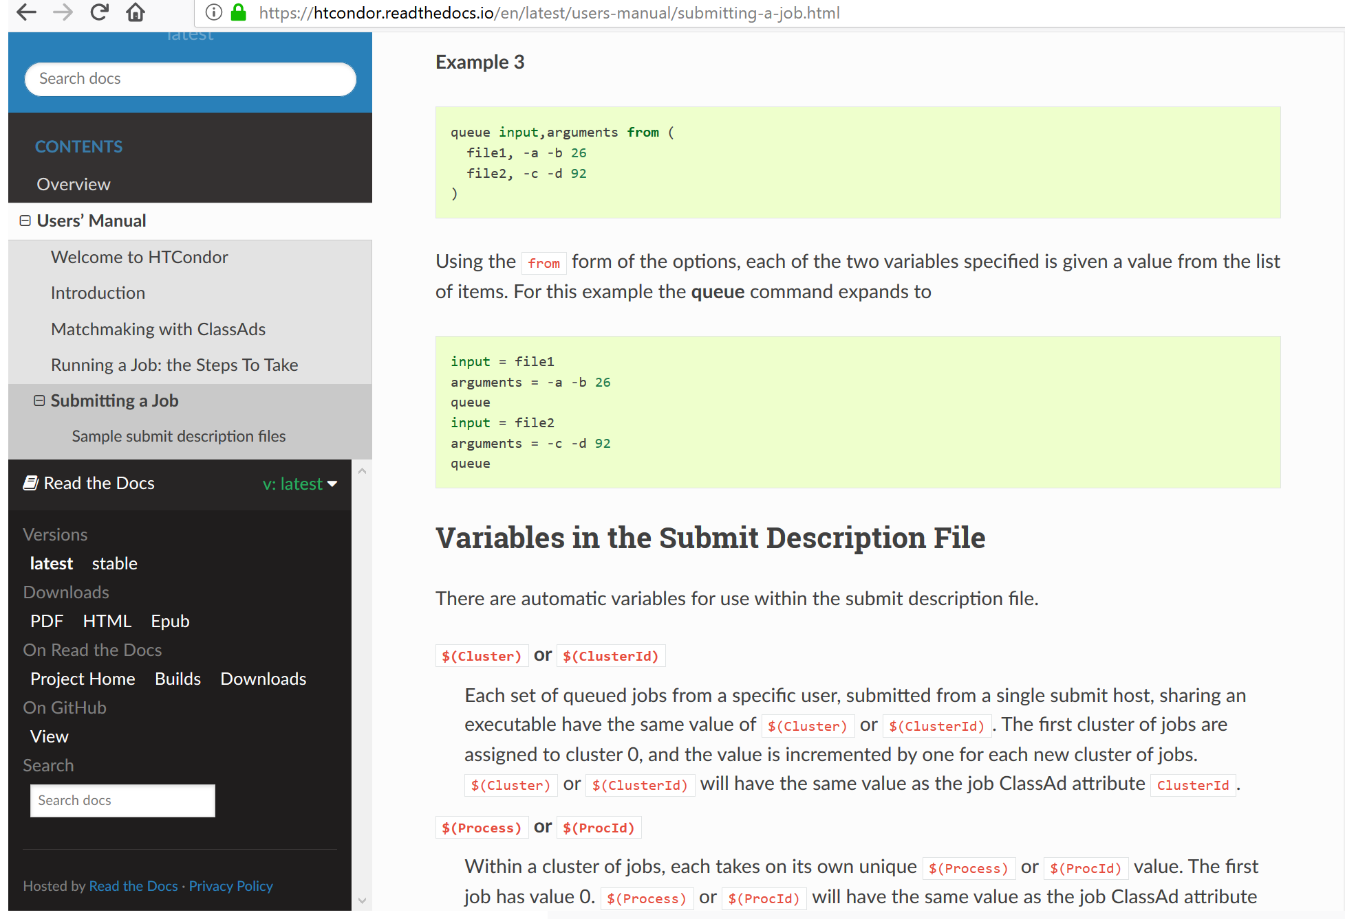
http://htcondor.readthedocs.io
Notes:
Search box! Latest, stable, and PDF/Epub in lower left! Single source of truth for Python API!

Slide 14
http://htcondor.readthedocs.io
Notes:
Search box! Latest, stable, and PDF/Epub in lower left! Single source of truth for Python API! Easily fork on GitHub and contribute via Edit Button

Slide 15
HTCondor Singularity Integration
What is Singularity?
Like Docker but…
No root owned daemon process, just a setuid
No setuid required (as of very latest RHEL7)
Easy access to host resources incl GPU, network, file systems
HTCondor allows admin to define a policy (with access to job and machine attributes) to control
Singularity image to use
Volume (bind) mounts
Location where HTCondor transfers files

Slide 16
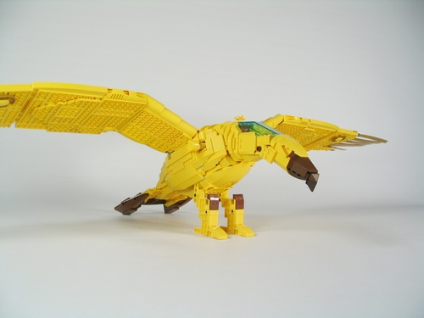
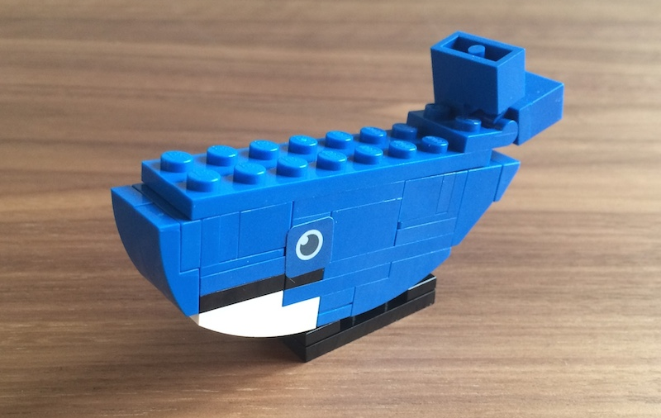
Docker Job Enhancements
Docker jobs get usage updates (i.e. network usage) reported in job classad
Admin can add additional volumes
Conditionally drop capabilities
Condor Chirp support
Support for condor_ssh_to_job
For both Docker and Singularity

Slide 17
Not just Batch - Interactive Sessions
Two scenarios for interactive sessions
Interactive session alongside a batch job
condor_ssh_to_job: Debugging job, monitoring job
Interactive session alone (no batch job)
condor_submit –i : Juptyer notebooks, schedule shell access
p.s. Jupyter Hub batchspawner supports HTCondor
Can tell the schedd to run a specified job immediately! Interactive sessions, test jobs
condor_now <job_id_to_run> <job_ids_to_kill>
No waiting for negotiation, scheduling

Slide 18
Higher Level Python Abstractions
Bring HTC into Python environments incl Jupyter
HTCondor Bindings (import htcondor) are steeped in the HTCondor ecosystem
Exposed to concepts like Schedds, Collectors, ClassAds, jobs, transactions to the Schedd, etc
Working on a new package (import htcondor_jobs)
Written on top of htcondor bindings
Simplified and streamlined to submit and manage jobs
Also released our HTMap package
No HTCondor concepts to learn, just extensions of familiar Python functionality. Inspired by BNL!

Slide 19
htcondor package
import htcondor
# Describe jobs
sub = htcondor.Submit('''
executable = my_program.exe
output = 'run$(ProcId).out'
''')
# Submit jobs
schedd = htcondor.Schedd()
with schedd.transaction() as txn:
clusterid = sub.queue(txn,count = 10)
# Wait for jobs
import time
while len(schedd.query(
constraint='ClusterId=='+str(clusterid),
attr_list=['ProcId'])):
time.sleep(1)

Slide 20
htcondor_jobs package
import htcondor_jobs as jobs
# Describe jobs desc = jobs.SubmitDescription(
executable = 'my_program.exe',
output = 'run$(ProcId).out'
)
# Submit jobs handle = jobs.submit(desc, count = 10)
# Wait for jobs
handle.wait()

Slide 21
Job!

Slide 22
import htmap
# Describe work def double(x):
return 2 * x
# Do work
doubled = htmap.map(double,range(10))
# Use results!
print(list(doubled))
# [0, 2, 4, 6, 8, 10, 12, 14, 16, 18]
htmap
package
See https://github.com/htcondor/htmap

Slide 23
HTCondor "Annex"
Instantiate an HTCondor Annex to dynamically add additional execute slots for jobs submitted at your site
Get status on an Annex
Control which jobs (or users, or groups) can use an Annex
Want to launch an Annex on
Clouds
Via cloud APIs
HPC Centers / Supercomputers
Via edge services (i.e. HTCondor-CE)

Slide 24
Grid Universe
Reliable, durable submission of a job to a remote scheduler
Popular way to send pilot jobs (used by glideinWMS), key component of HTCondor-CE
Supports many “back end” types:
HTCondor
PBS
LSF
Grid Engine
Google Compute Engine
Amazon AWS
OpenStack
Cream
NorduGrid ARC
BOINC
Globus: GT2, GT5
UNICORE
Notes:
24

Slide 25
V8.8 Added Grid Universe support for Azure, SLURM, Cobalt, soon k8s
Speak to Microsoft Azure
Speak native SLURM protocol
Speak to Cobalt Scheduler
Actively working on Kubernetes!
Jaime:
Grid
Jedi
Also HTCondor-CE "native" package
HTCondor-CE started as an OSG package
European Grid Infrastructure (EGI) wants to adopt HTCondor-CE without all the OSG dependencies….
Moving HTCondor-CE upstream from OSG to HTCondor Project (plus adding EGI/WLCG accounting support)

Slide 26
http://news.fnal.gov/2018/07/fermilab-computing-experts-bolster-nova-evidence-1-million-cores-consumed/
CPU cores!
FNAL HEPCloud
NOvA Run
(via Annex at NERSC)

Slide 27
No internet access to HPC edge service? File-based Job Submission
JobXXX
Schedd A
Schedd B
request
status.1
status.2
status.3
input
input
output
input
output
output

Slide 28
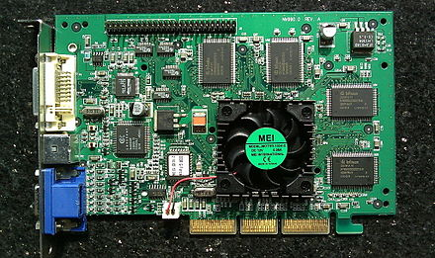
GPUs
HTCondor has long been able to detect GPU devices and schedule GPU jobs (CUDA/OpenCL)
New in v8.8:
Monitor/report job GPU processor utilization
Monitor/report job GPU memory utilization
Working on for v8.9.x: simultaneously run multiple jobs on one GPU device
Specify GPU memory?
Volta hardware-assisted Mutli-Process Service (MPS)?
Working with LIGO on requirements
Nvidia's GeForce 256 was marketed in Oct 1999
as "the world's first GPU"

Slide 29
Security
Version of HTCondor available that has Federal Processing Standard (FIPS) Compliance
Currently as a separate download
AES has hardware support in most Intel CPUs, so investigating at just doing TLS 1.3 all the time by default
TLS all the time may motivate us to drop UDP communications in HTCondor
Anyone care if UDP support disappears?

Slide 30
Security: From identity certs to authorization tokens
HTCondor has long supported GSI certs
Then added Kerberos/AFS tokens for CERN, DESY
Now adding standardized token support
SciTokens (http://scitokens.org)
OAuth 2.0 Workflow → Box, Google Drive, AWS S3, …

Slide 31
Token Authentication Method
Several Authentication Methods
File system (FS), SSL, pool password….
Adding a new "tokens" method
Administrator can run a command-line tool to create a token to authenticate a new submit node or execute node
Users can run a command-line tool to create a token to authenticate as themselves
"Promiscuous mode" support

Slide 32
USB "Thumb Drive" first introduced in Yr 2000 (8MB for $50)
File Transfer Improvements

Slide 33
File Transfer Improvements
Performance improvements. No network turn-around between files. Available v8.9.2
Error messages greatly improved: URL-based transfers can now provide sane, human-readable error messages when they fail (instead of just an exit code). Available in 8.8 series.
URLs for output: Individual output files can be URLs, allowing stdout to be sent to the submit host and large output data sent elsewhere. Available in 8.9.1.
Smarter retries. Including retries triggered by low throughput. Available in 8.9.2.
If you use HTCondor to manage credentials, these tokens can be used directly by URL-based transfers. Box.com transfers now natively supported, more to come. Available in 8.9.2.

Slide 34
executable = myprogram.exe
transfer_input_files = box://htcondor/myinput.dat
use_oauth_services = box
queue

Slide 35
Scalability Enhancements
Central manager now manages queries
Queries (ie condor_status calls) are queued; priority is given to operational queries
More performance metrics (e.g. in collector, DAGMan)
In v8.8 late materialization of jobs in the schedd to enable submission of very large sets of jobs
Submit / remove millions of jobs in < 1 sec
More jobs materialized once number of idle jobs drops below a threshold (like DAGMan throttling)

Slide 36
Late materialization
This submit file will stop adding jobs into the queue once 50 jobs are idle:
executable = foo.exe
arguments = -run $(ProcessId)
materialize_max_idle = 50
queue 1000000

Slide 37
From Job Clusters to Job Sets
Job "clusters" with late materialization mostly behave as expected
Can remove all jobs in a cluster
Can edit all jobs in a cluster
But some pieces are missing
Append jobs to a set (in a subsequent submission)
Move an entire set of jobs from one schedd to another
Job set aggregates exposed to policy engine

Slide 38
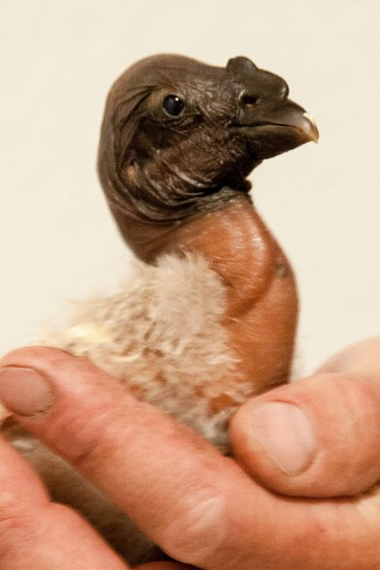
"Minicondor" Package
Minicondor package
yum install minicondor
apt-get install minihtcondor
"Personal Condor" = single machine, single user (daemons run as a regular user)
"Minicondor" = single machine, multi-user (daemons run as root)

Slide 39
The "iSmell"

Slide 40
Thank you!

