Slide 1
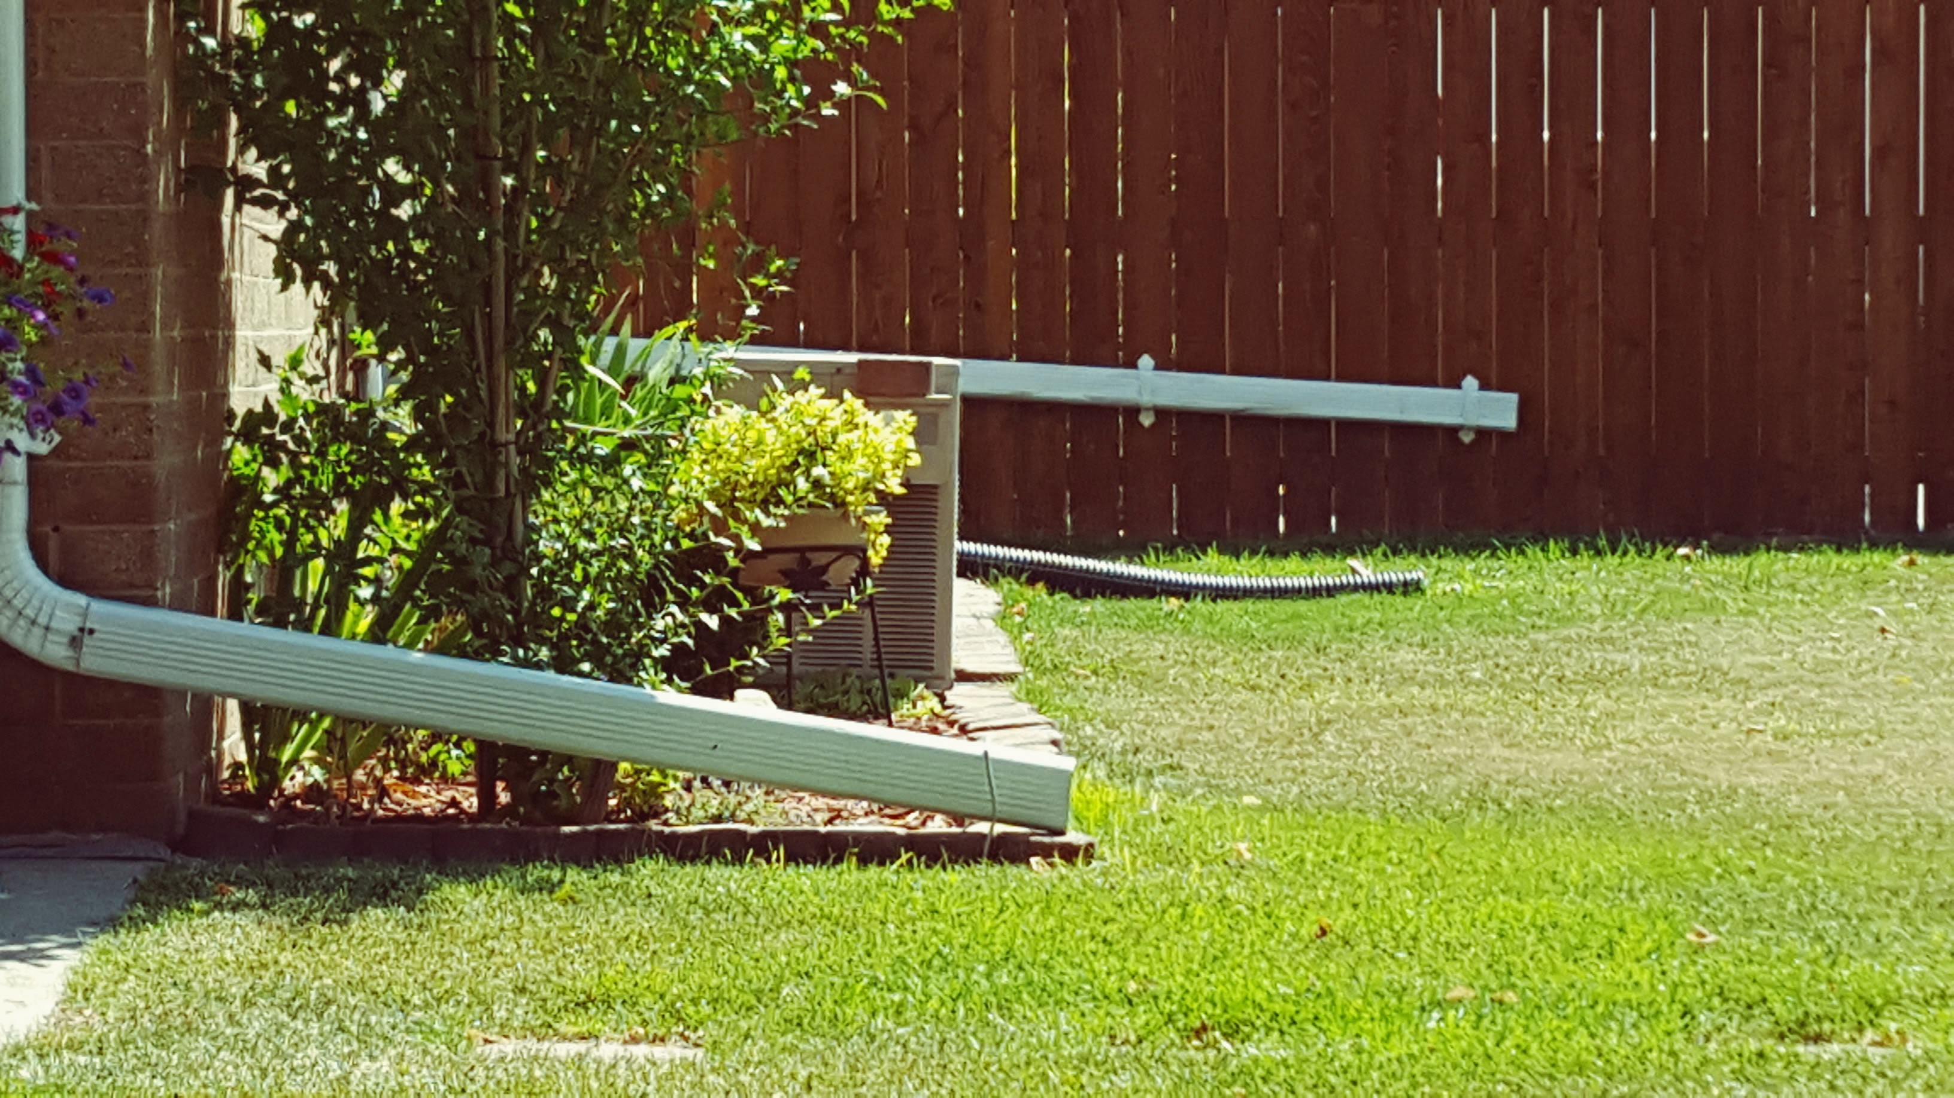



Improving the quality of my research on urban residential hydrology by increasing the quantity of simulations using HTCondor
HTCondor Week, May 22, 2019
Carolyn Voter, University of Wisconsin-Madison
cvoter@wisc.edu carolynbvoter.weebly.com @VoteWater

Slide 2


Urbanization messes with how water flows
NATURAL
URBAN
Rain
Rain
Evapotranspiration
Evapotranspiration
Runoff
Runoff
Infiltration
Infiltration

Slide 3
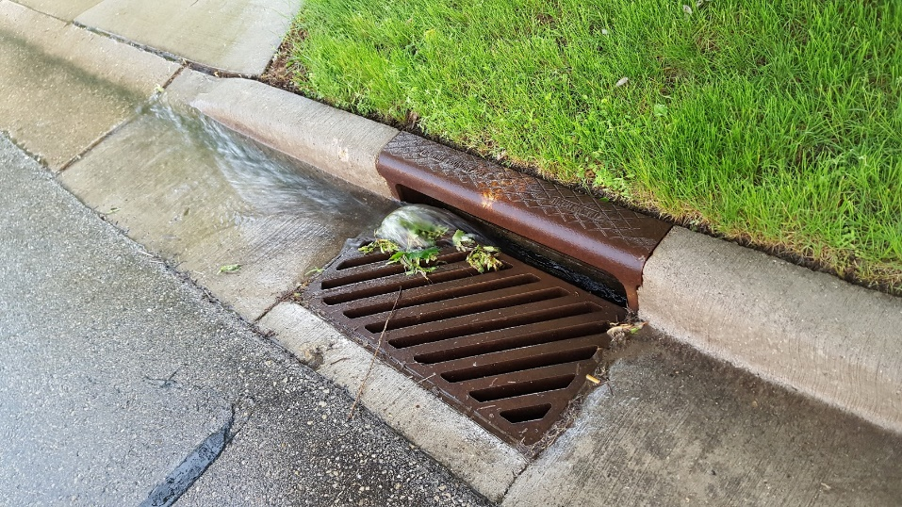
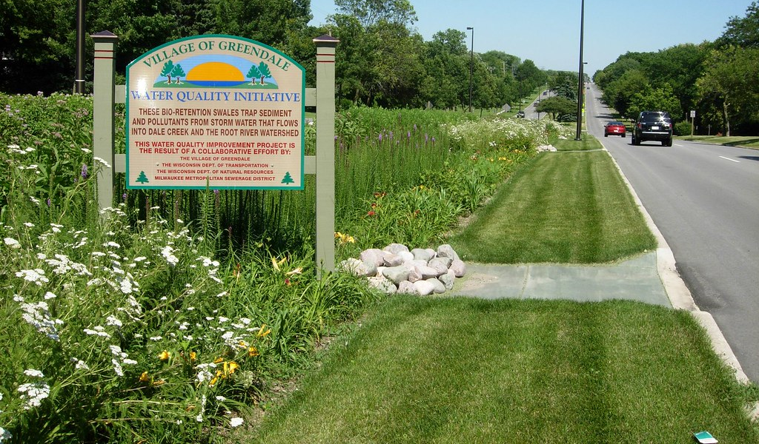
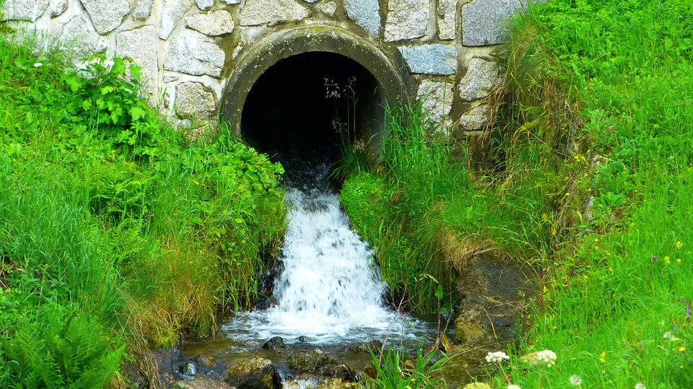
Urbanization messes with how water flows
Last Millennium's Approach
Today’s Approach

Slide 4





Homeowner decisions affect urban hydrology
Downspout
Soil Condition
Driveway
vs.
Microtopography
Sidewalk

Slide 5
Homeowner decisions affect urban hydrology
How do these practices interact with one another?

Slide 6
Homeowner decisions affect urban hydrology
How do these practices interact with climate?

Slide 7
Homeowner decisions affect urban hydrology
How do these practices interact with climate?

Slide 8
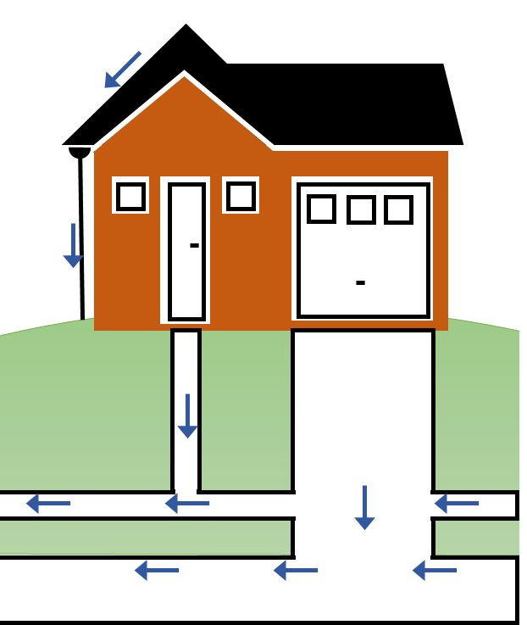

Homeowner decisions affect urban hydrology
How do your actions combine with your neighbors’ actions to impact larger scale hydrology?

Slide 9
Basic Lot Layout
= 0.5m x 0.5m grid cell
(to scale)
House
Garage
Front Walk
Driveway
Front Walk
Driveway
Sidewalk

Slide 10
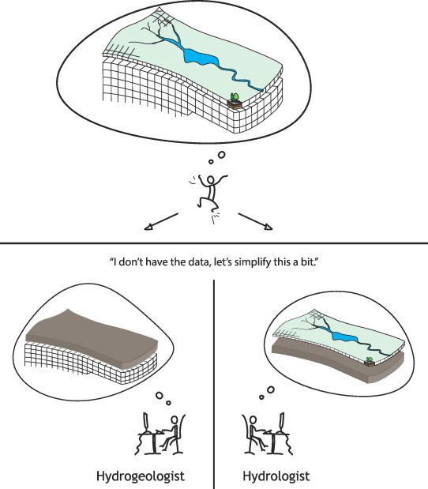
Why these models take forever*
*To me
time
Image:
Staudinger et al., 2019 https://doi.org/10.1016/j.jhydrol.2019.01.058

Slide 11
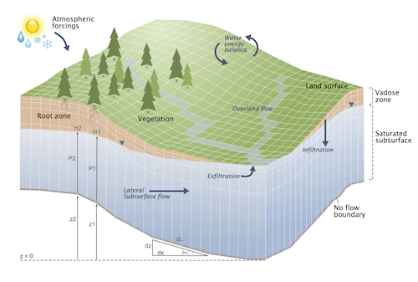
Why these models take forever*
*To me
Image: parflow.org

Slide 12
Why I started on HTC
Model too big for desktop → HPC
Postprocessing too small for HPC → Postprocess on HTC
Do everything on HTC!

Slide 13


HTCondor Workflow
submit server
gluster file server
SPLICE DAGman files
input
input
out01
out02
fluxB
fluxA
fluxB
fluxA
DAGman
convertInputs.sub
*.sh, *.tcl
convertInputs.sub
*.sh, *.tcl
input
fluxC
out03
out04
compute resources
runParflow.sub
*.sh, *.tcl
runParflow.sub
*.sh, *.tcl
fluxB
out04
fluxA
fluxD
fluxC
input
out02
out01
fluxC
out03
fluxB
fluxA
rearrangeOutputs.sub
*.sh
rearrangeOutputs.sub
*.sh
6-10 models running at any given time
Nearly all take >3 days
Use “+is_resumable”
Send outputs back regularly
1
1
2
3
4
1
2
3
4
2
3
Inputs need to be converted to parflow binary format and repackaged
Outputs saved by (model) time, I need to process them by hydrologic flux
Convert to Matlab files for analysis
convertOutputs.sub
*.sh, *.mat
Derive additional fluxes of interest, check water (mass) balance
convertOutputs.sub
*.sh, *.m
5
6
7
8
5
6
7
8
9
10
11
12
9
10
11
12
calculateOutputs
*.sh, *.mat
calculateOutputs
*.sh, *.m
13
14
15
16
13
14
15
16
17
18
19
20
17
18
19
20

Slide 14
Key wins along the way
Figuring out what “compiling” means
Using DAG and ultimately DAG splice
Sending back output regularly, but not too frequently
Custom script to extract current status of all models

Slide 15
Current Pinch Points
Limited to Gluster machines
So much data, no (cheap) place for it to go
As my models get bigger, back to hybrid HPC/HTC workflow

Slide 16


Quantity = Quality
1
7 scenarios
x 20 processors each
x 5-ish days each
More resources + time than I ever imagined spending on hydrologic modeling

Slide 17
Quantity = Quality
1
Baseline
Baseline Compaction = ?
Lowest-Impact
Notes:
But between these two extremes, there are a lot of possible combinations of interventions. So I run all those too. With each model scenario, I’m going to compare the growing season deep drainage to that from the baseline. So I’ll be looking at how much deep drainage changes and comparing those differences.

Slide 18
Quantity = Quality
1
Baseline
Baseline
Baseline
Highly Compacted
Moderately Compacted
K_{sat} ↓ 10x
K_{sat} ↓ 2x
Weather?
Lowest-Impact
Lowest-Impact
Lowest-Impact
Notes:
One thing that kind of bothered me about the baseline scenario is this concept of compacted soil. There are a few studies out there that have looked at urban soil hydraulic characteristics and tried to quantify how they are affected by compaction, but there’s a fairly wide range of what they find. So I decided to test 2 different baseline conditions. One where the soil “highly-compacted” and saturated hydraulic conductivity is reduced by a factor of 10, and the other where it’s only moderately compacted and Ksat is reduced by a factor of 2.

Slide 19
Quantity = Quality
1
Baseline
Baseline
Highly Compacted
Moderately Compacted
K_{sat} ↓ 10x
K_{sat} ↓ 2x
Average
Lowest-Impact
Lowest-Impact
Notes:
Another thing that kind of bothered me was just running this for “average” growing season in Madison, because conceptually, I can imagine a lot of interesting trade-offs might happen between deep drainage and ET under drier conditions. So I ran these for both an average and a dry year.

Slide 20
Quantity = Quality
1
Baseline
Baseline
Highly Compacted
Moderately Compacted
K_{sat} ↓ 10x
K_{sat} ↓ 2x
Dry
Lowest-Impact
Lowest-Impact

Slide 21
Quantity = Quality
1
Highly Compacted
K_{sat} ↓ 10x
Moderately Compacted
K_{sat} ↓ 2x
96 simulations
Notes:
Another thing that kind of bothered me was just running this for “average” growing season in Madison, because conceptually, I can imagine a lot of interesting trade-offs might happen between deep drainage and ET under drier conditions. So I ran these for both an average and a dry year.

Slide 22
Quantity = Quality
2
WET
DRY

Slide 23
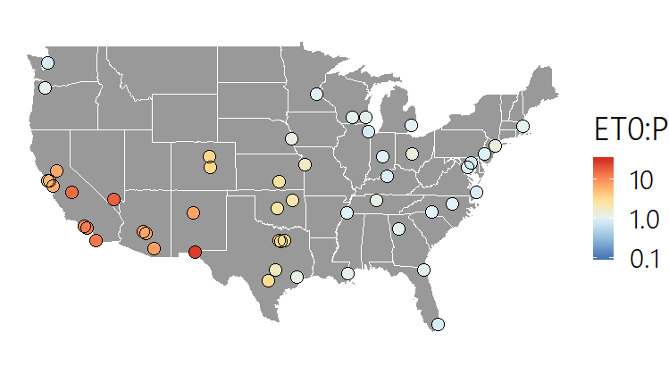
Quantity = Quality
2
2 Lot Types
X
50 Largest U.S. Cities (plus Madison)
Hourly weather data WY2014
Baseline
102 simulations
Low-Impact
ET₀:P
arid
humid

Slide 24
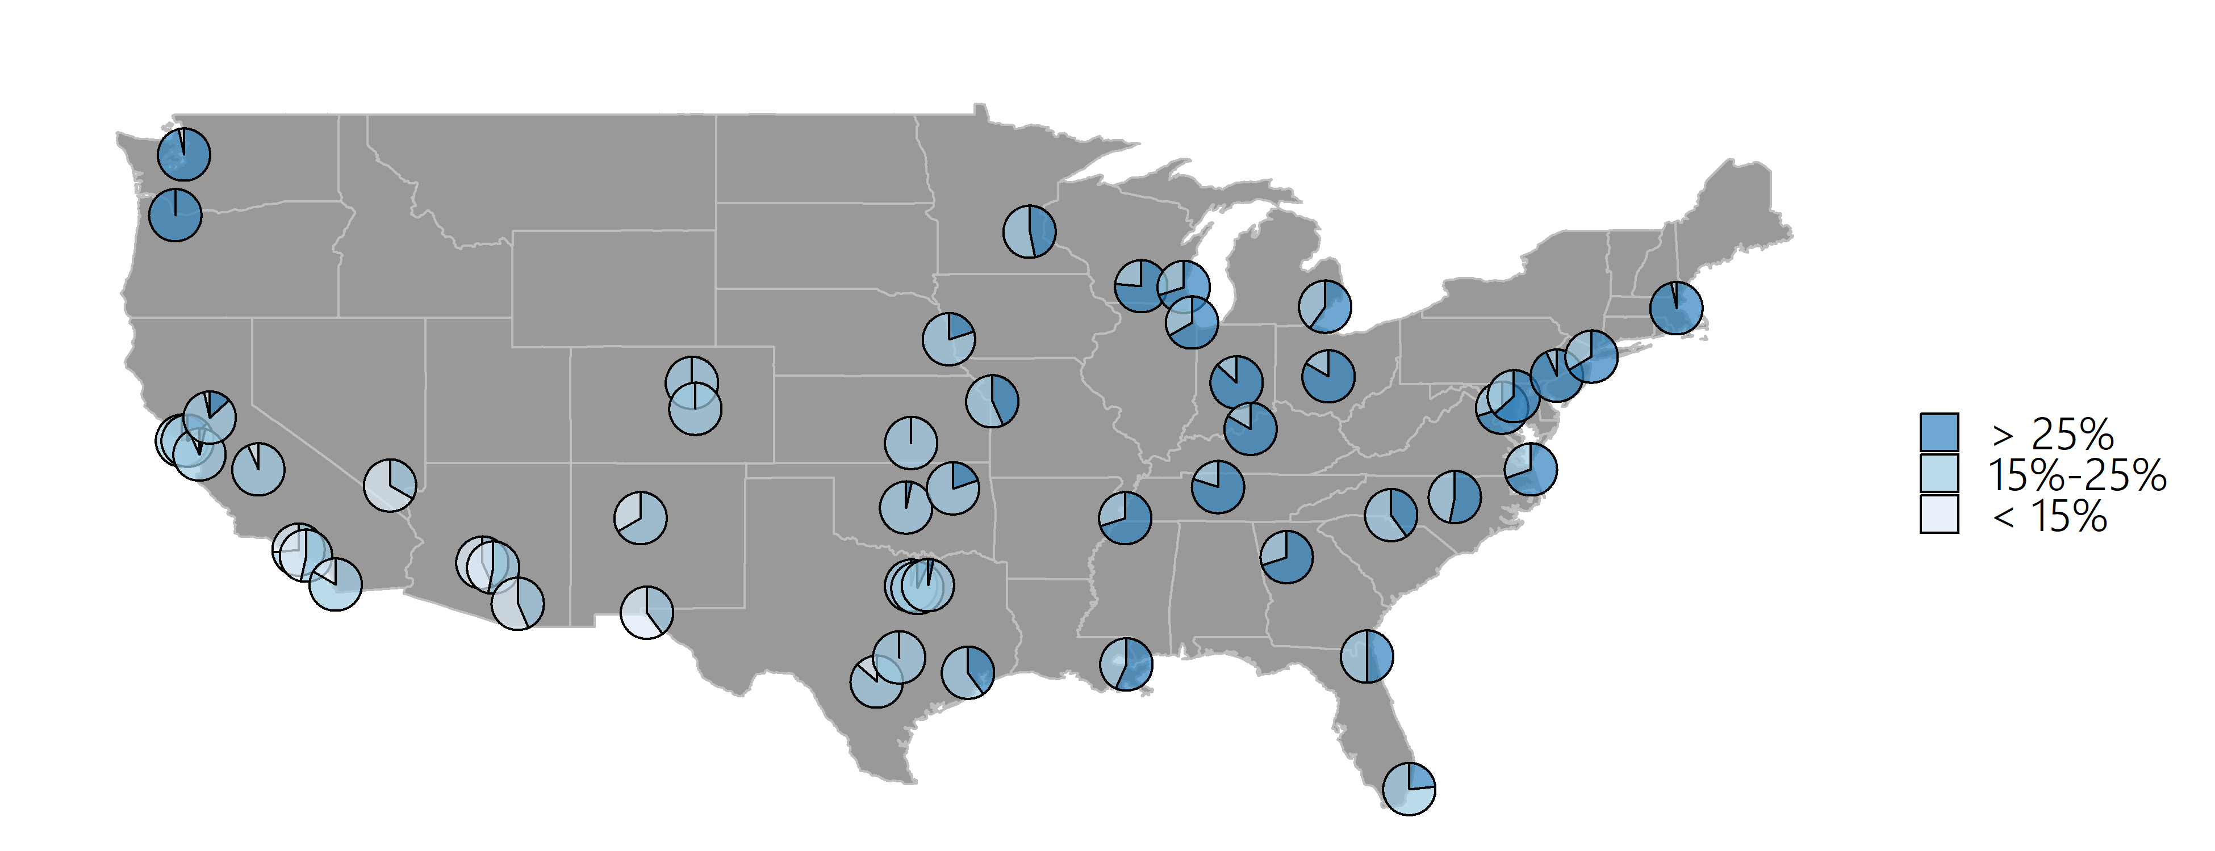
Quantity = Quality
2
Reduction in runoff
Estimates for WY1981 – WY2010

Slide 25
Quantity = Quality
3
Compaction ?

Slide 26
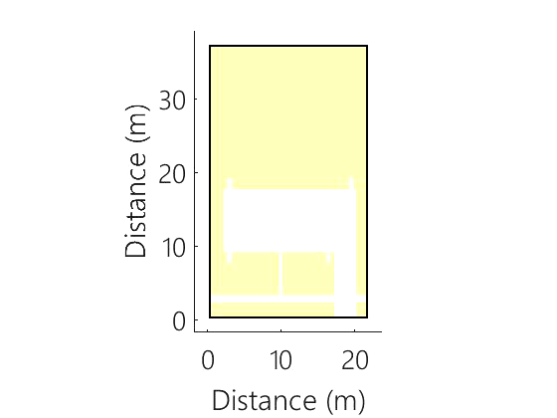
Overland Flow on Compacted Soil

Slide 27
Quantity = Quality
3
Top Ranked Pixel
(0.04% of yard)

Slide 28
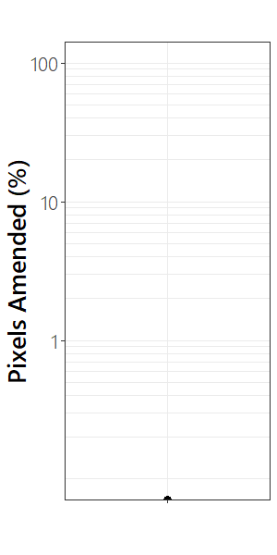
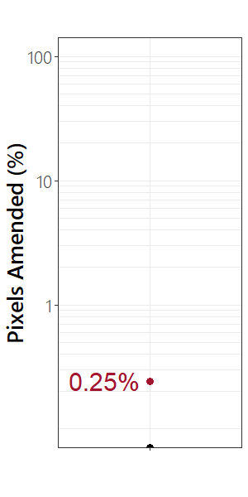
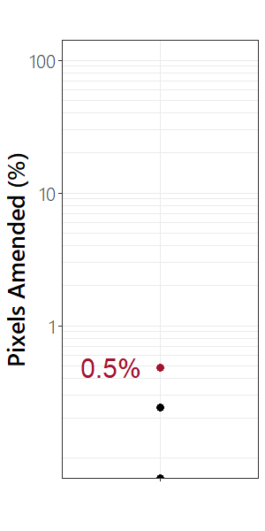
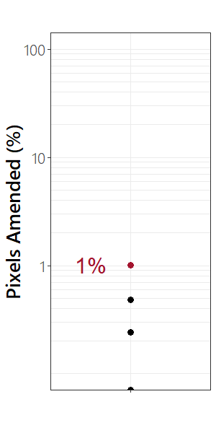
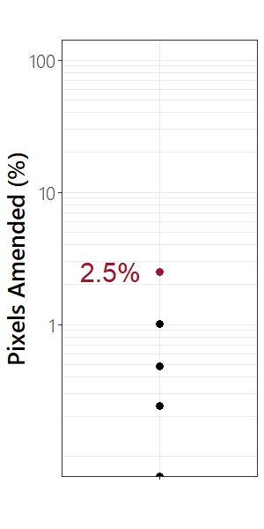
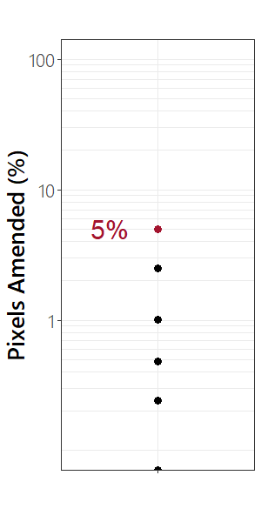
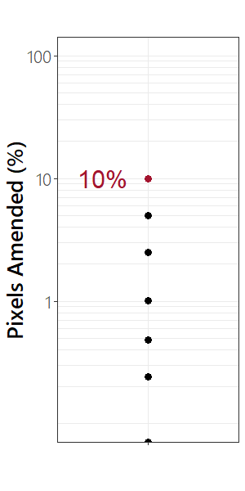
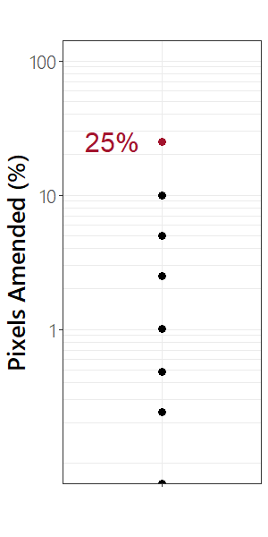
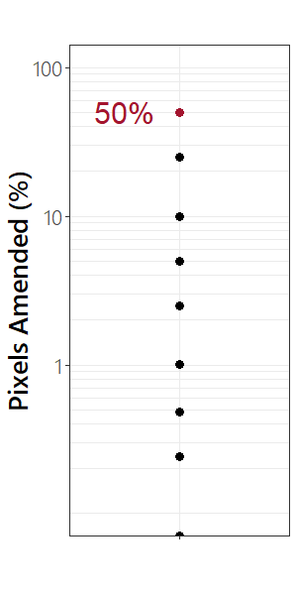
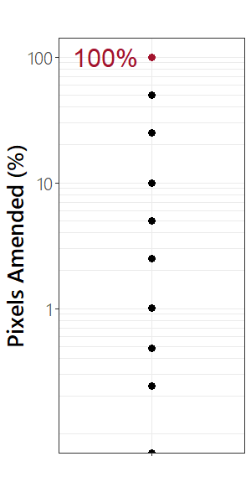
Quantity = Quality
3
= Amended pixels

Slide 29
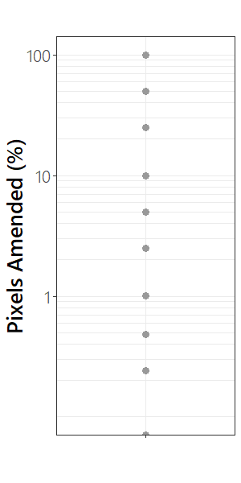
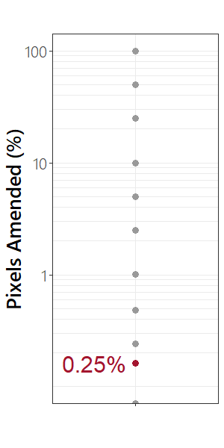
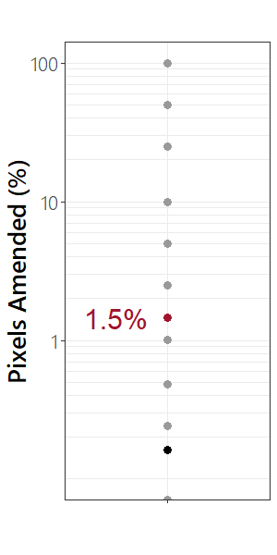
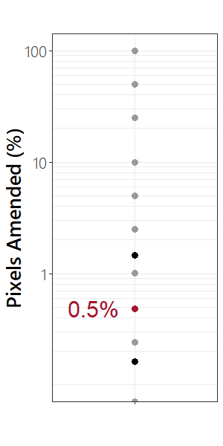
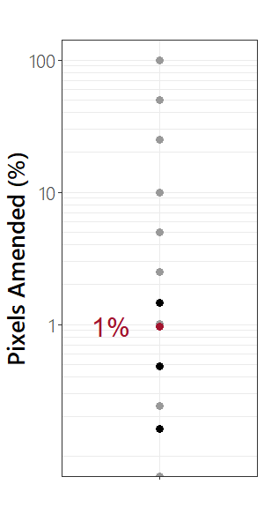
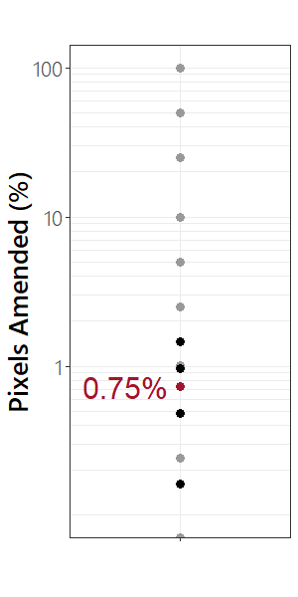
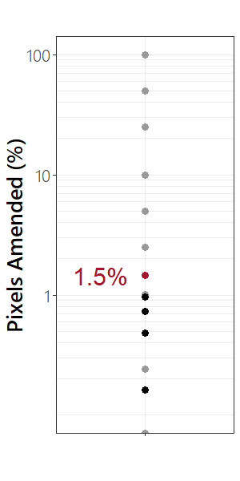
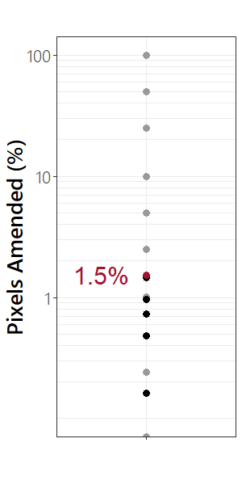
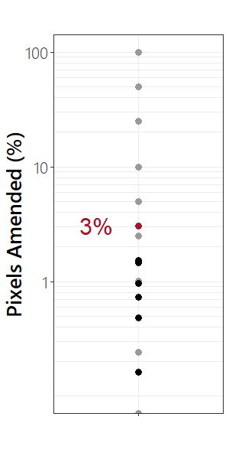
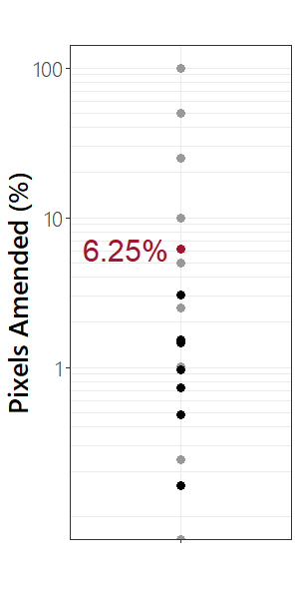
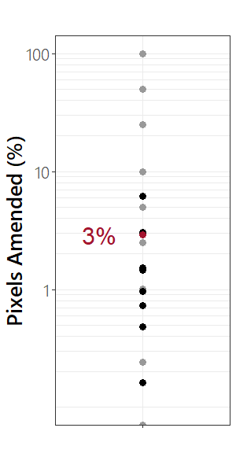
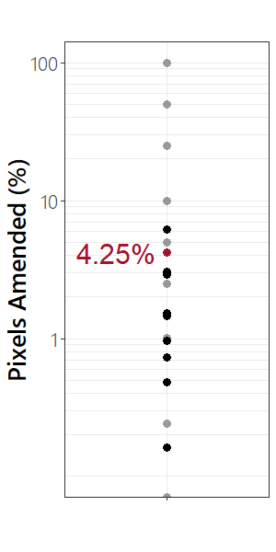
Quantity = Quality
3
= Amended pixels

Slide 30
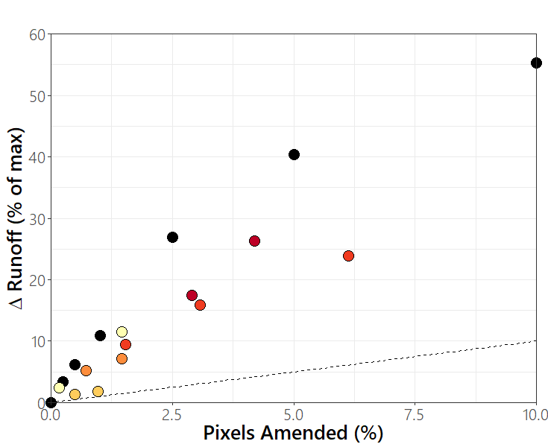
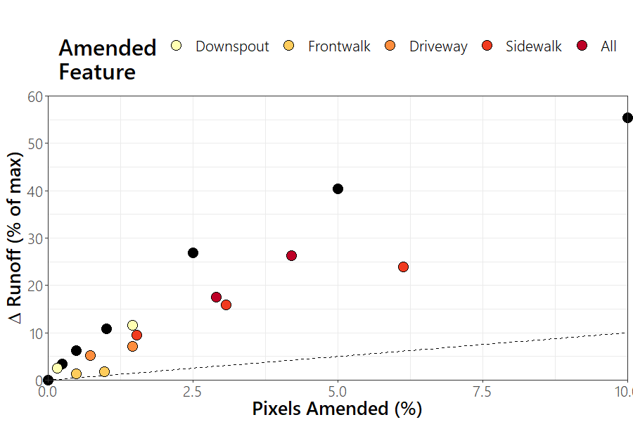
Quantity = Quality
3
Amended Features
All
18 simulations

Slide 31



Thank You!
Questions?
Funding
UW Water Resources Institute, WR12R002
UW Sea Grant Institute, RCE-05
LTER-NTL
Others
Hydroecology Lab
UW Center for High Throughput Computing
Carolyn Voter, Ph.D. Candidate, Civil & Environmental Engineering, UW-Madison
cvoter@wisc.edu carolynbvoter.weebly.com @VoteWater

