Slide 1
Managing a Dynamic Sharded Pool
Anthony Tiradani
HTCondor Week 2019
22 May 2019

Slide 2
Introduction
Some archaeology from my time at Fermilab
  Earliest archived Fermilab talks at HTCondor Week – 15 years ago!
  My earliest HTCondor Week talk in 2012
Describe the current state of the cluster(s)
Along the way, I hope to:
  Show some (maybe) unique uses of HTCondor
  Explain why we did what we did
  Give a peek into some future activities

Slide 3
In the Beginning… (At least for me)
There was HTCondor! And it was Good.
  When I started, the silent “HT” hadn’t been added to the name yet
Single VO
Grid-enabled
Priorities
CMS + OSG
Multi-VO Pool
Grid-enabled
Quotas
Many experiments + OSG
Single VO Pool
Local Analysis only
Priority based scheduling
Notes:
The two CMS clusters managed by the CMS Tier-1 team
GPGrid managed by the Grid Services team
Each cluster had different storage mounts, software installed, and user sets on the worker nodes.
Purpose built clusters for the specific needs and requirements

Slide 4
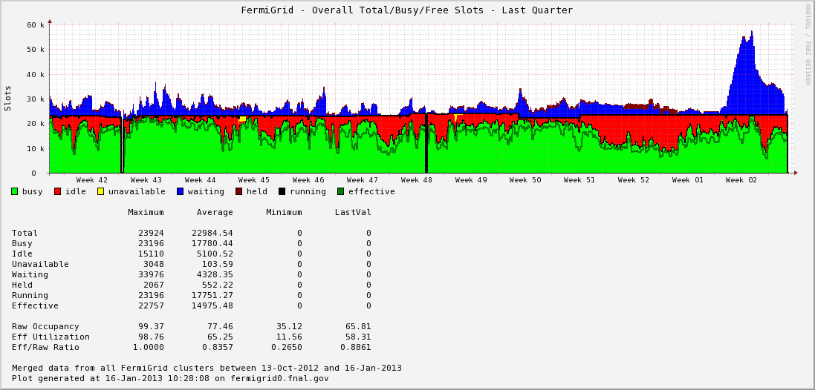
Net Batch Slot Utilization – 2013 Scientific Computing Portfolio Review
Last 3 months
24000
Queued
Idle
Busy
|- Holidays -|
5/16/19
Anthony Tiradani | HTCondor Week 2019

Slide 5
FIFEBatch
FifeBatch was created using GlideinWMS
  Main motivation was the desire to use OSG resources seamlessly.

Slide 6
FIFEBatch
FIFEBatch was a GlideinWMS pool
  All slots are similar – controlled by pilot (glidein)
  Used the glideinWMS Frontend to implement policies
  Used the OSG Factory for pilot submission
  Pilot “shape” defined by Factory
  All of the benefits of glideinWMS and OSG
All FNAL experiment jobs ran within the FifeBatch pool
FIFEBatch managed by experimental support team
GPGrid Managed by Grid Computing team
Notes:
All slots look similar to the GlideinWMS negotiator
Negotiation policies combined Local resources with OSG resources
Allowed pool to grow based on demand

Slide 7
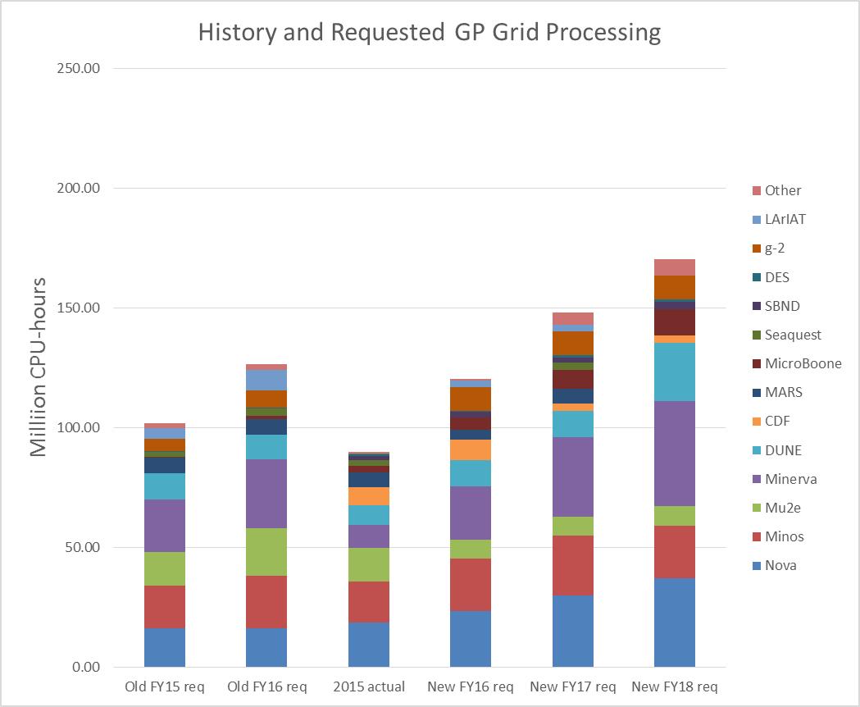
SC-PMT - GP Grid Processing requests:
Large memory or multi-core as single slot
We began to see increased demand for large memory or multi-core slots
For context:
  A “standard” slot was defined as 1 core, 2GB RAM
Partitionable slots limited by the pilot size
Unable to use extra worker resources beyond what is claimed by the pilot
Last year’s
SC-PMT
Notes:
Million CPU-Hours requested/used for large memory or multi-core jobs

Slide 8
Combined: GPGrid + FifeBatch = FermiGrid
Notes:
Single Pool
Single administrative group
Local worker nodes can be fully utilized by jobs
OSG Pilots added to the pool

Slide 9
CMS Tier-1 + LPC
New requirements:
  Make LPC available to CMS Connect
  Make CRAB3 jobs run on LPC resources
LPC workers reconfigured to remove all extra storage mounts
  Now LPC workers look identical to the Tier-1 workers
LPC needed Grid interface for CMS Connect and CRAB3
  The Tier-1 was already Grid-enabled
However, 2 competing usage models:
  Tier-1 wants to be fully utilized
  LPC wants resources at the time of need

Slide 10
CMS Tier-1 + LPC
Notes:
New requirements:
Make LPC available to CMS Connect
Make CRAB3 jobs run on LPC resources
Workers reconfigured to remove all extra storage mounts
Once this was done, the workers looked identical to the Tier-1 workers
LPC needed Grid interface for CMS Connect and CRAB3
The Tier-1 was already Grid-enabled
However, 2 competing usage models:
Tier-1 wants to be fully utilized
LPC wants resources at the time of need
Make good use of Negotiator constraints to specify jobs and resources to be considered
Thanks to HTCondor team for the extra knobs

Slide 11
CMS - Docker
Notes:
HTCondor-CE uses Job Router
LPC Schedds use Job Transforms
Workers advertise Docker Capable = True
Pilots advertise Docker Capable – False
Route/Transform sets the WantDocker attribute to an expression that is evaluated at match to determine whether the job should run in Docker
Docker image is set to an expression that currently uses desired OS to determine image name e.g. if OS == SL7 or “any” give an SL7 image
Local Schedds set DockerImage to be a protected attribute so that it cannot be changed afterwards (prevents users from specifying arbitrary images)
Docker Wrapper uses these attrs to launch Docker Image:
Wrapper handles changing docker syntax
Enforces images and allows black listing
Does an image pull (docker doesn’t do this by default)
Sets docker flag to create /etc/hosts entry to allow reverse DNS lookups
“disable” swap
All this has been fed back to HTCondor developers

Slide 12
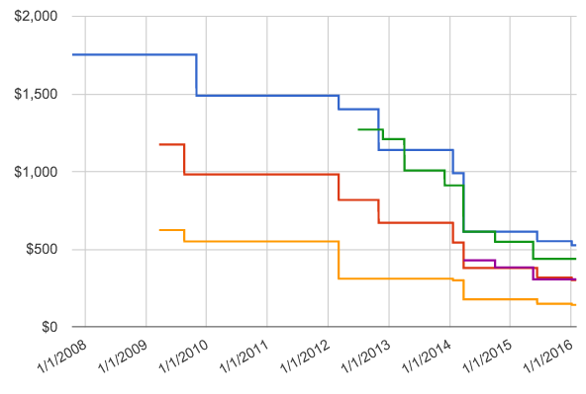
HEPCloud - Drivers for Evolving the Facility
HEP computing needs will be 10-100x current capacity
  Two new programs coming online (DUNE, High-Luminosity LHC), while new physics search programs (Mu2e) will be operating
Scale of industry at or above R&D
  Commercial clouds offering increased value for decreased cost compared to the past
Price of one core-year on
Commercial Cloud

Slide 13
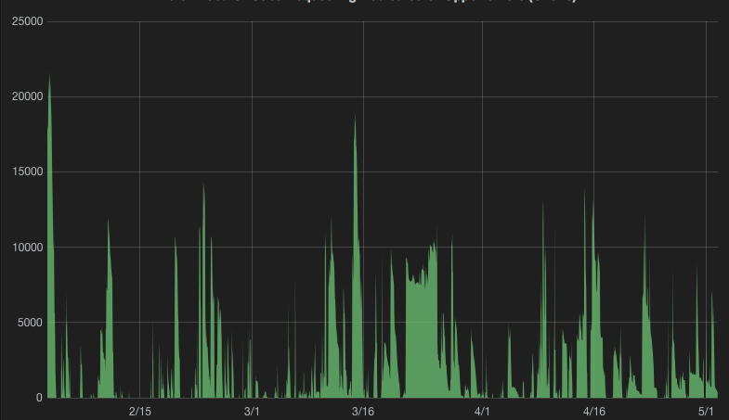
HEPCloud - Drivers for Evolving the Facility: Elasticity
Usage is not steady-state
Computing schedules driven by real-world considerations (detector, accelerator, …) but also ingenuity – this is research and development of cutting-edge science
NOvA jobs in the queue at FNAL
Facility size

Slide 14
HEPCloud - Classes of Resource Providers
Grid
Cloud
HPC
Virtual Organizations (VOs) of users trusted by Grid sites
VOs get allocations ➜ Pledges
  Unused allocations: opportunistic resources
Community Clouds - Similar trust federation to Grids
Commercial Clouds - Pay-As-You-Go model
  Strongly accounted
  Near-infinite capacity ➜ Elasticity
  Spot price market
Researchers granted access to HPC installations
Peer review committees award Allocations
  Awards model designed for individual PIs rather than large collaborations
“Things you borrow”
“Things you rent”
“Things you are given”
Trust Federation
Economic Model
Grant Allocation
Notes:
One box missing – Locally owned resources
Traditionally exist in the locally owned and Grid boxes

Slide 15
HEPCloud
New DOE requirements: Use LCF Facilities
HEPCloud adds Cloud and HPC resources to the pool
Cloud and HPC resource requests are carefully curated for specific classes of jobs
  Only want appropriate jobs to land on Cloud and HPC resources
  Additional negotiator also gives more flexibility in handling new resource types

Slide 16
HEPCloud Era
Notes:
HPC Resources are incorporated using GlideinWMS pilots
Currently requires outbound networking
Cloud resources are VMs that are pre-configured as pilots
Third negotiator added to handle any special constraints
CMS is flocking HEPCloud jobs
HEPCloud negotiator is using job constraint to select only the flocked jobs

Slide 17
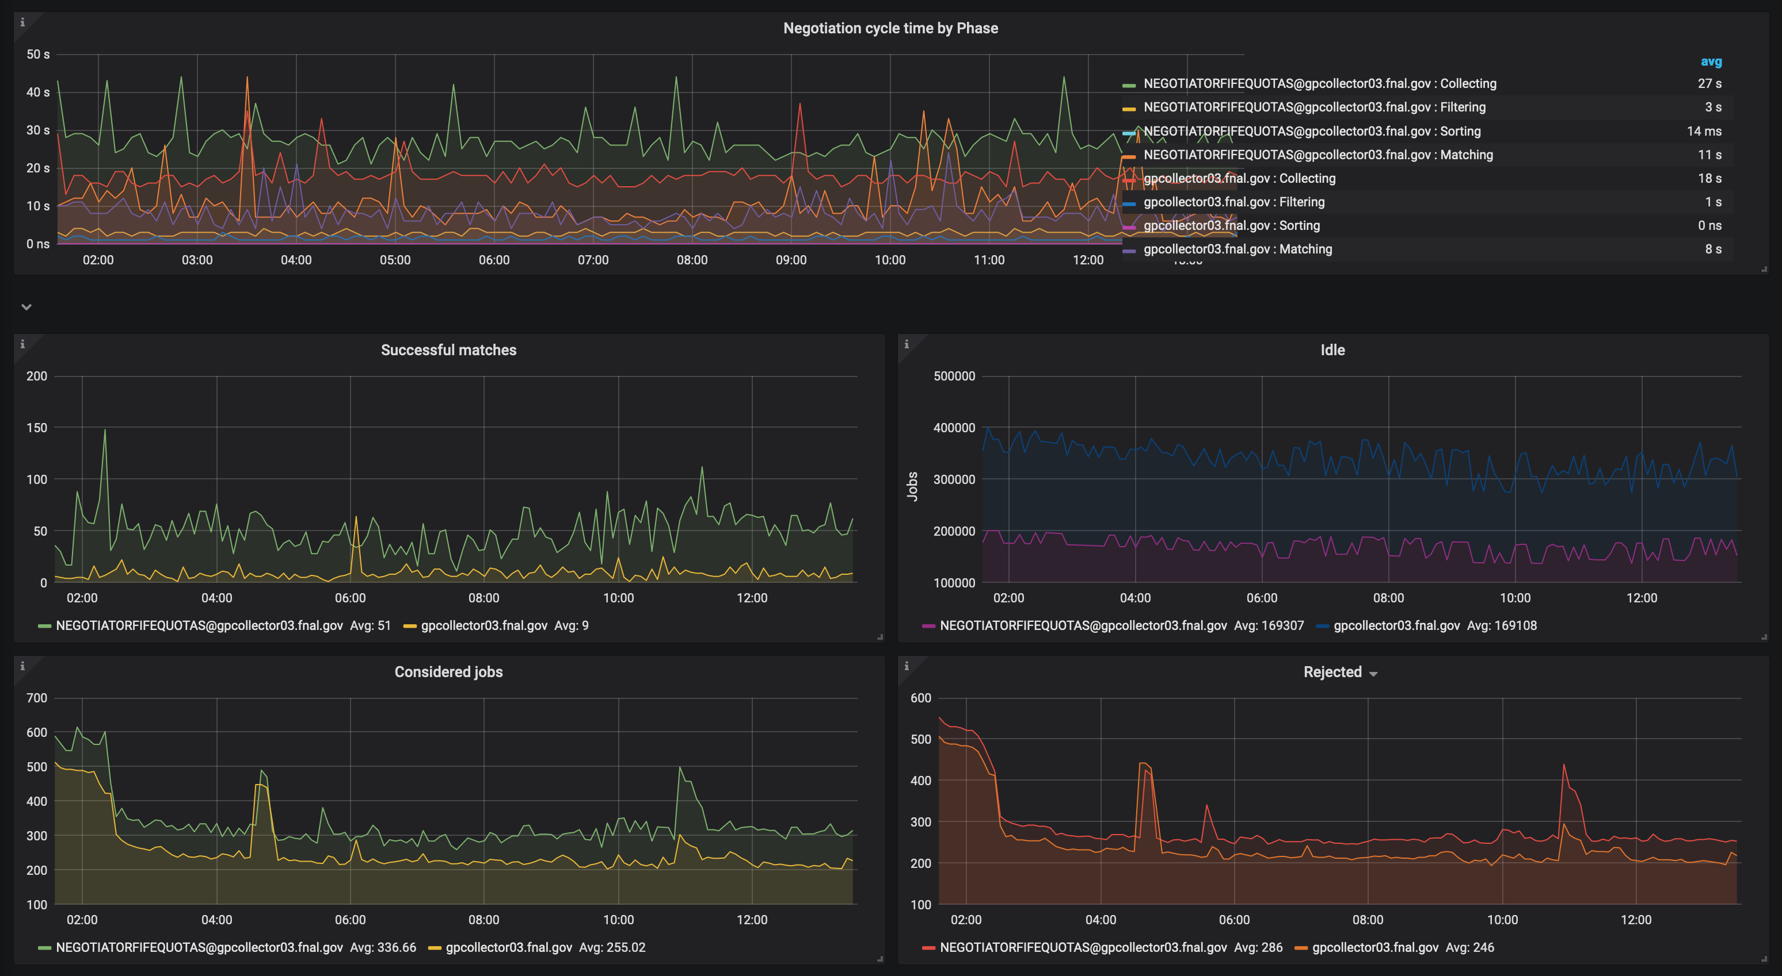
Monitoring – Negotiation Cycles
Negotiation Cycle Time
Idle Jobs
Successful Matches
Considered Jobs
Rejected Jobs

Slide 18
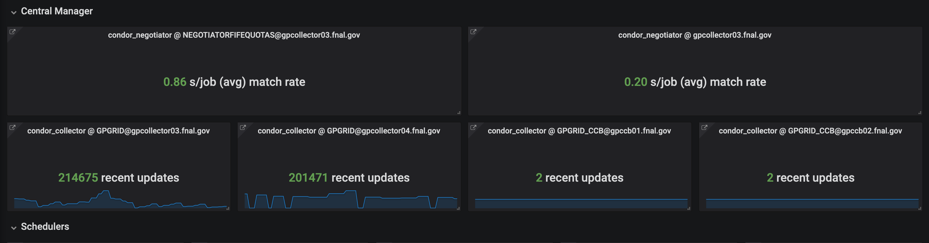
Monitoring – Central Manager
Average match rates
Recent Updates

Slide 19
Next Steps
CI/CD pipelines for Docker containers
Containerizing workers? (Kubernetes, DC/OS, etc.)
HTCondor on HPC facilities with no outbound networking
Better handling of MPI jobs
  No dedicated FIFO scheduler
  No preemption
Notes:
Containerizing Workers
Igor Sfiligoi’s talk is similar to what we want to explore
HTCondor – HPC no network
Mentioned in Todd’s talk of ”inconvenient truths”
Jaime’s talk later

Slide 20
Questions, Comments?
Notes:
HTCondor – HPC no network
Mentioned in Todd’s talk of ”inconvenient truths”
Jaime’s talk later

