Slide 1
(Building an) AI Platform on htcondor
Motivations, lessons learnt and Next Steps
Cedalion standing on the shoulders of Orion by Nicolas Poussin, 1658

Slide 2
agenda
Motivations
Design Guidelines
Platform Abstractions
Platform Architecture
Demo
Platform Roadmap
Summary
Questions

Slide 3
motivations
Team’s background was in Hadoop, Spark, Mesos and other ‘Big Data’ Technologies that came out of the valley
Worked with highly regulated industries like Healthcare and Finance trying to help leverage their data to answer hard questions
Was not satisfied with the restrictions that available technologies were placing along with lack of hybrid cloud support.
Lack of a truly End to End AI/ML platform was also a concern.
SAFE AI was usually non-existent or an after-thought
Security, Assurance, Fairness and Effectiveness (SAFE)

Slide 4
Design guidelines
Do not re-invent the wheel
Learn from the mistakes of others.
Newer does not always mean better
Measure twice and cut once
Security should not be an afterthought
Provide freedom of choice

Slide 5
Platform abstractions
Datasets
Upload and reference Data
Executables
Binary files, scripts
Libraries
Dependencies to Executables
Workflows
Abstractions on top of Pegasus DAX files
Dashboards
Visualization dashboards
Clusters*
Loosely translates to Condor pools
Models*
Handles Model file and API
Notebooks
Jupyter Notebook Support

Slide 6
Platform Architecture

Slide 7
demo

Slide 8
Platform roadmap
End to End ML Features – (Models, Apps)
SAFE AI Feature set
Cloud bursting Support (condor-annex looks very promising)
Grid Universe support
Open Source Core platform (Apache 2.0) Looking for potential contributors/users

Slide 9
Summary
Building a Data Science/AI/ML Platform is never fun
Open source tools like Pegasus, HTCondor make it a lot easier
Still a challenge to pick the right set of technologies
Still very use-case dependent
Get ready to do a lot of Devops (and then some more)
K8s has a lot of cool tools to help bundle complex platforms (helm charts etc)
Since all of these tools keep evolving, you are never done !

Slide 10
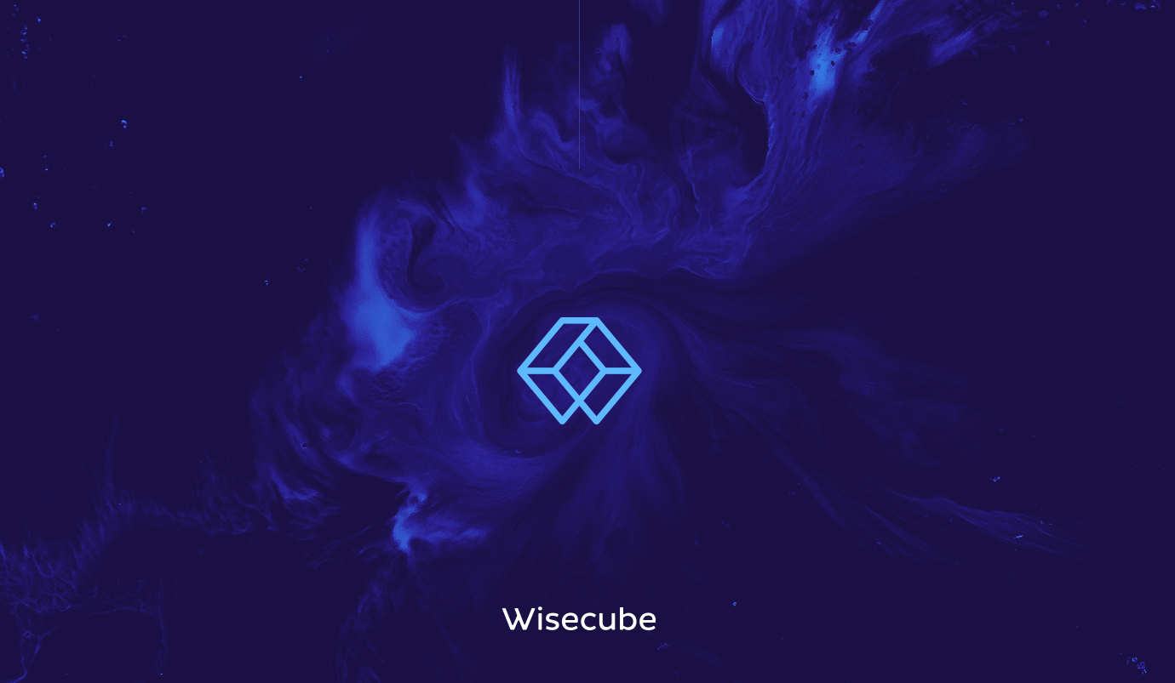
Questions?
vishnu@wisecube.ai
www.wisecube.ai

