Slide 1
HTCondor Philosophy
Greg Thain

Slide 2
Agenda
  The rest of the tutorials at this conference is about the hows of HTCondor
  This talk is about the why

Slide 3
After this talk, you should…
Know where to put policy and why: e.g.
Limit one IO heavy job per machine
How to hold job that runs > 24 hours
Where to change priority of user for pool

Slide 4
The Philosophy on 1 slide
To reliably run as many jobs as possible
on as many machines as possible
(in order of precedence)

Slide 5
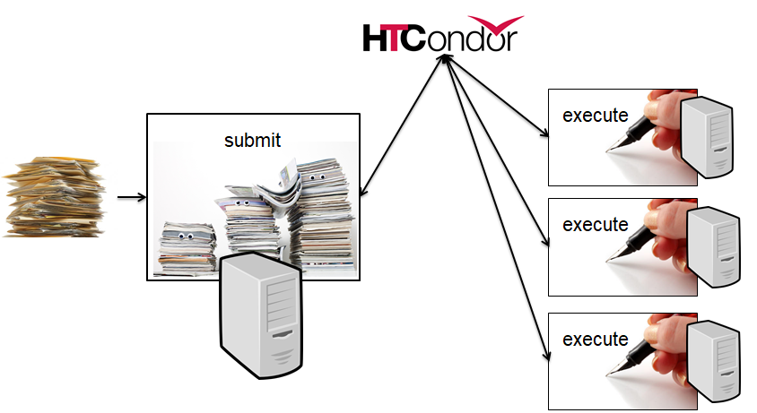
The Unstated Assumption
Many independent jobs make up a workflow
Bags, Dags, files as ipc
*whole talk about this downstairs

Slide 6


Overview of condor:
3 sides
Execute
Submit
Central Manager

Slide 7
To reliably run…
Reliability 1st priority
We can make HTCondor fast enough
  w/o sacrificing any reliability – no screw polishing

Slide 8
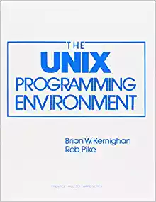
To reliably run…
Unix process per daemon
Each has failure semantics
Each cleans up on exit
Each has responsibility

Slide 9
To reliably run… requires parent
Small condor_master runs on all condor machines
Responsibilities:
  Like systemd init,
    starts, restarts, kills children
  condor_on,
  condor_off, condor_reconfig
  Detects hung kids and kills them(!)
  Exits if disk full
  Runs Linux kernel tuning script
master
On/off/restart
commands
TCP
Fork/exec
Fork/exec
child1
child2

Slide 10
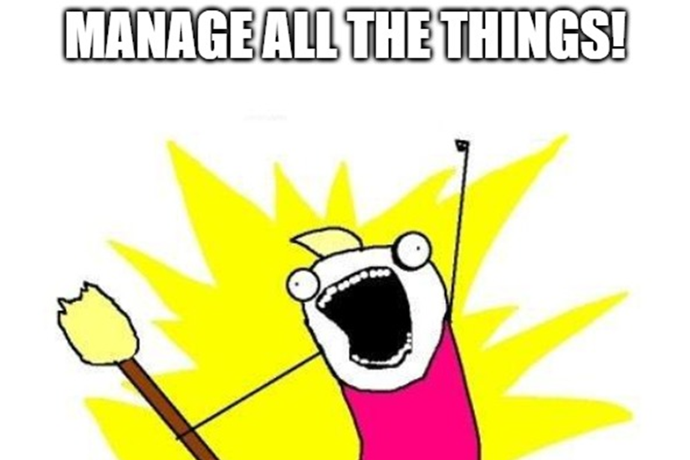
master manages process
Manage:
Remove what you create
  and what they created…
Measure what you create
  And report it
Limit what you create

Slide 11
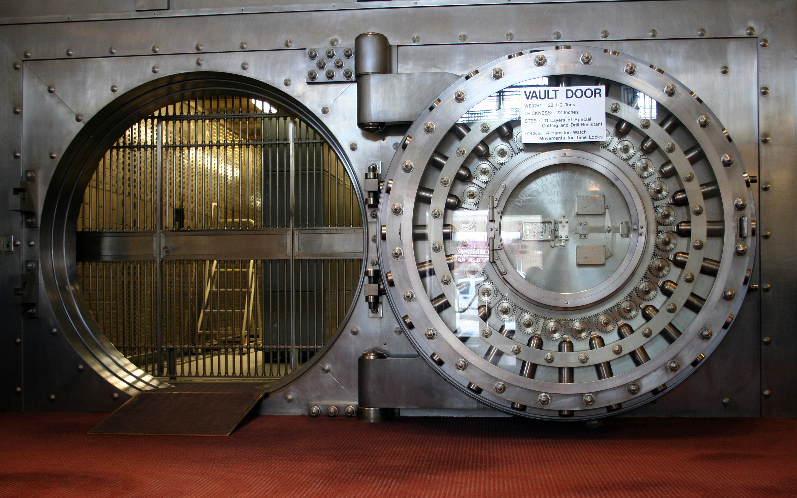
… as many jobs…
Requires a scheduler, the condor_schedd
Users submit jobs to schedd
Schedd is a database
reliable, slow
On crash, all restart
To support many jobs,
reliably means…

Slide 12
Scaling via many submit points
Execute
Central Manager
Submit machines

Slide 13
Scaling via many submit points
Adding submit points just helps scaling
Allows submit near the user
“Submit locally, run globally”

Slide 14
But the schedd doesn’t schedule
It does a little
Schedd has jobs, can request machines
But only uses the machines given to it

Slide 15
The shadow manage running, remote jobs
One process per running job on submit
Responsible for job’s policy remotely
  Tells the worker node what to do
Expensive? Yes – worth it

Slide 16
…on as many machines
Implies machines are heterogeneous
Could be foreign pools
Could be same pool with different config
Could be places without shared filesystem

Slide 17


Two-faced nature of HTCondor
Split responsibility:
Worker side
Submit side
We encourage different config on both sides
Always focusing on responsibility of the side
Always consider where responsibility goes

Slide 18
The startd
Startd represents the policy of the machine
Creates “slots”, places for jobs to run
Could conflict with job’s policy?
  Who wins?
Always the machine – the job is a guest

Slide 19
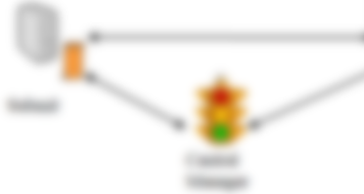

Startd Mission Statement
Near sighted
3 inputs only:
  Machine
  Running Jobs
  Candidate Running Job
Knows nothing about the rest of the system!

Slide 20
Things the startd can do
Only run some kinds of jobs
Preempt one job for another
Only run 1 job of some type
Expose and match custom resource

Slide 21
But the startd doesn’t run job
Doesn’t run jobs directly,
Creates (and manages!)
child process, the starter

Slide 22
The Starter
Startd manages machine, starter job
When job starts, startd spawns starter
One starter per job, thus one per slot

Slide 23
Starter Responsibilities
Starter manages running job on machine:
Create environment for job
Monitor, report job resource usage home
Creates “Universe” metaphor
Clean up after job
  Condor Philosophy: renters clean up after use
    (Startd cleans up after starter…)
File Transfer

Slide 24

A few words on file transfer…
We can use shared FS or File Transfer
Prefer File Transfer:
  Managed
  Portable
  Declarative

Slide 25
Moving on to the middle side…
Execute
Submit
Central Manager

Slide 26
The Central Manager
Part 1: The Collector
  The central database
  All in memory, lightweight
  Every thing reports to collector
    Everything is a classad
  condor_status queries

Slide 27
The Collector
Looses everything when it crashes
Protocol is always be updating
Not a central point of failure
Garbage collects if no updates

Slide 28
The Negotiator
Whole talk on this later…
Other “half” of scheduling
Slow, allocates machines to user
Not a single point of failure

Slide 29
Quiz Time
How to hold job that runs > 24 hours
  Or rather, where?
On the submit machine?
Or Execute Machine?
  Discuss!

Slide 30
Quiz Answer
It depends!
  Property of job or property of machine?

Slide 31
Thank you

