Slide 1
STScI and HTCondor Reporting on Today and Exploring Tomorrow
Mary Romelfanger and Mike Swam
21 May 2019

Slide 4
Mikulski Archive for Space Telescopes (MAST)
Active Missions
Hubble Space Telescope
James Webb Space Telescope
Transiting Exoplanet Survey Satellite
K2
Neil Gehels Swift Observatory
X-ray Multi-Mirror
Ground Based
Panoramic Survey Telescope & Rapid Response System (PANSTARRS)
Faint Images of the Radio Sky at Twenty-cm (VLA-FIRST)
Legacy Missions
International Ultraviolet Explorer (IUE)
Kepler
Galaxy Evolution Explorer (GALEX)
Far Ultraviolet Spectroscopic Explorer (FUSE)
Copernicus
Extrasolar Planet Observations and Characterization (EPOCH)
Extreme Ultraviolet Explorer (EUVE)
Hopkins Ultraviolet Telescope (HUT)
Ultraviolet Imaging Telescope (UIT)
Wisconsin Ultraviolet Photo Polarimeter Experiment (WUPPE)
Halfwave Polarimeter (HPOL)
Tübingen Echelle Spectrograph (TUES)
Interstellar Medium Absorption Profile Spectrograph(IMAPS)
Berkeley Extreme and Far-UV Spectrometer (BEFS)

Slide 5
Previous STScI Presentations at HTCondor Week
HTCondor Week 2016
HTCondor Use In Operational Data Processing
For The Hubble Space Telescope (HST)
And The James Webb Space Telescope (JWST)
Mike Swam
HTCondor Week 2018
Using HTCondor to Calibrate and Archive HST and JWST Data
Matthew Burger

Slide 6
Hubble Space Telescope

Slide 7
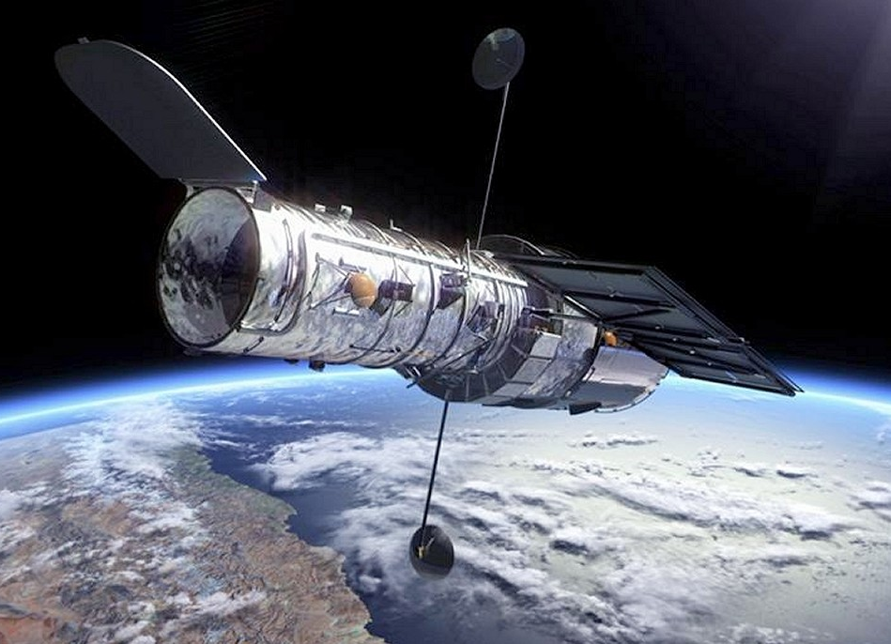
Hubble Space Telescope
Hubble Space Telescope (HST)
Launched 24 April 1990
Just celebrated the 29th Anniversary
2.4 Meter Primary mirror
43.5 feet (13.2 meters) long
size of a large school bus
Present Instruments
WFC3 - Wide Field Camera 3
COS - Cosmic Origins Spectrograph
ACS - Advanced Camera for Surveys (repaired during SM4)
STIS - Space Telescope Imaging Spectrograph (repaired during SM4)
NICMOS - Near Infrared Camera and Multi-object Spectrometer. (not currently operational)
FGS - Fine Guidance Sensors

Slide 8
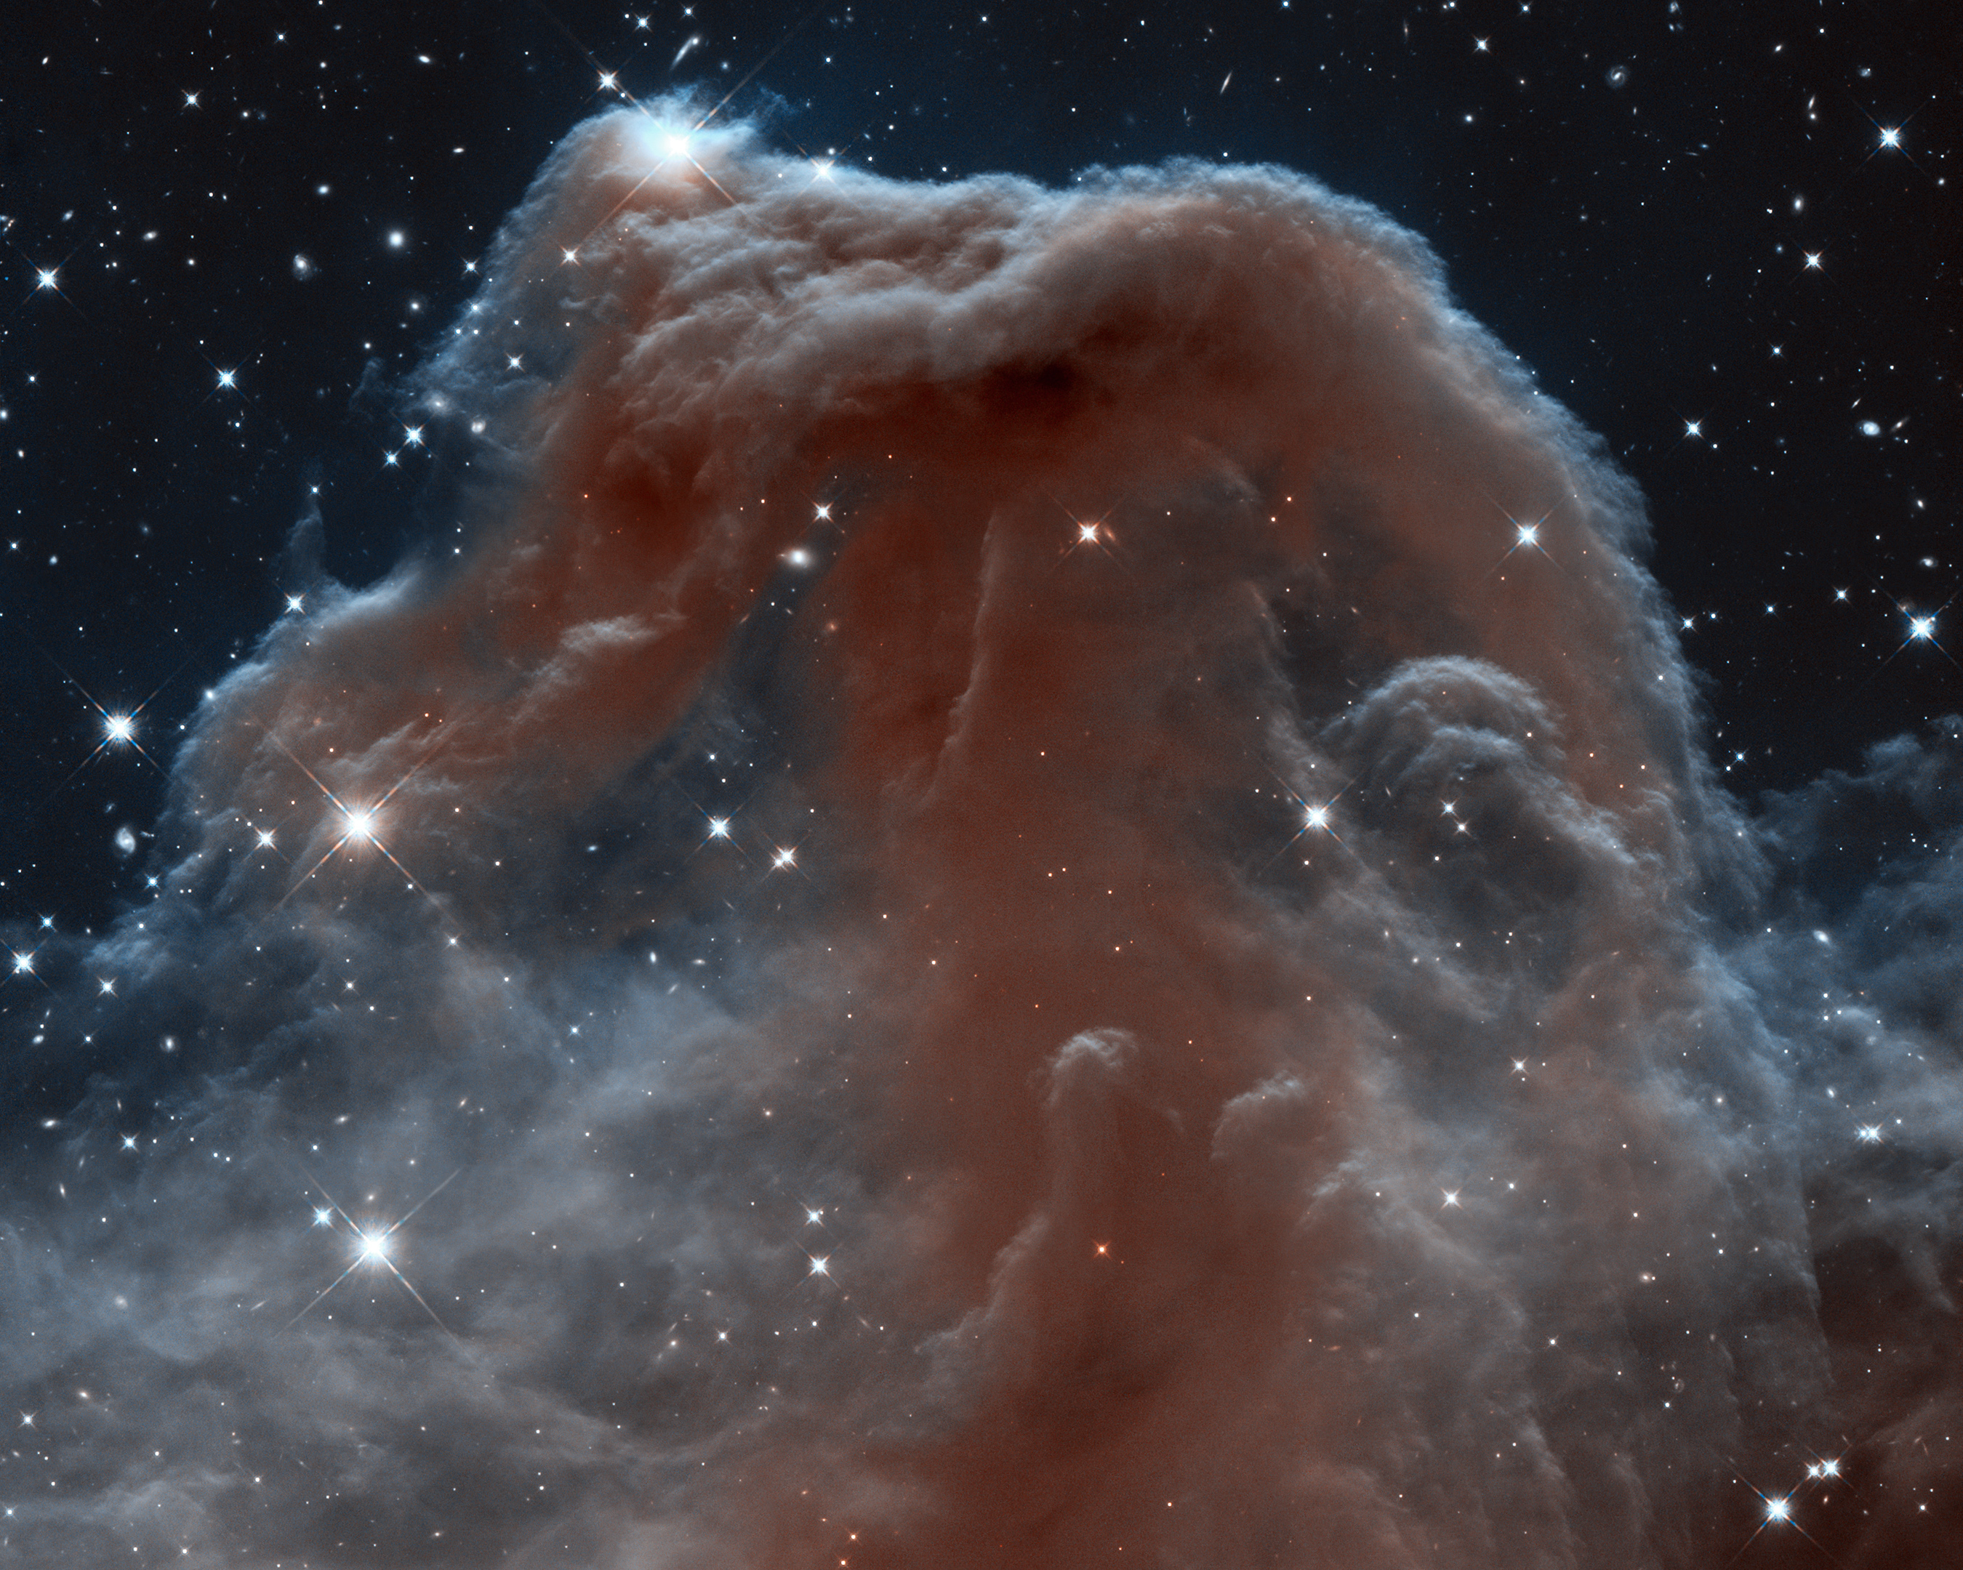
Hubble Space Telescope
5 servicing missions to replace instruments and make repairs.
Last Serviced 11 May 2009 -- 10 years ago!!
No Consumables - built in redundant parts and solar power
Originally had a 1.2 Gigabit reel-to-reel recorder
Replaced with a 12 Gigabit(1.5 Gigabyte) solid state drive 24 Dec 1999
Today HST Science Data Processing (SDP) generates
about 30 Gigabytes of data per day
11 Terabytes per year
Today the archive contains
166 Terabytes of HST Science Data
More than 1.3 Million unique observations
Over 15,000 scientific papers published
New ways to process data being added
Hubble Legacy Archive being moved to SDP
more accurate astrometry calculations
Horsehead Nebula
Hubble Heritage 2013

Slide 9
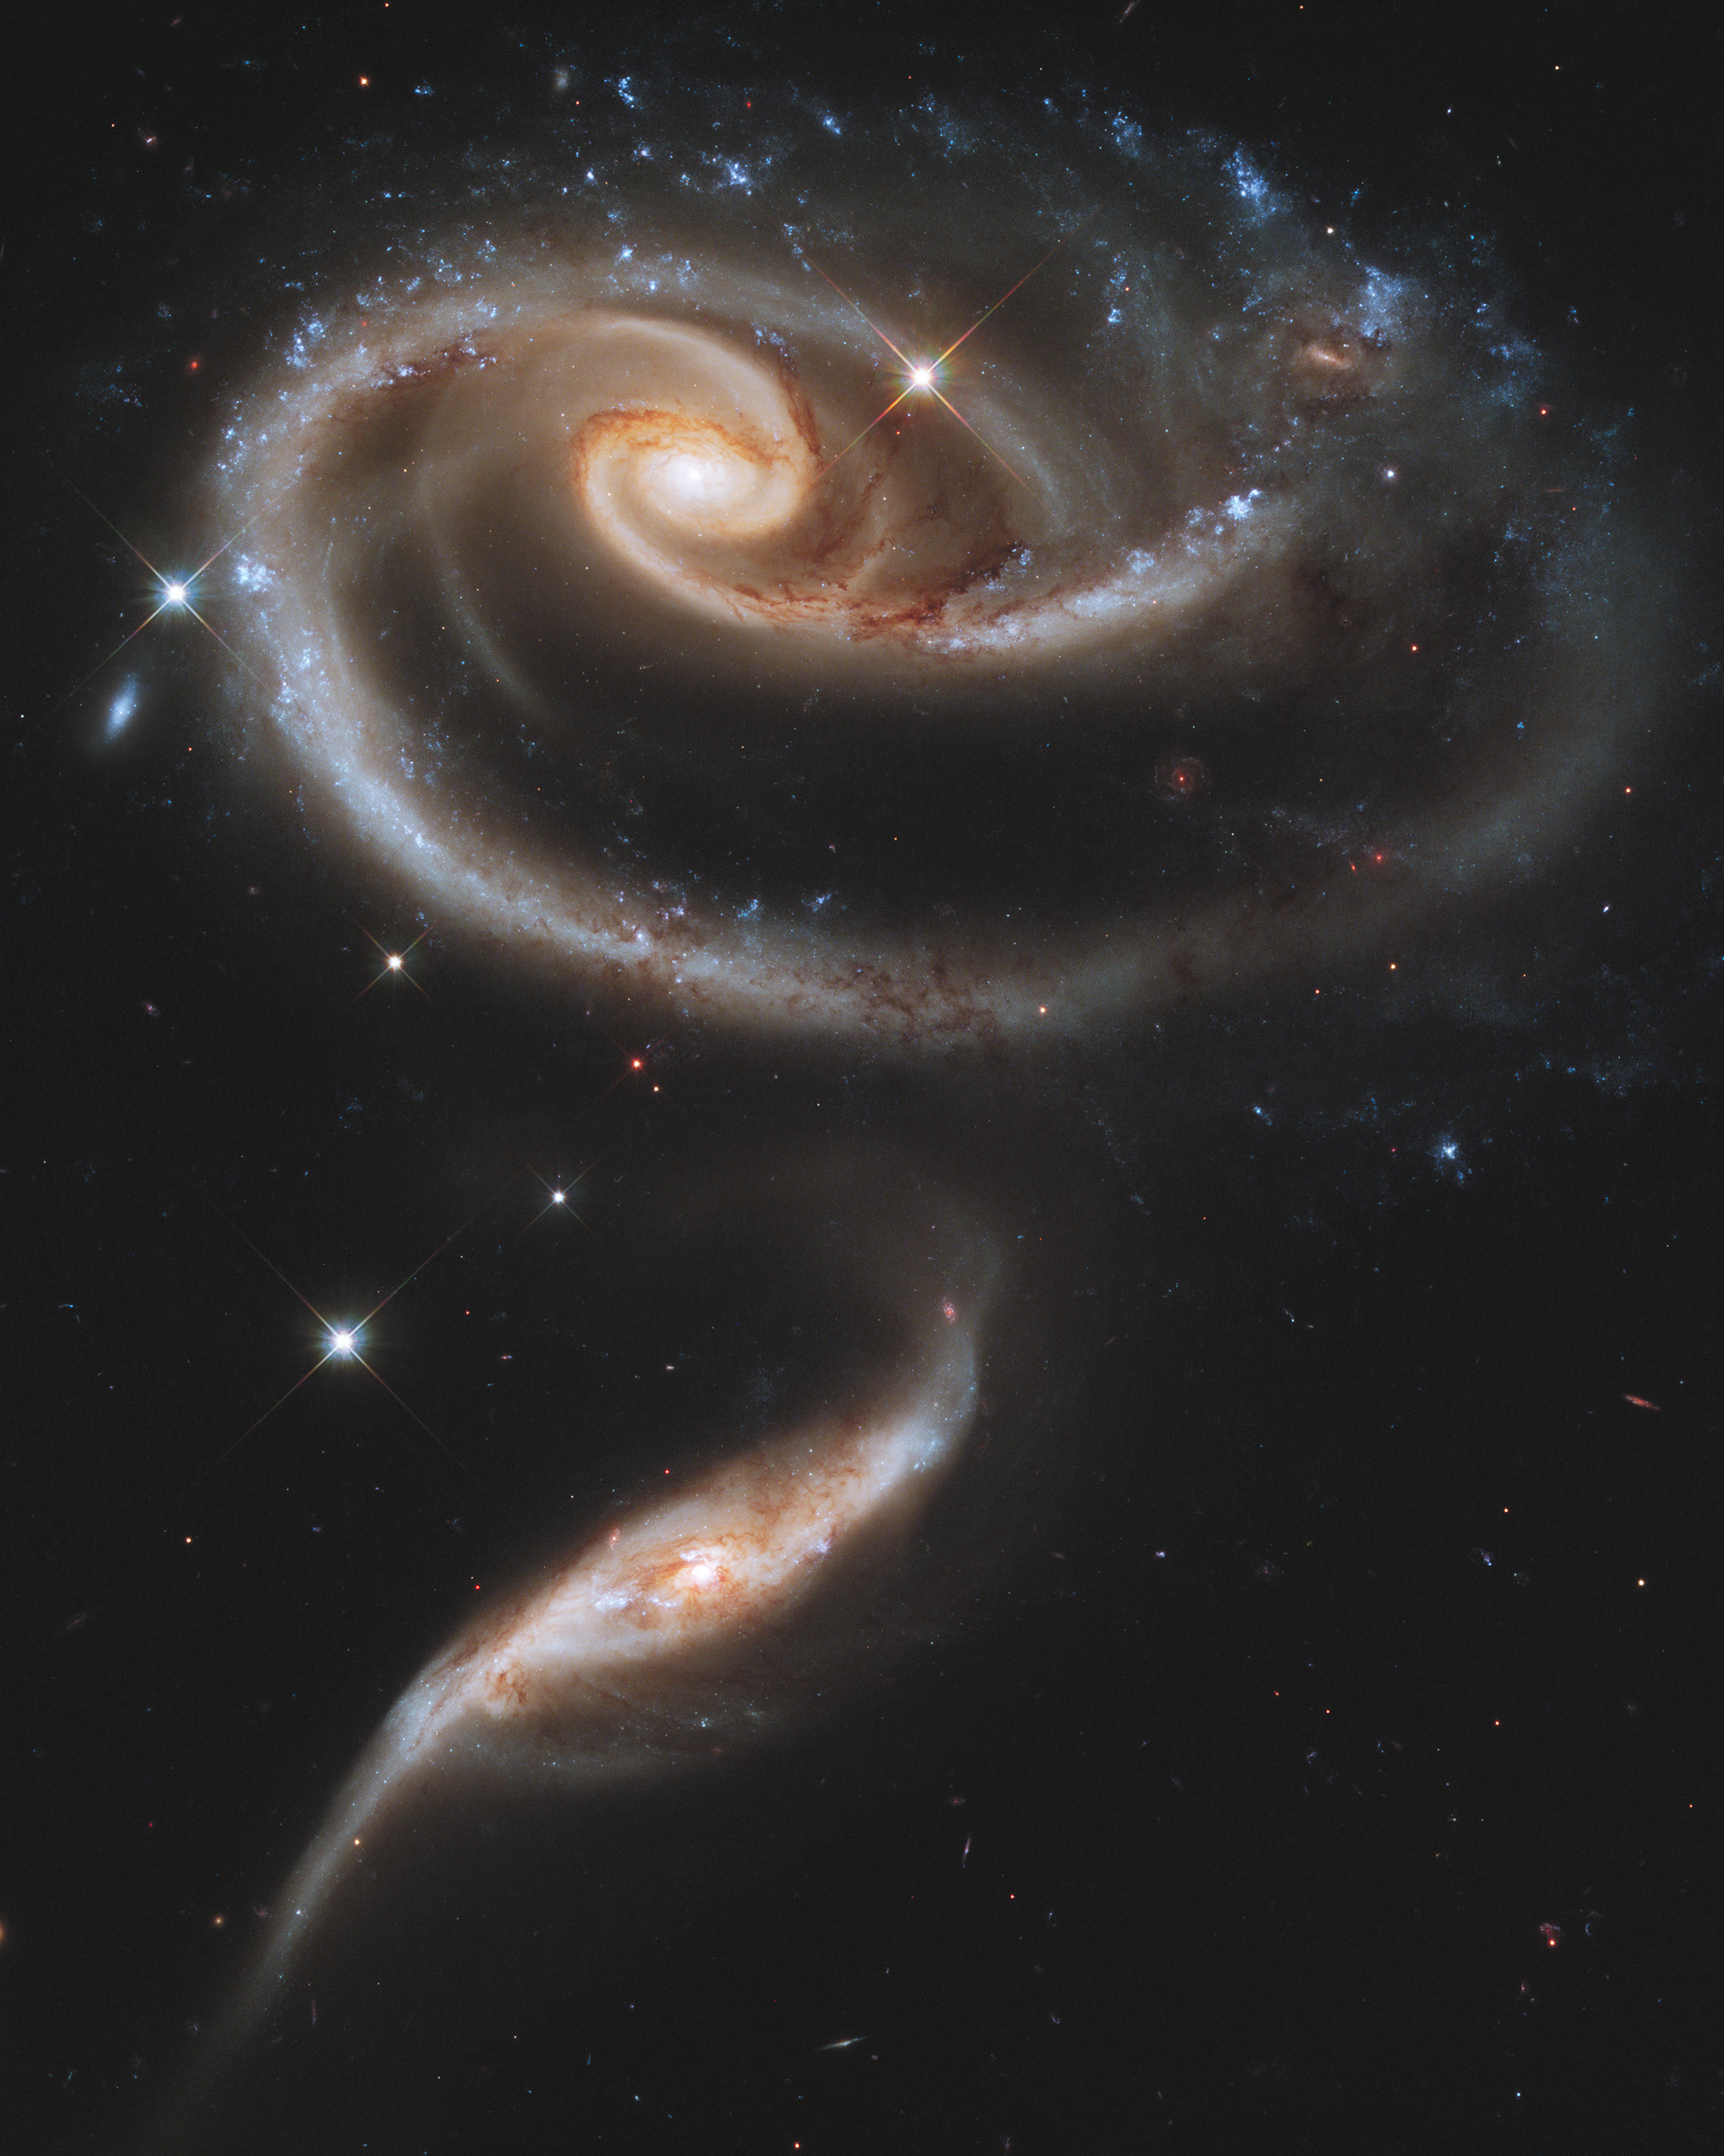
Hubble Space Telescope
We have many very small very quick jobs
We process HST data in a 240 core HTCondor pool with a shared nfs mounted partition.
This is an operational environment with a single user. This single user environment allows us to use job priorities to control the order of the processing and reprocessing.
The population of the database table used to track dataset progress through workflows is not completely reliable.
We see sporadic HTCondor job hook failures, likely due to database connectivity issues, so Operators can have difficulty in discerning real failures from errant reports in the database (most-­‐often the workflows completed OK, but the DB says otherwise)
The “Rose”
Hubble 21st Anniversary 2011

Slide 10
Southern Crab Nebula
This image was taken in 1999 by Wide Field and Planetary Camera 2(WFPC2). This is a pair of aging stars buried in the glow of the tiny, central nebula. One of them is a red giant, a star that is exhausting its nuclear fuel and is currently releasing its outer layers in a powerful stellar wind. Its companion is a hot, white dwarf, a burned-out star.
Credits: Romano Corradi, Instituto de Astrofisica de Canarias, Tenerife, Spain; Mario Livio, Space Telescope Science Institute, Baltimore, Md.; Ulisse Munari, Osservatorio Astronomico di Padova-Asiago, Italy; Hugo Schwarz, Nordic Optical Telescope, Canarias, Spain; and NASA

Slide 11
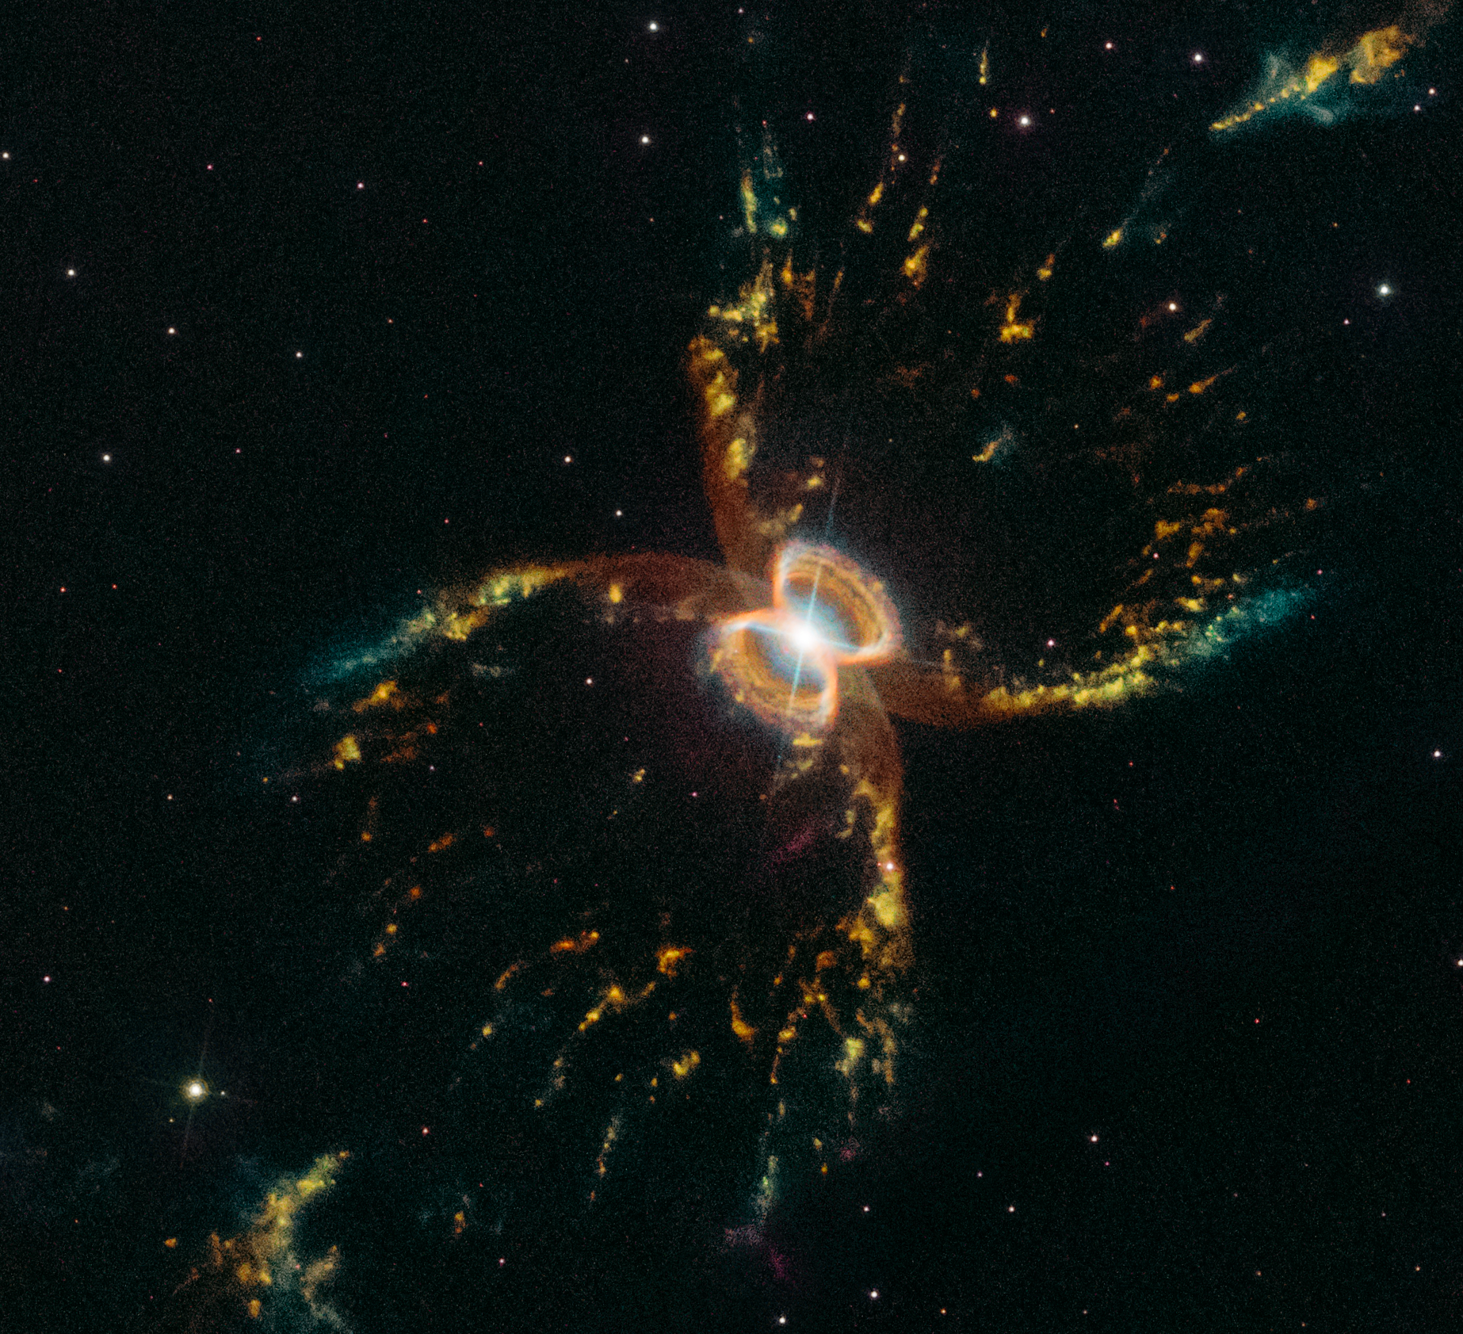
Southern Crab Nebula
This latest image of the Southern Crab Nebula was created from several exposures that were taken in March 2019 by Wide Field Camera 3. This image is a composite of exposures taken to detect various wavelengths of light that correspond to the glowing gases in the nebula.
Credits
NASA, ESA, and STScI

Slide 12
How HST photos are created is explained here.

Slide 13
Transiting Exoplanet Survey Satellite

Slide 14
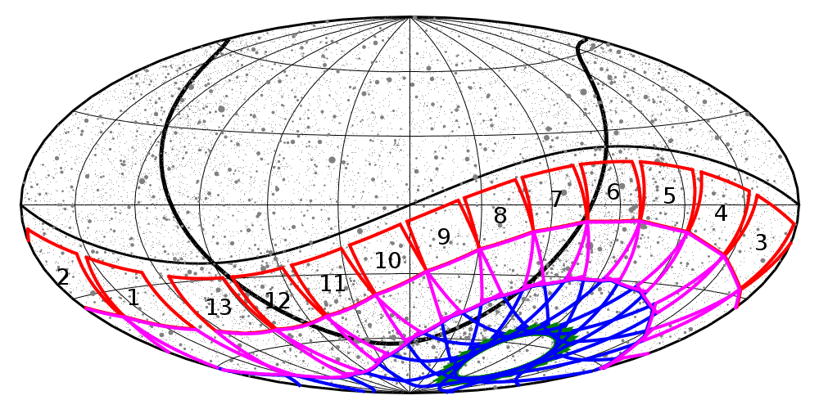
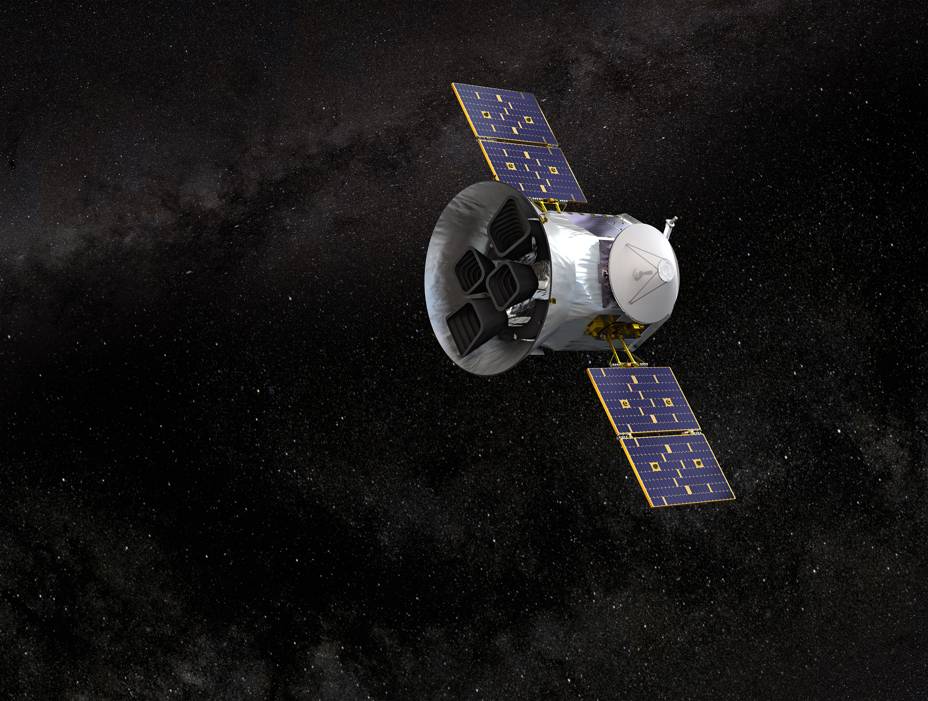
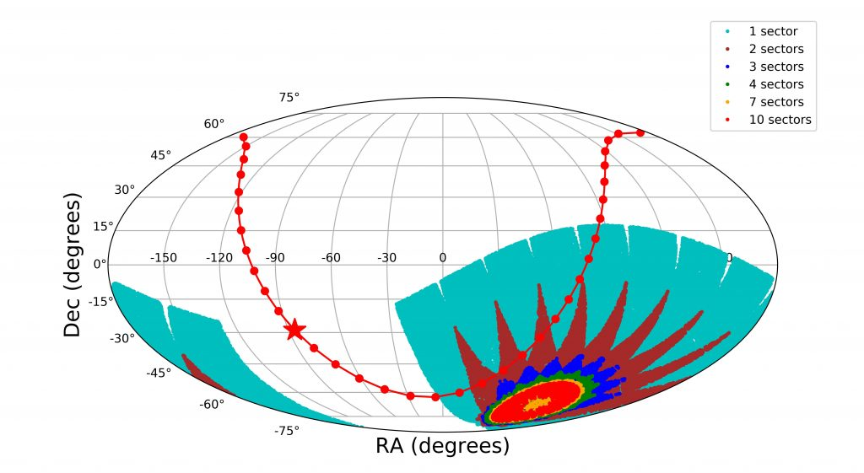
Transiting Exoplanet Survey Satellite (TESS)
Launched 18 April 2018
Primary mission is a two year survey
4 cameras observe each sector for 27 days
Maps show 1st year planned sectors and
the sectors that have been completed
Year 2 surveys the northern ecliptic hemisphere

Slide 15
Transiting Exoplanet Survey Satellite (TESS)
MIT led NASA Mission
Data processed and calibrated at NASA's Ames Research Center and MIT
Data is then delivered to STScI for Archive and Distribution in batches by sector
Per sector: 1.78 TB of Full Frame Images that cover 30 minute exposures of each 96 x 13 degree sector in the sky. They also produce an additional 1TB of individual target data where known good targets are monitored. This results in over 81,000 delivered files for each sector
Total archived (9 Sectors): 26TB in about 750,000 files
2 year (26 sectors) total expected: over 60TB in over 2 Million files.
For the expected years 3 and 4, these 26 sectors will repeat but at a higher resolution
This will more than double the data volume to about 4TB of data per sector
Fuel is available for many many more years of science.

Slide 16
Transiting Exoplanet Survey Satellite (TESS)
Once the data delivery is validated, HTCondor is used to parallelize metadata xml generation and Common Archive Observation Model (CAOM) postings for each of the 81,000+ delivered files
Average time to archive a sector: 24 hours – includes all data validation, archiving, and CAOM delivery steps.
This runs on a very small system that meets the needs of this project without interfering with the other projects.
Series of TESS exposures catches a comet
TESS reports two more planets May 2019 article

Slide 17
James Webb Space Telescope

Slide 18
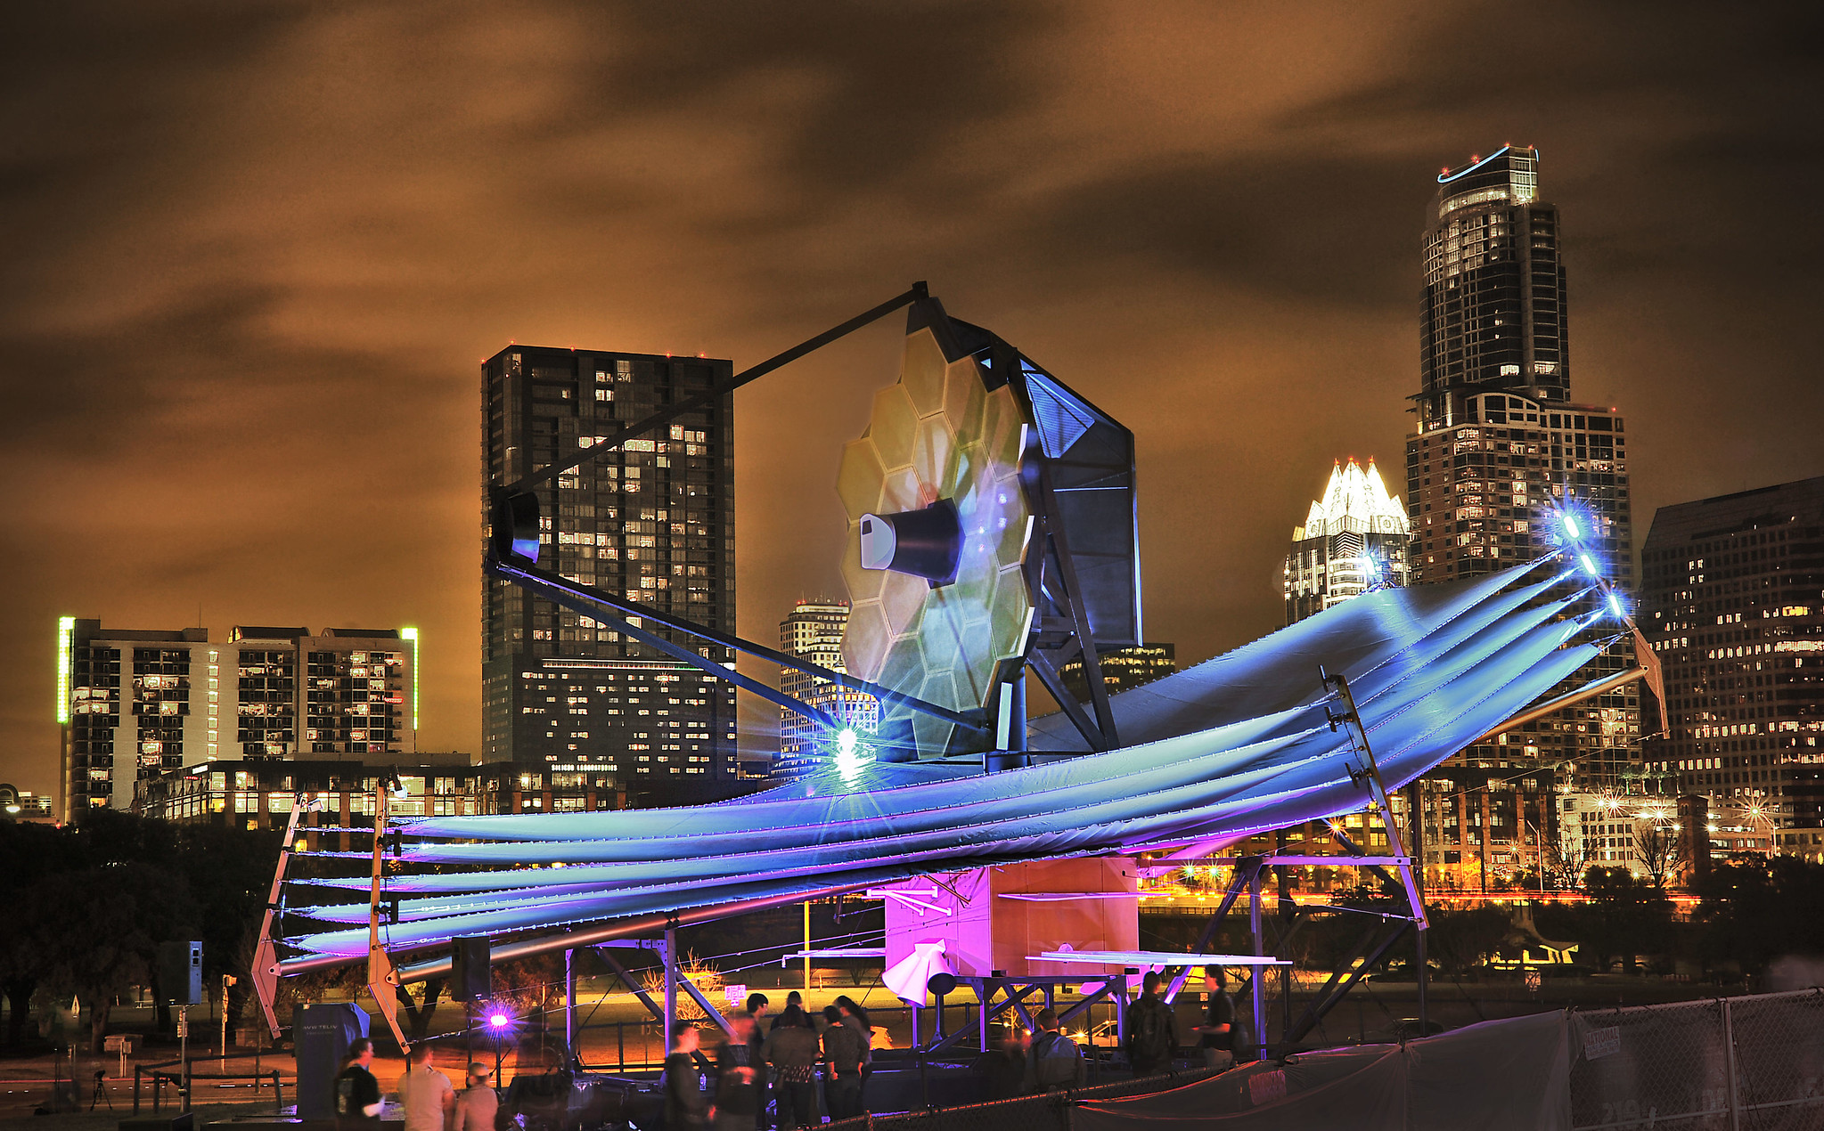
James Webb Space Telescope (JWST)
Launch date 30 March 2021
Ariane 5 rocket from Kourou, French Guiana
Shipping from California on a barge that will
travel through the panama canal
5 year primary mission
possible 5 year extension
There are consumables on board.
Servicing is not possible
Four Instruments
Near-Infrared Camera, NIRCam
Near-Infrared Spectrograph, NIRSpec
Mid-Infrared Instrument, MIRI
Fine Guidance Sensor/ Near InfraRed Imager and Slitless Spectrograph , FGS/NIRISS
Full Size Model of JWST at South by Southwest 2013

Slide 19
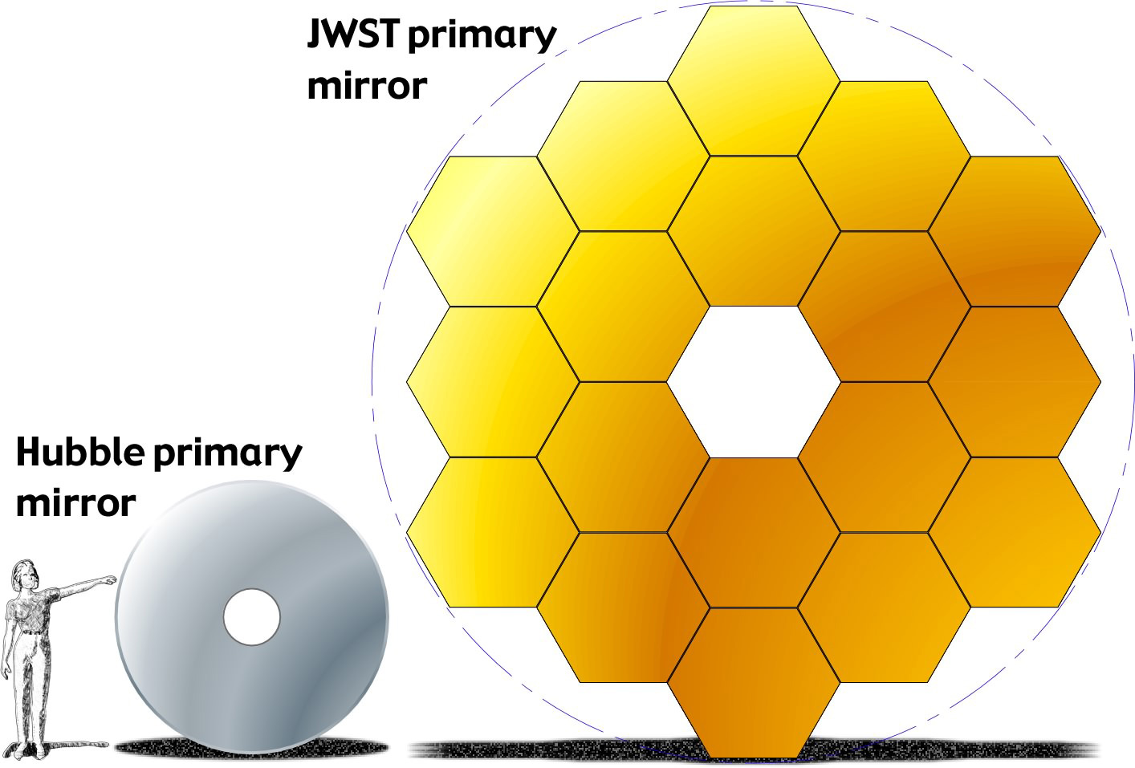
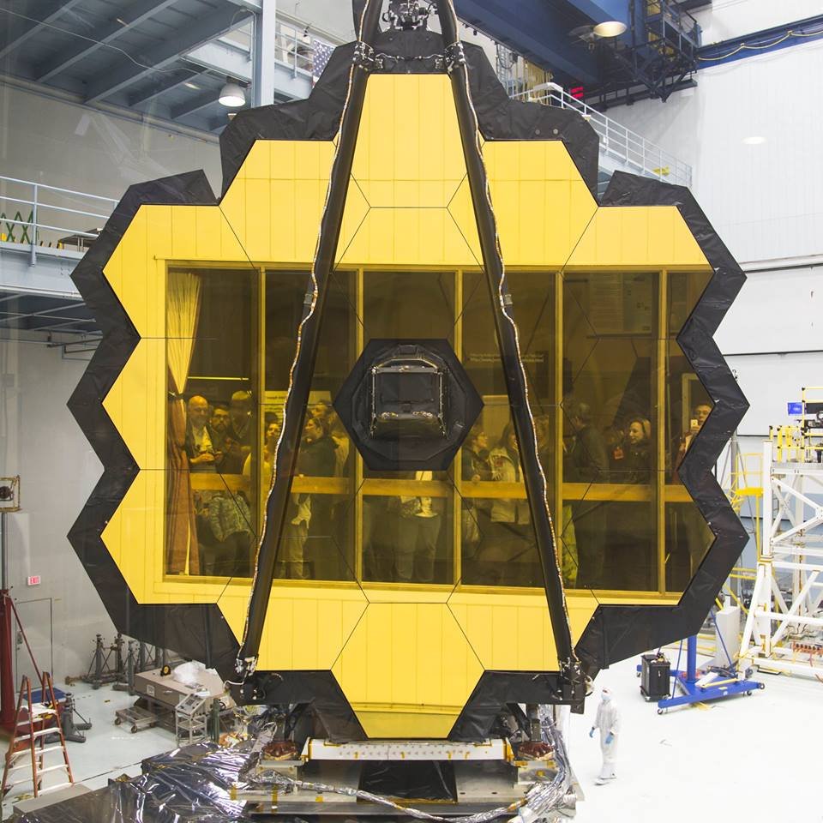
James Webb Space Telescope
Sun Shield is the size of a tennis court.
Primary mirror 6.5 meters (21 ft 4 in)
Each of the 18 hexagons is 1.32 meters (4.3 ft) and can be individually focused.
Each mirror is aligned to 1/10,000th the thickness of a human hair.
58.8 Gbytes onboard data storage
At least 28.6 GB of recorded science data downlinked during each contact.
Four hour contact made twice per day

Slide 20
JWST Data Processing Workflow
CRDS
Engineering Database
MAST
HTCondor Manager
Collector and Negotiator
CRDS APP Server
ORIOLE
Archive Users Interface
CRDS DB Server
CRDS Reference Files - Master
HTCondor Scheduler
Scheduler + OWL +
SDP Pollers & Shoveler
Distribution Archive
Archive Database
Data Inputs
Archive Database
DADS CAOM Server
Archive Distribution Server
HTCondor Execute Node 1
Isilon Distributed File System
HTCondor Execute Node 2
DADS ARCHIVE Server
HTCondor Execute Node 3
Data Processing Database
SAFESTORE
Archive Operators Interface
HTCondor Execute Node N
ITAR
RAID/ARCHIVE
Phoenix
PPS
OWL GUI
AWS/Glacier
OMNITOOLS
PPS Database

Slide 21
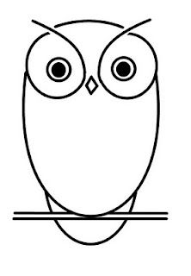
From DPQueue to HTCondor
Dataset Name
Workflow Name
Priority
Dataset Name
Workflow Name
Priority
Dataset Name
Workflow Name
Priority
DAGMan
Scheduler
Data Processing Queue (DPQ)
requests for processing of a particular dataset,
using a chosen workflow, at a specified priority
Workflow templates rendered with dataset specific values into DAGMan .dag and .job files are then ready for HTCondor scheduling and execution
One “shovel-full” of the highest priority workflow requests are periodically shoveled to OWL
Open
Workflow
Layer
The
Shoveler
Job Tracking
Database Entry
Workflow
Templates
OWL processes each request through the requested Workflow Name template

Slide 22
Data Processing Levels translate to Data Processing Job Steps
Science Data Processing Job Steps
CREATE_POD INGEST_05
LEVEL_1 PREVIEW_1A INGEST_1A
PREVIEW_1B INGEST_1B
LEVEL_2A PREVIEW_2A INGEST_2A
LEVEL_2B PREVIEW_2B INGEST_2B
LEVEL_3 PREVIEW_3 INGEST_3

Slide 23
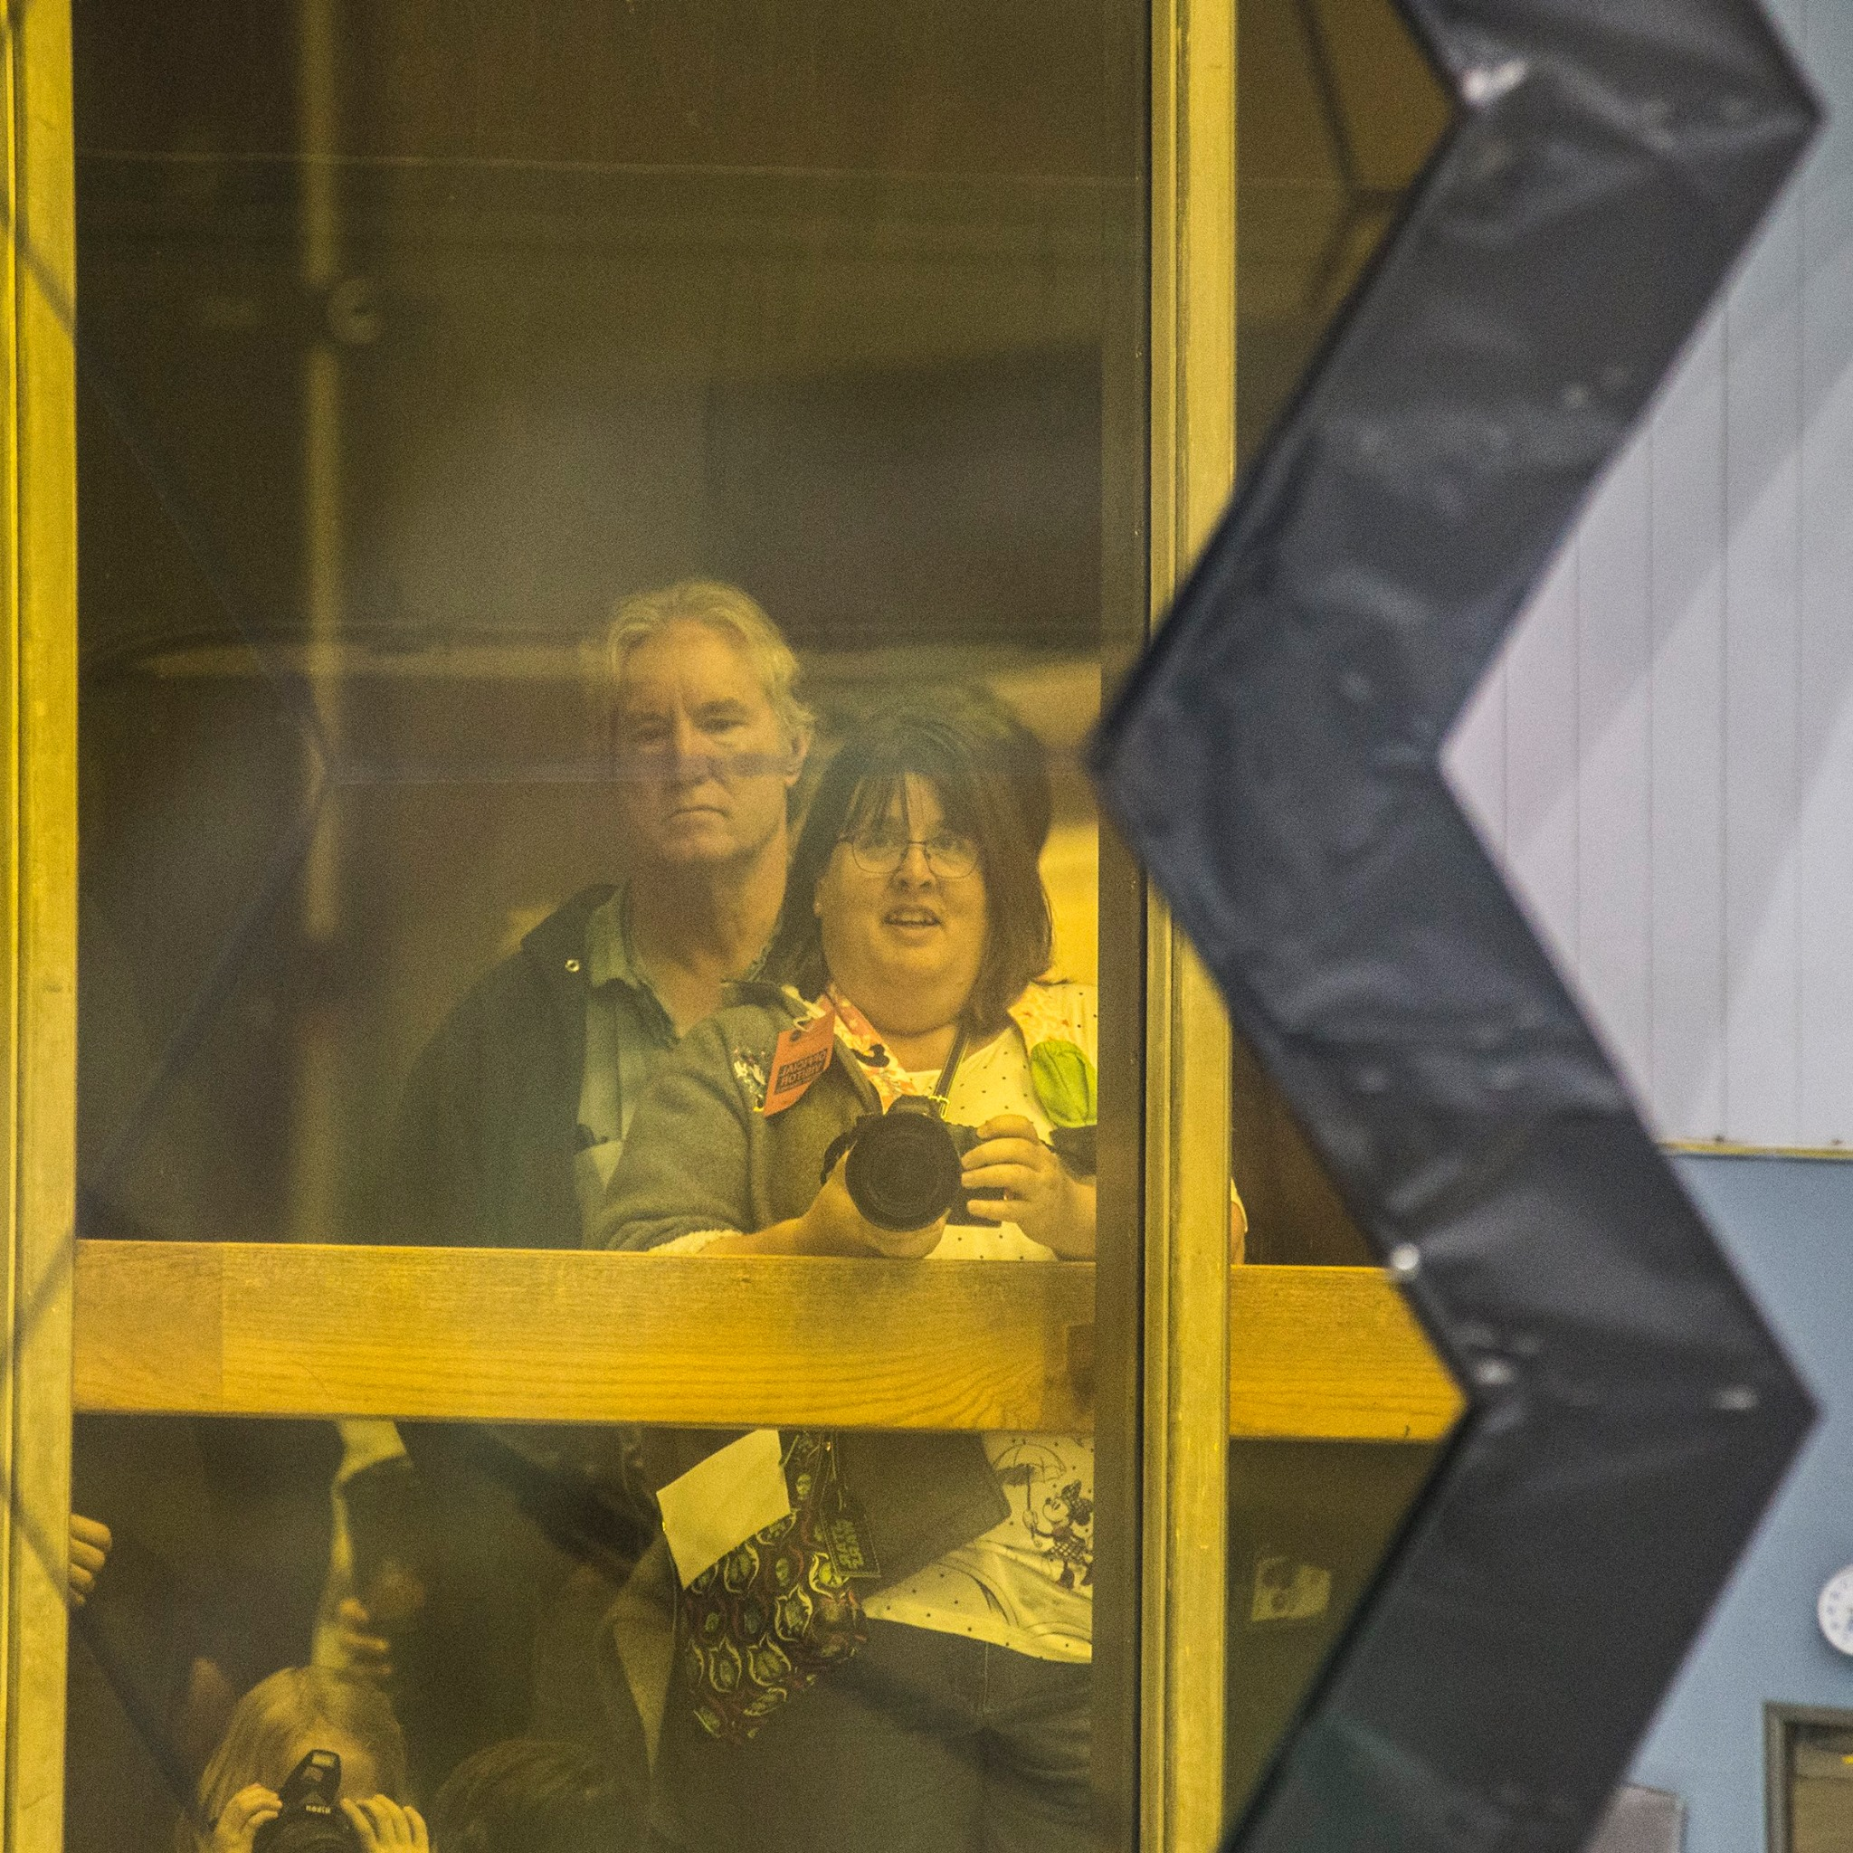
James Webb Space Telescope
James Webb Space Telescope (JWST)
Predicted to generate about:
114 TB of science data per year
650 TB total during the primary mission
Introduces one time critical processing path:
90 minute processing time for mirror focusing data
can be delivered mixed in with regular science data
Once identified it must move to the top of the queue
Launch Delay brings time for additional new tasks.
Explore cloud storage options for some JWST data
Explore Jupyter notebooks for new data processing ideas.
Explore making those Jupyter notebooks available to
all users of JWST data.

Slide 24
Wide Field Infrared Space Telescope

Slide 25
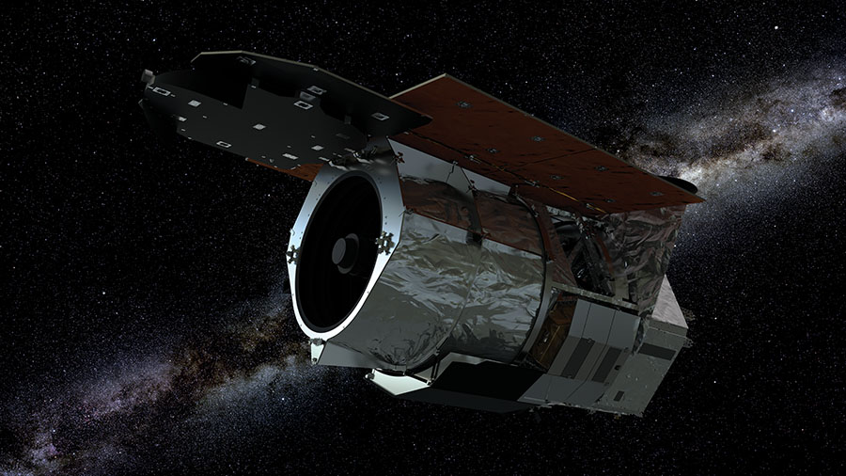
Wide Field Infrared Space Telescope (WFIRST)
Wide Field Infrared Space Telescope (WFIRST)
2.4 Meter Primary Mirror - Same size as Hubble Space Telescope’s primary mirror, but one fifth the weight of the Hubble mirror
5 year primary mission w/possible 5 year extension
Launch date mid 2020’s
Two Instruments:
Wide Field Instrument (WFI)
STScI responsible for data processing
STScI responsible for archiving
Coronagraph Instrument(CGI)
IPAC responsible for data processing
STSci responsible for archiving

Slide 26
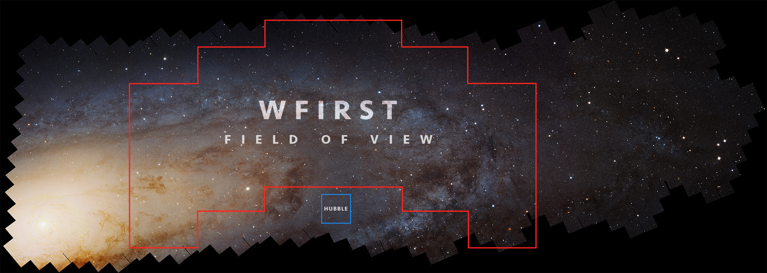
Wide Field Infrared Space Telescope (WFIRST)
Even though the mirror is the same size and resolution as the HST mirror, the Wide Field Instrument field of view is 100 times larger.
1.1 Terabyte Solid State Recorder
1.4 Terabytes downlinked data per day
24+ Petabytes data mission lifetime
32 Terabits of onboard storage

Slide 27
Wide Field Infrared Space Telescope
With this field of view and this large data volume, we have to rethink our data processing methods.
Instead of delivering data and software to the astronomer to use on their computer, we are working to bring the astronomer to the data and the software.
Some part of the data will be stored in the cloud (probably AWS)
Some parts of the data processing software will live in notebooks (probably Jupyter Notebooks)
We have to figure out what preprocessing will be done in house and what will be done in the cloud.
We have to figure out what calibration work will work on all data vs what to put in the notebooks.
We have to determine how and where to catalog the data for the archive so users can find data.
We have to determine how batch processing, priorities, multiple users, security will apply.
All of these questions will determine if and how HTCondor will be part of this new process.

Slide 28
Thank You!!
We at Space Telescope Science Institute would like to thank the HTCondor team at UW for their continued support and advice.
We would also like to thank the members of the HTCondor users list for their invaluable collective knowledge and willingness to share that knowledge.

Slide 29
Questions?

