Slide 1
Submitting with Subway
Collin Mehring

Slide 2
The Need for a Submission API
Render Queuing System resulted from combining two previous systems
Relied on submission wrapper scripts
Could not be easily used as an API by other applications
Too many command line flags
rqs_submit - 109
shot_submit - 87
frame_submit - 67
Used DEP graphs that relied on ADB files and ASG
While RQS was fast, these slowed things down
Use of ANI variables
RQS Transformers were a black-box
Overly complicated for simple use-cases
Notes:
ADB = Animation DataBase
ASG = Asset Scene Graph
ANI = ANImation Environment Variables
(notes from 2008)

Slide 3
Enter Subway
Went through a few name changes...
Job API -> RQS API -> Submission API -> Subway
Python API
Creates DAG and SDF files
Only specify a few required variables and any overrides
Automatically populate the remaining variables
Allows us to set defaults and add nodes
Writes files to a known location on the shared file system
Submits to HTCondor
Shells out to call condor_submit_dag
Hopefully will use the Python bindings in the future

Slide 4
Subway Major Versions
Subway 1
Job-centric submissions
Subway 2
Node-centric submissions, with the concept of frames
Full test coverage
Subway 3
Moved API out of ‘studio’ namespace, now a rez package
Removed last of ADB and ANI ties
Subway 4
Moved infrastructure facing pieces into services
REST API: Client now POSTs JSON to submission service
No longer needs HTCondor installed locally, or shared file system access
Notes:
Current productions use Subway 3, with our next pipeline using Subway 4

Slide 5
Examples
Notes:
Pulled from the “Subway 3.2 Tutorial” internal wiki page.

Slide 6
Hello World
import subway
subSession = subway.SubmissionSession(share="dragon3_misc")
# Create a node object
node = subway.Node("HelloWorld", command="echo Hello World")
subSession.addNode(node)
subSession.submit()

Slide 7
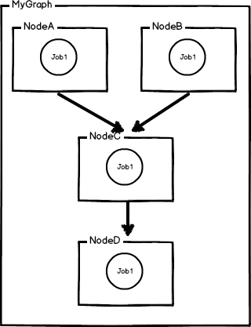
Simple Dependencies
import subway
subSession = subway.SubmissionSession(share="trolls_misc")
nodeA = subway.Node("NodeA", command="echo job in NodeA")
subSession.addNode(nodeA)
nodeB = subway.Node("NodeB", command="echo job in NodeB")
subSession.addNode(nodeB)
nodeC = subway.Node("NodeC", command="echo job in NodeC")
subSession.addNode(nodeC)
nodeD = subway.Node("NodeD", command="echo job in NodeD")
subSession.addNode(nodeD)
# Connect all the nodes together
subSession.addDependency(nodeA, nodeC)
subSession.addDependency(nodeB, nodeC)
subSession.addDependency(nodeC, nodeD)
subSession.submit()

Slide 8
Frame Nodes
import subway
subSession = subway.SubmissionSession(share="trolls_misc")
startupNode = subway.Node("startup", command="run_startup_create")
subSession.addNode(startupNode)
renderNode = subway.FrameNode("render", frameRange="101-200", command="run_render -c %(FRAME RANGE)s")
renderNode.minCpus = 16
renderNode.maxCpus = 32
subSession.addNode(renderNode)
# Every nuke job to run on the farm will render five frames
nukeNode = subway.FrameNode("nuke", frameRange="101-200", chunkSize=5,
command="run_nuke_render -script '/tmp/comp.nk' -frames %(FRAME RANGE)s")
subSession.addNode(nukeNode)

Slide 9
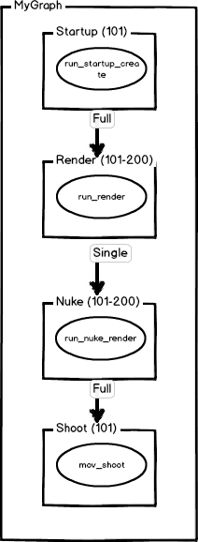
Frame Nodes (Continued)
shootNode = subway.Node("shoot", command="mov_shoot")
subSession.addNode(shootNode)
# Rig up our dependencies
subSession.addDependency(startupNode, renderNode) # Full dependency is implied by default
subSession.addDependency(renderNode, nukeNode, 's') # 's' is a valid alias for 'single'
subSession.addDependency(nukeNode, shootNode)
subSession.submit()
Notes:
Other dependency types include ‘mulit’ and ‘partial’. ‘Multi’ is like ‘single’ but with additional padding in either direction, and ‘partial’ means it uses our dependency service.

Slide 10
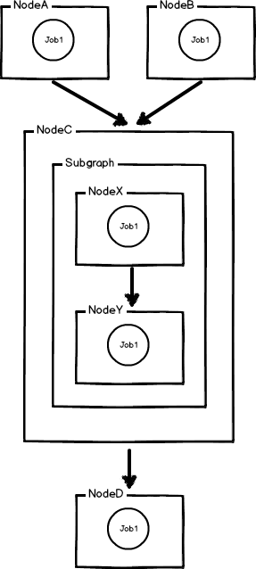
Subgraphs
import subway
subSession = subway.SubmissionSession(share="trolls_misc")
nodeA = subway.Node("NodeA", command="echo job in NodeA")
subSession.addNode(nodeA)
nodeB = subway.Node("NodeB", command="echo job in NodeB")
subSession.addNode(nodeB)
# Create subgraph
subGraph = subway.SubmissionGraph()
nodeX = subway.Node("NodeX", command="echo job in NodeX")
subGraph.addNode(nodeX)
nodeY = subway.Node("NodeY", command="echo job in NodeY")
subGraph.addNode(nodeY)
subGraph.addDependency(nodeX, nodeY)
nodeC = subway.Node("NodeC", job=subGraph)
subSession.addNode(nodeC)
nodeD = subway.Node("NodeD", command="echo job in NodeD")
subSession.addNode(nodeD)
Notes:
I clipped the dependencies from the bottom for space:
# Add dependencies
subSession.addDependency(nodeA, nodeC)
subSession.addDependency(nodeB, nodeC)
subSession.addDependency(nodeC, nodeD)
subSession.submit()

Slide 11
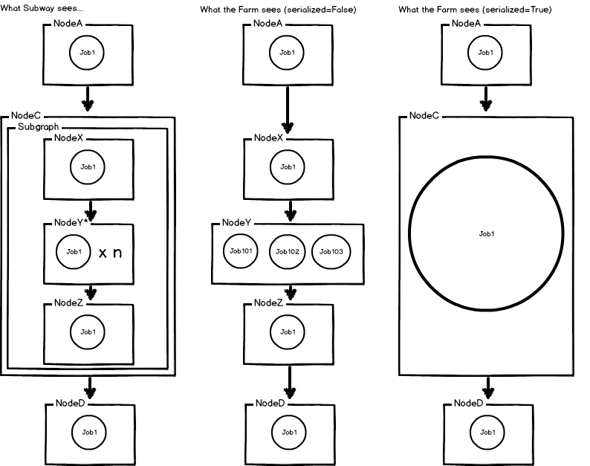
Serialized Subgraphs

Slide 12
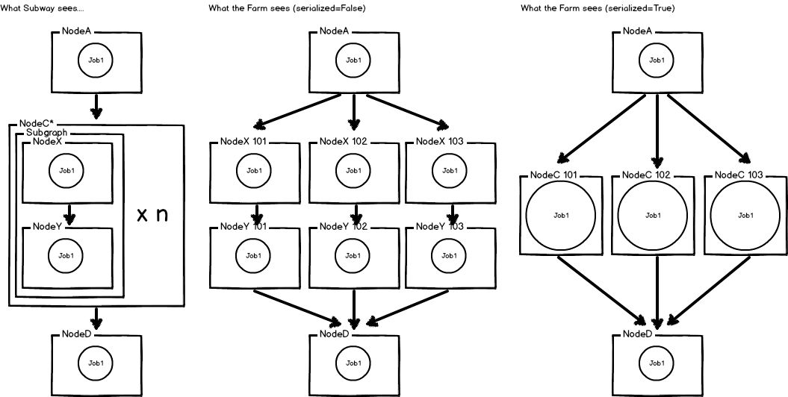
Subgraphs in Frame Nodes

Slide 13
Example Implementation

Slide 14
Example Submission
Notes:
The training shot is not part of the shot list, so the warning can be ignored.

Slide 15
Other Features
ParameterNode
Create jobs with attributes filled in by values from a list of dictionaries
Submit at specified time
Metrolink
REST API for editing Subway graphs
Currently used as a DAG stitching service
Allows overrides
Submit locally, or to Dev and Test environments
Progressive and FCFS priority
Job Runtime object
Releasing concurrency limits

Slide 16
Questions

