Slide 1
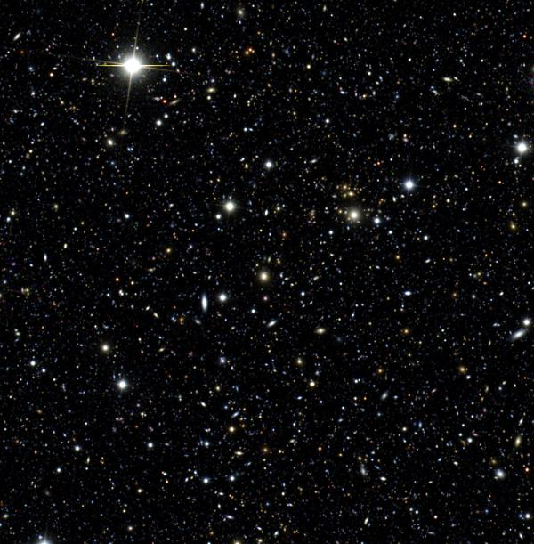
HTCondor in Astronomy
at NCSA
Michael Johnson, Greg Daues,
and Hsin-Fang Chiang
HTCondor Week 2019

Slide 2
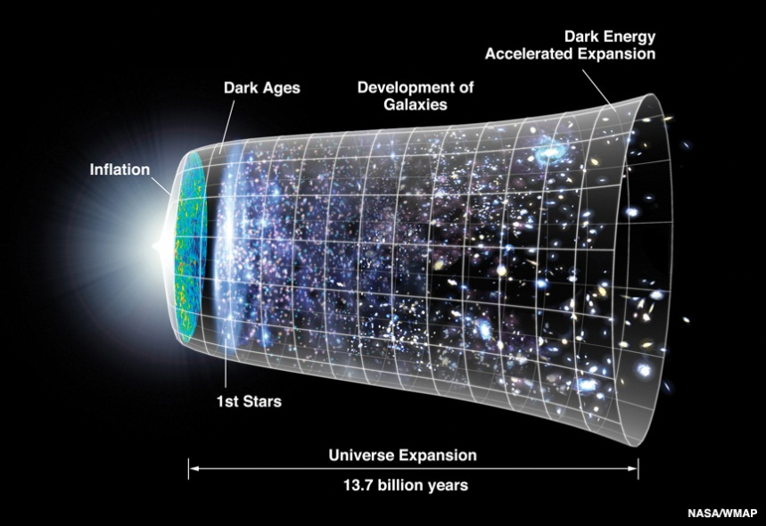
The Dark Energy Survey
“The Dark Energy Survey (DES) is designed to probe the origin of the accelerating universe and help uncover the nature of dark energy by measuring the 14-billion-year history of cosmic expansion with high precision.”
Notes:
Reference: http://map.gsfc.nasa.gov/media/060915/index.html

Slide 3
DES Collaboration
400+ scientists from 25 institutions in 7 countries

Slide 4
DES: Mapping the Sky
Notes:
DES is a 5.5-year optical survey covering 5000 deg² of the southern sky
Each section of the “footprint” is observed 2x a year in 5 different filters
Certain fields are revisited every ~10 nights to search for supernovae
The project is very similar to a high-energy physics experiment. The goal is to construct a large and uniform statistical dataset based on observations and derived measurements which can be analyzed for physical phenomena. The manner in which we process and analyze data draws on the HEP/open science community, including HTC.

Slide 5
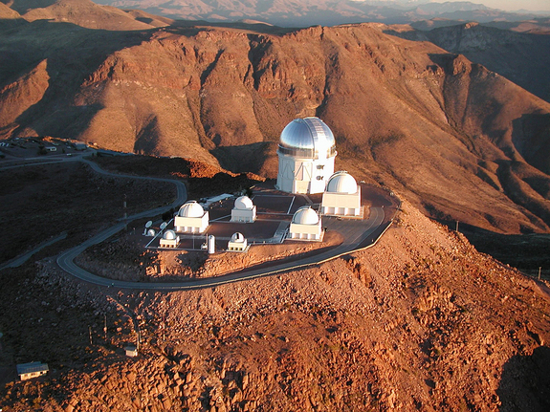
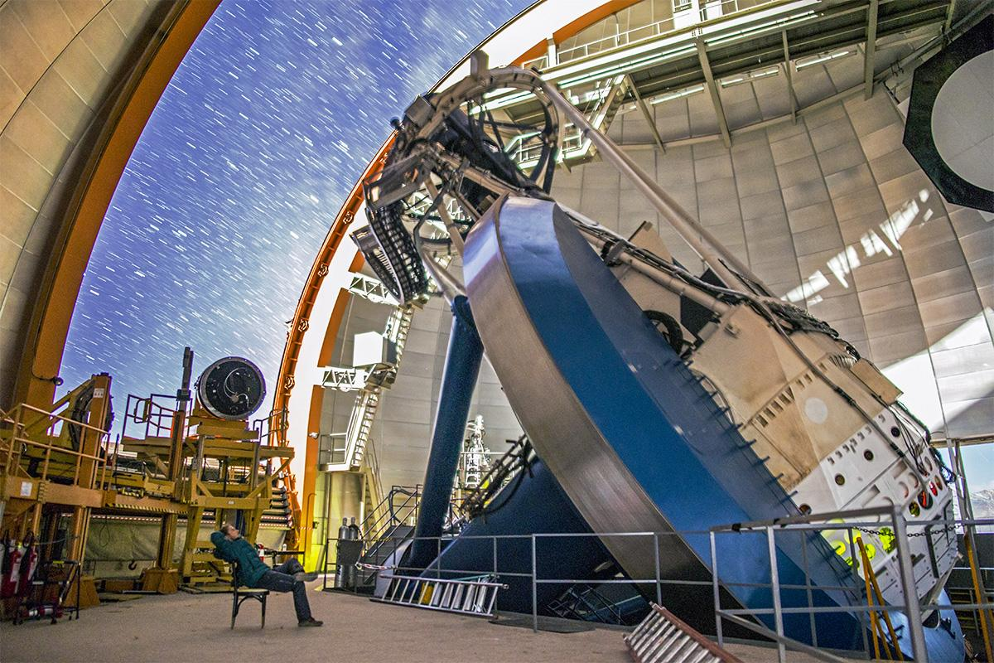
DES: Instrumentation
Blanco 4m Telescope @
Cerro Tololo Inter-American Observatory, La Serena, Chile
Sees
20x area of Full Moon!
570-Mpix, 62-CCD
camera
observes in 5-6 filters
Notes:
Reference (left): http://www.nasa.gov/centers/goddard/news/topstory/2007/noao_glast.html
Reference (right): https://www.noao.edu/image_gallery/html/im1047.html
Reference (bottom): Dark Energy Survey Collaboration

Slide 6
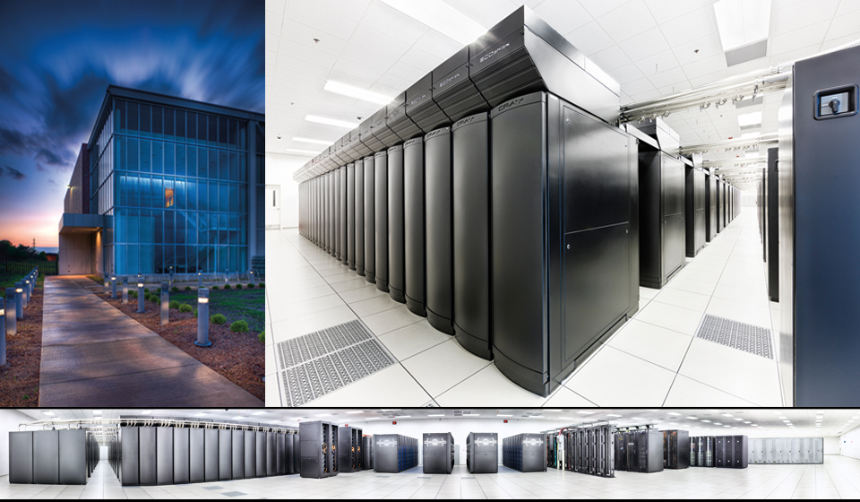
DES: Data Management
Raw images streamed from Chile → Tucson → NCSA
Images cleaned and millions of stars and galaxies cataloged
Over 18,000 images/night
1 TB raw data/night → 5 TB processed data/night
Data are archived at NSCA and served to the collaboration for scientific analysis
Notes:
Reference (globe): http://en.wikipedia.org/wiki/Americas#/media/File:Americas_(orthographic_projection).svg

Slide 7
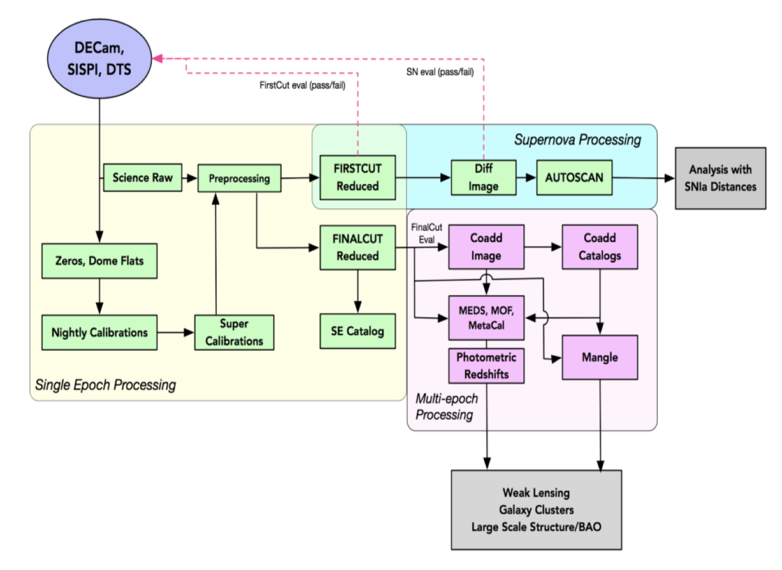
Data Processing Operational Modes
Run in several processing modes
Nightly (within 24 hrs)
Initial processing to assess data quality
Feedback to mountaintop
Annually
Latest and greatest calibrated processing over all prior data
Basis for internal and public data releases
Difference imaging
Always some level of processing (multiple pipelines) occurring at any given time. As we near survey’s end, we are running new value-added processing pipelines.

Slide 8
DESDM Data Management System
The DESDM system is based on a combined processing framework and data management framework
Centralized job configuration and management
Data movement orchestration
Provenance and metadata collection (Open Provenance Model)
Continual data annotation
Data lifecycle management
The DESDM system allows for configuring and managing the various and simultaneous processing “campaigns”
For a given campaign, specify which data to process (via metadata query), which pipelines and configs to use, where to archive the data, where to process data, what provenance to collect
Manage relative prioritization of campaigns
Annotating outputs for identification of data used for downstream processes (e.g., QA, release prep, data management activities)
Notes:
Centralized data management, distributed computing

Slide 9
DES and Beyond
DES is scheduled to end around 2021, but DECam is still a world-class instrument and will continue to be used for many more years.
Want to leverage our data management system for future needs:
Processing public DECam data sets to complement and expand DES (DECADE)
On-sky DECam follow-up for optical MMA
As future surveys come online can we use DECam as a follow-up instrument?
Are there other programs/initiatives that can make use of our system and take advantage of the knowledge we’ve gained processing for DES?

Slide 10
DESDM Workflow & HTCondor Infrastructure
Python wrapping HTCondor DAGMan submits
Nested DAG workflow for each Unit (Exposure, Tile, etc)
Numerous DAGs, No Overarching Workflow
Throttling Issues for PRE/POST
Submit Side Infrastructure
Separate Central Manager (collector, negotiator)
Two largish Submit nodes (schedd)
Multi-schedd process configuration (~OSG Login)
File Staging/Transfer
No-shared-filesystem processing
Data staged in & out via Curl/webdav

Slide 11
DESDM HTCondor Infrastructure & Platforms
Illinois Campus Cluster https://campuscluster.illinois.edu
Models: Investor, RCaaS, etc.
DESDM as an investor: provisions ~ 32 nodes, 900 cores, CentOS7
Main ICCP has PBS scheduler, DESDM nodes managed separately
DESDM Condor Pool - Partitionable Slots
Compute jobs run on Local Scratch Disk
Machine Ads for Processing Type/Campaign
Jobs of a species sent to targeted nodes (e.g., avoid defrag issues)
Best for ‘realtime’, quick turn around

Slide 12
DESDM HTCondor Infrastructure & Platforms
Blue Waters Computing System at NPCF
DESDM works with Innovation and Exploration Allocation
HTCondor Glide-ins submitted through PBS scheduler
Glide-in setup a driver for RSIP solution (general workflows)
HTCondor Execute directories on shared Lustre file system
Scale constrained by metadata server
FermiGrid
HTCondorCE : JobRouter to DES Nodes
DES Virtual Organization
Software Stacks in CVMFS /cvmfs/des.opensciencegrid.org
DESDM Software Services FHNW-Zurich

Slide 13
DESDM HTCondor Infrastructure & Platforms
DESDM setup for use of Open Science Grid
DESDM as a OSG project
Submit Node with Flocking setup
FLOCK_TO = flock.opensciencegrid.org
Data Origin for utilizing StashCache infrastructure
K8s worker node - OSG pods on PRP Kubernetes Cluster
Registered /cvmfs/desdm.osgstorage.org in DES VO
DESDM setup for OSG prototype for other efforts at NCSA

Slide 14
DESDM HTCondor Infrastructure & Platforms
Testing DESDM with HTCondor, condor_annex on AWS
Single Exposure test with DESDM framework on AWS
EC2 instance, used Singularity
Glide-in to ‘production pool’
Testing condor_annex in ‘personal condor’
Default HTCondor 8.6.x, Amazon Linux
Customized AMI with HTCondor 8.8.x, Amazon Linux 2
Encryptfs issue
Need to examine annex to ‘production pool’ / HTCondor as root

Slide 15
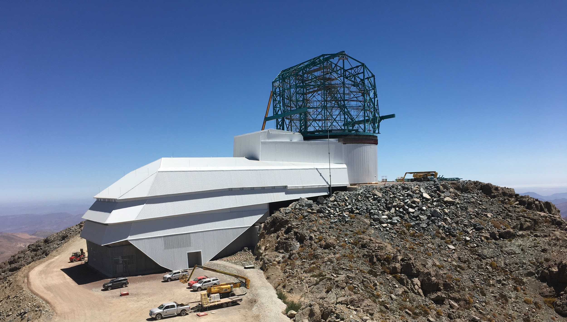
Large Synoptic Survey Telescope
A dedicated 10yr Deep-Wide-Fast Survey
LSST v.s. DES: 2 times mirror size, 5 times pixels
LSST can obtain “DES” in 1.5 months
4 times larger area
Repeat the full sky every 3-4 nights
Open data, open source
Science operations starts in 2023
~200,000 images per night
Raw data ~20TB per night
60PB of raw image data
500PB of final image data

Slide 16
Large Synoptic Survey Telescope
Data Processing & Workflow management
11 Public Data Releases
Proof-of-concept with DESDM system
Customization to the DESDM system would be needed for LSST
Proof-of-concept with HTCondor + Pegasus on AWS
Exploration just started this month
Plan to use HTCondor Annex
Plan to use S3 storage
Decision not finalized

