Slide 1
A Self-Stabilizing Metasurface Laser Sail To Explore The Stars
Joel Siegel
University of Wisconsin Madison
Physics Department
5/22/19

Slide 2
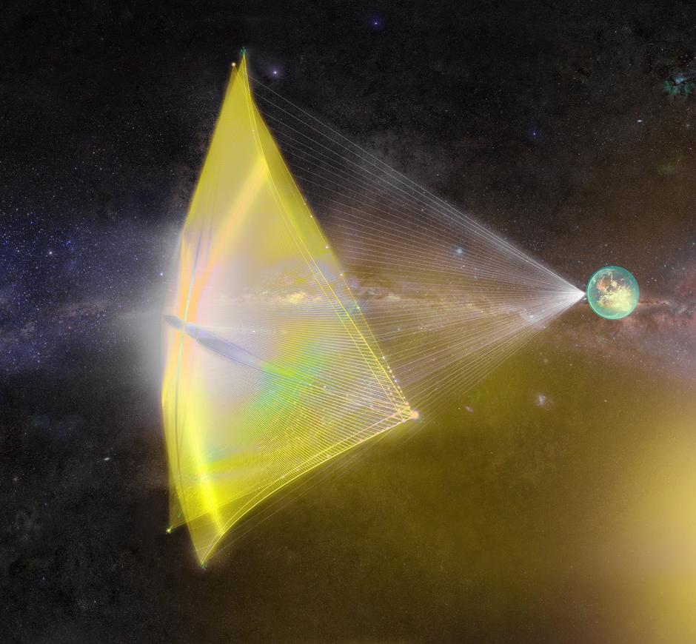
Laser Propelled Spacecraft
Laser Sail
~10 g,
4x4 m²
High-Power Laser
~100 GW
Traveling at 1/5th speed of light
Goal is to travel to Alpha Centauri
(~5 light years away)
But how do we keep the sail in the beam?
Starshot Breakthrough Initiative
Notes:
Picture of laser sail. *click* There is the laser sail. *click* There is the high power laser. Spacecraft is propelled by momentum transfer of incident photons from a high-power laser
*click* metasurfaces are a suggestion for these sails, but what are the optical forces like? *click* Big finish, can we use the forces to stabilize the sail?

Slide 3
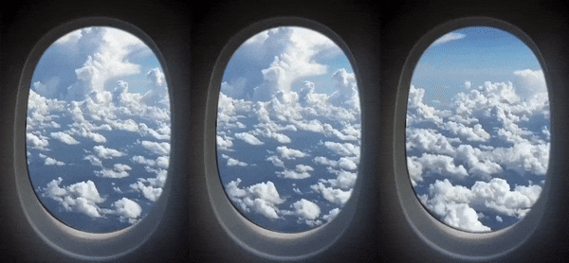
How fast is 1/5th the speed of light?
Took the first close up pictures of Pluto in 2015
One of the fastest man made objects
747
SR-71 Blackbird
New Horizons
(550mph)
(2,700 mph)
(36,000 mph)
New Horizons
65xNew Horizons
(36,000mph)
(177,000 mph)
(2,365,000 mph)
65xNew Horizons
65xNew Horizons
Laser Sail
Gif from Clay Bavor
(2,365,000mph)
(11,570,000 mph / 0.017c)
(152,000,000 mph / 0.2c)

Slide 4
Optical Forces
$$\vec{P_{i}}$$
$$\vec{P_{i}}$$
Force is determined by the reflected/refracted light
$$φ$$
$$\vec{R}$$
$$\vec{R}$$
If we control how the light reflects/refracts, we can control the optical forces
Force
Force
Laser Sail
Notes:
Now what I am going to talk about is the reflecting/refracting light imparting a force *click*. By conservation of momentum, there is a force on the metasurface. *click*, text appears.

Slide 5
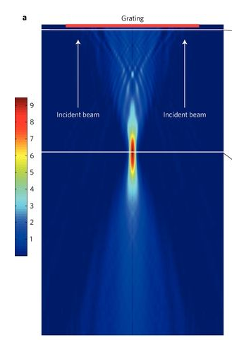
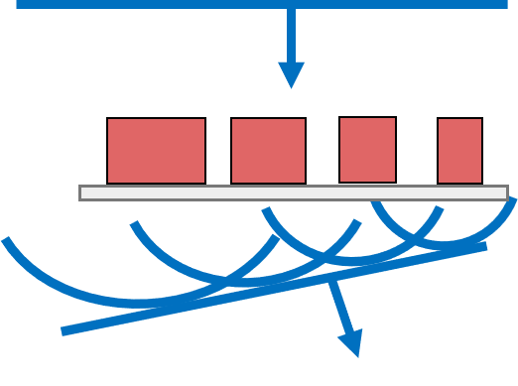
Metasurface Based Laser Sail
Thin, lightweight structure with subwavelength scattering elements
Controls the phase and magnitude of reflected/refracted light
Reflective Metasurface Focusing Lens
Optical Vortex Beam Creation
n
~μm
~cm
Prism Beam Steering
Metasurface Beam Steering
Y. Yang, et. al. Nanoletters 14, 1394 (2014).
Arbitrary wave-fronts can be generated with a metasurface
D. Fattal, et. al., Nature Photonics 4, 466 (2010).
Notes:
Can be highly reflective. Here we have a metasurface that is highly reflective and it focuses.
What is a Metasurface? Give definition. What makes it different than other optics? Well, consider a prism. Diffracts light. But it is thick. On the other hand, a Metasurface can do the same thing, but it is much thinner.

Slide 6
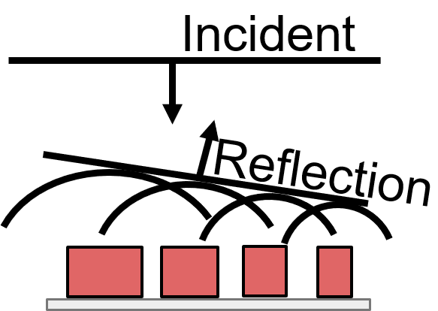
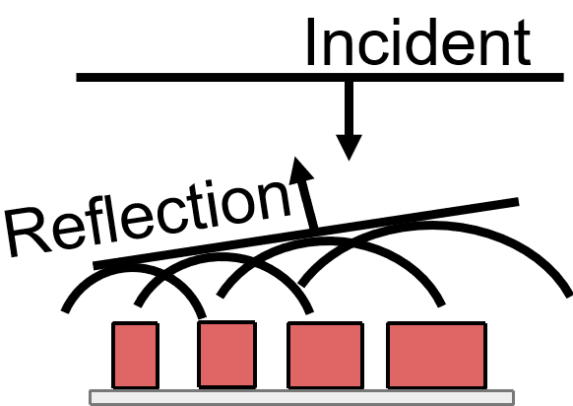
Metasurface Example
1
Gaussian Beam
Intensity
0
Forces
Example Metasurface
Notes:
Let’s imagine a metasurface. *click* Left side reflects to the right, *click* Details. *click* right side reflects to the left. *click* More details, note that it is basically opposite structure. *click* Let’s have a Gaussian Beam incident on the surface

Slide 7
Metasurface Motion
Gaussian Beam
Motion can be described by:
$$m\frac{∂^{2}δ}{∂t^{2}}=C_{1}δ+C_{2}θ$$
$$I\frac{∂^{2}θ}{∂t^{2}}=C_{3}δ+C_{4}θ$$
Dynamic Force Coefficients
Metasurface flies away
Moves back, but also rotates
Each metasurface/beam combination has different coefficients
Offset the Metasurface
Offset
Rotation
How can we control these coefficients to make a metasurface that is stable?
Example Metasurface
Notes:
Let’s imagine a metasurface. *click* Left side reflects to the right, *click* Details. *click* right side reflects to the left. *click* More details, note that it is basically opposite structure. *click* Let’s have a Gaussian Beam incident on the surface

Slide 8
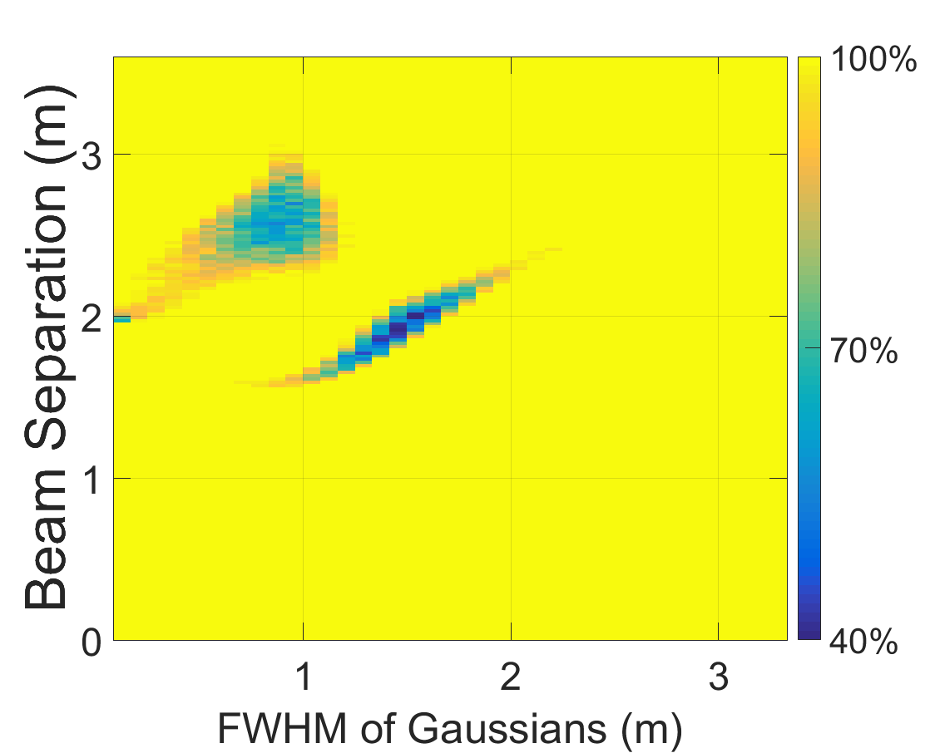
Designing a Stable Sail
Find a set of stable parameters
Noise Applied to Beam
Simulate that sail using realistic components
Create idealized sail to generate those coefficients
$$m\frac{∂^{2}δ}{∂t^{2}}=C_{1}δ+C_{2}θ$$
$$I\frac{∂^{2}θ}{∂t^{2}}=C_{3}δ+C_{4}θ$$
Sail to simulate with realistic components
Failure Rate
1 Million CPU hours to produce this plot
Requires many (>1 Million) computations with slight parameter variations
Human intuition for the sail designs
Computation Requirements
1 CPU
1MB of RAM
3 GB of Disk
Output of single file is ~10 bytes (0/1 for success/failure and an ID)
Requires 1 large computation
Sail design chose from previous stage
Computation Requirements
80 CPUs
500 GB of RAM
5 GB of Disk
Output is ~5 GB
Over 1 million output files! Had to write a shell script to “cat” them all together in pieces
Needed HPC to run– which introduced me to HTC

Slide 9
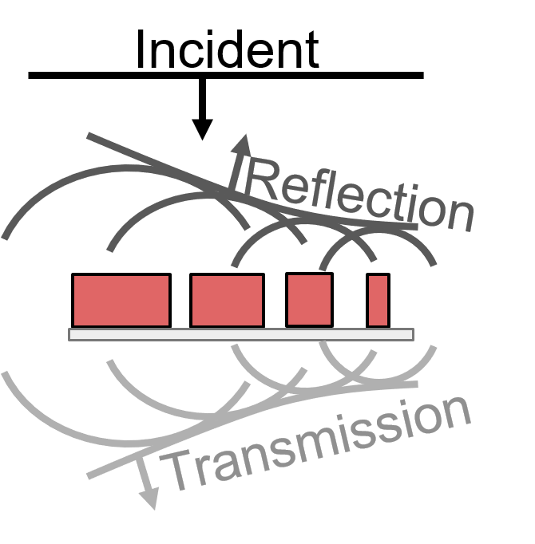
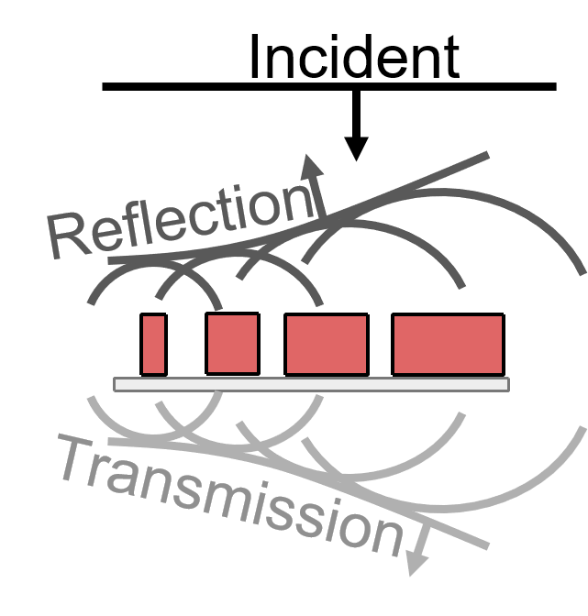
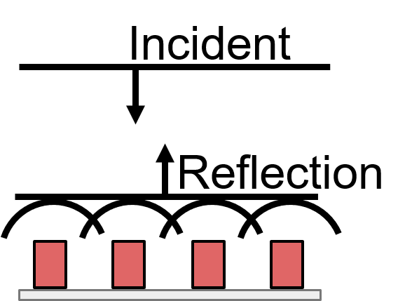
Idealized Metasurface to Generate Stable Coefficients
Inverted Cat Eye (ICE) Metasurface
Two Offset Gaussians
Partially Transmissive, Parabolic
Highly Reflective, Normal
Metasurface
Notes:
Let’s look at a more complex metasurface behaviors. First we have the beam. Two offset gaussians

Slide 10
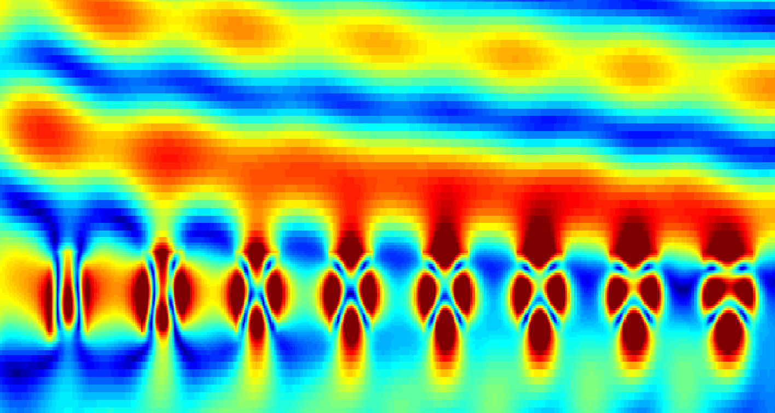
Full-Wave Simulation
Steering the Beam
Reflected Beam front
Simulated ICE Metasurface
Resonators
Transmitted Beam front
Partially Transmissive, Parabolic
Highly Reflective, Normal
504 μm, 420 Resonators

Slide 11
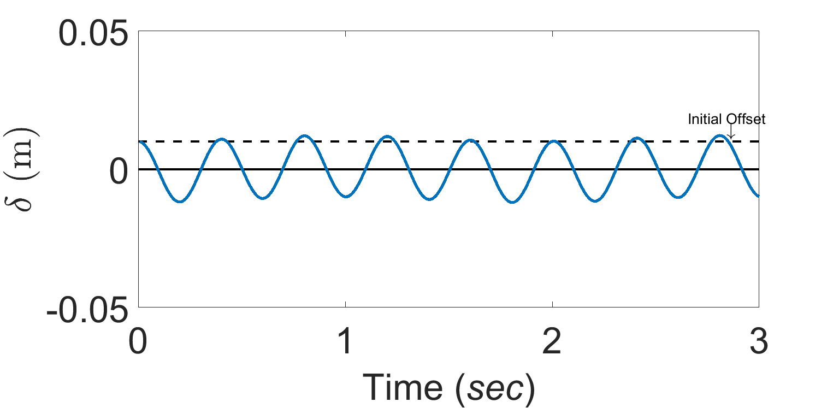
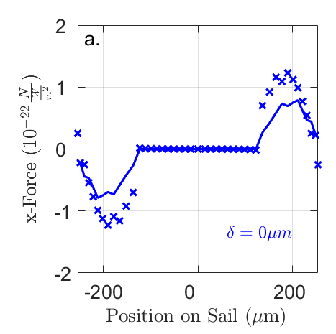
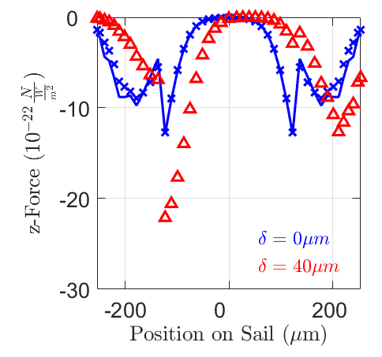
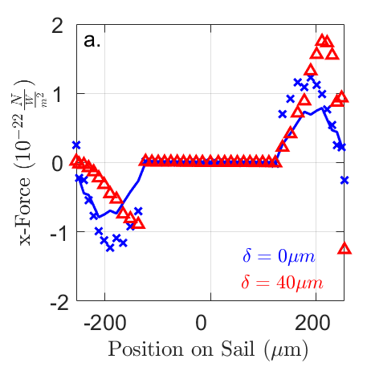
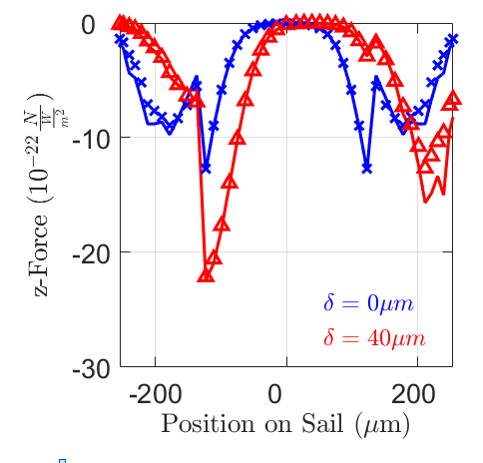
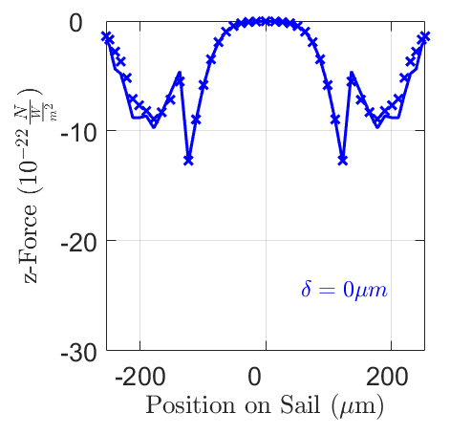
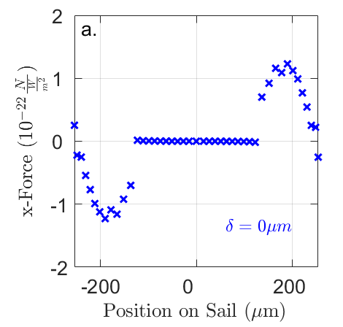
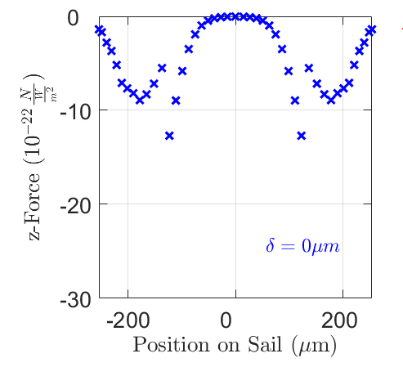
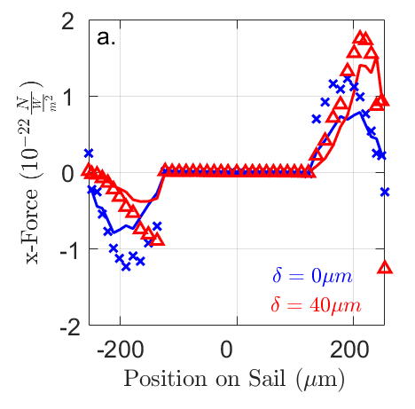
Local Optical Forces on Metasurface
Forces calculated at each point on sail
Overall good agreement
Full-Wave Sail is Stable!
Full-Wave
Full-Wave
Full-Wave
Full-Wave
Ideal
Ideal
No Offset
No Offset
Ideal
Offset
Ideal
Offset
Notes:
By offsetting the sail, we can determine the dynamic force coefficients.
We can extract the force coefficients this way and show plot of the motion that is stable. Have the plot overtop.

Slide 12
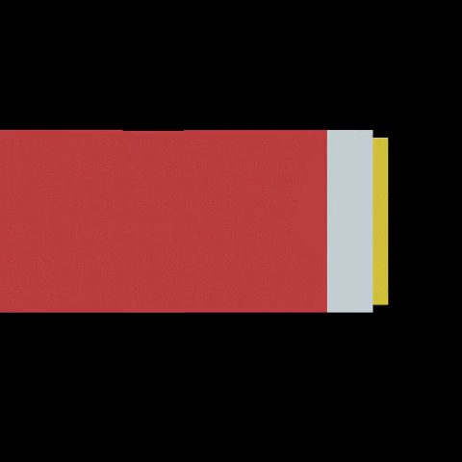
What’s next?
Incorporate optimization techniques that can take advantage of throughput computing to more efficiently explore the parameter space
Generate a sail based on a set of dynamic force coefficients without human intuition
Improve the efficiency of our realistic sails by using optimization based metastructures
Figure courtesy of Greg Holdman

Slide 13
Acknowledgments
Big Thank You to Christina Koch and Lauren Michael for helping me learn to use CHTC
Brar Group
Collaborators
Mikhail A. Kats –UW Madison
Sergey Menabde –KAIST
Min Seok Jang –KAIST

