Slide 1
HTCondor with Google Cloud Platform
Michiru Kaneda
The International Center for Elementary Particle Physics (ICEPP), The University of Tokyo
22/May/2019, HTCondor Week, Madison, US

Slide 2
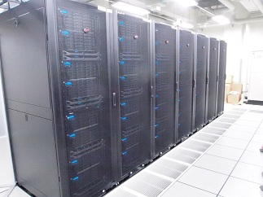
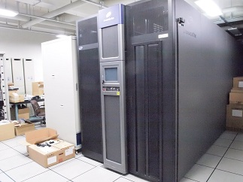
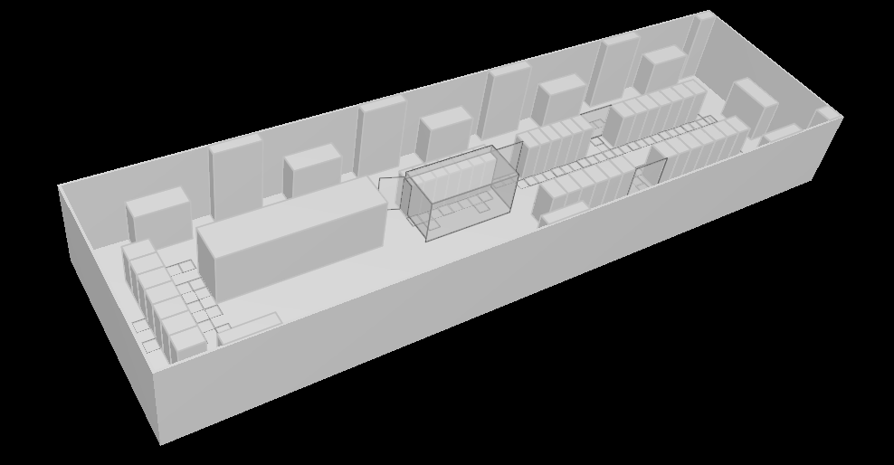
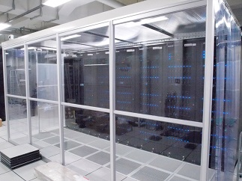
The Tokyo regional analysis center
The computing center at ICEPP, the University of Tokyo
Supports ATLAS VO as one of the WLCG Tier2 sites
  Provides local resources to the ATLAS Japan group, too
All hardware devices are supplied by the three years rental
Current system (Starting from Jan/2019):
  Worker node: 10,752cores (HS06: 18.97/core)
  (7,680 for WLCG, 145689.6 HS06*cores),
  3.0GB/core
  File server: 15,840TB,
  (10,560TB for WLCG)
Disk storage
Tape library
~270m²
Worker node

Slide 3
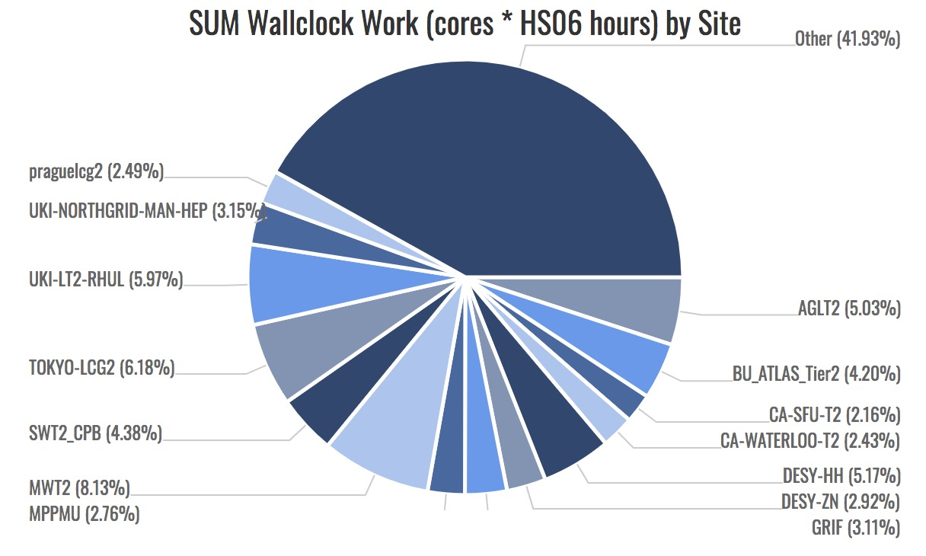
The Tokyo regional analysis center
The computing center at ICEPP, the University of Tokyo
Supports ATLAS VO as one of the WLCG Tier2 sites
  Provides local resources to the ATLAS Japan group, too
All hardware devices are supplied by the three years rental
Current system (Starting from Jan/2019):
  Worker node: 10,752cores (HS06: 18.97/core)
  (7,680 for WLCG, 145689.6 HS06*cores),
  3.0GB/core
  File server: 15,840TB,
  (10,560TB for WLCG)
Tier 2 Grid Accounting (Jan-Mar 2019)
TOKYO-LCG2 provides
6% of Tier 2

Slide 4
Increasing Computing Resources Requirement
Data amount of HEP experiments becomes larger and larger
  Computing resource is one of the important piece for experiments
CERN plans High-Luminosity LHC
  The peak luminosity: x 5
  Current system does not have
  enough scaling power
  Some new ideas are necessary
  to use data effectively
    Software update
    New devices: GPGPU, FPGA, (QC)
    New grid structure: Data Cloud
    External resources: HPC, Commercial cloud

Slide 5



Commercial Cloud
Google Cloud Platform (GCP)
  Number of vCPU, Memory are customizable
  CPU is almost uniform:
    At TOKYO region, only Intel Broadwell (2.20GHz) or Skylake (2.00GHZ) can be selected (they show almost same performances)
  Hyper threading on
Amazon Web Service (AWS)
  Different types (CPU/Memory) of machines
  are available
  Hyper threading on
  HTCondor supports AWS resource management from 8.8
Microsoft Azure
  Different types (CPU/Memory) of machines
  are available
  Hyper threading off machines are available

Slide 6
Google Computing Element
HT On
  All Google Computing Element (GCE) at GCP are HT On
  TOKYO system is HT off
System | Core(vCPU) | CPU | SPECInt/core | HEPSPEC | ATLAS simulation 1000events (hours)
TOKYO system: HT off | 32 | Intel(R) Xeon(R) Gold 6130 CPU @ 2.10GHz | 46.25 | 18.97 | 5.19
TOKYO system: HT on | 64 | Intel(R) Xeon(R) Gold 6130 CPU @ 2.10GHz | N/A | 11.58 | 8.64
GCE (Broadwell) | 8 | Intel(R) Xeon(R) CPU E5-2630 v4 @ 2.20GHz | (39.75) | 12.31 | 9.32
GCE (Broadwell) | 1 | Intel(R) Xeon(R) CPU E5-2630 v4 @ 2.20GHz | (39.75) | 22.73 | N/A
GCE (Skylake) | 8 | Intel(R) Xeon(R) Gold 6138 CPU @ 2.00GHz | (43.25) | 12.62 | 9.27
SPECInt (SPECint_rate2006):
  Local system: Dell Inc. PowerEdge M640
  GCE(Google Compute Engine)’s value were taken from Dell system with same corresponding CPU
    GCE (Broadwell): Dell Inc PowerEdge R630
    GCE (Skylake): Dell Inc. PowerEdge M640
ATLAS simulation: Multi process job 8 processes
  For 32 and 64 core machine, 4 and 8 parallel jobs were run to fill cores, respectively
  Broadwell and Skylake show similar specs
    Costs are same. But if instances are restricted to Skylake, instances will be preempted more
    Better not to restrict CPU generation for preemptible instances
  GCE spec is ~half of TOKYO system
Preemptible Instance
  Shut down every 24 hours
  Could be shut down before 24 hours depending on the system condition
  The cost is ~1/3

Slide 7




Current Our System
The Tokyo regional analysis center
ATLAS Central
CE
Worker node
Panda
ARC
Tasks
submitted through
WLCG system
HTCondor
Sched
SE
Task
Queues
Storage
Panda: ATLAS job management system,
using WLCG framework
ARC-CE: Grid front-end
HTCondor: Job scheduler

Slide 8

Hybrid System
The Tokyo regional analysis center
ATLAS Central
CE
Panda
ARC
Worker node
Tasks
submitted through
WLCG system
HTCondor
Sched
SE
Task
Queues
Storage
Some servers need certifications for WLCG
  There is a political issue to deploy such servers on cloud
    No clear discussions have been done for the policy of such a case
Cost of storage is high
  Additional cost to extract data
Only worker nodes (and some supporting servers) were deployed on cloud, and other services are in on-premises
  Hybrid system

Slide 9
Cost Estimation
Full on-premises system
Full cloud system
Hybrid System
On-premises
On-premises
Job Manager
Job Manager
Job Manager
Storage
Worker node
Storage
Worker node
Storage
Job output
Data export to other sites
Worker node
Estimated with Dell machines
10k cores, 3GB/core memory, 35GB/core disk: $5M
16PB storage: $1M
Power cost: $20k/month
  For 3 years usage: ~$200k/month
  (+Facility/Infrastructure cost,
  Hardware Maintenance cost, etc…)
For GCP, use 20k to have comparable spec
  Use Preemptible Instance
8PB storage which is used at ICEPP for now
Cost to export data from GCP
https://cloud.google.com/compute/pricing
https://cloud.google.com/storage/pricing

Slide 10
Cost Estimation
Full on-premises system
Full cloud system
Hybrid System
On-premises
On-premises
Job Manager
Job Manager
Job Manager
Storage
Worker node
Storage
Worker node
Storage
Job output
Data export to other sites
Worker node
Estimated with Dell machines
10k cores, 3GB/core memory, 35GB/core disk: $5M
16PB storage: $1M
Power cost: $20k/month
  For 3 years usage: ~$200k/month
  (+Facility/Infrastructure cost,
  Hardware Maintenance cost, etc…)
Resource | Cost/month
vCPU x20k | $130k
3GB x20k | $52k
Local Disk 35GBx20k | $36k
Storage 8PB | $184k
Network Storage to Outside 600 TB | $86k
Resource | Cost/month
vCPU x20k | $130k
3GB x20k | $52k
Local Disk 35GBx20k | $36k
Network GCP WN to ICEPP Storage 280 TB | $43k
  Total cost: $252k/month
  + on-premises costs
  (storage + others)
  Total cost: $480k/month

Slide 11
Technical Points on HTCndor with GCP
No swap is prepared as default:
  No API option is available, need to make swap by a startup script
Memory must be 256MB x N
yum-cron is installed and enabled by default
  Better to disable to manage packages (and for performance)
Preemptible machine
  The cost is ~1/3 of the normal instance
  It is stopped after 24 h running
    It can be stopped even before 24 h by GCP (depends on total system usage)
    Better to run only 1 job for 1 instance
Instances are under VPN
  They don’t know own external IP address
  Use HTCndor Connection Brokering (CCB)
    CCB_ADDRESS = $(COLLECTOR_HOST)
Instance’s external address is changed every time it is started
  Static IP address is available, but it needs additional cost
  To manage worker node instance on GCP, a management tool has been developed:
    Google Cloud Platform Condor Pool Manager (GCPM)

Slide 12


Google Cloud Platform Condor Pool Manager
https://github.com/mickaneda/gcpm
  Can be installed by pip:
    $ pip install gcpm
Manage GCP resources and HTCondor’s worker node list
On-premises
Cloud Storage
CE
HTCondor
Sched
Job Submission
pool_password
Task
Queues
Worker node
Compute Engine
Update
WN list
Check
queue status
SQUID
(for CVMFS)
Compute Engine
Create/Delete
(Start/Stop)
GCPM
Prepare before starting WNs

Slide 13
Google Cloud Platform Condor Pool Manager
Run on HTCondor head machine
  Prepare necessary machines before starting worker nodes
  Create (start) new instance if idle jobs exist
  Update WN list of HTCondor
  Job submitted by HTCondor
  Instance’s HTCondor startd will be stopped at 10min after starting
    ~ only 1 job runs on instance, and it is deleted by GCPM
      Effective usage of preemptible machine
On-premises
Cloud Storage
CE
HTCondor
Sched
Job Submission
pool_password
Task
Queues
Worker node
Compute Engine
Update
WN list
Check
queue status
SQUID
(for CVMFS)
Compute Engine
Create/Delete
(Start/Stop)
GCPM
Prepare before starting WNs

Slide 14
Google Cloud Platform Condor Pool Manager
Run on HTCondor head machine
  Prepare necessary machines before starting worker nodes
  Create (start) new instance if idle jobs exist
  Update WN list of HTCondor
  Job submitted by HTCondor
  Instance’s HTCondor startd will be stopped at 10min after starting
    ~ only 1 job runs on instance, and it is deleted by GCPM
      Effective usage of preemptible machine
Check requirement for number of CPUs and prepare
for each N CPUs instances
Each machine types (N CPUs) can have own parameters (disk size, memory, additional GPU, etc…)
On-premises
Cloud Storage
CE
pool_password file
for the authentication
is taken from storage
by startup script
HTCondor
Sched
Job Submission
pool_password
Task
Queues
Worker node
Compute Engine
Update
WN list
Check
queue status
SQUID
(for CVMFS)
Compute Engine
Create/Delete
(Start/Stop)
GCPM
Prepare before starting WNs

Slide 15
Google Cloud Platform Condor Pool Manager
Run on HTCondor head machine
  Prepare necessary machines before starting worker nodes
  Create (start) new instance if idle jobs exist
  Update WN list of HTCondor
  Job submitted by HTCondor
  Instance’s HTCondor startd will be stopped at 10min after starting
    ~ only 1 job runs on instance, and it is deleted by GCPM
      Effective usage of preemptible machine
SETTABLE_ATTRS_ADMINISTRATOR = \
$(SETTABLE_ATTRS_ADMINISTRATOR) WNS
WNS =
COLLECTOR.ALLOW_ADVERTISE_MASTER = $(CES), $(CMS), $(WNS)
COLLECTOR.ALLOW_ADVERTISE_SCHEDD = $(CES)
COLLECTOR.ALLOW_ADVERTISE_STARTD = $(WNS)
On-premises
Cloud Storage
CE
HTCondor
Sched
Job Submission
pool_password
Task
Queues
Worker node
Compute Engine
Update
WN list
Check
queue status
SQUID
(for CVMFS)
Compute Engine
Create/Delete
(Start/Stop)
GCP
Prepare before starting WNs

Slide 16
Google Cloud Platform Condor Pool Manager
Run on HTCondor head machine
  Prepare necessary machines before starting worker nodes
  Create (start) new instance if idle jobs exist
  Update WN list of HTCondor
  Job submitted by HTCondor
  Instance’s HTCondor startd will be stopped at 10min after starting
    ~ only 1 job runs on instance, and it is deleted by GCPM
      Effective usage of preemptible machine
On-premises
Cloud Storage
CE
HTCondor
Sched
Job Submission
pool_password
Task
Queues
Worker node
Compute Engine
Update
WN list
Check
queue status
SQUID
(for CVMFS)
Compute Engine
Create/Delete
(Start/Stop)
GCP
Prepare before starting WNs

Slide 17
Google Cloud Platform Condor Pool Manager
Set to execute `condor_off -peaceful –startd` after 10min (customizable) by the startup script for GCE instance
When a job finished, the instance is removed from `condor_status` list
Then GCPM deletes (sotps) the instance
Another method to run only one job:
  https://htcondor-wiki.cs.wisc.edu/index.cgi/wiki?p=HowToConfigRunOneJobAndExit
Run on HTCondor head machine
  Prepare necessary machines before starting worker nodes
  Create (start) new instance if idle jobs exist
  Update WN list of HTCondor
  Job submitted by HTCondor
  Instance’s HTCondor startd will be stopped at 10min after starting
    ~ only 1 job runs on instance, and it is deleted by GCPM
      Effective usage of preemptible machine
On-premises
Cloud Storage
CE
HTCondor
Sched
Job Submission
pool_password
Task
Queues
Worker node
Compute Engine
Update
WN list
Check
queue status
SQUID
(for CVMFS)
Compute Engine
Create/Delete
(Start/Stop)
GCP
Prepare before starting WNs

Slide 18

System for R&D
The Tokyo regional analysis center
SE
Stackdriver
ARGUS
Storage
Cloud Storage
Authorization
Log (condor logs)
by fluentd
ATLAS Central
CE
Job Submission
Worker node
Compute Engine
Panda
ARC
Create/Delete
(Start/Stop)
pool_password
Production/Analysis
tasks
HTCondor
Sched
Task
Queues
SQUID
(for CVMFS)
Compute Engine
SQUID
(for Condition DB)
Compute Engine
Update
WN list
Site Information
BDII
Check
queue status
Site-BDII
Xcache
Compute Engine
GCPM
Required
machines
Prepare before starting WNs
GCE Instance limit for R&D
1 vCPU instances: Memoery 2.6GB, Disk 50GB, max 200 instances
8 vCPU instances: Memory 19.2GB, Disk 150GB, max 100 instances
→ Total vCPU max: 1000

Slide 19
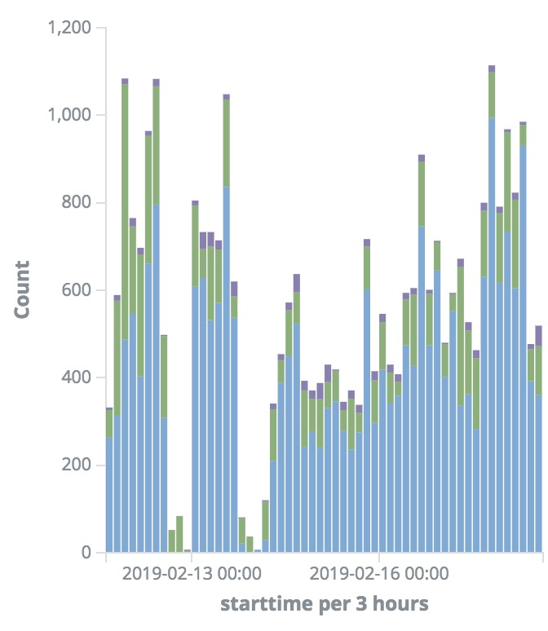
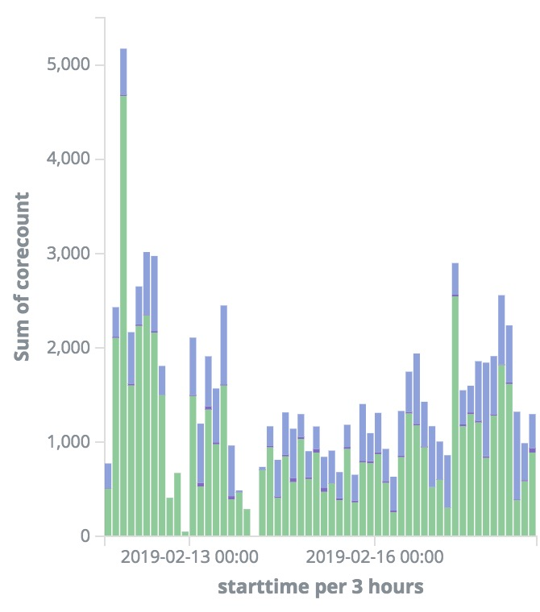
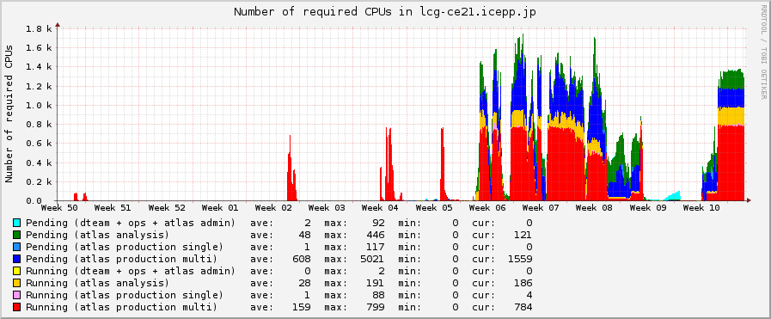
Jobs Running on GCP
Monitors of job starting time
Analysis job: 1core
Production job: 1core
Production job: 8cores
Analysis job: 1core
Production job: 1core
Production job: 8cores
Number of jobs
Number of vCPUs
2.0k
Analysis job: 1core idle
Production job: 8cores idle
Analysis job: 1core running
Production job: 8cores running
vCPUs
1.0k
0
HTCondor status monitor

Slide 20
1 Day Real Cost
On-premises
Job Manager
Worker node
Storage
Hybrid system: 1k cores, 2.4GB/core memory
  Cost for month (x30), with 20k cores (x20): ~$240k + on-premises costs
1 Day Real Cost (13/Feb)
 | Usage | Cost/day | x30x20
vCPU (vCPU*hours) | 20046 | $177 | $106k
Memory (GB*hours) | 47581 | $56 | $34k
Disk (GB*hours) | 644898 | $50 | $30k
Network (GB) | 559 | $78 | $47k
Other services |  | $30 | $18k
Total |  | $391 | $236k
Cost Estimation
Resource | Cost/month
vCPU x20k | $130k
3GB x20k | $42k
Local Disk 35GBx20k | $28k
Network GCP WN to ICEPP Storage 300 TB | $43k
Total | $243k
vCPU: 1vCPU instances max 200, 8 vCPUs instances max 100
Memory: 2.4 GB/vCPU
Disk: 50GB for 1vCPU instance, 150 GB for 8 vCPUs instance

Slide 21
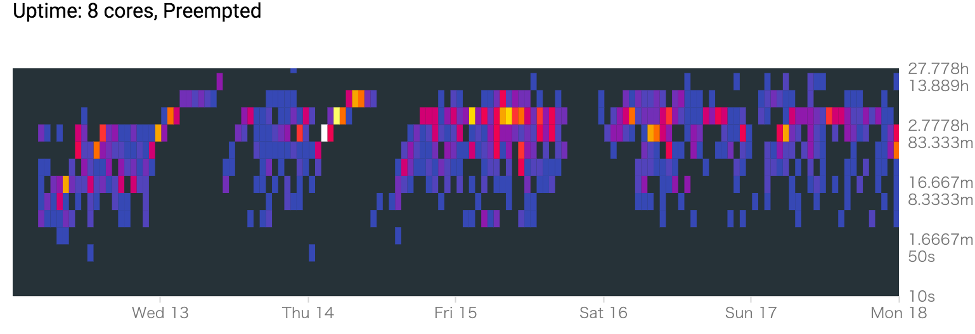
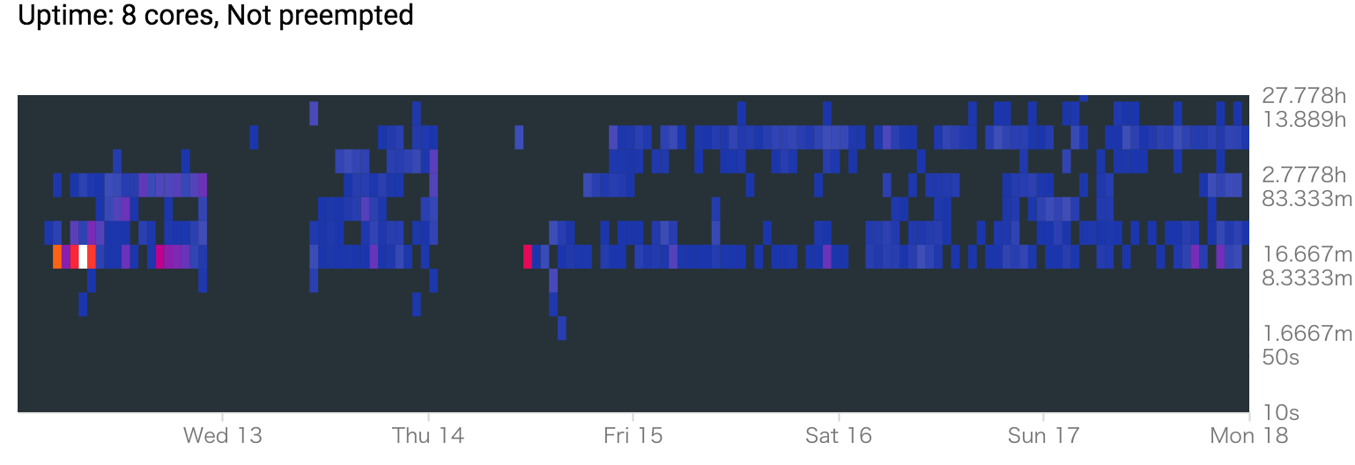
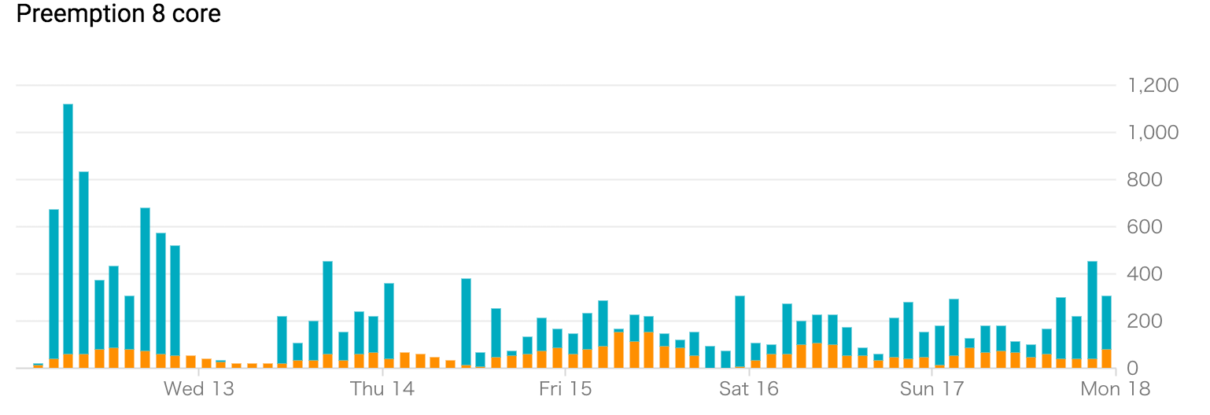
Preemption
HTCondor can manage jobs even if instance preemption happened
  The job is evicted and submitted to another node
30% jobs were affected for 10 hours jobs
Some upstream managers may not able to manage in such a case, though…
8 core instances
Not Preempted
Preempted

Slide 22
Summary
The cost of GCP is reasonable
  Same order compared with on-premises,
  especially if preemptible instances are used
Hybrid system with GCPM works on the ATLAS Production System in WLCG
  HTCondor+GCPM can work for small clusters, too,
  in which CPUs are always not fully used
    You need to pay only for what you used
    GCPM can work for GPU worker nodes, too
GCPM is available:
  https://github.com/mickaneda/gcpm
    You can install by pip: $ pip install gcpm
  Puppet example for head and worker nodes:
    https://github.com/mickaneda/gcpm-puppet
HTCondor natively supports AWS worker nodes since 8.8
  Integration of GCPM functions in HTCondor…?

Slide 23
Backup

Slide 24

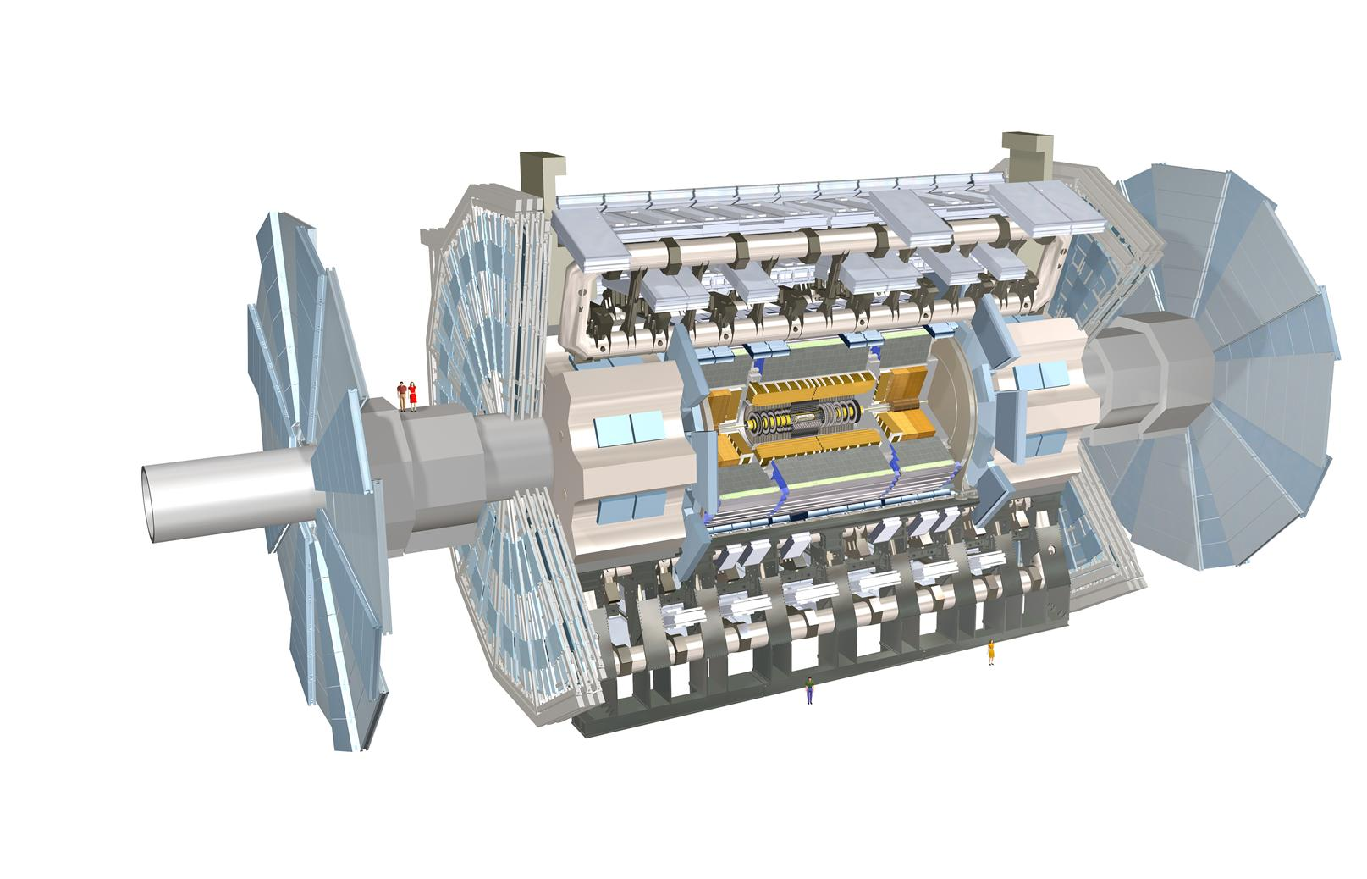
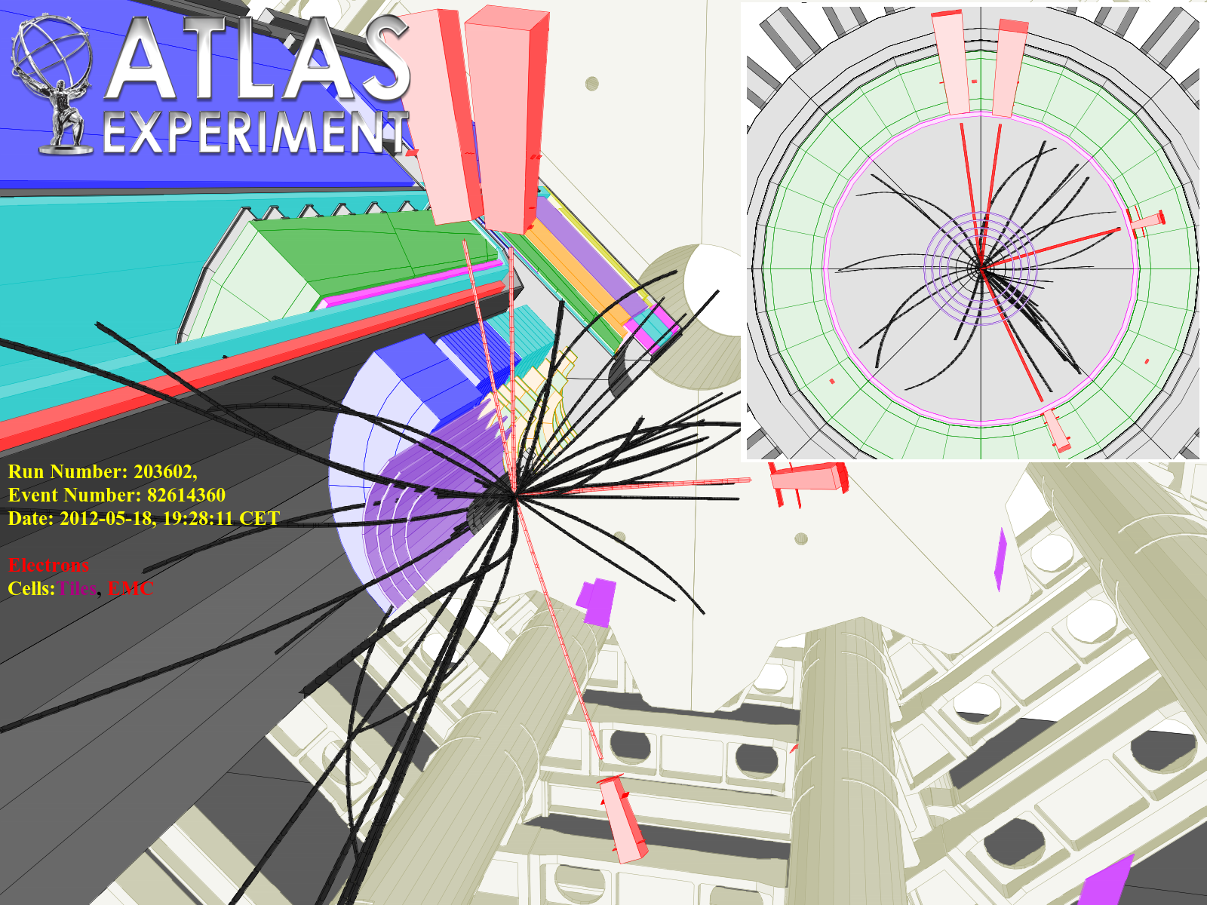
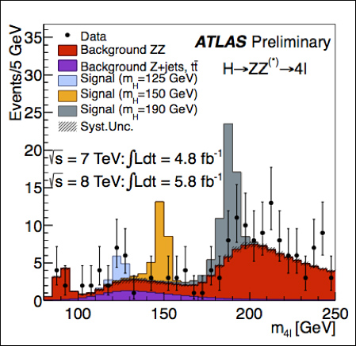
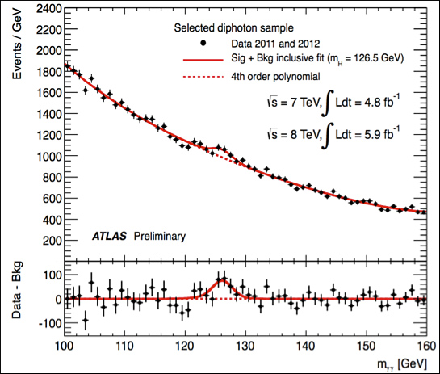
The ATLAS Experiment
The Higgs Boson Discovery in 2012

Slide 25
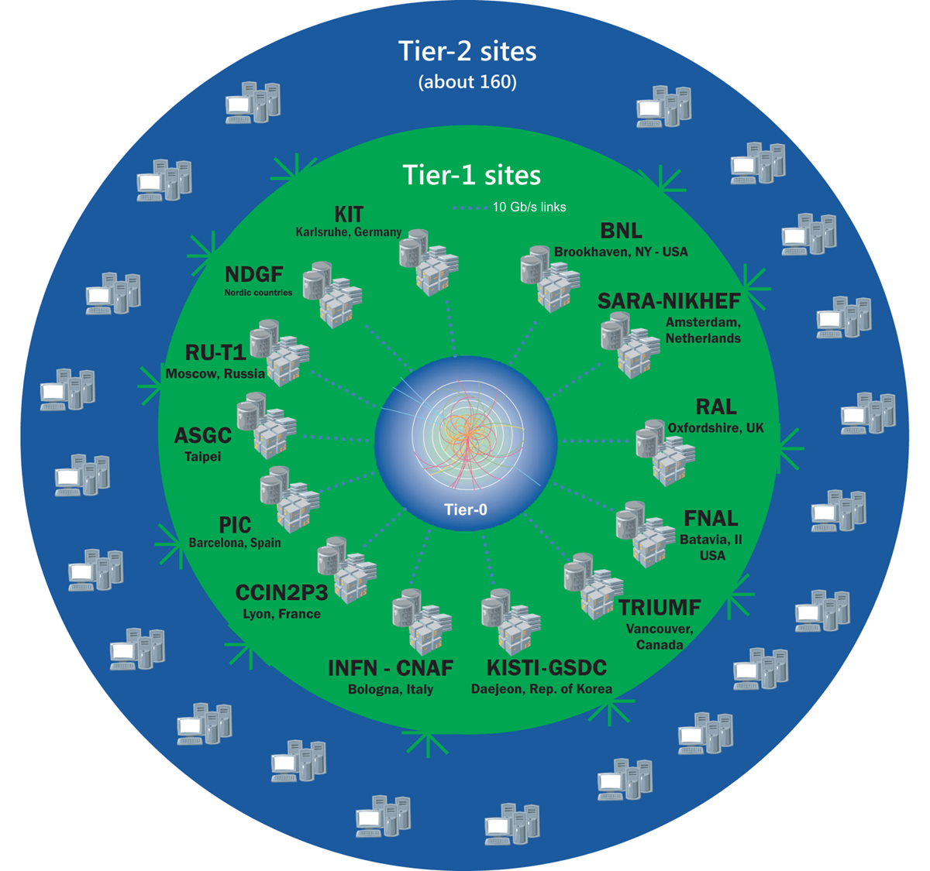
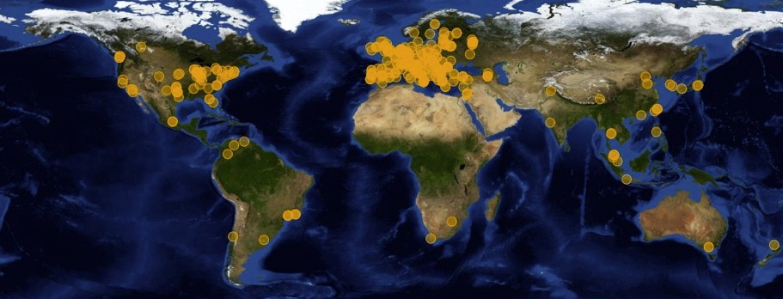
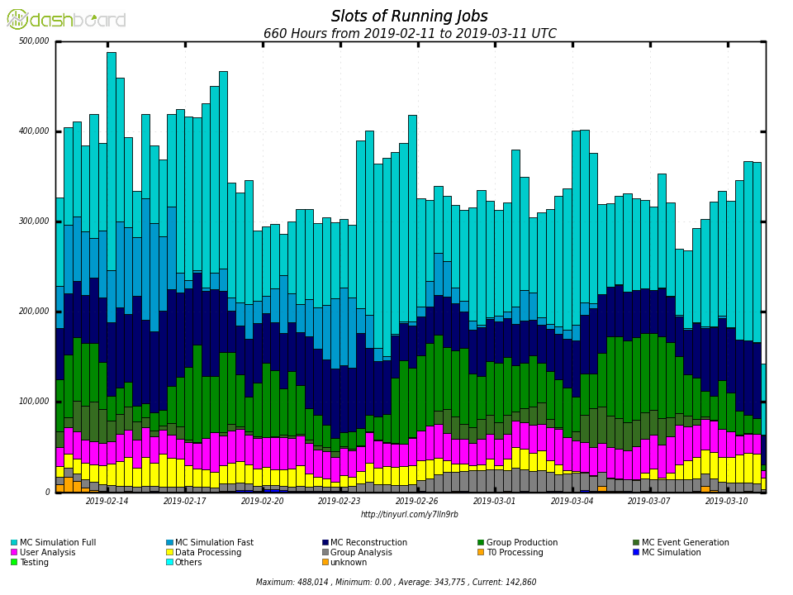
Worldwide LHC Computing Grid (WLCG)
42 countries
170 computing centers
Over 2 million tasks run every day
1 million computer cores
1 exabyte of storage
A global computing collaboration for LHC
  Tier0 is CERN
The Tokyo regional analysis center is one of Tier2 for ATLAS
500,000
400,000
300,000
200,000
100,000
0
Number of cores used by ATLAS

Slide 26
Computing Resources for HEP
Data amount of HEP experiments becomes larger and larger
  Computing resource is one of the important piece for experiments
CERN plans High-Luminosity LHC
  The peak luminosity: x 5
  Current system does not have
  enough scaling power
  Some new ideas are necessary
  to use data effectively
    Software update
    New devices: GPGPU, FPGA, (QC)
    New grid structure: Data Cloud
    External resources: HPC, Commercial cloud

Slide 27
Commercial Cloud
Google Cloud Platform (GCP)
  Number of vCPU, Memory are customizable
  CPU is almost uniform:
    At TOKYO region, only Intel Broadwell (2.20GHz) or Skylake (2.00GHZ) can be selected (they show almost same performances)
  Hyper threading on
Amazon Web Service (AWS)
  Different types (CPU/Memory) of machines
  are available
  Hyper threading on
  HTCondor supports AWS resource management from 8.8
Microsoft Azure
  Different types (CPU/Memory) of machines
  are available
  Hyper threading off machines are available

Slide 28
ARC CE Hacking
ARC checks a number of available slots before submitting jobs
  If a job specifies a number of CPUs and there are not enough slots, job submission fails
  GCP pool has no slot at the start, jobs cannot be submitted
  Hack /usr/share/arc/Condor.pm to return non-zero cpus if it is zero
#
# returns the total number of nodes in the cluster
#
sub condor_cluster_totalcpus() {
# List all machines in the pool. Create a hash specifying the TotalCpus
# for each machine.
my %machines;
$machines{$$_{machine}} = $$_{totalcpus} for @allnodedata;
my $totalcpus = 0;
for (keys %machines) {
$totalcpus += $machines{$_};
}
# Give non-zero cpus for dynamic pool
$totalcpus ||= 100;
return $totalcpus;
}

Slide 29
Other Features of GCPM
Configuration files:
  YAML format
Machine options are fully customizable
Can handle instances with different number of cores
Max core in total, max instances for each number of cores
Management of other than GCE worker nodes
  Static worker nodes
  Required machines
  Working as an orchestration tool
Test account
Preemptible or not
Reuse instances or not
Pool_password file management
Puppet files are available for
  GCPM set
  Example worker node/head node for GCPM
  Example frontier squid proxy server at GCP

Slide 30
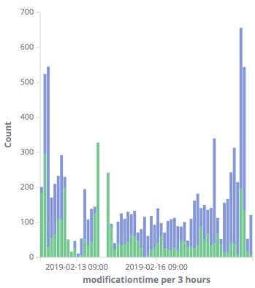
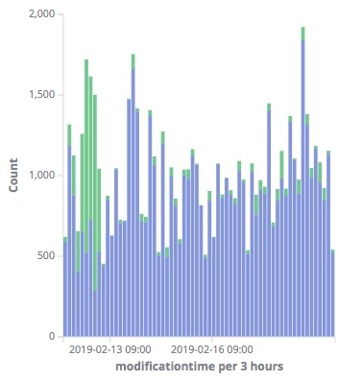
Failure Rate (Production Jobs)
Succeeded
Failed
Succeeded
Failed
GCP Worker Nodes
(Production Job)
ICEPP Worker Nodes
(Production Job)
Job Type | Error rate
GCP Production (Preemptible) | 35%
GCP Production (Non-Preemptible) | 6%
Local Production | 11%
Mainly 8 core jobs, long jobs (~10 hours/job)

Slide 31
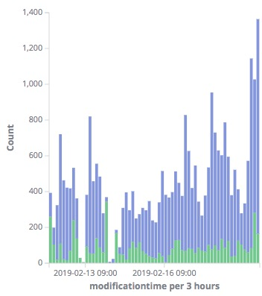
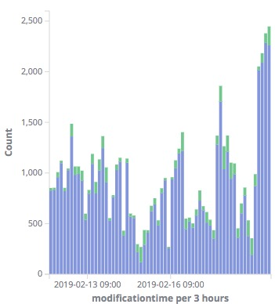
Failure Rate (Analysis Jobs)
Succeeded
Failed
Succeeded
Failed
GCP Worker Nodes
(Analysis Job)
ICEPP Worker Nodes
(Analysis Job)
Job Type | Error rate
GCP Analysis (Preemptible) | 19%
GCP Analysis (Non-Preemptible) | 14%
Local Analysis | 8%
Only 1 core job, shorter jobs

Slide 32
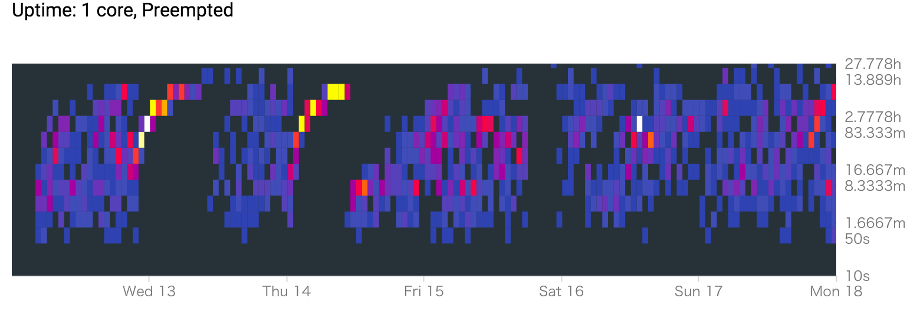
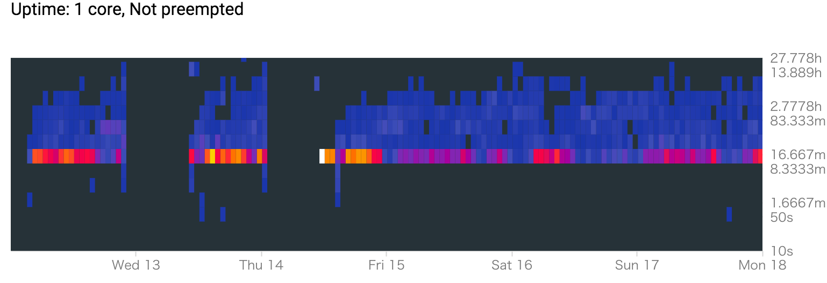
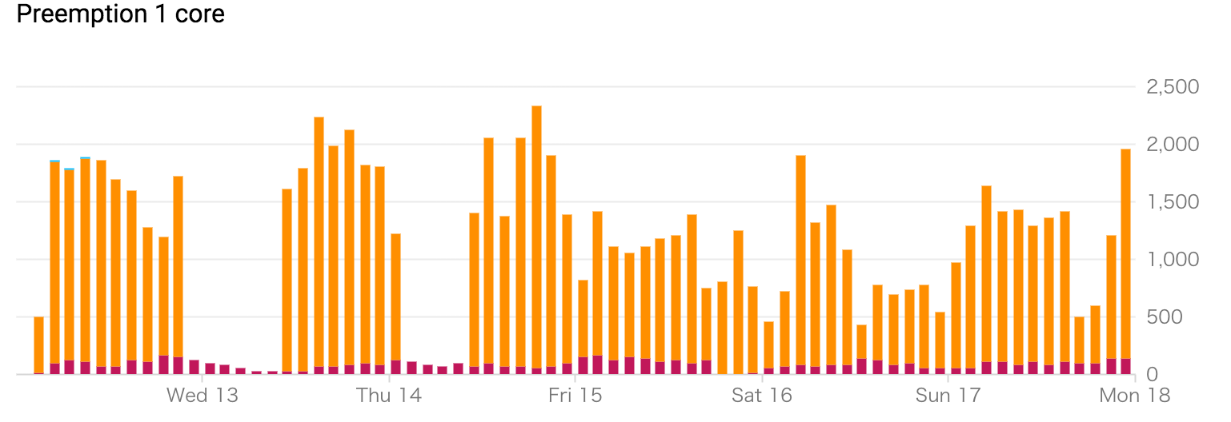
Preemption
1 core instances
8 core instances
Not preempted
Preempted
Not Preempted
Preempted

Slide 33
Preemption v.s. Failure jobs
5~30 % instances were shut down by Preemption
  Made failure jobs
Typically shut down around 3~10 hours
  Some instances were shutdown before 1 hours running
More preemptions in 8 core jobs (production: reco/sim) because job running times are longer
Not preempted
Preempted
Not Preempted
Preempted

Slide 34



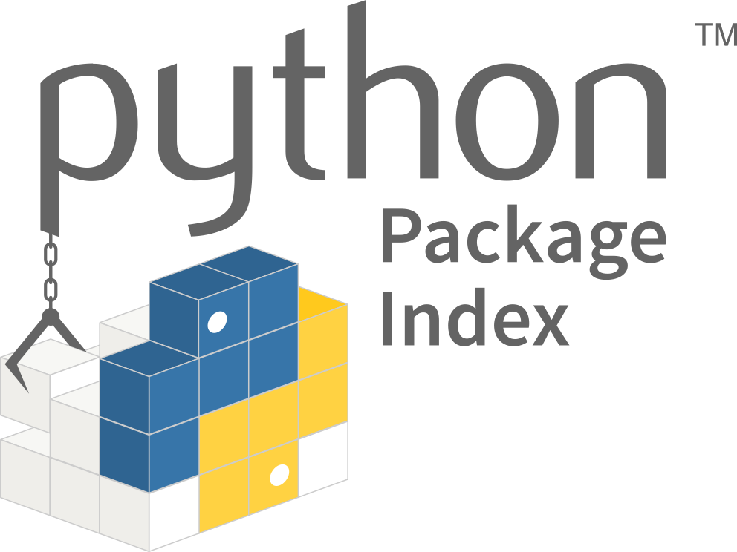

Develop Environment for Python-GCPM
Package manager: Poetry
CLI: made with python-fire
License: Apache 2.0
Secret files are encrypted by git-crypt
travis encrypt-file is also used for travis job
(service account file for gcp, etc…)
GitHub
Local Machine
Tests by pytest
On Ubuntu Xenial
For python 2.7, 3.5, 3.6, 3.7
pytest-cov result
(in gh-pages branch)
Travis CI
The Python Package Index (PyPI)
($ pip install gcpm)

Slide 35
Develop Environment for Python-GCPM
Package manager: Poetry
CLI: made with python-fire
License: Apache 2.0
Package manager: Poetry
Directory Structure
gcpm
|--|-- pyproject.toml
|-- src
| |-- gcpm
| | |-- __init__.py
| | |-- __main__.py
| | |-- __version__.py
| | |-- cli.py
| | |-- core.py
|-- tests
| |-- __init__.py
| |-- conftest.py
| |-- data
| | |-- gcpm.yml
| | |-- service_account.json
| |-- test_cli.py
Package initialization
Management of package dependencies
Build & Publish to PyPi
Automatic virtualenv management
Easy to make CLI tool
Secret files are encrypted by git-crypt
travis encrypt-file is also used for travis job
(service account file for gcp, etc…)
GitHub
Local Machine
Tests by pytest
On Ubuntu Xenial
For python 2.7, 3.5, 3.6, 3.7
$ poetry init # Initialize package
$ poetry add fire # Add fire to dependencies
$ poetry run gcpm version # Run gcpm in virtualenv
$ poetry run pytest # Run pytest in virtualenv
$ poetry publish –build # Build and publsh to PyPi
Travis CI
The Python Package Index (PyPI)
($ pip install gcpm)

Slide 36
Develop Environment for Python-GCPM
Package manager: Poetry
CLI: made with python-fire
License: Apache 2.0
CLI: made with python-fire
from .core import Gcpm
import fire
class CliObject(object):
def __init__(self, config=""):
self.config = config
def version(self):
Gcpm.version()
def run(self):
Gcpm(config=self.config).run()
def cli():
fire.Fire(CliObject)
if __name__ == "__main__":
cli()
Library for automatically generating CLI from absolutely any Python object
Secret files are encrypted by git-crypt
travis encrypt-file is also used for travis job
(service account file for gcp, etc…)
GitHub
Local Machine
pytest-cov result
(in gh-pages branch)
$ gcpm version
gcpm: 0.2.0
$ gcpm –-config /path/to/config run
Starting gcpm
…
Tests by pytest
On Ubuntu Xenial
For python 2.7, 3.5, 3.6, 3.7
Travis CI
The Python Package Index (PyPI)
($ pip install gcpm)

Slide 37
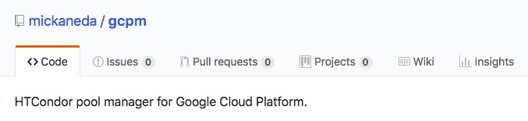
Develop Environment for Python-GCPM
Package manager: Poetry
CLI: made with python-fire
License: Apache 2.0
Secret files are encrypted by git-crypt
travis encrypt-file is also used for travis job
(service account file for gcp, etc…)
GitHub
Local Machine
Source code at: GitHub
Tests by pytest
On Ubuntu Xenial
For python 2.7, 3.5, 3.6, 3.7
pytest-cov result
(in gh-pages branch)
Open source
  License: Apache 2.0
Automatic test/build on Travis CI at push
Travis CI
The Python Package Index (PyPI)
($ pip install gcpm)

Slide 38
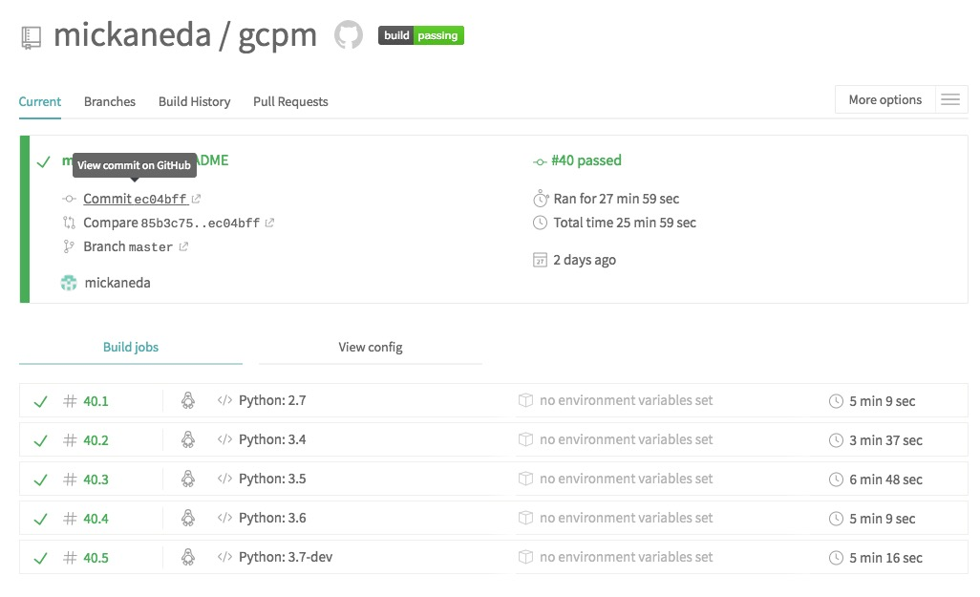
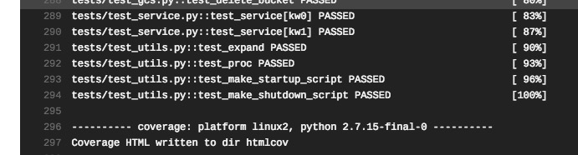
Develop Environment for Python-GCPM
Package manager: Poetry
CLI: made with python-fire
License: Apache 2.0
Test/Build on Travis CI
Secret files are encrypted by git-crypt
travis encrypt-file is also used for travis job
(service account file for gcp, etc…)
GitHub
Local Machine
Tests by pytest
On Ubuntu Xenial
For python 2.7, 3.5, 3.6, 3.7
pytest-cov result
(in gh-pages branch)
Run pytest for every push
Tested with python2.7, 3.4, 3.5, 3.6 and 3.7-dev
Build & publish to PyPi after test on Tag may be useful (not implemented)
Travis CI
The Python Package Index (PyPI)
($ pip install gcpm)

Slide 39
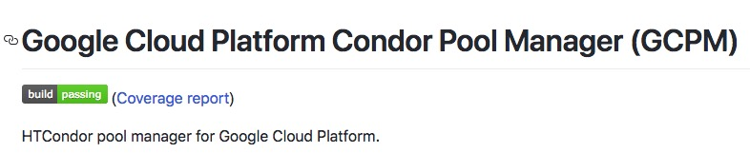
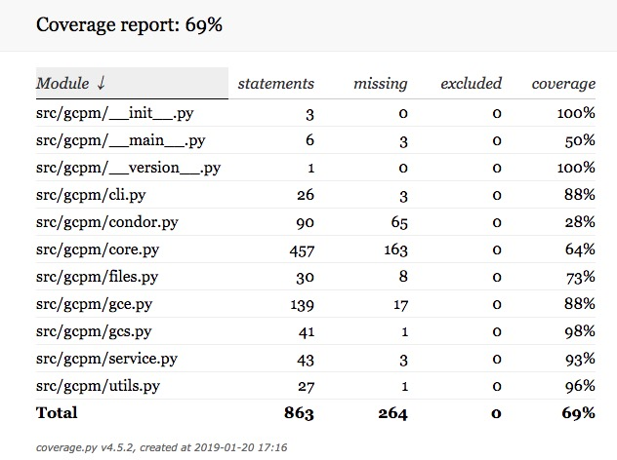
Develop Environment for Python-GCPM
Package manager: Poetry
CLI: made with python-fire
License: Apache 2.0
pytest-cov result in gh-pages branch
Test coverage is measured by pytest-cov
There result is published in gh-pages of gcpm repository at GitHub
Secret files are encrypted by git-crypt
travis encrypt-file is also used for travis job
(service account file for gcp, etc…)
GitHub
Local Machine
Tests by pytest
On Ubuntu Xenial
For python 2.7, 3.5, 3.6, 3.7
pytest-cov result
(in gh-pages branch)
Travis CI
The Python Package Index (PyPI)
($ pip install gcpm)

Slide 40
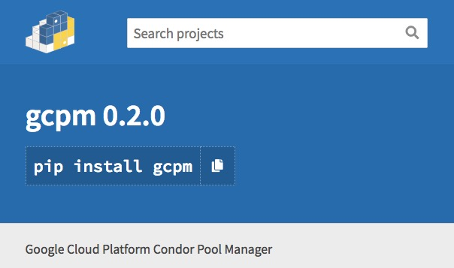
Develop Environment for Python-GCPM
Package manager: Poetry
CLI: made with python-fire
License: Apache 2.0
Published on the Python Package Index (PyPI)
Secret files are encrypted by git-crypt
travis encrypt-file is also used for travis job
(service account file for gcp, etc…)
GitHub
Local Machine
Tests by pytest
On Ubuntu Xenial
For python 2.7, 3.5, 3.6, 3.7
pytest-cov result
(in gh-pages branch)
$ pip install gcpm
Travis CI
The Python Package Index (PyPI)
($ pip install gcpm)

