Slide 1
High Throughput Computing Notebooks
HTCondor Week 2019
Todd Tannenbaum
Center for High Throughput Computing

Slide 2
Jupyter Notebook
Open source browser-based application to create and share interactive documents that contain
Live code
Python, R, Julia, Scala, Bash, …
Equations
Visualizations
Narrative Text
Also has a console window and file mover

Slide 3
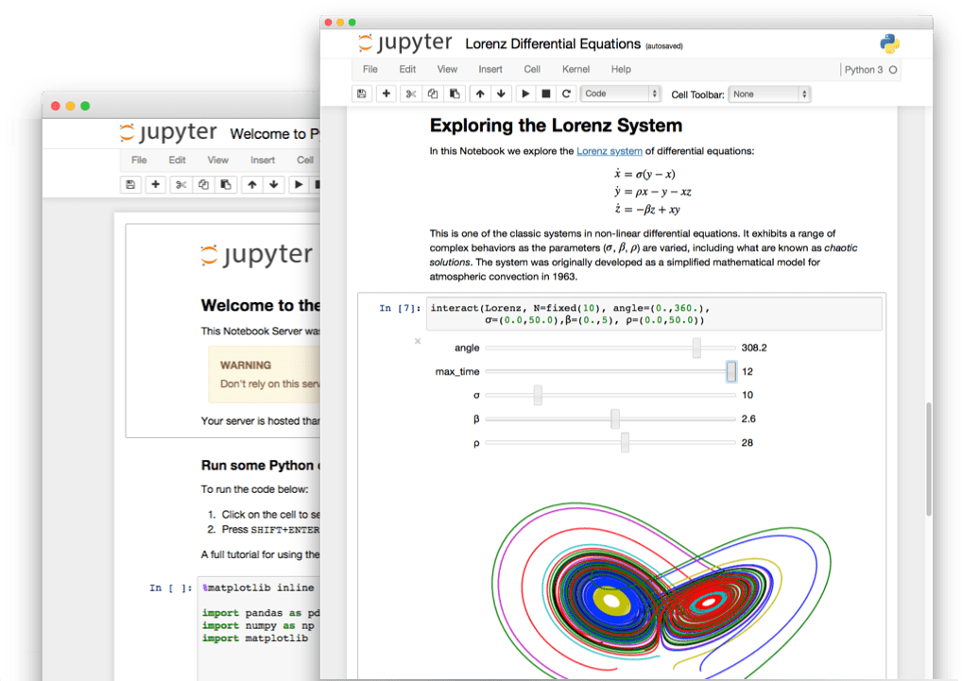

Slide 4
Can start a Jupyter instance on your laptop
Install Jupyter via Anaconda or PIP, e.g.
% pip install jupyter
And fire it up
% jupyter notebook
This command will start a small embedded web server on your laptop; point your browser at http://localhost:8888 and go.

Slide 5
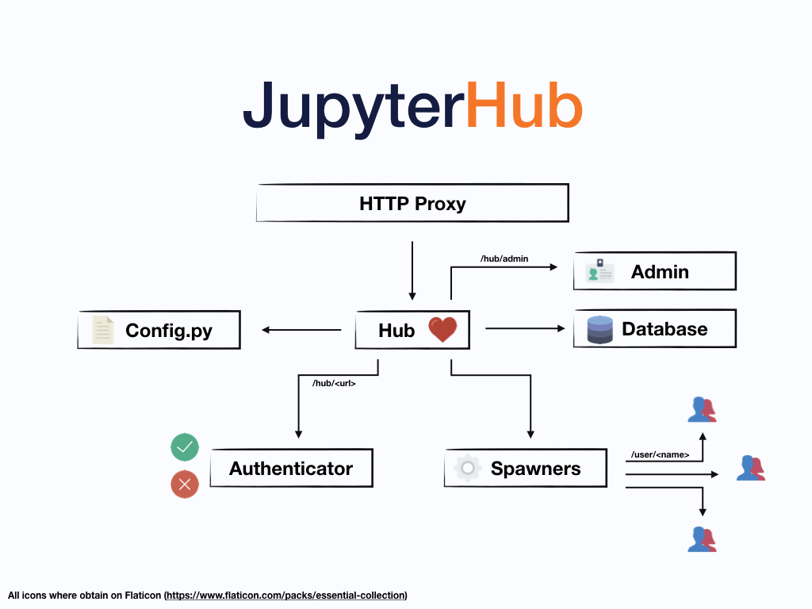
Can start a Jupyter instance on a remote server
Point your browser at a URL where a JupyterHub server is listening

Slide 6
Goal: Bring distributed High Throughput Computing into the scientific Python environment
Allow users to easily develop/test using a small/responsive pool (eg their laptop!), and then easily run using all the cores in an HTCondor cluster

Slide 7
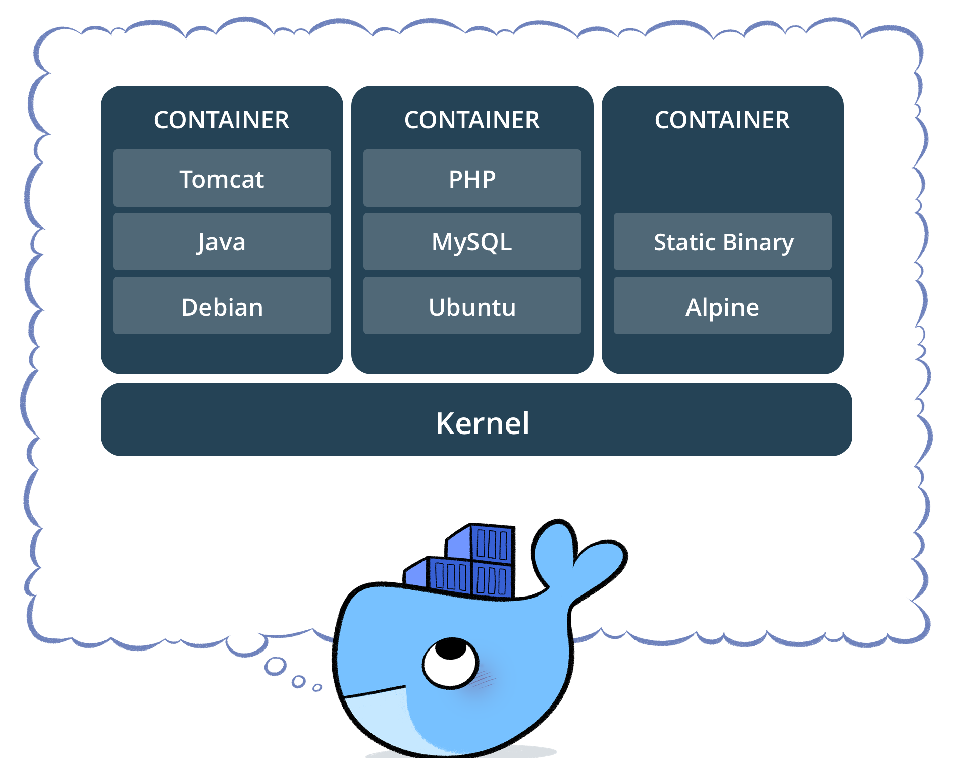
High Throughput Computing Notebook
Docker container with
Python 3
Jupyter
Popular Python science packages
HTCondor Python bindings
HTMap
Personal HTCondor pool
Started if no _condor_SCHEDD_HOST environment variable set

Slide 8
High Throughput Computing Notebook
Run it on your laptop
Container will start up a personal HTCondor pool, and then Jupyter
HTMap uses the personal pool
Run it on a server that has both JupyterHub and a HTCondor Schedd connected to your site's pool
Container will start Jupyter
HTMap uses the entire site pool

Slide 9
Run htc-notebook on your laptop with a personal pool
condor_schedd
Container will start up a personal HTCondor pool, and then Jupyter
HTMap uses the personal pool

Slide 10
Run htc-notebook on a remote server with a personal pool

Slide 11
Run htc-notebook on a remote server with a personal pool
condor_schedd

Slide 12
Run on a remote server using entire site pool
condor_schedd

Slide 13
Run on a remote server using entire site pool
condor_schedd

Slide 14
Run on a remote server using entire site pool
condor_schedd

Slide 15
Docker Hub (images) / GitHub Repos (src)
https://hub.docker.com/u/htcondor
https://github.com/htcondor/htc-notebook
Run it on your laptop
docker run –p 8888:8888 htcondor/htc-base-notebook
(then open your web browser as instructed)
Pick a software environment!
htcondor/htc-scipy-notebook
htcondor/htc-tensorflow-notebook
htcondor/htc-r-notebook
htcondor/htc-pyspark-notebook
htcondor/htc-datascience-notebook

Slide 16
Thank You Interested? Talk to us!
Docker Hub (images) / GitHub Repos (src)
https://hub.docker.com/u/htcondor
https://github.com/htcondor/htc-notebook

