Slide 1
SciTokens and Credential Management
Zach Miller zmiller@cs.wisc.edu
Jason Patton jpatton@cs.wisc.edu
HTCondor Week 2019
This material is based upon work supported by the National Science Foundation under Grant No. 1738962. Any opinions, findings, and conclusions or recommendations expressed in this material are those of the author(s) and do not necessarily reflect the views of the National Science Foundation.
Notes:
The SciTokens project (https://scitokens.org), in collaboration with the HTCondor team, is helping to bring capability-based authorization for least-privilege access to scientific computing infrastructures using the JSON Web Token (JWT) and OAuth standards, which are already used by services like Box, Dropbox, and Google Drive. This talk will give an introduction to the SciTokens model, including an introduction to JWTs and OAuth, and will discuss motivating use cases including PyCBC workflows using HTCondor in LIGO.

Slide 2
SciTokens Project
The SciTokens project, started July 2017, aims to:
  Introduce a capabilities-based authorization infrastructure for distributed scientific computing,
  Provide a reference platform, combining CILogon, HTCondor, CVMFS, and XRootD, and
  Implement specific use cases to help our science stakeholders (LIGO and LSST) better achieve their scientific aims.

Slide 3
Identity-based Authorization
At the core of today’s grid security infrastructure is the concept of identity and impersonation.
  A grid certificate provides you with a globally-recognized identification.
  The grid proxy allows a third party to impersonate you, (ideally) on your behalf.
  The remote service maps your identity to some set of locally-defined authorizations.
We believe this approach is fundamentally wrong because it exposes too much global state: identity and policy should be kept locally!

Slide 4
Capability-based Authorization
We want to change the infrastructure to focus on capabilities!
  The tokens passed to the remote service describe what authorizations the bearer has.
  For traceability purposes, there may be an identifier that allows tracing of the token bearer back to an identity.
  Identifier != identity. It may be privacy-preserving, requiring the issuer (VO) to provide help in mapping.
Example: “The bearer of this piece of paper is entitled to write into /data/zmiller".

Slide 5
Capabilities versus Impersonation
If GSI took over the world, an attacker could use a stolen grid proxy to make withdrawals from your bank account.
With capabilities, a stolen token only gets you access to a specific authorization (“stageout to /data/zmiller at Wisconsin”).
SciTokens is following the principle of least privilege for distributed scientific computing.

Slide 6
SciTokens Model
T
= token
Integrating an OAuth2 client on the HTCondor submit host
Enhancing HTCondor to manage token refresh and delivery to jobs
Enhancing data services (e.g. Xrootd) to allow read/writes using tokens instead of grid proxies
Submit
Execute
Data
Scheduler
Launcher
Data
Server
T
T
token
T
T
User
Token
Manager
Job
Token
Server
T

Slide 7
Architecture
R
= refresh tokens
A
= access tokens
Policy DB
Token Server
Job Submission
Job Execution
condor_submit
condor_startd
User
Identity Provider
condor_schedd
condor_starter
Data Access
condor_credd
credmon
User’s job
Data Server
A
A
A
(XRootD)
condor_shadow
A
R

Slide 8
CredD
Runs under the condor_master like all other HTCondor daemons
Manages credentials stored in a special “credential directory” with restricted permissions. Regular users cannot read or write within this directory, but the CredD can.

Slide 9
CredD
Has two “modes”
  Kerberos mode, which I talked about last year
  OAuth mode, which I am talking about now
Currently the two modes cannot coexist due to different conventions for layouts of the credential directory
Future work includes merging these modes so both can be used at the same time

Slide 10
CredD
In the old “Kerberos Mode”, the CredD would only hold one credential per user.
The CredD in “OAuth Mode” can now hold multiple credentials per user
I’m skipping the internals for this talk and focusing more on the higher-level concepts, but please come talk to me if you are curious or have questions.

Slide 11
CredD
Okay… back to OAuth mode!
The CredD in “OAuth Mode” can now hold multiple credentials per user
These can be tokens from different services:
  scitokens
  box.com
There can be different scopes (permissions) for the same service:
  scitokens_uw_read_zmiller
  scitokens_uw_write_jpatton

Slide 12
CredD
The user defines the tokens they need and the names (handles) and scopes in their submit file
Jason will describe and demo that later…
  w00t! DEMO! ☺

Slide 13
CredD
The CredD itself deals with the secure storage and retrieval of the the credentials
It does NOT know or understand the contents of the credentials – they are opaque to the CredD
Another component is in charge of understanding and manipulating OAuth tokens: the CredMon

Slide 14
CredMon
Responsible for obtaining tokens by talking to the various services
Monitors the existing tokens and knows how to refresh them
Receives signals from the CredD when there is potentially new work for it do do

Slide 15
Architecture
R
= refresh tokens
A
= access tokens
Policy DB
Token Server
Job Submission
Job Execution
condor_submit
condor_startd
User
Identity Provider
condor_schedd
condor_starter
Data Access
condor_credd
credmon
User’s job
Data Server
A
A
A
(XRootD)
condor_shadow
A
R

Slide 16
Credential Flow
User specifies in their submit file what credentials they need.
Run condor_submit:
Hello, zmiller.
Please visit:
https://baphomet.cs.wisc.edu/key/f40740d...34a0eebac1
User does so and follows directions
  That’s Jason’s demo and I’m not going to steal his thunder!

Slide 17
Credential Flow
User specifies in their submit file what credentials they need.
Run condor_submit:
Submitting job(s).
1 job(s) submitted to cluster 39033.
This time it worked because condor_submit checked with the CredD and all the tokens were present. Thus, the job can now run!

Slide 18
Credential Flow
Job matches and starts running
After the sandbox directory is created, but BEFORE any files are transferred, the condor_starter calls back to the condor_shadow to fetch tokens
Only the tokens for THAT job are sent
Only the ACCESS tokens are sent
HTCondor ensures the communication channel is encrypted, or it refuses to send the tokens.

Slide 19
Credential Flow
The access tokens are placed into the job sandbox in the .condor_creds directory
Environment variable within the job _CONDOR_CREDS points to the full path for that directory
Tokens are refreshed periodically while job continues running
Tokens are cleaned up automatically when job exits since they are in the job sandbox
my_prog --token=$_CONDOR_CREDS/scitokens.use

Slide 20
Configuration
Get a certificate for their submit server
Configure box.com
  You need a developer account
  Create a new app
Register your submit server
Configure HTCondor
This will appear in more and complete detail on the HTCondor Wiki:
  https://htcondor-wiki.cs.wisc.edu/index.cgi/wiki

Slide 21
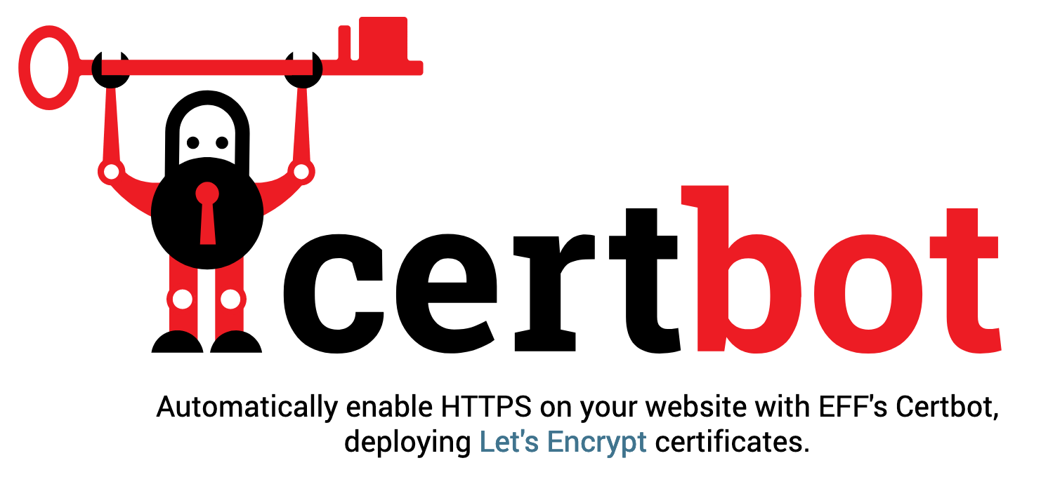

Configuration
One fairly straightforward way to get a certificate is by using the Let’s Encrypt service and certbot
https://letsencrypt.org/

Slide 22
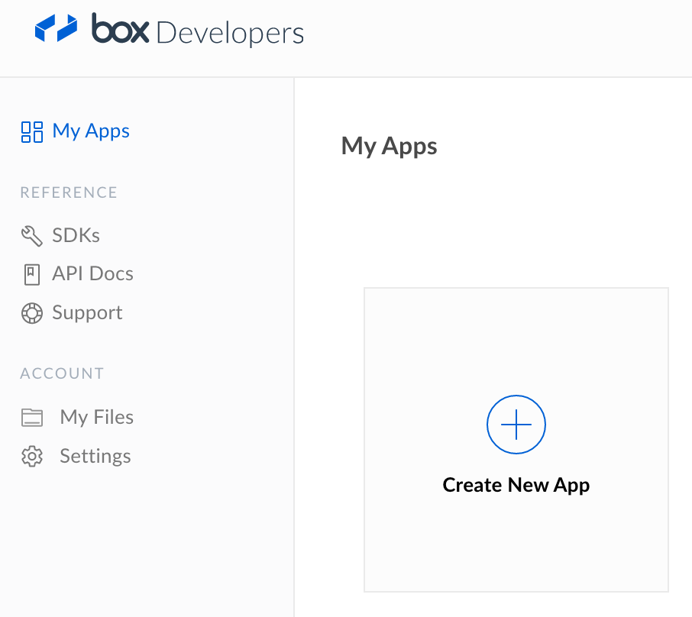
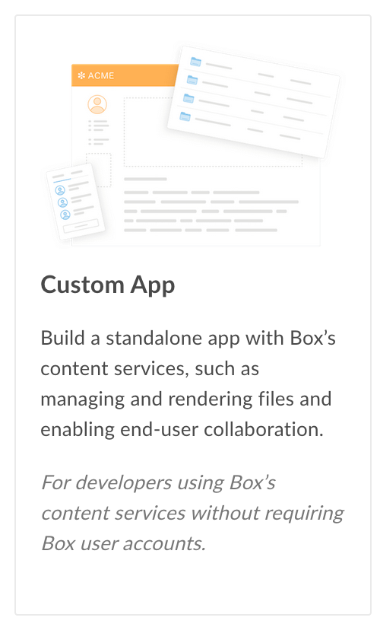
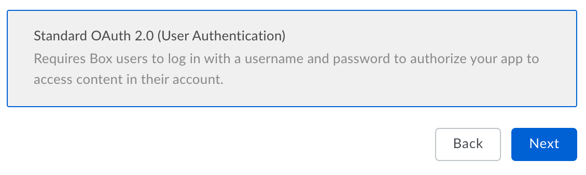
Configuration
Create a custom box.com app that uses OAuth

Slide 23
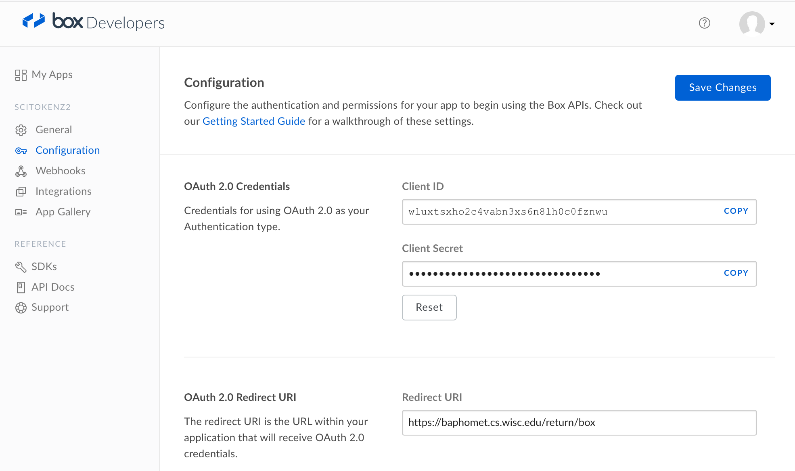
Configuration
Register submit machine

Slide 24
Configuration
Example configuration for the submit machine to interface with box.com
# Box.com client
BOX_CLIENT_ID = wluxtsxho2c4vabn3xs6n8lh0c0fznwu
BOX_CLIENT_SECRET_FILE = /etc/condor/.secrets/box
BOX_RETURN_URL_SUFFIX = /return/box
BOX_AUTHORIZATION_URL =
https://account.box.com/api/oauth2/authorize
BOX_TOKEN_URL = https://api.box.com/oauth2/token
BOX_USER_URL = https://api.box.com/2.0/users/me

Slide 25
Configuration
Many details were glossed over

Slide 26
SciTokens Credmon and Job Submission

Slide 27
SciTokens Credmon
Two parts:
  Credential Monitor
  Web app (Python Flask framework)
Currently supports:
  OAuth2-style tokens
  (including SciTokens)
  Locally issued SciTokens
  (i.e. issue-on-submit)
Separate package from HTCondor
  Near future: yum install
  python-scitokens-credmon
SciTokens Credmon
Credential Monitor
Web app

Slide 28
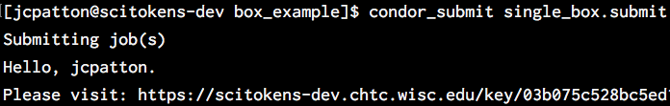
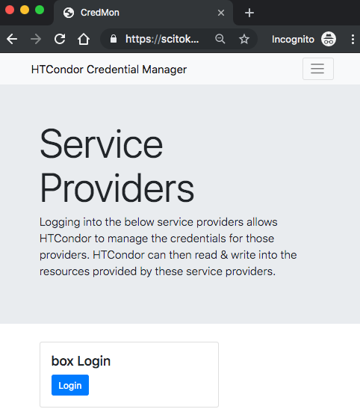
SciTokens Credmon – OAuth2 Support
Web app
Gathers initial tokens
Reads ”key” file with user’s and OAuth2 providers’ info.

Slide 29
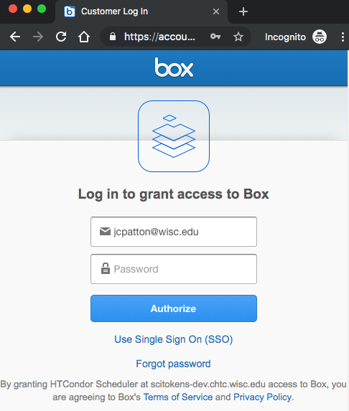
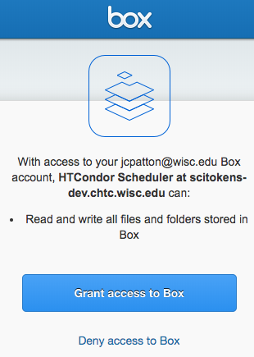
SciTokens Credmon – OAuth2 Support
Web app
Gathers initial tokens
Reads ”key” file with user’s and OAuth2 providers’ info.
Sends user to OAuth2 providers for authentication and authorization.

Slide 30
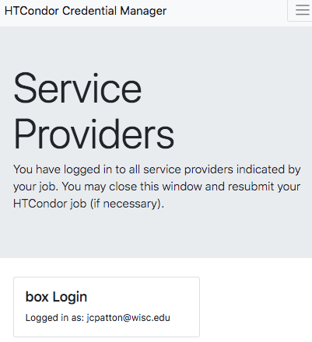

SciTokens Credmon – OAuth2 Support
Web app
Gathers initial tokens
Reads ”key” file with user’s and OAuth2 providers’ info.
Sends user to OAuth2 providers for authentication and authorization.
Stores refresh and access tokens in credential directory.

Slide 31
SciTokens Credmon – OAuth2 Support
Credential Monitor
Keeps active tokens refreshed
Scans credential directory for valid refresh tokens.

Slide 32
SciTokens Credmon – OAuth2 Support
Credential Monitor
Keeps active tokens refreshed
Scans credential directory for valid refresh tokens.
Refreshes corresponding access tokens.

Slide 33

SciTokens Credmon – OAuth2 Support
Credential Monitor
Keeps active tokens refreshed
Scans credential directory for valid refresh tokens.
Refreshes corresponding access tokens.
Writes CREDMON_COMPLETE (watched by CredD).

Slide 34
Submitting OAuth2 Jobs

Slide 35
OAuth2 Submit Syntax
use_oauth_services = <service1, service2, …>
  REQUIRED list of requested OAuth2 service providers, which must match (case-insensitive) the provider names in the HTCondor config.
Minimal example - Single provider with no required scopes or resources:
executable = transfer_my_box_file.py
arguments = htcondor/testfile.txt
use_oauth_services = box
queue
$_CONDOR_CREDS/box.use

Slide 36
OAuth2 Submit Syntax
use_oauth_services = <service1, service2, …>
  REQUIRED list of requested OAuth2 service providers, which must match (case-insensitive) the provider names in the HTCondor config.
<SERVICE>_oauth_permissions[_<HANDLE>] = <scope1, scope2, …>
  List of requested token scopes. OPTIONAL IF the OAuth2 service provider does not require a scope. The user can provide a handle to give a unique name to the token.
<SERVICE>_oauth_resource[_<HANDLE>] = <resource>
  The resource that the token should request permissions for. OPTIONAL IF the OAuth2 provider does not require a resource (a.k.a. audience) to be defined.
Note that service providers are defined by the admin in the config and handles are user-defined (optional).

Slide 37
OAuth2 Submit Example
Multiple scopes and resources:
executable = compute_stats
arguments = --in=https://mironlab.wisc.edu/shared/rawdata.zip
--out=https://jpatton.wisc.edu/home/jpatton/analysis.txt
use_oauth_services = uwtokens
uwtokens_oauth_permissions_read = read:/shared
uwtokens_oauth_resource_read = https://mironlab.wisc.edu/
uwtokens_oauth_permissions_write = write:/home/jpatton
uwtokens_oauth_resource_write = https://jpatton.wisc.edu/
queue
$_CONDOR_CREDS/uwtokens_read.use
$_CONDOR_CREDS/uwtokens_write.use

Slide 38
Live Demo

Slide 39
Thank You! jpatton@cs.wisc.edu zmiller@cs.wisc.edu

