Slide 1
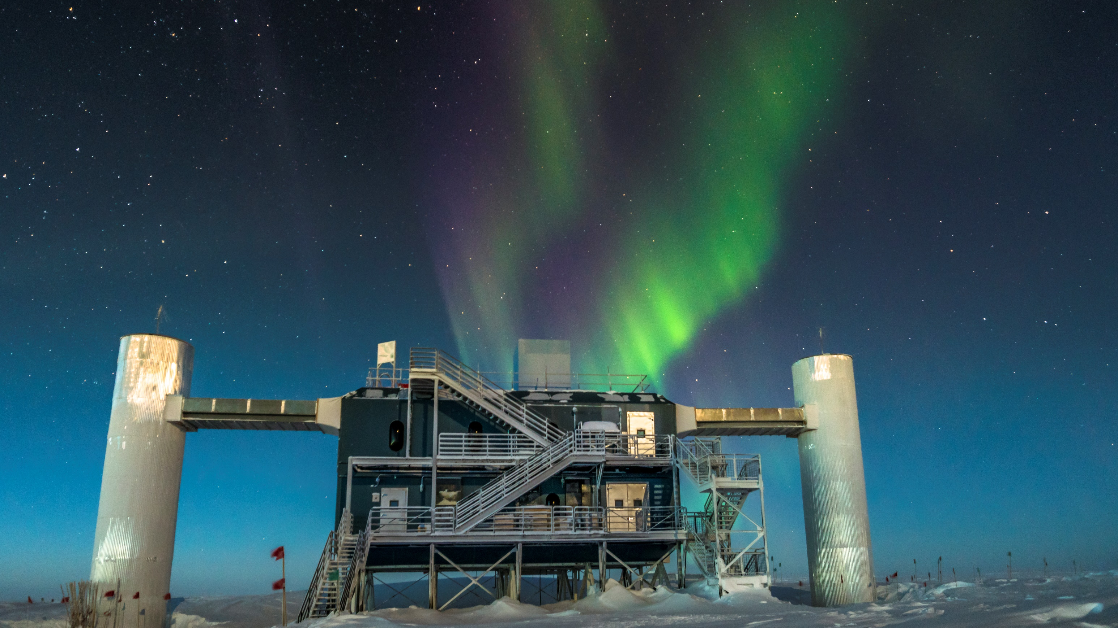


IceCube Computing
Benedikt Riedel
HTCondor Week 2019
May 21 2019

Slide 2

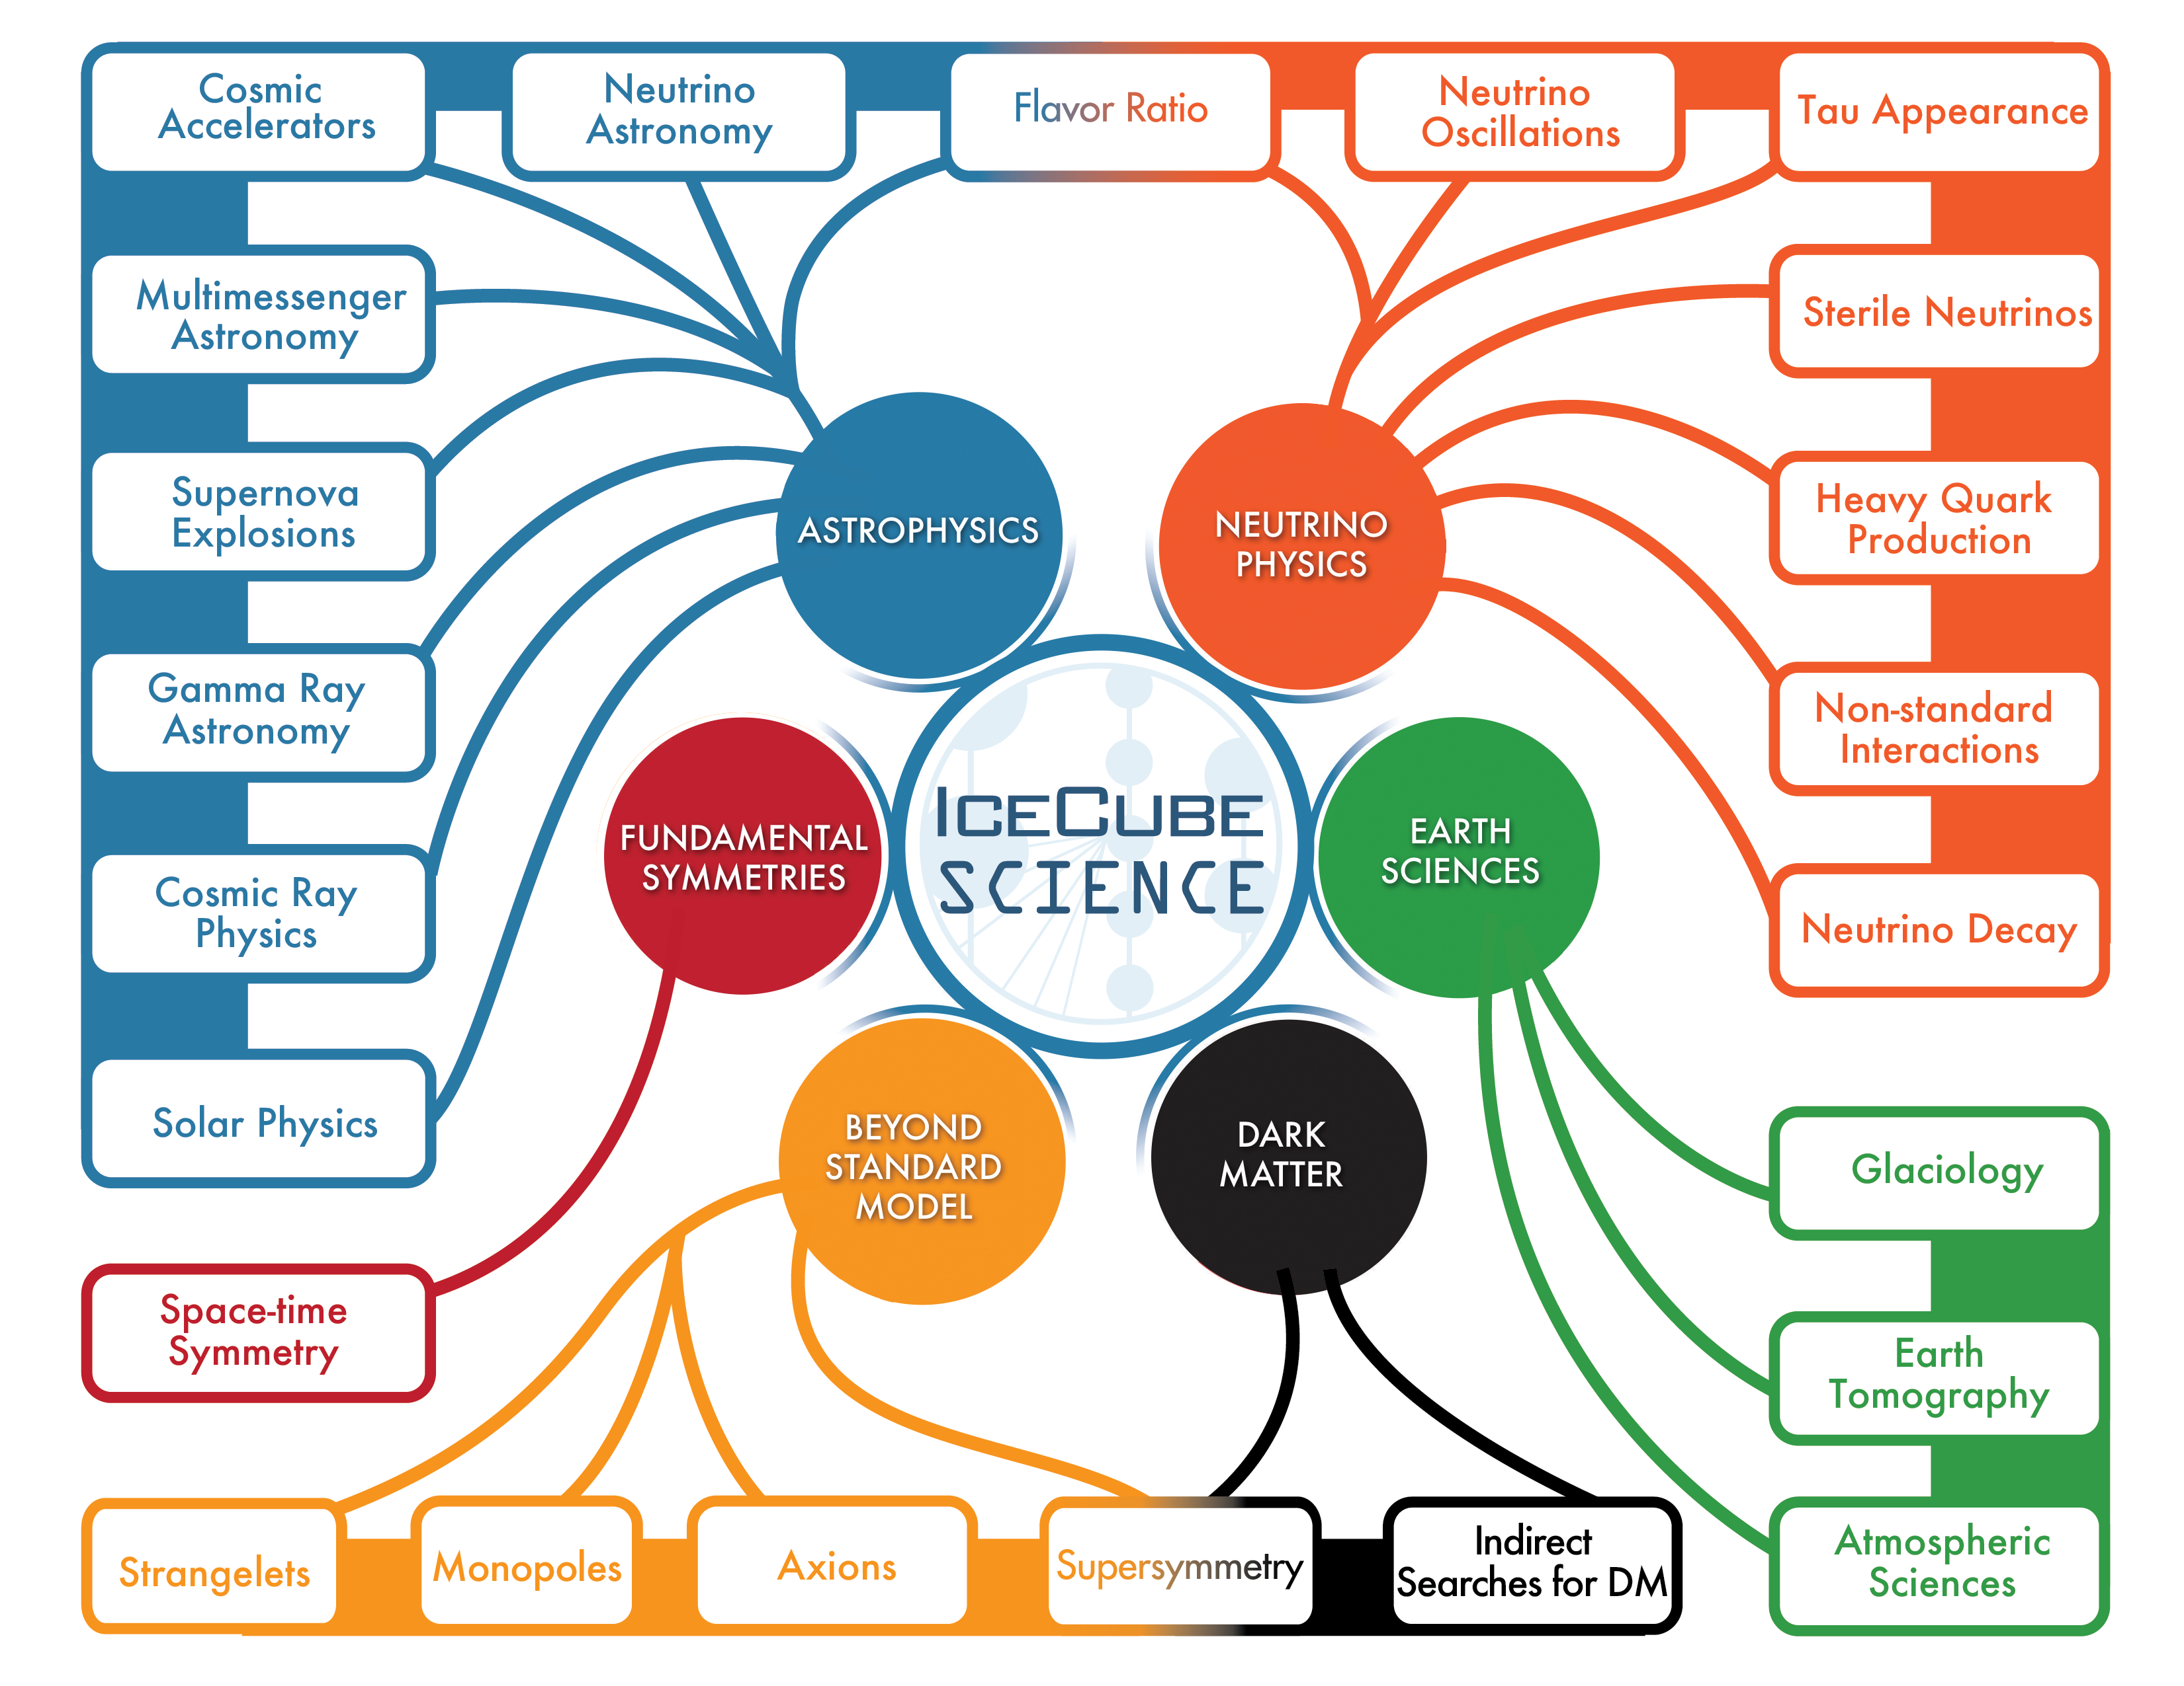
IceCube Computing – What drives us?
Novel instrument in multiple fields
Broad science abilities, e.g. astrophysics, particle physics, and earth sciences
Lots of data that needs to be processed in different ways
Lots of simulation that needs to be generated

Slide 3
IceCube Computing – 30000 Foot View
Classical Particle Physics Computing
  Trivially/ingeniously parallelizable – Grid Computing!
  "Events" - Time period of interest
  Number of channels varies between events
  Ideally would compute on a per event-basis
Several caveats
  No direct and continuous network link to experiment
  Extreme conditions at experiment (-40 C is warm, desert)
  Simulations require "specialized" hardware (GPUs)
  In-house developed and specialized software required
  Large energy range cause scheduling difficulties – Predict resource needs, run time, etc.

Slide 4
South Pole Cyberinfrastructure – Data Management
  Data Rate – 3 TB/day
  Using both data transfer options for data transfer – Drives/tapes and satellite
  Limited bandwidth from South Pole to Northern Hemisphere – 125 GB/day
  High bandwidth, high latency – Disks transfers every austral summer
  Need to filter data down to from ~3 TB to ~80 GB

Slide 5
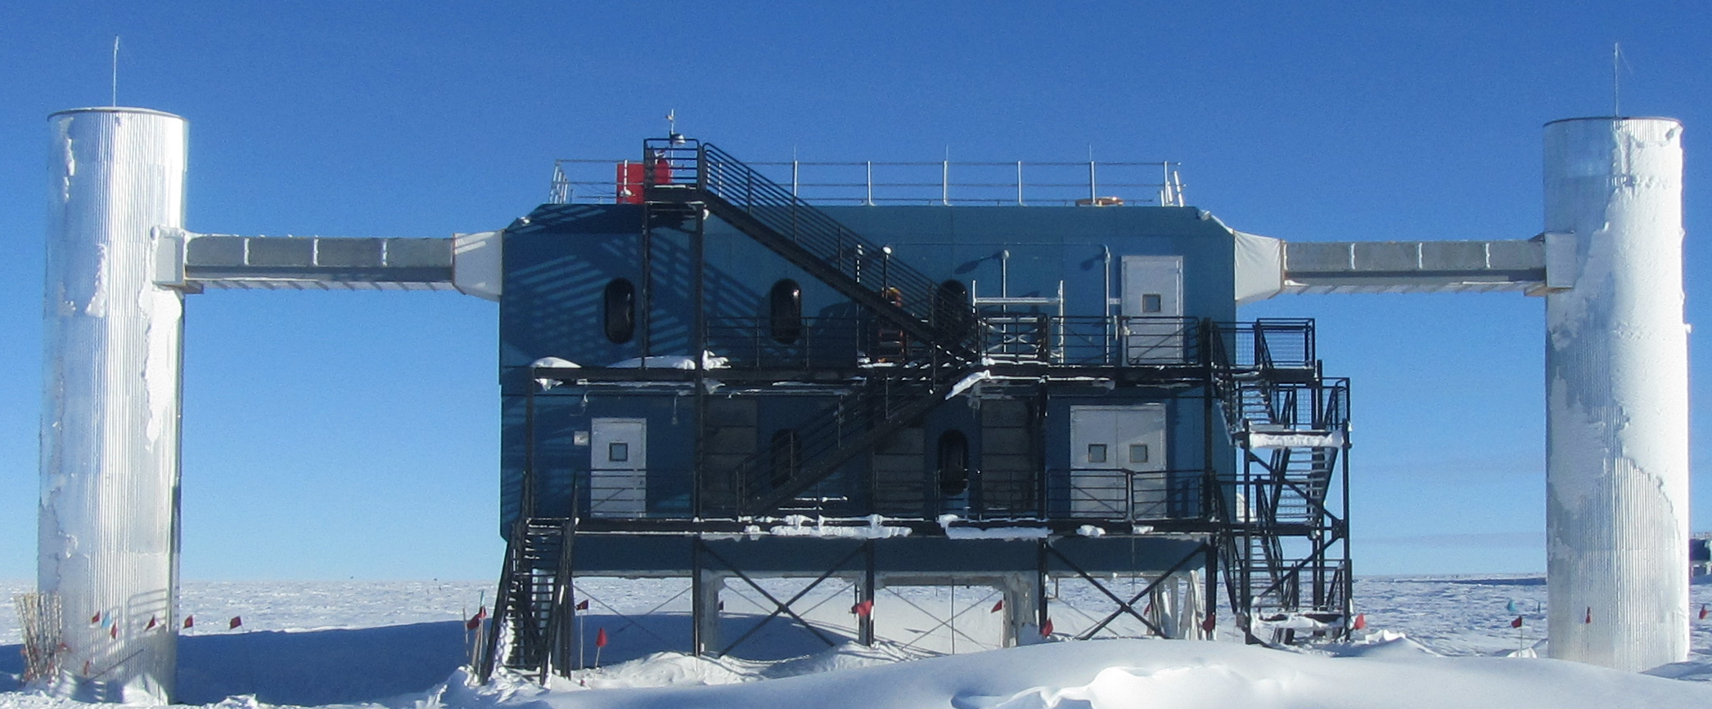
South Pole Cyberinfrastructure – IceCube Lab
  ~500 core filtering cluster
  ~100 machines for detector readout
  Fiber connection to main station
  Data is triggered and filtered at the lab and shipped off to main station for "archival" and satellite transfer
  Cooling is an issue if air handlers freeze shut – Front of room freezes while back at 80 C
  Power can drop out randomly
Detector Readout and Computing
Lab Space

Slide 6
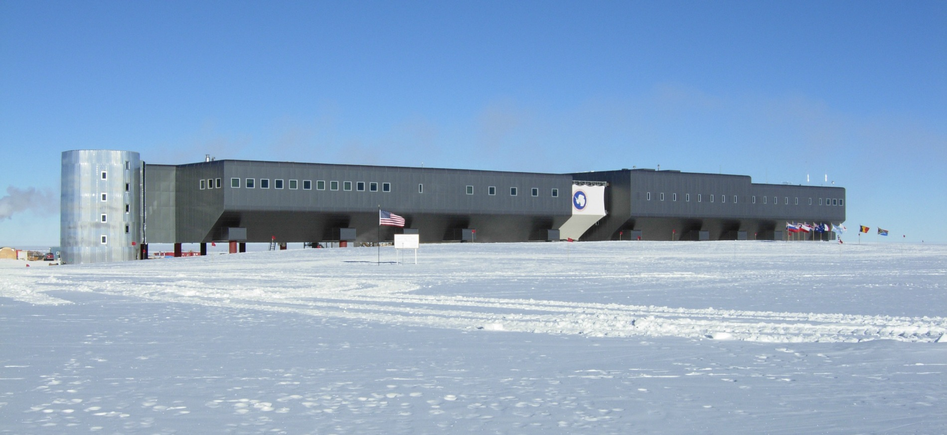
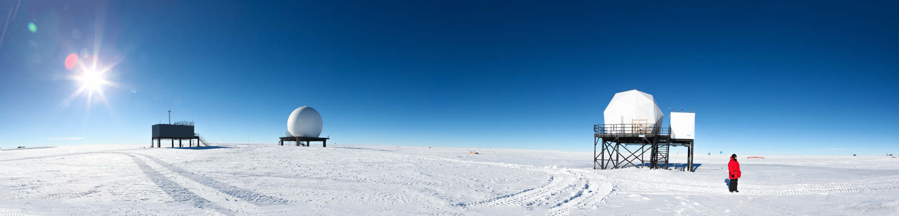
South Pole Cyberinfrastructure – Station
Science Lab
  Amundsen-Scott South Pole Station
  Lab with disk arrays for archival and servers to transfer data US Antarctic Program satellite transfer
Satellite Uplink

Slide 7
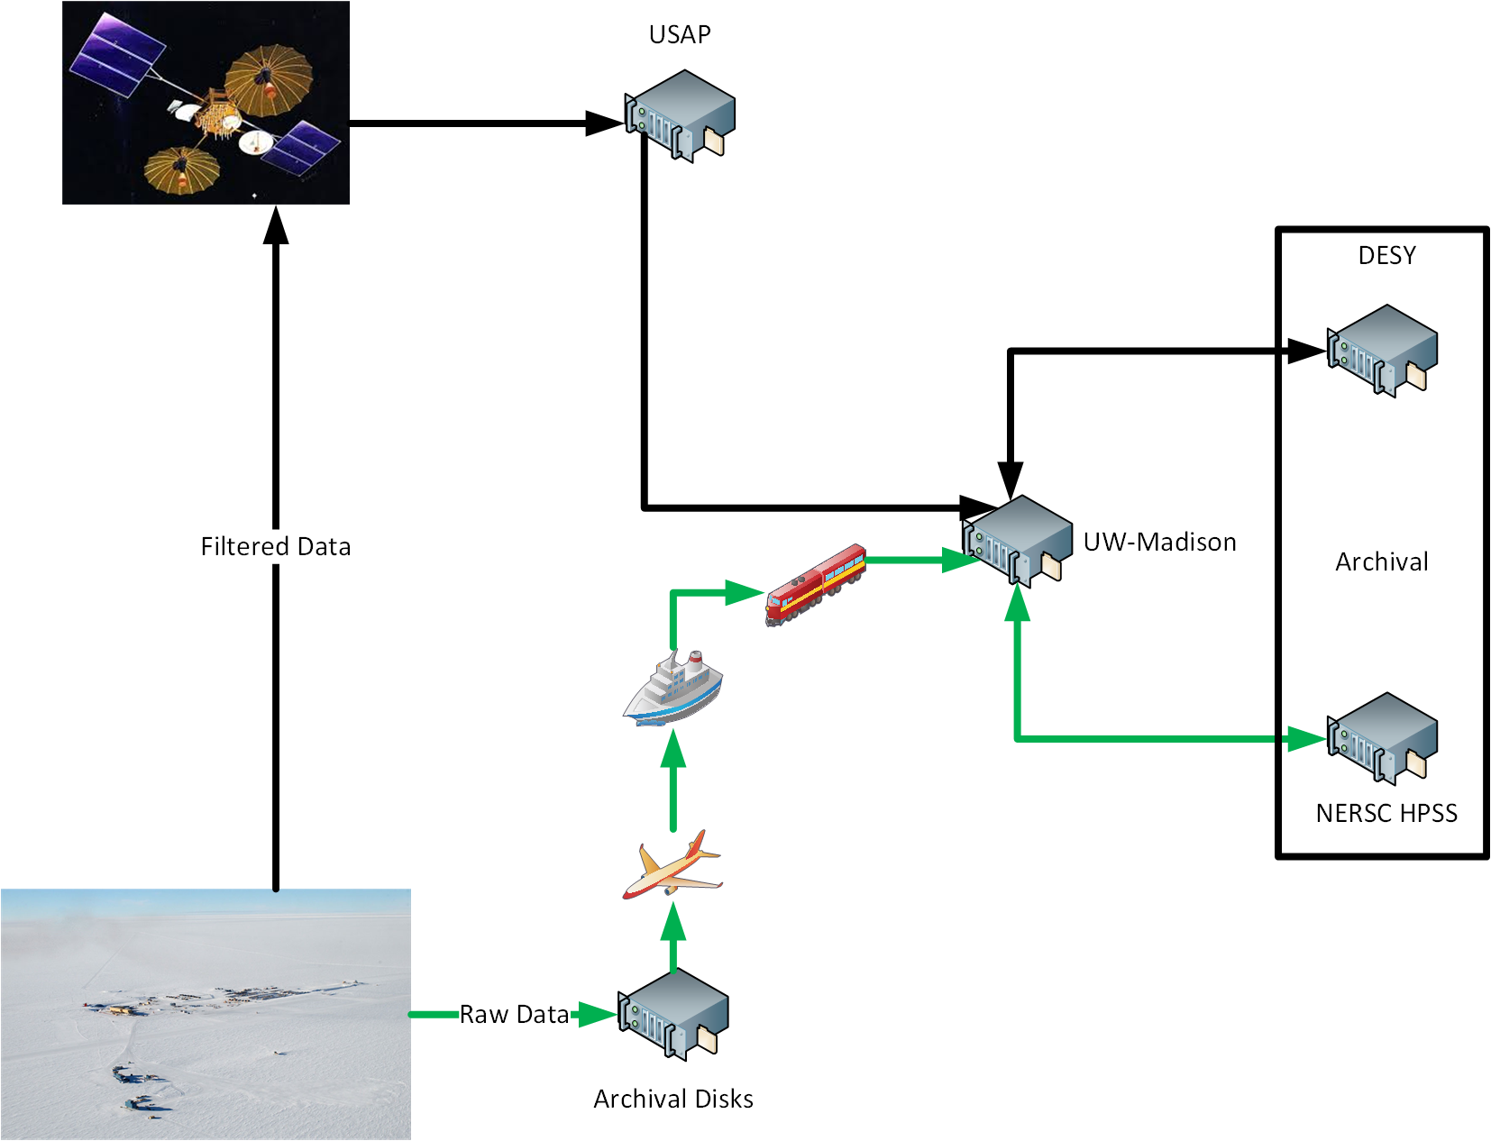
South Pole Cyberinfrastructure – Data Flow
  Filtered Data comes via satellite
  Raw data is shipped once a year on disks – First on plane, then boat, finally

Slide 8
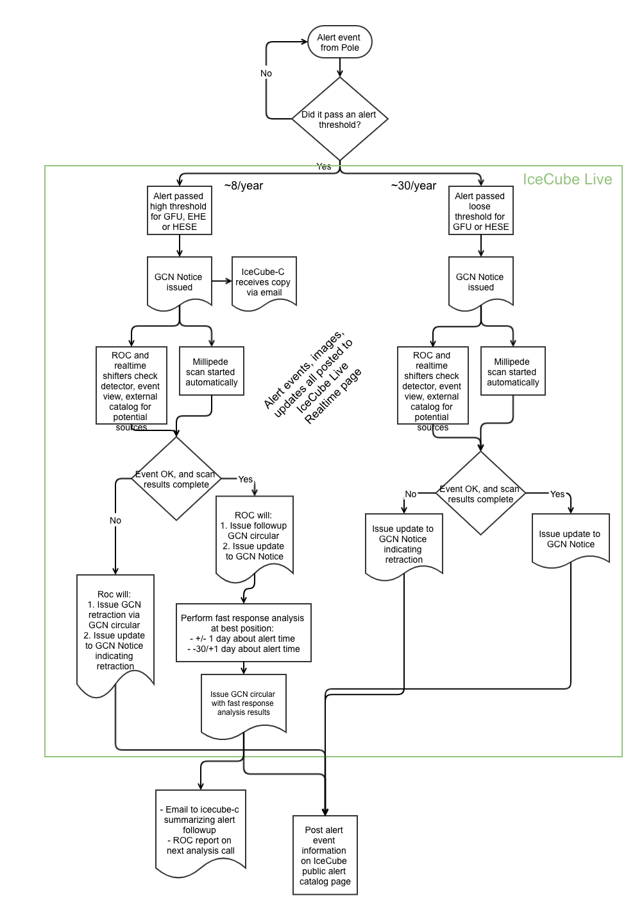
South Pole Cyberinfrastructure – Alerts
  Alerting the community about interesting events – Multimessenger Astrophysics (one of NSF's 10 Big Ideas)
  Want to alert the community at large about interesting events
  Fast event stream that is separate from main data frame
  Special filtering based on previous analyses
  Alerts are currently limited by
    Knowledge about neutrino sources – Is it astrophysical?
    Available CPUs for follow-up studies to improve error on direction on the sky – Very bursty usage, 12000 cores for 30 min once a month

Slide 9
Northern Hemisphere Cyberinfrastructure
  Central Data Processing and Analysis Facility at UW-Madison
    ~6500 core, ~300 GPU cluster
    ~10 PB storage – Roughly even split between data, simulation, analysis output, user data
    Connected to SciDMZ through Starlight – ESNet for connection to DOE facilities
    End user analysis infrastructure
    Access to IceCube Grid, OSG, and EGI
  Every group has respective campus-based resources, e.g. campus cluster
  Pledge system to contribute CPU and GPU
  Use XSEDE (and DOE) resources – Mostly for GPU, scavenge allocated CPU, DOE resources (Titan) hard to use or just added (NERSC)
  Use CVMFS to distribute software

Slide 10
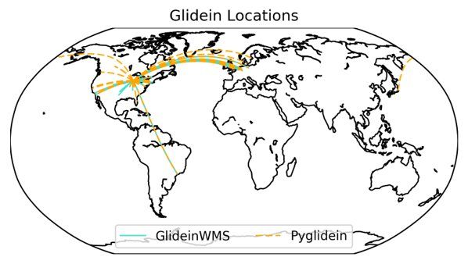
Northern Hemisphere Cyberinfrastructure – IceCube Grid
  IceCube has computing allocations at campus facilities, national facilities (XSEDE), and uses opportunistic computing
  Resources are a mix of both CPU and GPU
  Depending on facility the usage ranges from few hours to ~55M hours per year
  In-house developed software to tie resources together and workload management

Slide 11
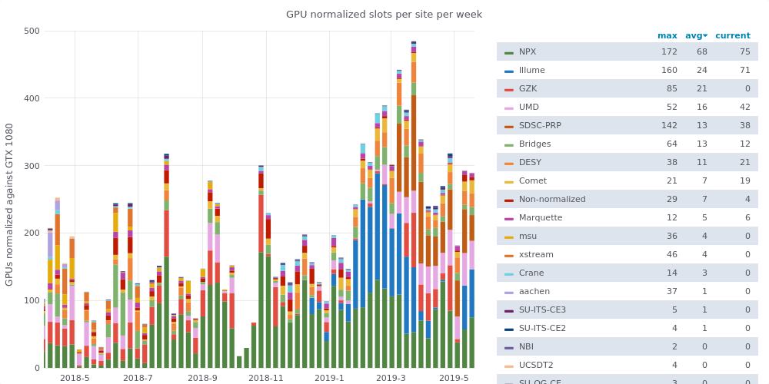
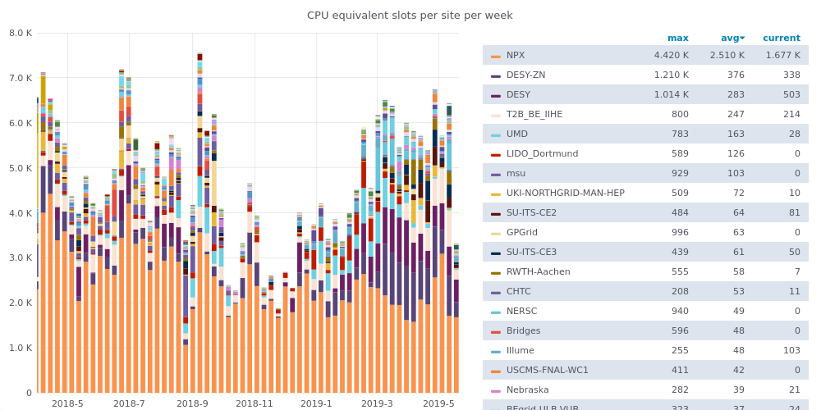
Northern Hemisphere Cyberinfrastructure – IceCube Grid
  Steadily expanding resources
  Fairly continuous use
  Slow transition to the "grid" for users – Biggest pain points are data access and job failure
  Big issue – Lots of scavenging of resources and transition between CPU and GPU resources means a lot of data movement

Slide 12
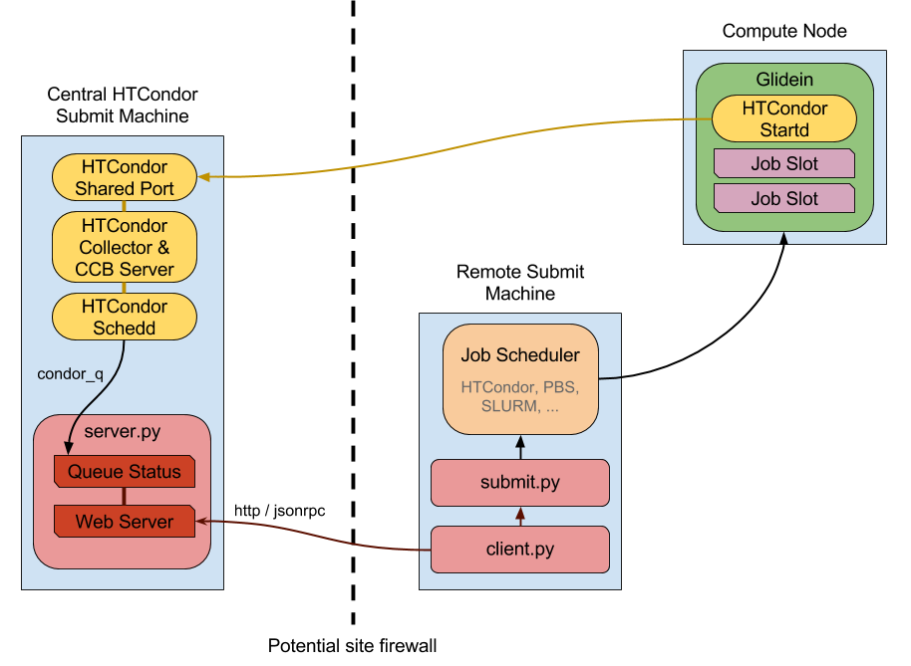
Northern Hemisphere Cyberinfrastructure – Pygl idein
  Pyglidein – In-house developed Python library that starts jobs on remote sites - Pull jobs to remote site
  Lightweight as possible – Knows how to query server and submit to local scheduler
  Server-side
    Server reads a HTCondor queue
    Determines job requirements
  Client-side
    Client periodically queries server for jobs
    If jobs match site-specific requirements, submit a job
    Job will execute a HTCondor startd and connect back to global pool
  No advanced logic
    No on limit number of a times a task is submitted – Will be used by other jobs or die quickly
    No job routing

Slide 13
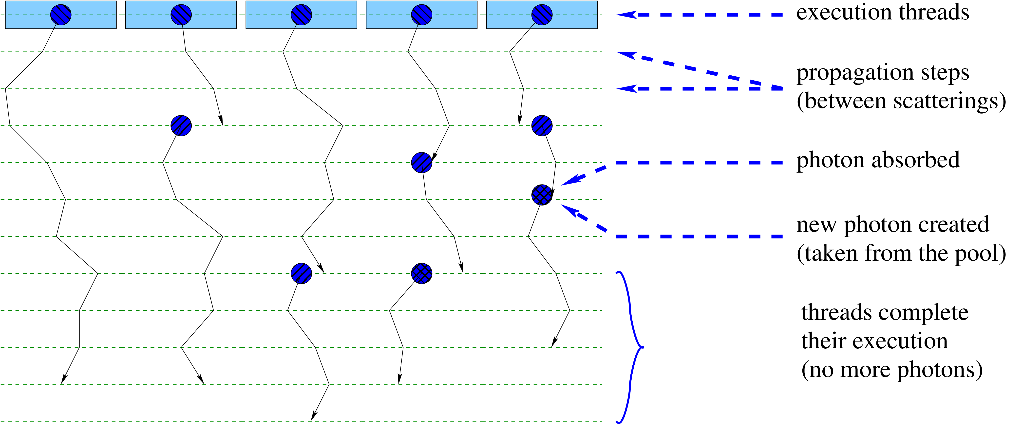
Northern Hemisphere Cyberinfrastructure – GPUs
  Why does IceCube need GPUs? – Propagating photons produced by neutrino interaction products in the ice
  Calibration has to be all done in-situ – Little information about optical properties are beforehand
  Previously statistically modelled
    Could not account for all optical properties of the ice
    Discovered new optical features in the ice
  GPUs provide 100-200x speed up compared to CPUs
  Still a scarce resources – Most GPUs are bought by member institutions
  Currently ~300 GPUs dedicated, another ~500 GPUs pledged
  Biggest bottleneck – Resource contention

Slide 14
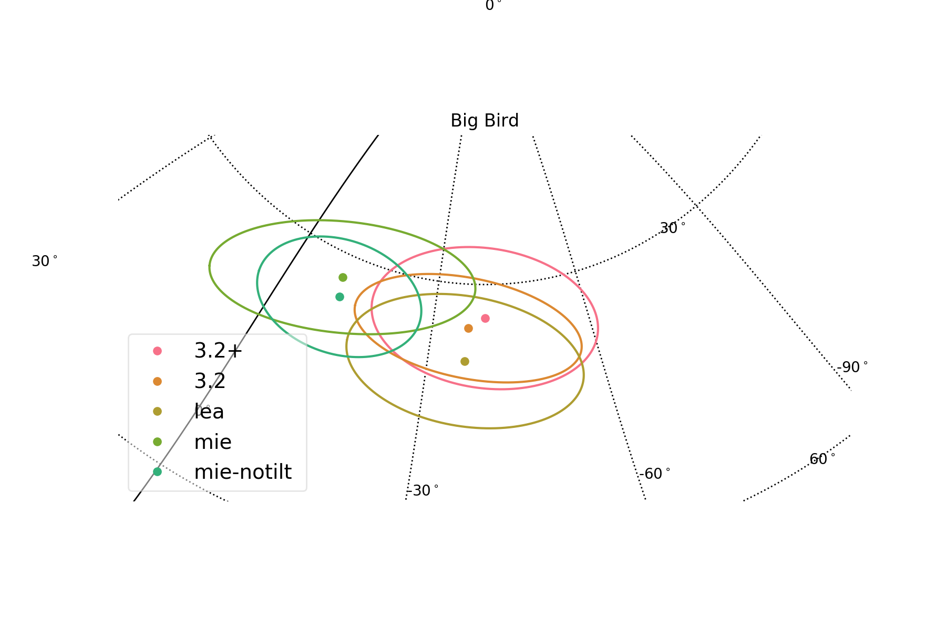
Northern Hemisphere Cyberinfrastructure – Ice Model
  Modelling the ice is very important – Esp. In era of Multimessenger Astrophysics
  Want to alert the community at large about interesting events
  Need to inform telescopes where to point
  Ice model can shift the location of event on sky significantly
  Optical telescopes have a minute area of the sky they cover
  Need to be as precise as possible, else wasting valuable telescope time or will miss source (transient sources)

Slide 15
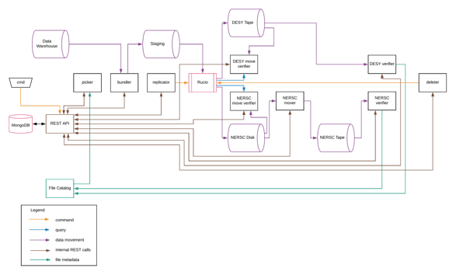
Northern Hemisphere Cyberinfrastructure – Current Projects
  Cloud Computing – E-CAS award from Internet2
  Machine Learning
    Machine learning becoming more popular
    Building first test infrastructure – Already have experience with running and using GPUs
    First results are promising – Needs more study before deployment in production
  Backups
    Refactoring code that modes data to tape backups at DESY and NERSC
    Part of CESER grant
  Expanding resources – More XSEDE resources and campus resources
  Automated and user CVMFS builds

Slide 16
Northern Hemisphere Cyberinfrastructure – Future Projects
  Re-thinking data organization, management, and access
    Xrootd-based solution?
    Spreading data across multiple locations?
    Ceph-based solution?
    www-based solution?
  Other resources
    Cloud
      Bursting into cloud for multimessenger studies?
      Using cloud GPUs?
      Cloud machine learning resources?
    Resource sharing in multimessenger astronomy
  Continuous integration/deployment
    Starting with production software
    Science software – How to test properly?

Slide 17
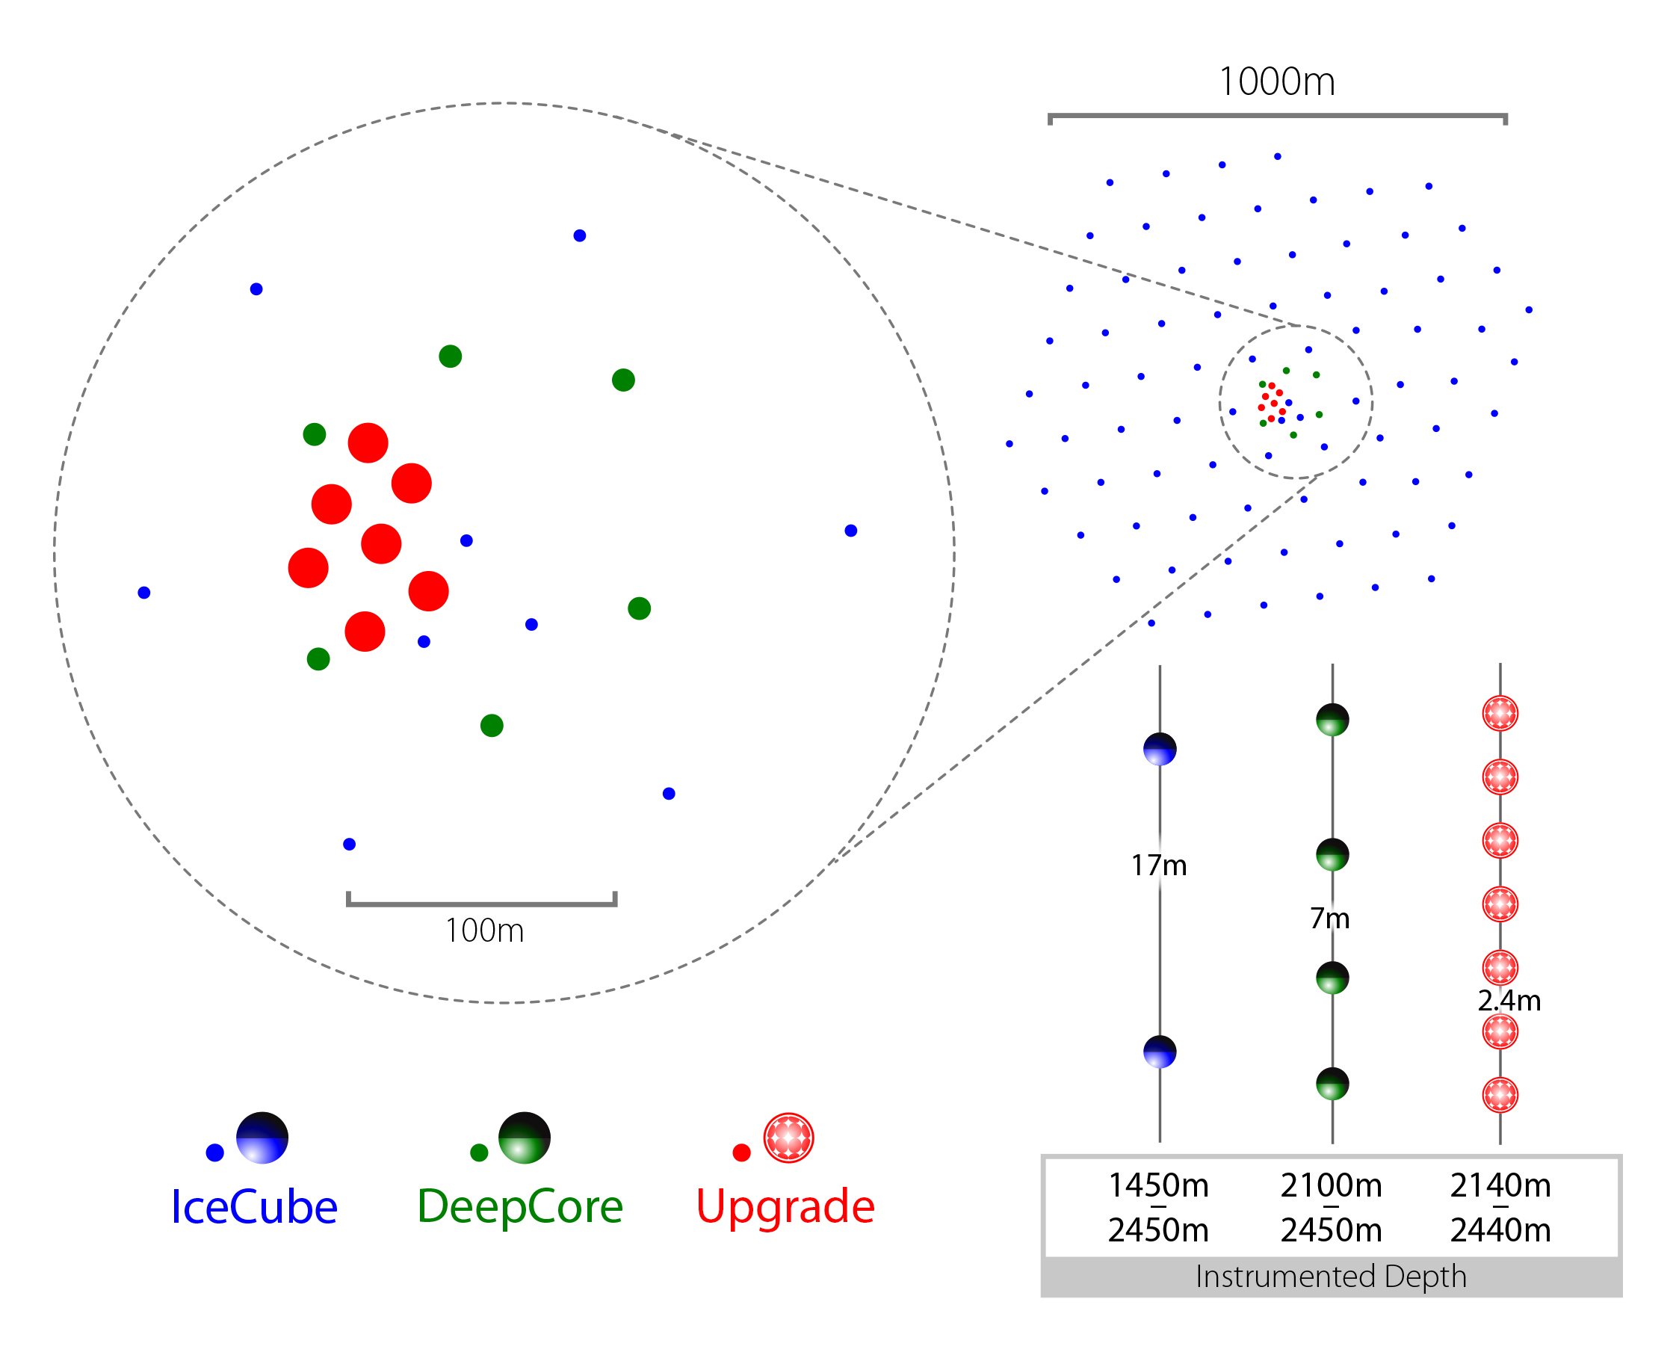
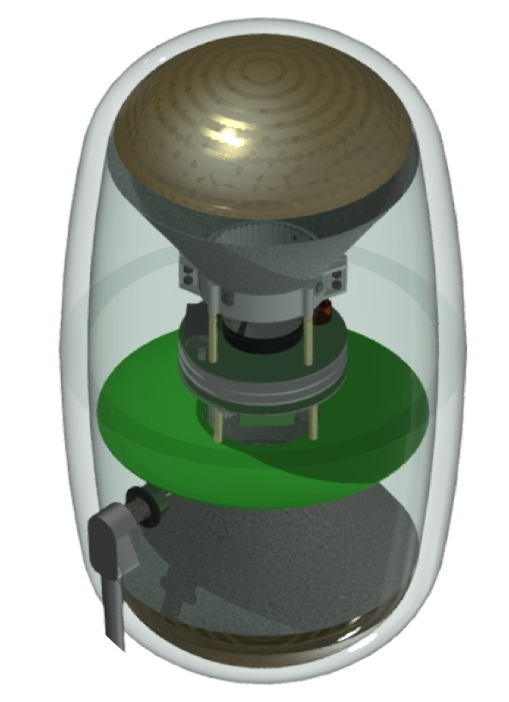
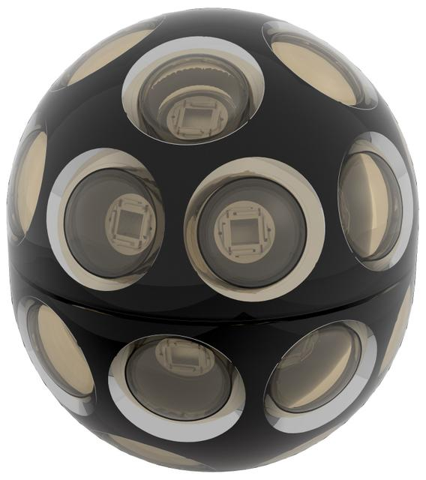
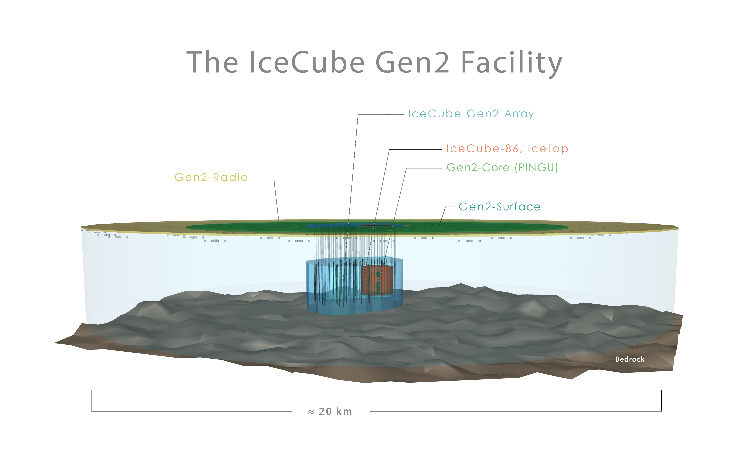
Future of IceCube
  IceCube Upgrade
    Deploying next generation detector modules in an in-fill
    Lower energy threshold
    Test new technology and designs for future expansions
  IceCube-Gen2
    Much larger detector focused on high energies
    Including several ways to do astroparticle physics at the South Pole – Radio detection of neutrinos, air Cherenkov detectors, etc.
  Will need to rethink computing

Slide 18
Summary
  Globally distributed, heterogenous resources pool
  Atypical usage model, resources requirements and software stack
    Mostly opportunistic and shared usage
    Accelerators (GPUs)
    Broad physics reach - Lots of physics to simulate
    Data flow includes leg across satellite
    “Analysis” software is produced in-house
      “Standard” packages, e.g. GEANT4, don’t support everything or don’t exist
      Niche dependencies, e.g. CORSIKA (air showers)
  Detector up time at 99+% level
  Significant changes of requirements over the course of experiment - Accelerators, Multimessenger Astrophysics, alerting, etc.

Slide 19
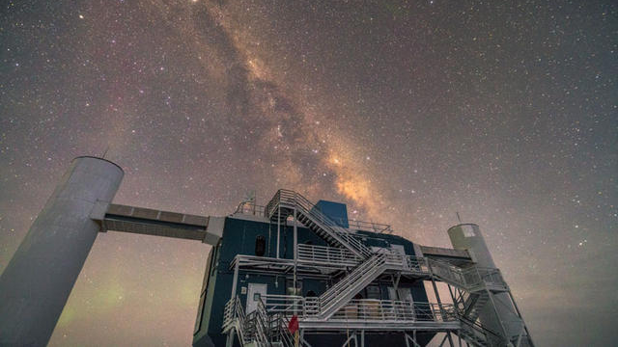
Thank you!
Questions?

