Slide 1
From neutrino DIS to the Higgs DIScovery:
An Overview of Wesley’s HEP Career
Sabine Lammers*
Indiana University
WesleyFest: August 30-31, 2019
*Special thanks to Michael Schaevitz who provided most of the material for the CCFR program
Thanks to Tulika Bose, Isobel Ojalvo and Wesley Smith for their input. All errors are my own.

Slide 2
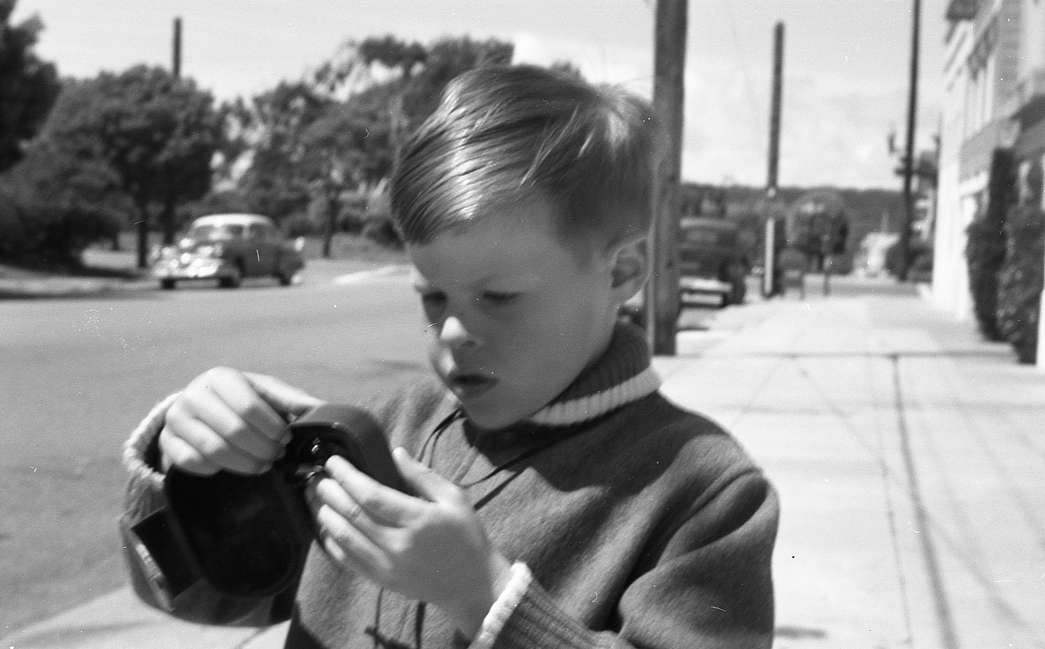
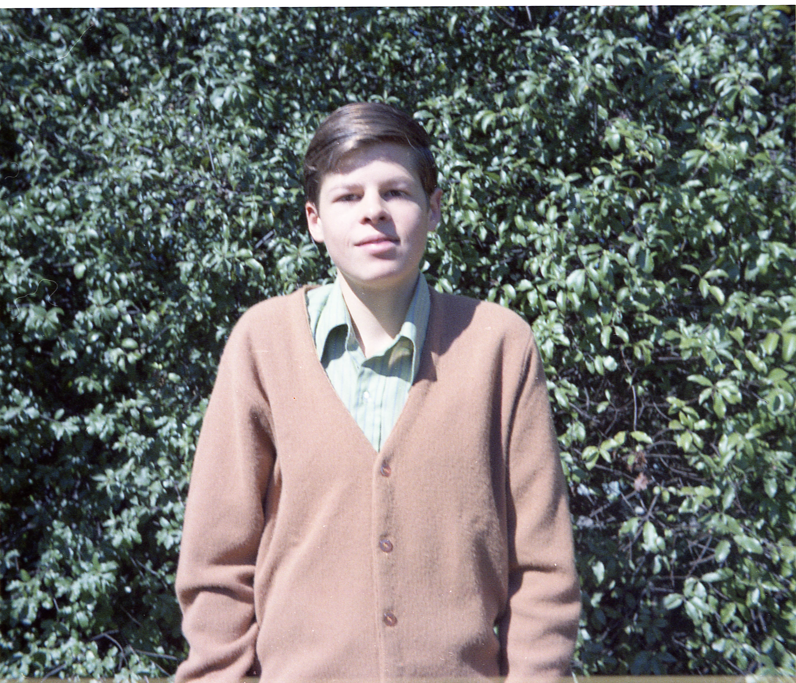
Biographical Overview
A.B/A.M. from Harvard 1976
PhD from Berkeley 1981
  Advisors: Leroy Kerth and Mark Strovink
Postdoc at Columbia 1981/82
  Joins CCFR Neutrino Experiment at Fermilab
Asst. Prof. at Columbia 1982
  Spokesman, Fermilab E770: CCFR Neutrino Experiment
  NSF Presidential Career Award and DOE OJI Award
Assoc/Full Prof. at UW 1988/92
  Builds ZEUS Calorimeter First Level Trigger (CFLT)
  ZEUS Trigger Technical Coordinator
  Election to APS Fellowship
  DOE High Energy Physics Advisory Panel
  Builds CMS Regional Calorimeter Trigger
Bjorn Wiik named professorship 2006
  CMS Trigger Coordinator
  CMS Trigger Upgrade Project Manager
39 PhDs, 16 postdocs, >1000 refereed publications,

Slide 3
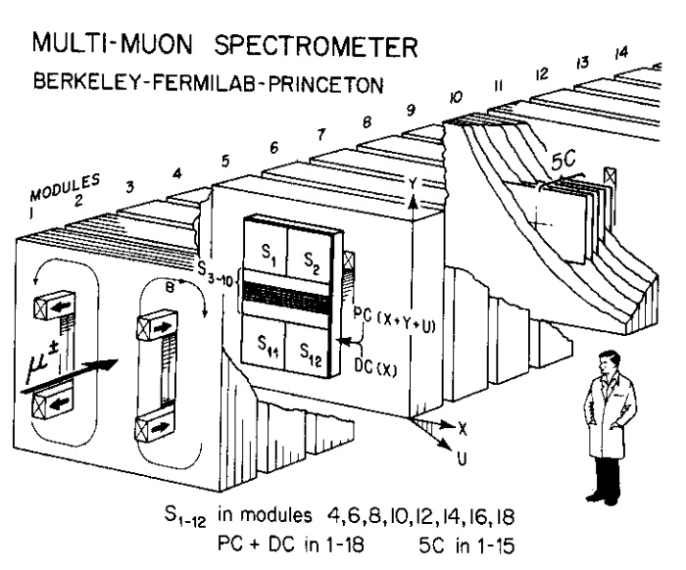
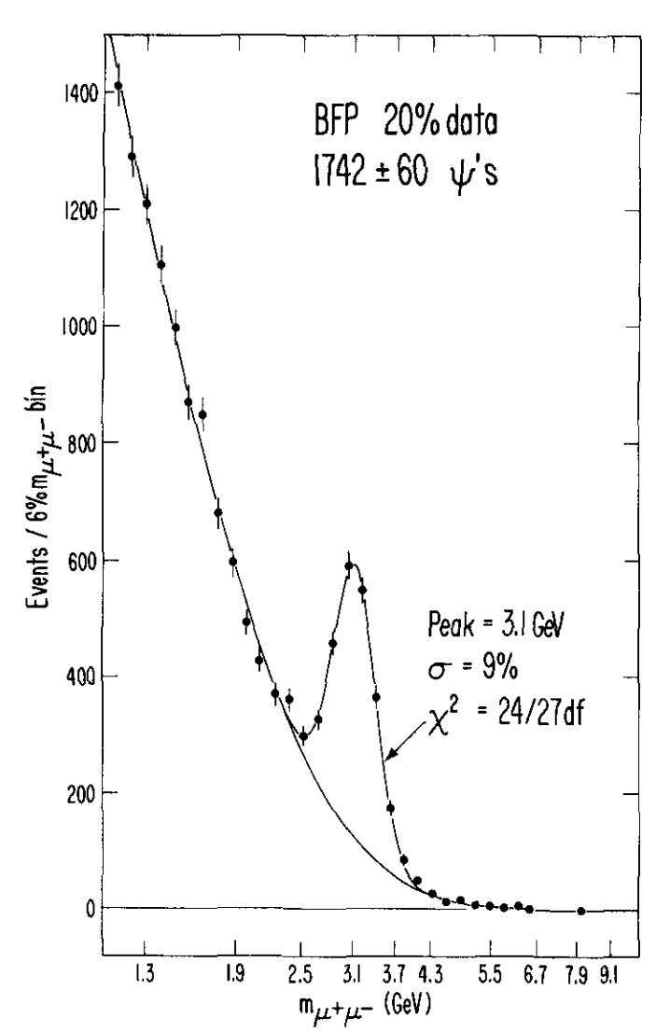
Wesley’s First HEP Experiment
Situated in the Fermilab muon beam
Muon scattering off steel (hadron absorber)
Scintillator counters sandwiched inside
- for triggering, hadron calorimetry,
Proportional and drift chambers
J/Psi mass peak

Slide 4
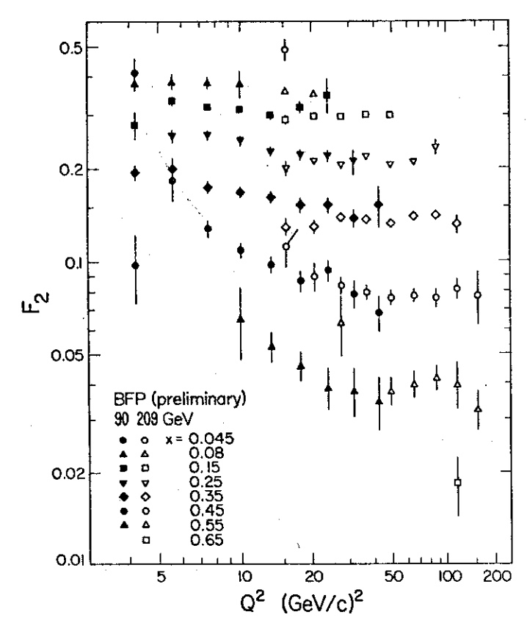
Wesley’s First HEP Experiment
Situated in the Fermilab muon beam
Muon scattering off steel (hadron absorber)
Scintillator counters sandwiched inside
- for triggering, hadron calorimetry,
Proportional and drift chambers
Early nucleon structure
function measurement

Slide 5
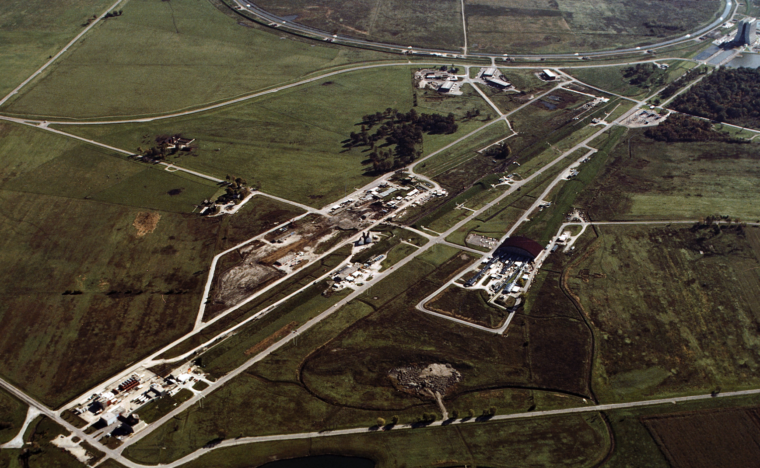
Fermilab in 1977
Decay Pipe
Wonder
Bldg
Lab E

Slide 6
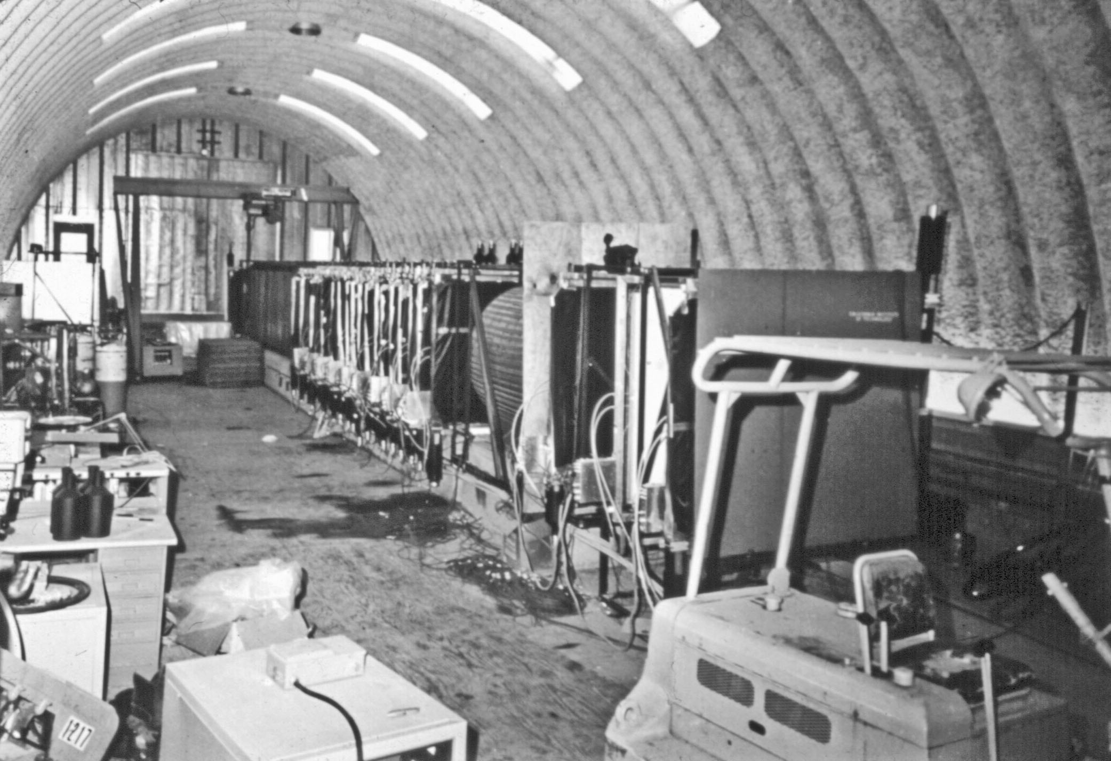
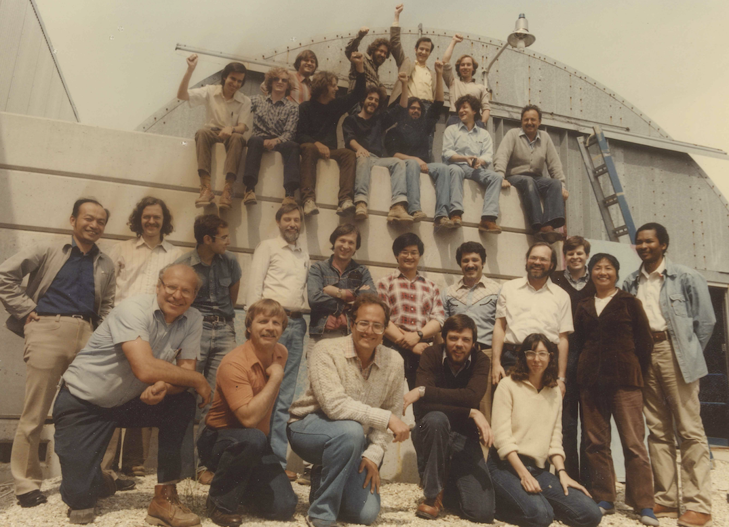
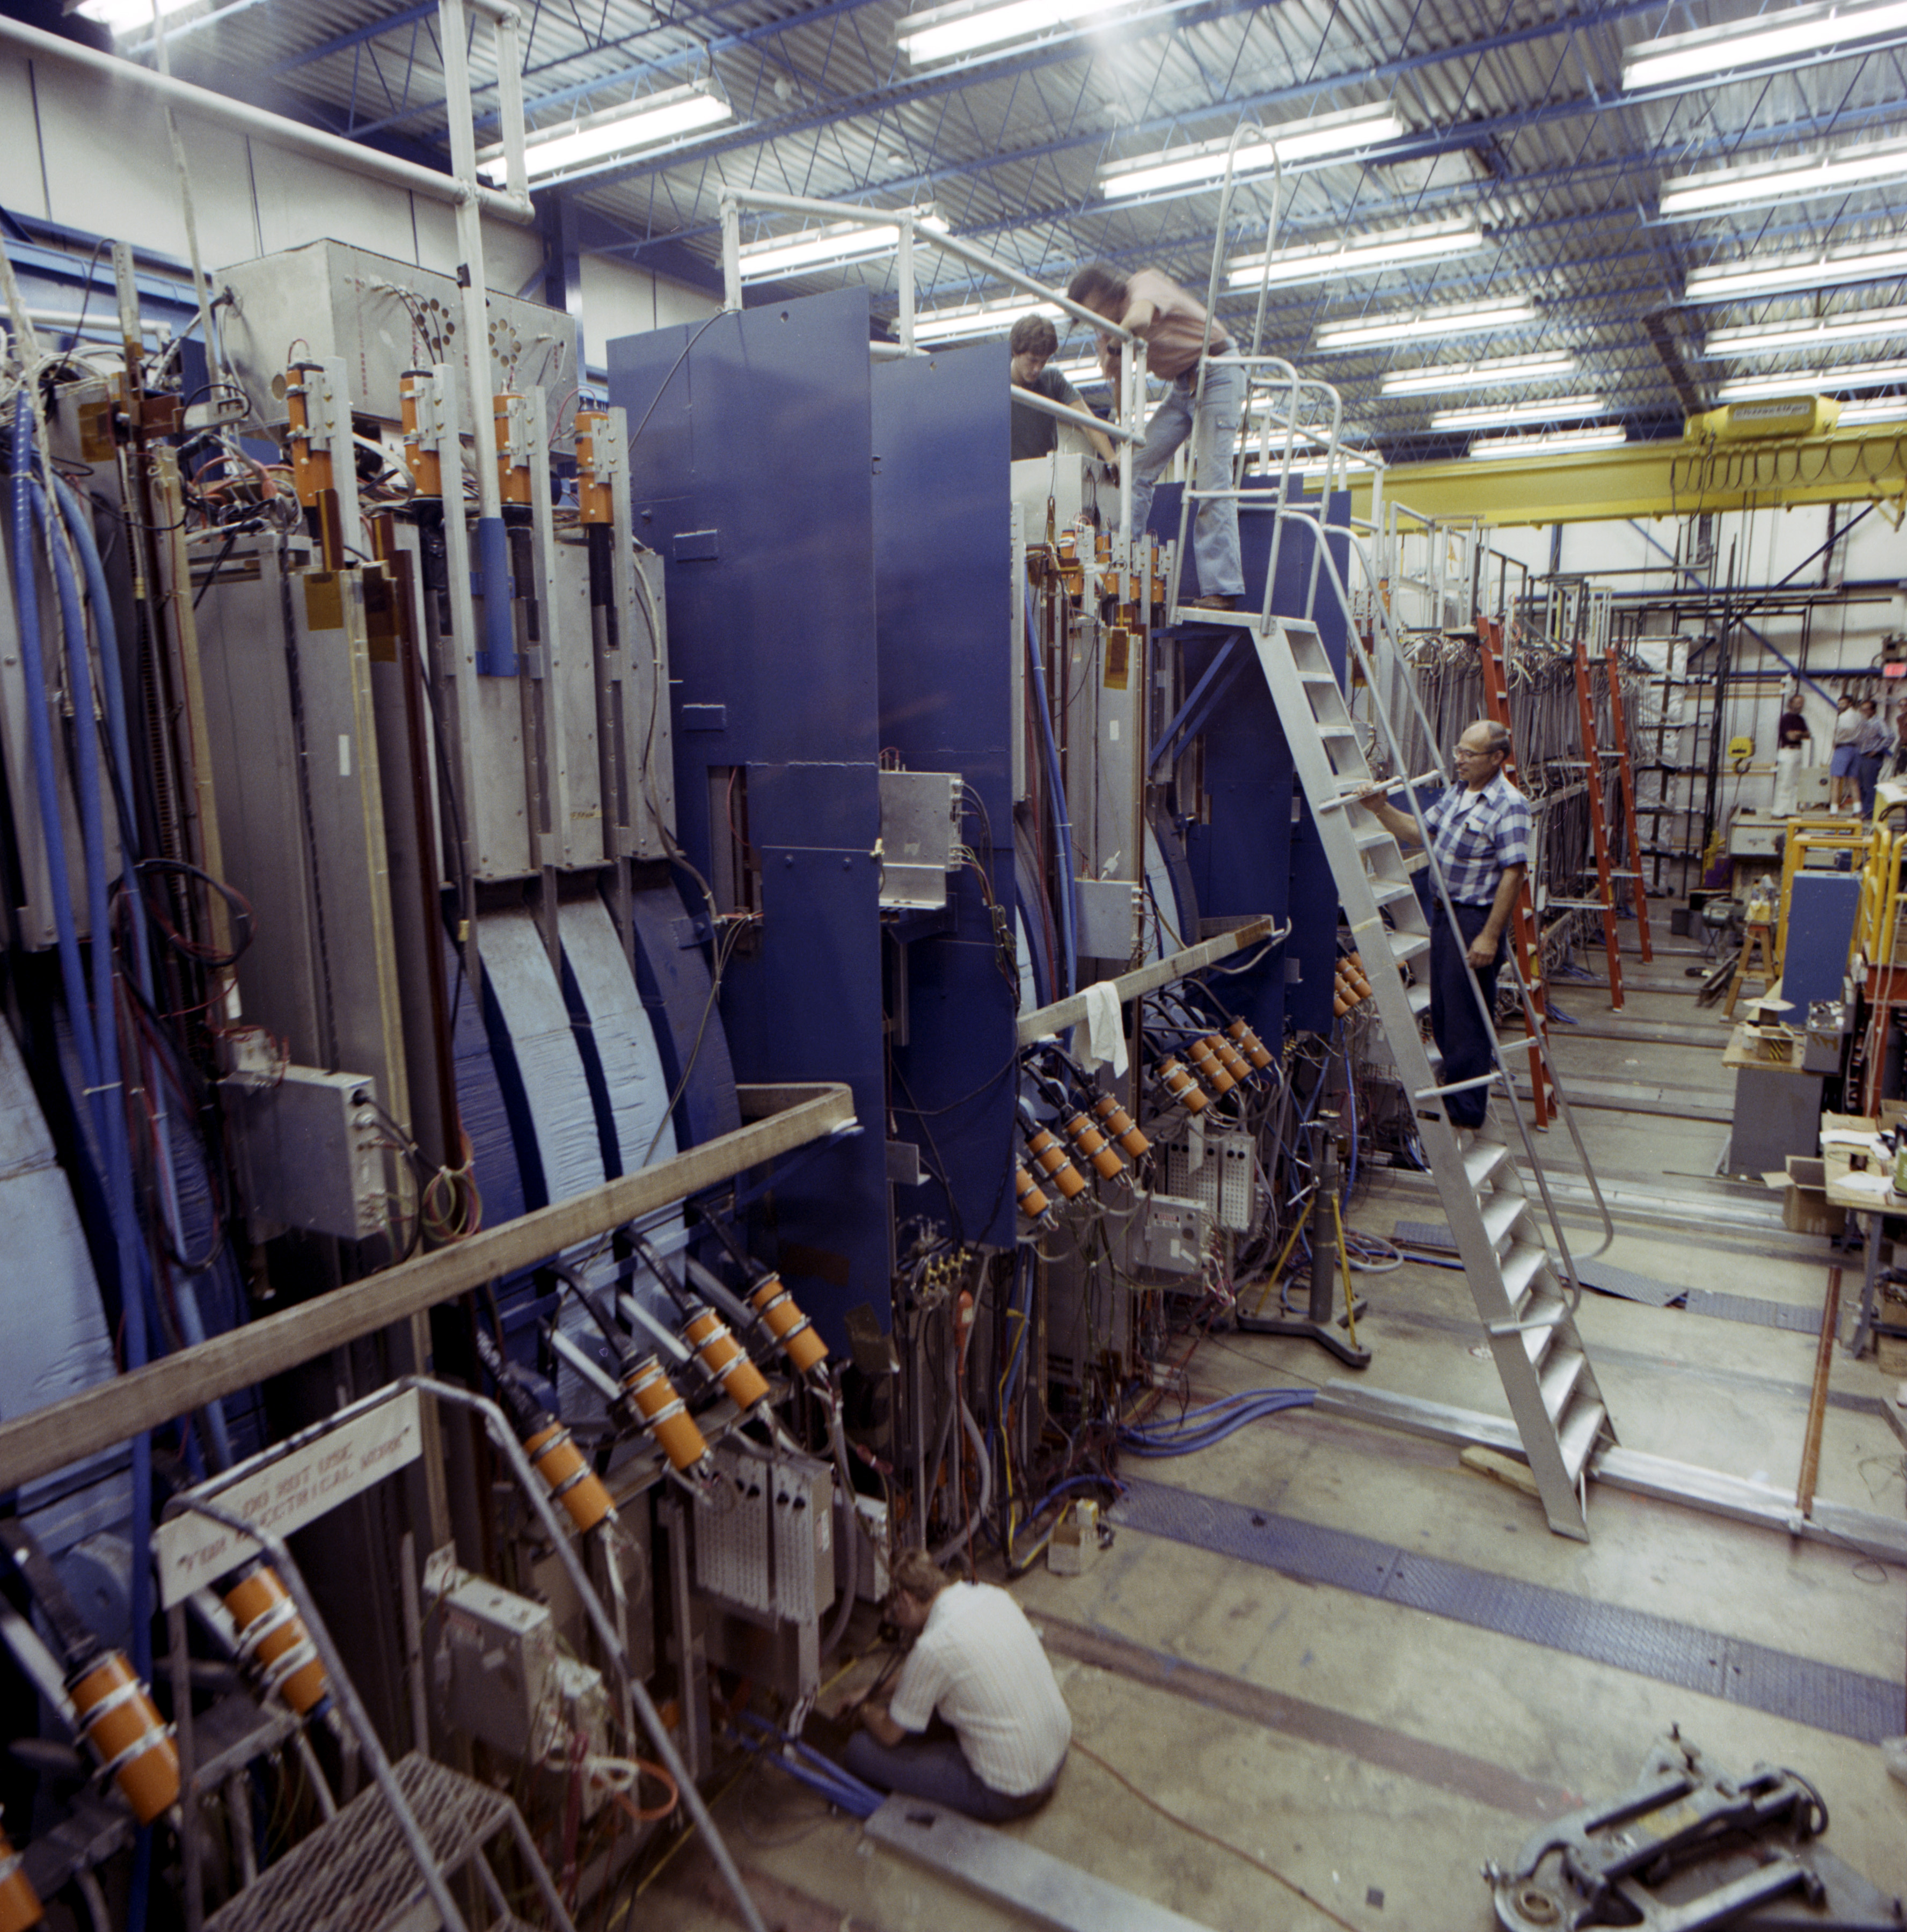
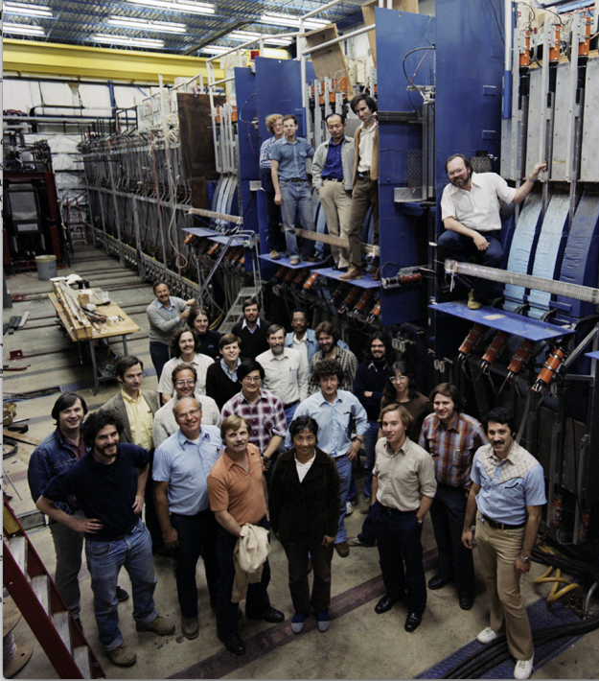
Timeline of CCFR Fermilab Neutrino Experiments during the 70’s and 80’s
E-21 𝜈 Exp
(Wonder Bldg)
E701-Osc. Exp.
(Lab E +
Wonder Bldg)
1970
1972
1974
1977
1980
1985
1990
CCFR
(New Lab E)
E616
CCFR
Tevatron
E744 / E770

Slide 7
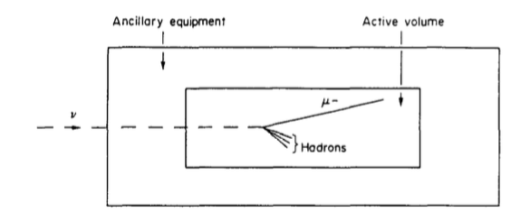
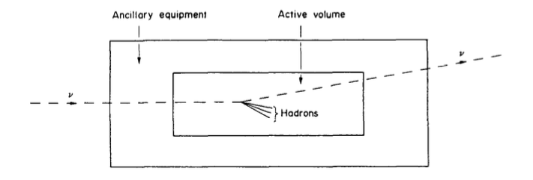
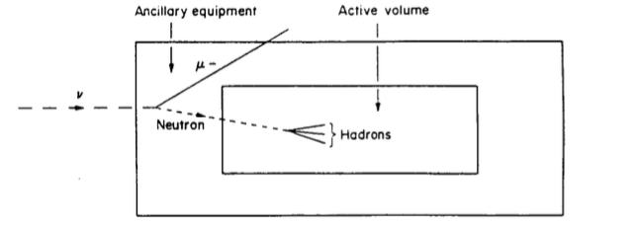
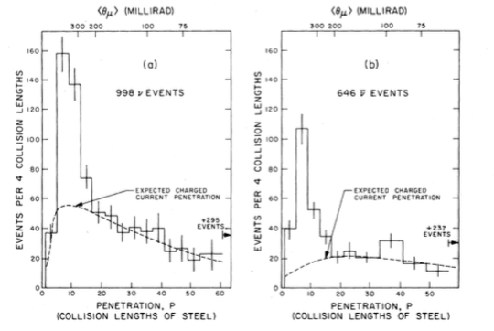
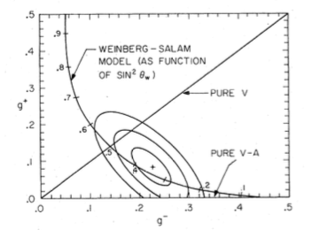
Neutral Currents
In 1972, Glashow, Salam and Weinberg propose neutral currents as a crucial ingredient of weak interactions.
  They challenged experimental groups to prove or disprove whether neutral currents exist ?
Neutral current events hard to isolate
  They had no penetrating muon
  Looked like background - for example, neutron interactions
1975 PRL
1978 PRD

Slide 8
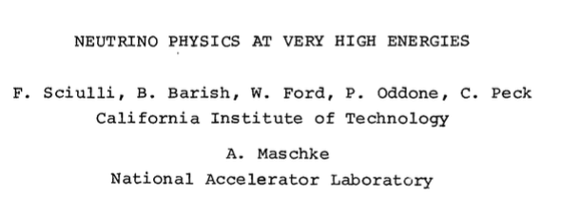

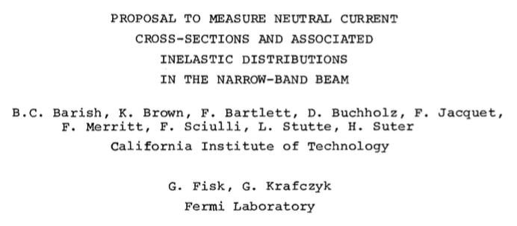

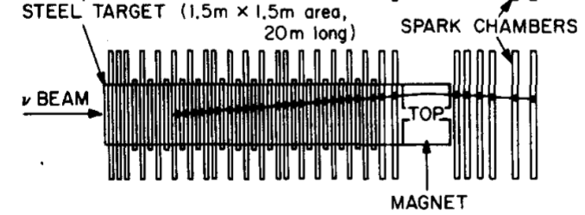
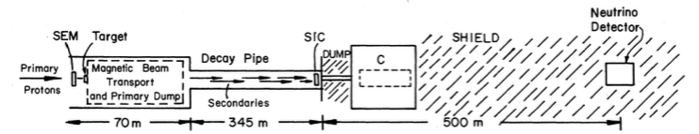
E-21 Caltech-Fermilab: The Start of the CCFR Program
High energy, sign-selected (dichromatic) beam
  𝜈 flux and energy known
  Separate 𝜈 vs‾ν runs
Physics measurements:
  𝜈 total xsec vs energy
  𝜈 quark distributions in the nucleon
  Isolate neutral current events and measure coupling
  Observation of 2𝜇 events
E-21 showed definitively that Neutral Currents exist with couplings as expected

Slide 9
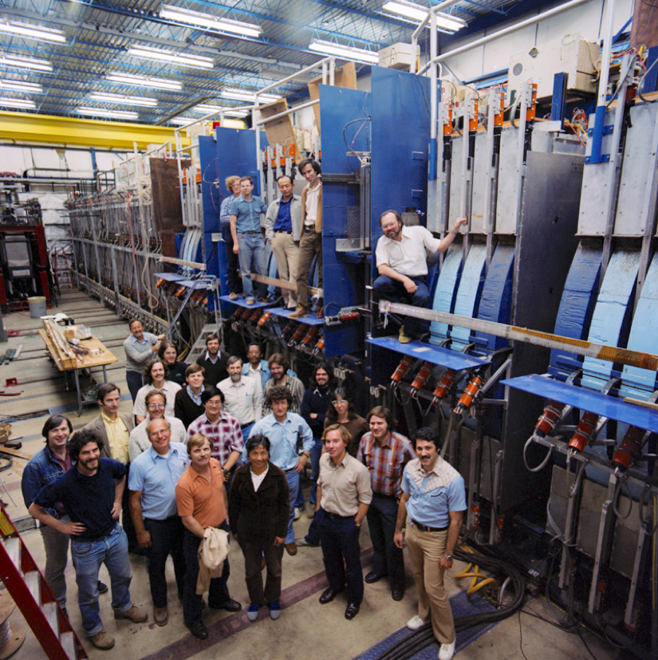
Next Step: Upgrade Detector and Beam
⇒ Lab E Detector for E616
To exploit the neutrino opportunities at Fermilab
  Need to build larger, improved detector in a new lab building (Lab E)
    New 3m x 3m spark chambers and scintillation counters constructed
    Better containment of outgoing particles
    Better energy and angle resolution
  Need improved beam
    Better flux calibration and normalization.
Physics emphasis:
  𝜈 /‾ν total cross section vs E_{𝜈}
  Diff. xsec’s and quark structure functions
  Better neutral current measurements
  Higher statistics dimuon studies
Collaboration grew to include:
Columbia, Chicago, Rockefeller and Rochester along with Caltech and Fermilab
Wesley joined Columbia in 1981 and began to work on E616.
⇒ CCFR (Besides Fermilab it appeared that only institutions starting with C’s or R’s were allowed)

Slide 10
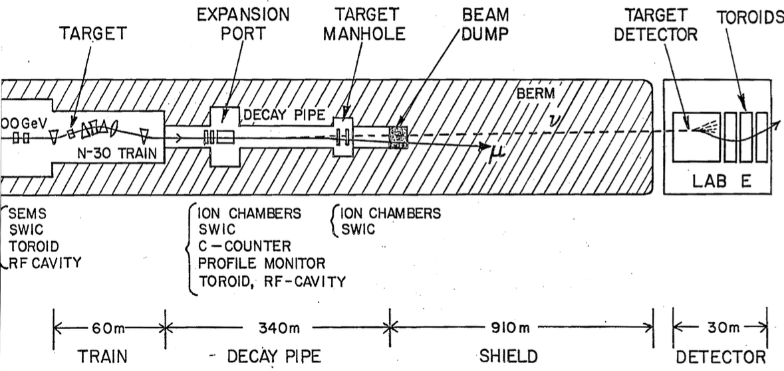
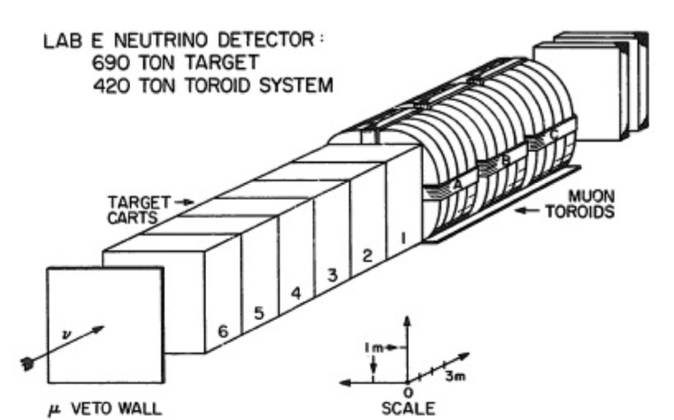
E616 Beam and Detector Layout
Target: 3m x 3m x 19m
Toroid: 3.4m diameter x 12m

Slide 11
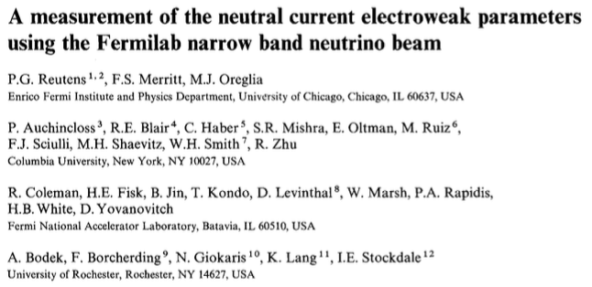
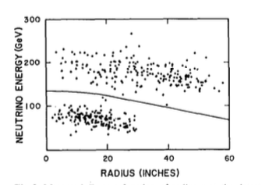
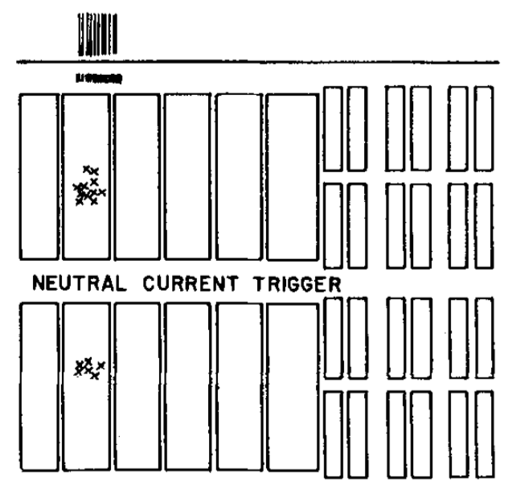
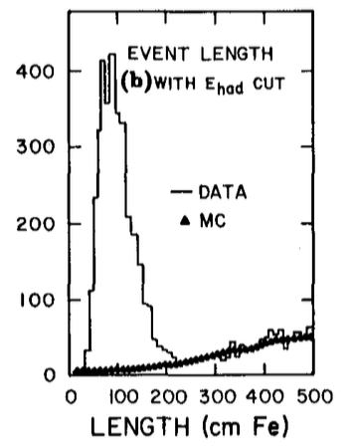
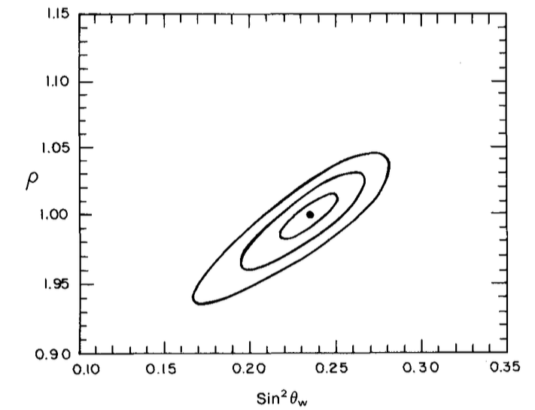
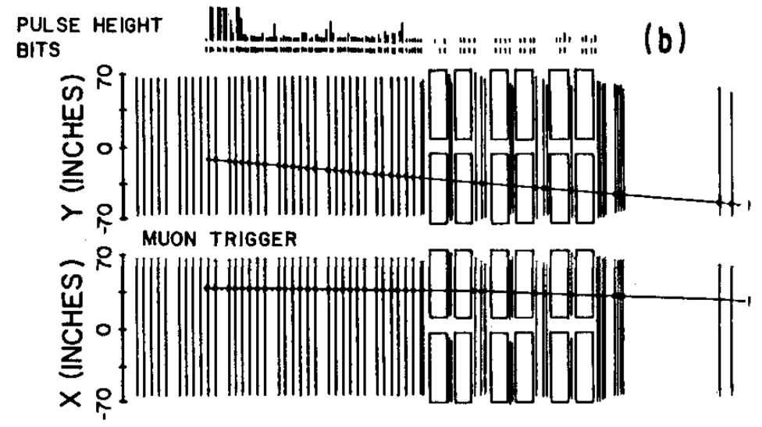
E616 Neutral Current Measurement
Z.Phys. C45 (1990) 539
(Also Phys.Lett. 152B (1985) 404)
Dichromatic Beam: E_{𝜈} vs Radius
E616 + E701: sin²𝜃_{W} = 0.238 ± 0.006

Slide 12
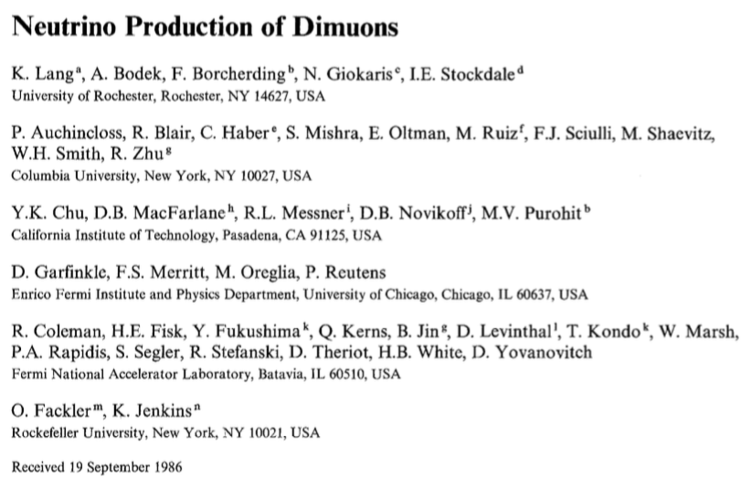

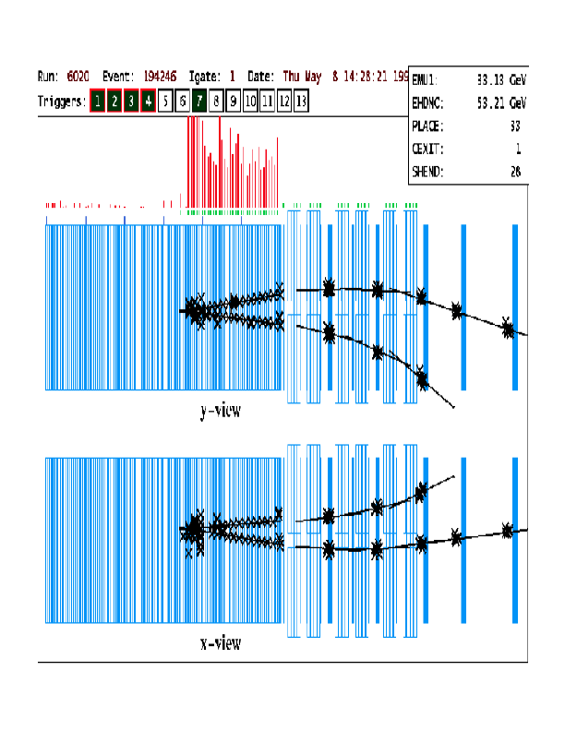
E616 Dimuon Results
Neutrinos scattering can pick out strange quarks through the charm production process:
ν +s ➝ μ⁻ + c with c decaying to μ⁺
⇒ Two final state muons
Need high intensity and dense detector to reduce 𝜋-decay bkgnd
Dimuons measure:
Strange content s(x)
⇒ We are all about 5% strange!
Z.Phys.C33:483,1987

Slide 13
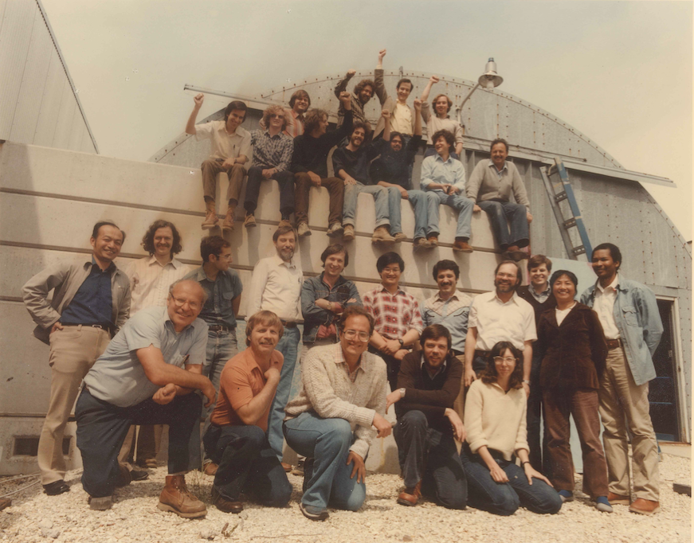
E701 at the Wonder Building

Slide 14
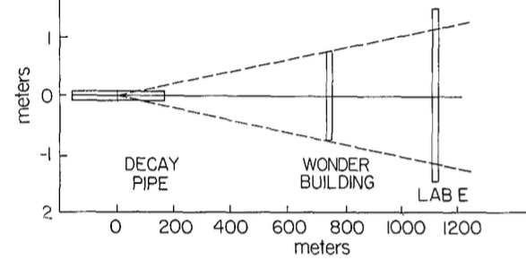
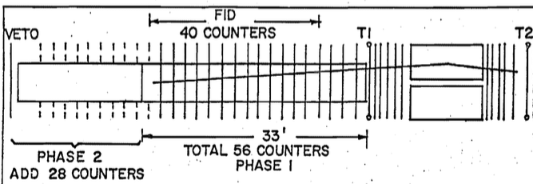
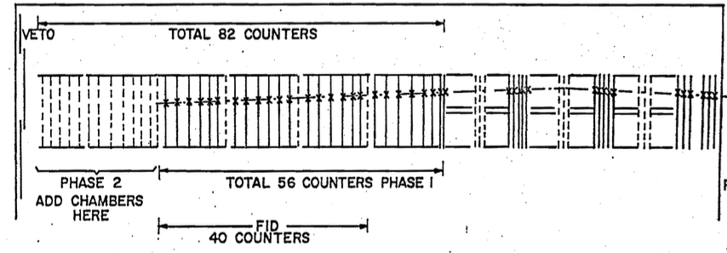
E701 Experiment on a Fast Track
Experiment idea was to record 𝜈_{𝜇} events in two detectors
  Any difference in rate could indicate disappearance of 𝜈_{𝜇} due to oscillations
Re-use as much detector equipment as possible
  Lab-E far detector already completed (56 of 82 counters)
  Resurrect old E-21 detector in Wonder Bldg
    Build 40 new 1.5m x 1.5m acrylic
    scintillation counters
    Transfer E-21 3m x 1.5m spark
    chambers from Lab-E toroid system
Use existing dichromatic neutrino beam
Wonder Bldg.
𝜈-Detector Setup
Lab E
𝜈-Detector Setup

Slide 15
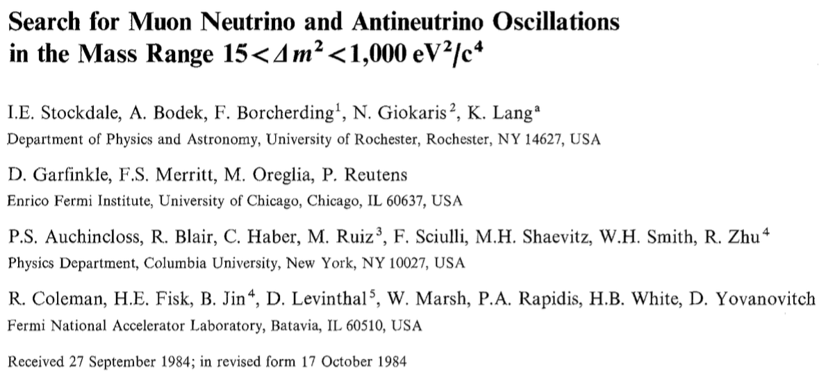
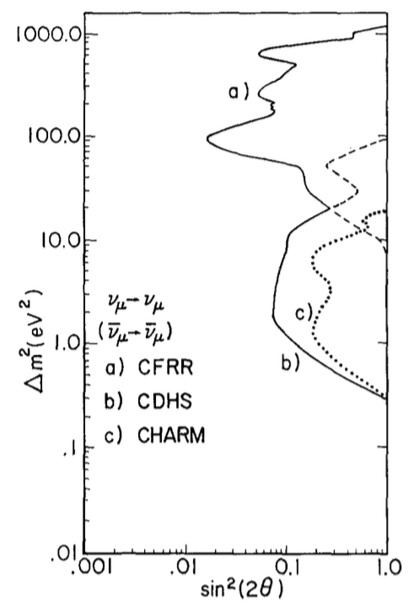
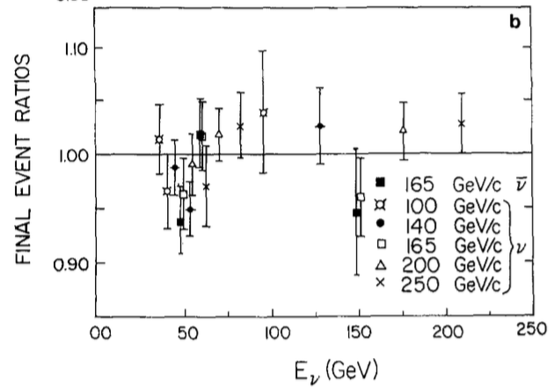

E701 Oscillation Results
Z.Phys. C27 (1985) 53
Unfortunately the event ratios showed no
difference between Lab E and Wonder Bldg
⇒ No indications of oscillations ⇒ E701 sets limits

Slide 16
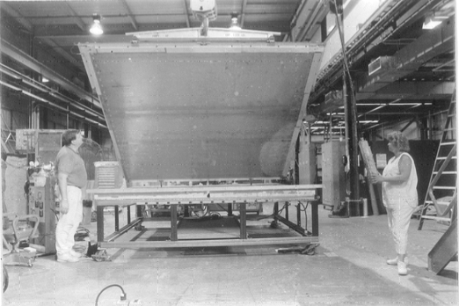
Moving into the Tevatron Era – E744 / E770
Collaboration grew much larger
  Cinicinnati , Chicago
  Columbia , Fermilab
  Kansas State , Northwestern
  Rochester , Wisconsin
~ 40 collaborators
  Postdocs ⇒ Faculty
  Institutions without C or R join collab.
E744 Data Run 1984–85
(Spokesman Frank Merritt)
E770 Data Run 1987-1988
(Wesley Spokesperson 1986 - 1998)
Fermilab upgraded the proton accelerator by adding a new superconducting Tevatron Ring
  Completed in 1983 with an energy of 800 GeV (compared to old 400 GeV)
  This had a big impact on neutrino physics since neutrino energy and interaction rate x2 higher.
Neutrino beam changed to a quadrupole-triplet wide-band beam
  Gave a significant increase in neutrino flux hitting the detector.
  But no flux normalization and 𝜈 and‾ν collected unseparated ⇒ Use E616 xsec
The higher interaction rate in the the Lab E detector meant that the spark chambers with long dead-time needed to be replaced.
  Needed to build new 3m x 3m drift chambers for this new run.
  Wesley added flash ADC readout
  (Nucl.Instrum.Meth. A340 (1994) 474)

Slide 17
E770 Proposal Letter

Slide 18
E744 / E770 Physics Program

Slide 19
Many E744 / E770 Physics Publications
Wesley Spokesperson 1986 - 1998
~35 Articles Published
Structure Function and QCD Measurements
  950,000 𝜈_{𝜇} and 170,000 𝜈 _{𝜇} events (E616: 150,000 𝜈_{𝜇} and 23,000‾ν_{𝜇} )
  Measurements of F₂, xF₃ ⇒ 𝛼_{S} , Λ_{QCD} , GLS sum rule
  Measurement of R=𝜎_{L}/𝜎_{T}
  (Un-Ki Yang et al Phys.Rev.Lett. 87 (2001) 251802)
Dimuon Measurements
  6,100 dimuon events (E616: 500 events)
  (A.O. Bazarko et al. Z.Phys. C65 (1995) 189)
  Measurements of the size of the strange sea and |V_{cd}| coupling
Resolution of the same-sign dimuon anomaly
(P. Sandler et al. Z. Phys. C 57 (1993) 1)
Precision Electroweak Measurements
  sin²𝜃_{W} = 0.2236 ± 0.0041 ⇒ Equivalent of M_{W} = 80.35 ± 0.21
  (K.S. MacFarland et al. Eur.Phys.J. C1 (1998) 509)
Limits on 𝜈_{𝜇} ➝ 𝜈_{e} oscillations in the Δm² > 10 eV² region
  Novel technique to identify 𝜈_{e} events using shower profile.
  (A. Romosan et al. Phys.Rev.Lett. 78 (1997) 2912
  D. Naples et al. Phys.Rev. D59 (1999) 031101)

Slide 20
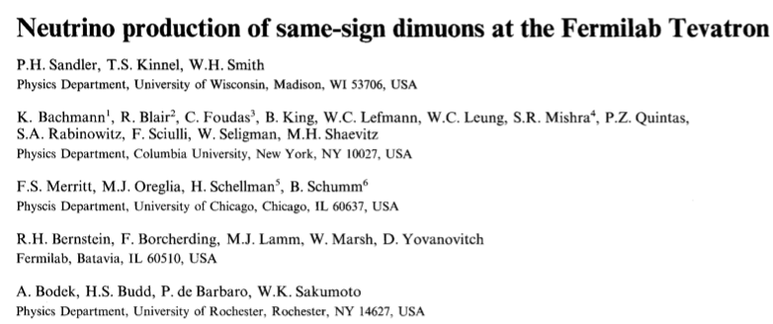
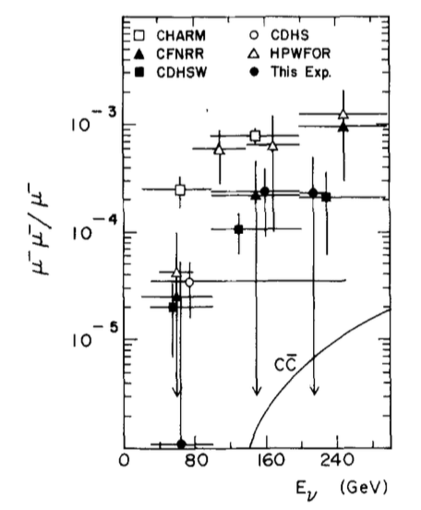
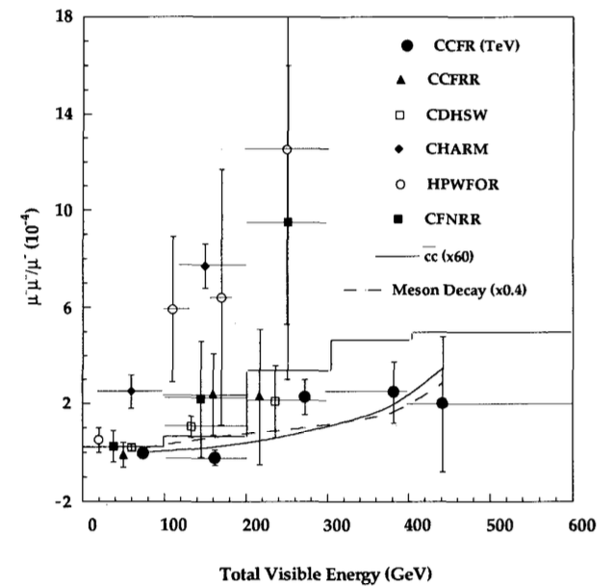
Like-Sign Dimuon Puzzle
Neutrino production of the like-sign dimuons (𝜇⁻ 𝜇⁻) showed an unexpectedly high rate
  ⇒ Led to many new physics models to explain
Needed many more events and needed to go to higher energy to see if anomaly remained.
⇒ E744/770: high statistics, high energy data showed there was no anomaly.
After
E770
Before
E770
E744/770 (CCFR) Pamela Sandler et al.
Z. Phys. C 57 (1993) 1
(Pam was Wesley‘s grad student)
E616 (CCFR) K. Lang et al.
Z.Phys. C33 (1987) 483

Slide 21
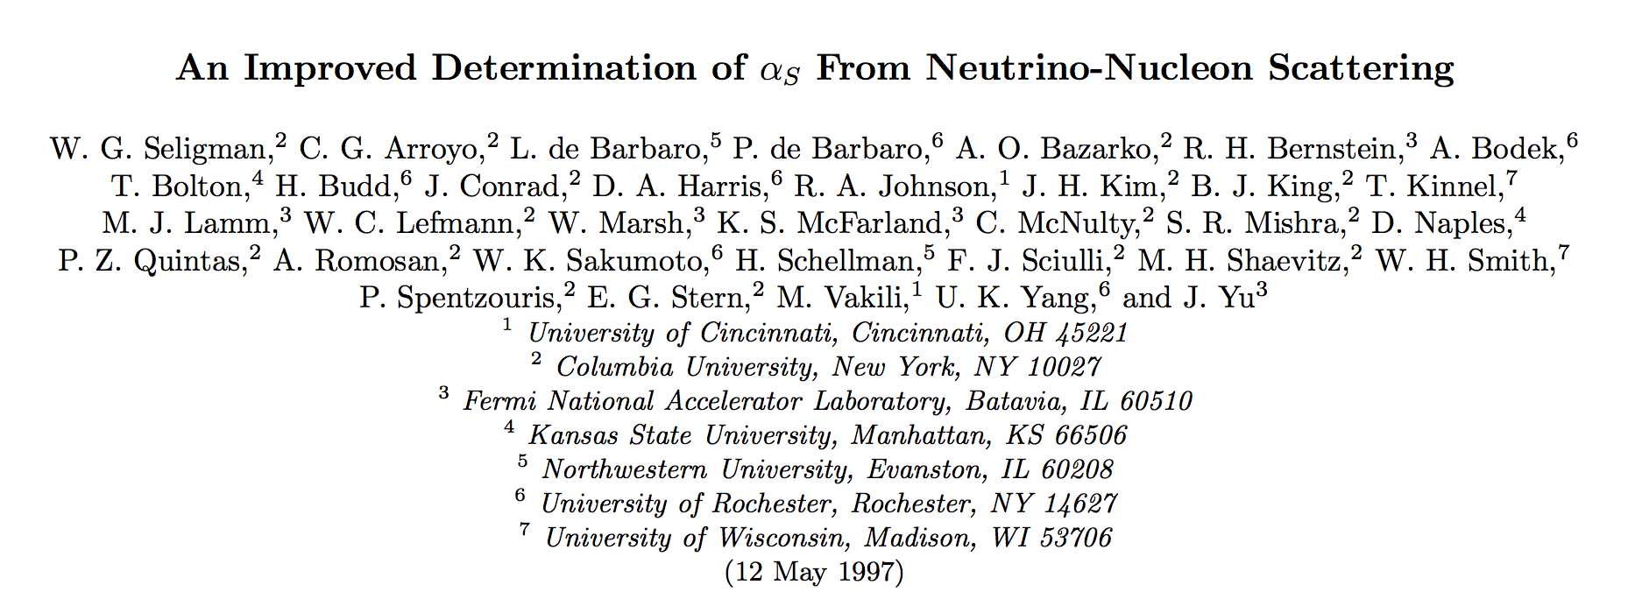
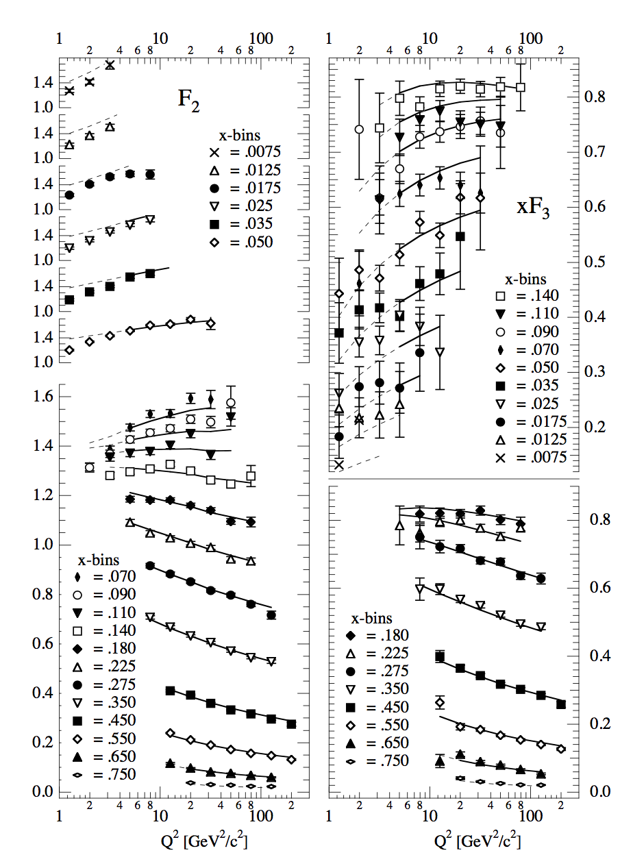
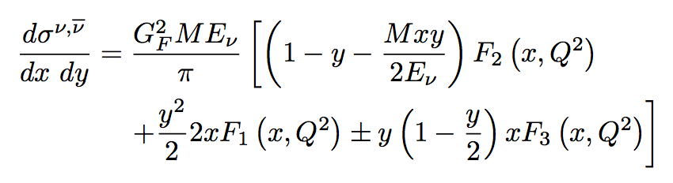
𝛂_s and Structure Functions with CCFR
10x events collected in E744/E770 than E616/701
This data has become the premier
neutrino DIS data set in the world.

Slide 22
Final Thoughts from Mike
The CCFR era at Fermilab was a Golden Time
  An extremely productive period for doing neutrino physics
  Many opportunities because of the unique high energy, high intensity neutrino beams.
Wesley was a main leader for the CCFR neutrino program.
  He was always looking to get the most out of the data and broadening the program.
For me, he was a great colleague and a good friend
⇒ We had lots of fun while doing lots of physics.

Slide 23
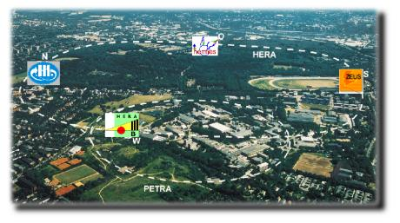
The HERA Era
Othmarschen, Hamburg, Germany

Slide 24
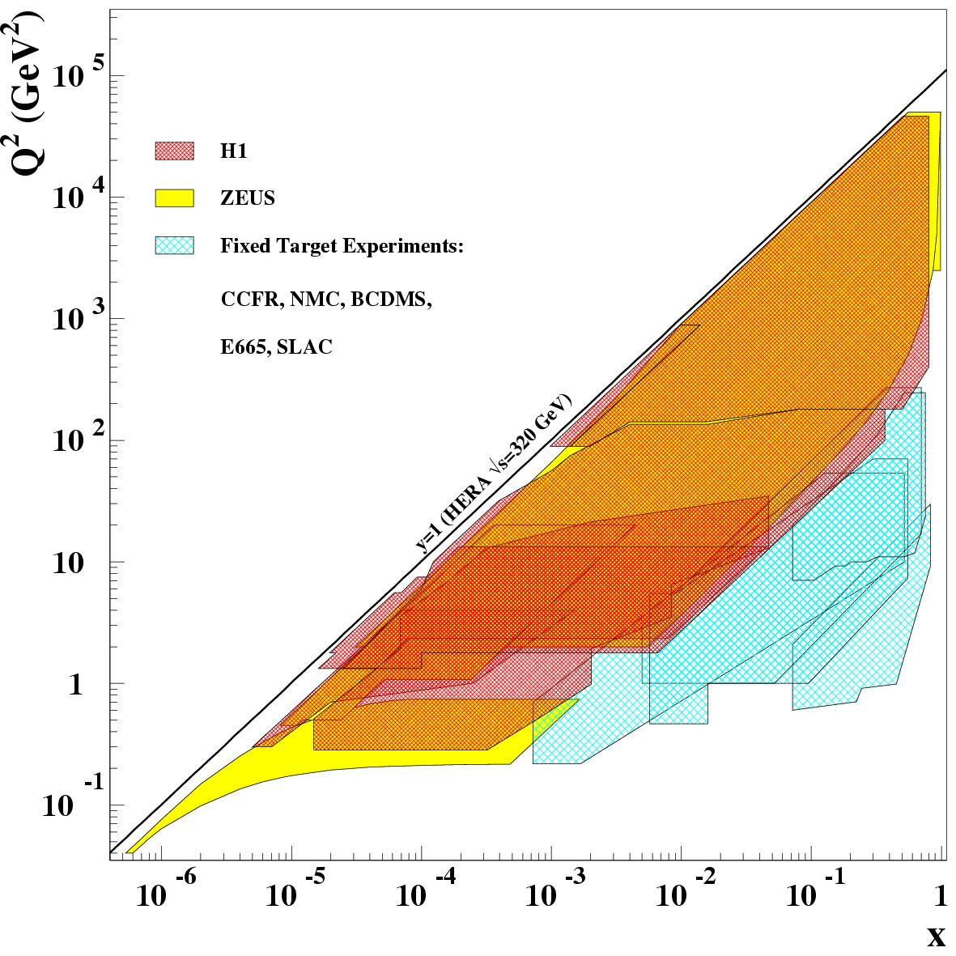
HERA Accelerator
HERA: an electron-proton collider at DESY in Hamburg, Germany
HERA: 1992-2007
HERA dramatically extended kinematic reach beyond fixed target experiments
820/920 GeV protons
27.5 GeV e±
300/318 GeV c.o.m. energy
220 bunches, 96ns. crossing time
Built to discover leptoquarks

Slide 25
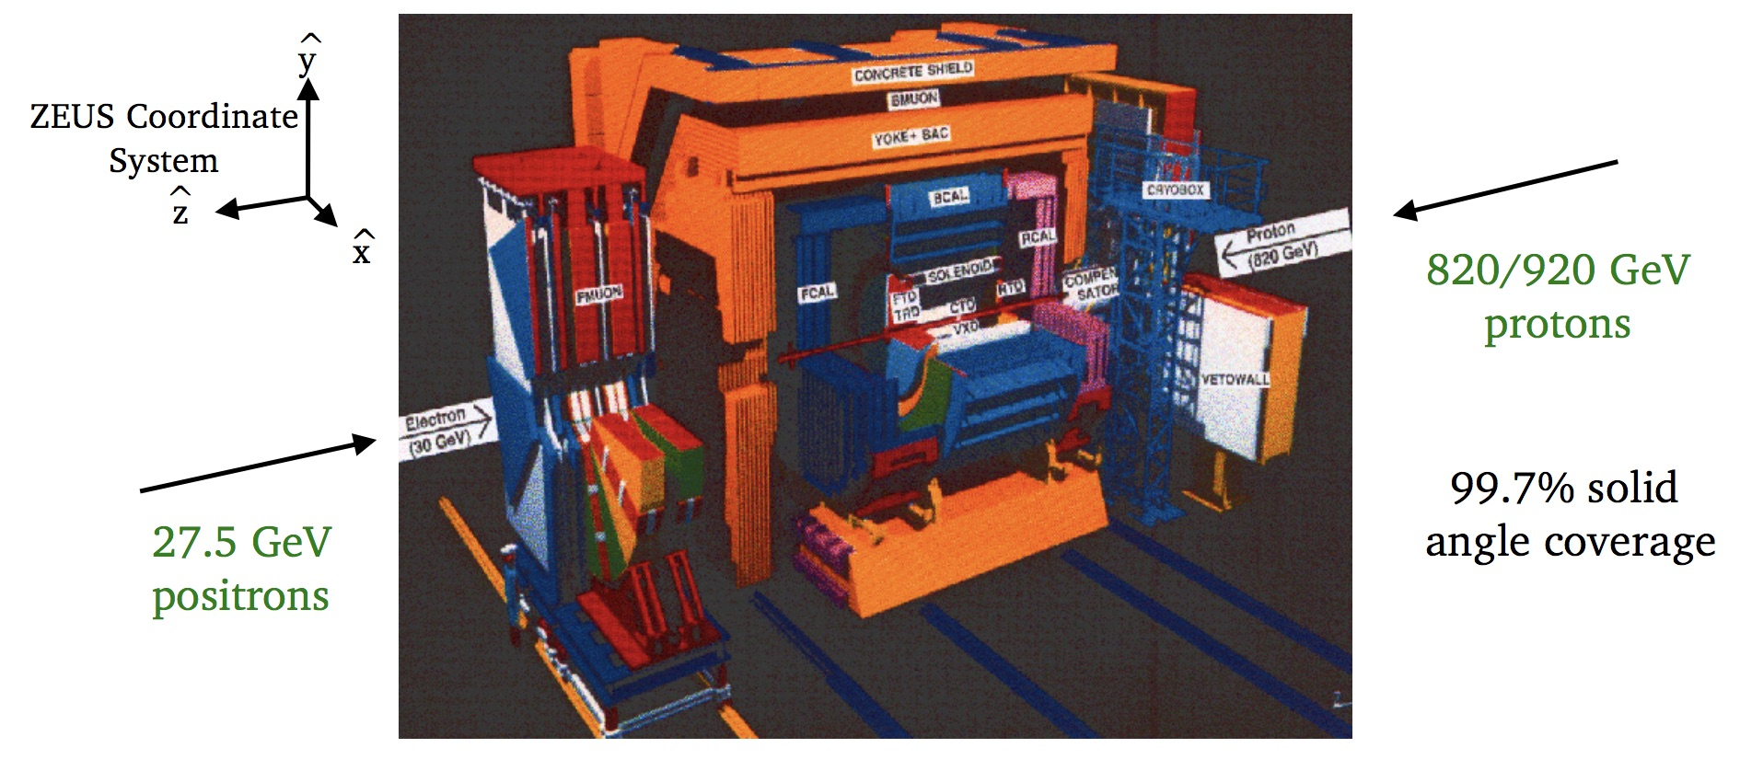
ZEUS
Wesley joins ZEUS Experiment in ~1990
Continues study of DIS in electron-proton scattering
Builds the ZEUS Calorimeter First Level Trigger!

Slide 27
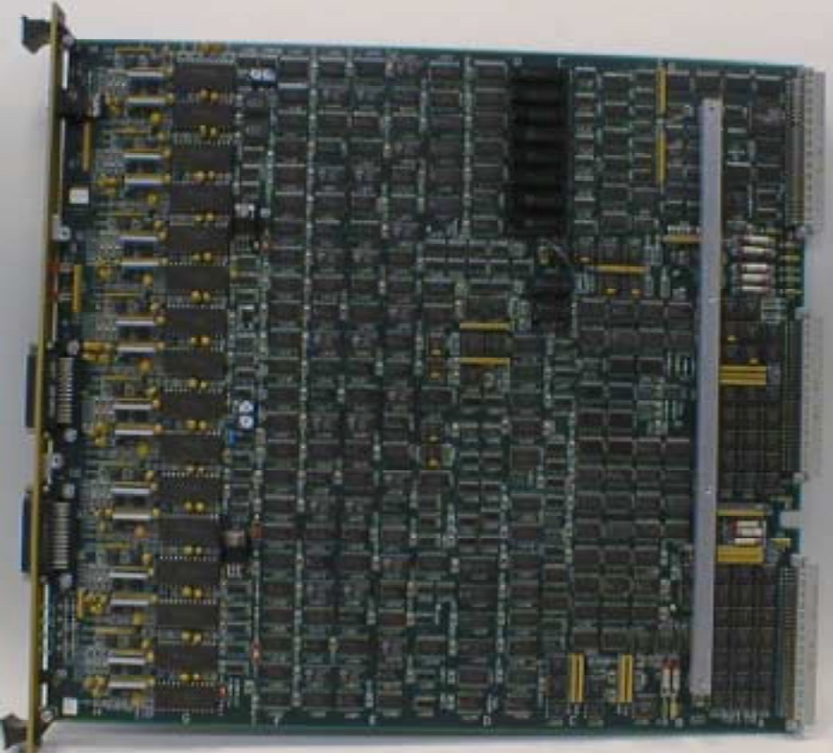
ZEUS
Trigger Encoder Card (TEC)

Slide 28
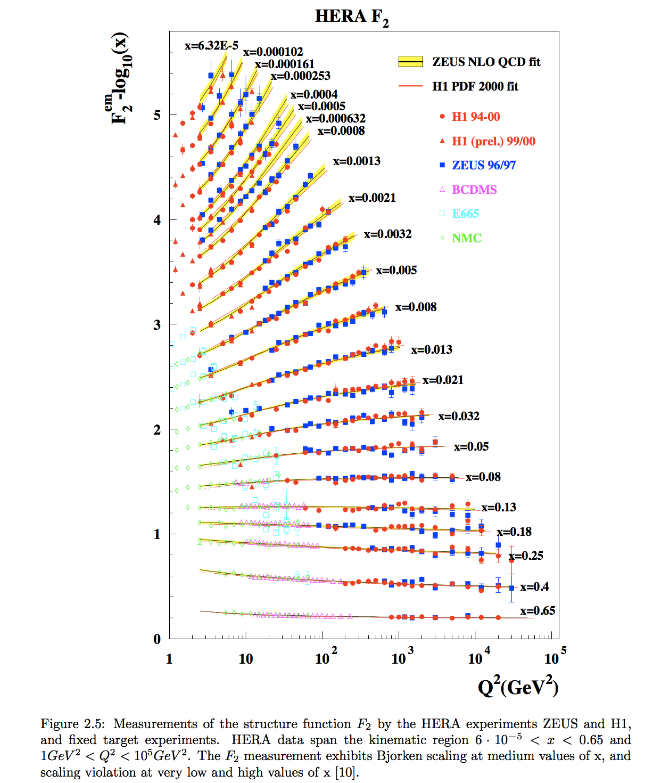
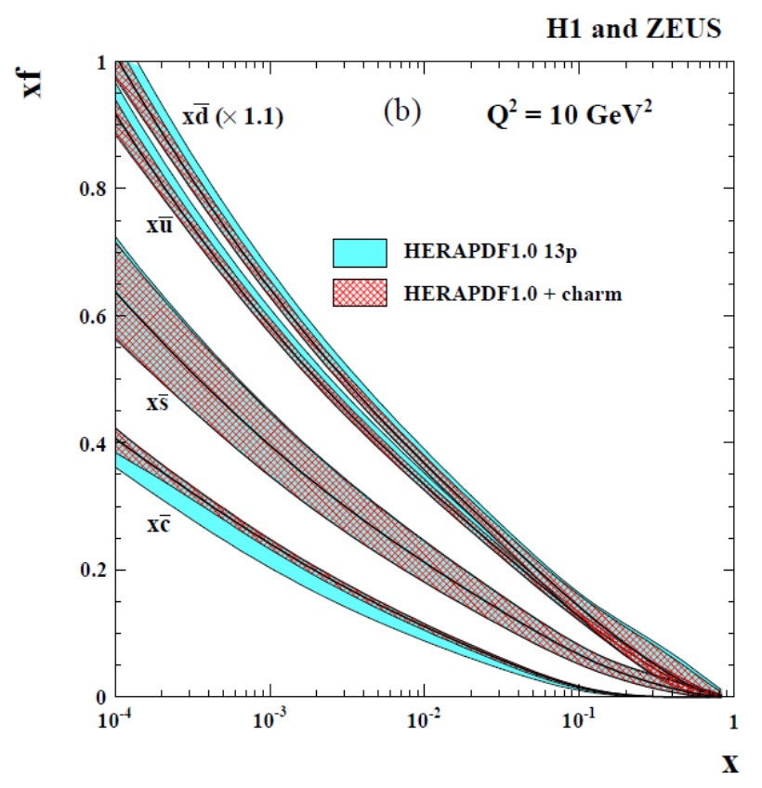
HERA Legacy

Slide 29
LHC Era

Slide 30

Large Hadron Collider
Design specs:

Slide 31

An LHC Collision
ATLAS Experiment
© 2013 CERN

Slide 32

CMS
Regional Calorimeter Trigger
  Hundreds of boards in scores of racks
Advent of the 2-level trigger
  Sorting objects in hardware using high-speed electronics
  Possibility to trigger on topological event characteristics rather than just the number of objects above threshold

Slide 34







CMS – Physics Results from Wesley’s Group

Slide 35


The Higgs Boson is Found
The Higgs Boson discovery was announced July 4, 2012 by the ATLAS and CMS experiments, and was made by combining data from all production and decay channels.
With the full Run1 dataset, the Higgs resonance is visible in some individual production/decay channels

Slide 36
Final Thoughts
Wesley’s activities in HEP spanned four decades and four orders of magnitude in energy.
His dedication to excellence is evident to all who work with him.
His unbound energy and love for physics has produced hundreds of results, many of which will stand the test of time.
Wesley’s commitment to his students and his active mentoring of them into strong physicists make him beloved by those who are lucky enough to work for him.
So Wesley:

