Slide 1
TriggeRs for Hadron Collider Physics
Darin Acosta
University of Florida ( Go Gators ! )

Slide 2
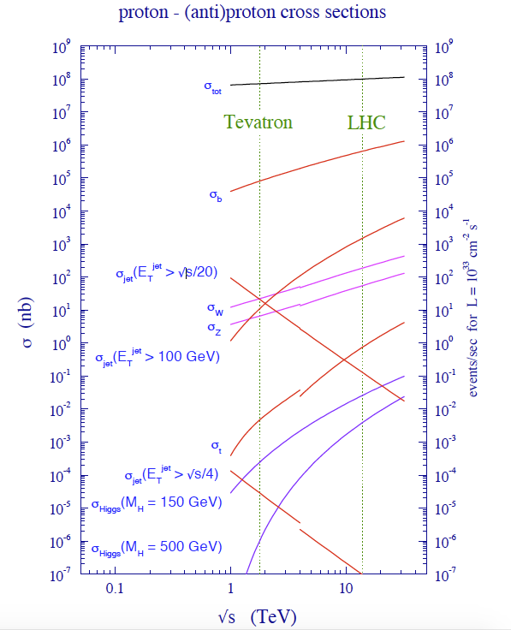
Hadron Collider Cross Sections & Rates
arXiv: 1002.0274v2
for L =2 x 10³⁴ Hz/cm²
← Total collision rate: 2 GHz
← b quark rate: 10 MHz
← W boson rate: 4 kHz
Keep for storage
← Higgs boson rate: 1 Hz
Challenge of triggering at hadron colliders: cannot keep all physics processes in order to collect enough data on interesting rare processes
Notes:
Why a trigger

Slide 3
Trigger Systems at Collider Experiments
Segmented into multiple levels, with decreasing output rates and longer processing times (latencies)
Level-1:
Custom electronic designs for maximum throughput and shortest latencies (microseconds).
Initially custom chips (ASICs) to meet needs, but later commercial programmable logic (FPGAs) became available
Processing logic done in a maximally parallel way for shortest latency
Level-2:
Combination of custom electronics and commercial computing equipment
Level-3:
Commercial computing clusters of up to thousands of CPUs and about a second per event processing time

Slide 4
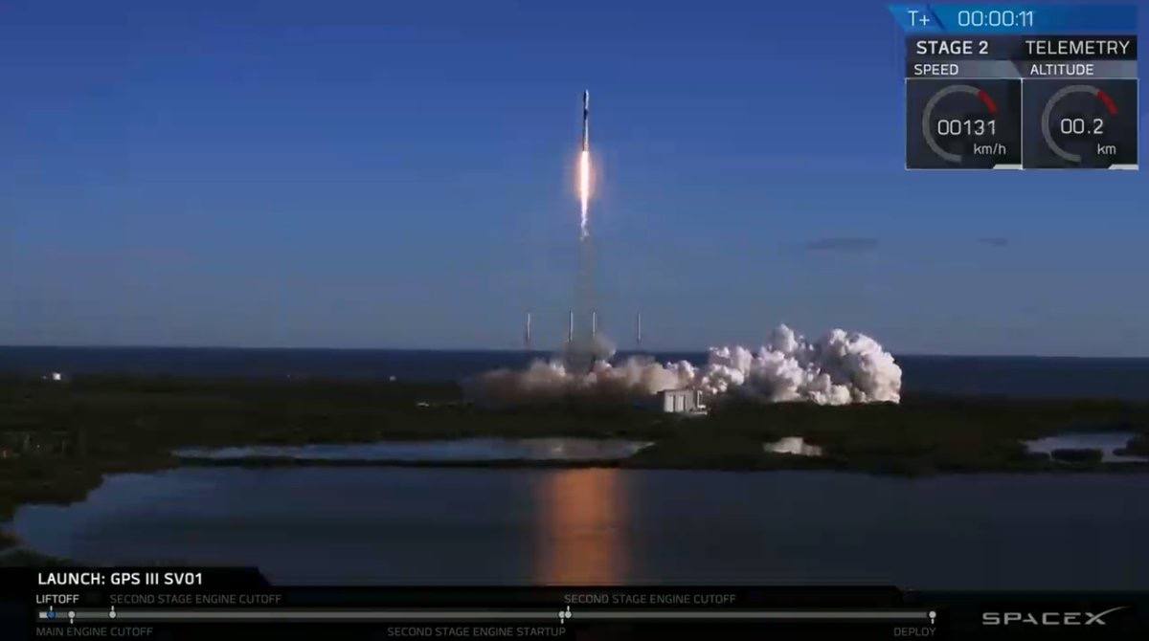
Cost Effective with Multiple Stages

Slide 5
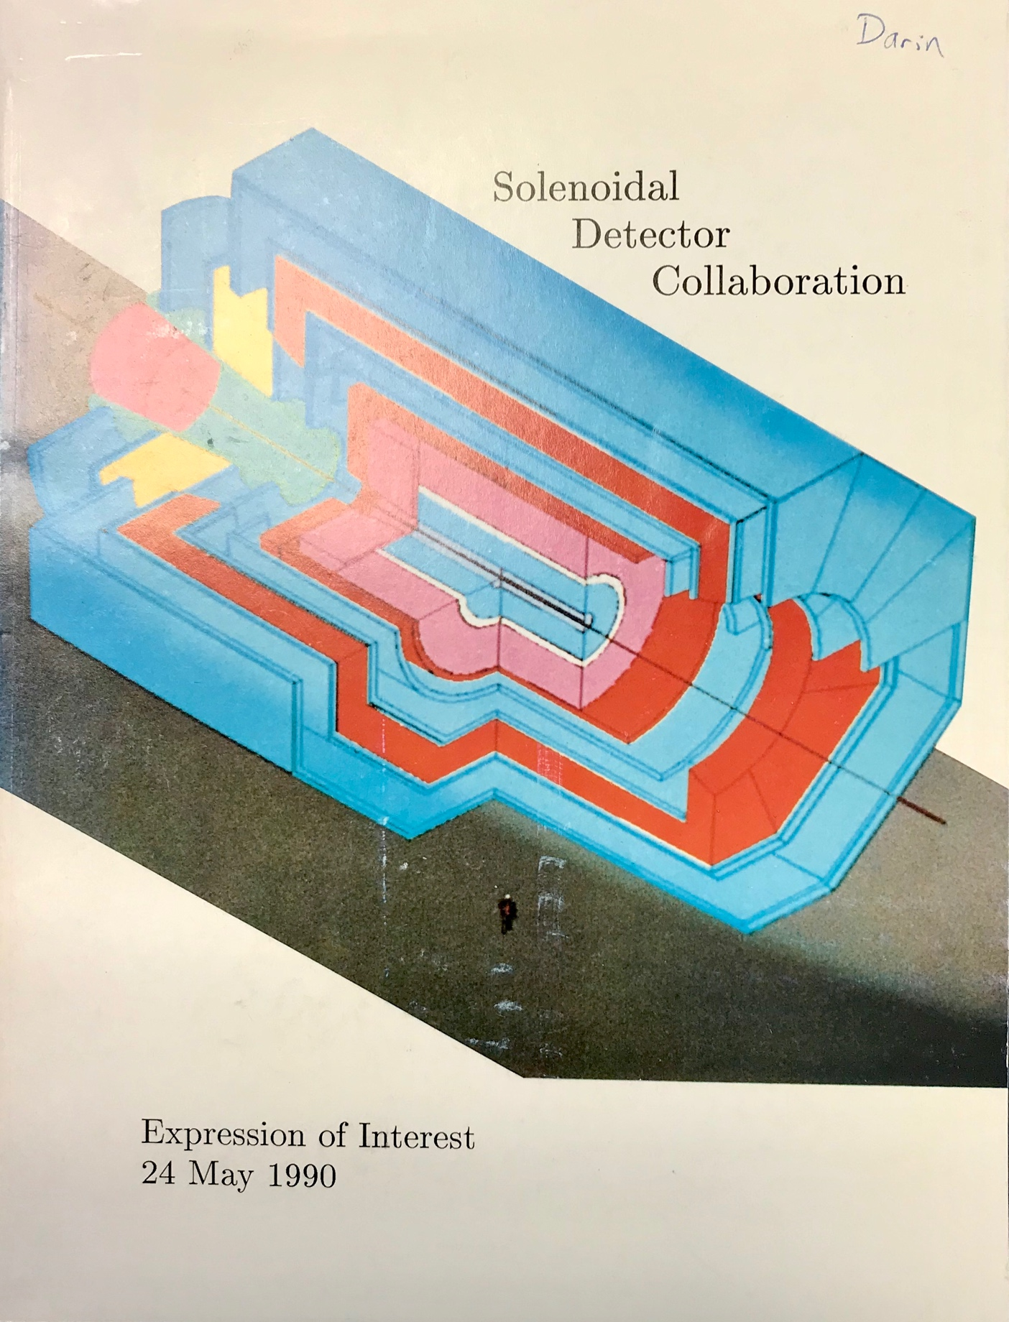
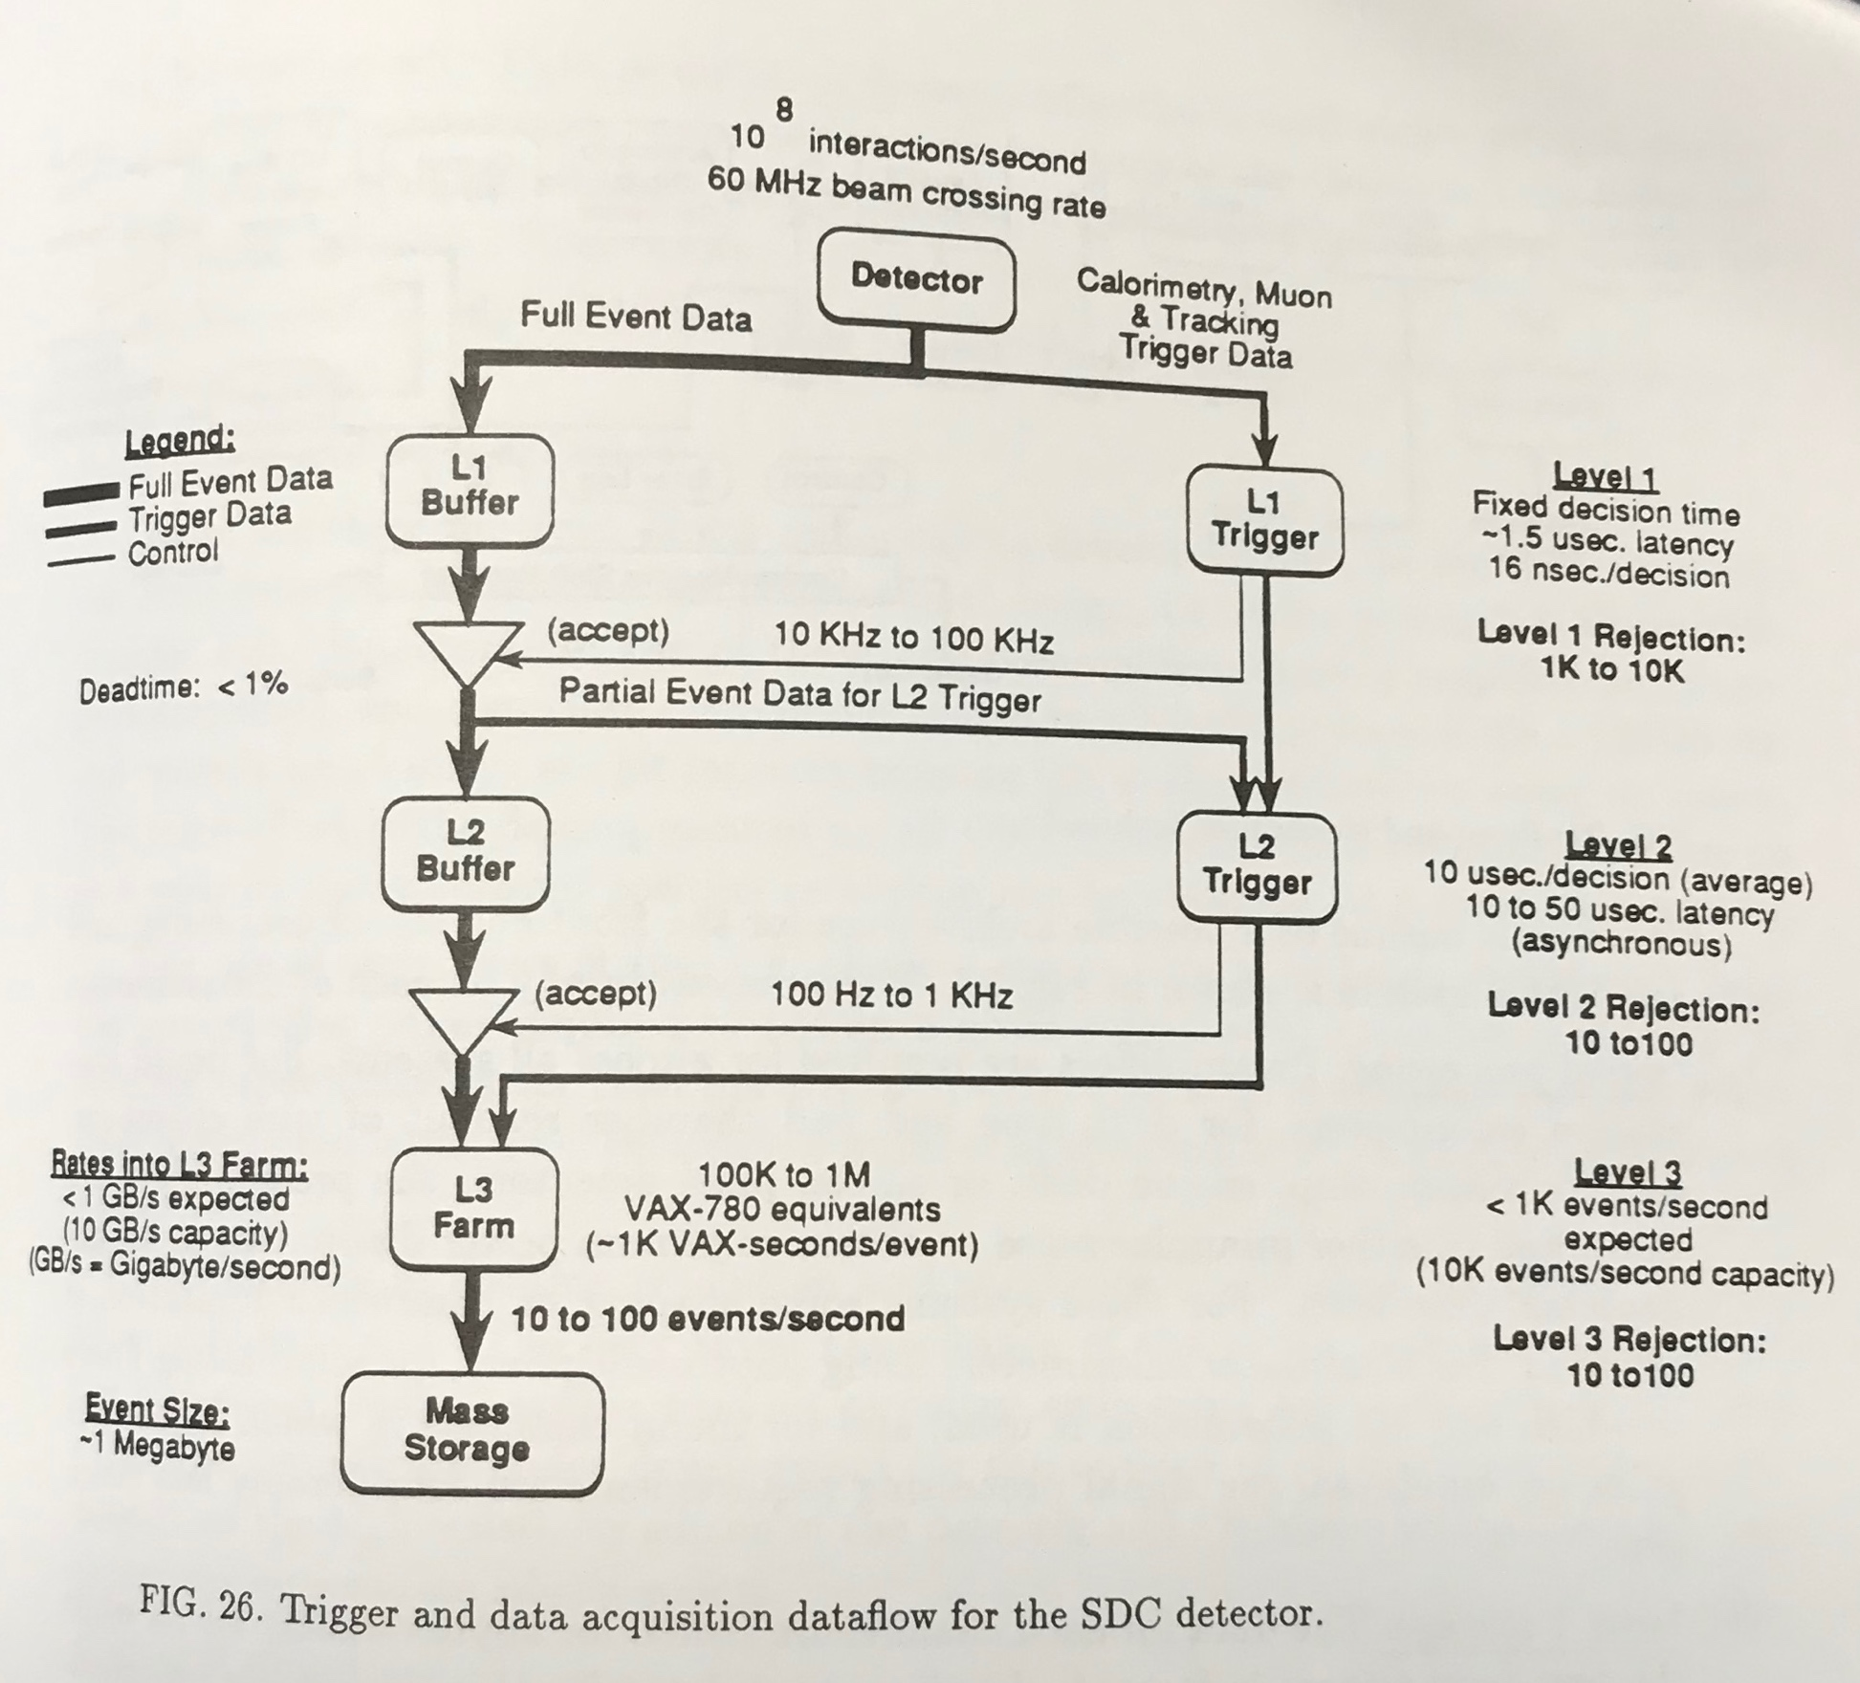
But Before there WAS CMS & LHC, There was SDC & The SSC Plan…
Level-1 Trigger:
Ambitious even now! Only 16ns BX spacing, 1.5 𝜇s latency
(Tighter than LHC reqs!)
My first and only SDC meeting took place in 1993, and was the first time I met Wesley (and Sridhara)
Notes:
My first and only SDC meeting was in 1993, with Wesley running a trigger meeting

Slide 6
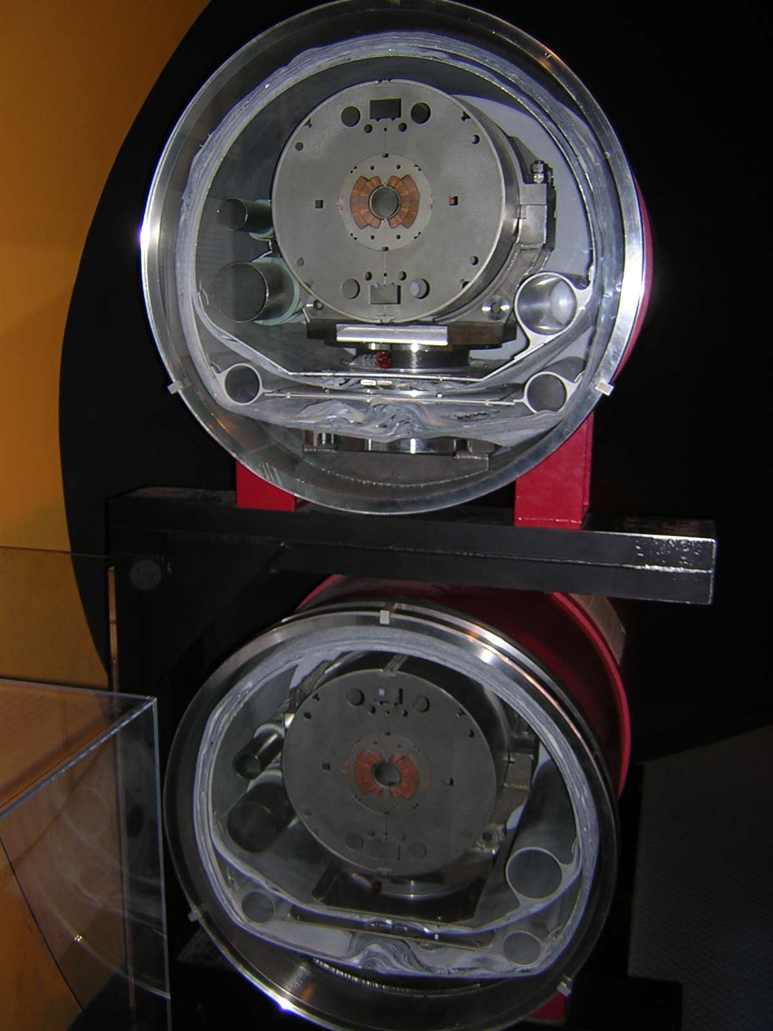
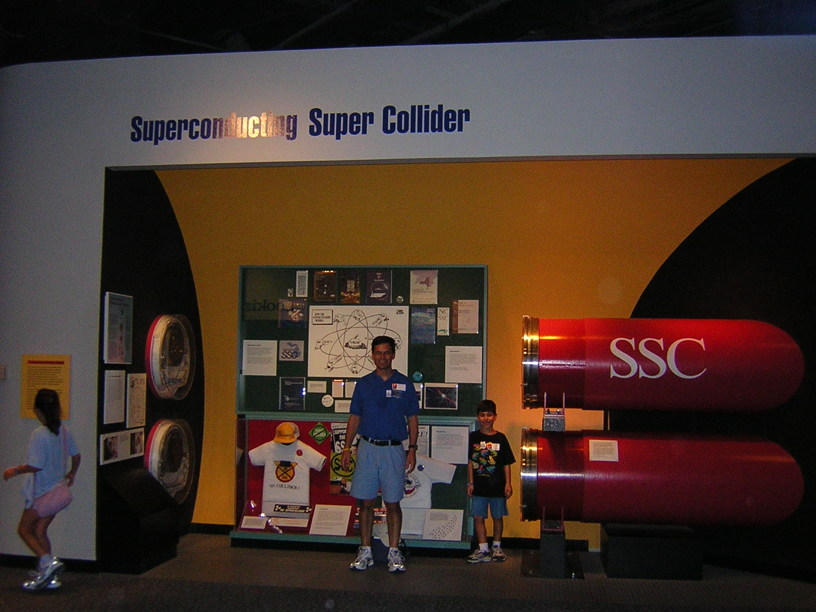
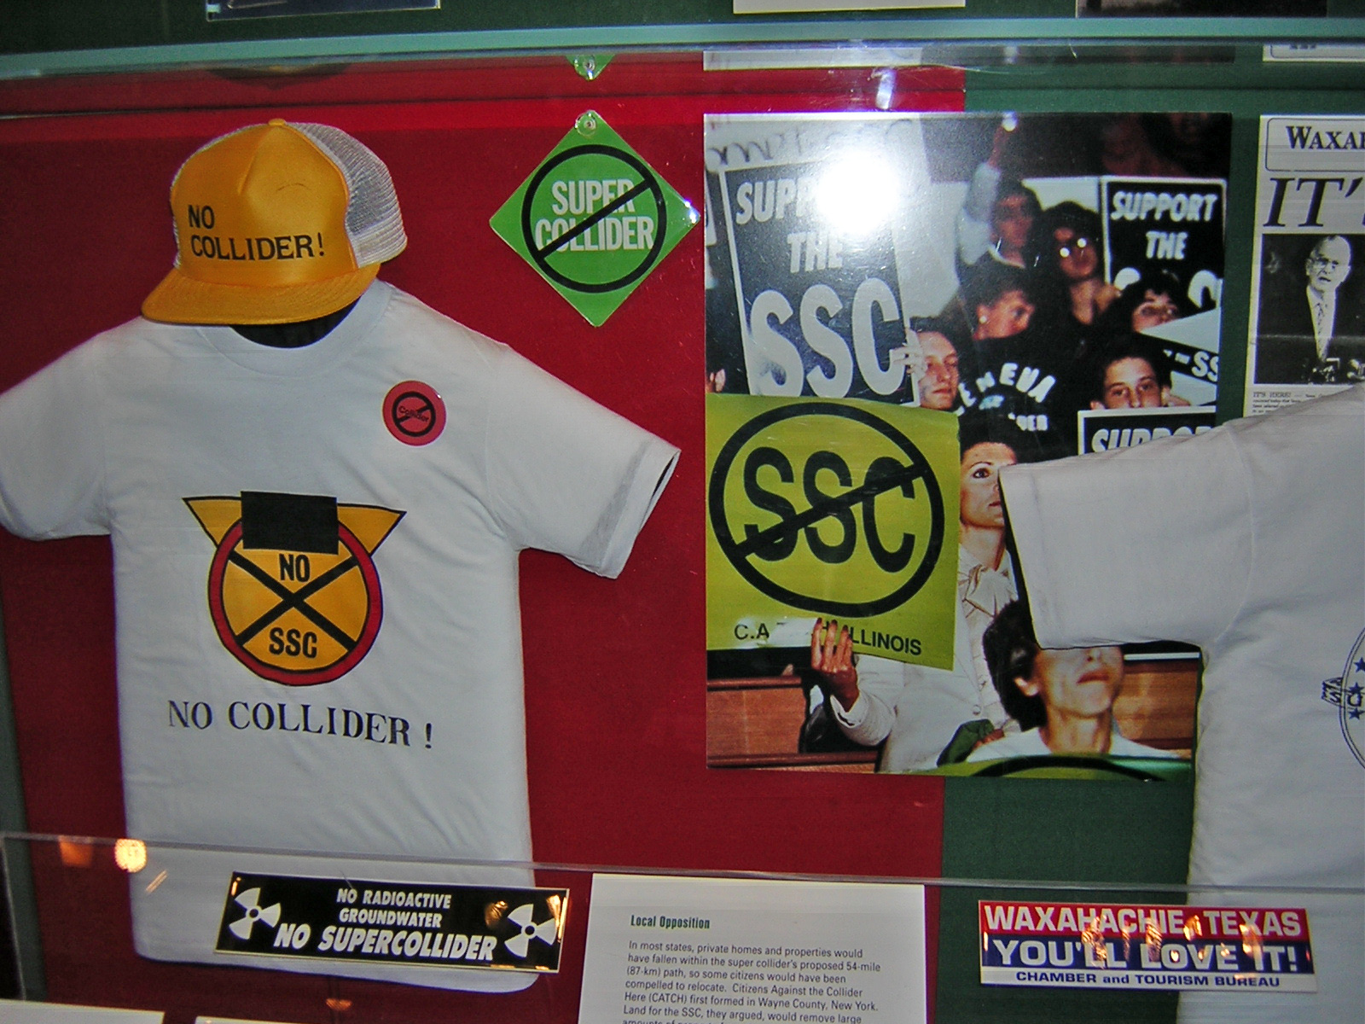
Now A Footnote in the Smithsonian
The Superconducting Super Collider
40 TeV center-of-mass energy
Waxahachie, TX
R.I.P. 1993
Circa 2005

Slide 7
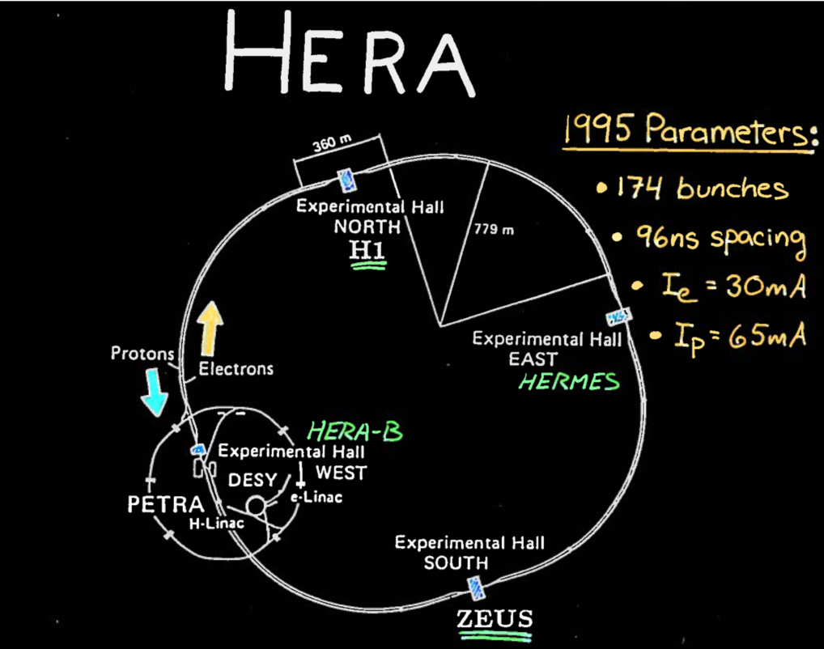
HERA Electron-Proton Collider
@ DESY, Hamburg Germany
Launched 1992
Ee=27.5 GeV
Ep=820-920 GeV
Still tight bunch spacing! Significantly less than Tevatron Run 1 (microseconds)
Trigger system development benefited from Supercollider efforts

Slide 8
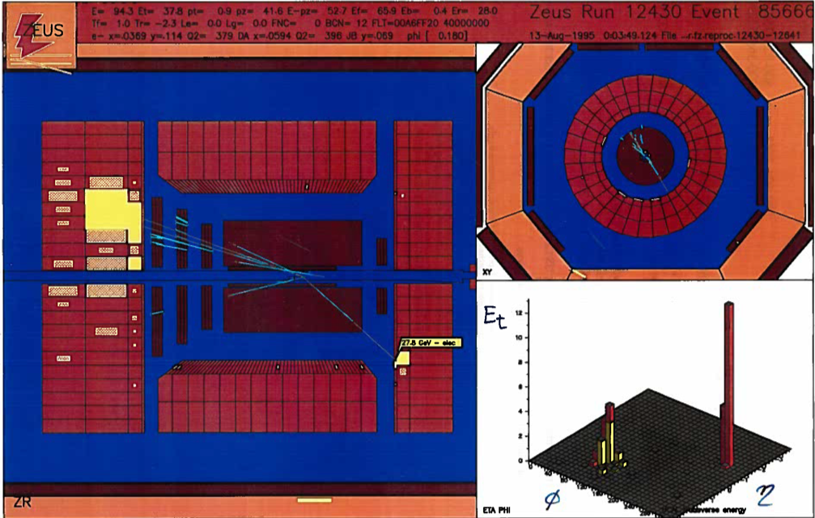
Zeus Deep Inelastic Scattering Event
LAZE event display
Uranium-Scintillator calorimeter. Barrel built by US groups (“AMZEUS”)
e →
← p
Data processed by calorimeter trigger

Slide 9
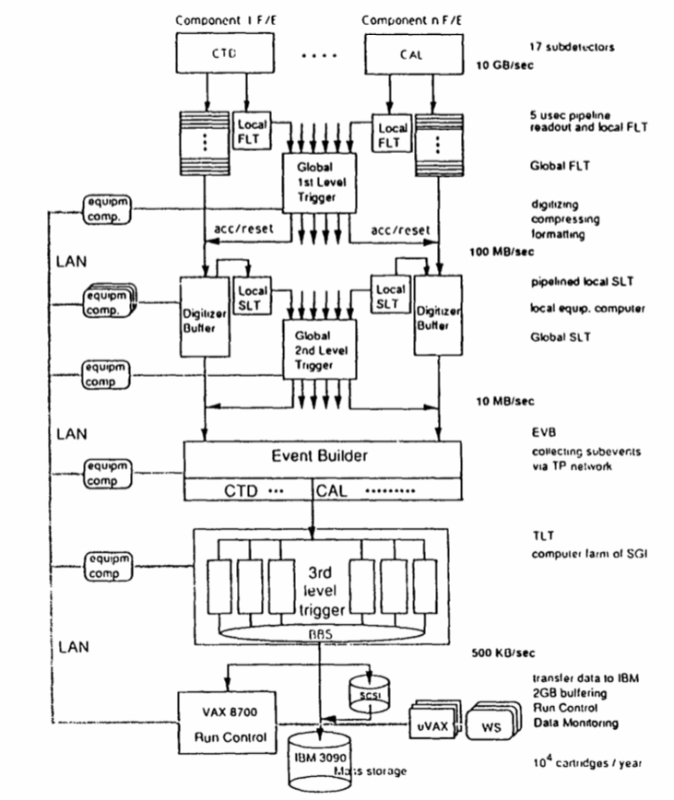
ZEUS Trigger System
Three Level Trigger system
Dominant background at HERA is beam gas interactions which occur at a typical rate of few hundred kHz
Only half of a hadron collider...
Level-1 takes in data at 10 MHz beam crossing input rate, and reduces to < 1 kHz
Total Latency 5.5 μs
Calculations are pipelined in 96 ns steps (i.e. no dead time)
“Transputers” comprise Level-2, 3 and Event Builder
Early parallelized real-time computing platform
NIM A332 (1993) 253

Slide 10
The ZEUS Calorimeter First Level Trigger (CFLT)
NIM A360 (1995) 322
A Wisconsin, Argonne effort
Processes 896 trigger towers (from calo PMT signals) in 16 regions (and VME crates) of 7x8 towers
Each crate has 14 Trigger Encoder cards (digitizes calo data) and 2 Trigger Adder cards to perform sums
Determines the total, transverse, and missing transverse energy, and identifies isolated electrons and muons(!), and sums energies in programmable subregions.
The Calorimeter Trigger essentially IS the Level-1 trigger, since no dedicated muon trigger
Thankfully a MIP trigger is enough, as background rates at HERA are low

Slide 11
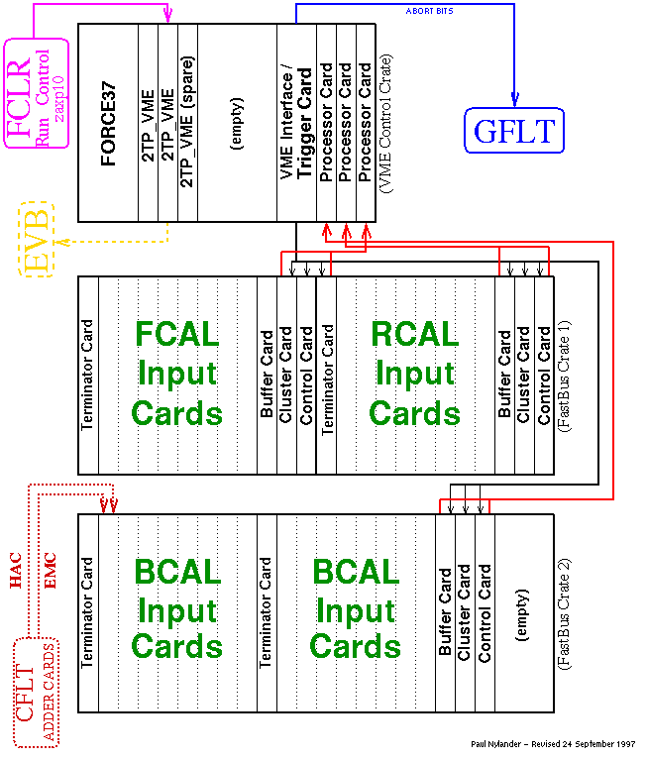
The ZEUS Fast Clear, a “Level-1.5”
Developed by OSU
Cluster finder for electrons and jets
The Fast Clear processed the calorimeter trigger data from the Wisconsin electronics during the time the DAQ data were being digitized.
Larger 15 μs latency for processing
The Fast Clear would abort the detector digitization to reduce the rate of data going to the second level global trigger.
In addition to clustering, Fast Clear calculated E-P_{z} from the calorimeter data, and used it to reduce the rate of Neutral Current triggers

Slide 12
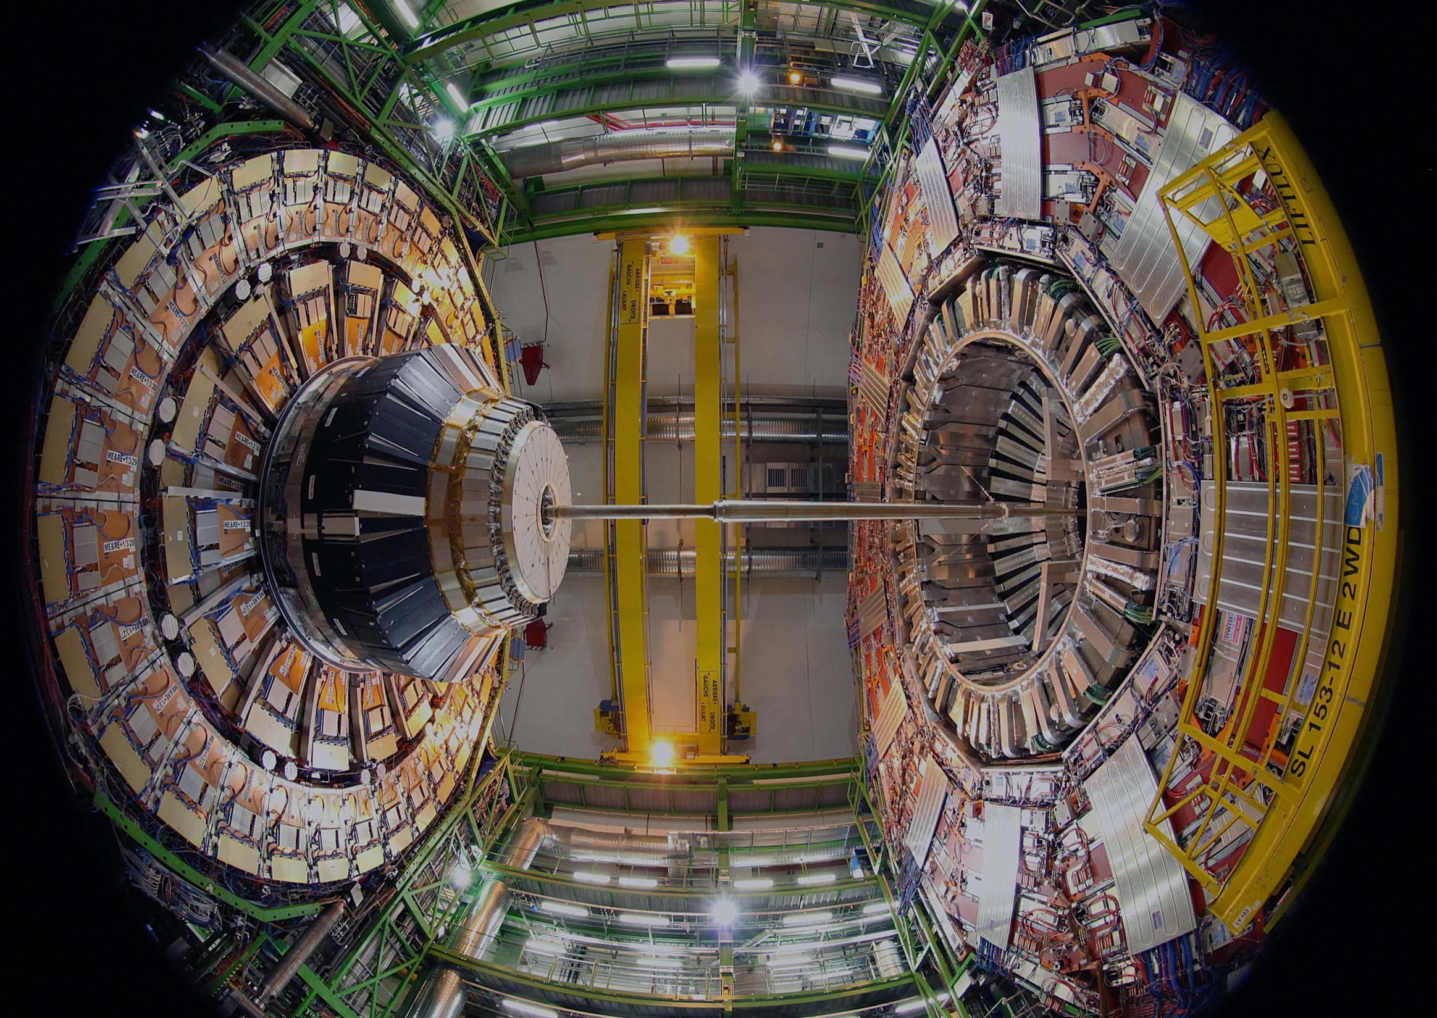
The CMS Experiment

Slide 13
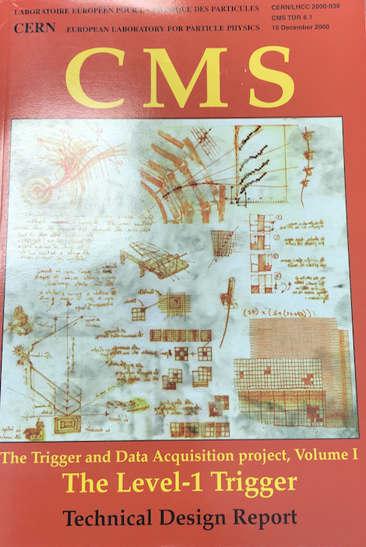
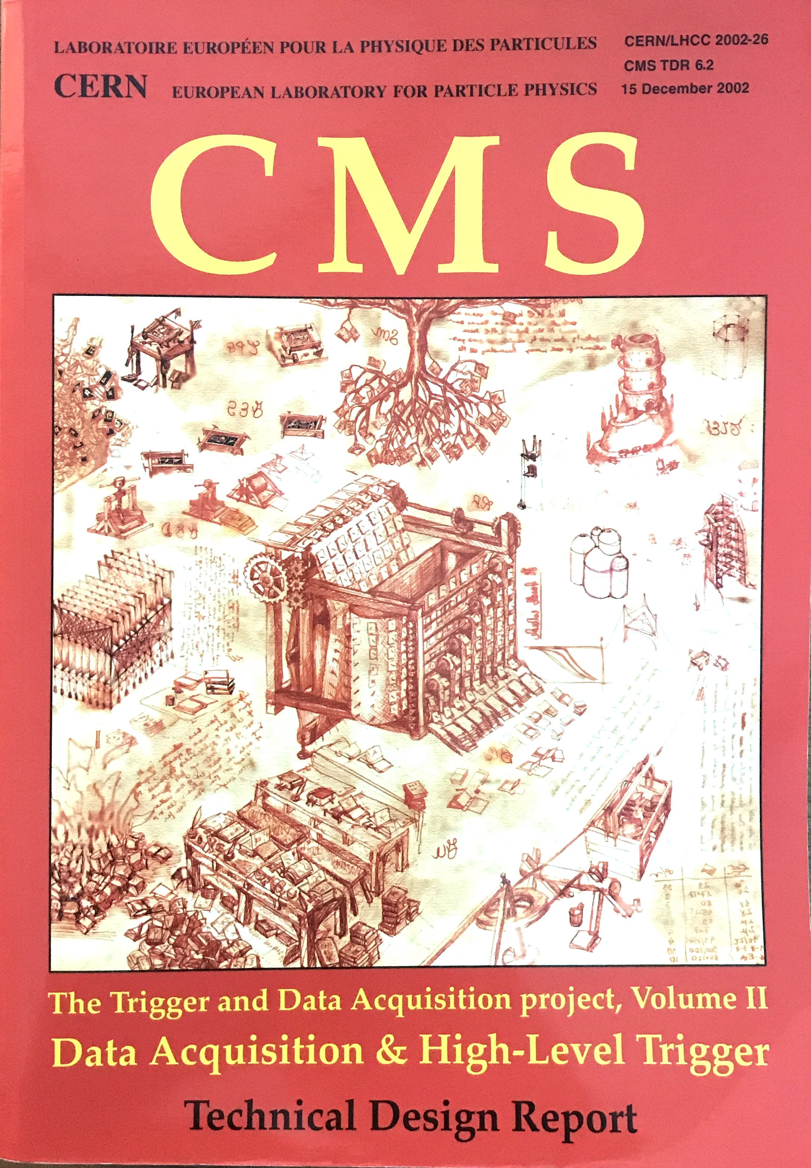
First CMS Level-1 Trigger, TDR 2000
Simulation results obtained using the first C++ framework of CMS: “ORCA”.
Revised in 2002 in DAQ/HLT TDR

Slide 14
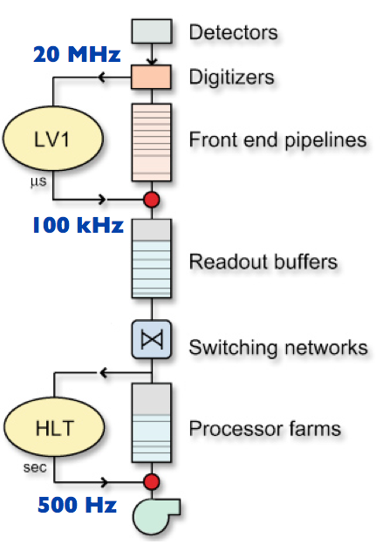
CMS Trigger Architecture
Only two levels*:
Level-1: custom electronics to reduce the data from a collision rate of 40 MHz to no more than 100 kHz for the detector readout electronics, with only a 4 μs latency (buffer depth)
High Level Trigger (HLT): event filter farm comprised of commercial CPUs running software to further reduce event rate to storage to an average of ~1kHz (for LHC Run 2)
40 MHz
1 kHz
*CMS was a leader in adopting a powerful HLT.
Notes:
HLT rate is increase since Run 1, factor 2 increase in lumi, and from sqrt(s)

Slide 15
Collider Trigger Comparisons
One to two orders of magnitude increase
 | Tevatron / CDF (2004) | LHC / CMS (2018)
Beam Energy | 1 TeV | 6.5 TeV
Inst. Lumi. (cm⁻²s⁻¹) | 10³² | 2x10³⁴
Bunch xing freq / Time spacing | 2.5 MHz / 400 ns | 40 MHz / 25 ns
L1 pipelined ? | No (Run 1) | Yes
L1 output rate | 25 kHz | 100 kHz
L2 output / HLT input | 400 Hz | 100 kHz
L3 output rate | 90 Hz | 1000 Hz
Event size | 0.2 MB | 1 MB
Filter Farm | 250 CPUs | O(10 000) CPUs
200X
16X
4X
250X
10X
5X
40X

Slide 16
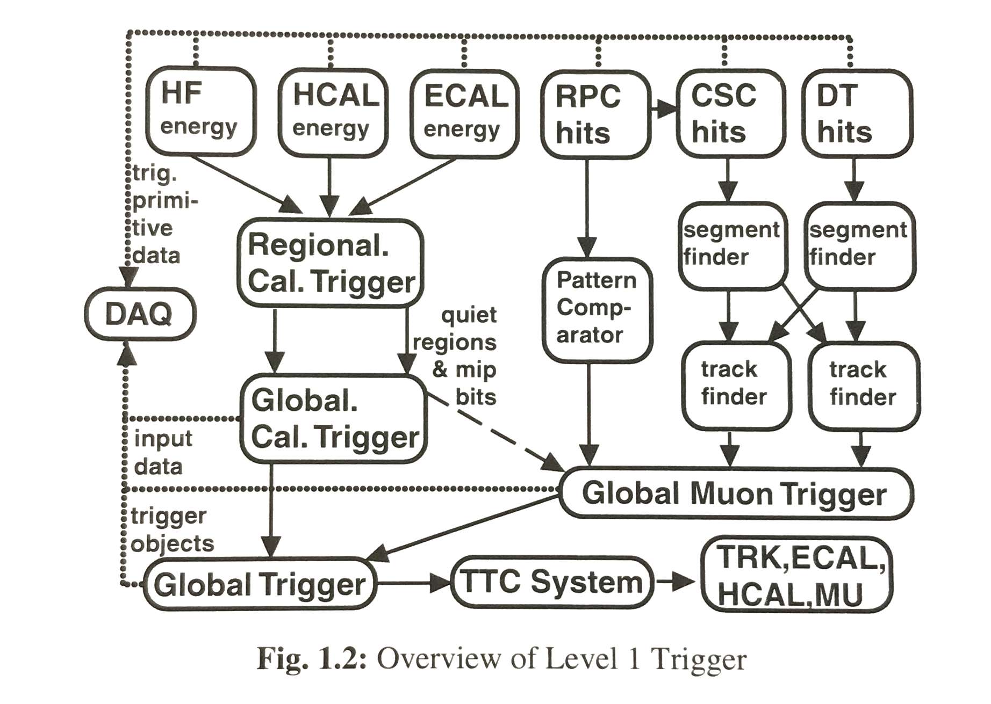
First CMS L1 Trigger Architecture
But one major missing ingredient: no inner tracking at L1.
Makes trigger job that much harder compared to earlier experiments.
e.g. Muon momentum must be measured in the magnet yoke. No electron/photon discrimination.
UW “RCT” Effort

Slide 17
Silicon Tracking to be Added for HLLHC
Wesley was already thinking about addressing this limitation as early as 2004
Notes:
Will be achieved 22 years later!

Slide 18
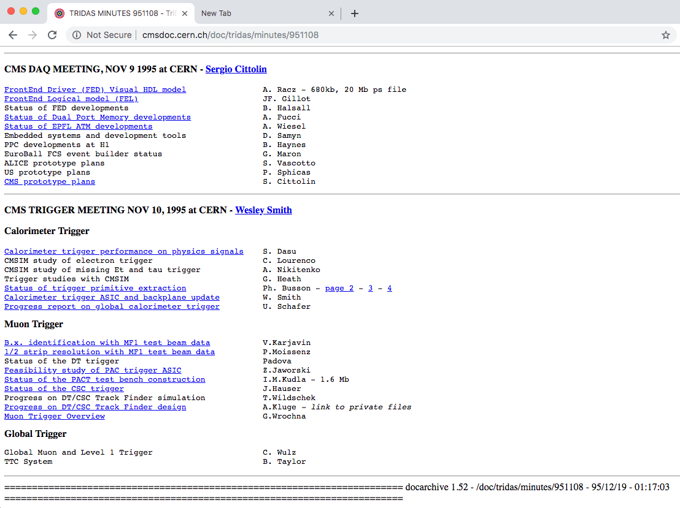
Wesley Was the CMS L1 Trigger Manager since The Earliest Days
Links to meetings still valid even after 24 years!

Slide 19
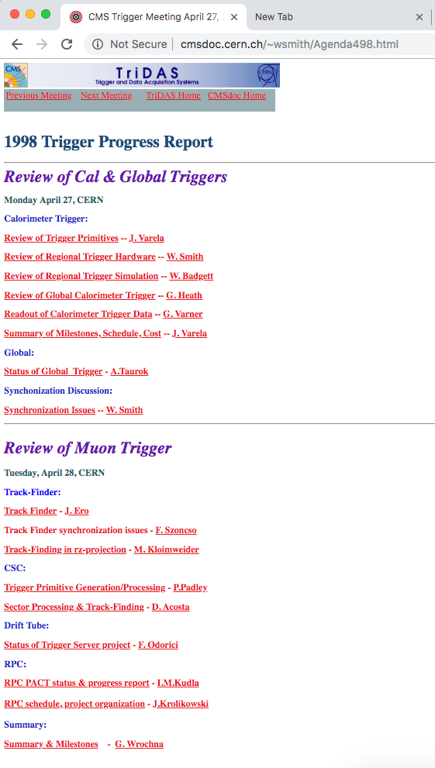
I Joined The Project in 1998

Slide 20
Typical Wesley Slide
Always busy, with many, many acronyms!
Note the heavy use of ASICs, a product of the earlier SSC and HERA calorimeter trigger work
Notes:
Many Acronyms…

Slide 21
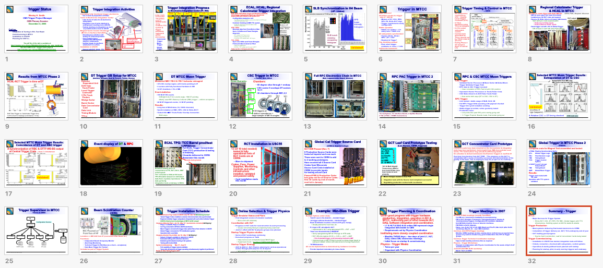
Typical Wesley Talk
Always at a high rate ☺
Notes:
So much for guideline of 1 slide per minute

Slide 22
First CMS Level-1 trigger Electronics
RCT was implemented in 18 VME crates
Also five high-speed custom GaAs ASICs were designed and manufactured by Vitesse: a phase ASIC, an adder ASIC, a boundary scan ASIC, a sort ASIC, and an electron isolation ASIC.
The muon trigger subsystems, such as the CSC Track-Finder, typically occupied 1-2 VME crates each and utilized Xilinx FPGAs and a few ASICs for pattern finding
The FPGA revolution was taking hold, as well as high-speed optical links for data transmission (~1 Gbps)

Slide 23
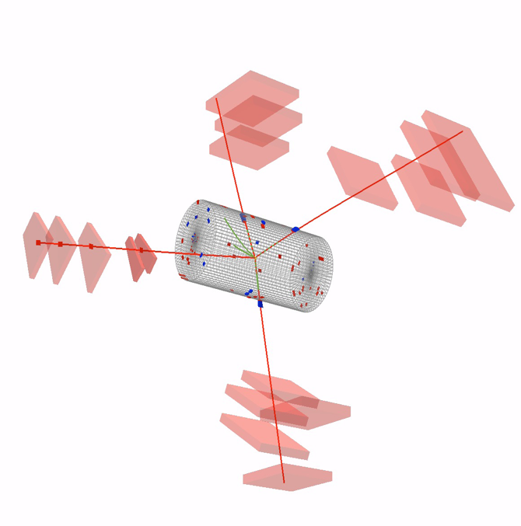
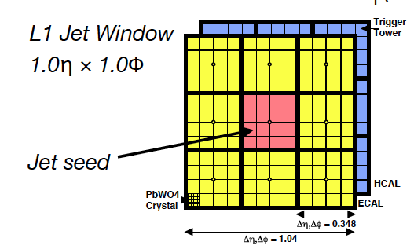
Level-1 Trigger Algorithms
Muon Track Finding
Extrapolation-based matching of segments from one muon detector station to another (aka “Tracklet”)
Momentum assignment based on the deflection in 𝜑 from one station to the next from the fringe field in the yoke
Electron, tau, and jet clustering
Each TT has 𝛥𝜑𝛥𝜂 = 0.0875x0.0875
Electron candidates (isolated and nonisolated) found in 4x4 TT regions
Sliding window for jets across 4x4 TT regions

Slide 24
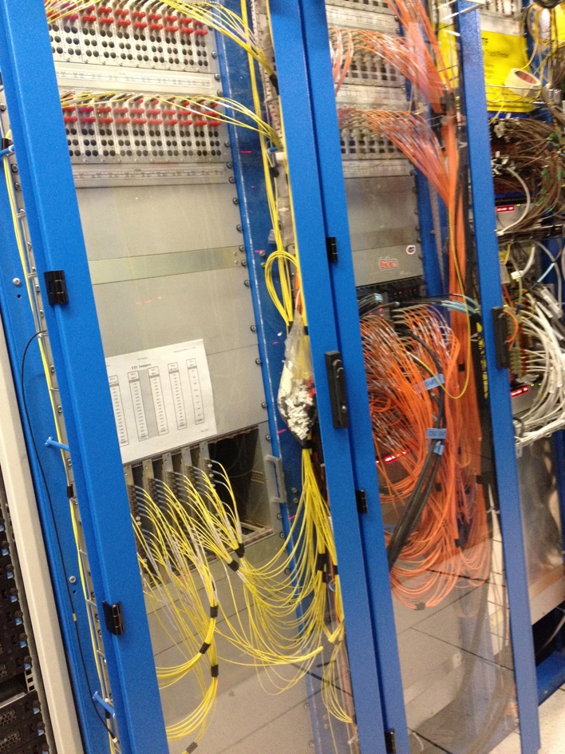
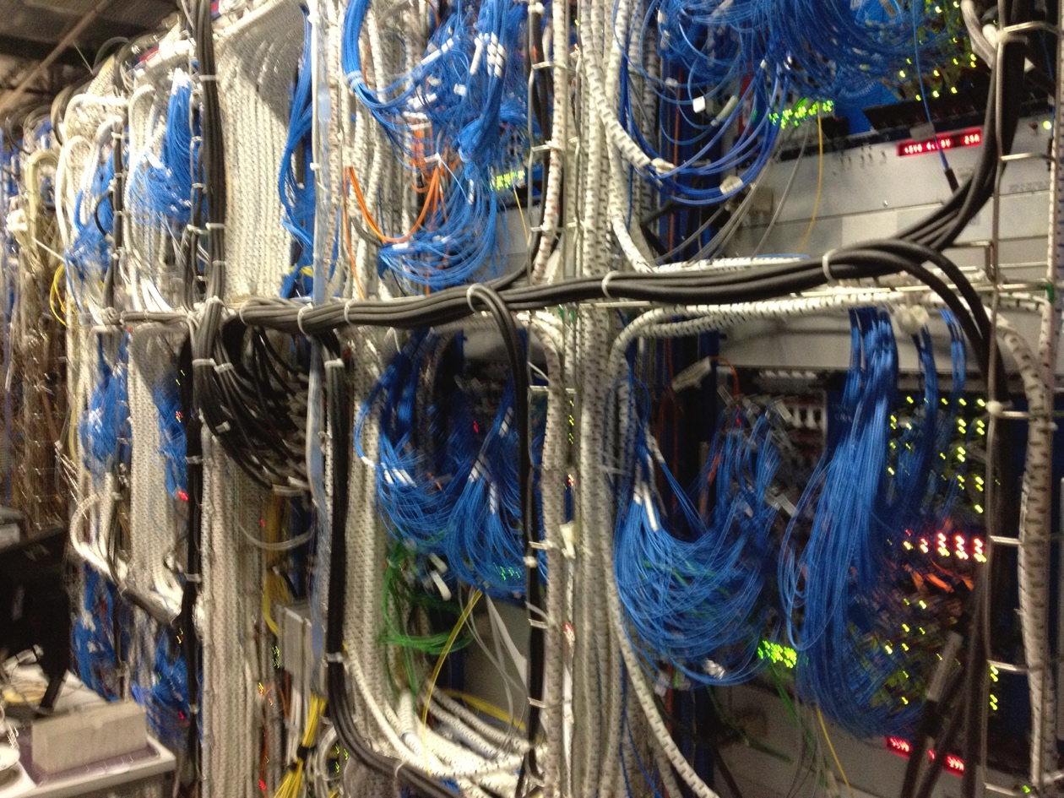
CMS Level-1 Trigger System Installed
CSC Track-Finder
RPC Trigger Electronics

Slide 25
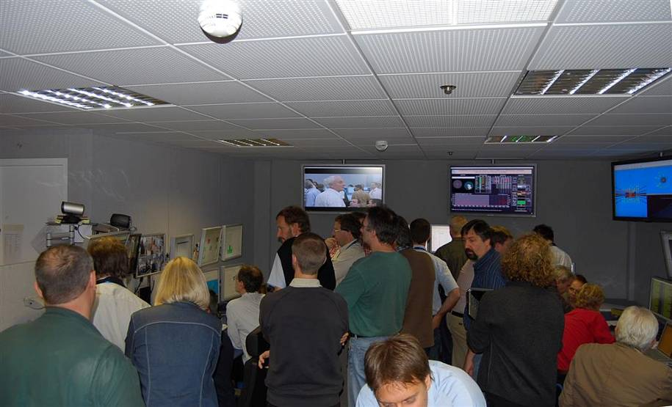
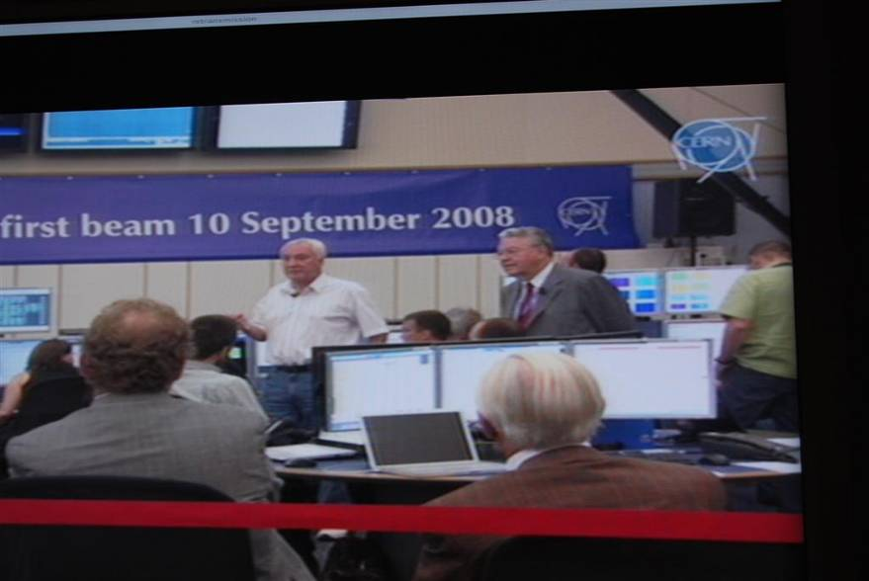
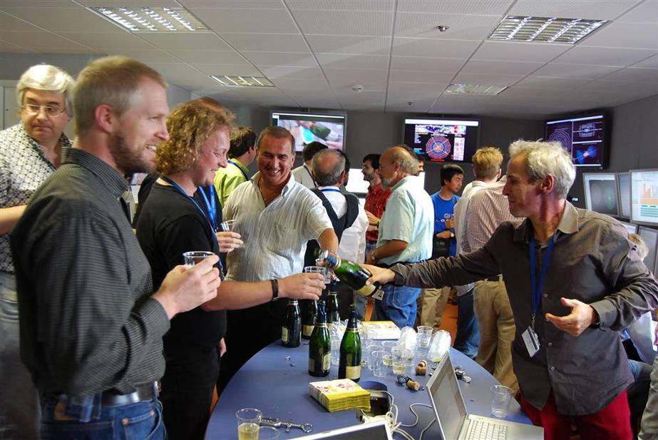
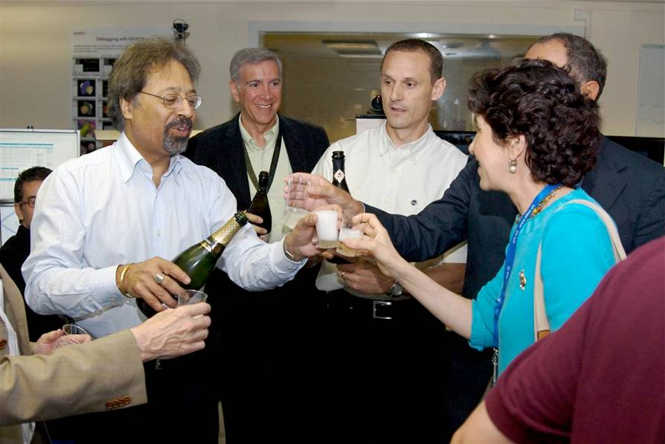
Ready for First LHC beams in 2008
LHC Control Room
CMS Control Room
About a week later we were 5 days away from first pp collisions, and yet CMS had no HLT menu yet!
But we did take the opportunity to upgrade the FPGAs on the endcap muon trigger at least to add more margin!
Sadly, the LHC suffered a major malfunction on a black Friday, September 19, 2008, delaying things by more than a year and forcing us to lower the beam energy

Slide 26
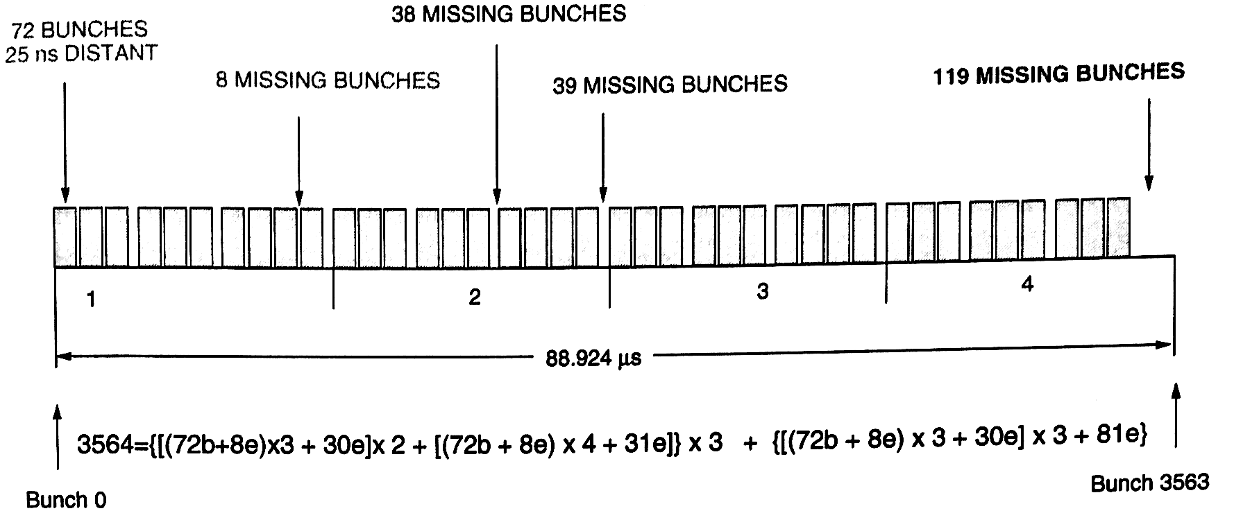
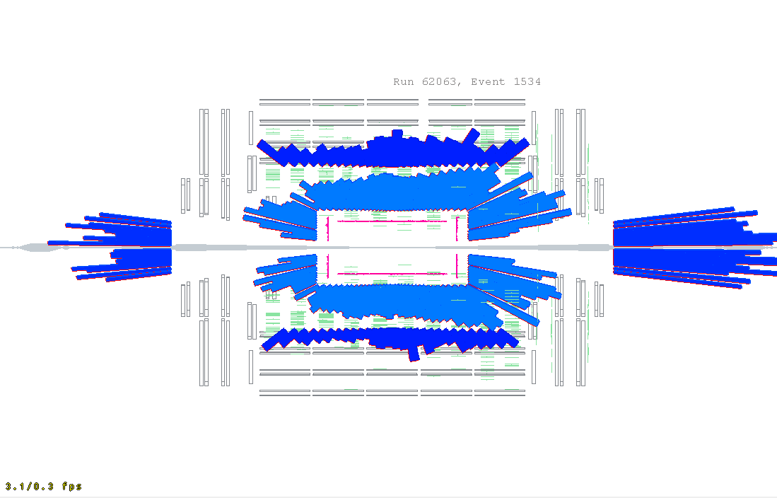
Some Challenges that Require Agility
Synchronization of millions of channels
Relative synchronization of neighboring detectors
Absolute synchronization using LHC bunch structure
LHC beam collimator “splash” events !
ECAL APD spikes from neutral hadrons
Jeopardized electron trigger with high rates!
Fortunately crystal size is narrow enough to lead to energy sharing among neighbors for real electrons → spike suppression algorithm
Trigger prefiring
Calorimeters trigger primitives can fire early, causing us to read wrong BX for DAQ
Solution: veto unfilled colliding bunches
Problem: how to trigger on possible slow HSCPs?
Solution 2: Latch and hold RPC trigger hits for 2 BX (50 ns)
Wesley’s suggestion

Slide 27
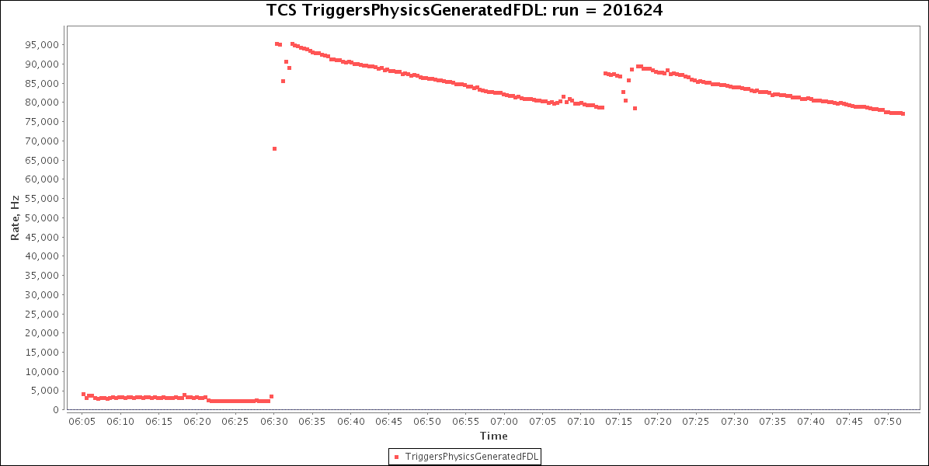
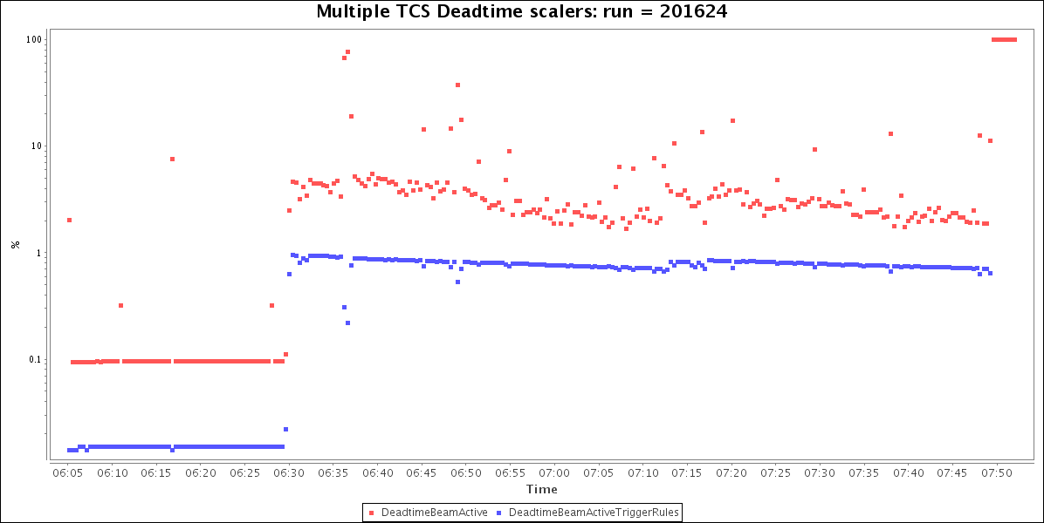
But eventually Everything Worked!
95kHz
L1 rates happily cruising at near 100 kHz !
Fill from 2012
Low deadtime
Trigger control and throttling system, and DAQ, all working!
7E33 prescale column
6E33 prescale column
7.5E33
6.7E33

Slide 28
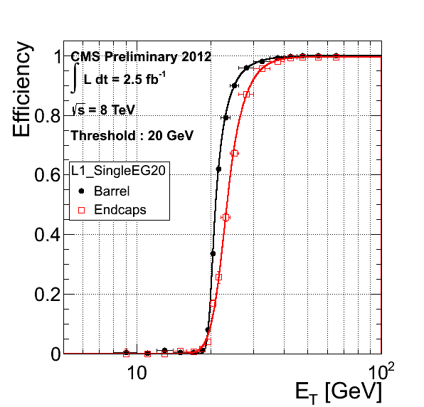
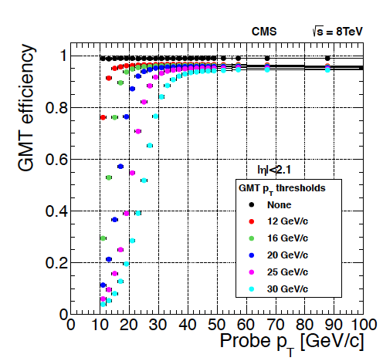
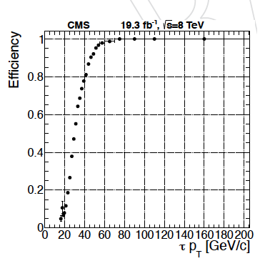
Good Efficiency for Physics!
Electrons
Muons
Taus

Slide 29
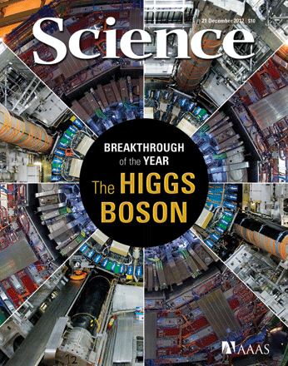
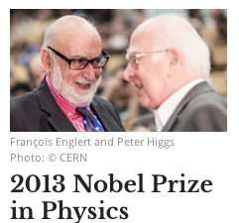
in 2012: Discovery of the Higgs

Slide 30
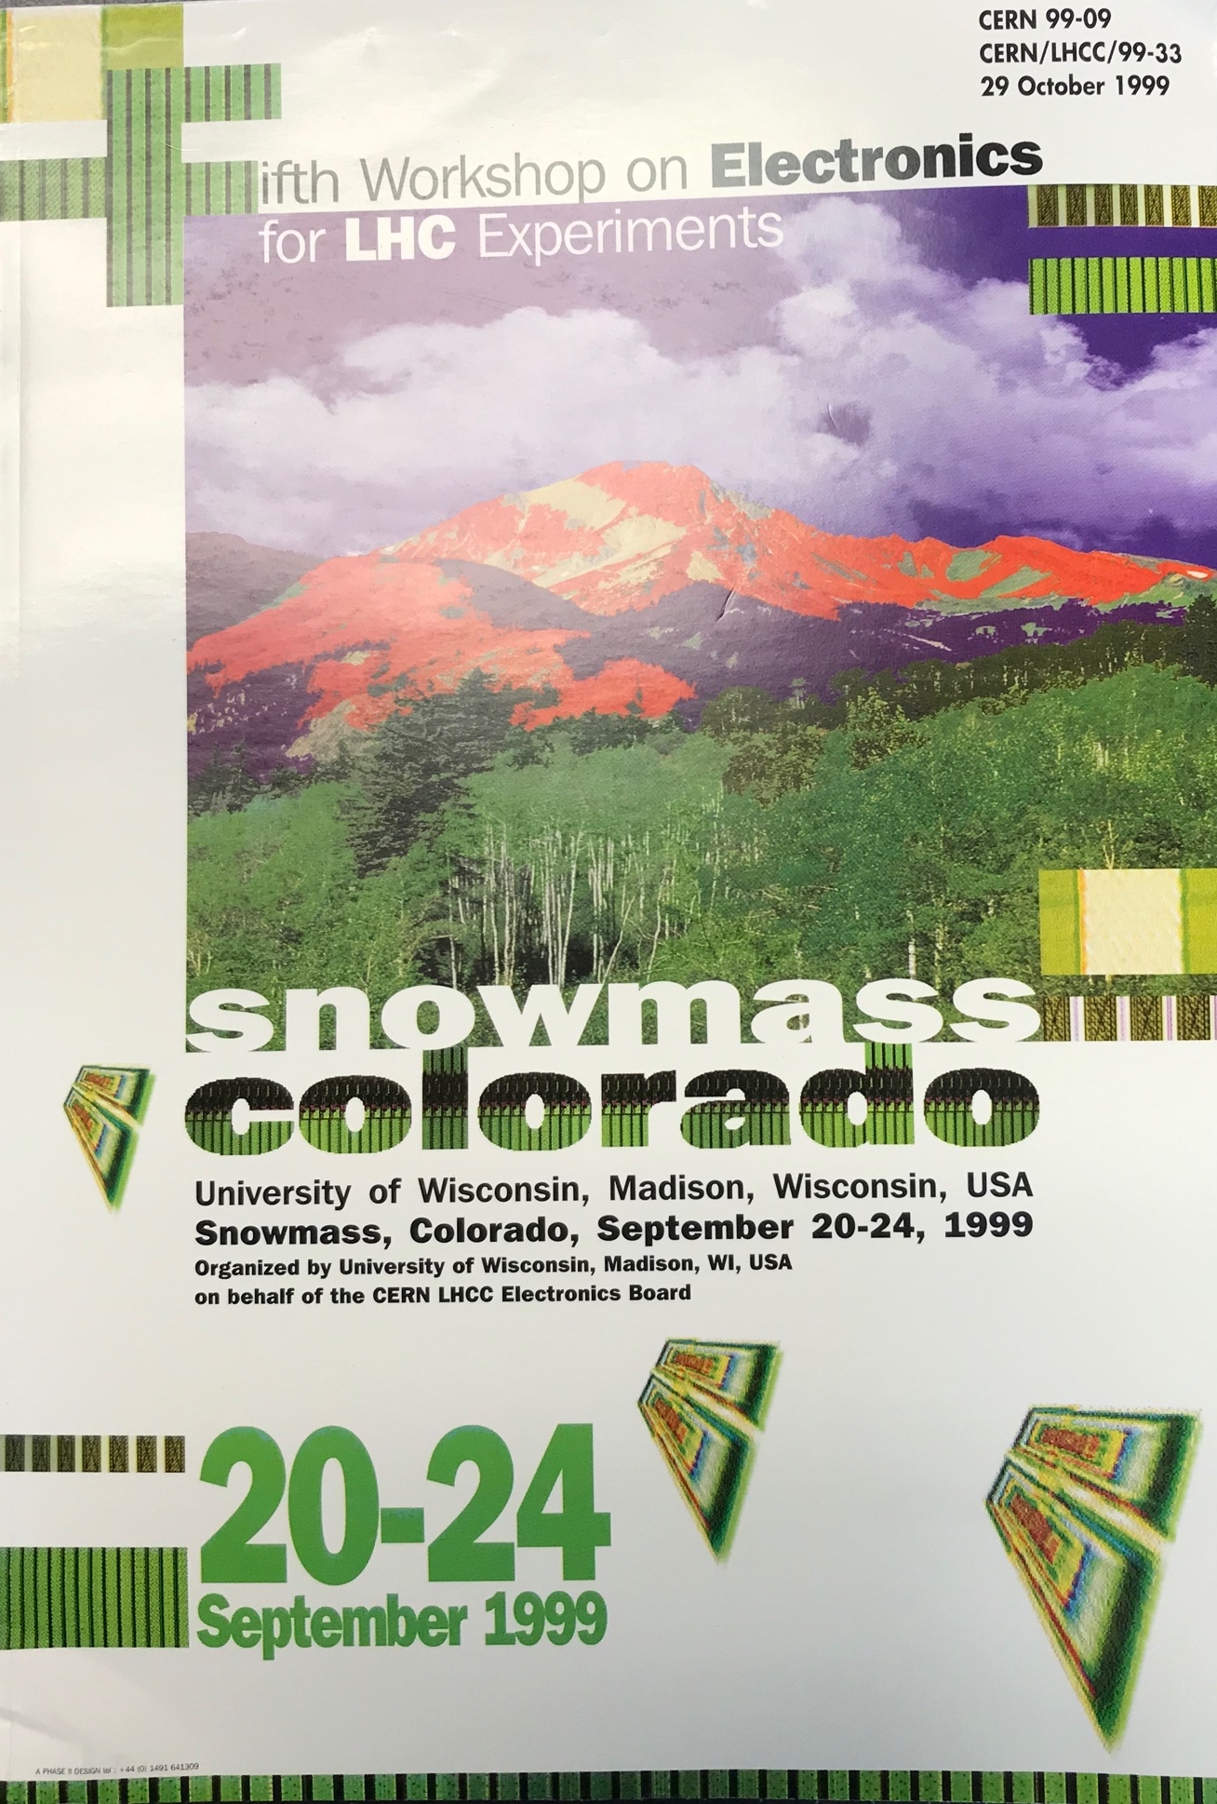
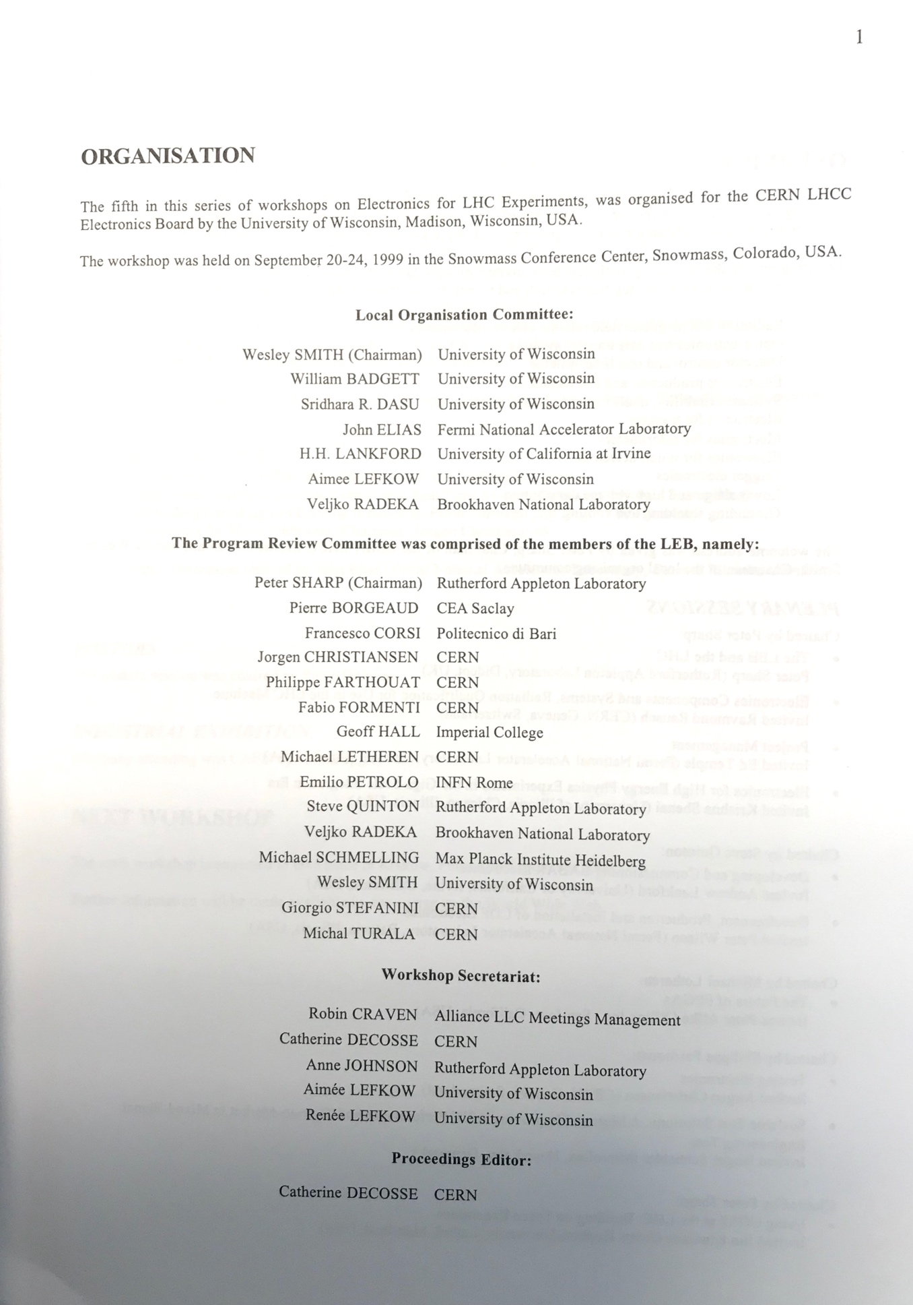
A Leader in LHC Electronics Development
LEB Workshops, now TWEPP

Slide 31
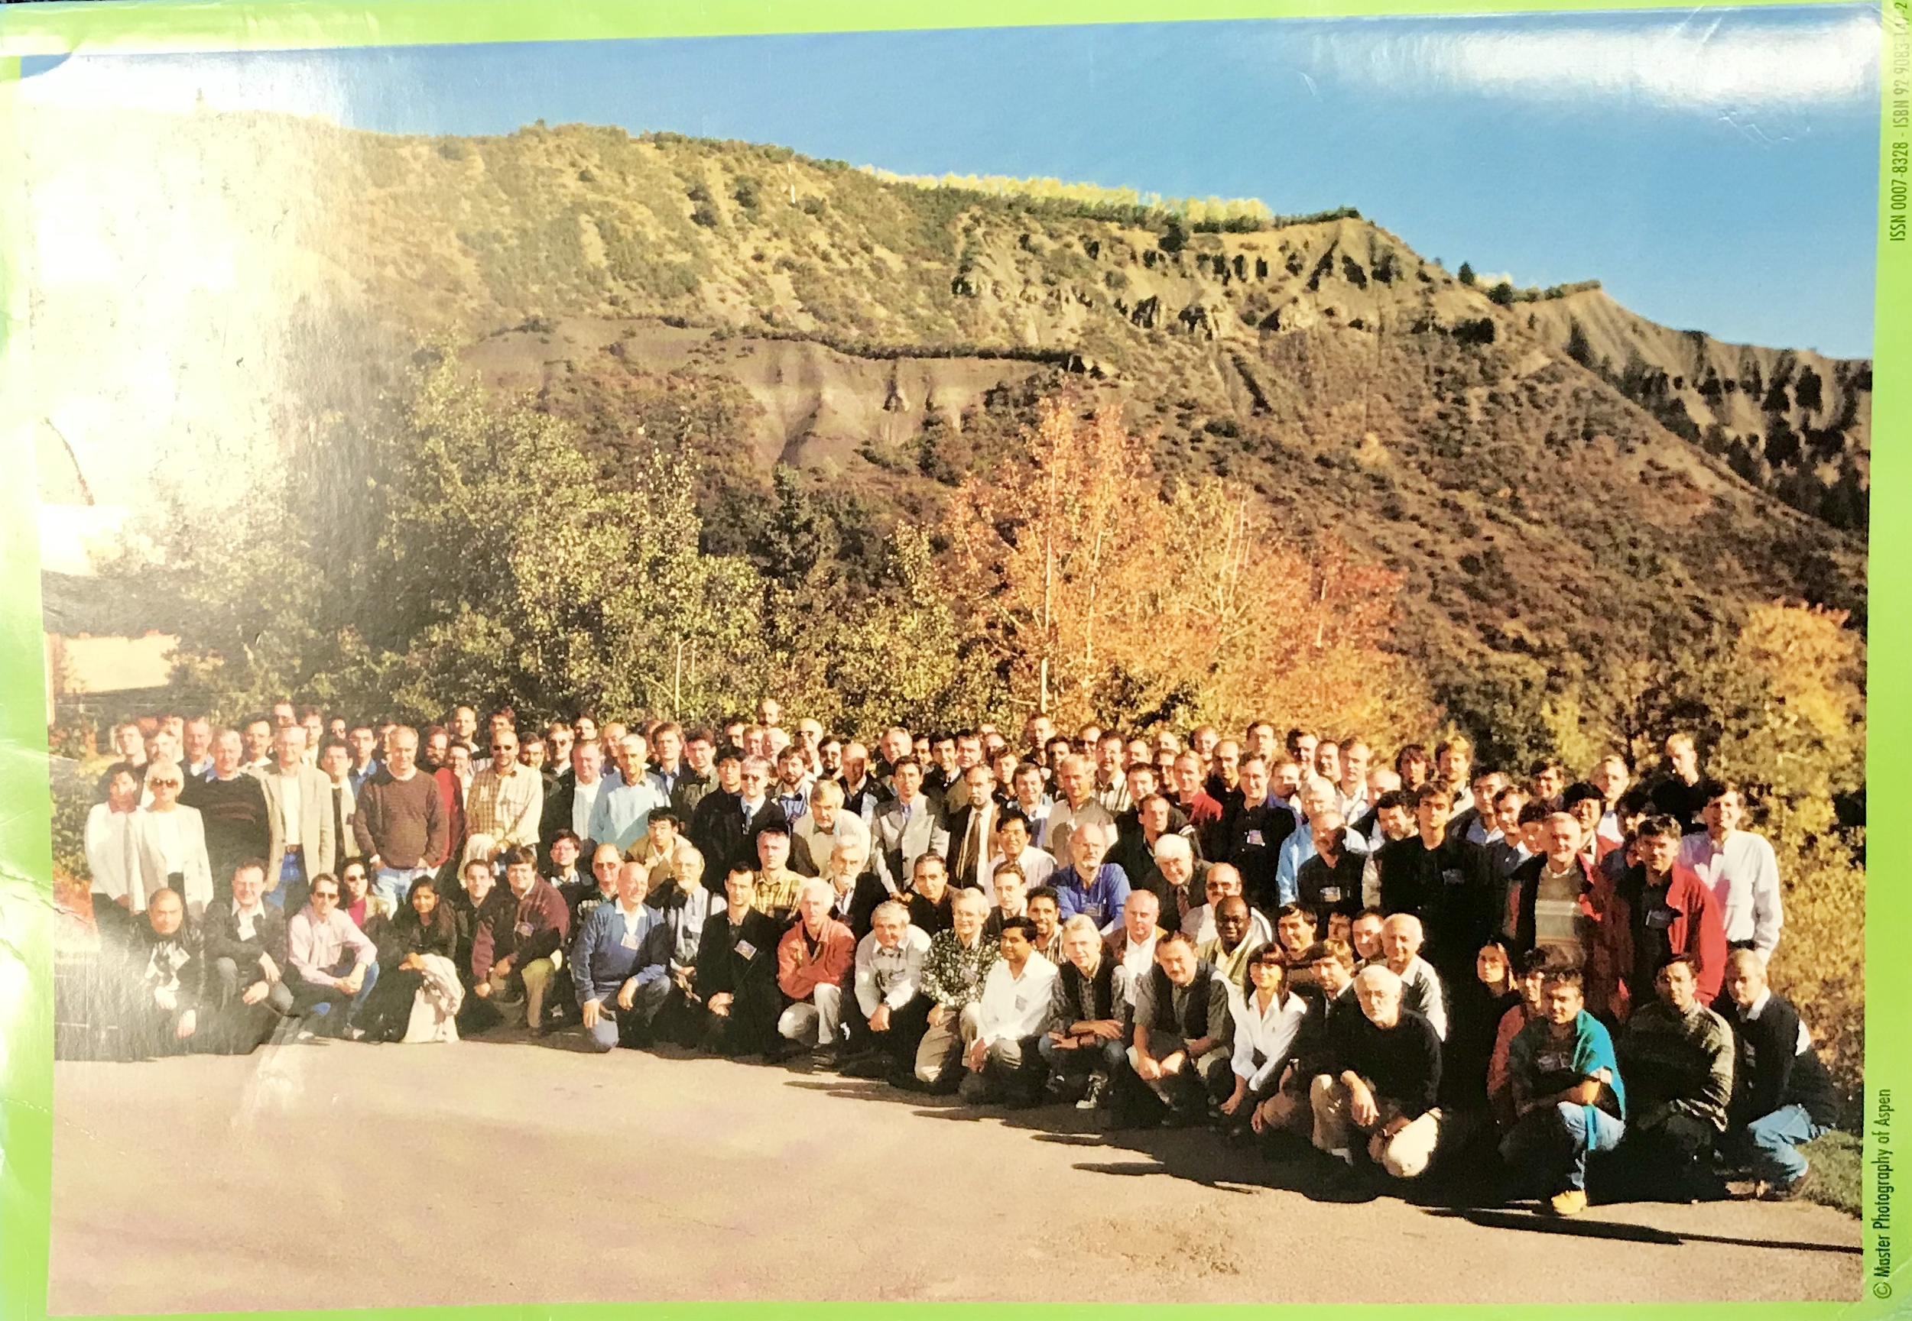
LHC Electronics Workshops
Notes:
Where was I? I think on a longer than expected hike…

Slide 32
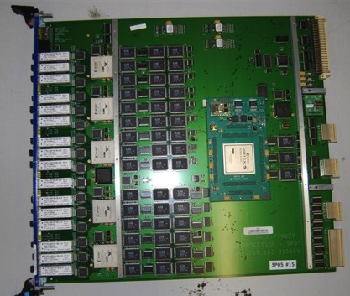
Reasons for an Upgrade: Phase-1
The DTTF “Green Salad”
CSCTF VME processor
LHC Run 2 anticipates: luminosity and pileup twice higher than design!
ASICs cannot be reprogrammed
Older FPGAs near capacity, and memory look-up tables small
Lots of copper cabling (data volume and format fixed)
Large, fragile VME cards

Slide 33
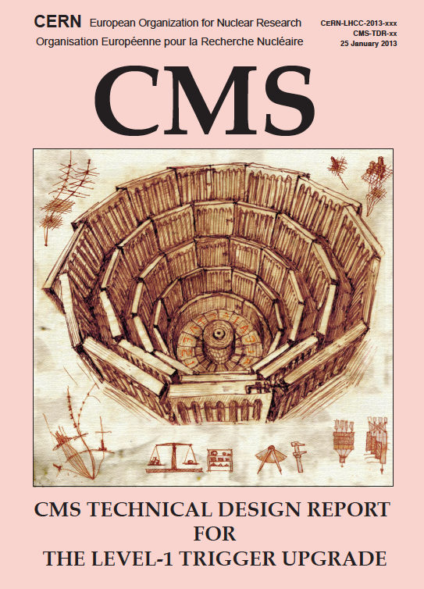
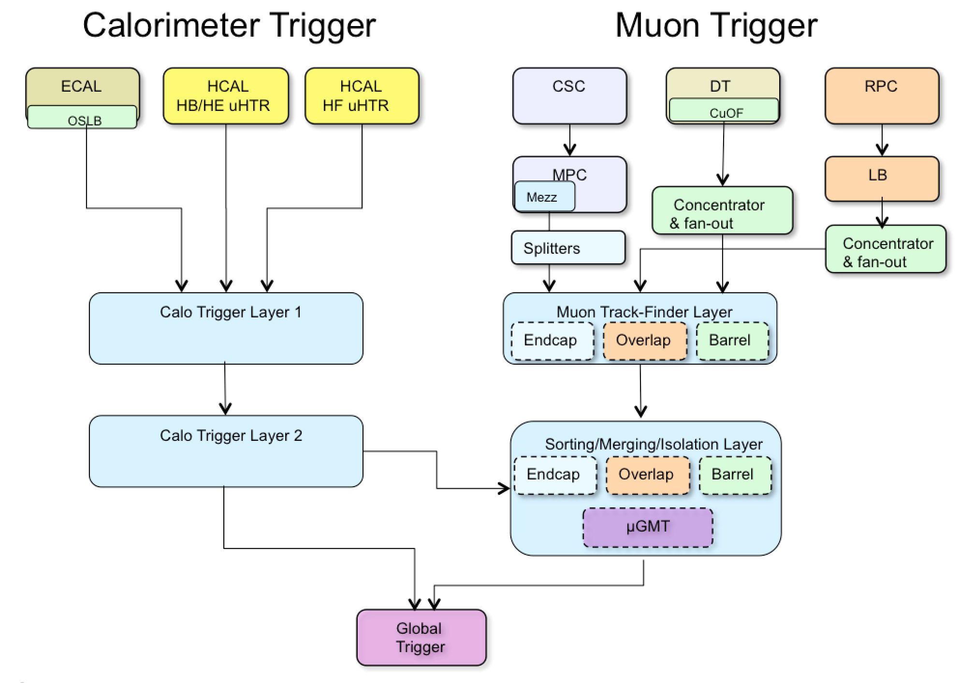
Phase-1 Trigger Upgrade
Mitigate rates by improving:
e/γ isolation
τ id
muon p_{T} resolution and muon isolation
jets with PU subtraction
L1 menu sophistication
Increase system flexibility with higher bandwidth optical links (~10 Gbps) and larger Xilinx FPGAs
Standardize on the μTCA telecomm standard in CMS (something Wesley started with a Los Alamos connection)
TDR in 2013

Slide 34
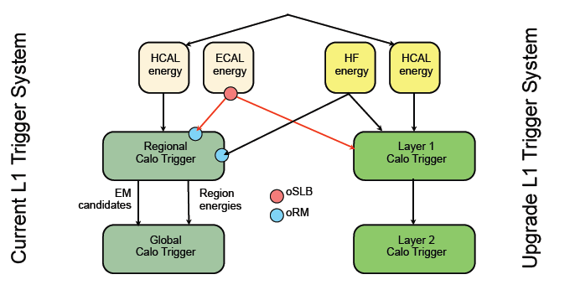
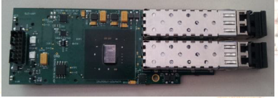
Calo Trigger Transition to Phase-1
Wesley and Wisconsin had a good plan here, including also a “Stage-1” early upgrade deployment in 2015
Important to build and commission upgrade in parallel with current trigger system to safeguard physics, decouple from LHC schedule
e.g. Duplicate ECAL signals with active optical components, and split HCAL optical inputs to HCAL back-end electronics

Slide 35
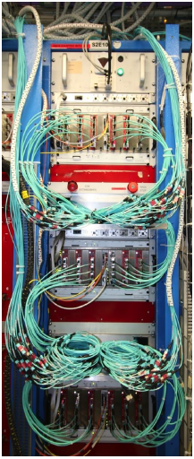
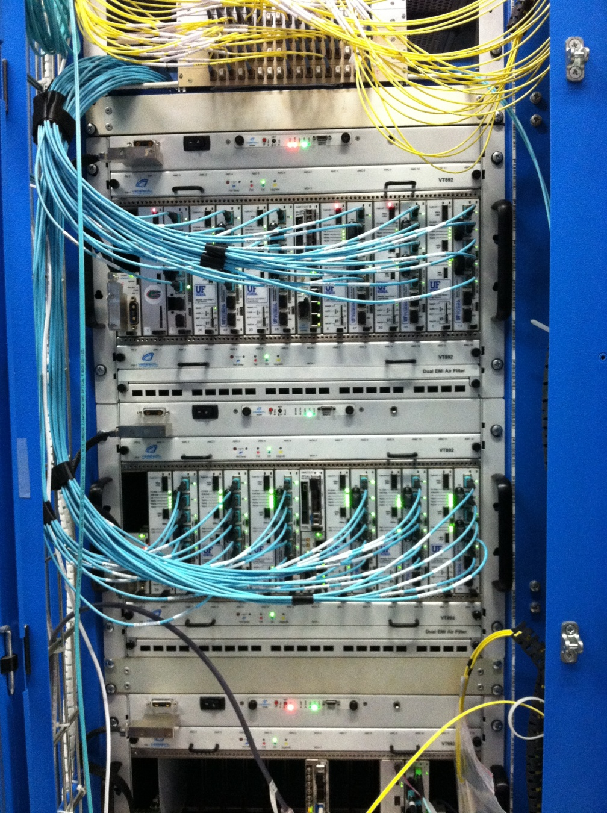
Phase-1 trigger Hardware
Thankfully it too worked!
But maybe only because Wesley ensured enough latency margin in the overall trigger design (we used every last BX…)
CTP7 rack for Calo Layer-1
MTF7 rack for EMTF

Slide 36
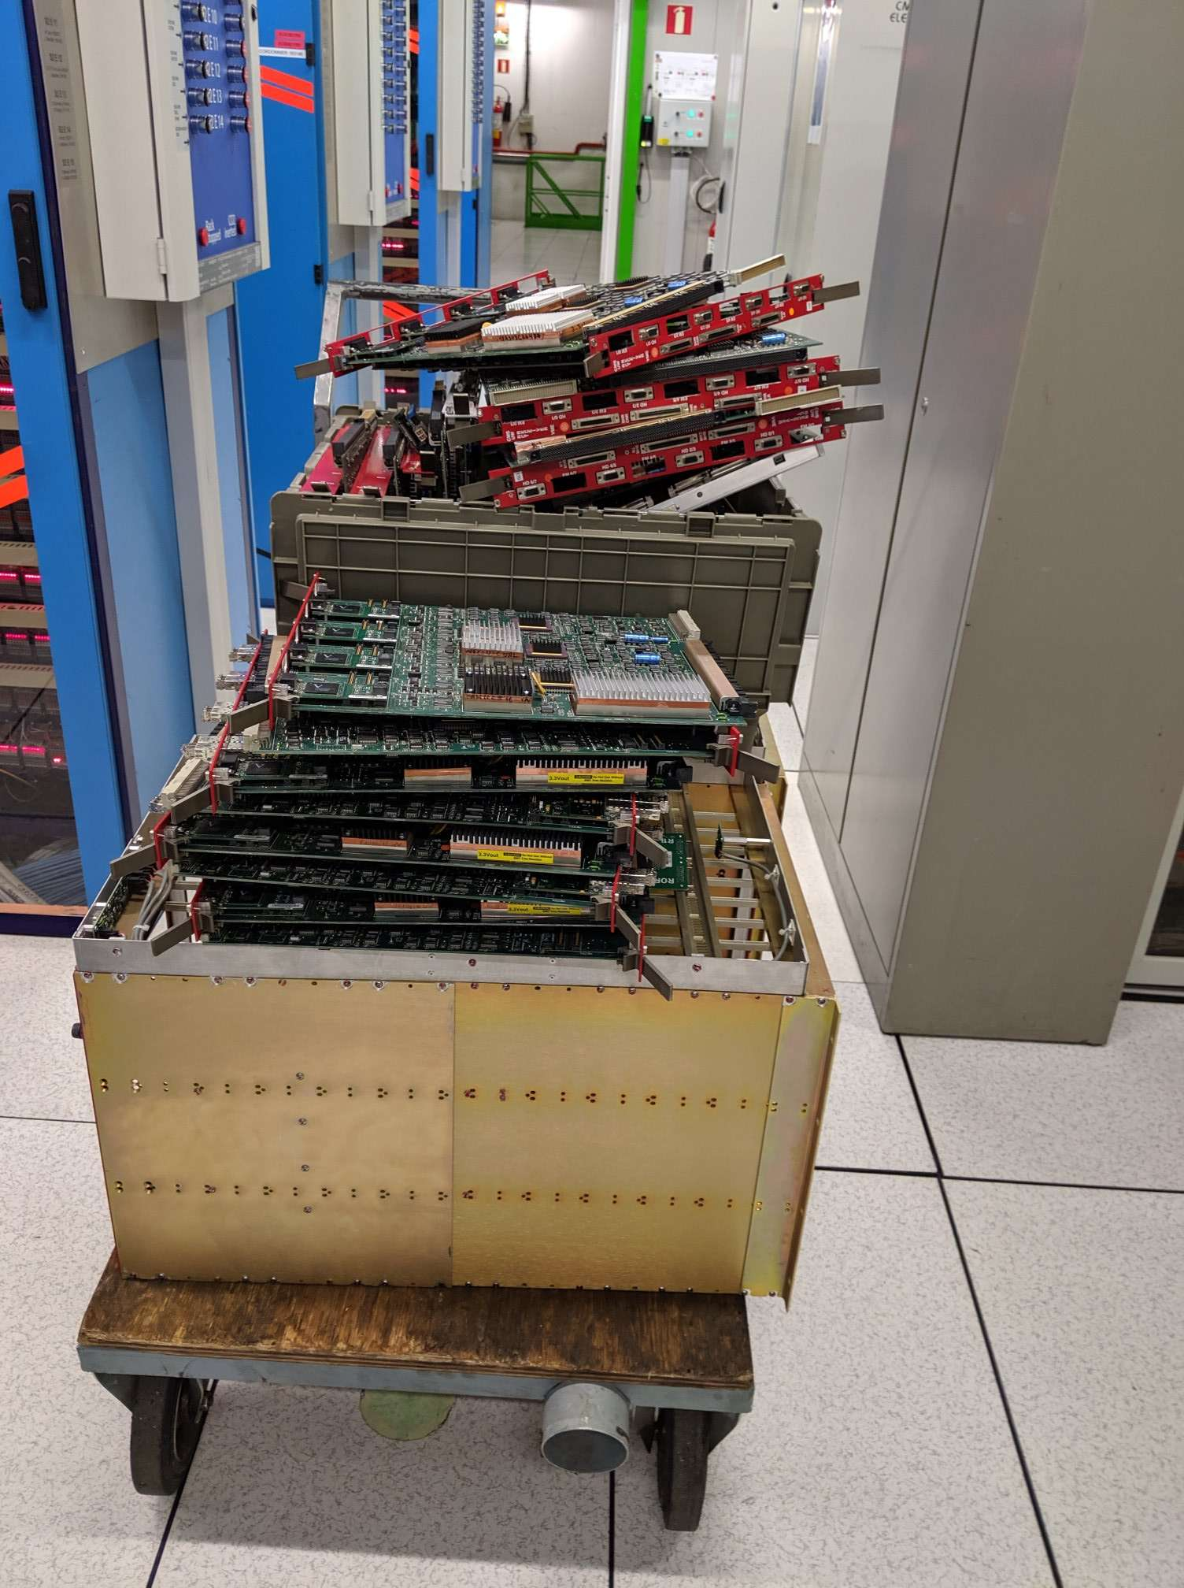
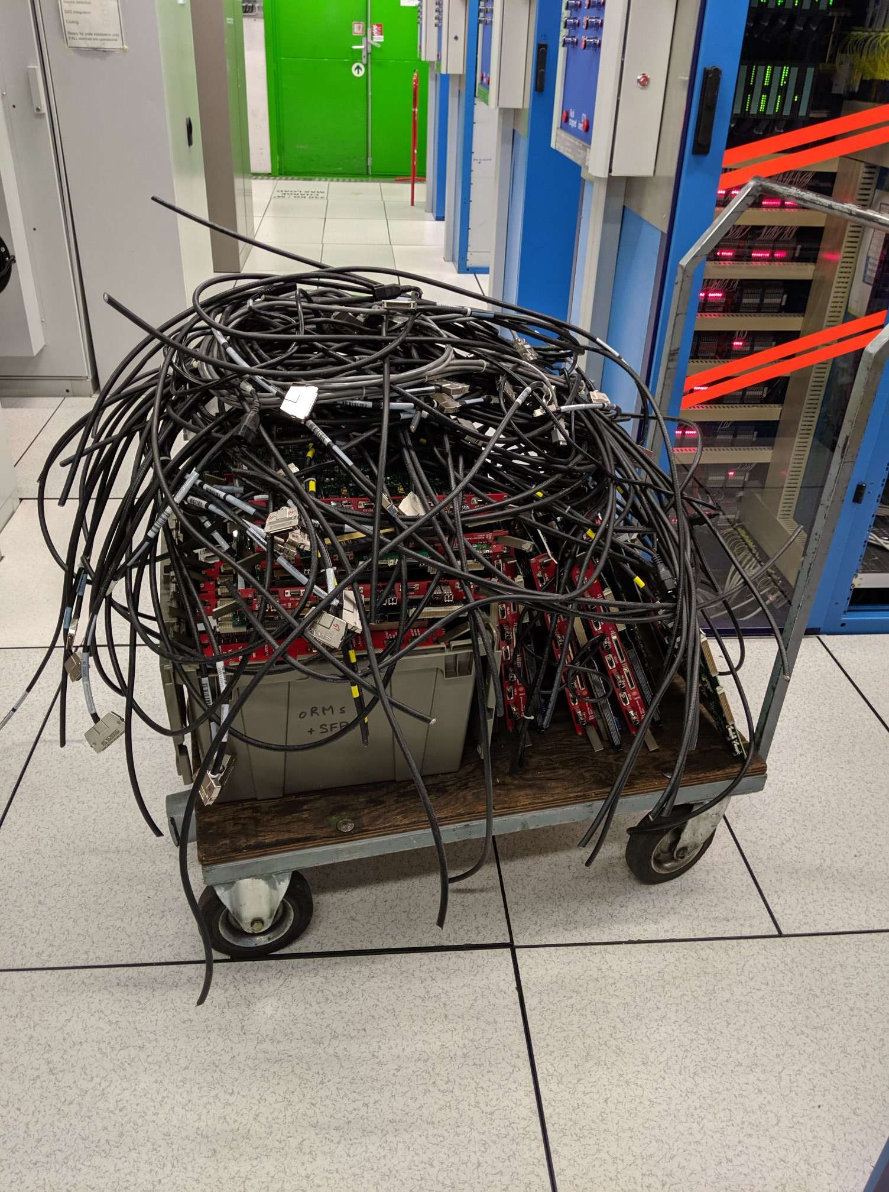
Original RCT Recently Decommissioned
The original Regional Calorimeter Trigger now decommissioned in 2019, as it has been replaced by the Phase-1 upgrade in 2016

Slide 37
Next Generation L1 Trigger For HL LHC
Incorporation of tracking at Level-1 from the silicon tracker
Major missing ingredient!
Correlation of tracks with other Level-1 objects
Better charged lepton ID, refine (muon) momentum, assign jet vertex, determine primary vertex, provide track-based isolation …
Introduction of crystal granularity at Level-1 for ECAL barrel
ΔϕΔη = 0.0175 × 0.0175 vs. 0.0875 × 0.0875
Better spike rejection and EM shower identification
Incorporation of Phase-2 forward muon detectors into muon trigger
Increased redundancy, more bending angles
Trigger rates up to 750 kHz @ Level-1, 7.5 kHz @ HLT (vs. 100 kHz and 1 kHz today)
Level-1 trigger latency of 12.5 μs (vs. 4.0 μs today )
Allow time for additional processing (Track Trigger, Correlation)
Foresight to push both for tracking @ L1, and increased output bandwidth to better balance L1 and HLT

Slide 38
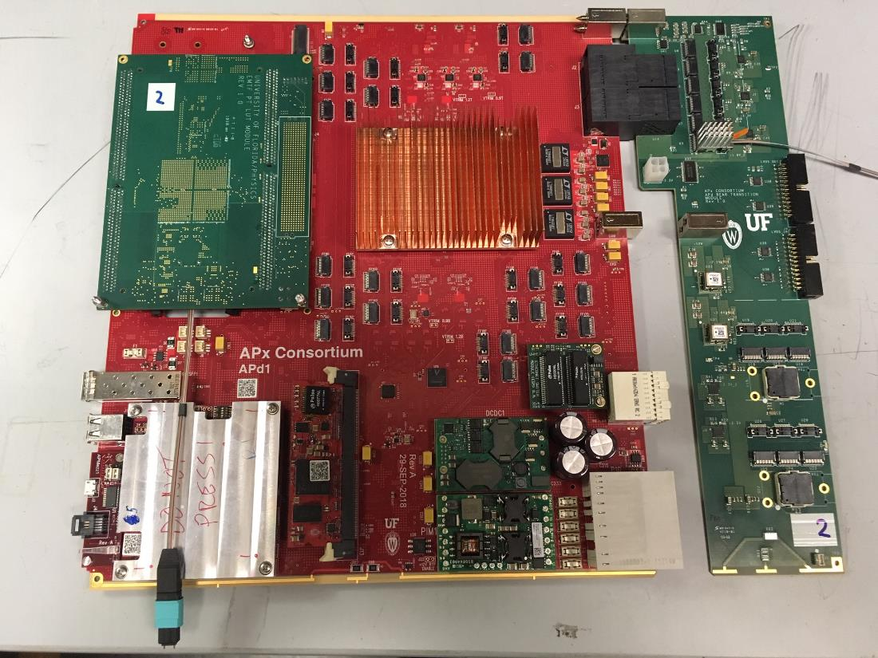
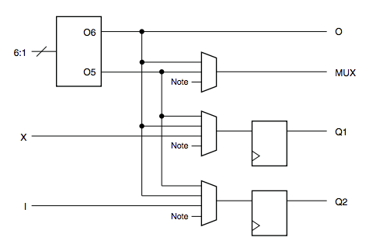
And we’re on our Way!
APx R&D:
I/O: 25 terabits/sec
2.5 million logic cells

Slide 39
A Large Leap from the past
A far cry from the ~32 AND gates that I programmed into a PAL for the CsI trigger logic of the SLAC TPC/2Gamma experiment in 1988
Or the wire-wrapped trigger logic for the CLEO-II experiment…

Slide 40
Future Circular Collider (Hadron)
But APD may be just as primitive compared to a system for a FCC, 40+ years from now !
Goals:
Higher energy: ~100 TeV
Explore high energy frontier
Higher luminosity: 5-30 x 10³⁴ Hz/cm²
High precision, e.g. Higgs boson couplings
Trigger Challenges:
Pileup: O(1000) pp collisions per beam crossing (20X more than LHC)
Higher detector channel count from increased granularity
Radiation levels in tracking volume
FCC-ee
FCC-hh
Notes:
And a new generation of scientists and engineers!

Slide 41
Travel & Eating
Notes:
What physicists talk about when then eat… How many miles has Wesley flow????

Slide 42
Pizza in Meyrin
Notes:
Probably had 100s of pizza here. Wesley would program the GPS in his rental car to get around, which really wasn’t needed to get to places we visited ~100 times!

Slide 43
Volcanos
Wikipedia
Kept us a bit longer than anticipated at CERN
Notes:
Hurricanes too!

Slide 44
In conclusion
“So long, and thanks for all the triggers!”
Your legacy will always be a part of the experiments, and the high-energy physics community
You set a good example of taking the correct, hard decisions, and fighting to achieve them (triggers, physics, management, etc.)
Thanks for all the opportunities!
I wish you well in a hard-earned retirement

Slide 45
Thanks
To Stan Durkin and Ben Bylsma for help with ZEUS trigger info

Slide 46
An Aside on Kinematics at Colliders
Energy and momentum is always conserved in general, but observed quantities may not because of particles escaping down the beam pipe or because of neutrinos (and neutralinos?)
e+e- colliders
Total observed energy and momentum is conserved for annihilation processes (thus provides a √s constraint)
Hadron colliders
Observed longitudinal momentum (p_{z}) is not conserved in hadron-hadron colliders, because of the unknown parton momentum fraction x in each struck hadron
Transverse momentum is. Unbalanced attributed to MET from unmeasured particles
e p colliders
While p_{z} is not conserved, E – p_{z} = 2E_{e} is for an ep collider. Provides another kinematic constraint handle that pp colliders do not have

Slide 47
SSC R&D symposium, 1990

