Slide 1
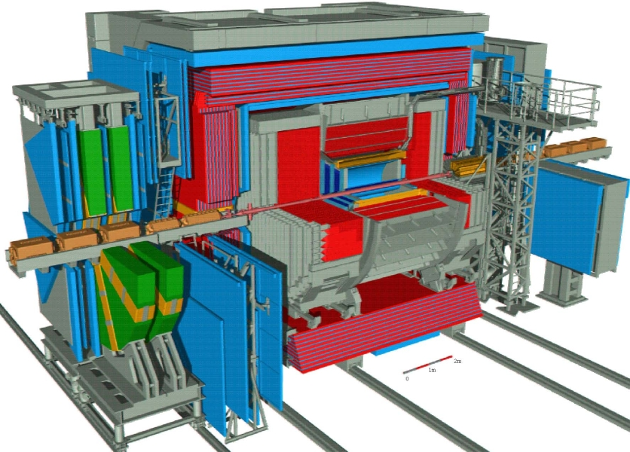
The Zeus CFLT
C Calorimeter
F First
L Level
T Trigger
Sam Silverstein, William Badgett

Slide 2
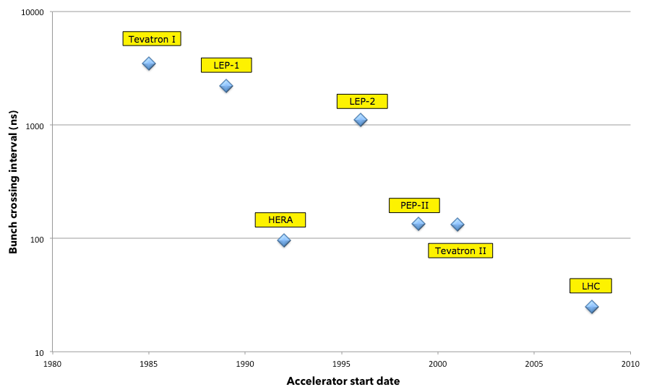
The HERA experiments were pioneers in using pipelined level-1 triggers
Evolution of Beam Crossing Period
Decreasing time to make a L1 trigger decision
⇒ Pipelined data processing prior to trigger readout decision
3.5𝜇s
132ns
96ns
25ns
BC interval << readout time
Background rate (beam gas) >> physics
SSC
😢
16ns

Slide 3
The ZEUS CFLT design
Beam gas background could be reduced with strategies similar to later experiments
Total, transverse and missing transverse Et
Isolated leptons
[Jets] (fast clear)
Extensive use of lookup tables (SRAM)
Arbitrary functions in a single clock cycle (low latency)
Can change LUT contents at will (flexible)
High bandwidth trigger readout and processing
Backplane readout at 8$×$ BC rate (83 MHz ECL)
High speed pattern logic and energy summation

Slide 4
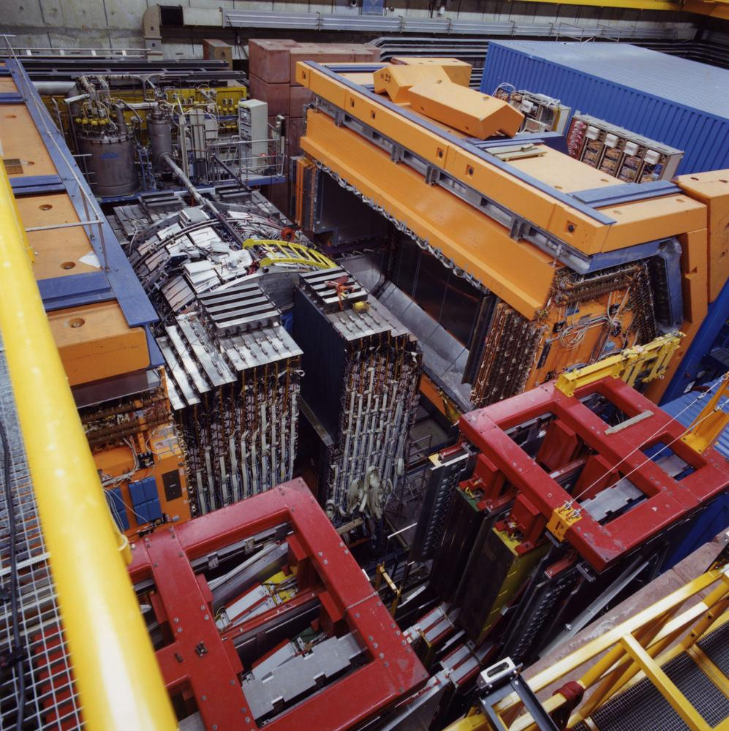
Front-end electronics
Collect and add summed PMT pulses from the analog front-end cards
Shape pulses into ‘square’ 100ns analog pulses
Transmit pulses to electronics house (Rucksack) over shielded twisted pair cables
Long installation and debug campaign!

Slide 5
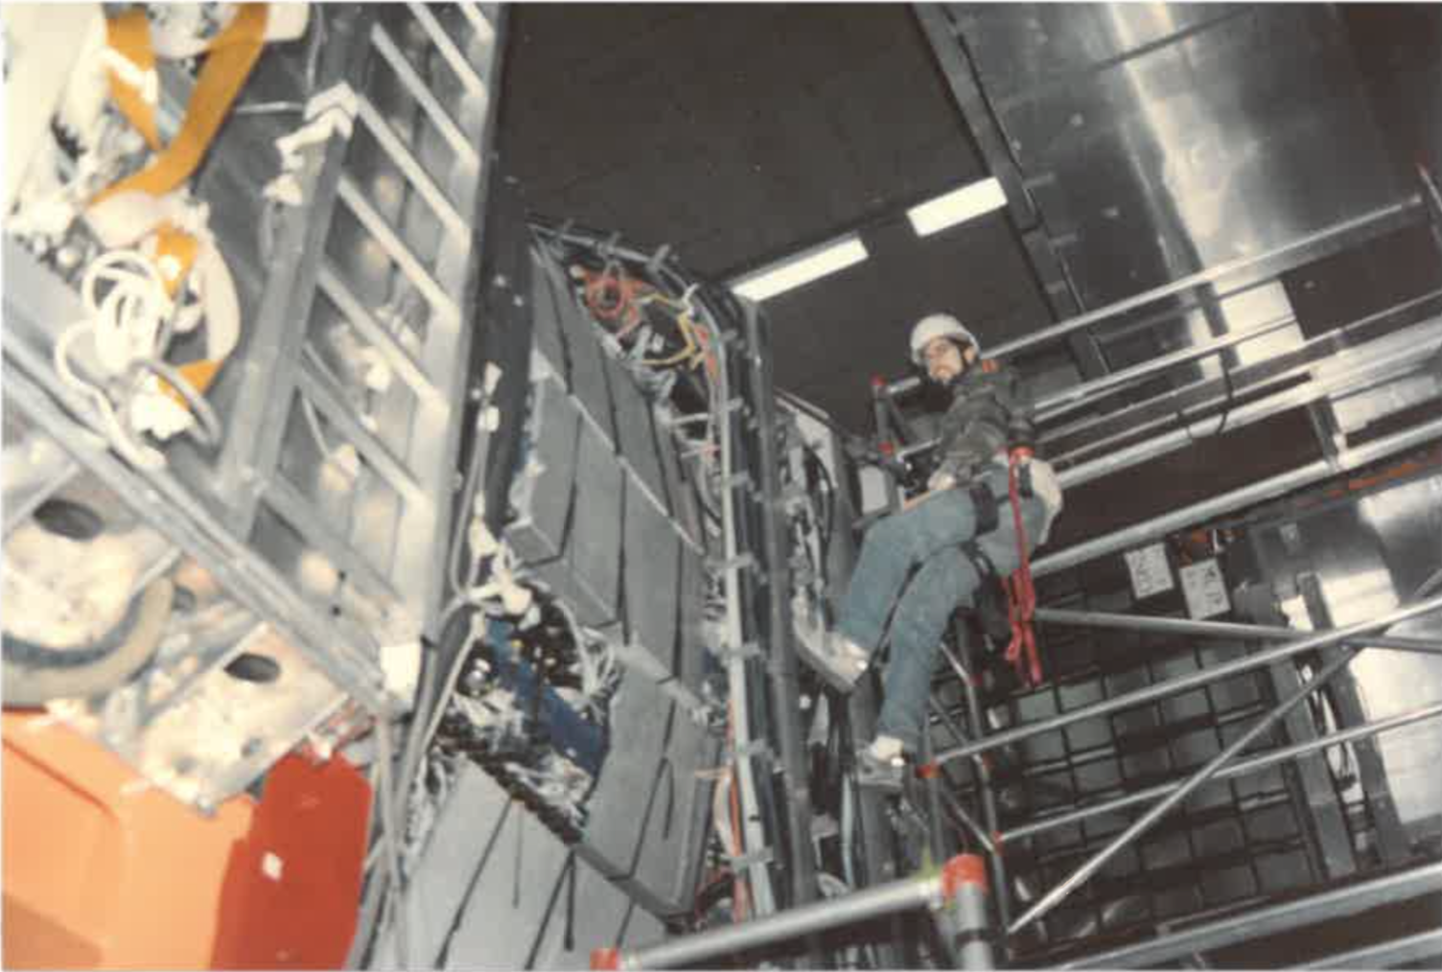
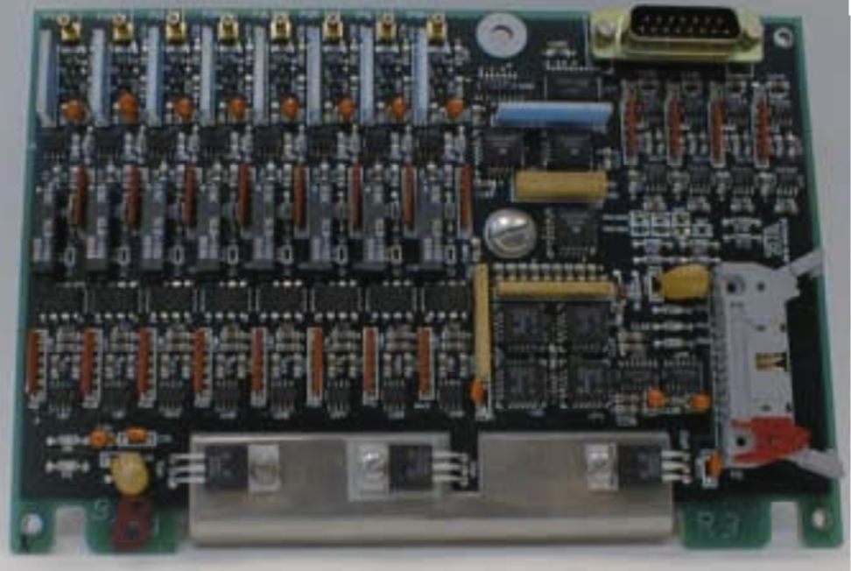
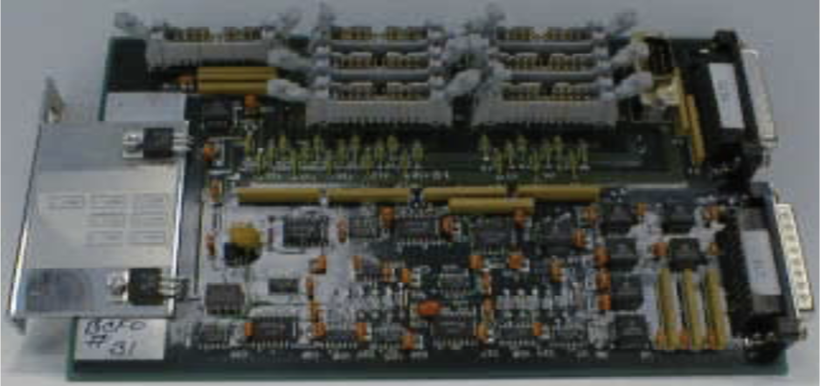
On-detector installation & cabling
>700 Trigger sum cards (TSC) with varying input summation schemes
>100 Fanout cards to power and control the TSCs
>5000 coaxial input cables, with majority (FCAL and RCAL) hand-labeled

Slide 6
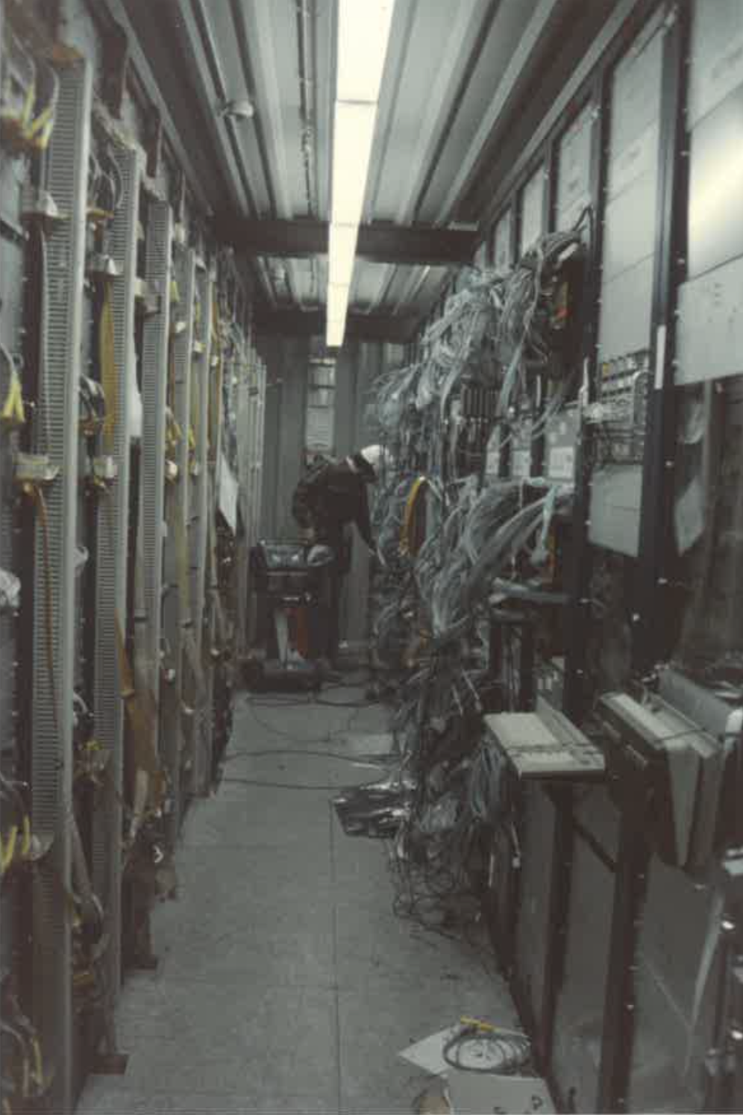
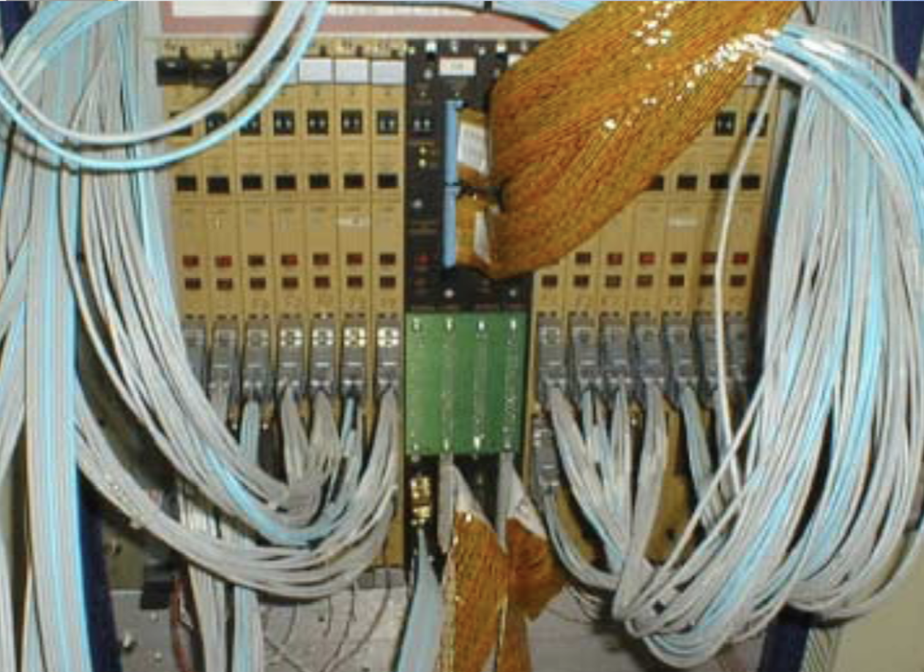
Off-detector input cabling
Analog cables from CAL with >2800 active twisted pairs remapped to the TEC inputs by splitting them into individual pairs and recombining them (by hand)

Slide 7
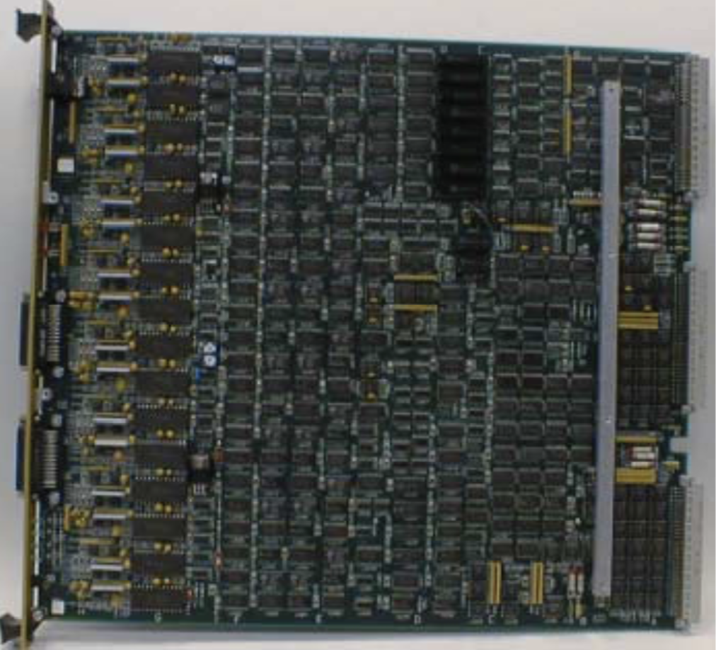
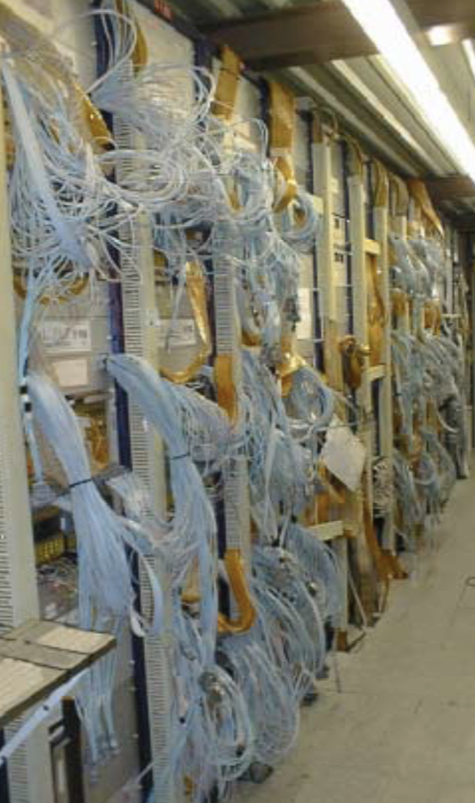
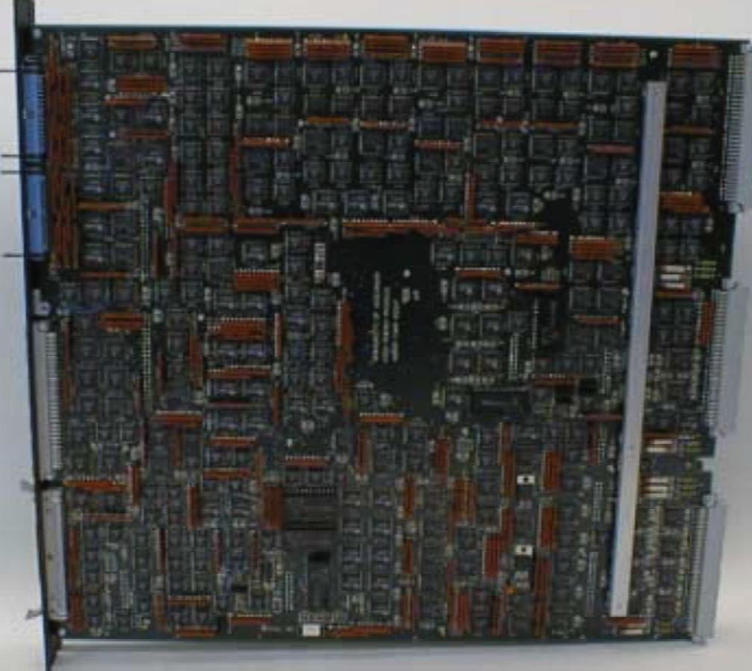
Off-detector electronics
224 Trigger Encoder
Cards (TEC), each serving 4 EMC/HAC trigger towers
32 double
Trigger Adder
Cards, performing
Crate-level summation
And ISOLATION pattern
logic

Slide 8
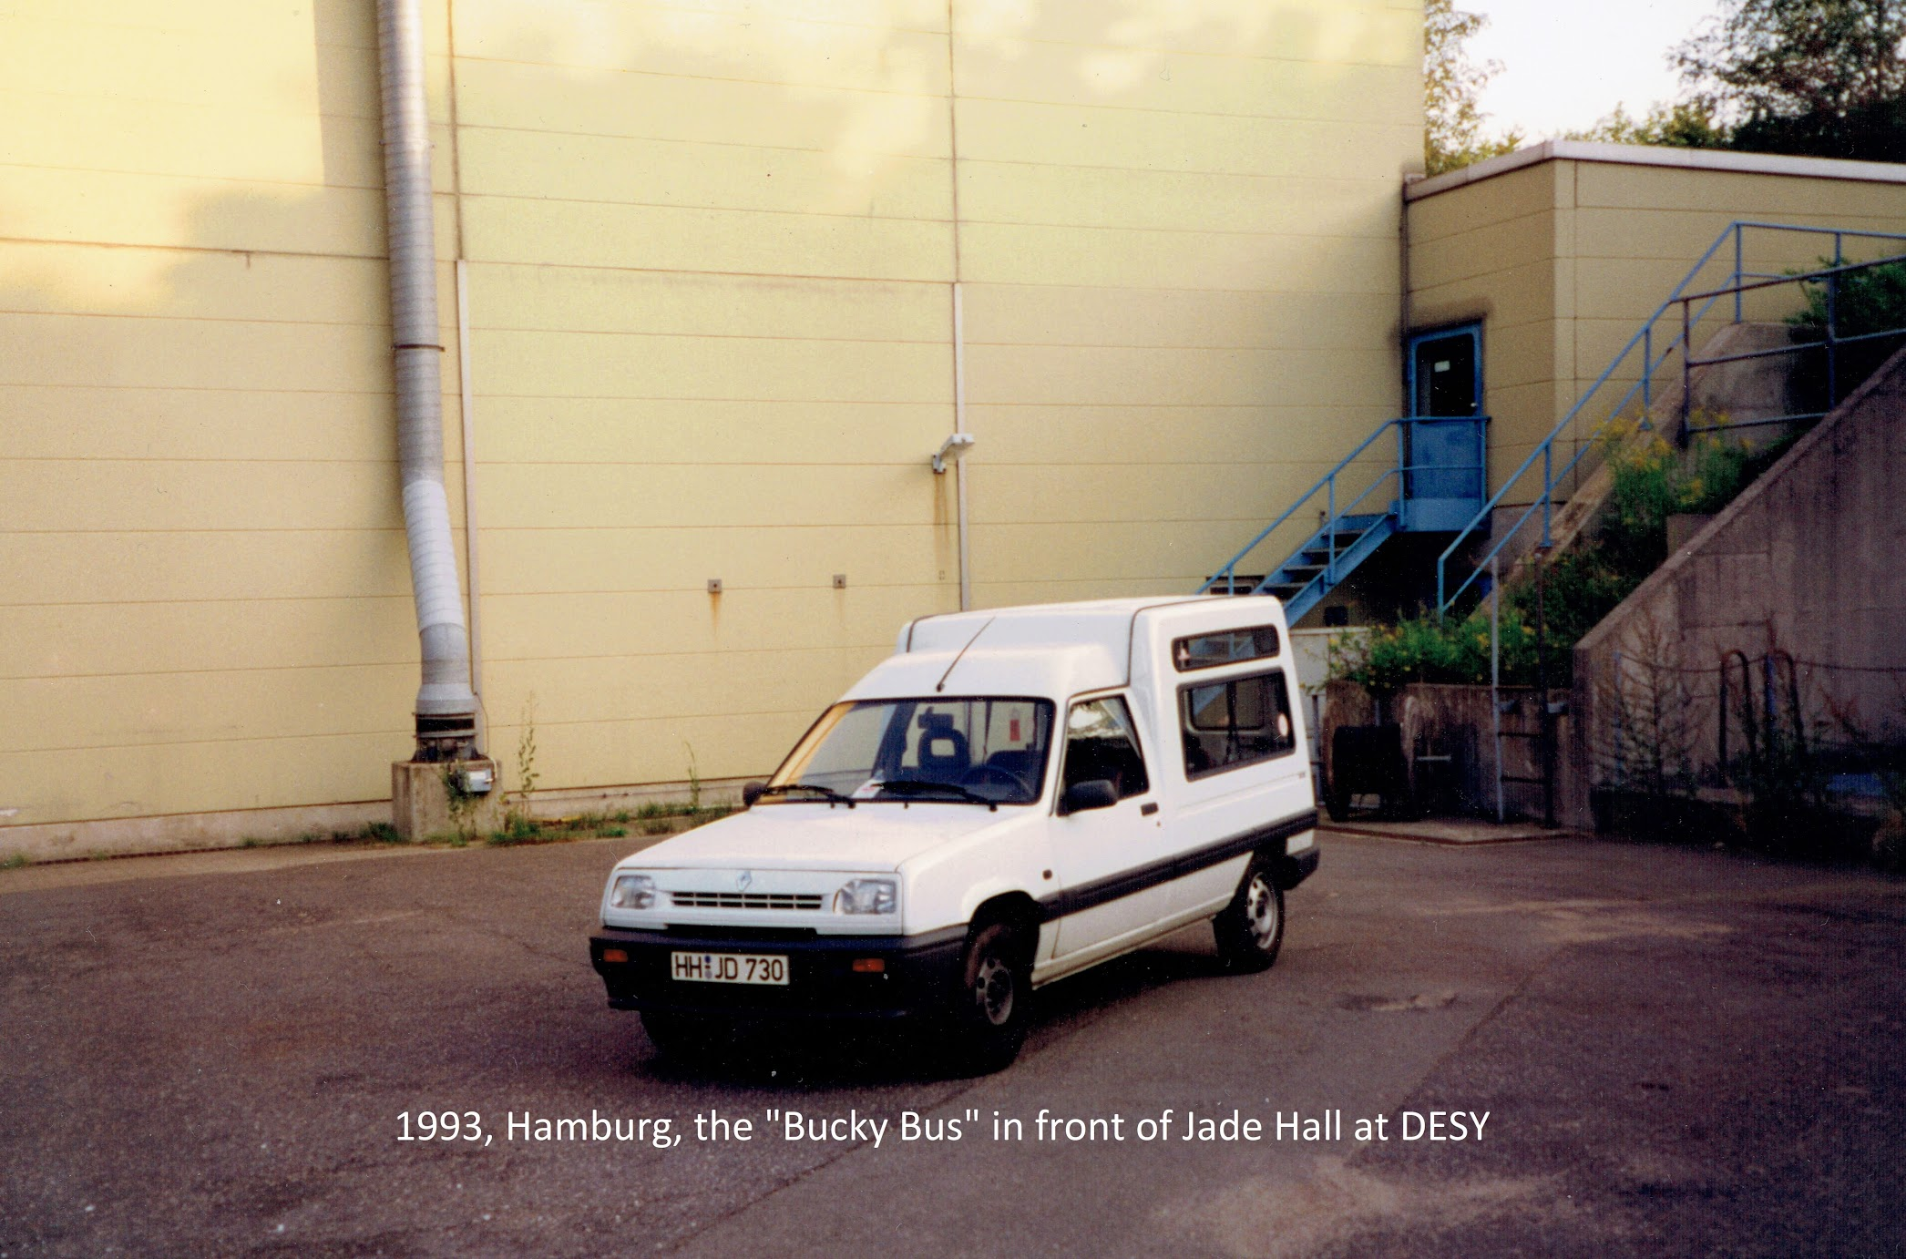
Most critical part of CFLT operations: getting to The South Hall to rescue Zeus

Slide 9
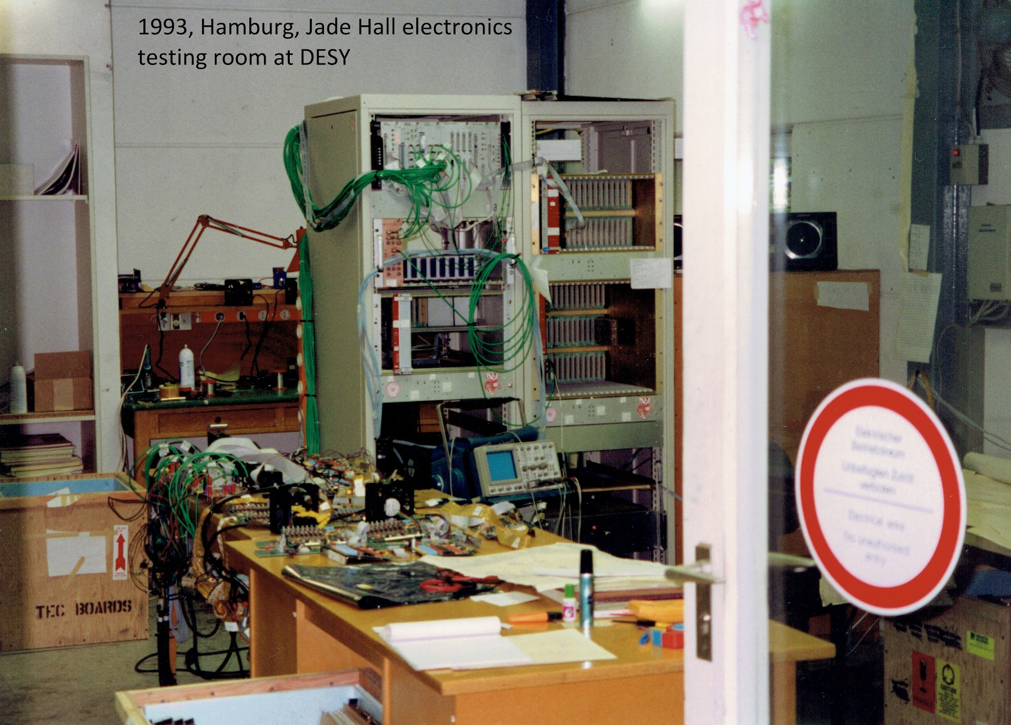
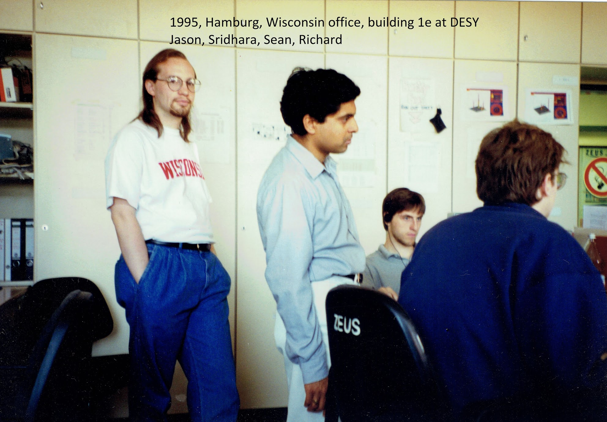
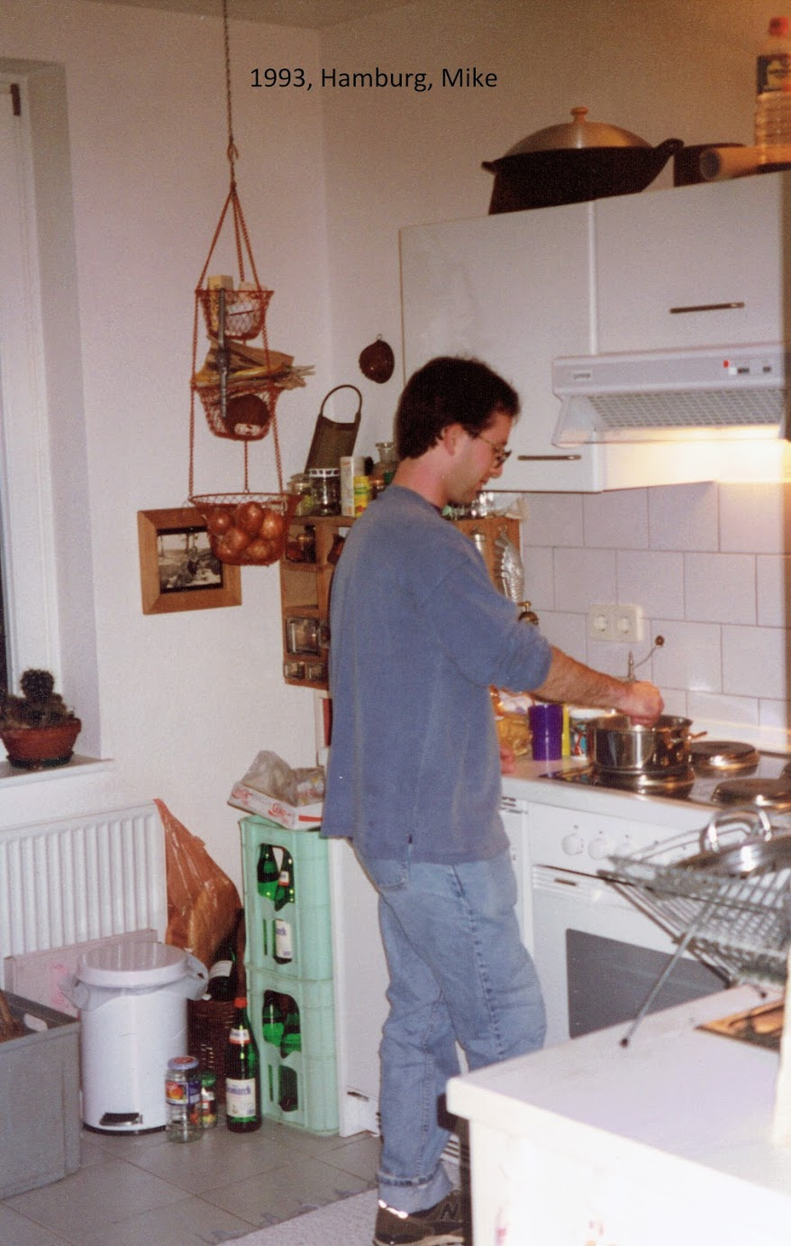
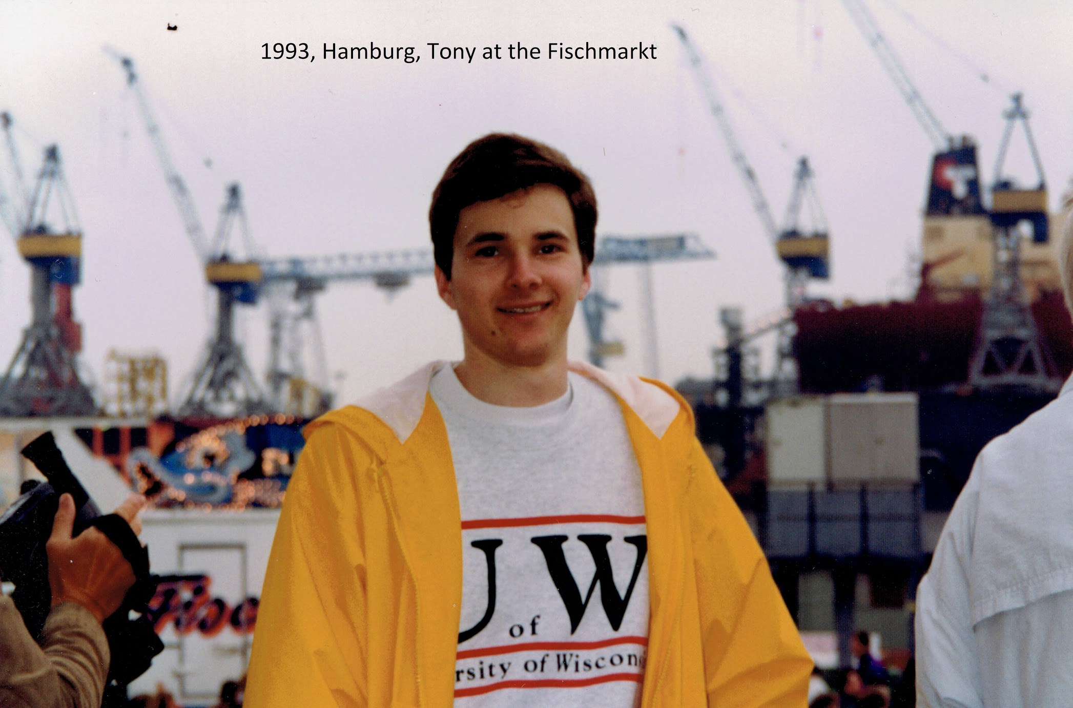
Some of the CFLT Crew
Mid 1990’s

