Slide 1
CMS Calorimeter Trigger Operations
Pam Klabbers
Fermilab

Slide 2
Much more…
We did so much over the years
We started up…
Commissioning, learning to operate all the pieces together
The LHC started up…then did not
More commissioning
A few late arrivals went online
LHC restarted
Things got real
LHC takes a break (aka Long Shutdown 1
But we don’t get a break – the first upgrades go into place
LHC Run 2

Slide 3
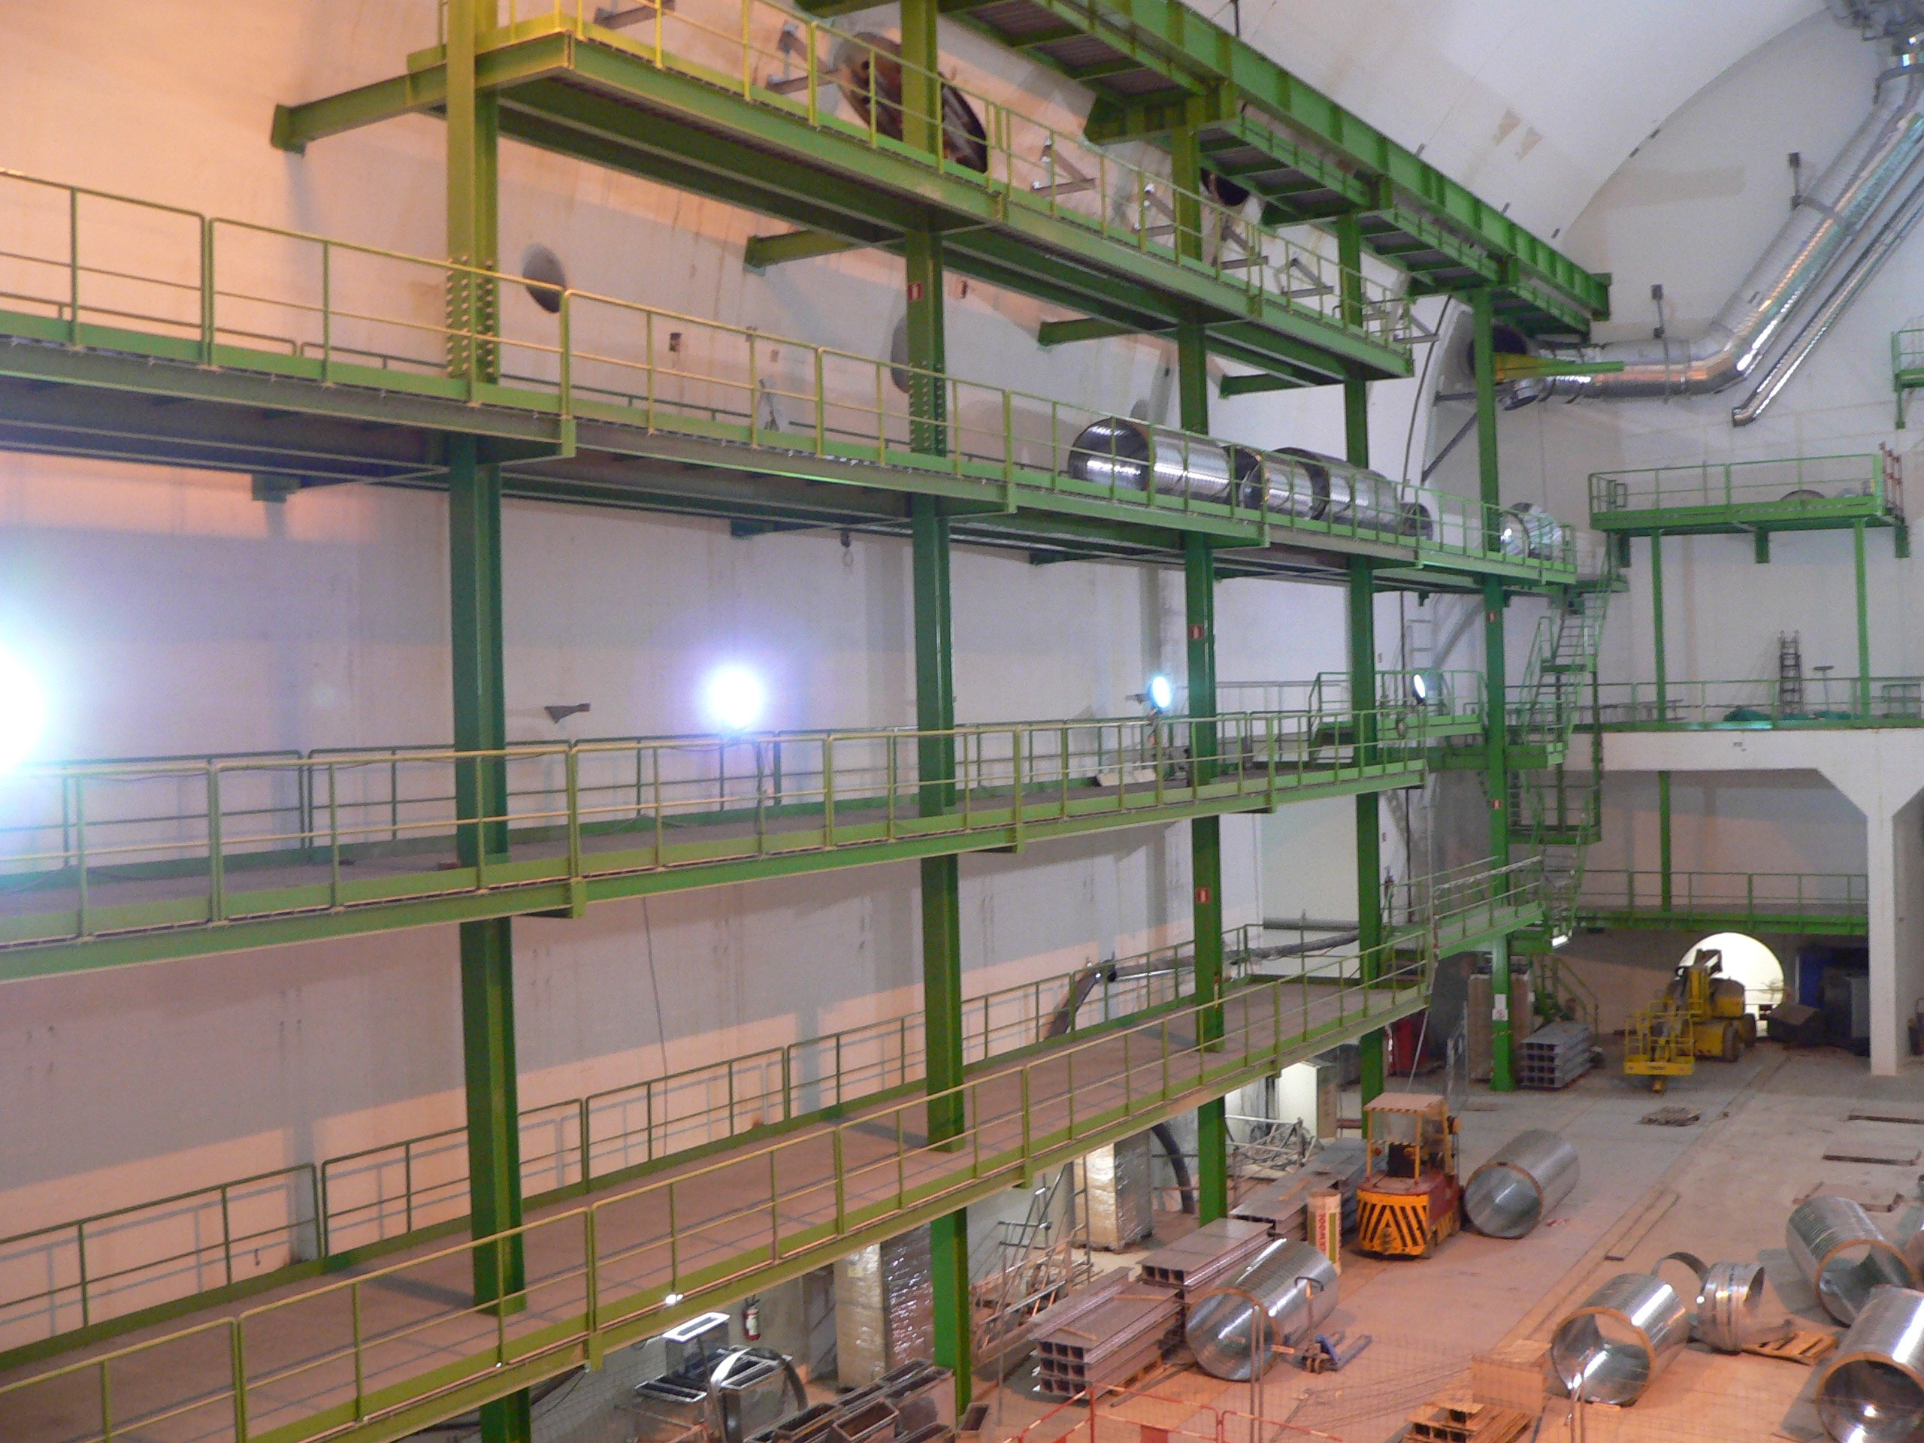
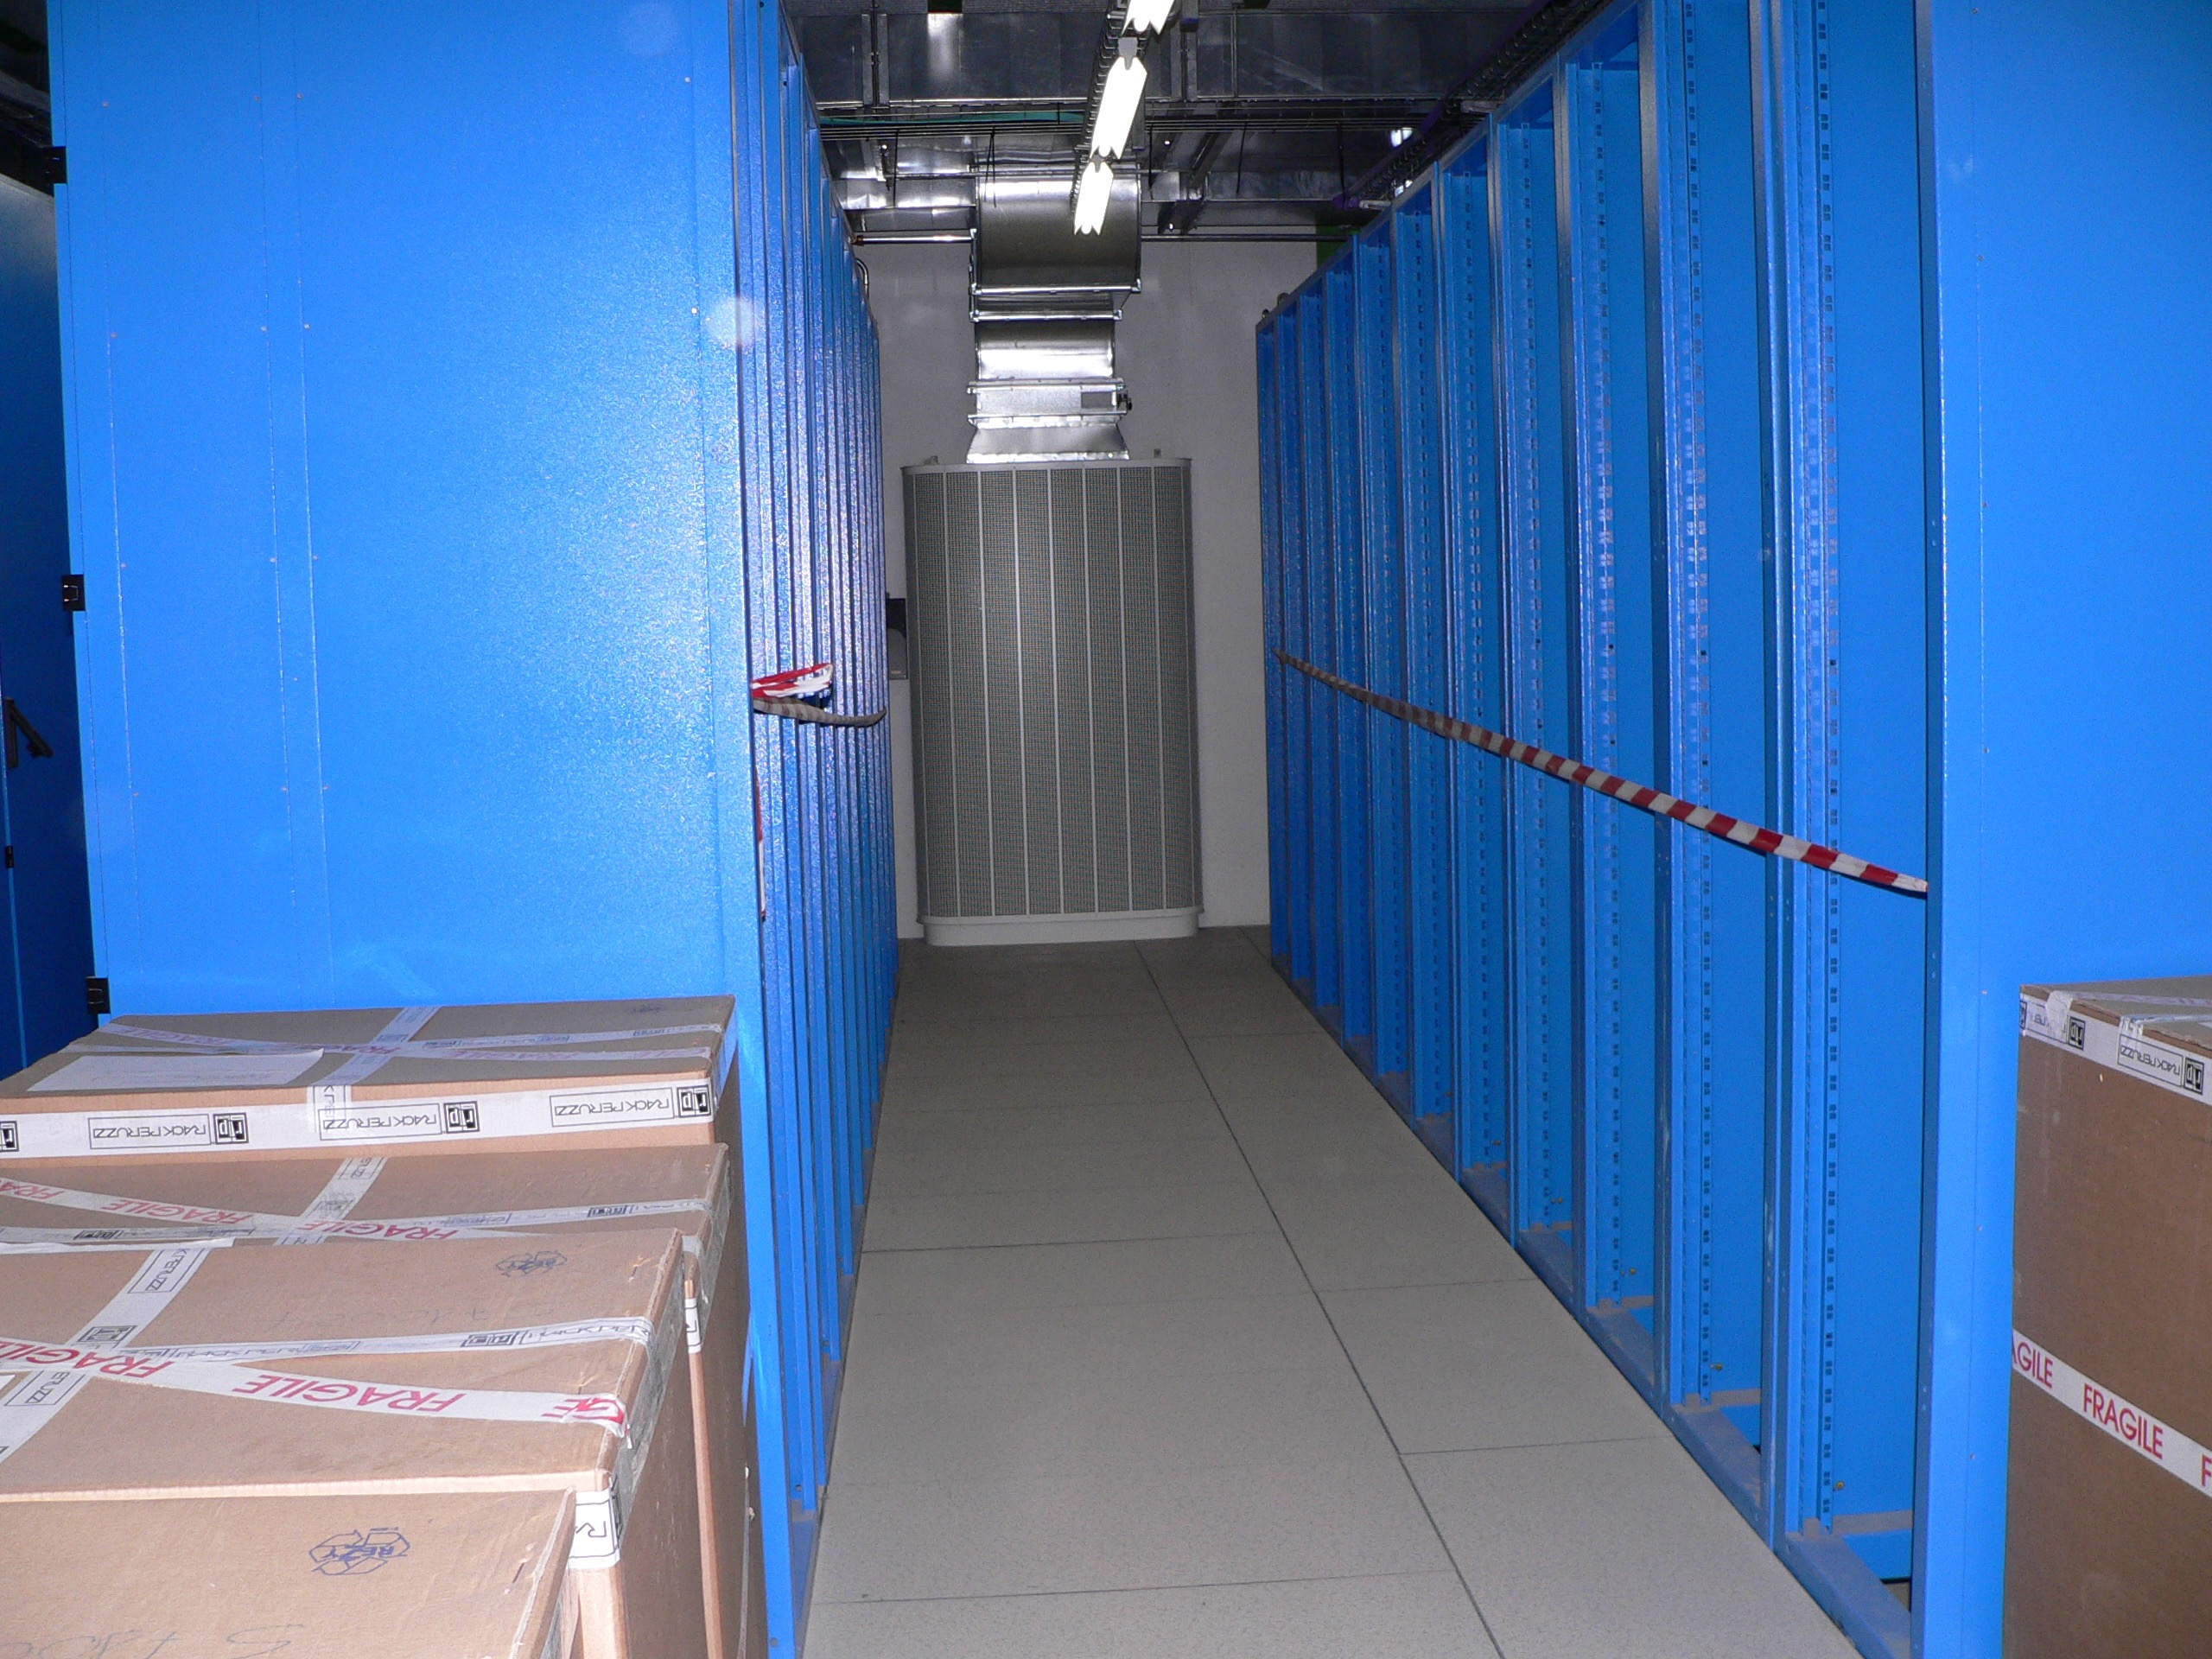
2005: Things were kind of bare
Calorimeter Trigger hardware was in production
CMS facility still under construction
Need: a central CERN-based integration area.
Wesley advocated for such a space

Slide 4
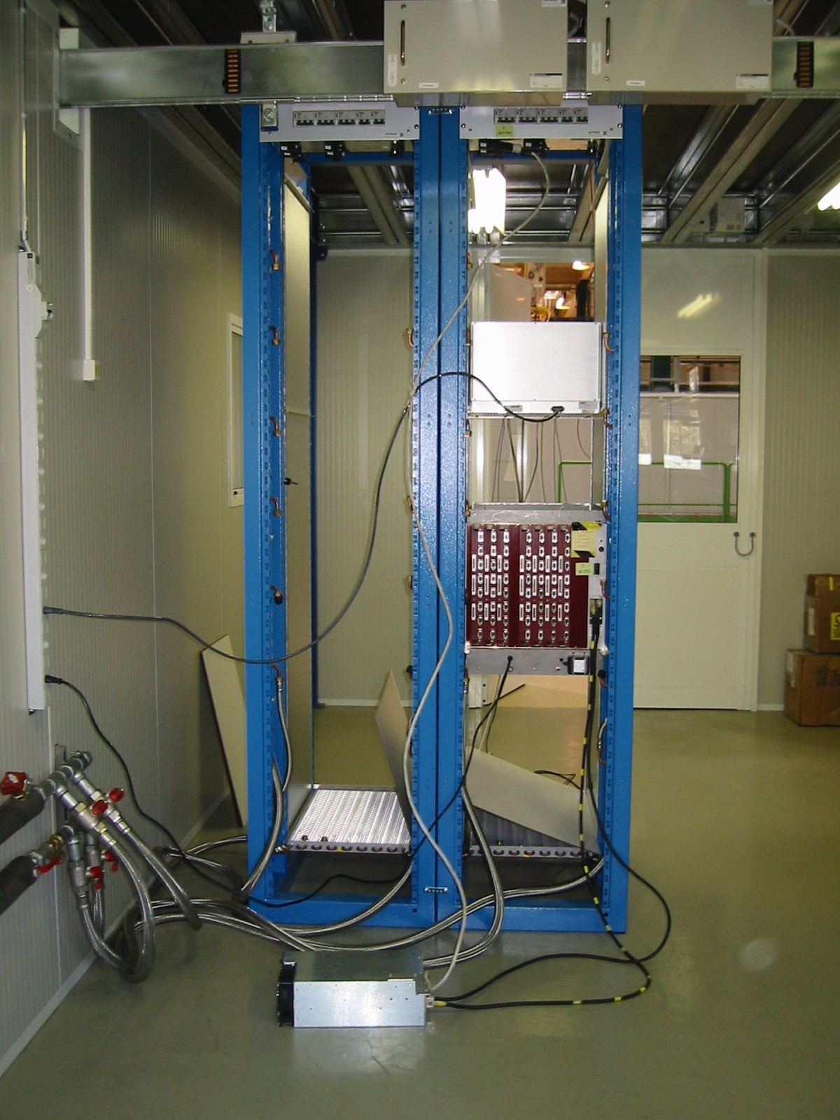
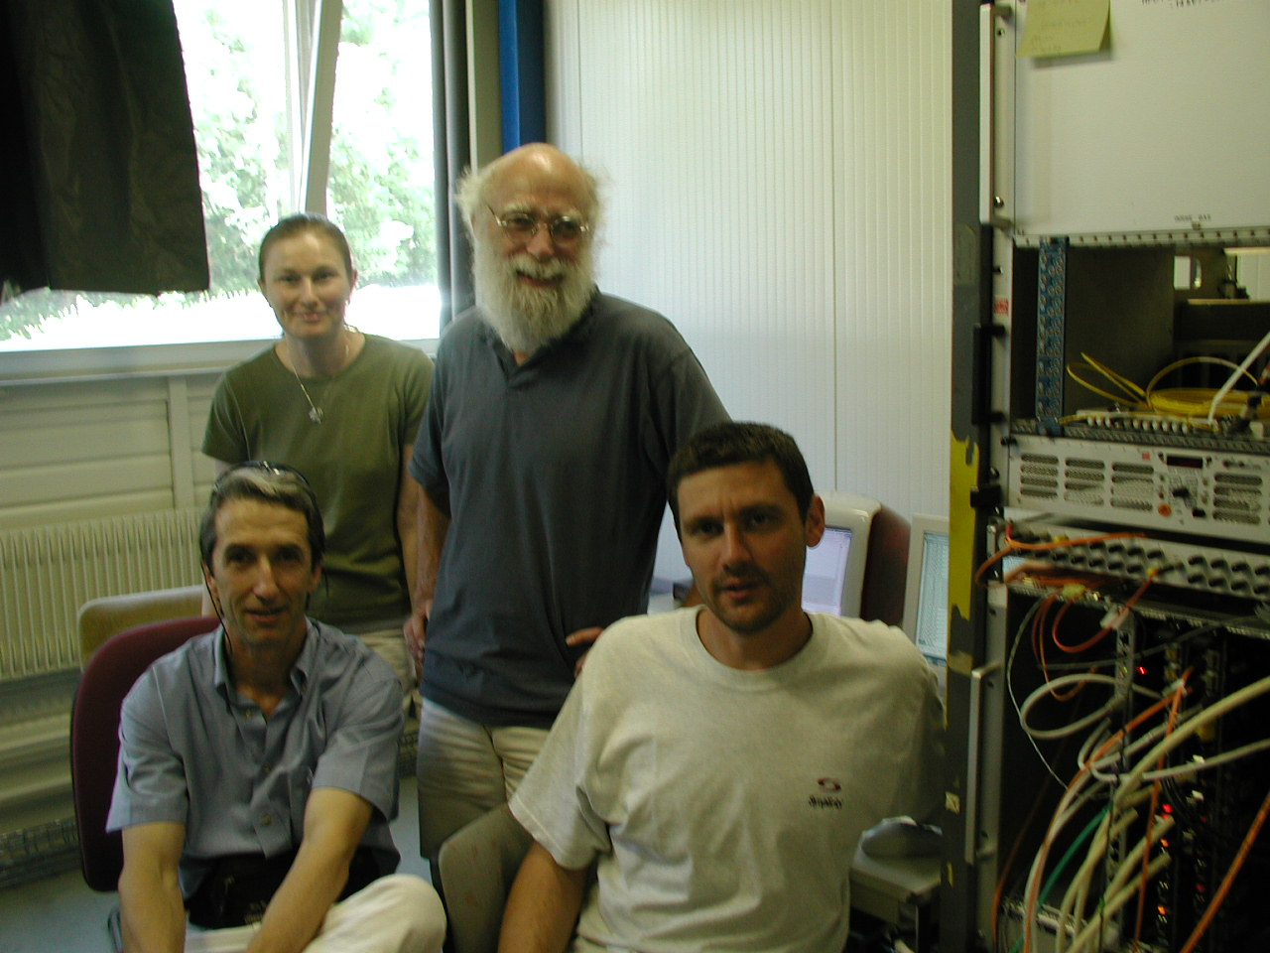
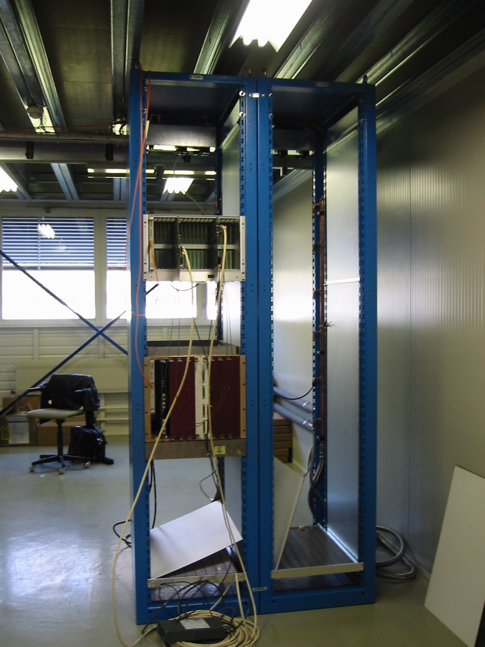
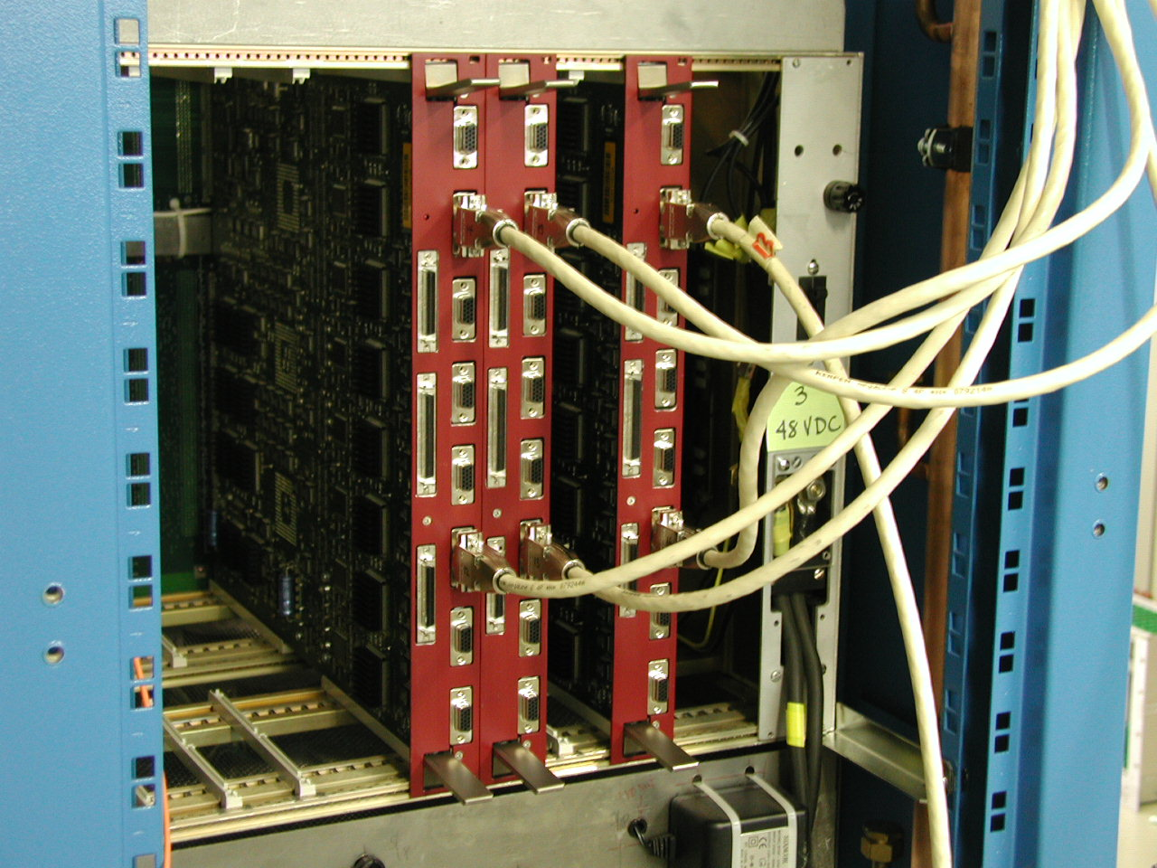
Electronics Integration Center
AKA “904”
The Synchro Team June 2005
At first it was a little spartan…
But it got the job done!
A prime spot for tests and coffee for many years…
HCAL-RCT Integration

Slide 5
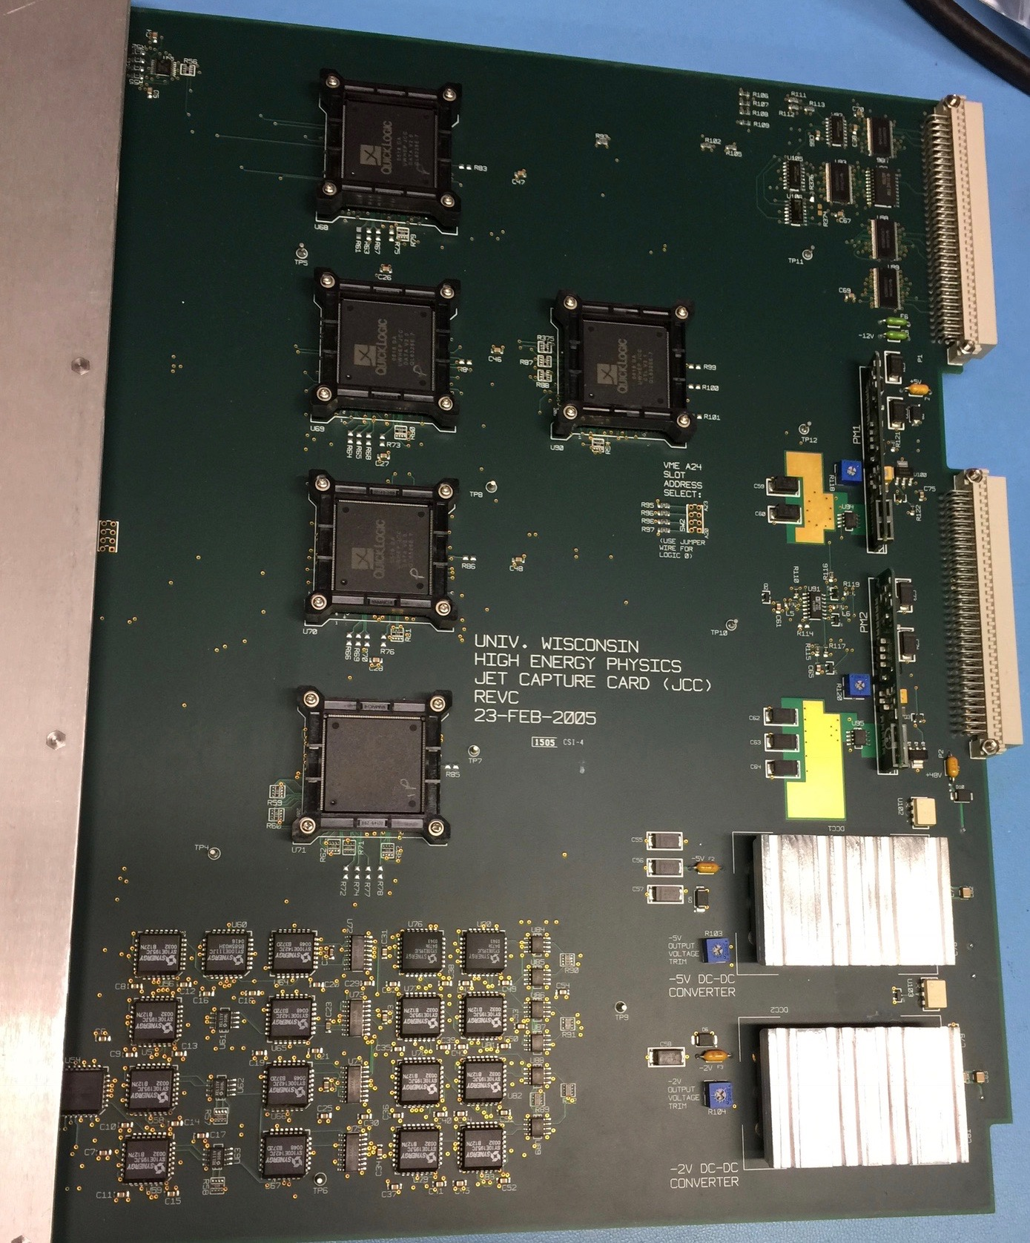
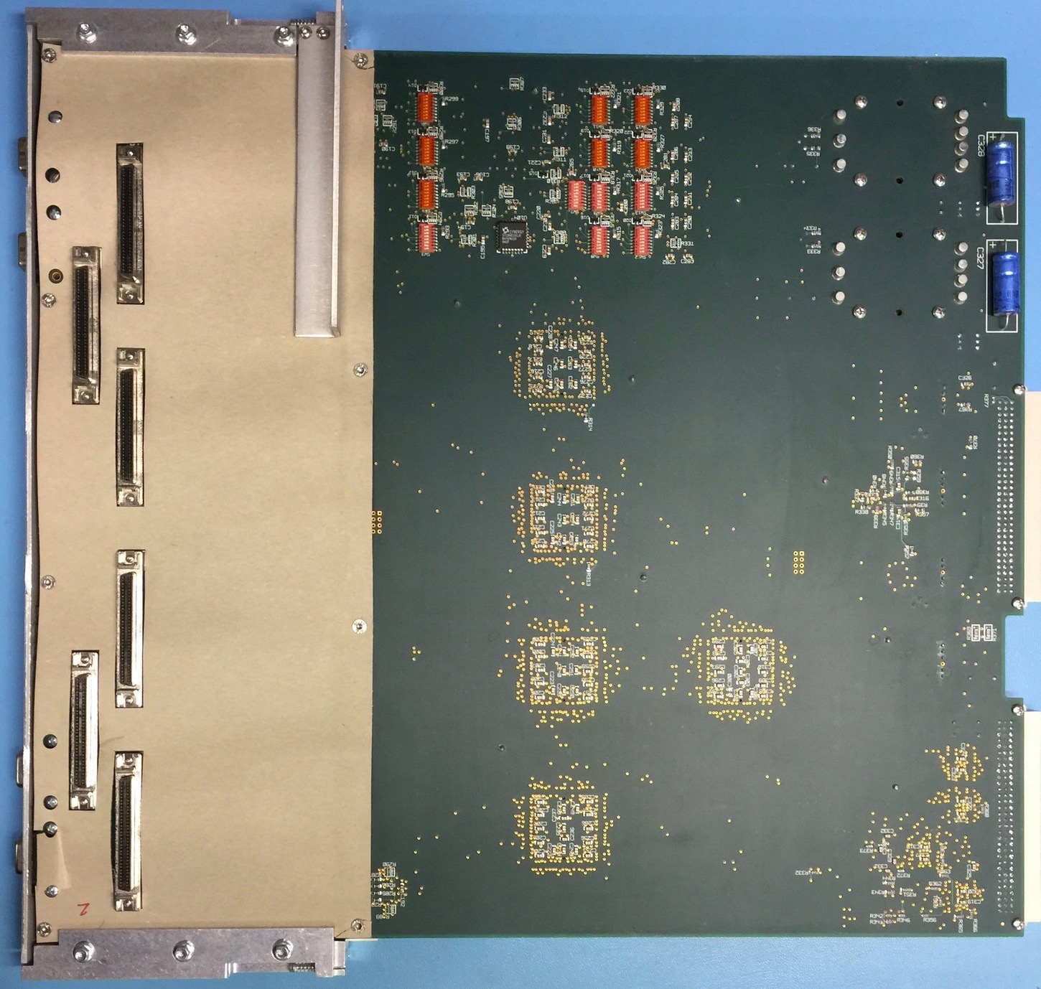
Wisconsin Jet Capture Card
RCT did not have readout.
Wesley’s idea and Tom’s design
Became a commissioning workhorse
Can provide triggers if needed

Slide 6
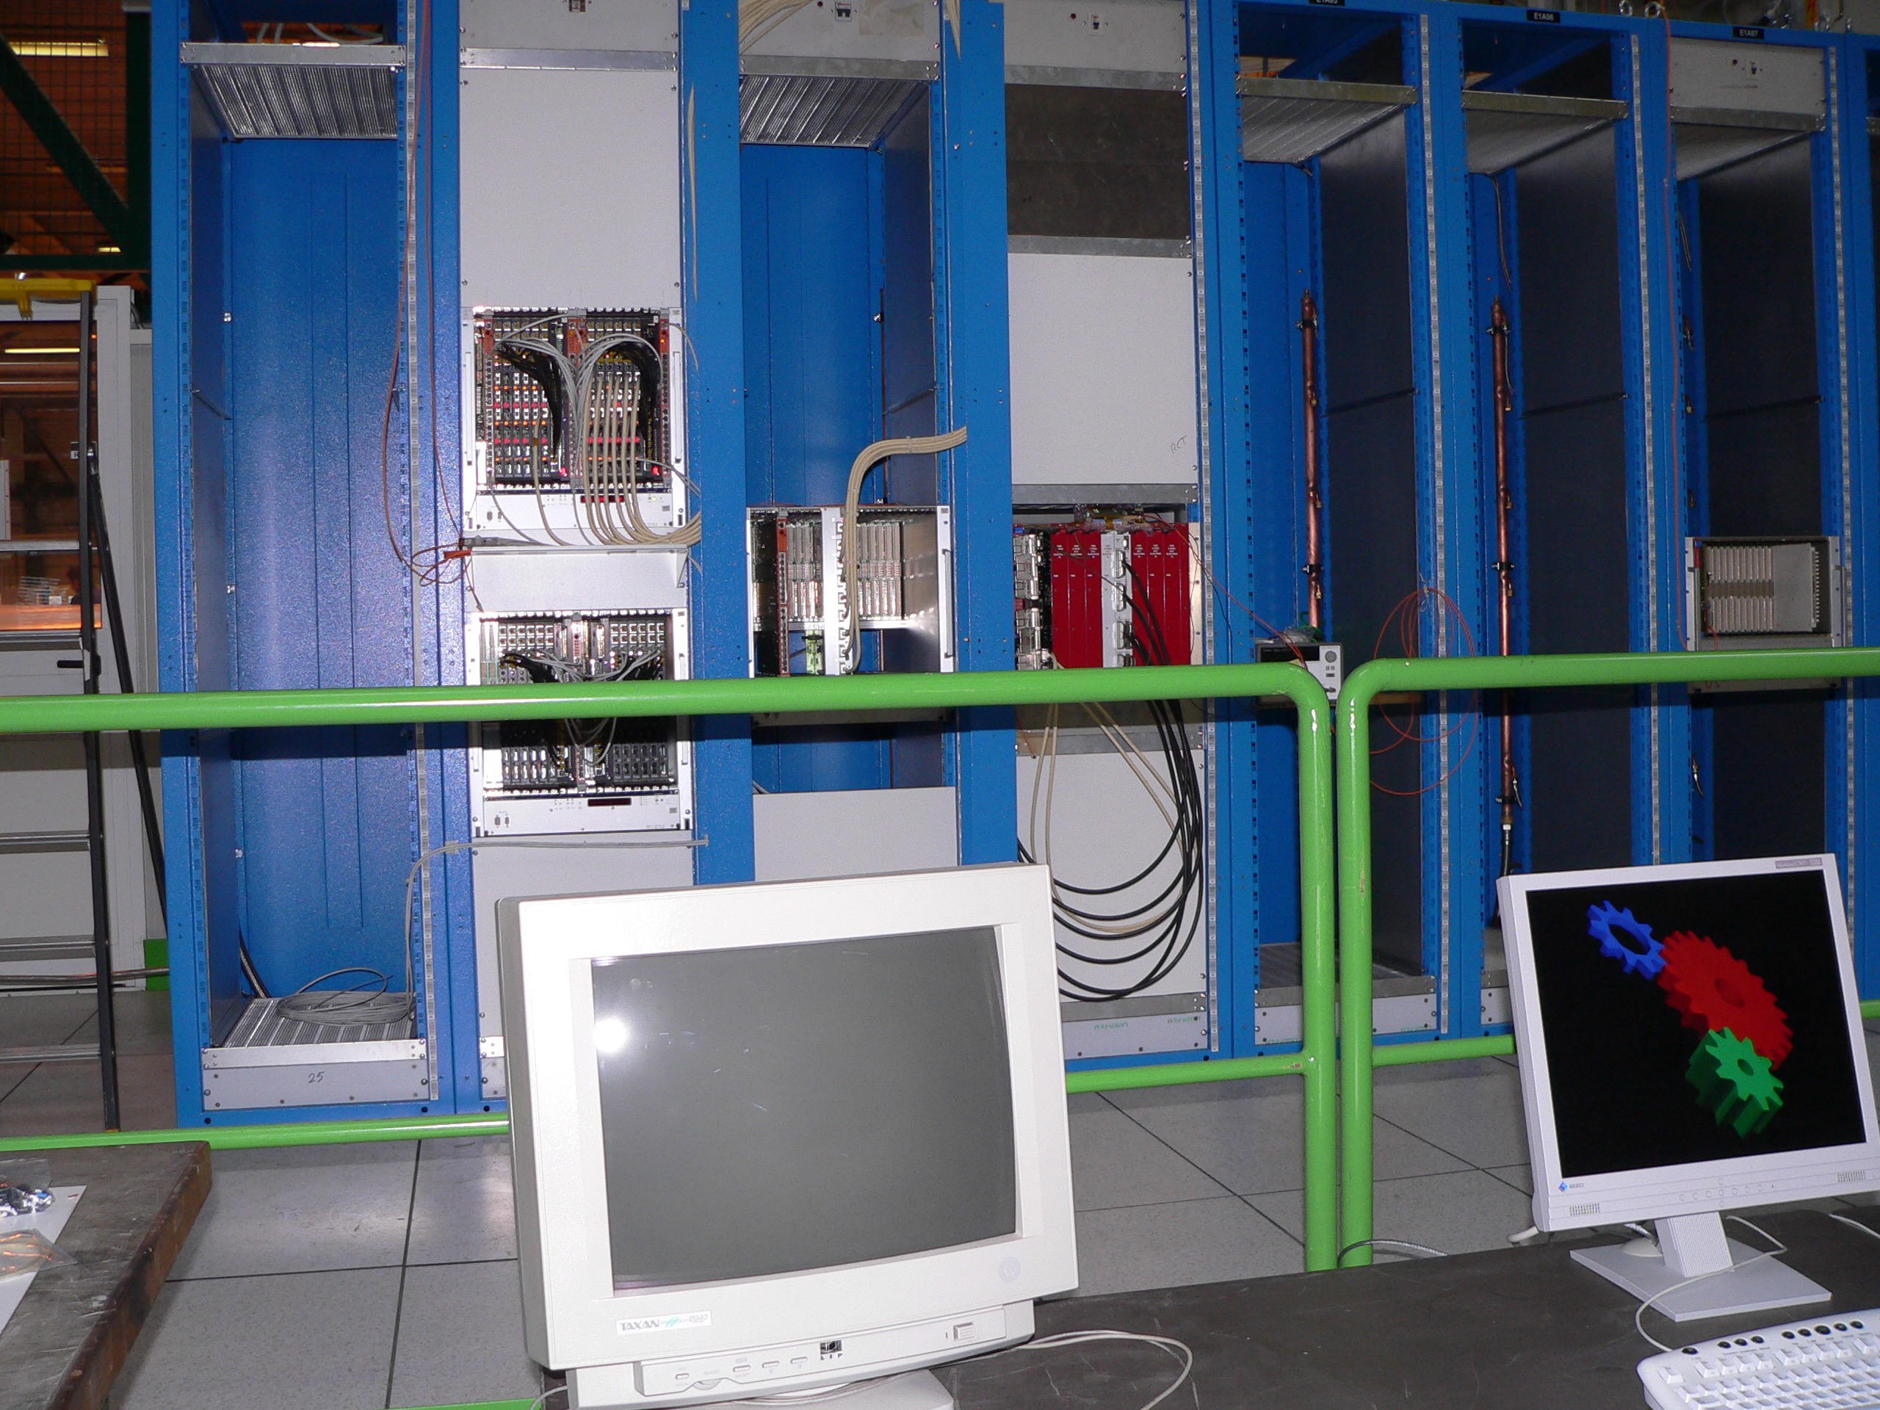
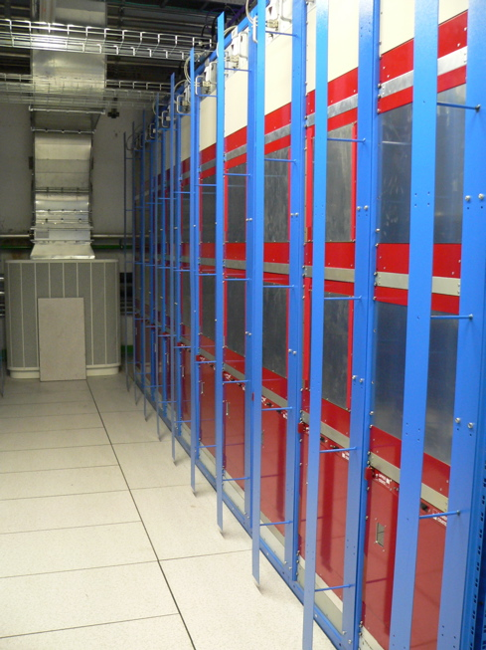
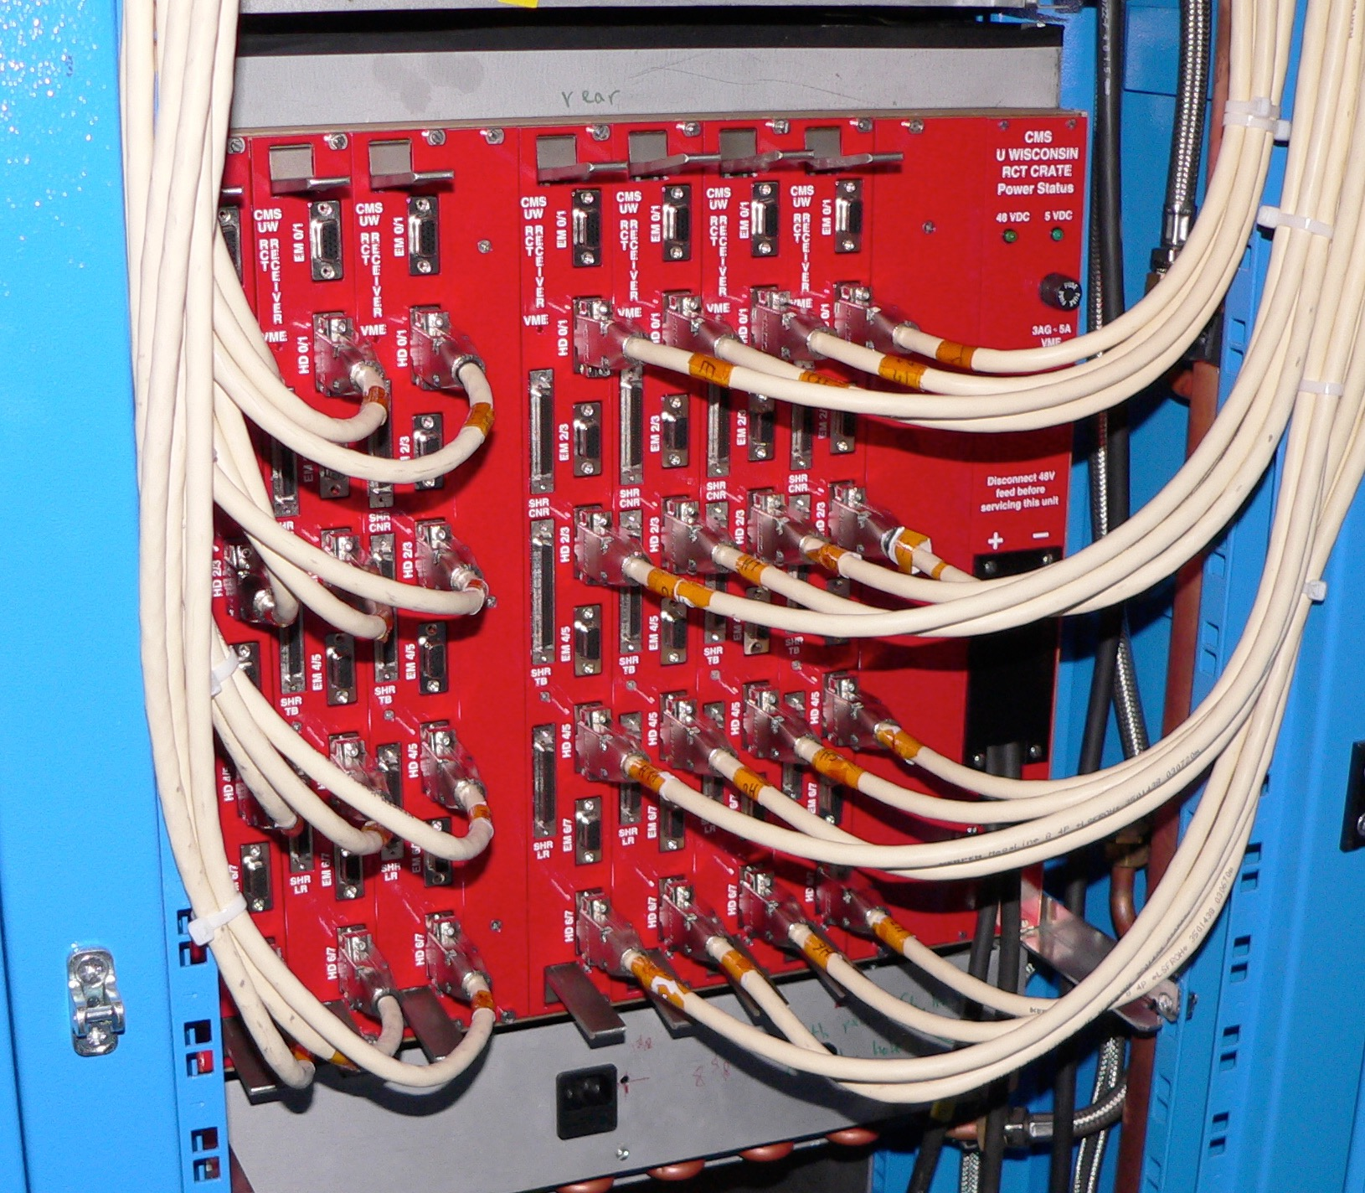
Things started to come into place
CMS Service Cavern July 2006
We were one of the earliest in!
November 2005 ECAL+HCAL to RCT at 904

Slide 7
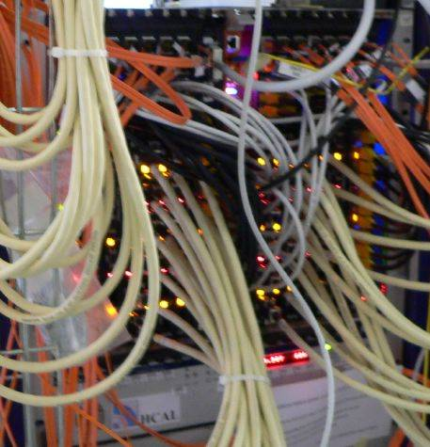
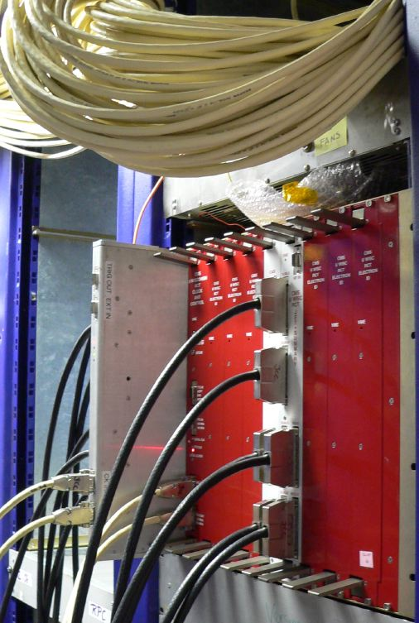
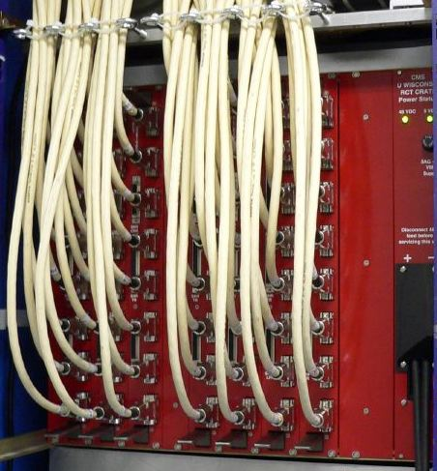
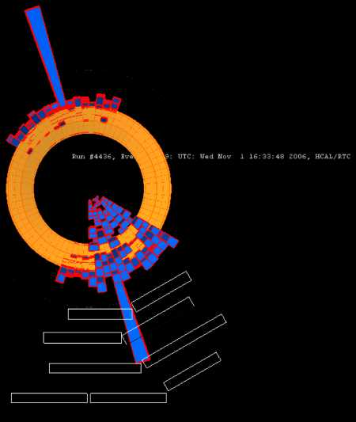
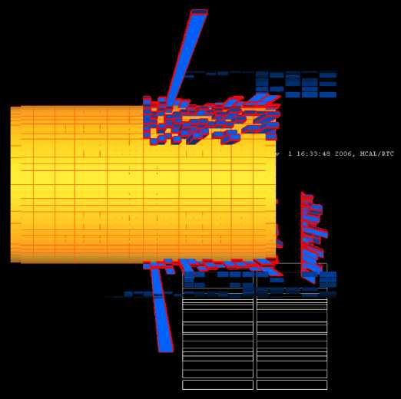
CMS Magnet Test and Cosmic Challenge November 2007
Wesley wanted to take part – how to do this?
RCT received HCAL Quality bit and ORed top and bottom separately - AND of both OR’s created with NIM logic and send to LTC for global use.
Bonus: Got to spend quality time in the “Green Barrack” (now White)
Only time we used the Jet Capture Card as a trigger ☺
RCT Back
HCAL
RCT Front
With Jet Capture Card to final Logic
RCT/HCAL Event
From MTCCII

Slide 8
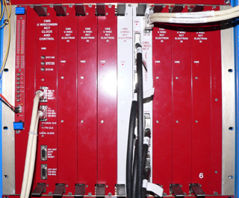
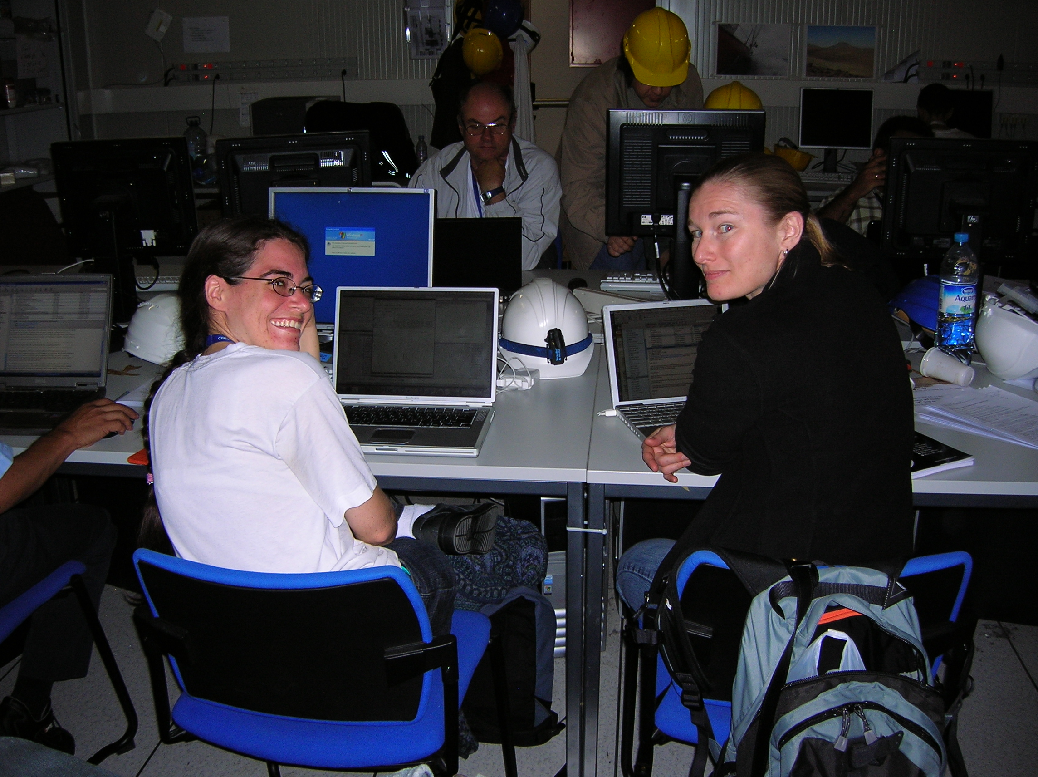
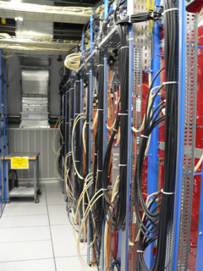
Commissioning could begin…
Fully installed early 2008
Underground Control Room
Lots of mini commissioning runs GREN, CRUZET, CRAFT – 2008 and 2009

Slide 9
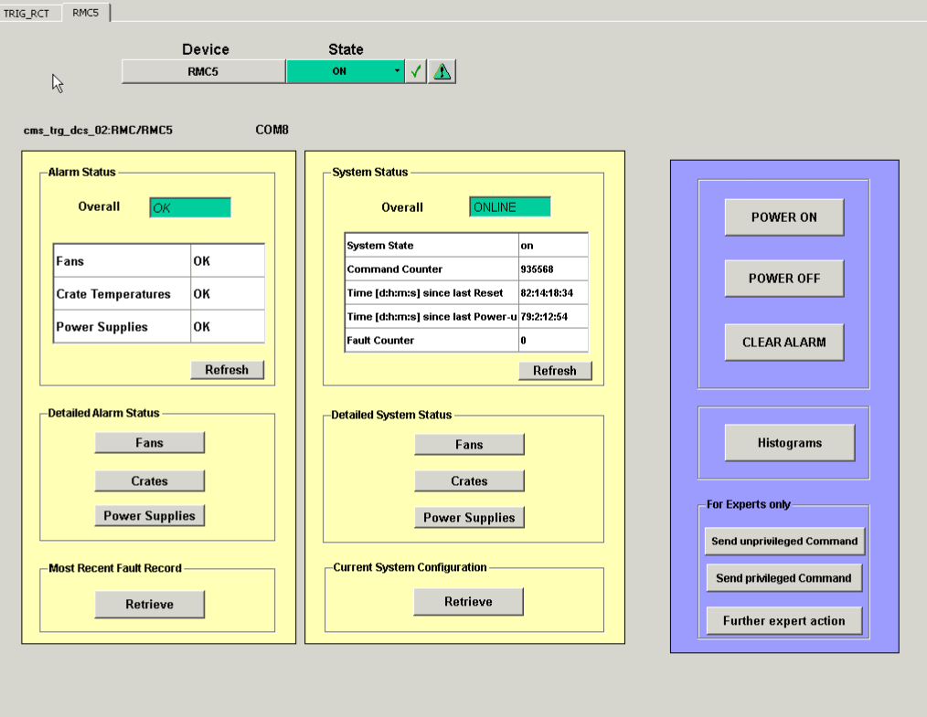
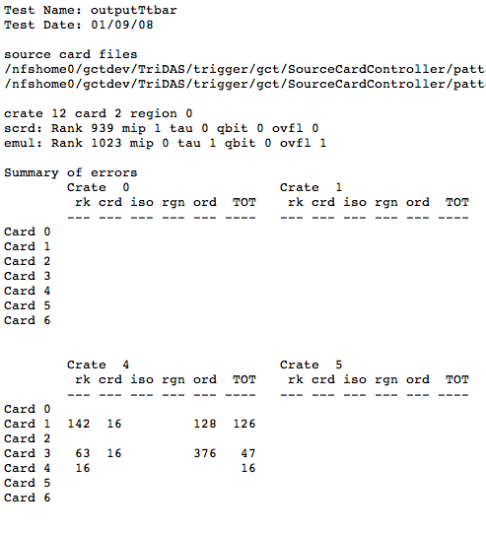
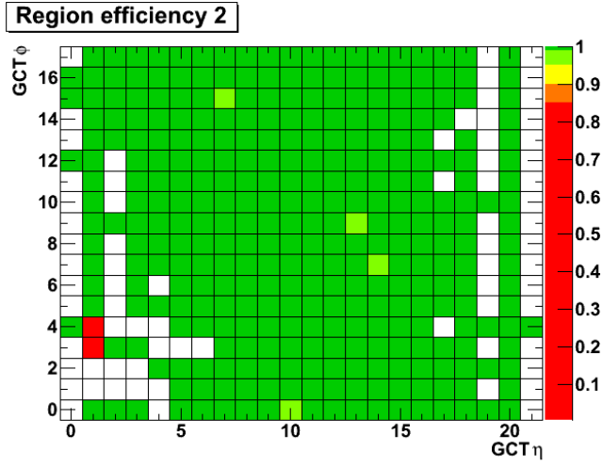
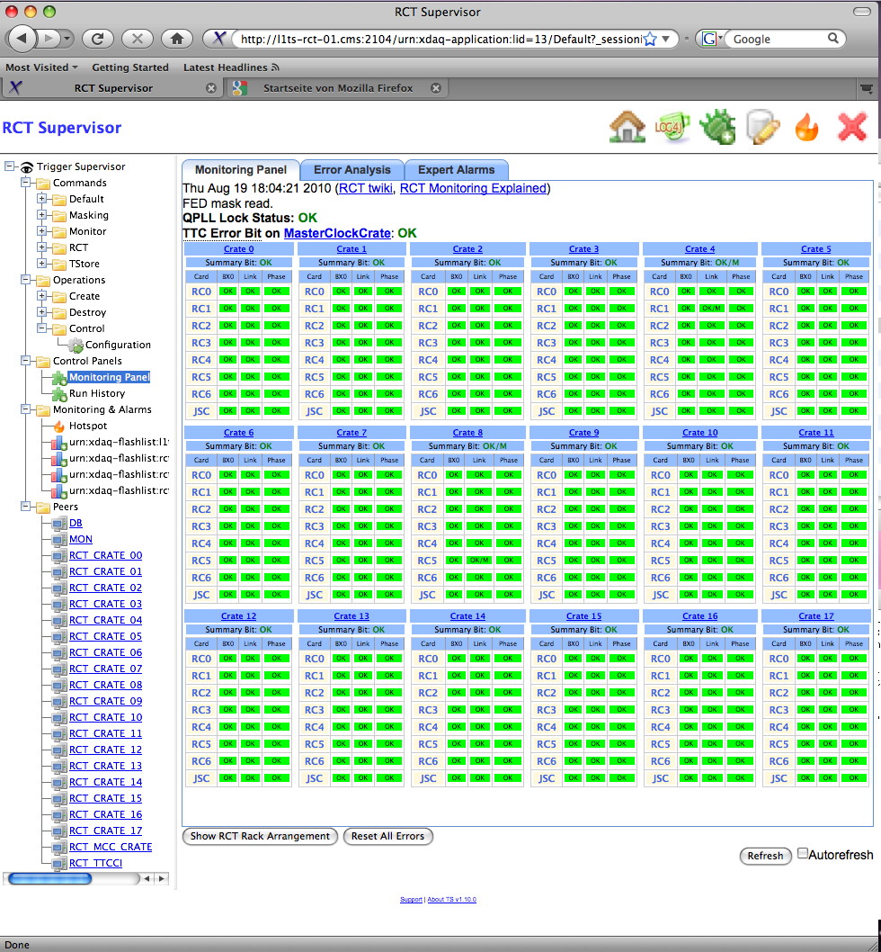
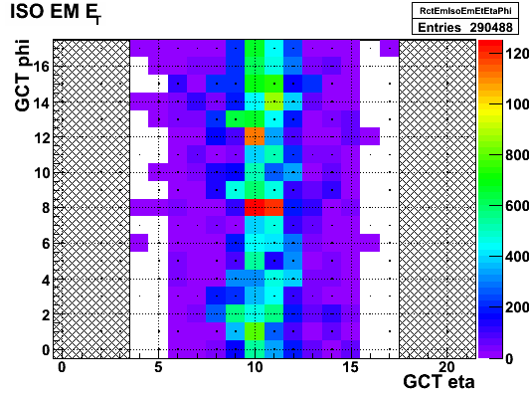
Before beam we worked out the kinks
Slow Control
Pattern Tests
Trigger Control
Data Quality
Wesley made sure we had the team and the tools to do this!

Slide 10
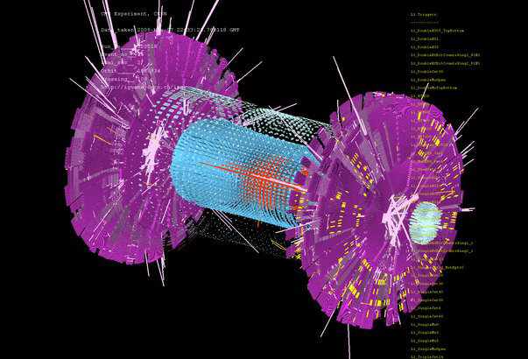
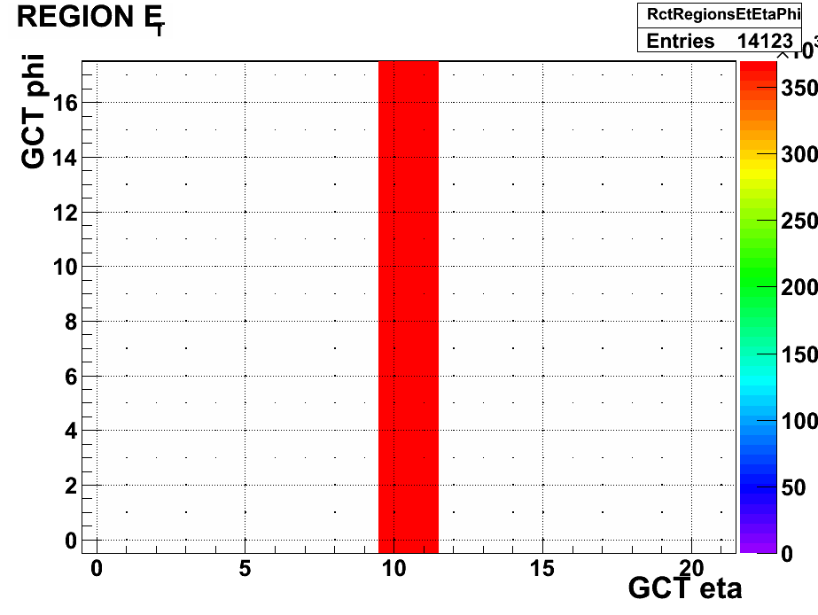
Beam Splash November 2009
Late one evening…
Custom key to mask off all but two regions of ECAL

Slide 11
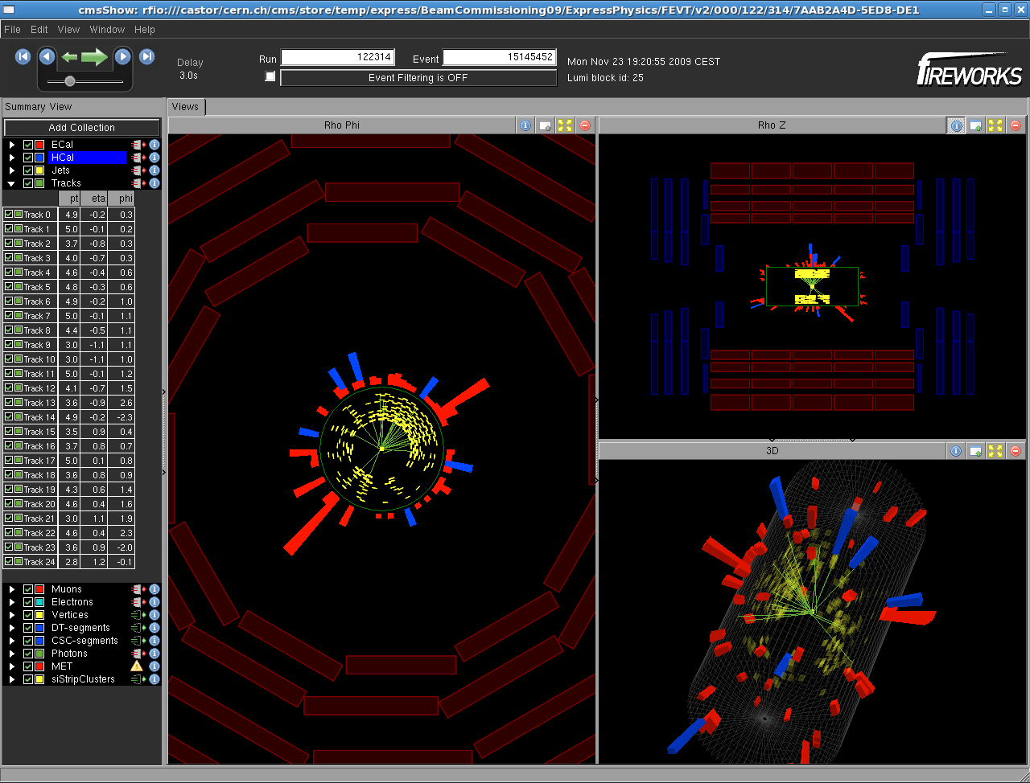
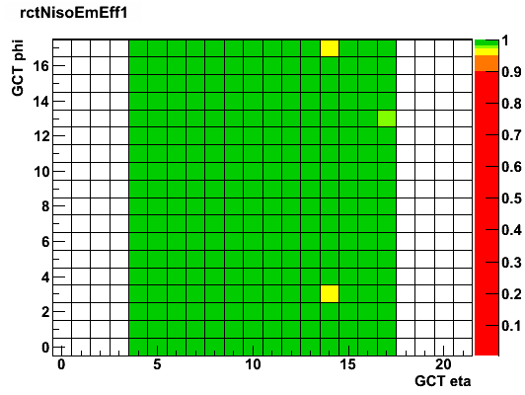
First Collisions March 2009
RCT was ready!
From Online DQM

Slide 12
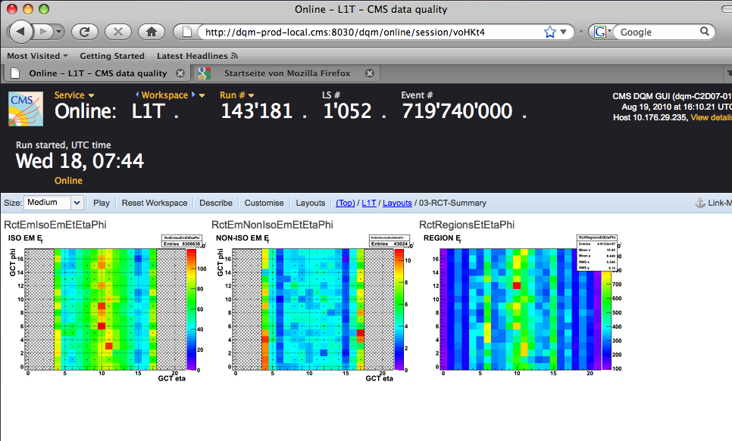
LHC Run 1 2009-2013
RCT was very reliable
Operation became routine
RCT on-calls kept an eye on things
While we were busy,
the upgrade took shape

Slide 13
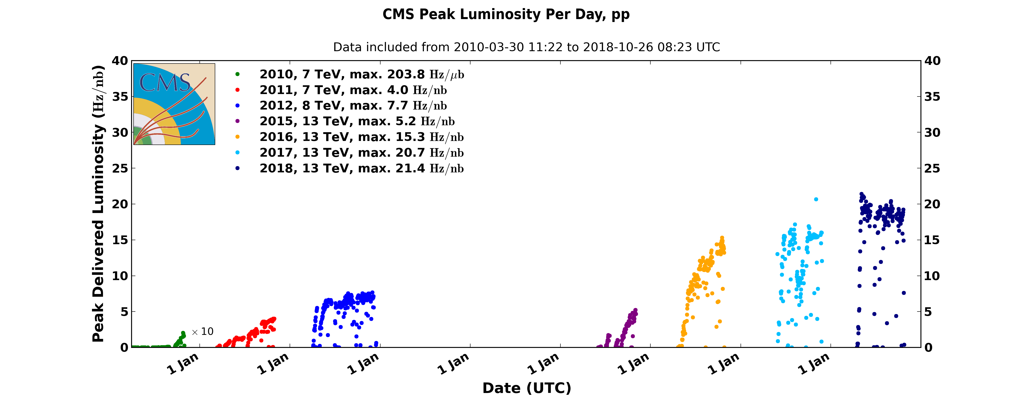
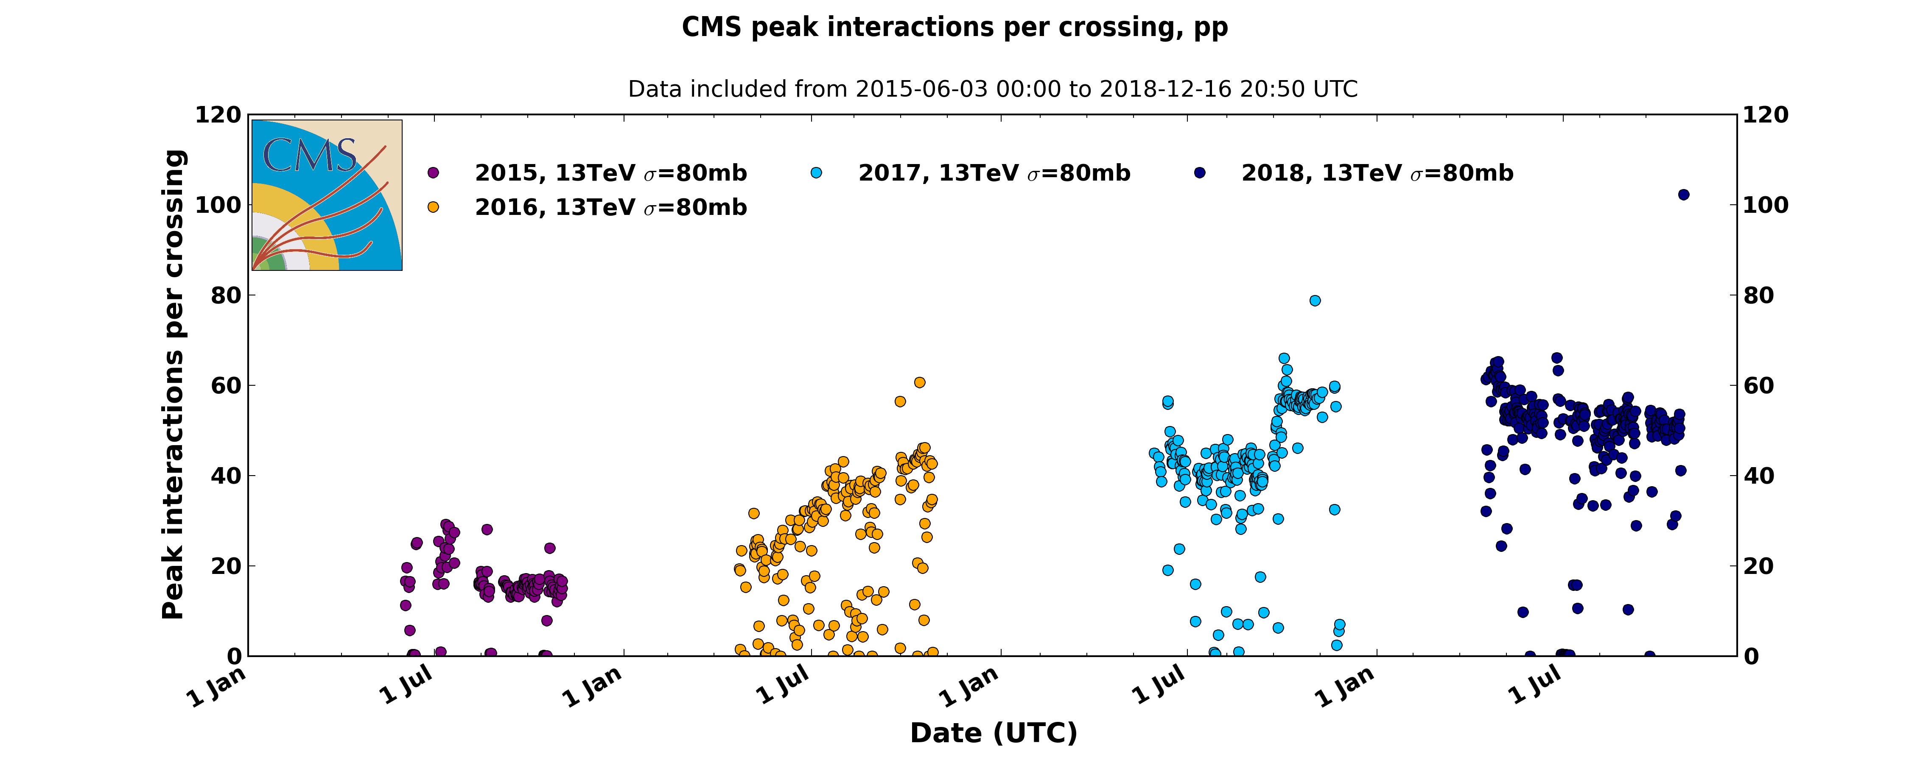
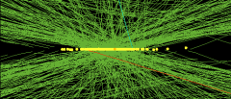
Run 2 Conditions
2017
2017
2012
2016
2011
2015
2010
78 vertices from a special high pile-up run

Slide 14
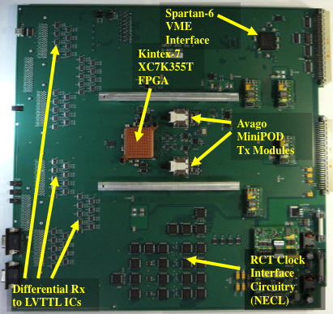
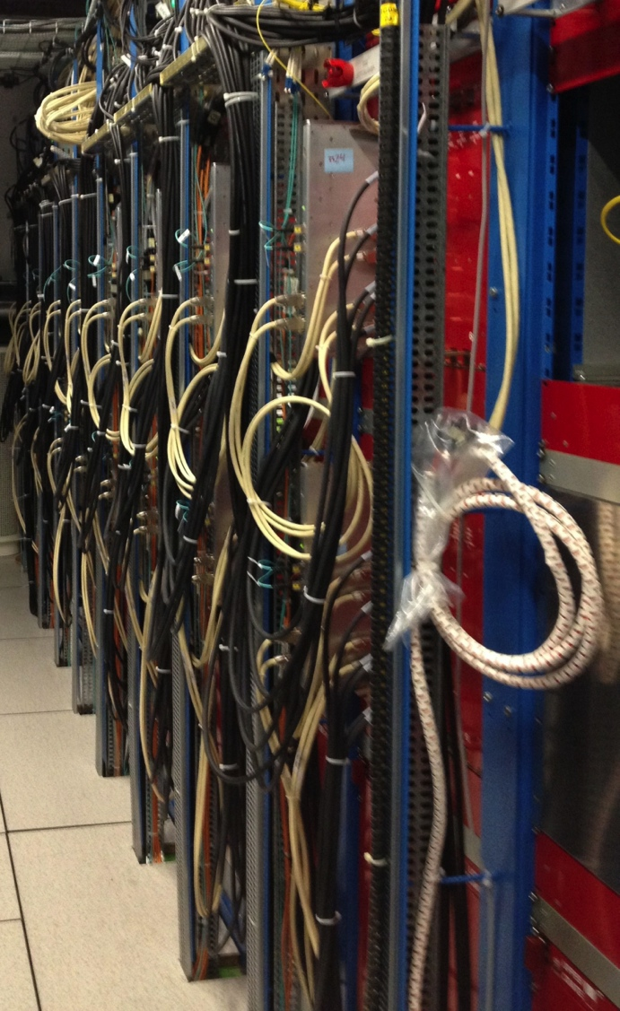
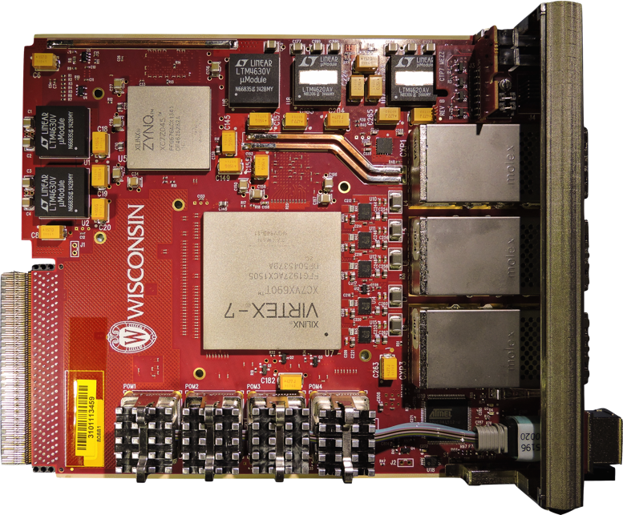
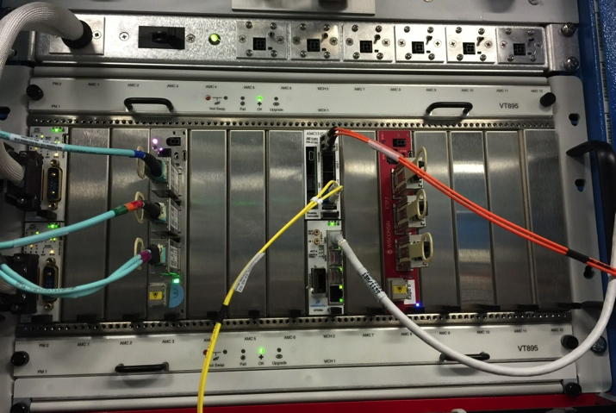
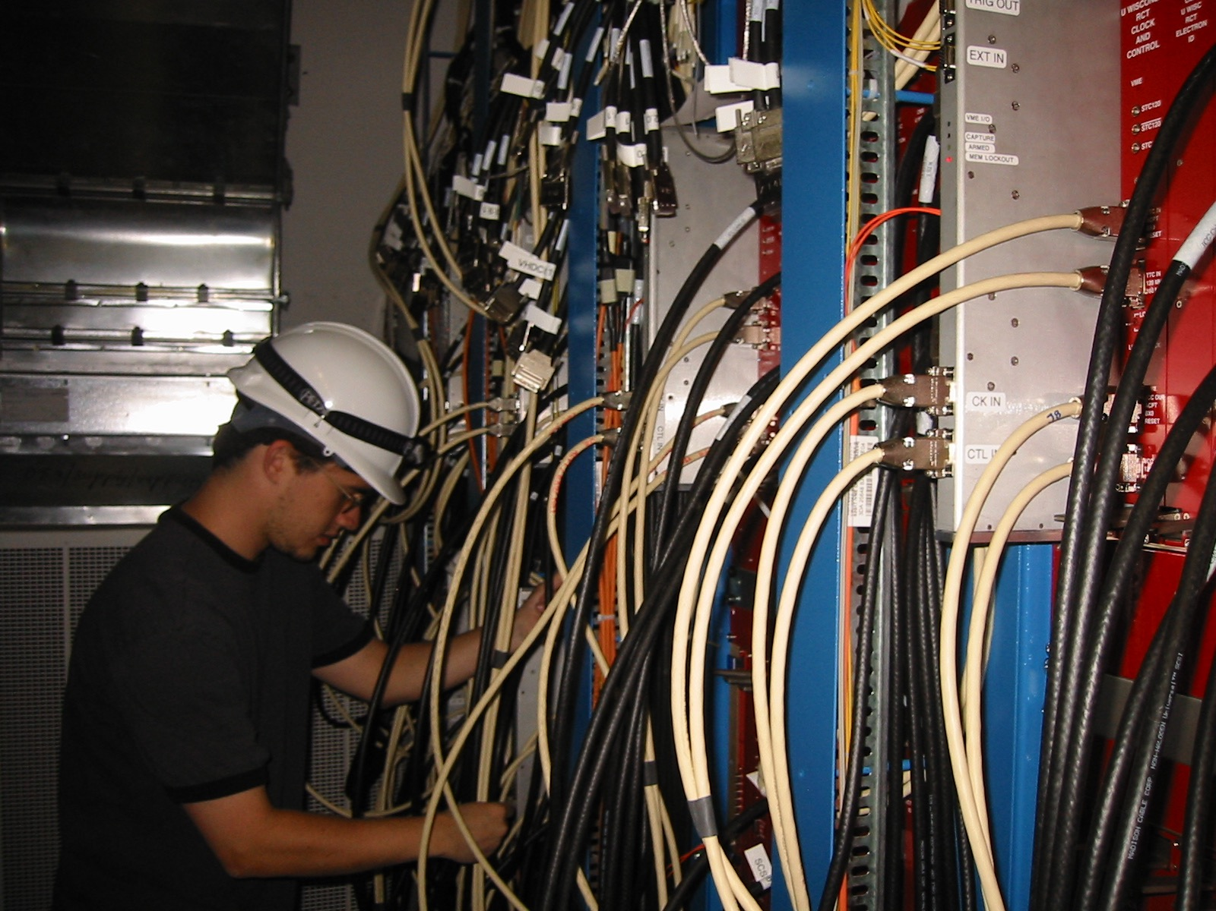
Stage-1 Calorimeter Upgrade (2015)
Calorimeter Trigger Processor (CTP7) - UW
Optical Regional Summary Card (oRSC) - UW
CTP7 Crate
Installed!

Slide 15
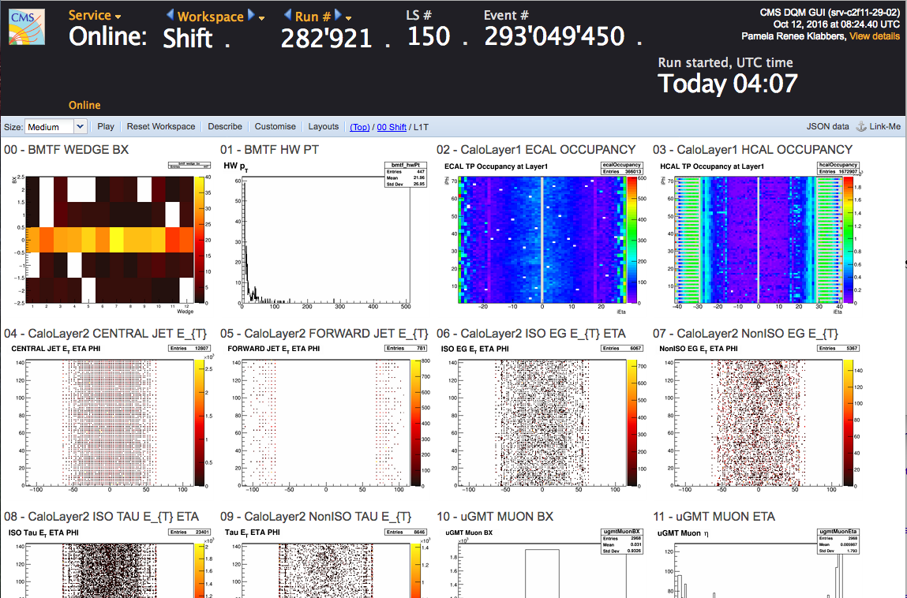
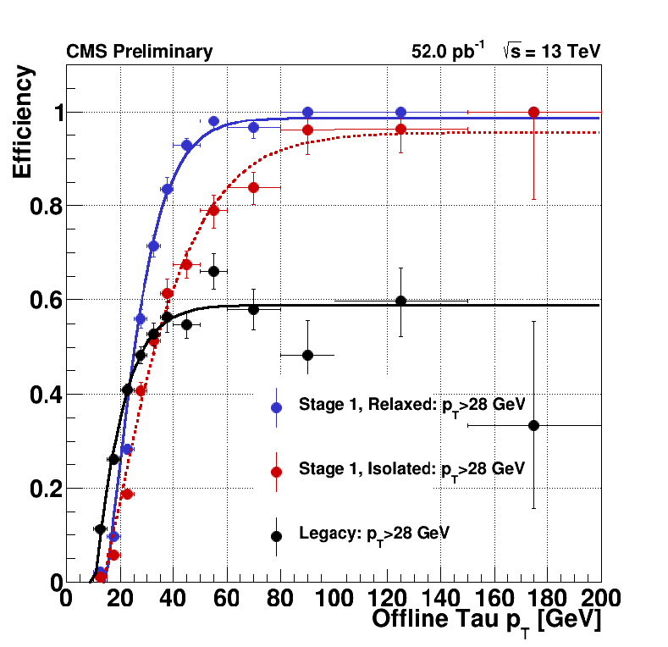
LHC Run 2 2015-2018
Stage 1 operated in 2015
By 2016 Stage 2 was online
Stage-1
Improvement
Tau Improvement

Slide 16
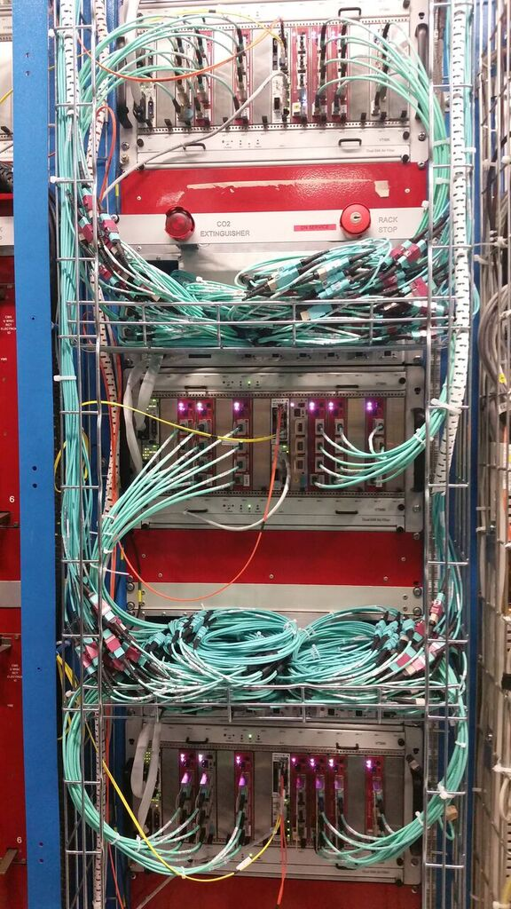
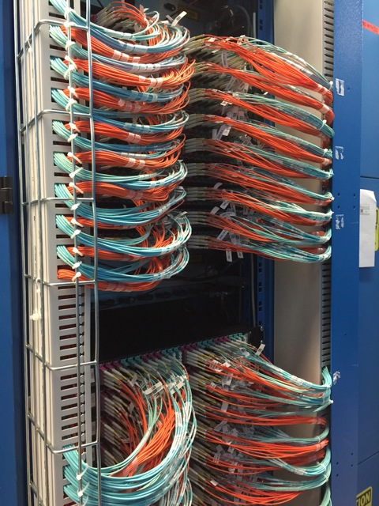
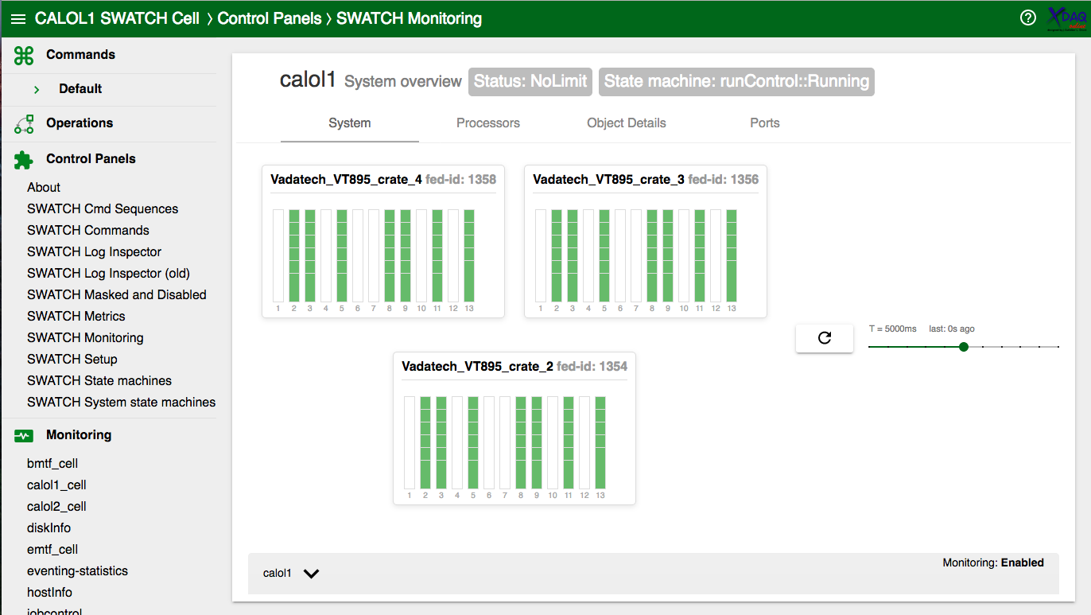
2016 Calorimeter Trigger (Stage 2)
Convert everything to optical
ECAL + HCAL out
Calorimeter Trigger Processor (CTP7) - UW
Control Software

Slide 17
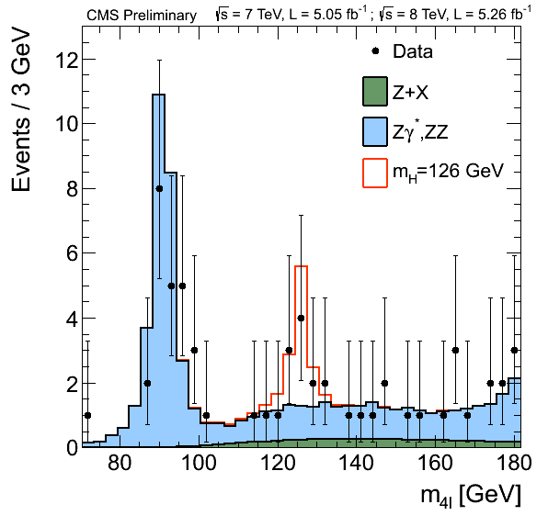
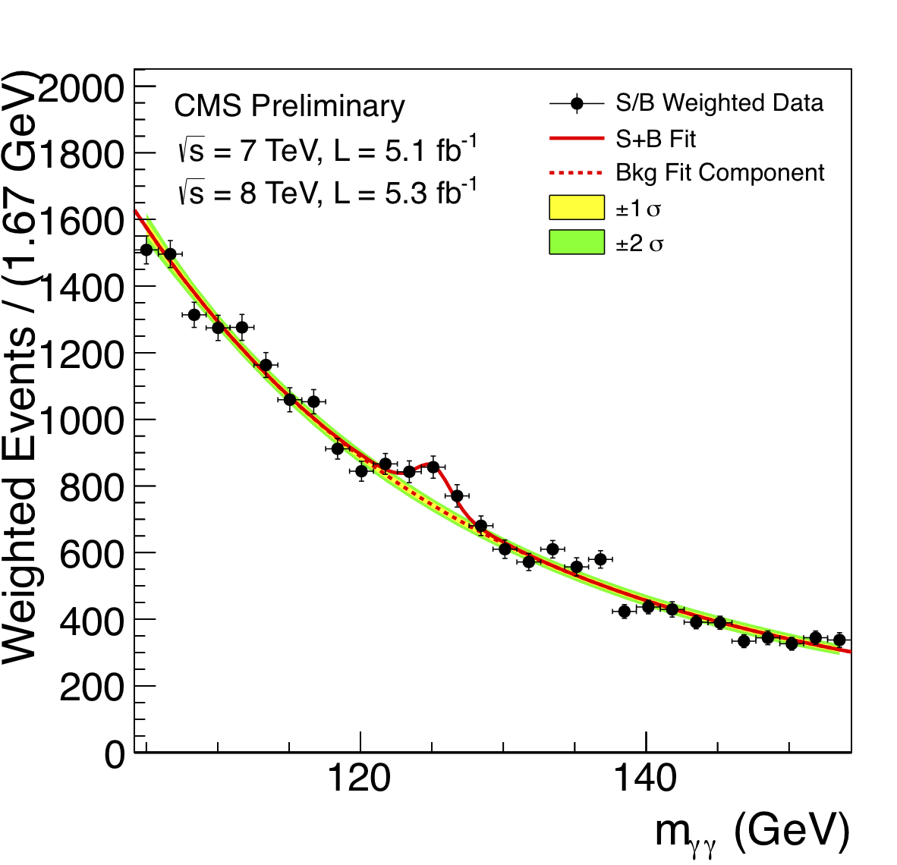
Final words
I cannot even begin to cover everything
I didn’t speak at all about High-Level Trigger
Wesley and UW had a huge part in this.
So many energetic and bright people joined Wesley’s group

Slide 18
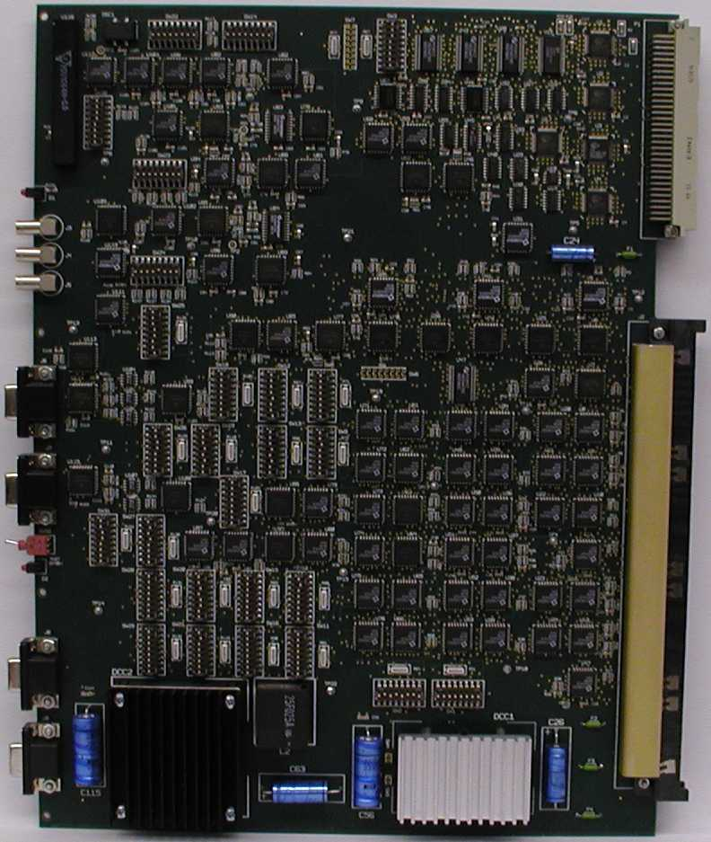
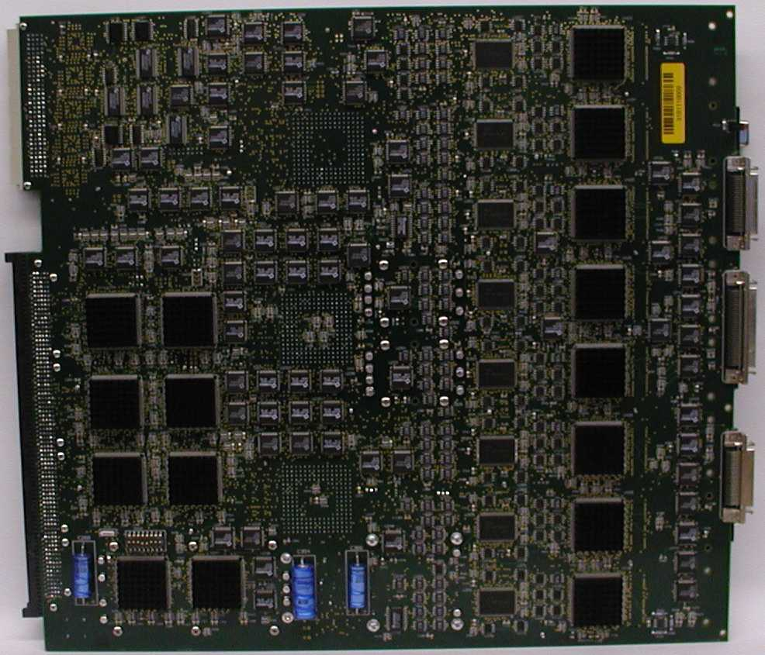
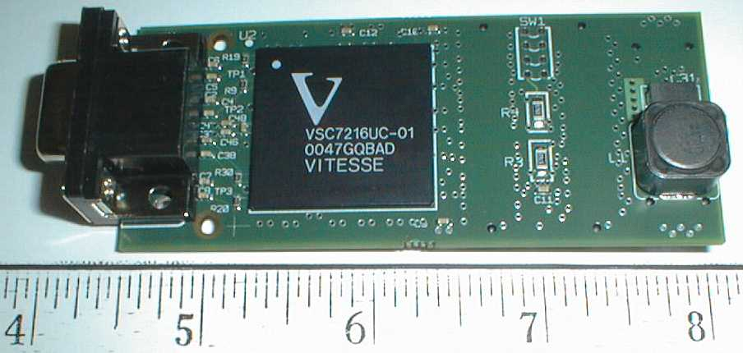
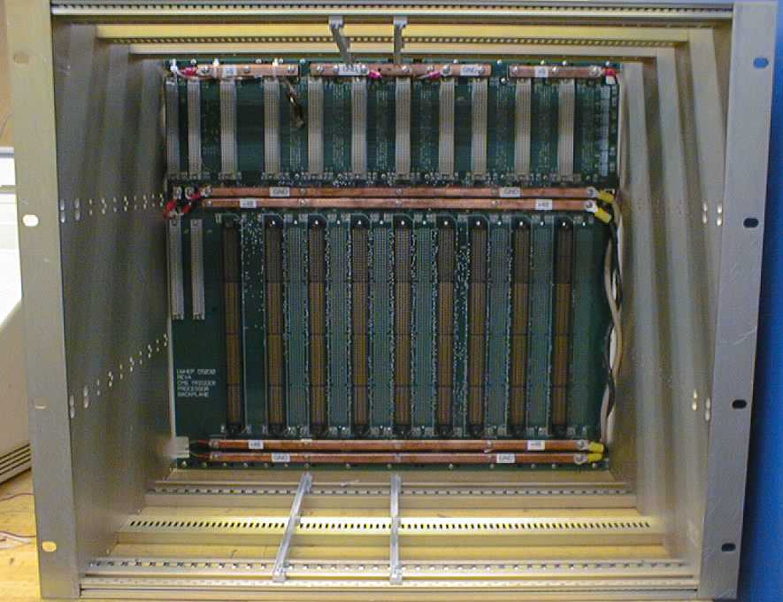
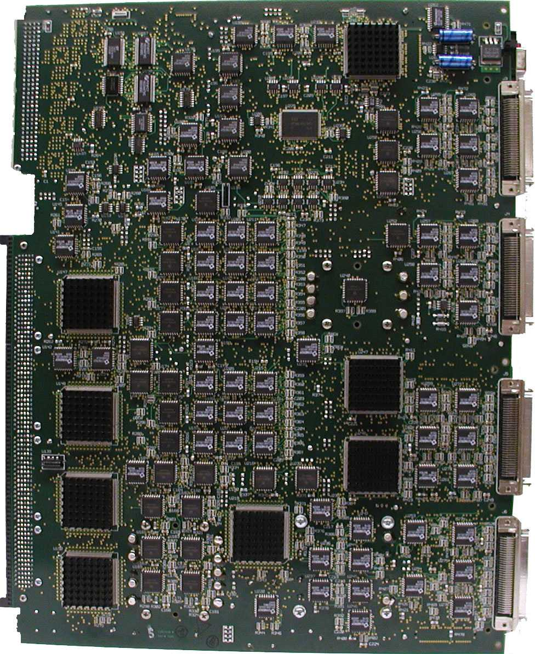
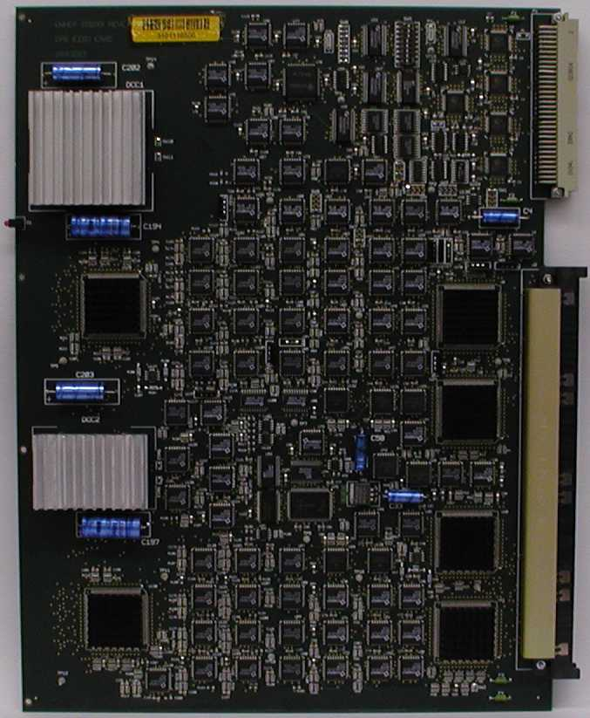
Regional Calorimeter Trigger (RCT)
Engineers: J. Lackey and T. Gorski
Clock &
Control
1 per crate
Adder
ASICs
On back
Receiver
7 per crate
LUTs
Phase
ASICs
Receiver Mezzanine
Card
On back
BSCAN
ASICs
RCT Backplane
Phase
ASIC
Electron
ID
7 per crate
Jet
Summary
1 per crate
HF LUTs
EISO
ASICs
Sort
ASICs
BSCAN
ASICs
Sort
ASICs

