Slide 1
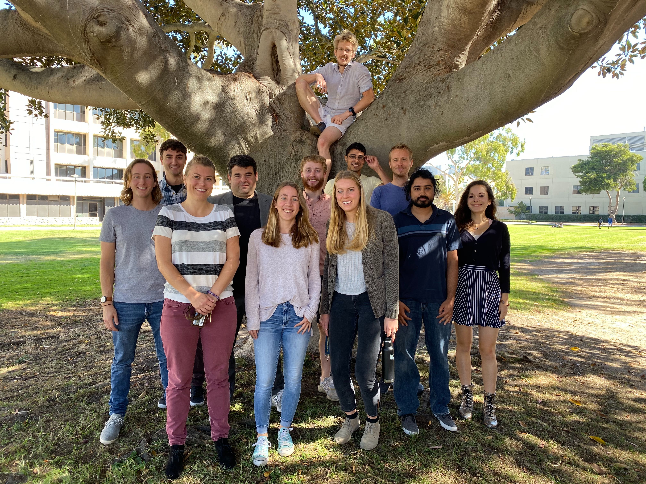



Recent Advances in OIR MKIDs
Ben Mazin, Dec 2019
The UVOIR MKID Team:
UCSB: Ben Mazin, Alex Walter, Clint Bocksteigel, Neelay Fruitwala, Isabel Liparito, Nicholas Zobrist, Grégoire Coiffard, Miguel Daal, Sarah Steiger, Noah Swimmer, Jeb Bailey, Jenny Smith, Kristina Davis, Rupert Dodkins
Subaru: Olivier Guyon, Julien Lozi
Caltech: Dimitri Mawet, Nem J.
JPL/IPAC: Seth Meeker, Bruce Bumble, Gautam Vashisht, Mike Bottom
Durham: Kieran O’Brien
Fermilab: Gustavo Cancelo, Juan Estrada
NIST: Paul Szypryt

Slide 2
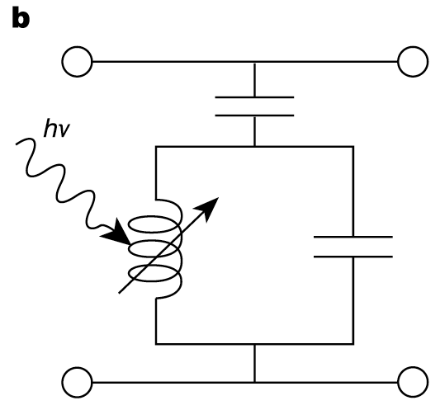
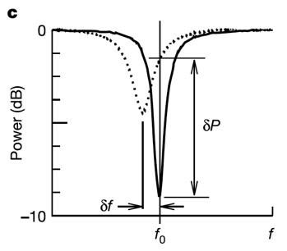
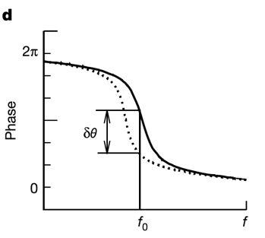
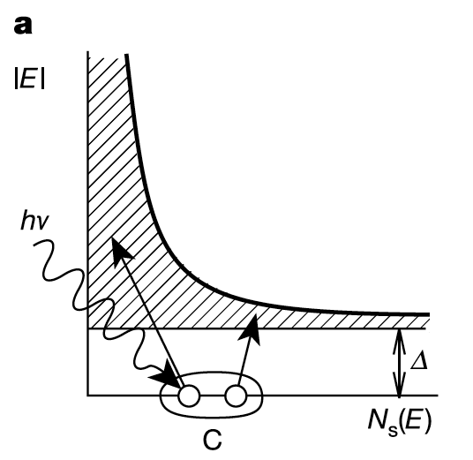

MKIDs
MKID Equivalent Circuit
Typical Single Photon Event
Inductor is a
Superconductor!
Energy Gap
Silicon – 1.10000 eV
PtSi or TiN – 0.00013 eV
Energy resolution:
Cooper Pair

Slide 3
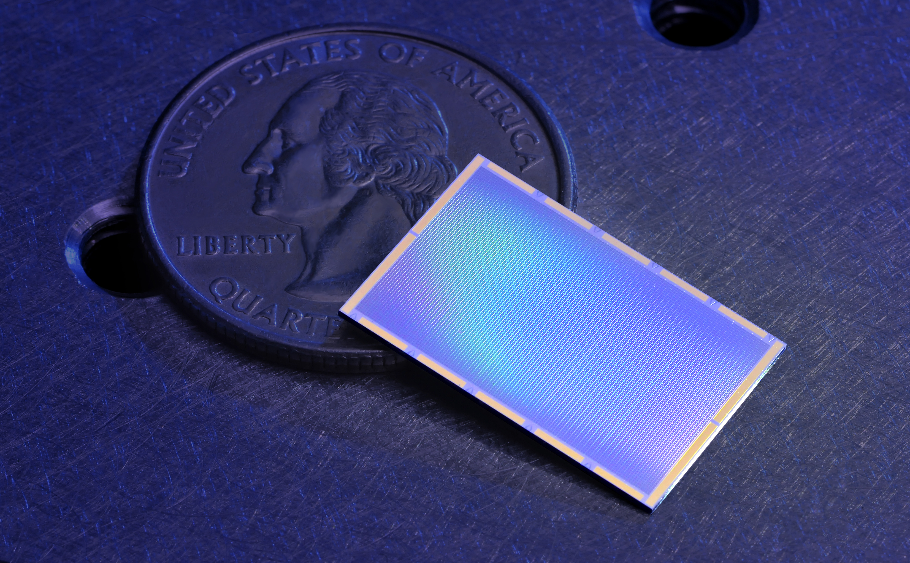
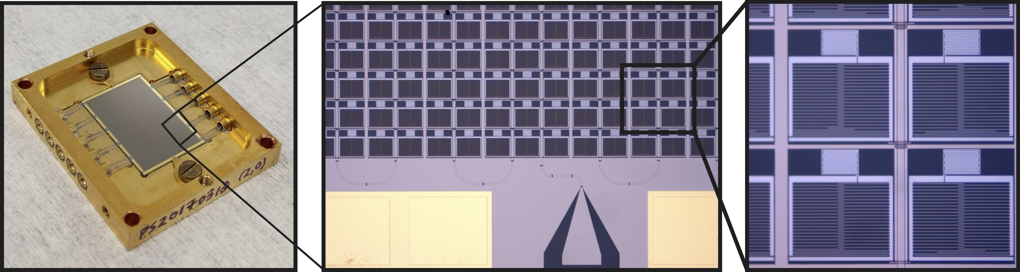
10 kpix DARKNESS Array
Funded to build 3 10-20 kpix instruments
DARKNESS for Palomar (NSF): Commissioned!
MEC for Subaru (Japan): Commissioned!
PICTURE-C Balloon (NASA): 2020

Slide 4
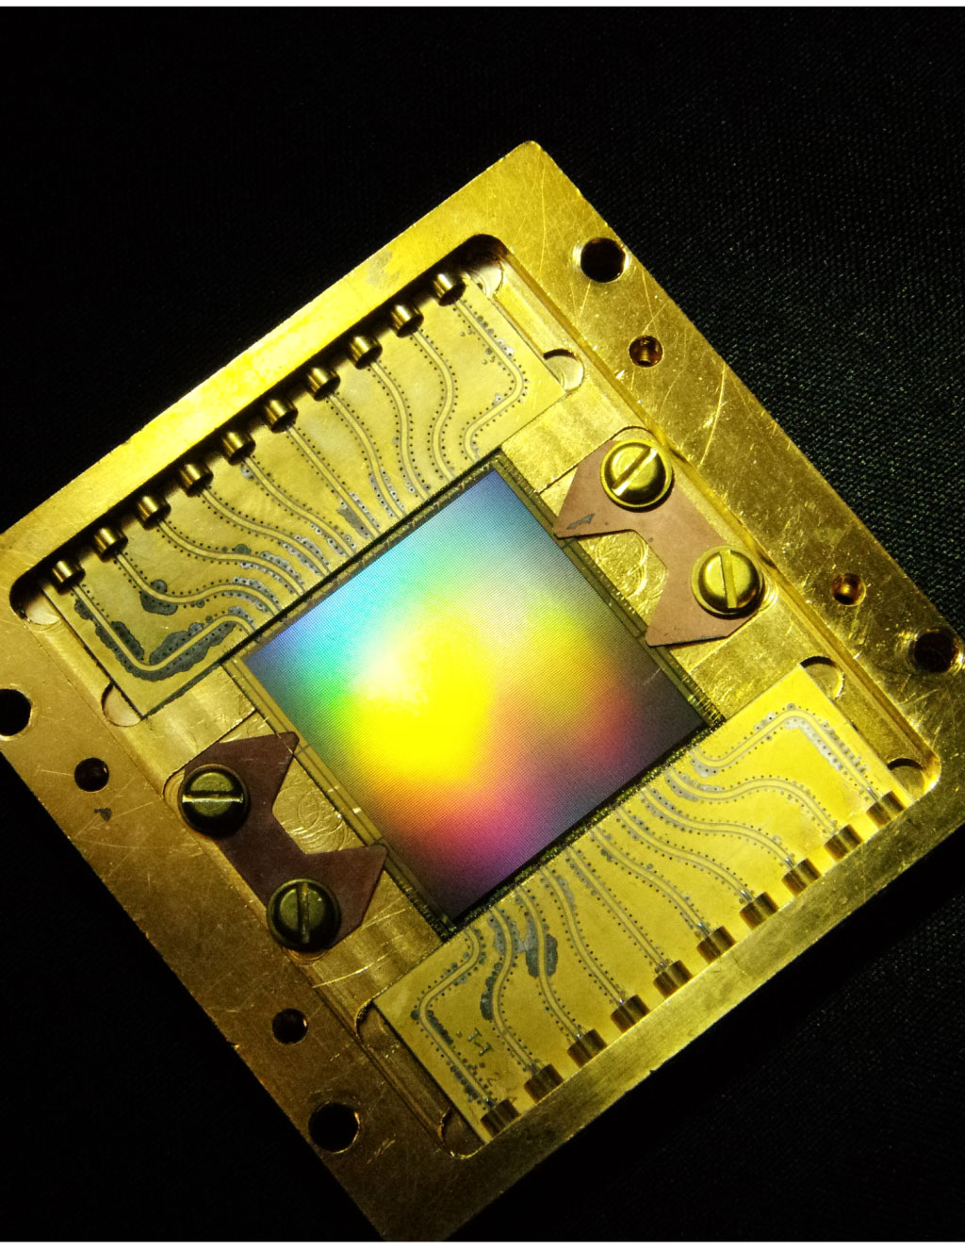
MEC Array
20 kpix PtSi MKID array for Subaru SCExAO-MEC
140x146 pixels
150 micron pixel pitch
22x22 mm imaging area
Pixel Yield ~85%
R≅10 at 1 micron
Array fabricated at UCSB by P. Szypryt and G. Coiffard.
Szypryt et al. 2017, Optics Express

Slide 5
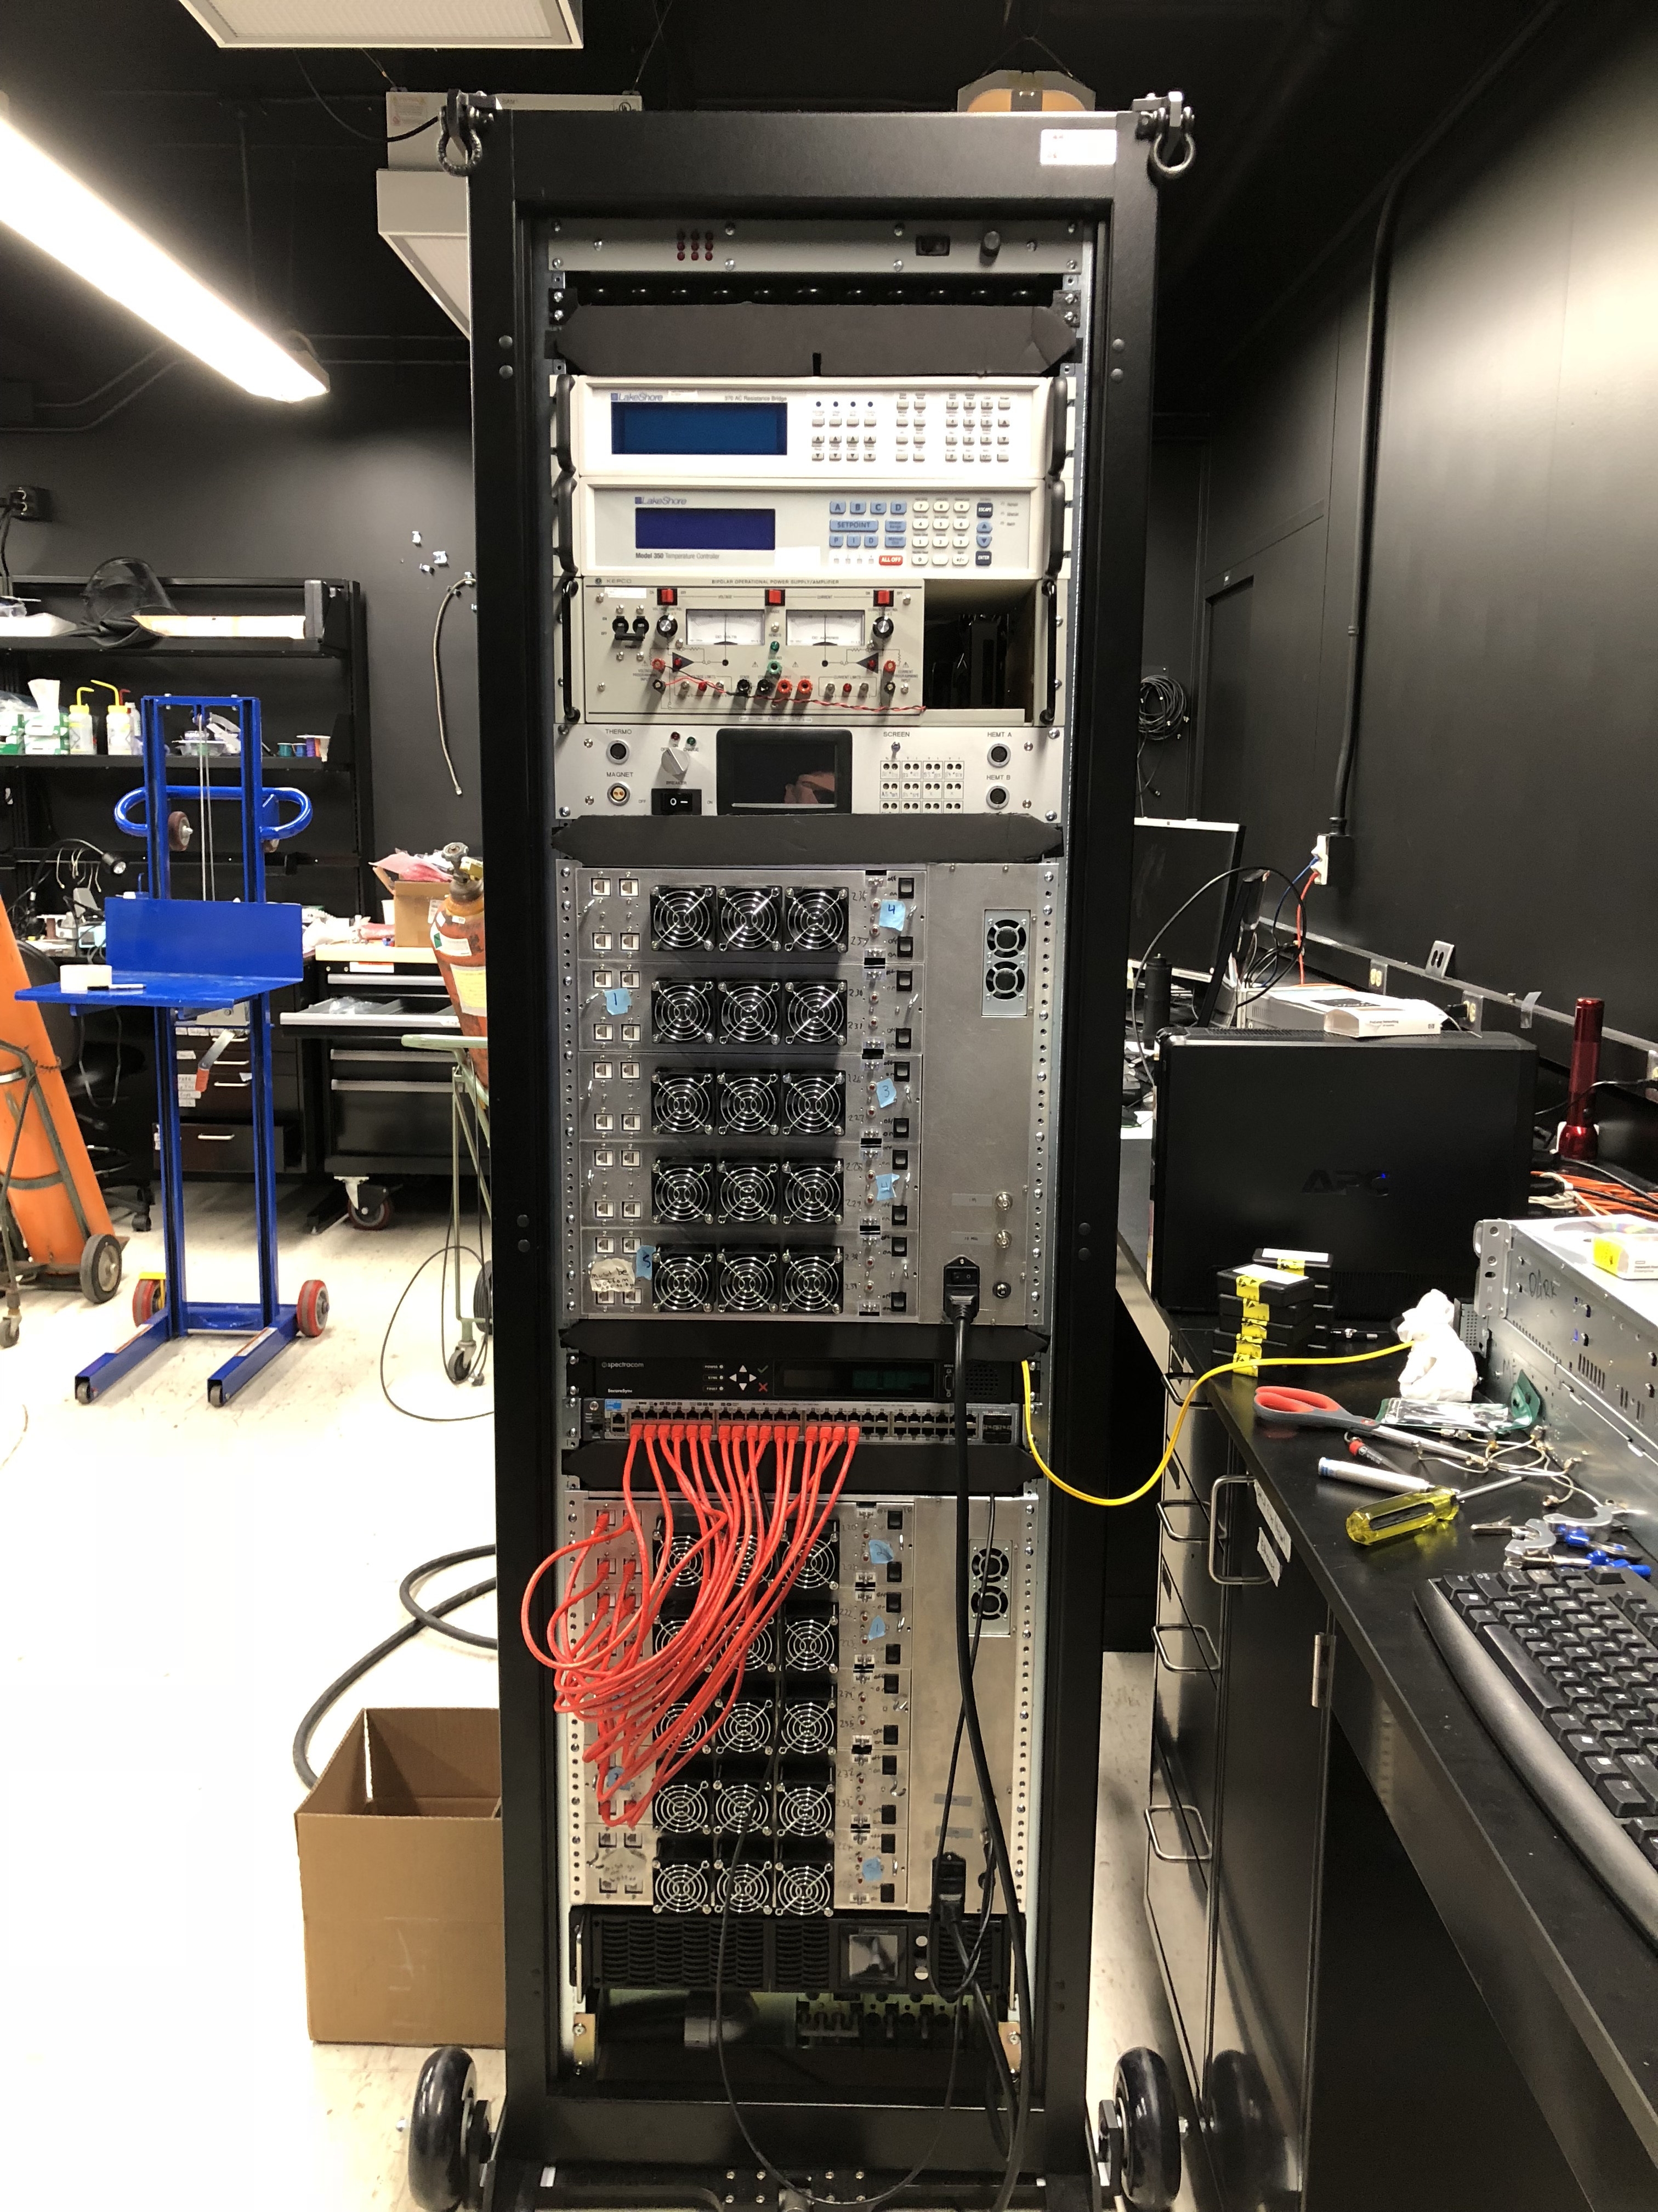
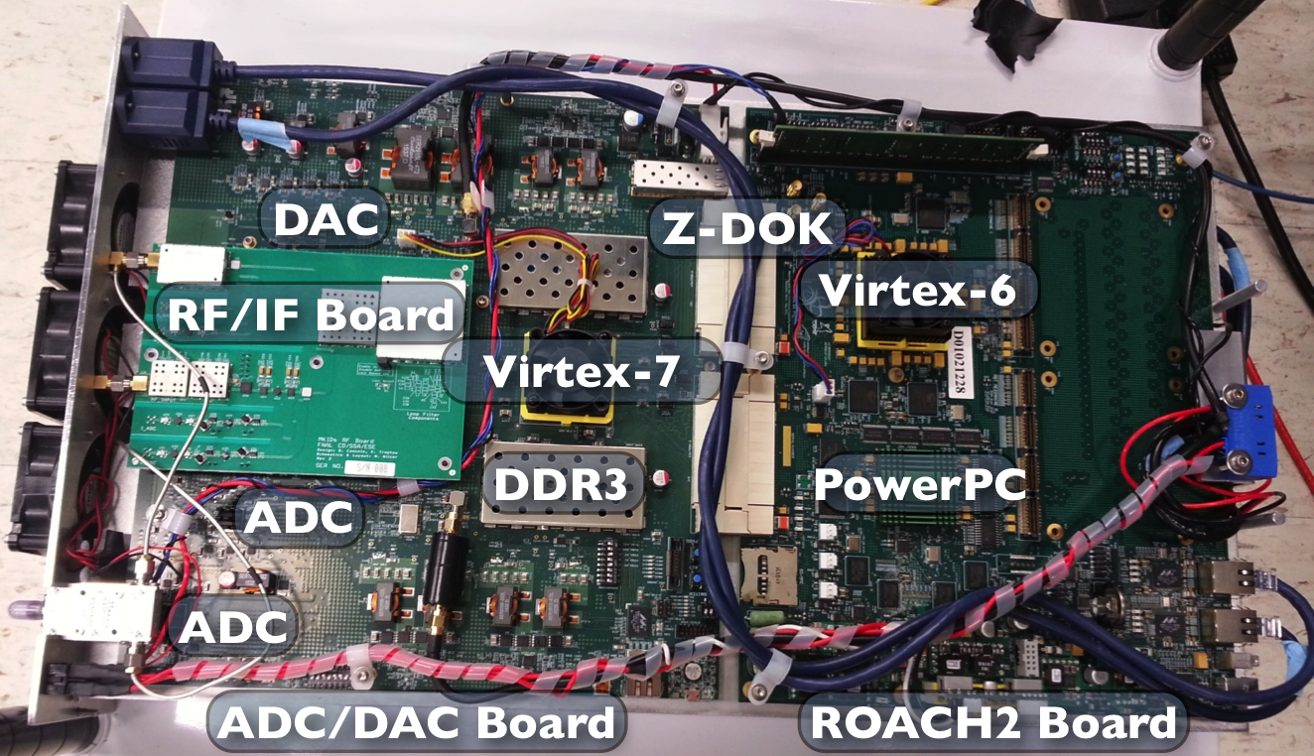
MEC’s Gen 2 Readout
Designed in collaboration with Fermilab
Based on Casper ROACH2 (Virtex 6)
Uses dual 2 GSPS 12 bit ADC
Reads out 1024 pixels in 2 GHz
2 boards per feedline in 4-8.5 GHz band
  scalable to 30+ kpix
Air to Water/Glycol heat exchangers
Cost: ~$5-10/pixel, excluding HEMT and FPGAs

Slide 6
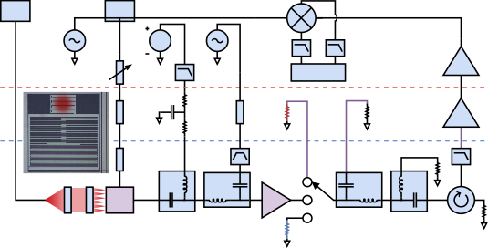
Quantum Limited Parametric Amplifier
Quantum limited travelling wave parametric amplifier (Peter Day will discuss later in the week) allows us to probe the noise of our resonators in ways we couldn’t do before
  Big difference over JPAs is operation at much higher input powers
  Will eventually make their way into instruments, but some work needs to be done to reduce the number of components
Zobrist et al., 2019, APL

Slide 7
Para-amp + PtSi MEC Array
Noise reduced as expected
Zobrist et al., 2019, APL

Slide 8
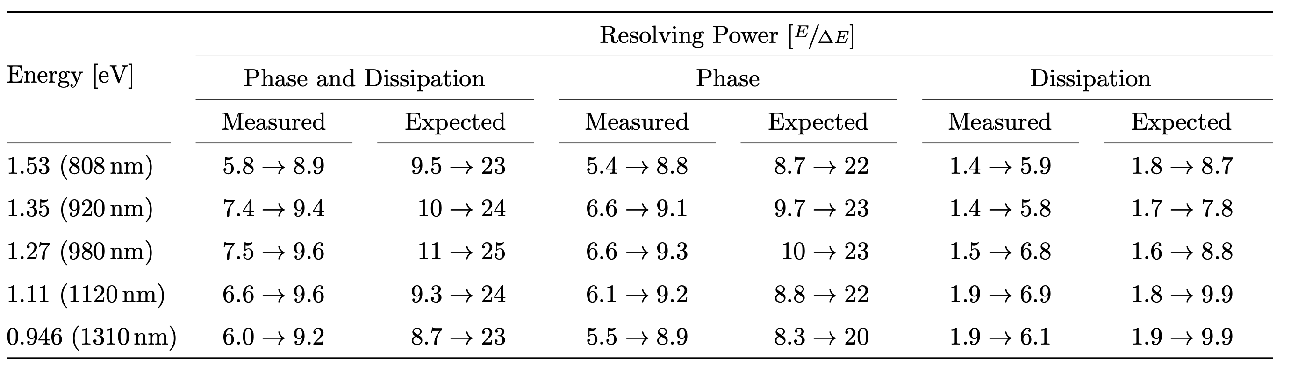
Spectral Resolution
Zobrist et al., 2019, APL

Slide 9
Resolution Broadening
Para-amp shows we are getting spectral resolution broadening from an unknown source
  Geometric effects in the pixel (absorption location, gap variations)
  Hot phonon loss into the substrate
Best guess is hot phonon loss, backed up by new data from SRON (de Vissers, using aluminum on silicon)
We are currently testing Hf MKIDs that are much thicker (200 nm vs 55 nm) which should lower hot phonon escape
  Recently saw R=15.5 at 0.8 micron – best ever! R_{expected} = 36!
Engineering solutions to hot photon escape are being devised
With para-amp, TLS noise starts to limit performance
  Working on ways to decrease TLS noise by improving substrate cleaning and film deposition

Slide 10
Low Tc MKIDs - Hafnium
We have developed Hf on sapphire resonators for MKIDs
  We avoid Si substrates because having a semiconductor bandgap in our active wavelength range has proven to be very problematic
Elemental superconductor, easier to deposit than PtSi
Tc ~ 350-400 mK for best films (bulk Tc~130 mK)
Superconducting properties resemble other high resistivity superconductors like TiN
Freq. response: blue
Disp. response: orange

Slide 11
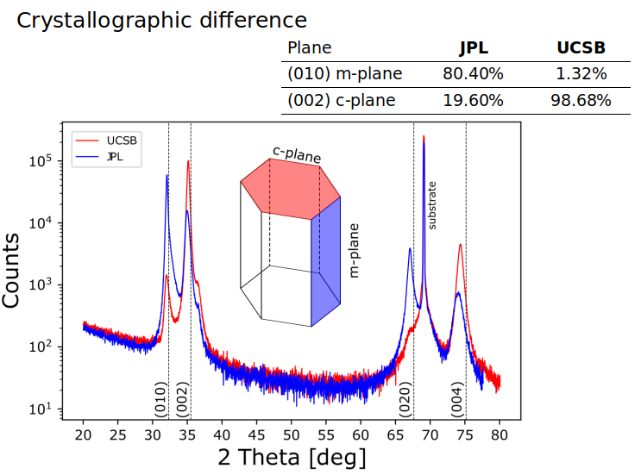
Hf Sputtering
Hf Deposition conditions matter!

Slide 12
Gap Smearing
Measurements consistent with various models that have some gap broadening mechanism

Slide 13
Hf OIR MKID Performance
Already seeing better R than PtSi with para-amp
Low Q_{m} High Q_{m}

Slide 14
Quantum Efficiency
QE increased with Anti-Reflection (AR) Coatings
No degradation in Spectral Resolution R
With AR No AR

Slide 15
DEEPDISH
DEEPDISH: Dark-matter Extended Energy Probe: Dielectric Infrared Superconducting Haloscope

Slide 16
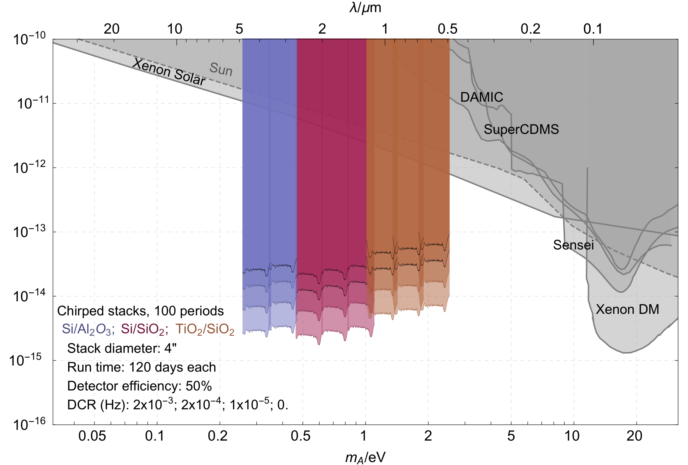
DEEPDISH
Just proposed to NSF Astroparticle (Second try, $1.75M)

Slide 17
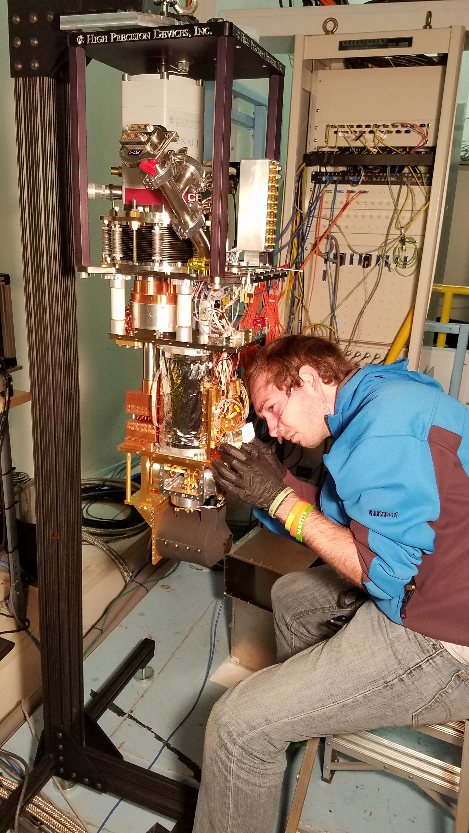
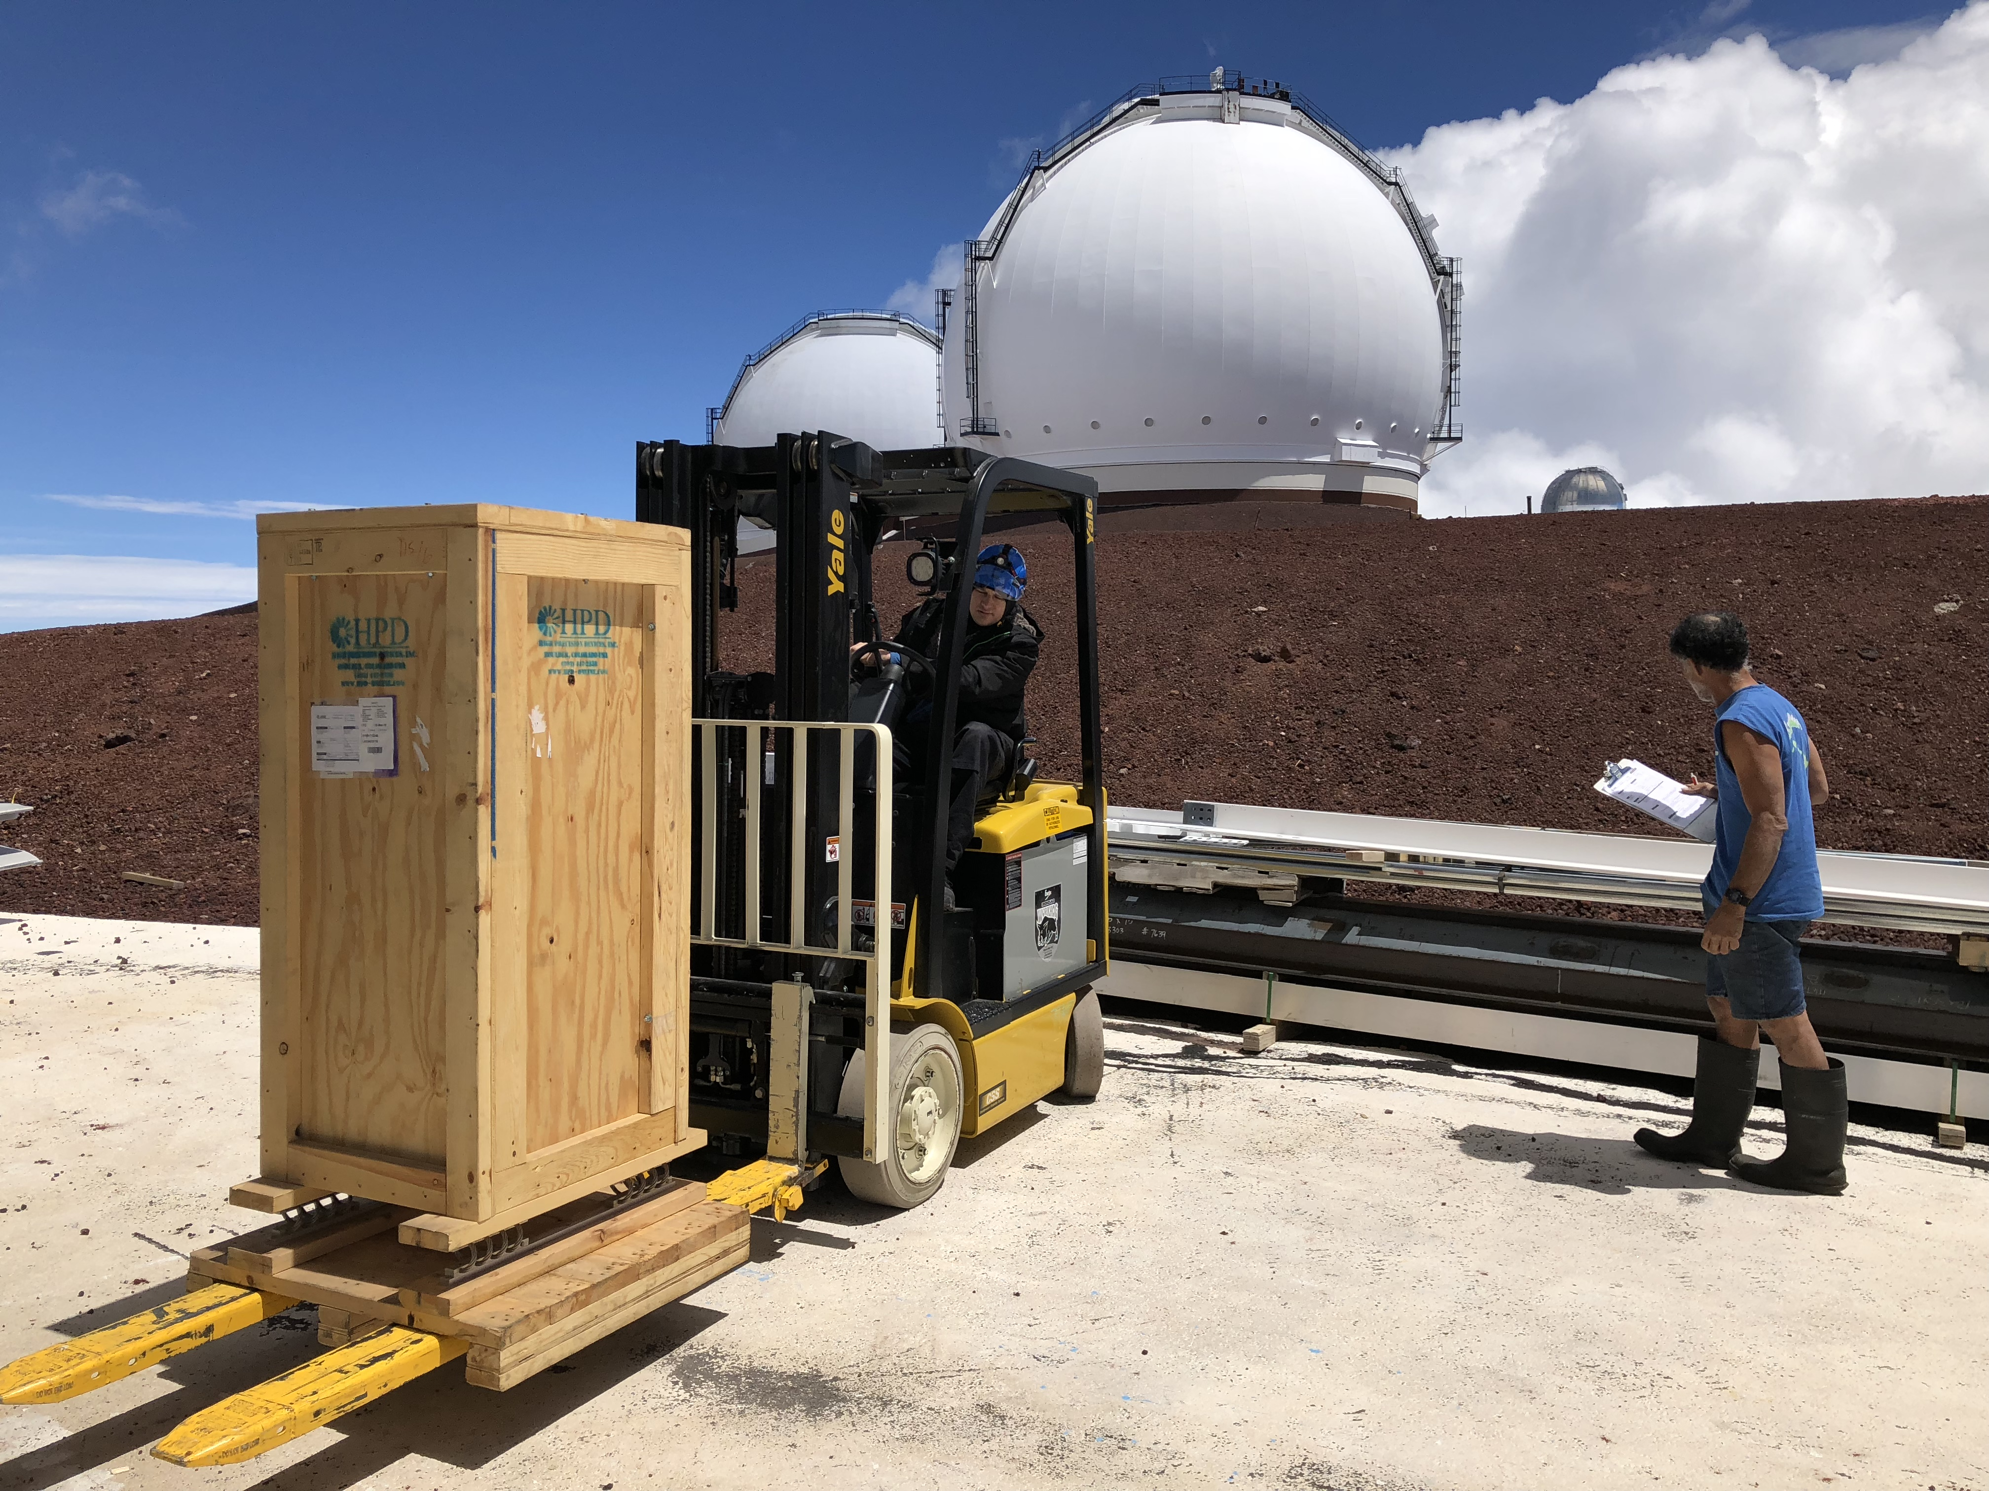
MEC
MEC is a 20 kpix MKID Exoplanet Camera for Subaru SCExAO
SCExAO
  Extreme AO
  Lyot/PIAA/Vector Coronagraphs
Goal: Observe cold gas giants in reflected light
MEC was the thesis project of Alex Walter

Slide 18
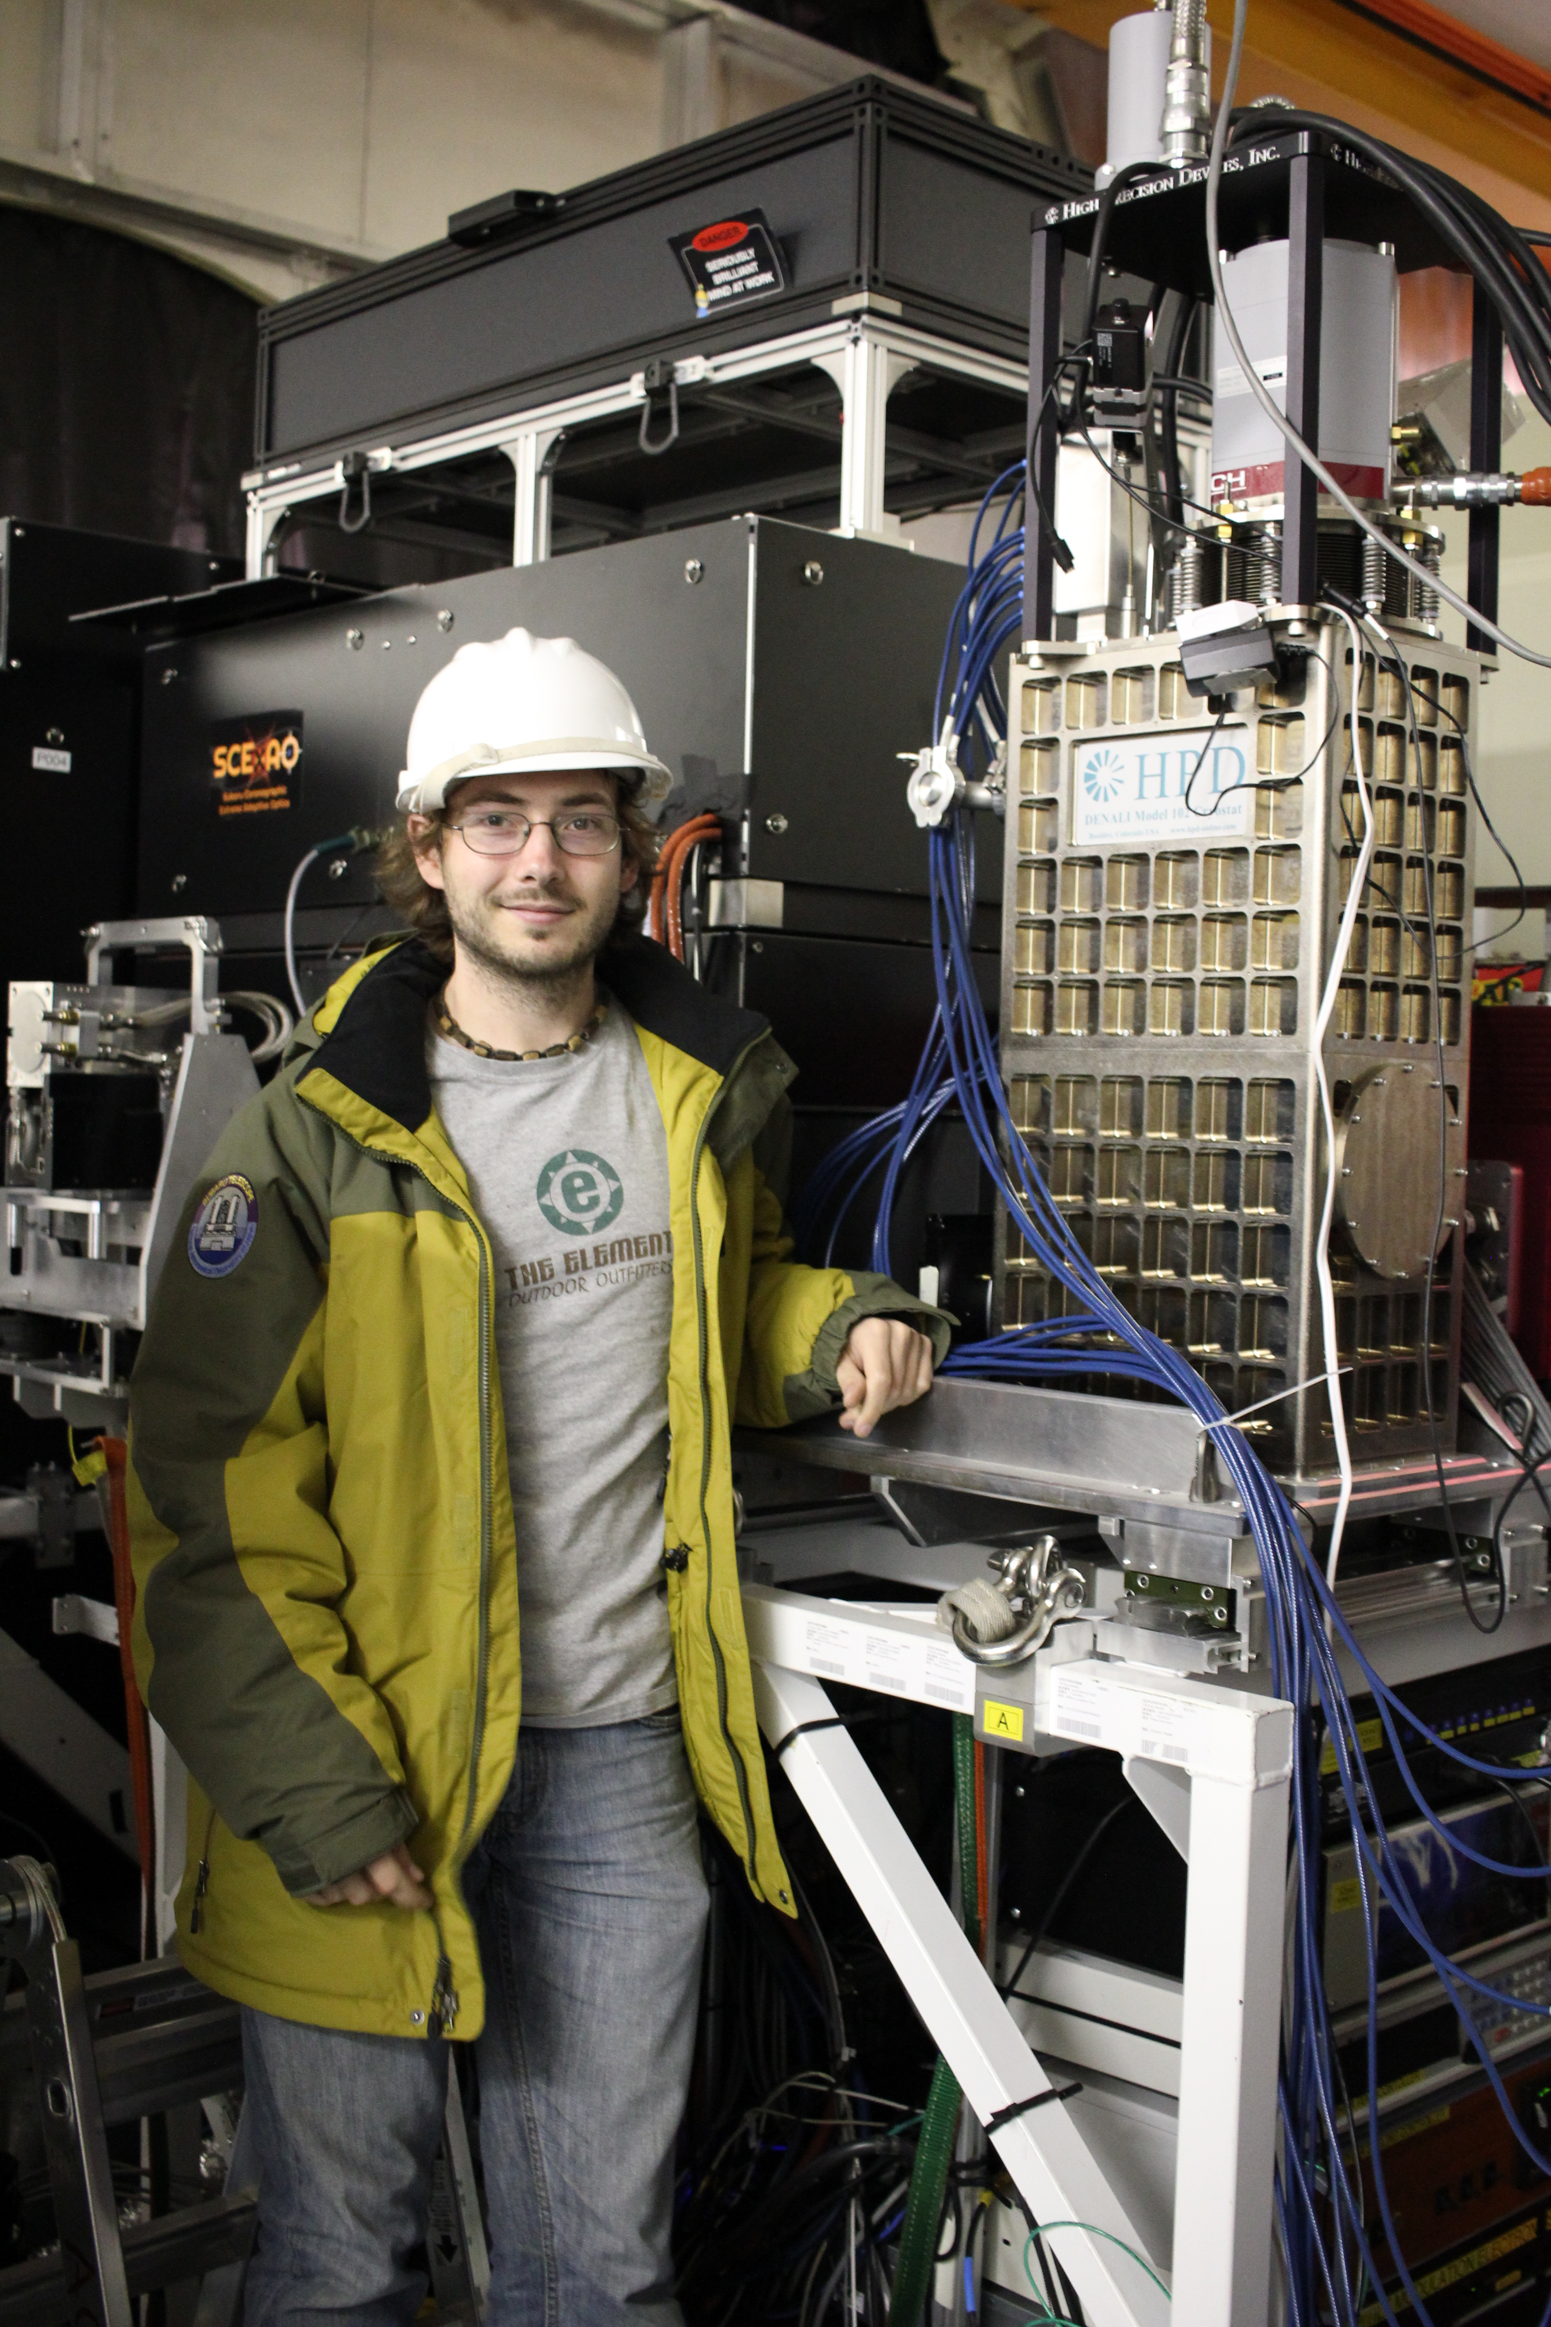
MEC
MEC has been operational for over a year
We have done fully remote observing runs
Achieving expected performance after a recent wiring upgrade

Slide 19
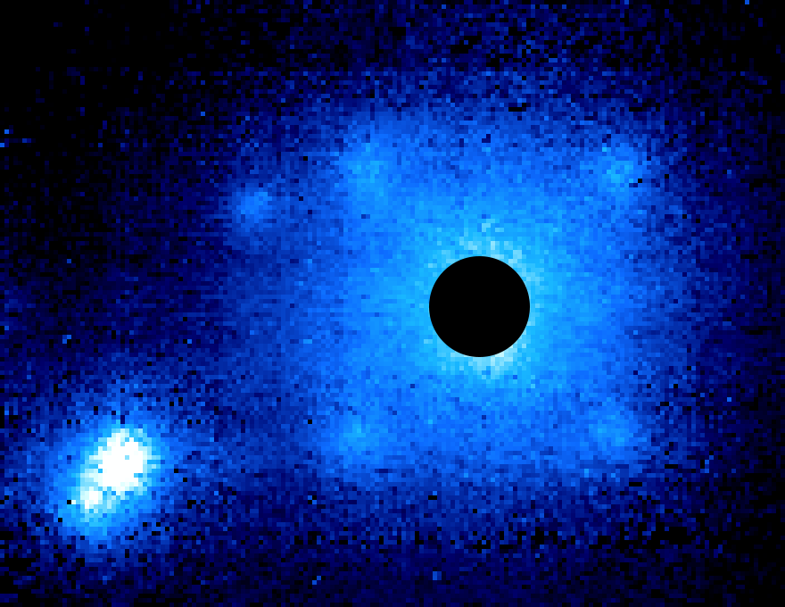
It works!
Theta Orionis B

