Slide 1
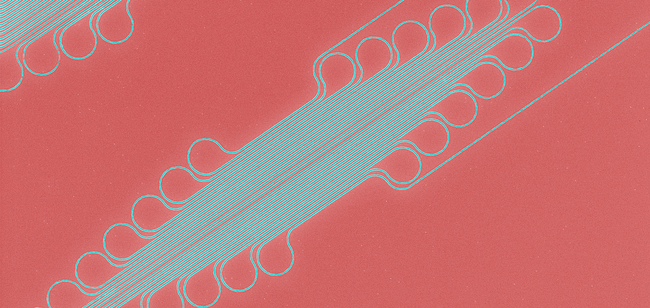
Superconducting nanowire single photon detectors and their performance in strong magnetic fields
December 10th, 2019
erhtjhtyhy
Tomas Polakovic
PHY Argonne
Drexel University
W.R. Armstrong, V. Yefremenko, J.E. Pearson, K. Hafidi, G. Karapetrov, Z.-E. Meziani, V. Novosad
CPAD 2019,
Madison, Wisconsin

Slide 2
But why magnetic fields?
And other bad things…
Applications of quantum detectors outside of QIS
Nuclear/particle physics, cosmology, etc.

Slide 3
But why magnetic fields?
Detectors
Nature papers

Slide 4
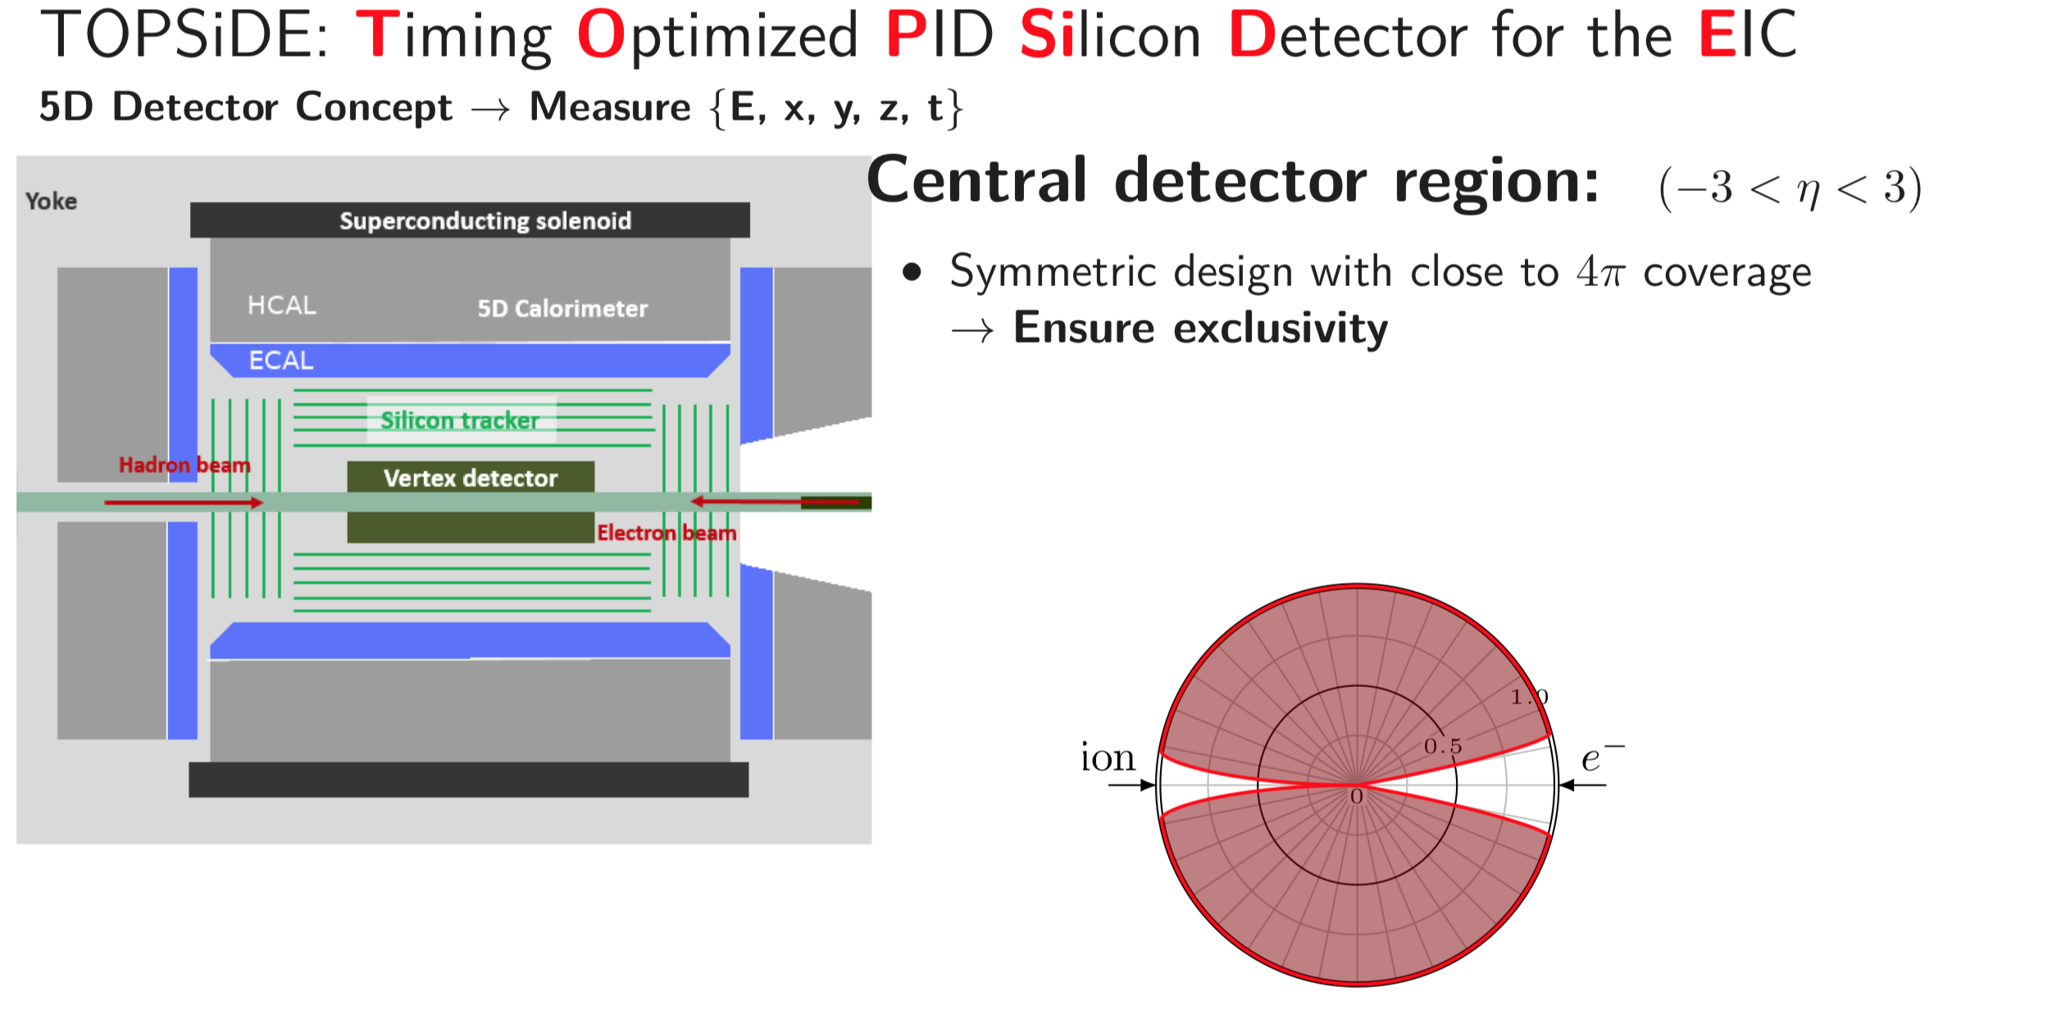
Hostile conditions?
And other bad things…
Detectors
Nature papers
W. Armstrong
W. Armstrong

Slide 5
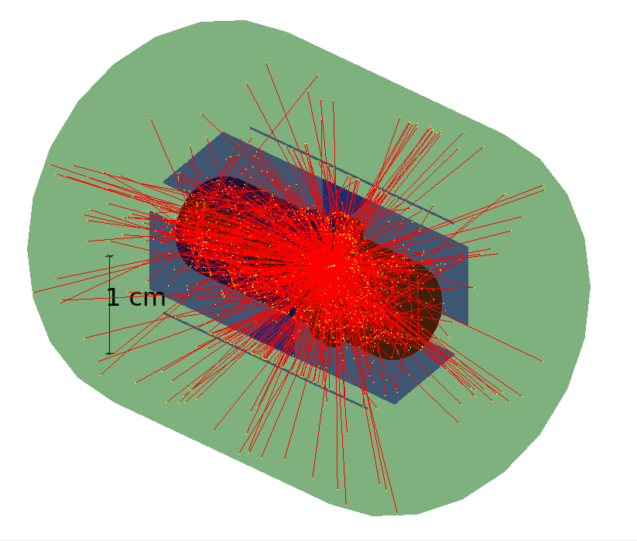
But why magnetic fields?
And other bad things…
Low energy recoil detector for photodisintegration of polarized deuteron targets
³He tagging in J-Ψ electron production

Slide 6
What do we need?
Fast + precise (>= 1GHz + ~10 ps jitter)
Rad hard
Mag field resistant (~3 T)
Not too cold (> 4.2 K)
Small

Slide 7
single photon superconducting nanowire detectors
Devices utilizing superconducting nanowires biased close to critical currents
Excitation of quasi-electrons from a Cooper pair starts an avalanche process that turns the whole wire cross section normal
Transition is from a superconducting to fully normal, high resistance (>1 MΩ) state
  No squid current preamplification needed
Currently the best timing and rate photo-detectors available
Can also do particles not really an explored field
  Lack of interest (historically)

Slide 8
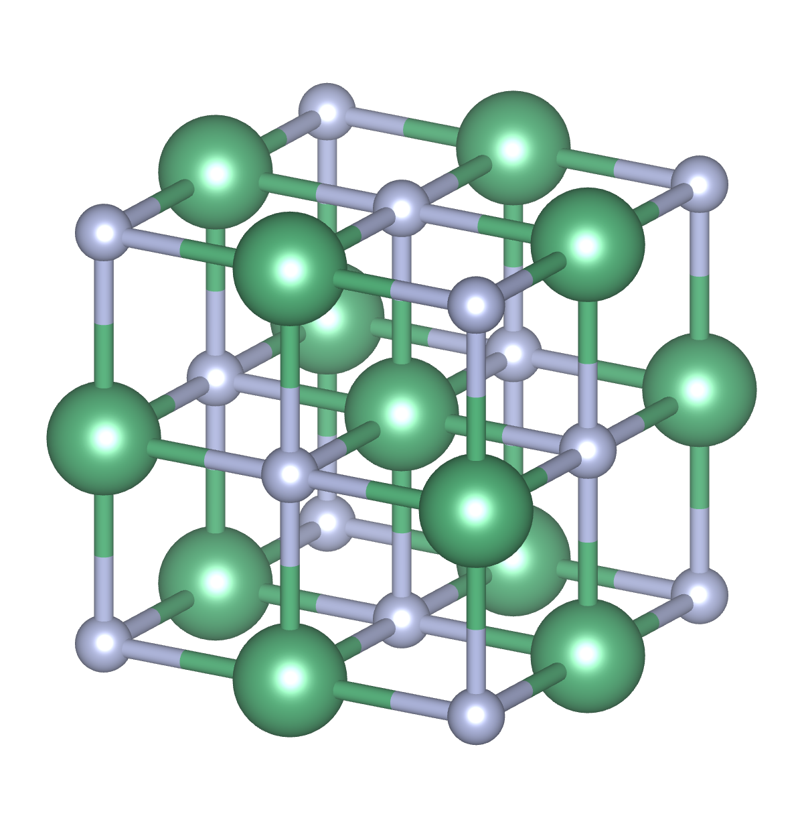
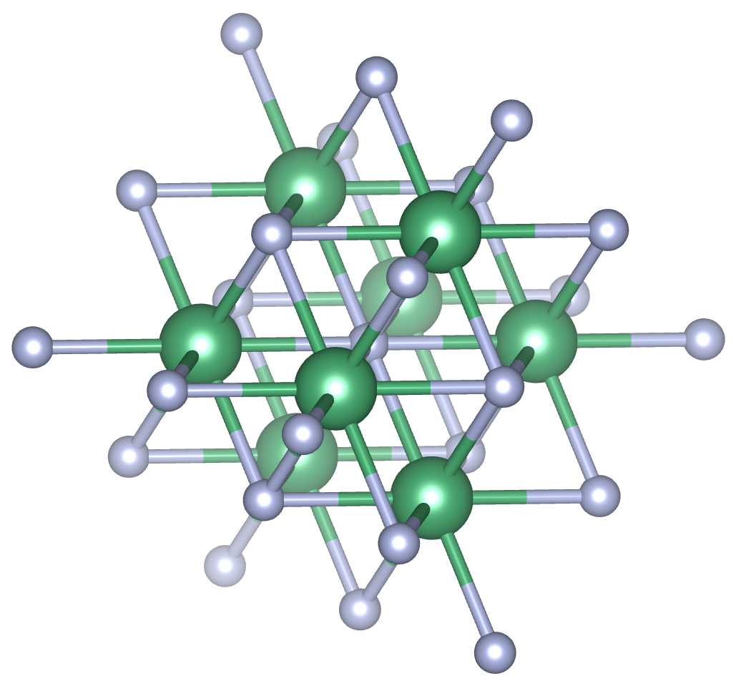
Niobium Nitride as detector material
Technological complications
Rad hard?
  Yes. NbN is a crappy form of Zircalloy
Not too cold?
  Yes (T_{C} > 8 K)
Can handle strong fields?
  Yes, H_{c2}(0) ~ 30 T
SC δ-cubic NbN
Thermodynamically stable
Non-SC δ’-hexagonal NbN

Slide 9
Niobium Nitride as detector material
Technological complications
Rad hard?
  Yes. NbN is a crappy form of Zircalloy
Not too cold?
  Yes (T_{C} > 8 K)
Can handle strong fields?
  Yes, H_{c2}(0) ~ 30 T
    Wait…What?
SC δ-cubic NbN
Thermodynamically stable
Non-SC δ’-hexagonal NbN

Slide 10
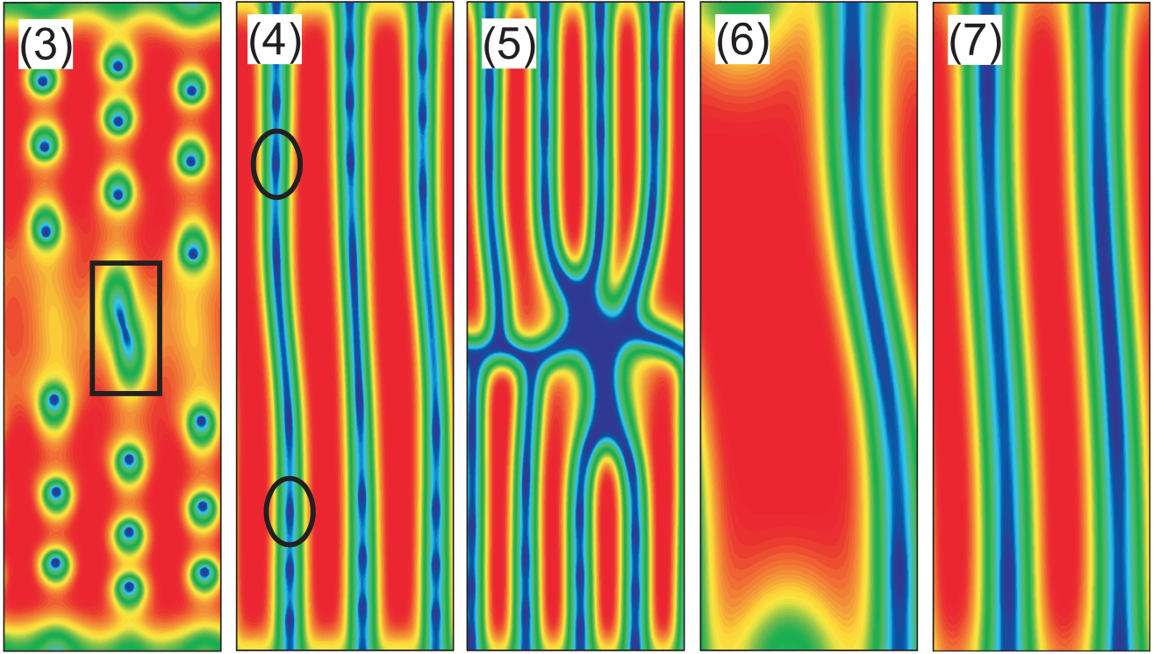
How?
G. Berdiyorov, et. al., PRB (2014)

Slide 11
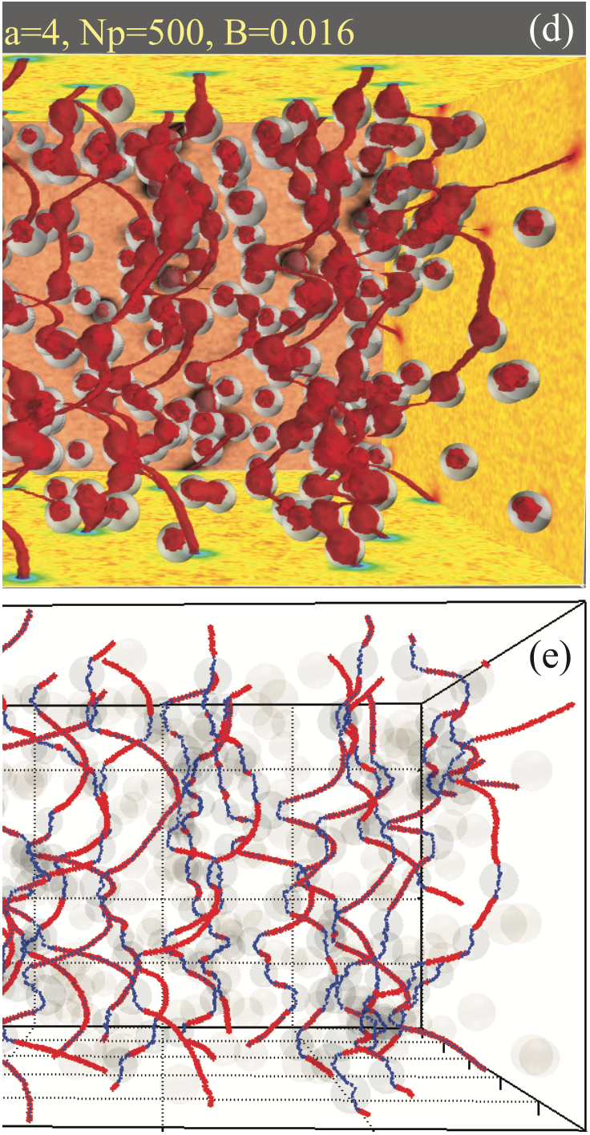
How?
A.E. Koshelev, et. al., PRB (2016)

Slide 12
Ion Beam Assisted Sputtering
Technology developed as a solution
N2
Si
Sputtering technique developed during NbN nanowire R&D
Replaces passive N₂ gas with N plasma
Increased in particle energy eliminates need for high temperatures
Different momentum distributions allow for growth on non-epitaxial substrates
Invention report ANL-IN-17-164
Polakovic, et. al., APL Mat (2018)
Conventional sputtering
Nb
Si
IBAS
Nb
e⁻
N⁺

Slide 13
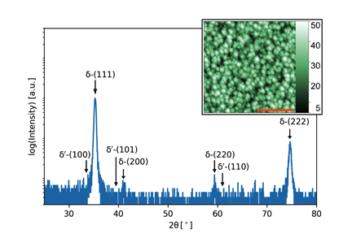
Ion beam assisted sputtering of NbN
material properties
Growth of films achieved with bulk T_{c} as high as 14.5 K
ρ_{N} = 110 μΩ.cm – disordered films
Perpendicular H_{c2} = 32 T (in-plane ξ=3.2 nm)
Reduced sensitivity to Nitrogen concentration
Textured (111) growth on Si substrates
No presence of non-superconducting phases of NbN
Process works at room temperature and on Si substrates
Polakovic, et. al., APL Materials (2018)

Slide 14
Ion beam assisted sputtering of NbN
Devices typically use ultra-thin films
  Behavior of superconductivity in 2D limit has been explored
A superconductor-insulator transition is observed at thickness of approx. 2 nm
Can be explained either by electron wave leakage (quantization of order parameter) or weak localization (strong Coulomb interaction of electrons)
Both theories predict similar behavior
  Impossible to determine which effect is dominant
b = 0.73 Å
c = 2.84 Å²
τ = 2.43e-15 s
Polakovic, et. al., APL Materials (2018)

Slide 15
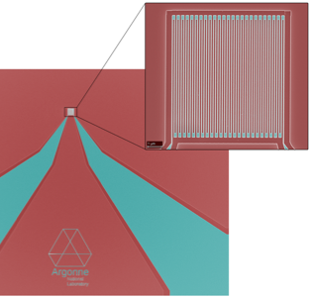
Superconducting nanowire detectors
SC Nanowires at Argonne
Detectors capable of single-photon detection with saturated QE in fields up to 8 T
Operational temperatures of 4 K
Detection rates at least 100 MHz with 0 dark counts
Polakovic, et. al., arXiv:1907.13059 (2019)

Slide 16
Superconducting nanowire detectors
SC Nanowires at Argonne
Detectors capable of single-photon detection with saturated QE in fields up to 8 T
Operational temperatures of 4 K
Detection rates at least 100 MHz with 0 dark counts
Polakovic, et. al., arXiv:1907.13059 (2019)

Slide 17
Superconducting nanowire detectors
SC Nanowires at Argonne
Detectors capable of single-photon detection with saturated QE in fields up to 8 T
Operational temperatures of 4 K
Detection rates at least 100 MHz with 0 dark counts
Polakovic, et. al., arXiv:1907.13059 (2019)

Slide 18
Superconducting nanowire detectors
SC Nanowires at Argonne
400 nm
Detectors capable of single-photon detection with saturated QE in fields up to 8 T
Operational temperatures of 4 K
Detection rates at least 100 MHz with 0 dark counts
Current characterization focus on high-energy photons
Particles + calorimetry soon
900 nm
Polakovic, et. al., arXiv:1907.13059 (2019)

Slide 19
Summary
We can fabricate SNSPDs with all their benefits that work in fields as high as 8 T
Preliminary results show no degradation in radiation fields of accelerators (ANL ATLAS)
Can operate at LHe temperatures (no need for additional expensive cooling facilities)
Stay tuned for particle ID and calorimetry in near future

Slide 20
Thank you for your attention

