Slide 1
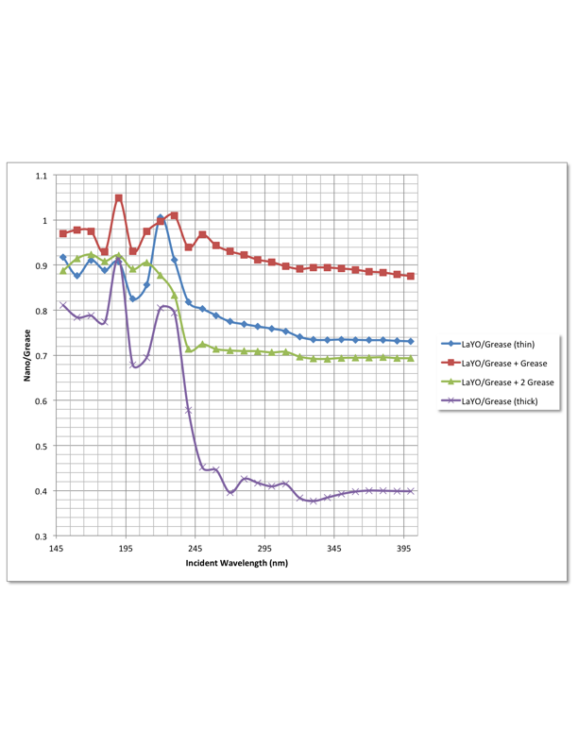
Nanoparticle-enhanced readout for crystal calorimetry
Detection of 220 nm (UV) fast component of BaF₂ scintillation
Nanoparticle type that absorbs 220 nm emission
Preferably little absorption >250 nm (filtering and/or blocking of 300 nm component)
Large Stokes shift to visible wavelength range for detection
BaF2 Xtal
Nano candidate simulation
Absorption, then Stokes shift over slow component
-> no sensitivity in this region
Nano candidate data
Thin Samples
Combined:
UV Absorption
Stokes shift
Vis Emission
Thick Sample
S.R. Magill Argonne National Laboratory

Slide 2
Nanoparticle Wavelength Shifting
Quantum Confinement changes material properties when particle size < electron wavelength
E_{g} increases with decreasing particle size -> UV photon absorption
Discrete energy levels form at the band-edges
Stokes Shift is difference between absorption and emission wavelength
Emission wavelength decreases with decreasing size

Slide 3
BaF2 Crystal Readout – Mu2e Upgrade
Fast components (195, 224 nm)
  Decay time ~1 ns
Slow component (250 -> 400 nm)
  Decay time ~650 ns
SiPM peak sensitivity
(425 nm)
Absorption, then Stokes shift over slow component to sensor
no sensitivity for slow component!

Slide 4
Absorption/emission of candidate nanoparticle
Absorption:
strong < 250 nm
weak > 250 nm
Emission:
300 nm < λ < 600 nm
Stokes Shift:
~200 nm peak-to-peak

Slide 5
Candidate nanoparticle for BaF2 Readout
224 nm emission of BaF2
absorption peak of nanoparticle
Little absorption for wavelengths >250 nm
Overlap of slow component and nanoparticle emission:
1) wave-shift to longer wavelength, or 2) resin coating on the SiPM

Slide 6
Tests of selected nanoparticles
Tested a nanoparticle sample made at UTA by mixing nanoparticles in UV-transparent grease (DOW-Corning)
Compare blue, purple – it appears that passing through more nanoparticles helps – small reduction in the peak at 220 nm and a larger reduction in the signal > 245 nm.
-> determine the amount of nanoparticles in the grease by optimizing the 220/300 ratio for maximum rejection of light >250 nm.
-> Ratio of 220/300 for purple (thick) sample is ~2/1
Nano/grease+
Thin sample
Nano/grease++
Thick sample

Slide 7
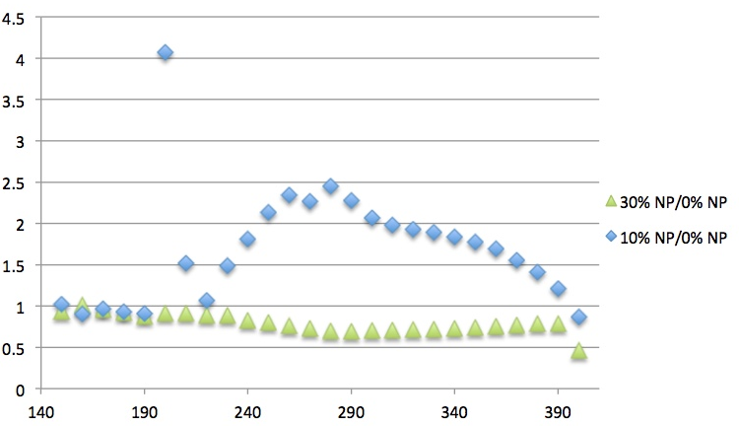
Nanoparticle-enhanced Night Vision
From ScienceDaily
Bats Scan The Rainforest With UV-Eyes
“Bats from Central and South America that live on nectar from flowers can see ultraviolet light (Nature, 9 October 2003).”
“There is little light at night. But compared to daylight, the colour spectrum is shifted towards short, UV-wavelengths.”
“Interestingly, bats achieve an absorption efficiency in the UV bandwidth of nearly 50 percent of their photoreceptors major peak of absorbance (alpha-band). This is nearly five times the value expected from in-vitro measurements of beta-band absorption in rhodopsin molecules. Whether this indicates a novel mechanism for light perception in the bats eye that is still unkown for mammals remains open.”
-> High efficiency for UV absorption is a characteristic of quantum confinement in nanoparticles – Bat eye rods are coated with nanoparticles!?
. . . and Deer
. . . and now Us!
Ratio N%/0% LaF3:Ce
UTA LaF3:Ce nanoparticles in transparent polycarbonate (contacts)
Enhancement for 10% LaF3:Ce:
230 nm < λ < 390 nm
Wavelength (nm)

