Slide 1
Calorimeter BRN
Roger Rusack – The University of Minnesota

Slide 2
WHO
Conveners – Francesco Lanni (BNL) and Roger Rusack (Minnesota)
Sub-conveners –
Nural Akchurin (Texas Tech)
Sarah Eno (Maryland)
Paolo Rumerio (Alabama)
Renyuan Zhu (Caltech)
With input from: Marty Bradenbach, Vitaliy Fadeyev, Jim Brau, Marcello Mannelli, Paul Lecoq, Jim Hirschauer, Craig Woody, Stephen E. Derenzo David Hitlin, Paul Lecoq, Sasha Ledovskoy, Charles L. Melcher,, Adam Para,
Gaudio Gabriella, Lorenzo Pezotti, Paolo Giacomelli, Artur Apreysian, Maria Spiropolou, Alessandro Tricolli, Martin Aleska, Hong Ma.
Not a complete representation of the field, but good representation from multiple sub-disciplines.

Slide 3
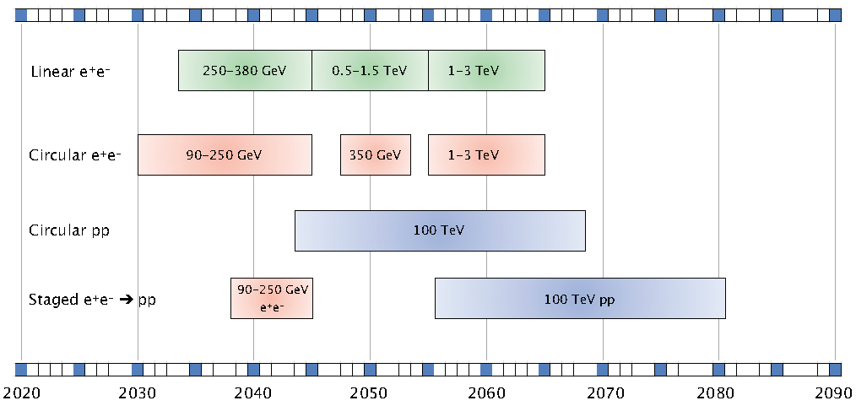
Timeline:
Our focus was on calorimeters for collider experiments, because that is where the next major challenges in calorimetry will come from. There are of course others but the main physics driver that requires novel calorimetry is experiments at future colliders.
And we don’t know what they are!
But we can guess.

Slide 4
Preparatory Meetings
The calorimetry group held several min-workshops on different aspects of calorimetry these were:
Imaging – with input from SiD and HGAL groups.
Crystals – Novel crystals for calorimetry
Dual Readout – new ideas in dual readout calorimeters
Electronics for calorimeters
Noble liquids.
Timing with calorimeters
Focus was on the applications of calorimetry in future collider experiments, what is the current state-of-the-art and what direction we might go in.
Each meeting started with the question: What can we invest in now to develop technology that would help make better calorimeters in ten years from now.
Game changers preferred but incremental improvements too.

Slide 5
Recent paradigm shifts
Particle Flow:
No longer use calorimeters in isolation. Calorimeters and tracker information combined to understand the event.
Precision Timing
Measurement of the time of arrival of a shower to better than 30 ps has been demonstrated
5D Calorimetery:
Measure position, energy and time of signal. Use all signals to disentangle complex events.
UV sensitive photodetectors
Developments in neutrino and dark matter detectors → Cerenkov signal detection and photosensors in LAr calorimeters.
MAPS Technology
Development of integrated sensor and readout technology with high voltage silicon.

Slide 6
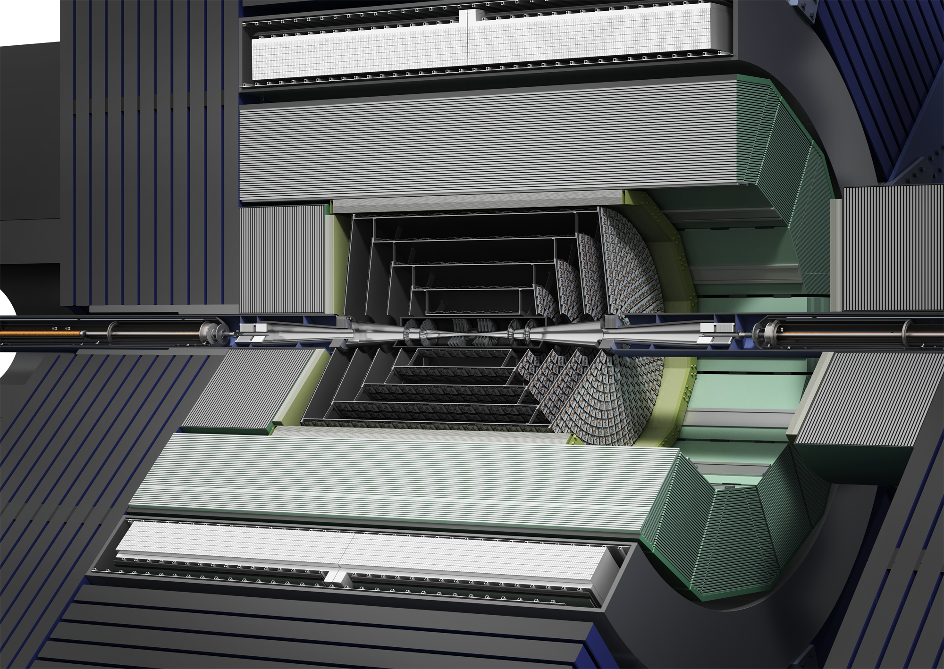
Imaging calorimeters
EM resolution ~20/√E.
Main focus was on how to simplify the construction using MAPS technology and counting hits in small pixels.
Suitable for linear and circular ee machines.

Slide 7
Noble Liquids at FCC hh
Radiation levels will be ten times larger than HL-LHC and pileup ~ 1,000!
Inspired by ATLAS and HGCAL

Slide 8
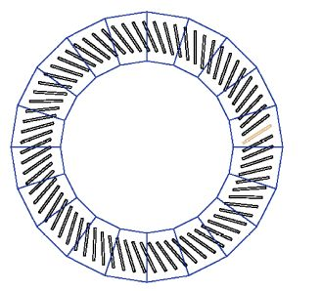
FCC –hh Calorimeter
EM Barrel
EM and Hadronic EndCap

Slide 9
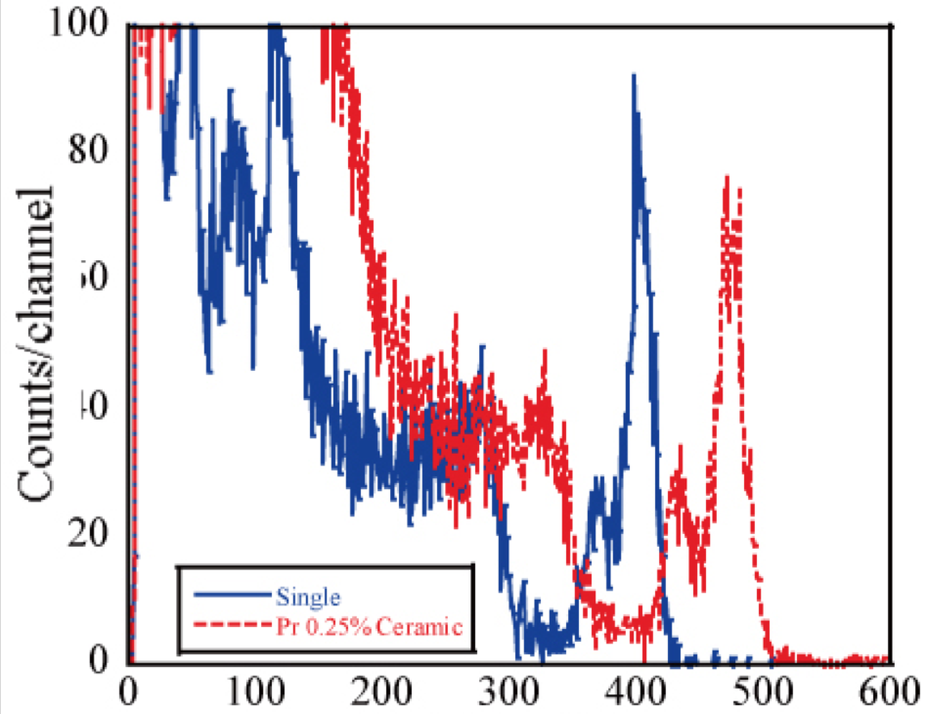
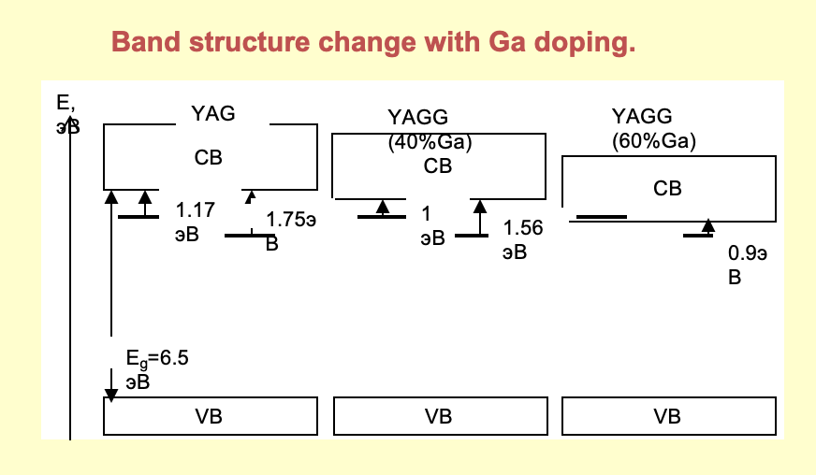
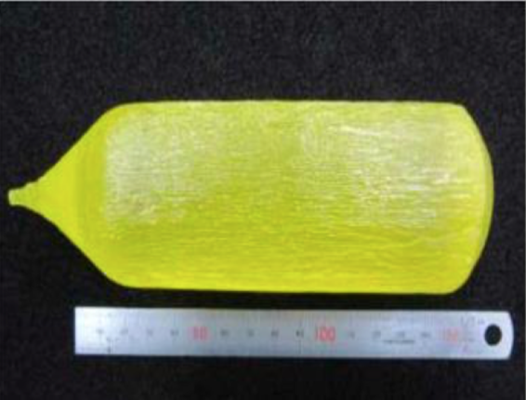
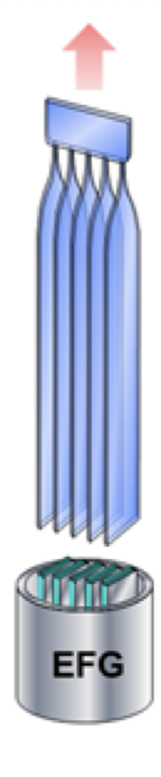
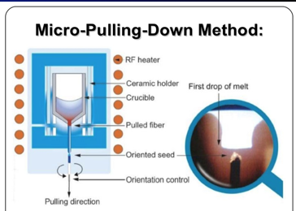
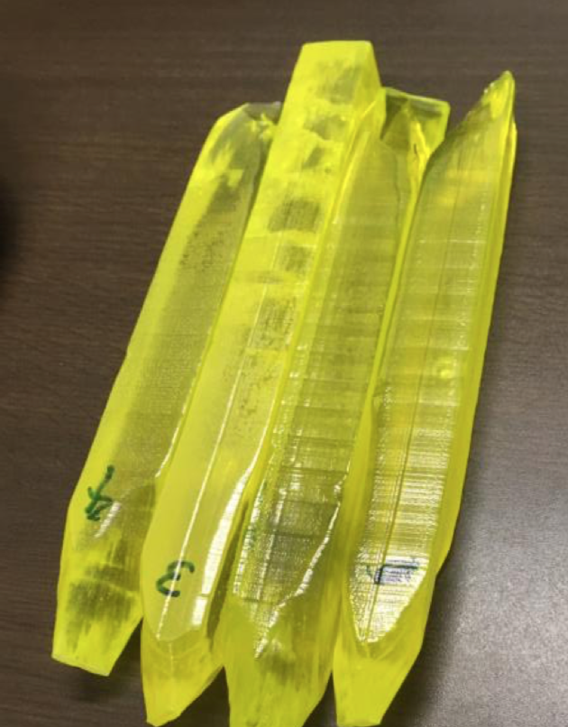
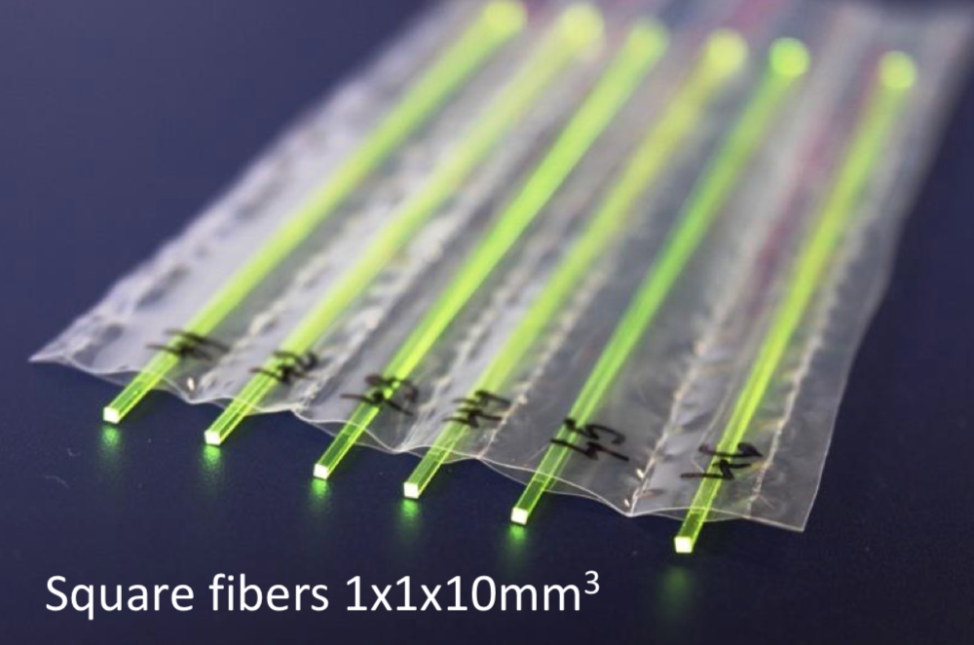
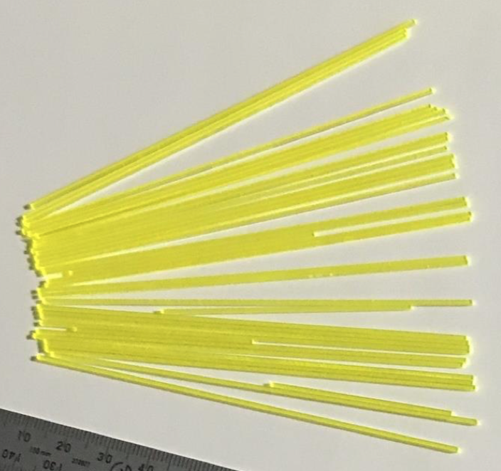
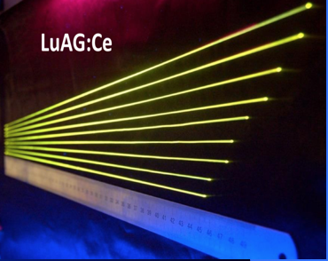
New perspectives with Garnets
YAG, LuAG, GGAG, GYAG, GLuAG, Ce³⁺ or Pr³⁺ doped
 | YAG | LuAG | GGAG | GYGAG | GLuGAG
Density g/cm³ | 4.56 | 6.73 | 6.7 | 5.8 | 6.8
Wavelength nm | 550 | 520 | 520 | 560 | 545
Light Yield Ph/MeV | 11000 | 14000 | 46000 | 60000 | 50000
Decay time ns | 70 | 100 | 80/800 | 100/600 | 75/190
Can be produced as Ceramics
Lu-escape peak
GLuGAG-2.5” diameter
Efficient di-valent co-doping strategies (Mg²⁺)
  To suppress slow components
  To shorten decay time
  To improve radiation hardness
From the bulk
Crystal Growth flexibility
  Standard Czokralski: large ingots with high mechanical stability
  EFG: Edge Film Growth for plates
  μPLD: Micro-Pulling-Down for fibers
Square fibers 1x1x100mm³

Slide 10
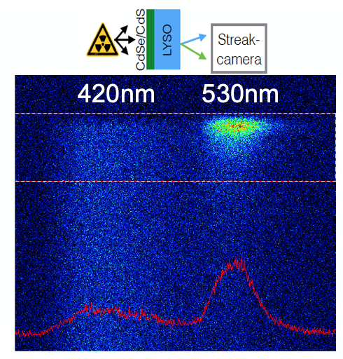
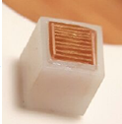
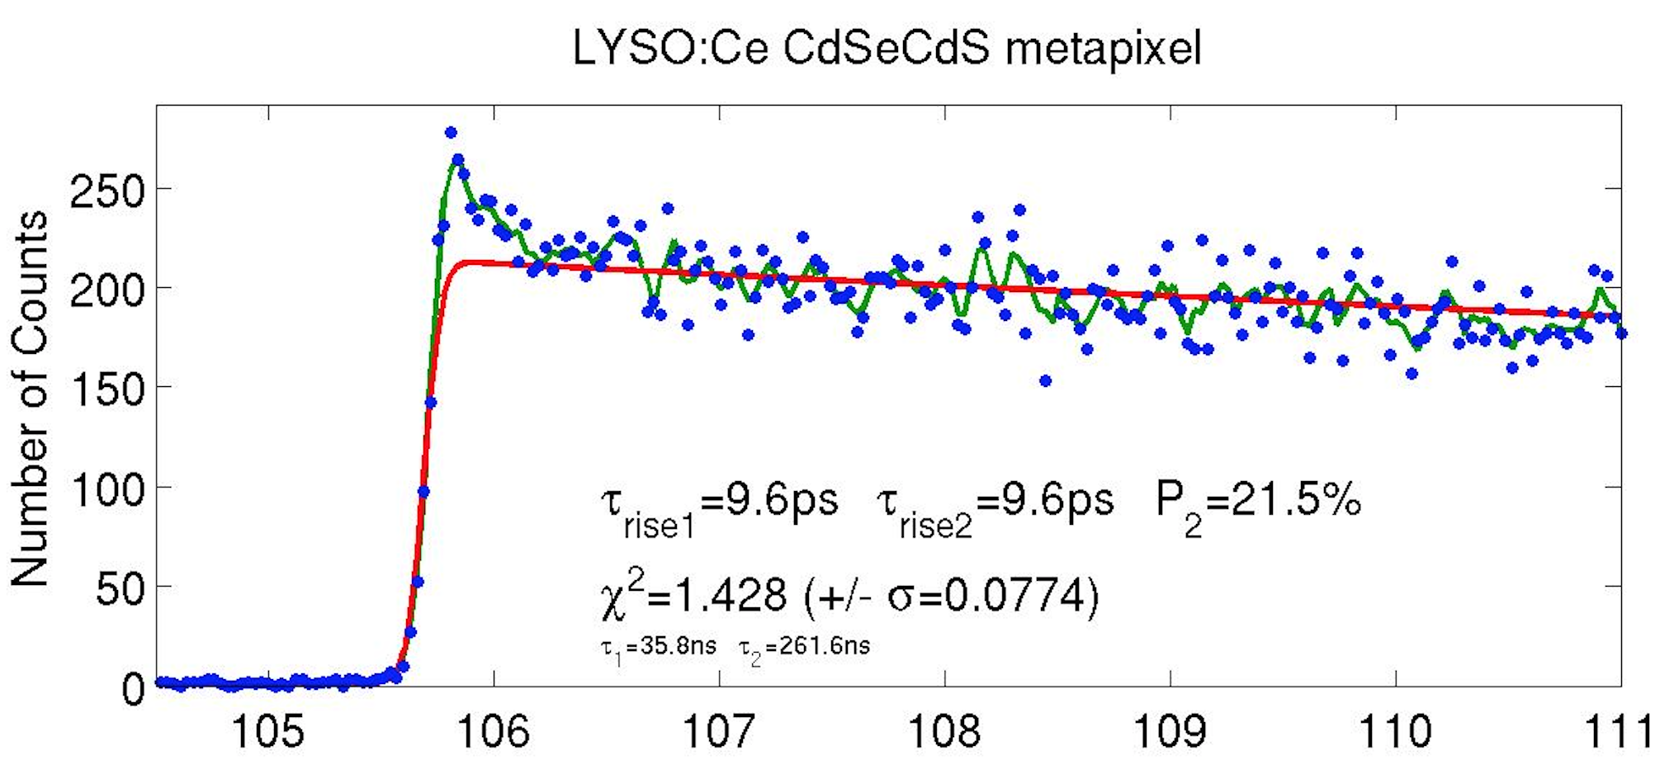
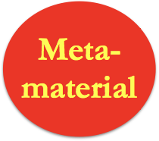
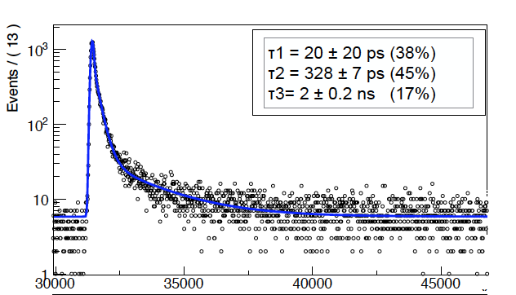
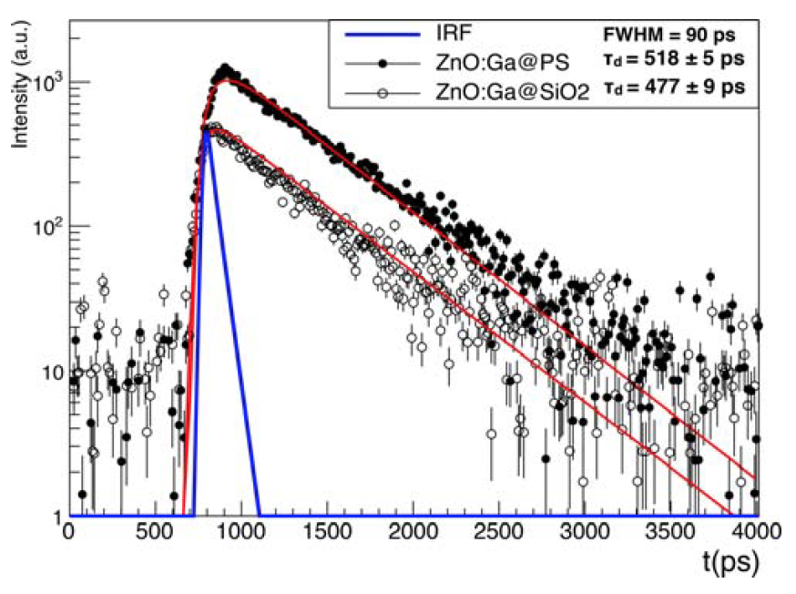
Fast Timing: Metascintillators
High stoping power
L(Y,G)SO, (La,Ce)Br3,
BGO, CsI
Prompt emission
Quantum confined (bi)-excitons
in nanocrystals
CdSe/CdS
nanoplatelets
ZnO:Ga powder
ZnO:Ga in PS
Also: ZnO:Ga nanorods
Methyl-amonium perovskites
HfO quantum dots
InGaN/GaN MQW structures
Light transport to SiPM
Photonic crystals, photonic fibers

Slide 11
Priority Research Needs for Calorimeters
For noble liquid calorimeters
  Multi-layer electrodes with high transverse and longitudinal segmentation to fully exploit particle flow algorithms.
    the development of cold electronics, transmission line technology and high-channel cryogenic feedthroughs.
For Silicon sampling calorimeters,
  Integration of readout electronics into the the silicon sensor substrate to improve energy resolution of EM calorimeters and to simplify their construction.
Crystals
  Investigation of low-cost, high-light-yield, fast and radiation-tolerant inorganic scintillators.
Plastic scintillators:
  Investigation of low-cost, high-light-yield, fast and radiation-tolerant plastic scintillators.
Photodetector technology:
  improved UV sensitivity, larger dynamic range though smaller pixels, direct coupling to, or integration with readout electronics.

Slide 12
Cross-Cutting Needs
Picosecond-level clock distribution systems.
  Any system that relies on precisely measuring the time interval between signals between different detector channels requires a high quality, low-jitter and low-wander clock distribution system.
Precision test beams.
  Low-dispersion electron beams for accurate characterization of calorimetry. Energies of less than 20 GeV with a dispersion of better than 0.5\% would compliment the beams available at the CERN SPS.
Datalinks with 100 Gbs data rates.
Continued access to radiation hard ASIC technology.
Continued development of GEANT to match the new information being used in calorimeters
Modern image processing technology.
  Both hardware (GPUs, FPGAs) and software (image processing and deep learning) to reconstruct complex events both in real time and offline.
Power delivery systems, in particular improved DC-DC converters.

Slide 13
Feedback from you.
Please send your thoughts, comments, criticisms and ideas to Francesco Lanni and me at:
rusack@umn.edu
flanni@bnl.gov

