Slide 1


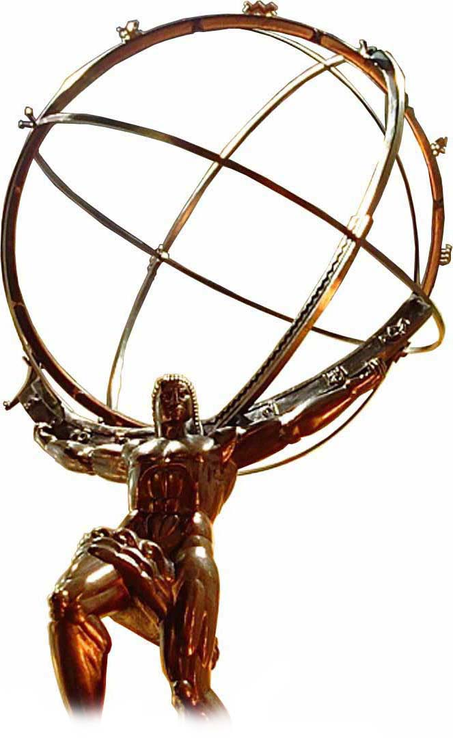


R&D on LGAD Radiation Tolerance: The HL-LHC and Beyond
CPAD Instrumentation frontier workshop 2019
Dr. Simone M. Mazza (SCIPP, UC Santa Cruz),
on behalf of the SCIPP UCSC group

Slide 2
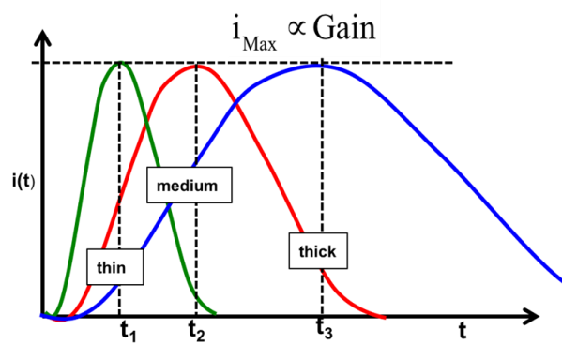
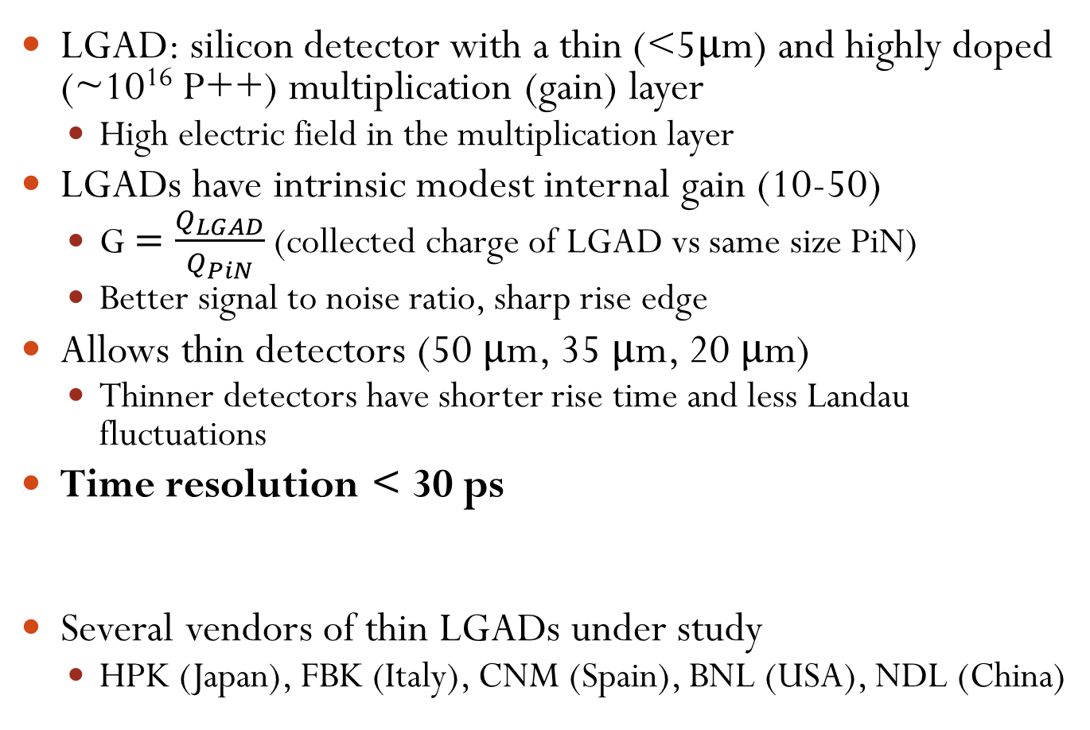
LGADs
LGAD: silicon detector with a thin (<5μm) and highly doped (~10¹⁶ P++) multiplication (gain) layer
  High electric field in the multiplication layer
LGADs have intrinsic modest internal gain (10-50)
  G $=\frac{Q_{LGAD}}{Q_{PiN}}$ (collected charge of LGAD vs same size PiN)
  Better signal to noise ratio, sharp rise edge
Allows thin detectors (50 μm, 35 μm, 20 μm)
  Thinner detectors have shorter rise time and less Landau fluctuations
Time resolution < 30 ps
Several vendors of thin LGADs under study
  HPK (Japan), FBK (Italy), CNM (Spain), BNL (USA), NDL (China)

Slide 3
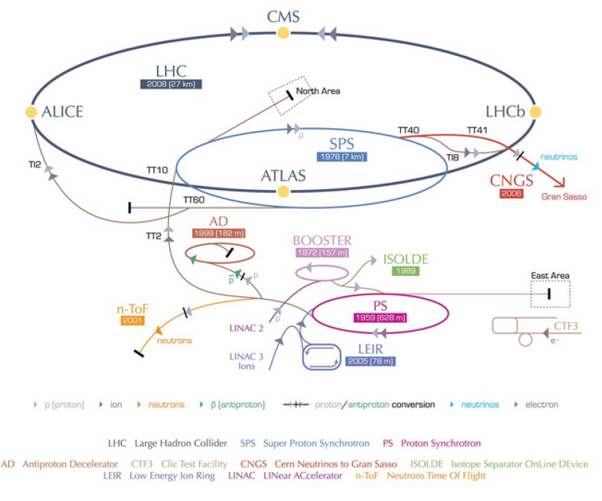
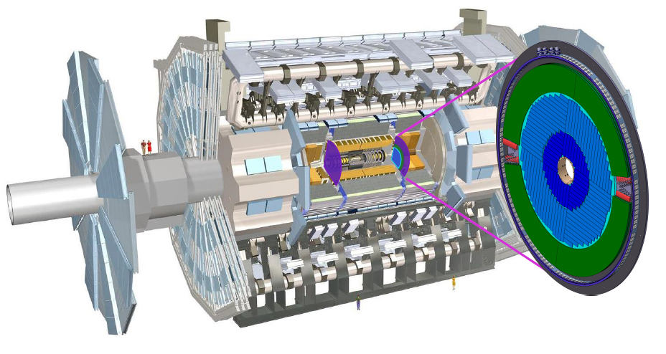
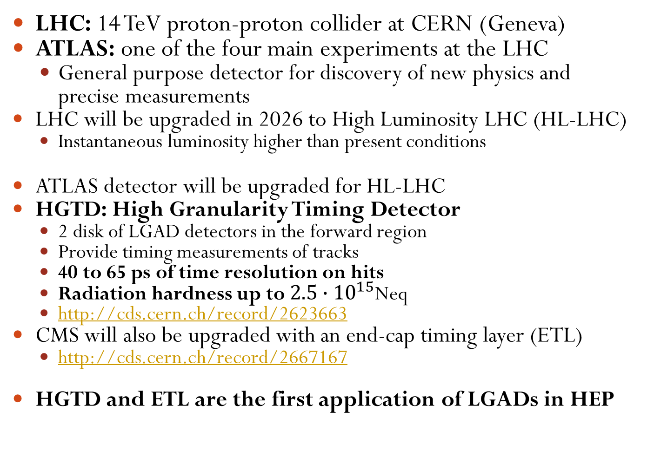
HGTD, ATLAS and LHC high luminosity
LHC: 14 TeV proton-proton collider at CERN (Geneva)
ATLAS: one of the four main experiments at the LHC
  General purpose detector for discovery of new physics and precise measurements
LHC will be upgraded in 2026 to High Luminosity LHC (HL-LHC)
  Instantaneous luminosity higher than present conditions
ATLAS detector will be upgraded for HL-LHC
HGTD: High Granularity Timing Detector
  2 disk of LGAD detectors in the forward region
  Provide timing measurements of tracks
  40 to 65 ps of time resolution on hits
  Radiation hardness up to $2.5∙{10}^{15}$Neq
  http://cds.cern.ch/record/2623663
CMS will also be upgraded with an end-cap timing layer (ETL)
  http://cds.cern.ch/record/2667167
HGTD and ETL are the first application of LGADs in HEP
HGTD

Slide 4
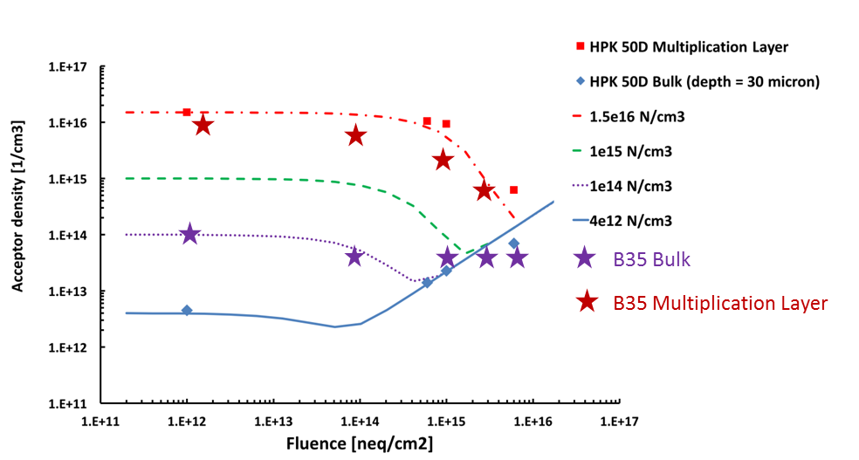
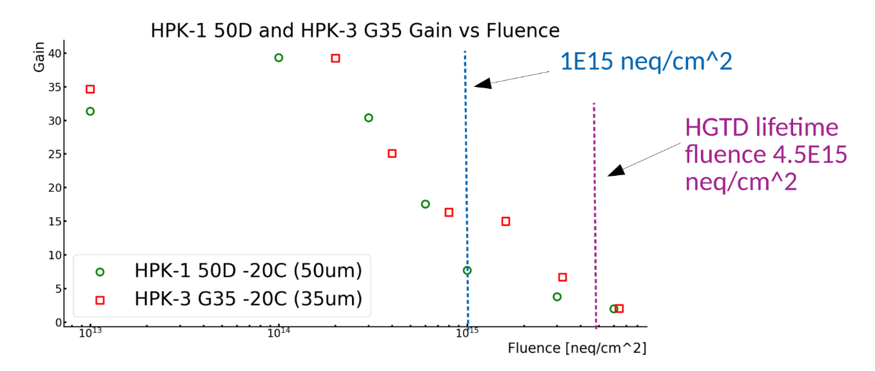
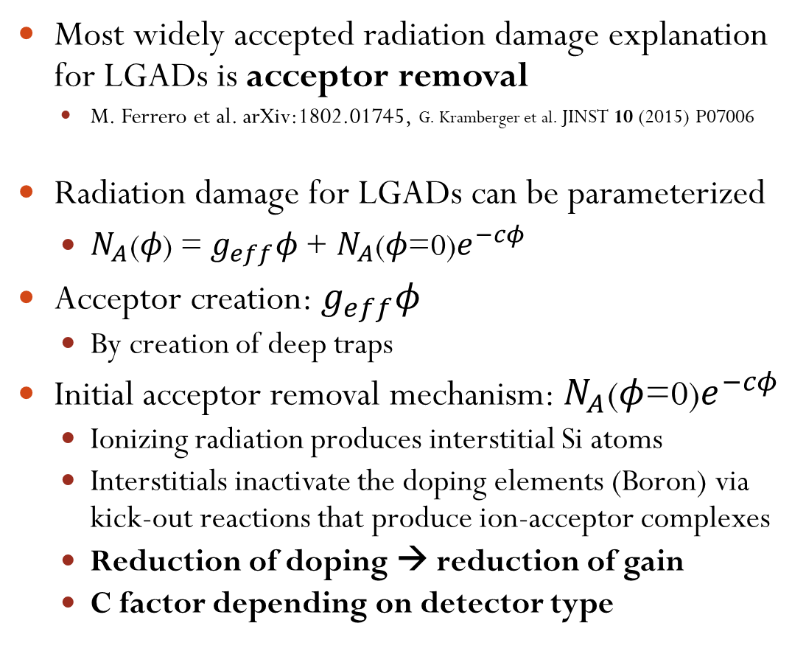

Radiation damage on LGADs
$$N_{A}\text{(}φ\text{) = }g_{eff}φ\text{ + }N_{A}\text{(}φ\text{=0)}e^{−cφ}$$
Most widely accepted radiation damage explanation for LGADs is acceptor removal
  M. Ferrero et al. arXiv:1802.01745, G. Kramberger et al. JINST 10 (2015) P07006
Radiation damage for LGADs can be parameterized
  $N_{A}\text{(}φ\text{) = }g_{eff}φ\text{ + }N_{A}\text{(}φ\text{=0)}e^{−cφ}$
Acceptor creation: $g_{eff}φ$
  By creation of deep traps
Initial acceptor removal mechanism: $N_{A}\text{(}φ\text{=0)}e^{−cφ}$
  Ionizing radiation produces interstitial Si atoms
  Interstitials inactivate the doping elements (Boron) via kick-out reactions that produce ion-acceptor complexes
  Reduction of doping → reduction of gain
  C factor depending on detector type
Multiplication layer
Bulk
Y. Zhao et al. 10.1016/j.nima.2018.08.040
Pre-rad
5E15 Neq/cm²
Y. Zhao presentation at ULITIMA conference
https://indico.fnal.gov/event/ANLHEP1390/session/8/contribution/68/material/slides/0.pdf

Slide 5
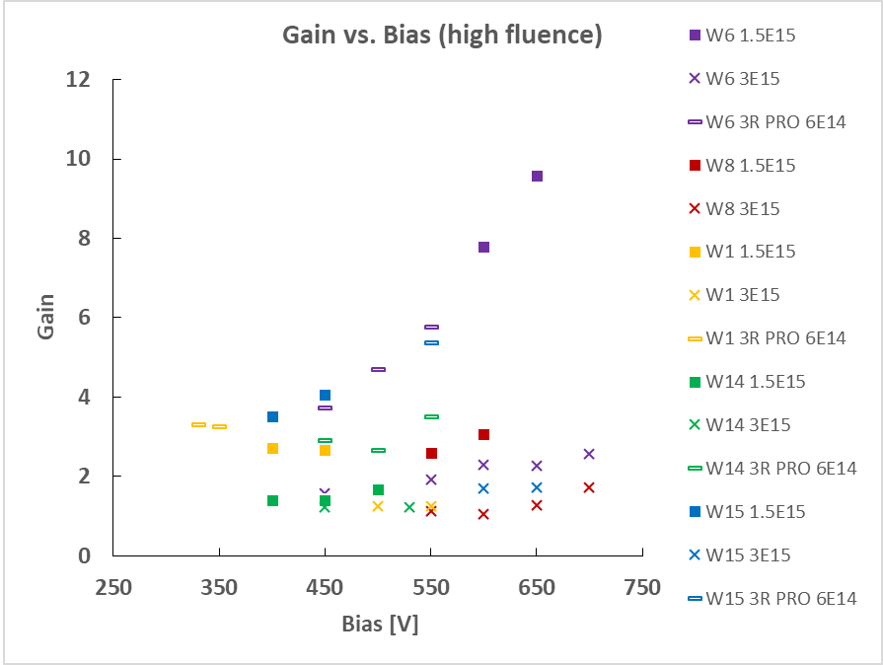
Mitigation of radiation damage on LGADs
Studies ongoing to mitigate the effect of radiation damage on multiplication (gain) layer
  Gallium as dopant instead of Boron (proven not effective and more expensive)
  Carbon infusion
  Thin and deep multiplication layer
FBK (Fondazione Bruno Kessler) sensors
Carbon infusion
Carbon is electrically inactive (no effect pre-irradiation)
  Slight reduction of gain pre-rad because of implantation procedure
Catch interstitials instead of Boron
Reduces acceptor removal after irradiation
1.5E15 N_{eq}/cm²
Boron+Carbon sensor
Gain ~10
1.5E15 N_{eq}/cm²
Boron sensor, Gain ~3
S.M. Mazza et al. arXiv:1804.05449
M. Ferrero et al. arXiv:1802.01745
Y. Zhao et al. 10.1016/j.nima.2018.08.040

Slide 6
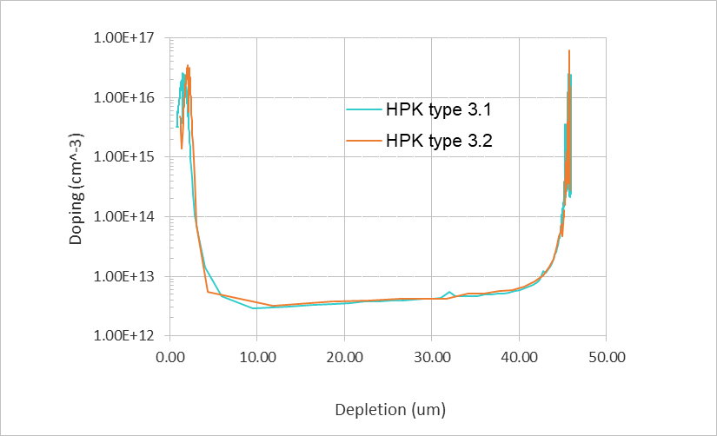
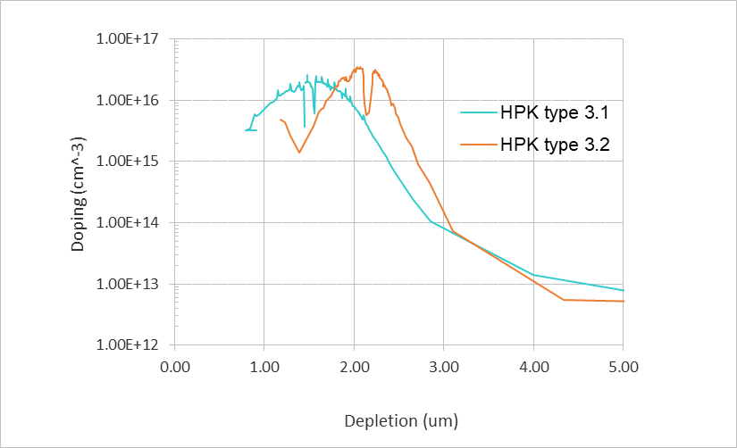
Mitigation of radiation damage on LGADs
HPK (Hamamatsu Photonics) sensors
Thin but highly doped gain layer
  Higher initial doping concentration
  Takes more time to be inactivated
Deep gain layer
  High field for larger volume
Gain layer between 1um to 2um in instead of ~0.5-1 um
“Regular” LGAD

Slide 7
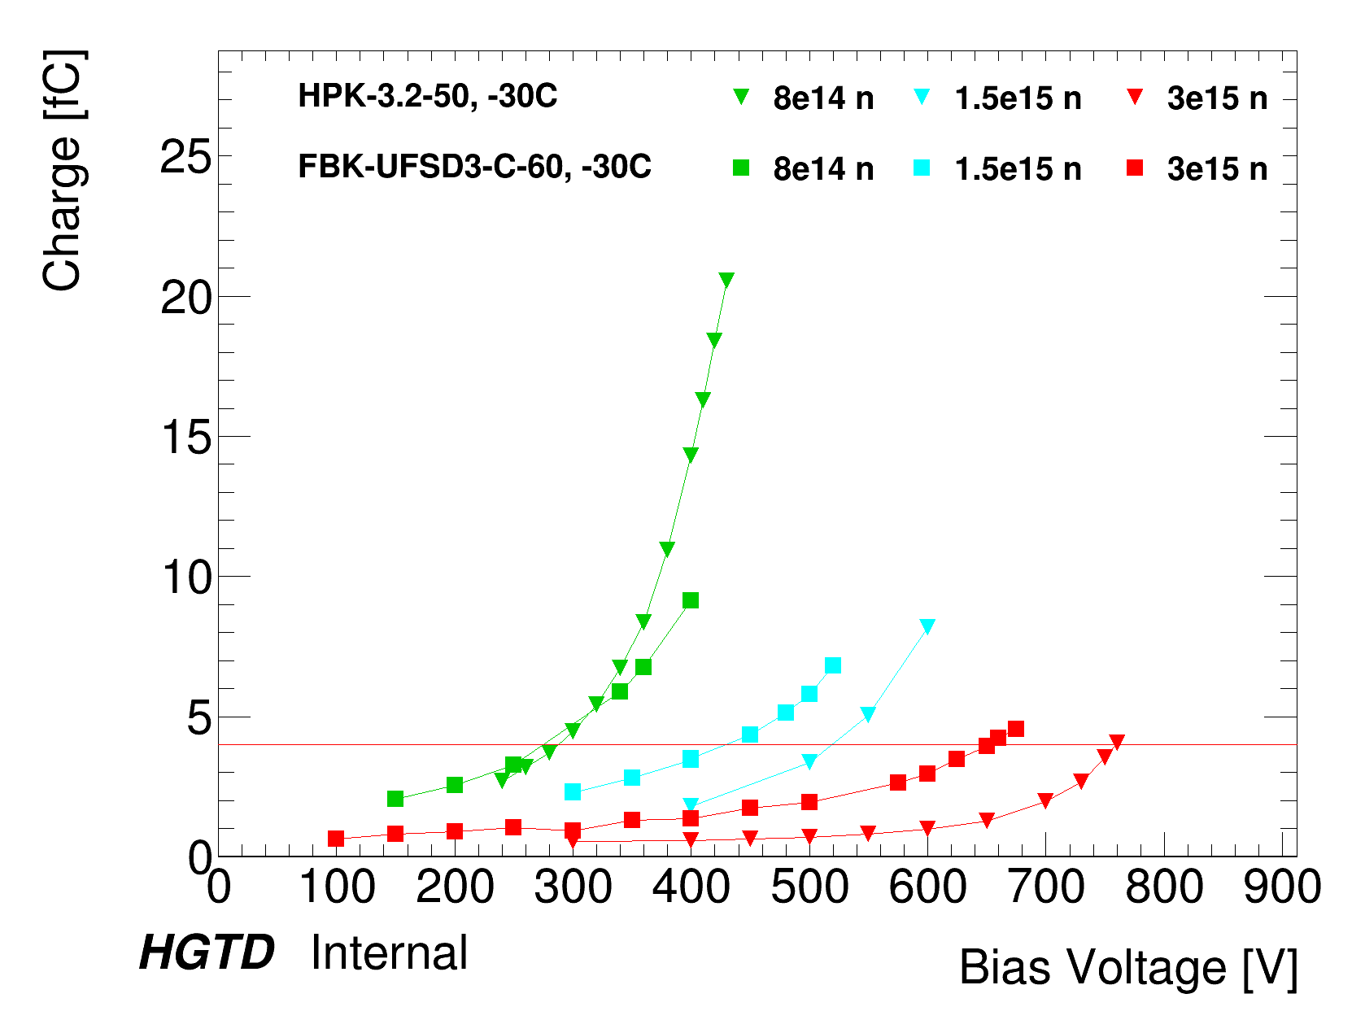
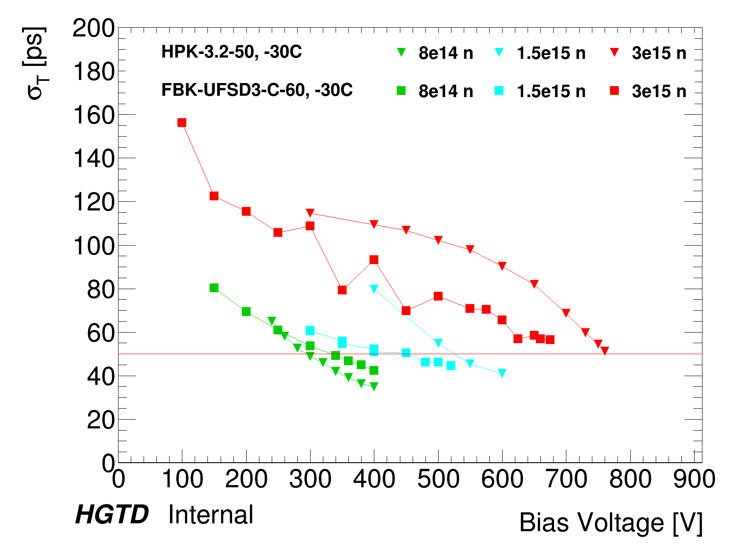
Performance vs fluence
In term of performance both HPK and FBK show good behavior
Independent effect of Carbon (FBK) and deep gain layer (HPK)

Slide 8
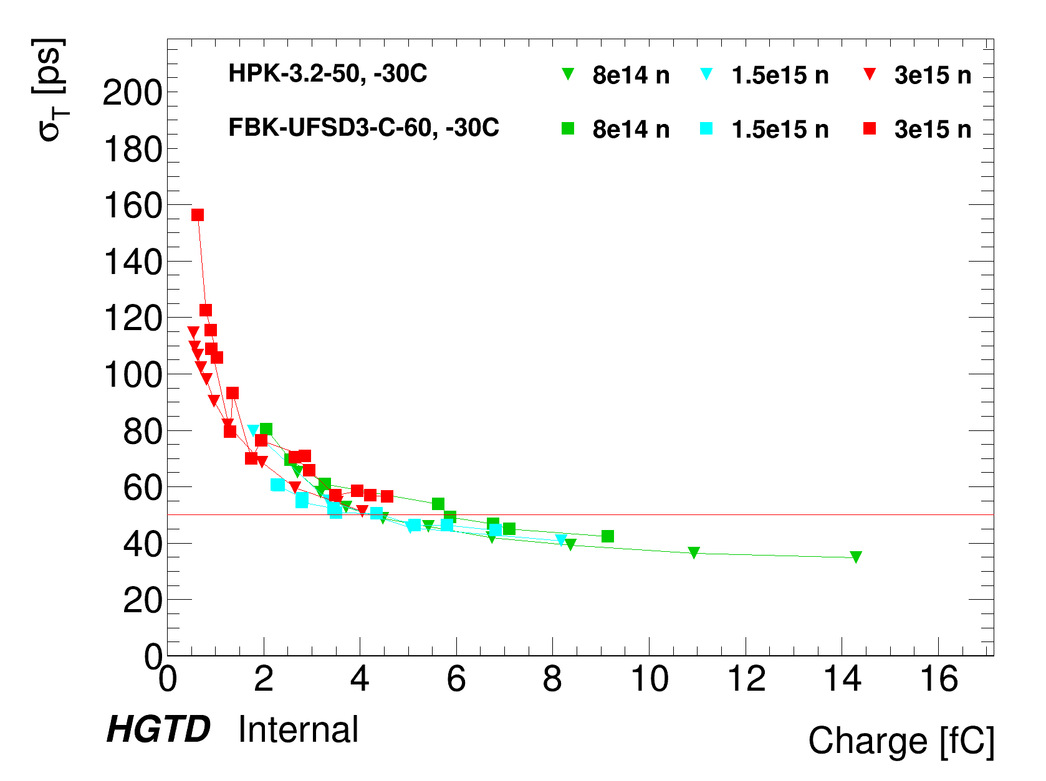
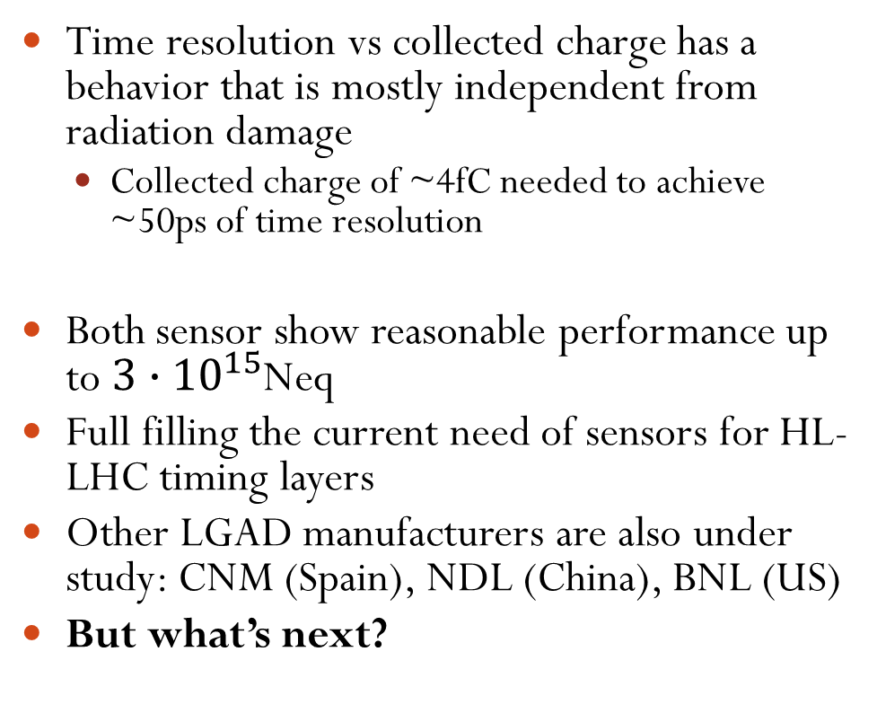
Performance vs fluence
Time resolution vs collected charge has a behavior that is mostly independent from radiation damage
  Collected charge of ~4fC needed to achieve ~50ps of time resolution
Both sensor show reasonable performance up to $3∙{10}^{15}$Neq
Full filling the current need of sensors for HL-LHC timing layers
Other LGAD manufacturers are also under study: CNM (Spain), NDL (China), BNL (US)
But what’s next?

Slide 9
Future radiation hard challenge

Slide 10
Radiation challenge in future hadron colliders
Silicon sensors at the High-Luminosity LHC will be 100-200um thick
  Signals of 1-2 fC for pre-rad
Irradiation on silicon causes 3 main effects:
  Decrease of charge collection efficiency due to trapping
  Doping creation/removal
  Increased leakage current, shot noise
Thick detectors at very high fluence need extremely high voltages to reach depletion
Plus the current is high so detectors need very high power to run
Extrapolating irradiation models from 1E14 – 1E15 n/cm2 → silicon detectors (~ 200 um thick) are almost impossible to operate
(New) V_{FD} << V_{Bias}
(Φ~1E15 n/cm²) V_{FD} ~ 0.5 V_{Bias}
(Φ~5E15 n/cm²) ) V_{FD} >> V_{Bias}
200V
500V
750V
Fully depleted at low Vbias
Fully depleted at high Vbias
Partially depleted at very high Vbias

Slide 11
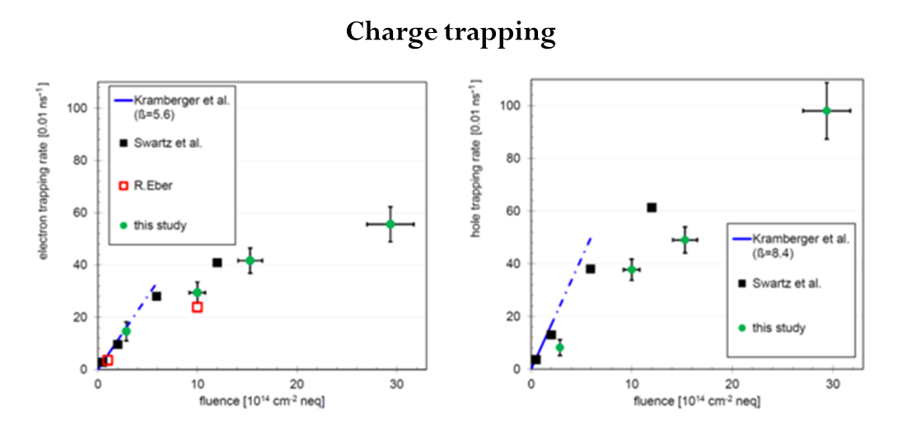
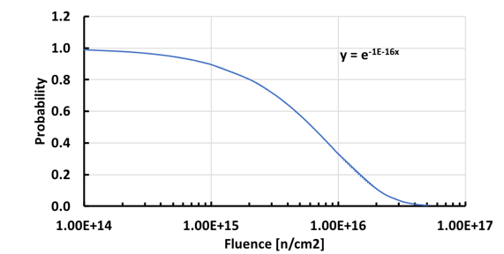
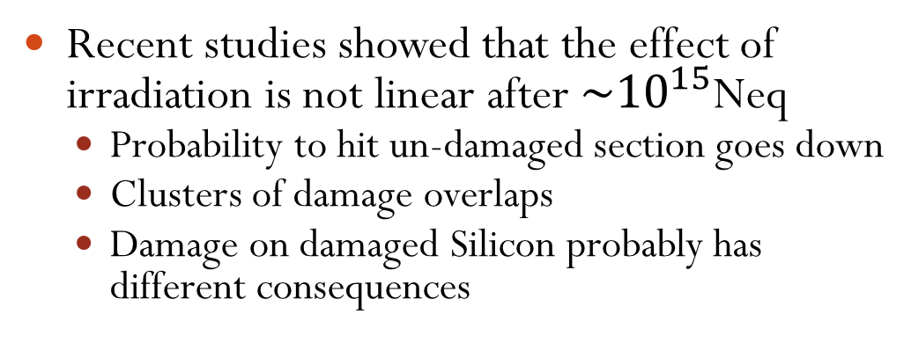
Saturation of radiation damage
Marko Mikuž at AIDA2020 Topical Workshop on Future of Tracking, Oxford, April 2nd, 2019
N. Cartiglia, INFN. Terascale meeting - 27-Nov-2019
Recent studies showed that the effect of irradiation is not linear after $\sim {10}^{15}$Neq
  Probability to hit un-damaged section goes down
  Clusters of damage overlaps
  Damage on damaged Silicon probably has different consequences
Charge collection is still high because of charge multiplication in the bulk (Higher electric field)
Silicon detectors at fluences 1E16 – 1E17 n/cm2 behave better than expected!
  Need to actually measure silicon behavior at very high fluence
saturation
1E16 n/cm2 30% of particles
will hit undamaged area
https://indico.desy.de/indico/event/24272/session/0/contribution/13/material/slides/0.pdf

Slide 12
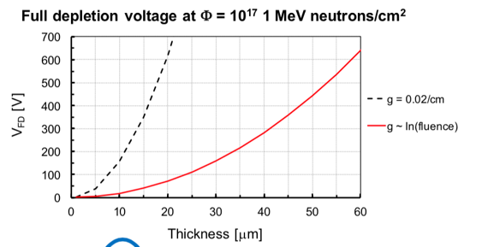
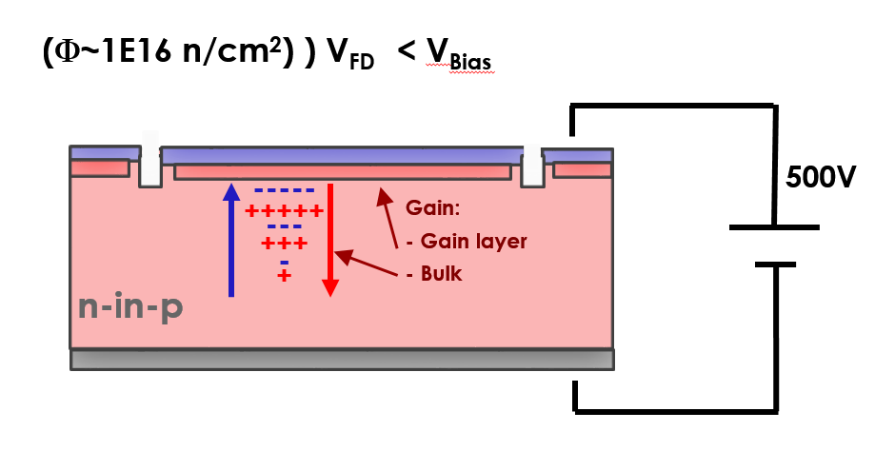
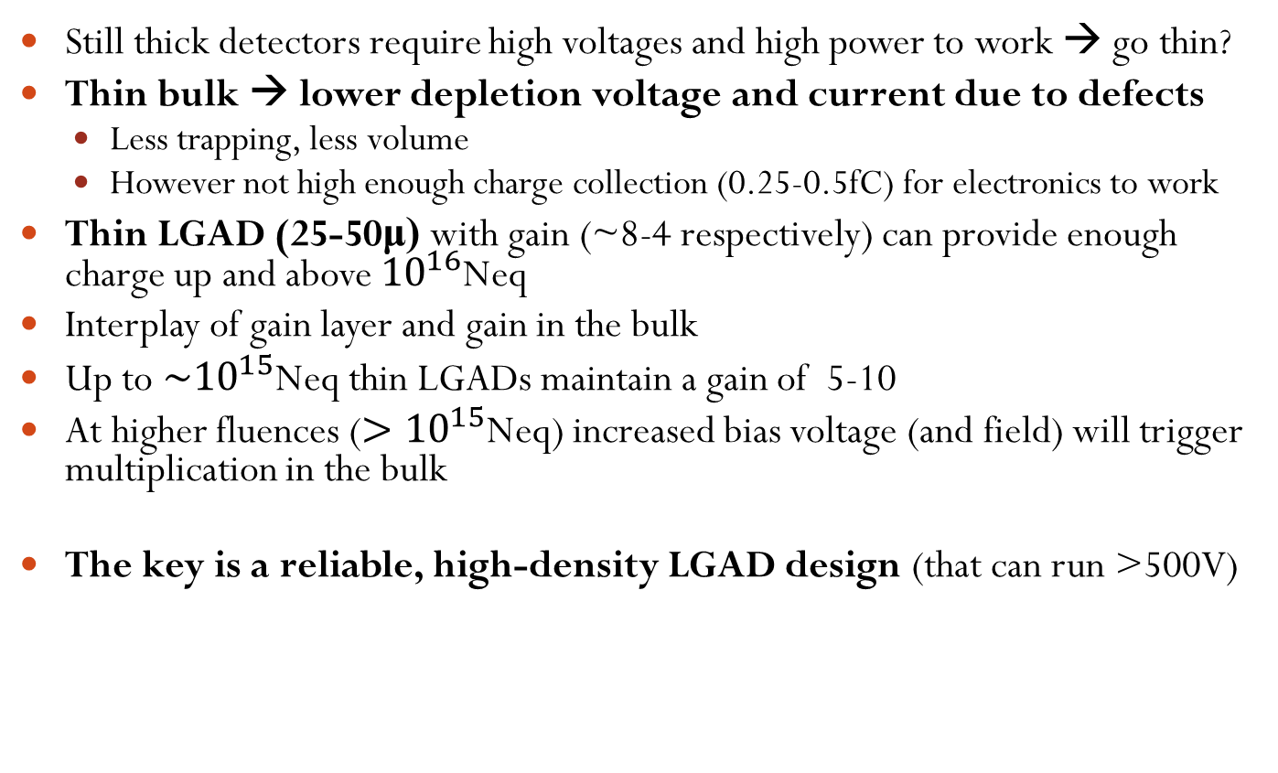
Thin sensors
Still thick detectors require high voltages and high power to work → go thin?
Thin bulk → lower depletion voltage and current due to defects
  Less trapping, less volume
  However not high enough charge collection (0.25-0.5fC) for electronics to work
Thin LGAD (25-50μ) with gain (~8-4 respectively) can provide enough charge up and above ${10}^{16}$Neq
Interplay of gain layer and gain in the bulk
Up to $\sim {10}^{15}$Neq thin LGADs maintain a gain of 5-10
At higher fluences ($>{10}^{15}$Neq) increased bias voltage (and field) will trigger multiplication in the bulk
The key is a reliable, high-density LGAD design (that can run >500V)
500V to deplete 50um
sensor at 1E17Neq
  See arXiv:1908.11605v1

Slide 13
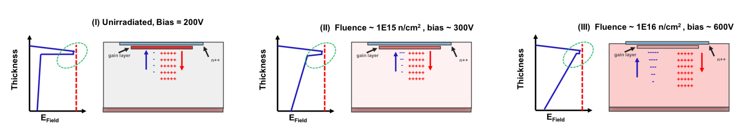

Thin LGAD sensors evolution with fluence
Higher bias voltage
asd
Increased electric
field in the bulk
OK performance
Bad performance
$$N_{A}\text{(}φ\text{) = }g_{eff}φ\text{ + }N_{A}\text{(}φ\text{=0)}e^{−cφ}$$
Good performance
?
Current Fluence Need
In this fluence range overall performance
of LGADs is not good anymore:
No gain in multiplication layer or bulk

Slide 14
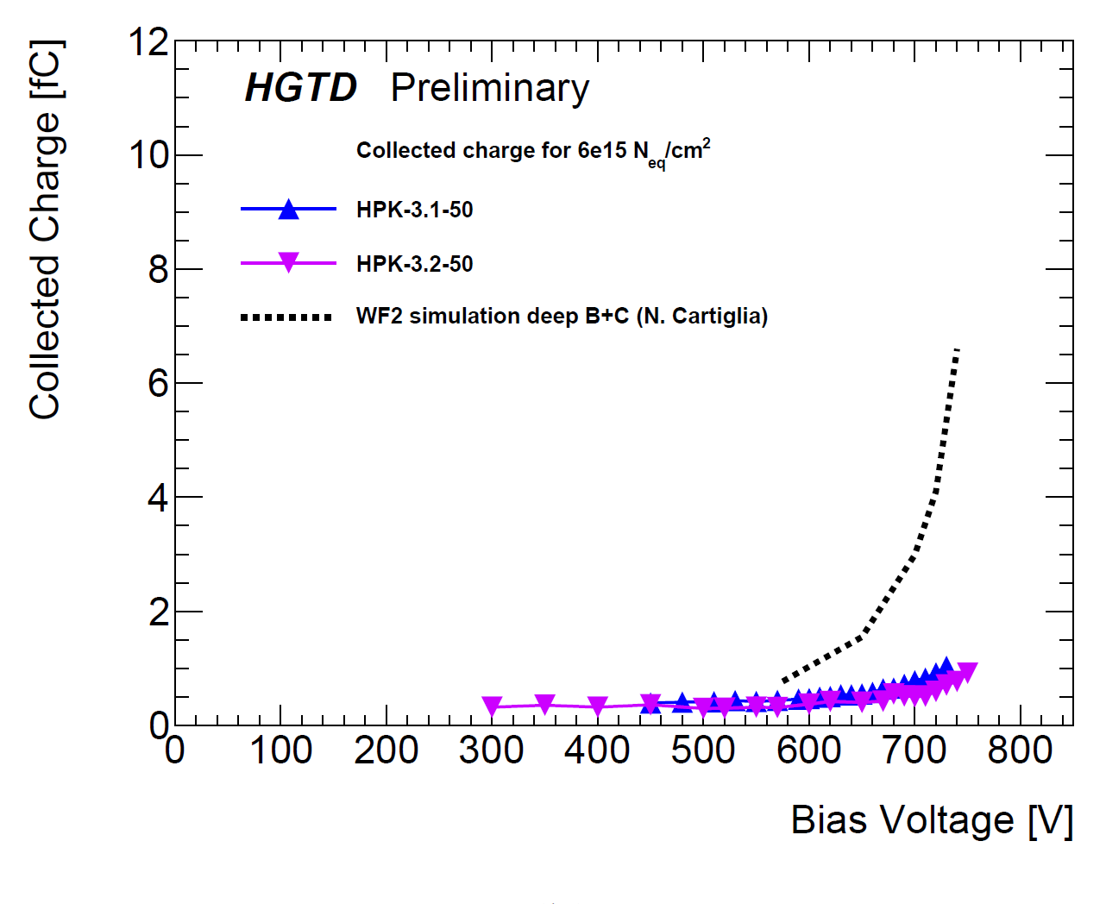
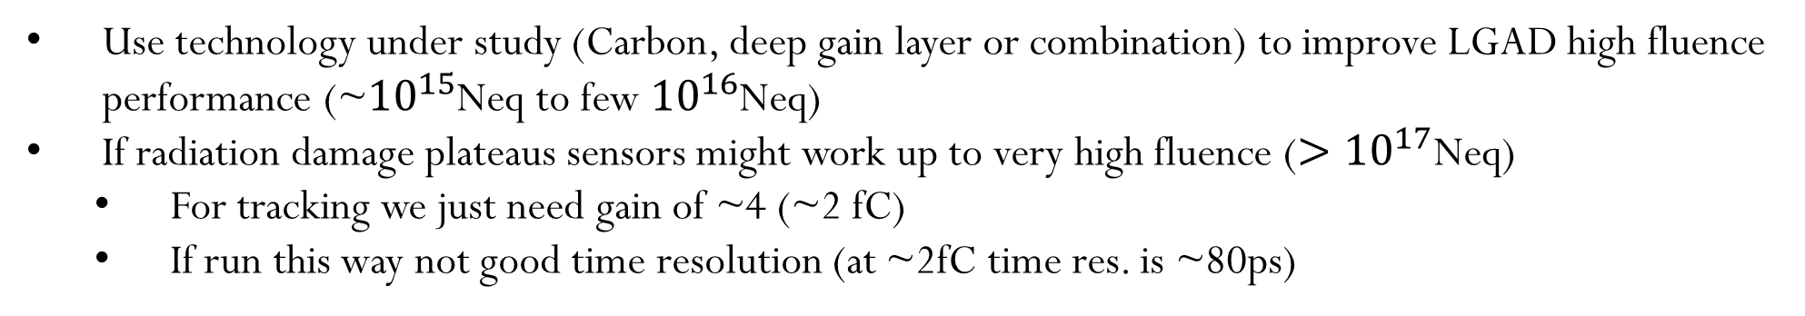
Radiation hard thin sensors with Carbon
Use technology under study (Carbon, deep gain layer or combination) to improve LGAD high fluence performance (~${10}^{15}$Neq to few ${10}^{16}$Neq)
If radiation damage plateaus sensors might work up to very high fluence (${>10}^{17}$Neq)
  For tracking we just need gain of ~4 (~2 fC)
  If run this way not good time resolution (at ~2fC time res. is ~80ps)
Good performance
OK performance
?
Thin sensor with Carbon and deep gain implant (Simulation)
https://twiki.cern.ch/twiki/bin/view/AtlasPublic/LArHGTDPublicPlots#2018_2019_Sensor_Performance_TDR

Slide 15


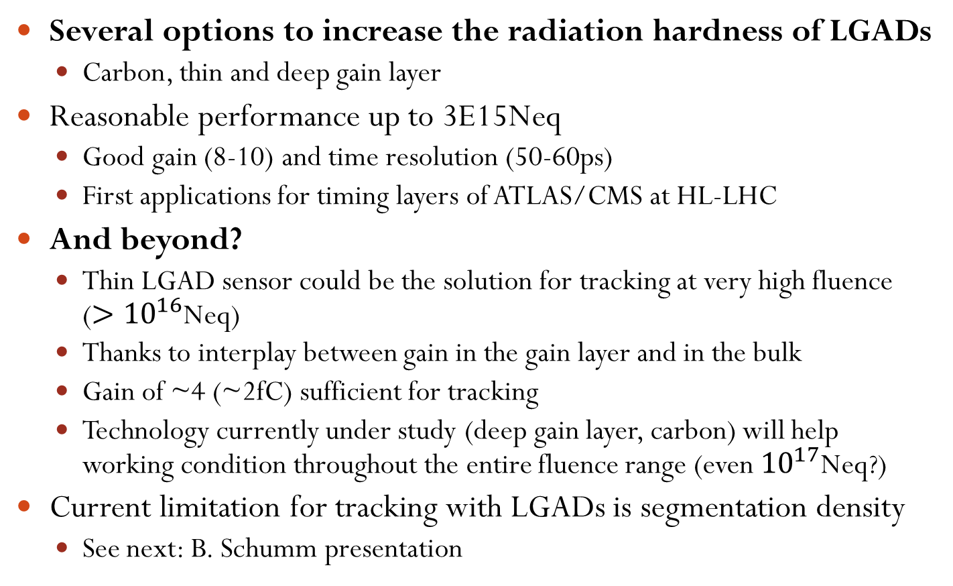
Conclusions
Several options to increase the radiation hardness of LGADs
  Carbon, thin and deep gain layer
Reasonable performance up to 3E15Neq
  Good gain (8-10) and time resolution (50-60ps)
  First applications for timing layers of ATLAS/CMS at HL-LHC
And beyond?
  Thin LGAD sensor could be the solution for tracking at very high fluence (${>10}^{16}$Neq)
  Thanks to interplay between gain in the gain layer and in the bulk
  Gain of ~4 (~2fC) sufficient for tracking
  Technology currently under study (deep gain layer, carbon) will help working condition throughout the entire fluence range (even ${10}^{17}$Neq?)
Current limitation for tracking with LGADs is segmentation density
  See next: B. Schumm presentation

Slide 16
This work was supported by the United States Department of Energy,
grant DE-FG02-04ER41286
This work was partially performed within the CERN RD50 collaboration.
Part of this work has been financed by the European Union’s Horizon 2020 Research and Innovation funding program, under Grant Agreement no. 654168 (AIDA-2020) and Grant Agreement no. 669529 (ERC UFSD669529), and by the Italian Ministero degli Affari Esteri and INFN Gruppo V.
This project was supported in part by a Launchpad Grant awarded by the Industry Alliances & Technology Commercialization office from the University of California, Santa Cruz.

Slide 17
Backup

Slide 18
Putting things together
Future trackers need to provide:
Accurate timing
Excellent pixellation
Be very rad-hard
A very simplified design:
Very inner layer:
  Position, thin sensors, with small gain
Medium – far away layers:
  timing layers
  Position, thick sensors
Note: Limited number of timing layer: probably, they require too much power

Slide 19

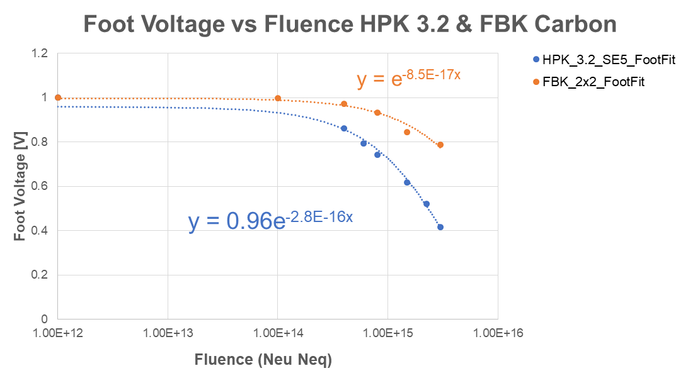
Gain layer vs. Fluence: The Effect of Carbon
HPK 3.2
FBK Carbon
Acceptor removal constant (C) is different for different types of sensors
  The FBK Carbon sensors has smaller range for “foot” voltage
  The HPK 3.2 shows a much larger declination and broader range of “foot” voltages
Carbon seems to give significant improvement where C is about factor 3 smaller for FBK

Slide 20
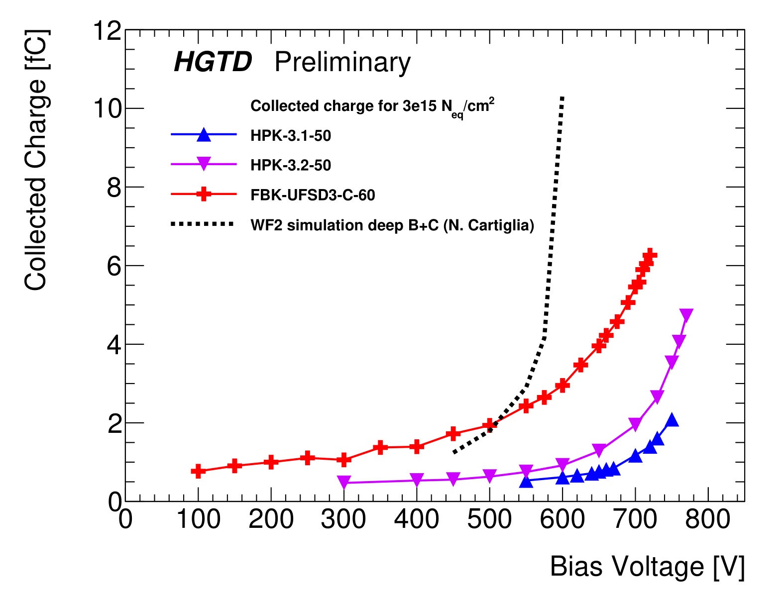
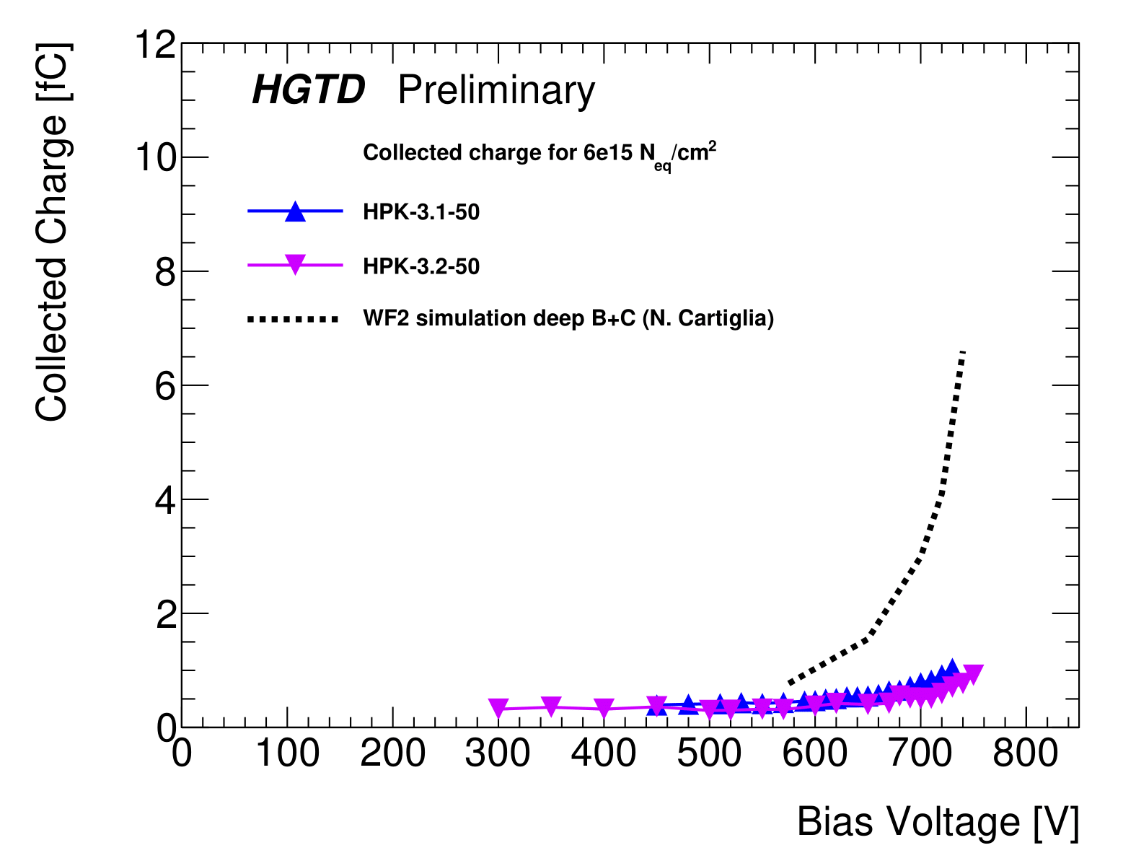
Future prospect – deep gain layer + Carbon
Combine Carbon (FBK) with deep implantation (HPK 3.2)
Preliminary simulation with Weightfield2 predict a collected charge of 5 fC at 6E15 Neq!
https://twiki.cern.ch/twiki/bin/view/AtlasPublic/LArHGTDPublicPlots#2018_2019_Sensor_Performance_TDR

Slide 21
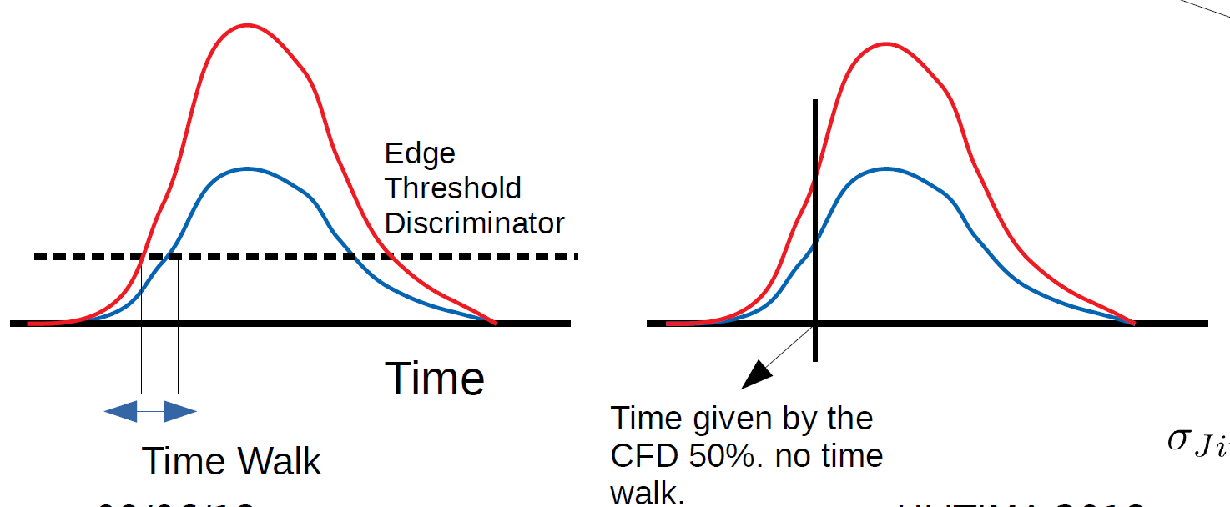
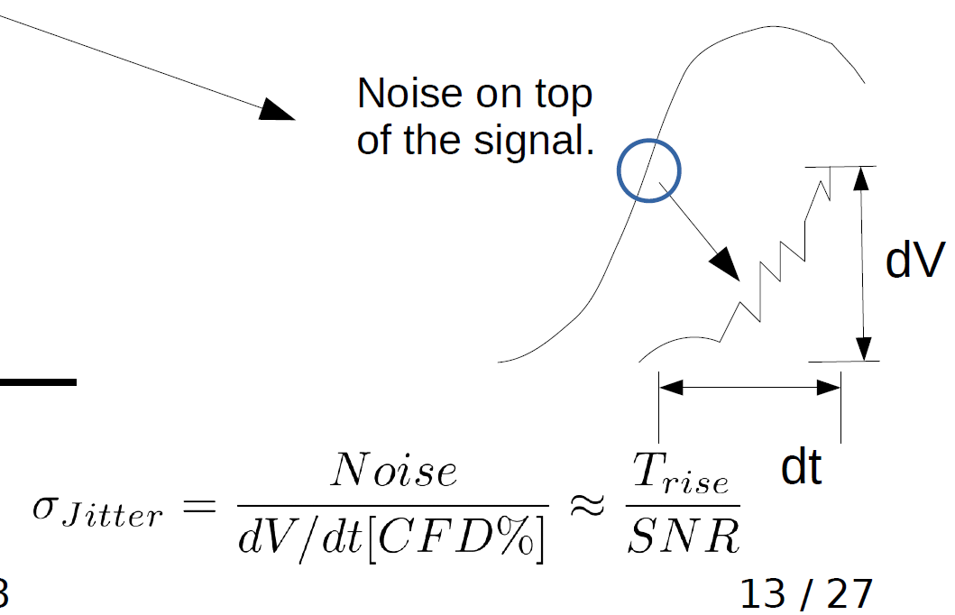
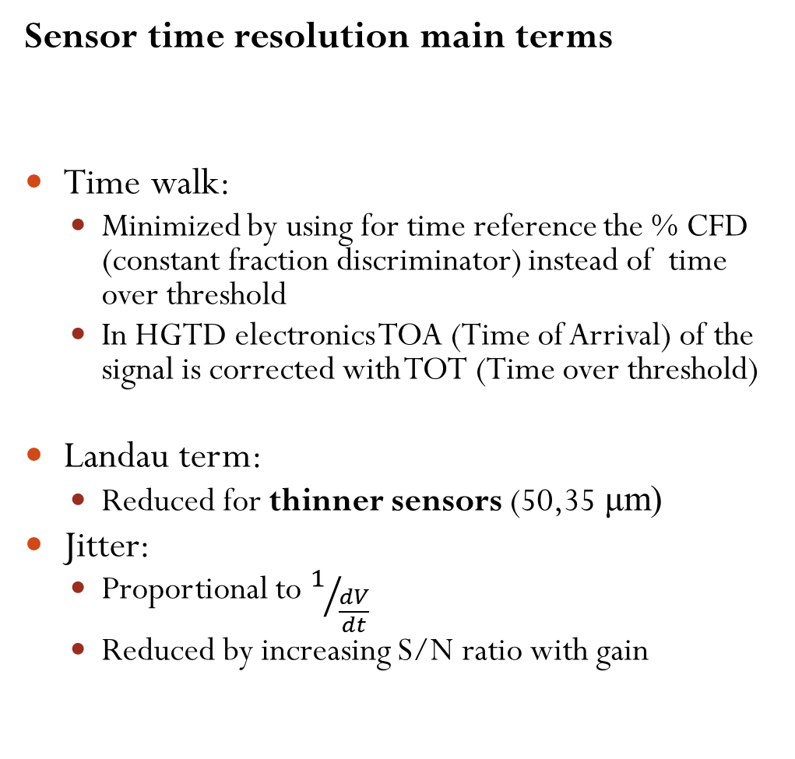
LGADs timing resolution
Sensor time resolution main terms
Time walk:
  Minimized by using for time reference the % CFD (constant fraction discriminator) instead of time over threshold
  In HGTD electronics TOA (Time of Arrival) of the signal is corrected with TOT (Time over threshold)
Landau term:
  Reduced for thinner sensors (50,35 μm)
Jitter:
  Proportional to $1/{\frac{dV}{dt}}$
  Reduced by increasing S/N ratio with gain

Slide 22
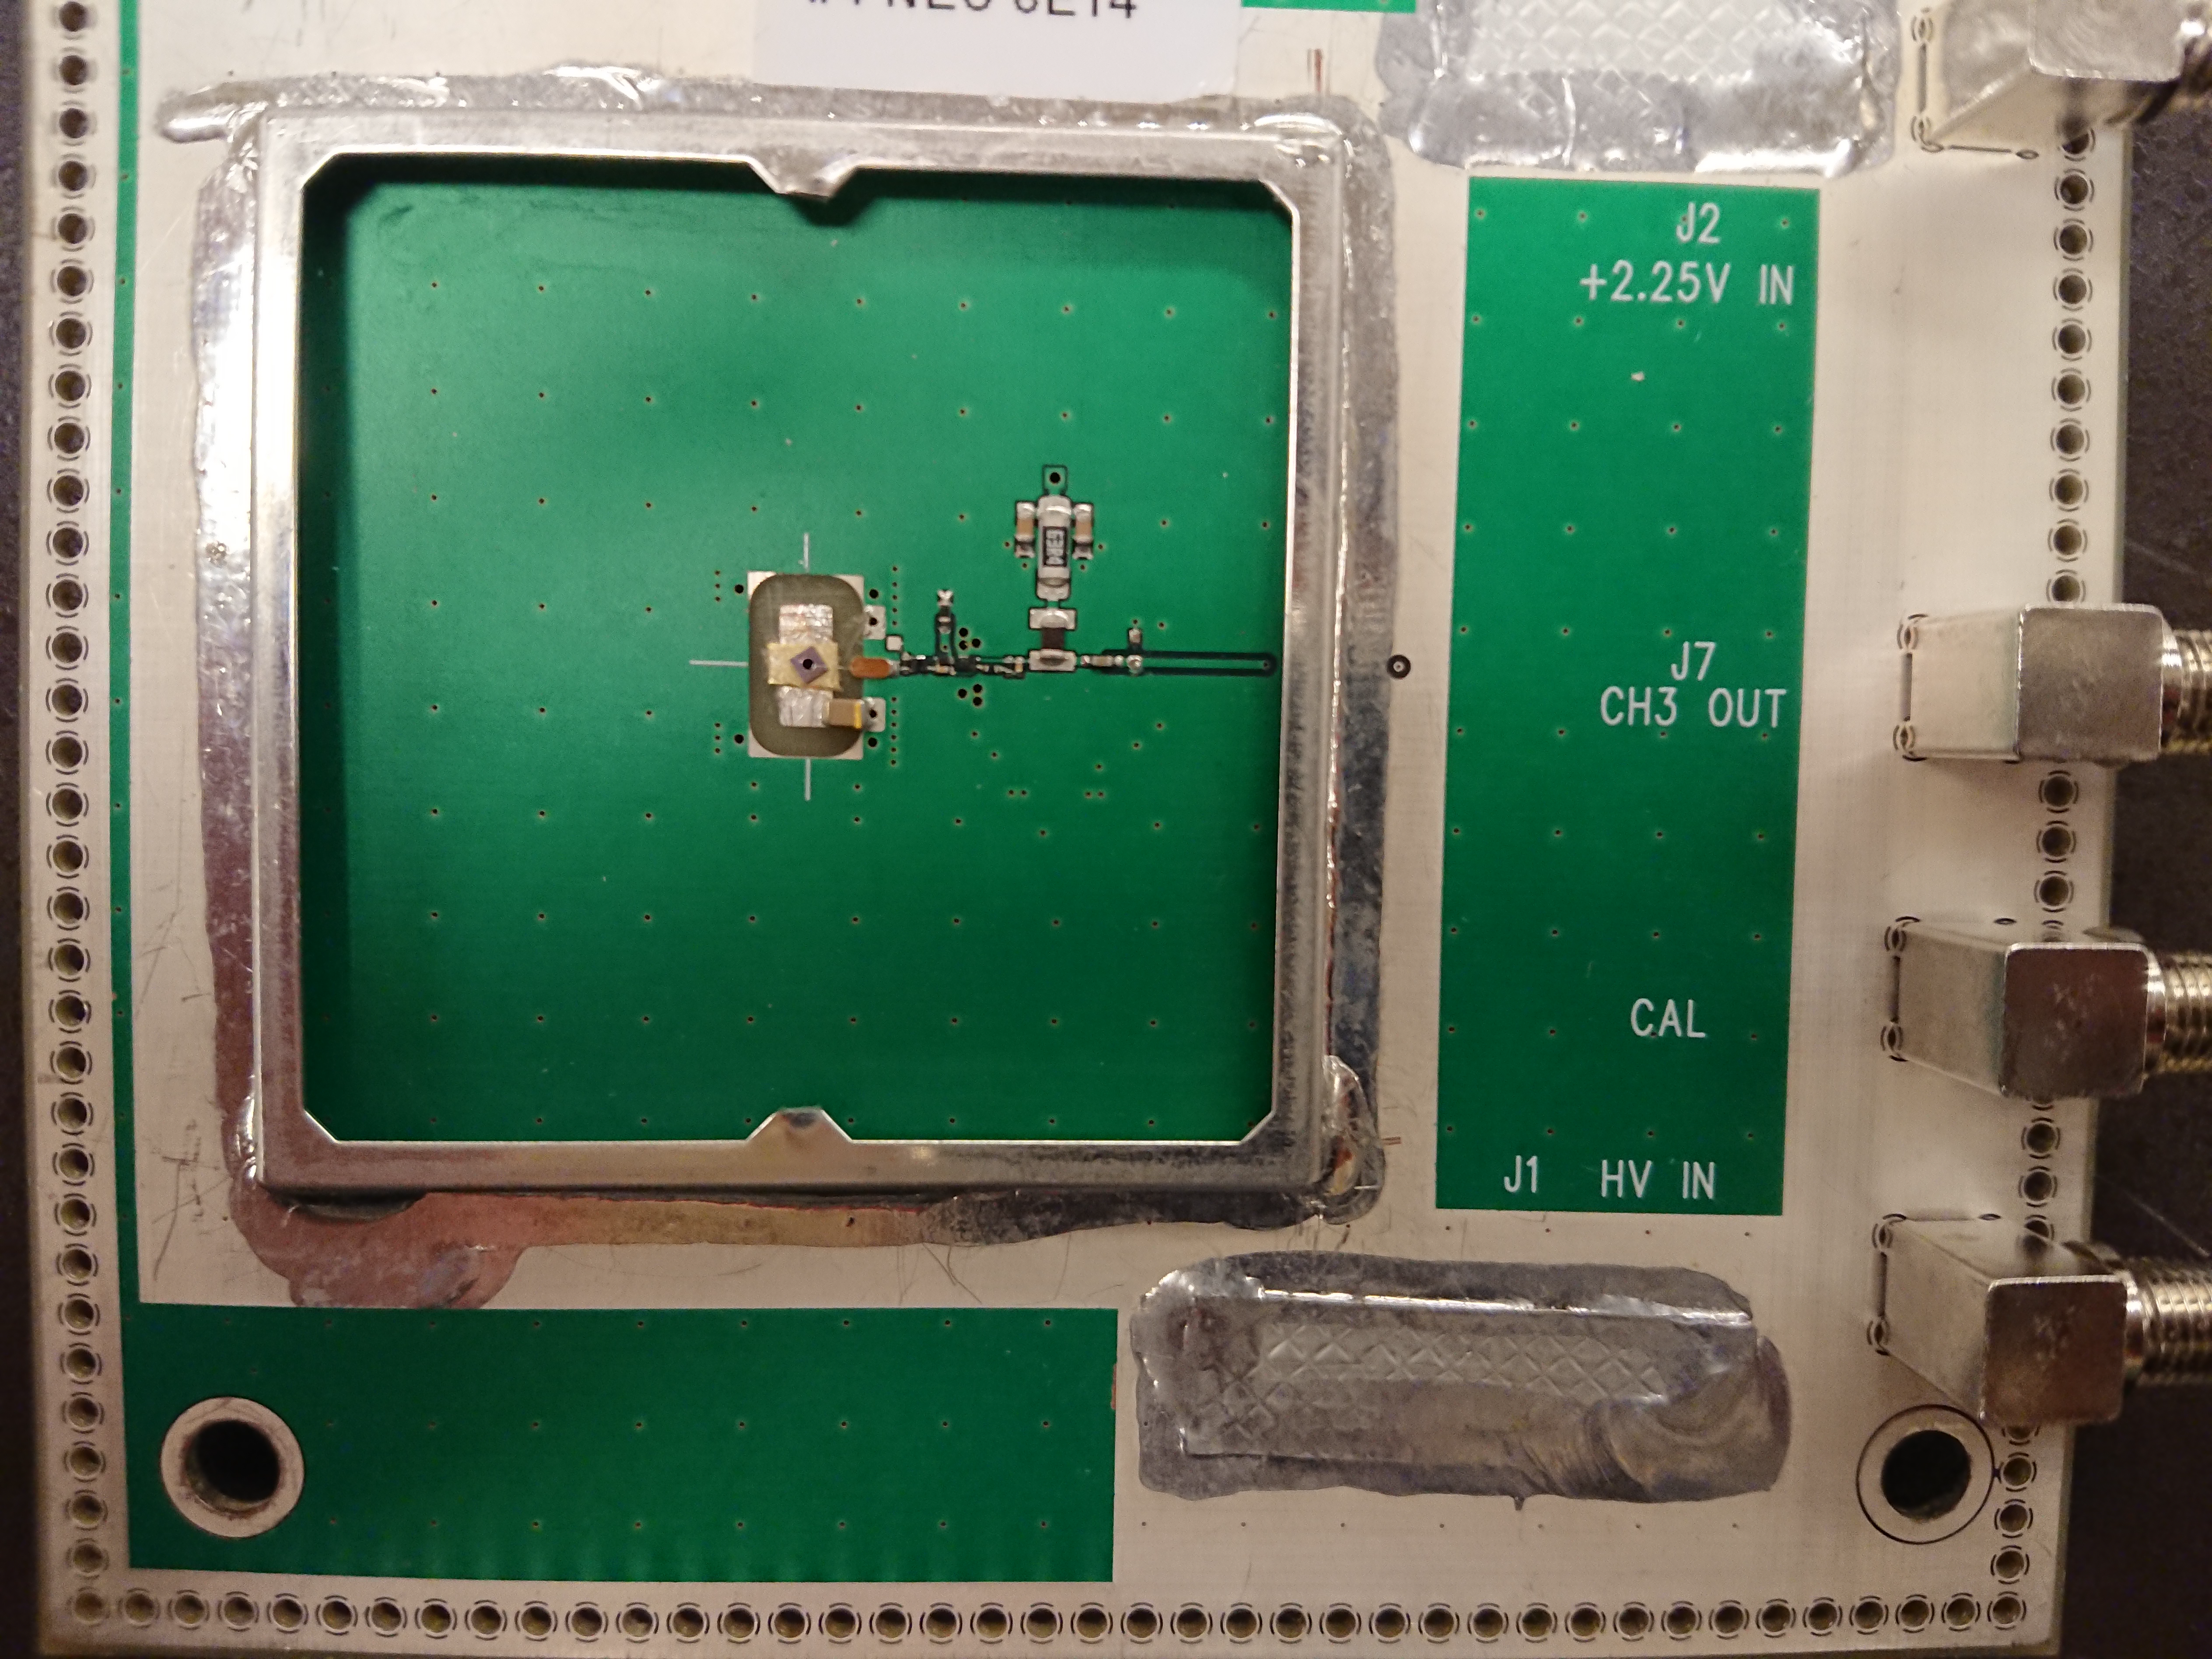
Sensor testing – Sr90 telescope
  Dynamic laboratory testing
    Using MiP electrons Sr90 β-source
    Signal shape, noise, collected charge, gain, time resolution
β-telescope
  Sensors mounted on analog readout board designed at UCSC (Ned Spencer, Max Wilder, Zach Galloway) with fast amplifier (22 ohm input impedance, bandwidth > 1GHz)
  Trigger sensor (fast timing trigger) on the back
    DUT (Device Under Test) is read in coincidence
  Setup in climate chamber to run cold and dry
    20C/-20C/-30C
  (no position information)
LGAD

Slide 23
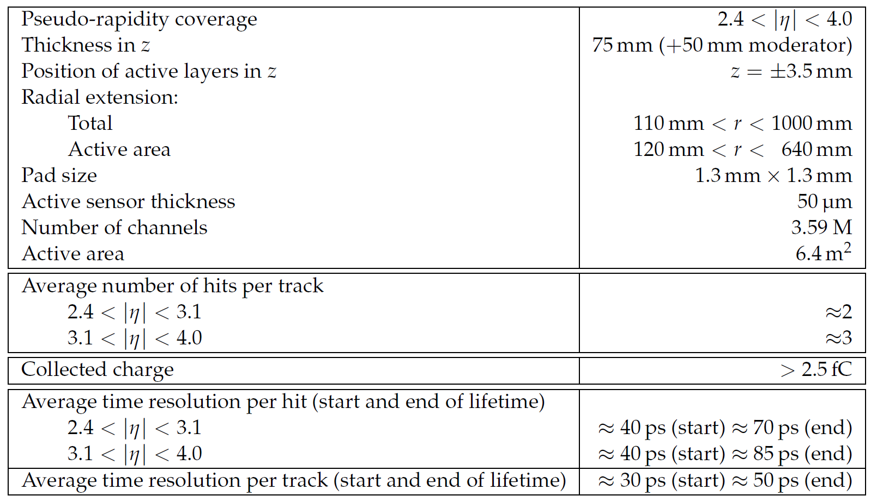
HGTD position in ATLAS
High Granularity Timing Detector (HGTD) will replace current MinBias detector
Requirements
Time resolution < 30-50ps per track
Occupancy < 10%
Radiation hardness up to 5.4E15 N_{eq}/cm²

Slide 24
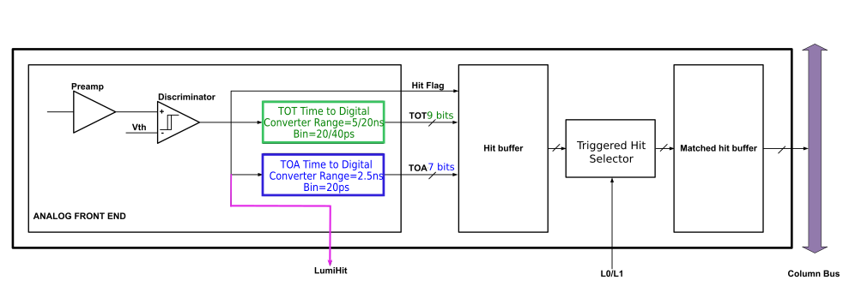
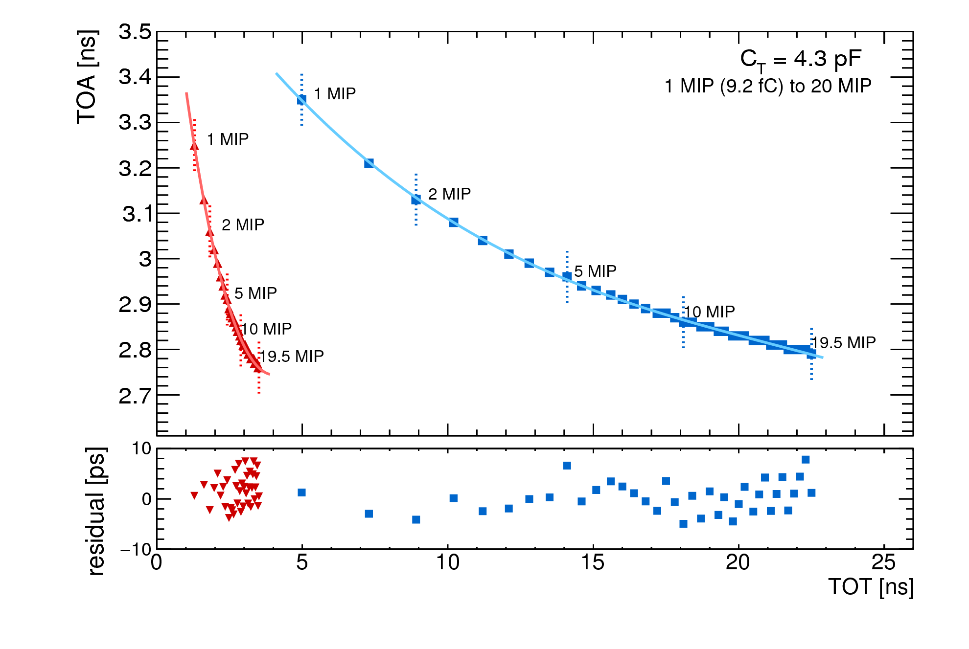
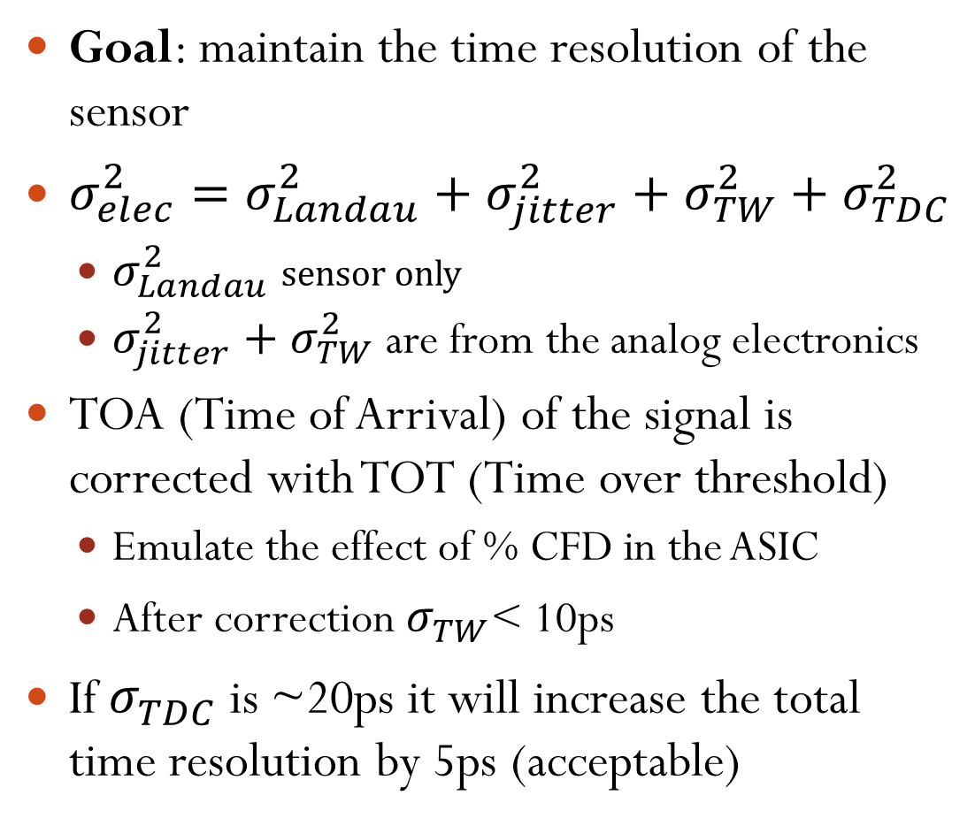
Readout electronics
One pixel cell
Goal: maintain the time resolution of the sensor
$σ_{elec}^{2}=σ_{Landau}^{2}+σ_{jitter}^{2}+σ_{TW}^{2}+σ_{TDC}^{2}$
  $σ_{Landau}^{2}$ sensor only
  $σ_{jitter}^{2}+σ_{TW}^{2}$ are from the analog electronics
TOA (Time of Arrival) of the signal is corrected with TOT (Time over threshold)
  Emulate the effect of % CFD in the ASIC
  After correction $σ_{TW}^{}$< 10ps
If $σ_{TDC}^{}$ is ~20ps it will increase the total time resolution by 5ps (acceptable)
Two different amplifiers

Slide 25
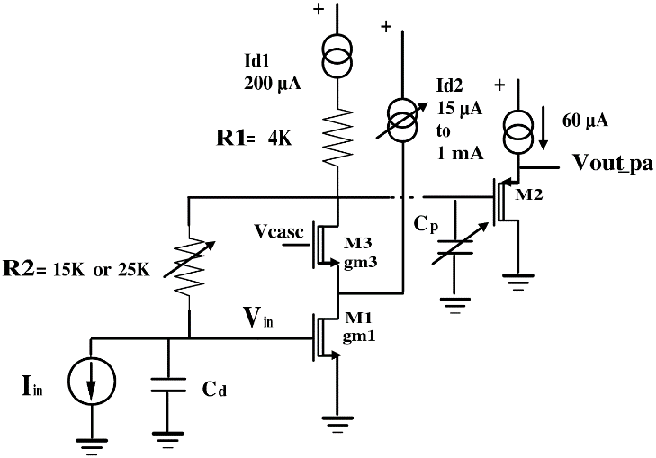
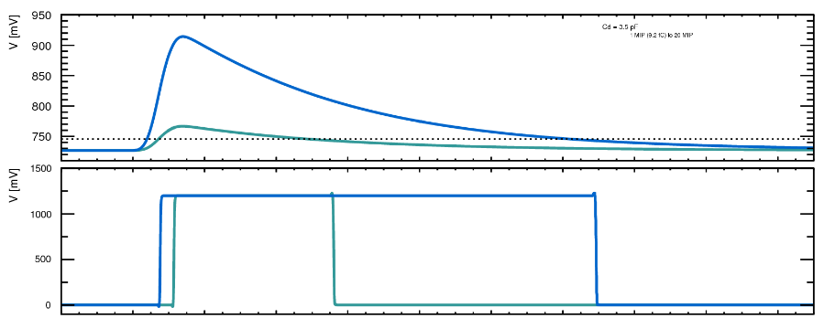
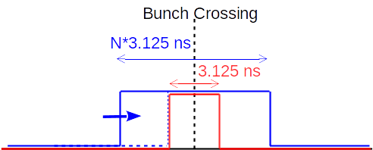
Readout electronics
Preamplifier: broad band amplifier
  Size of input transistor optimized to minimize noise and power consumption
  Rise time ~0.5-1 ns (as the sensor) to minimize the jitter
  Designed for 1-2 μA leakage current of the sensor
Bunch by bunch luminosity measurement capability
  Sums of hits in two time windows to evaluate the background bunch by bunch
  (Only a subsets of ASICS is used for luminosity calculation)
ASIC has to withstand high radiation levels
  Inner circle will be replaced with the LGADs
  Irradiation campaign will be done also on the ALTIROC chip

Slide 26
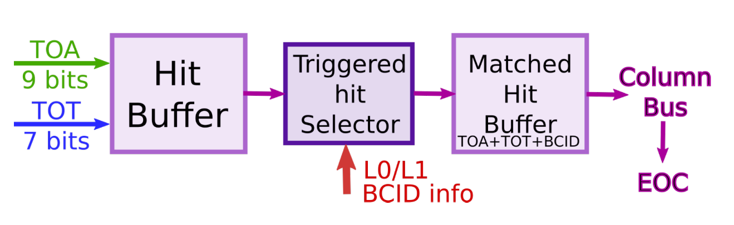
Readout electronics
ToA and ToT TDCs with slow and fast delay line with 20ps (ToA) and 40ps (TOT) time measurement bins
Per pixel hit buffer memory, passed over only if there is signal from L0/L1 triggers
ALTIROC 0v2 tested at CERN October test beam
  Applied correction to Time of Arrival as a function of the Amplitude
ALTIROC 0v2 (bump bonded to CNM 2x2 LGAD) shows 35ps of time resolution after time walk correction
  ALTIROC 1: working with 5 × 5 LGAD arrays, testing will start soon with a test FPGA developed by SLAC

Slide 27
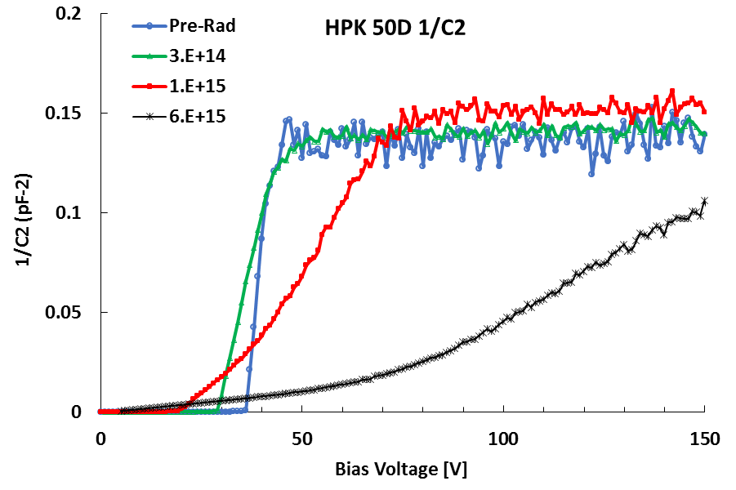
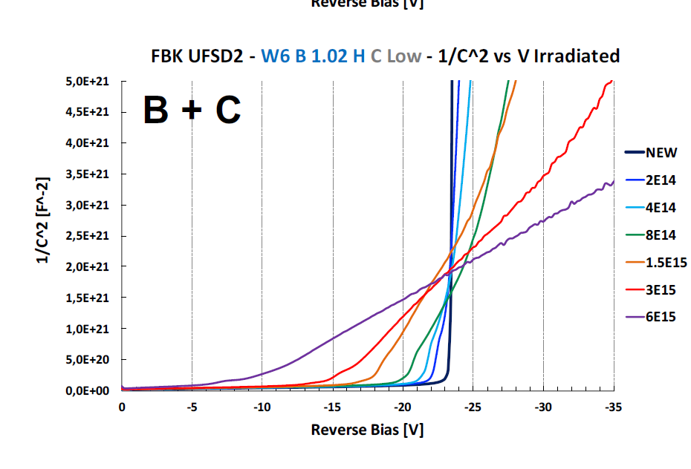
Gain layer and CV
Capacitance over voltage (CV)
  Study doping concentration profile and full depletion of the sensor
Study of the “foot” for LGADs on 1/C²:
  1/C² is flat until depletion of multiplication layer because of the high doping concentration
  Proportional to gain layer active concentration
Bulk doping concentration proportional to the slope in 1/C²
After radiation damage the “foot” changes with the gain layer
Y. Zhao et al. 10.1016/j.nima.2018.08.040
“foot” changes with
radiation damage
M. Ferrero et al. arXiv:1802.01745

Slide 28
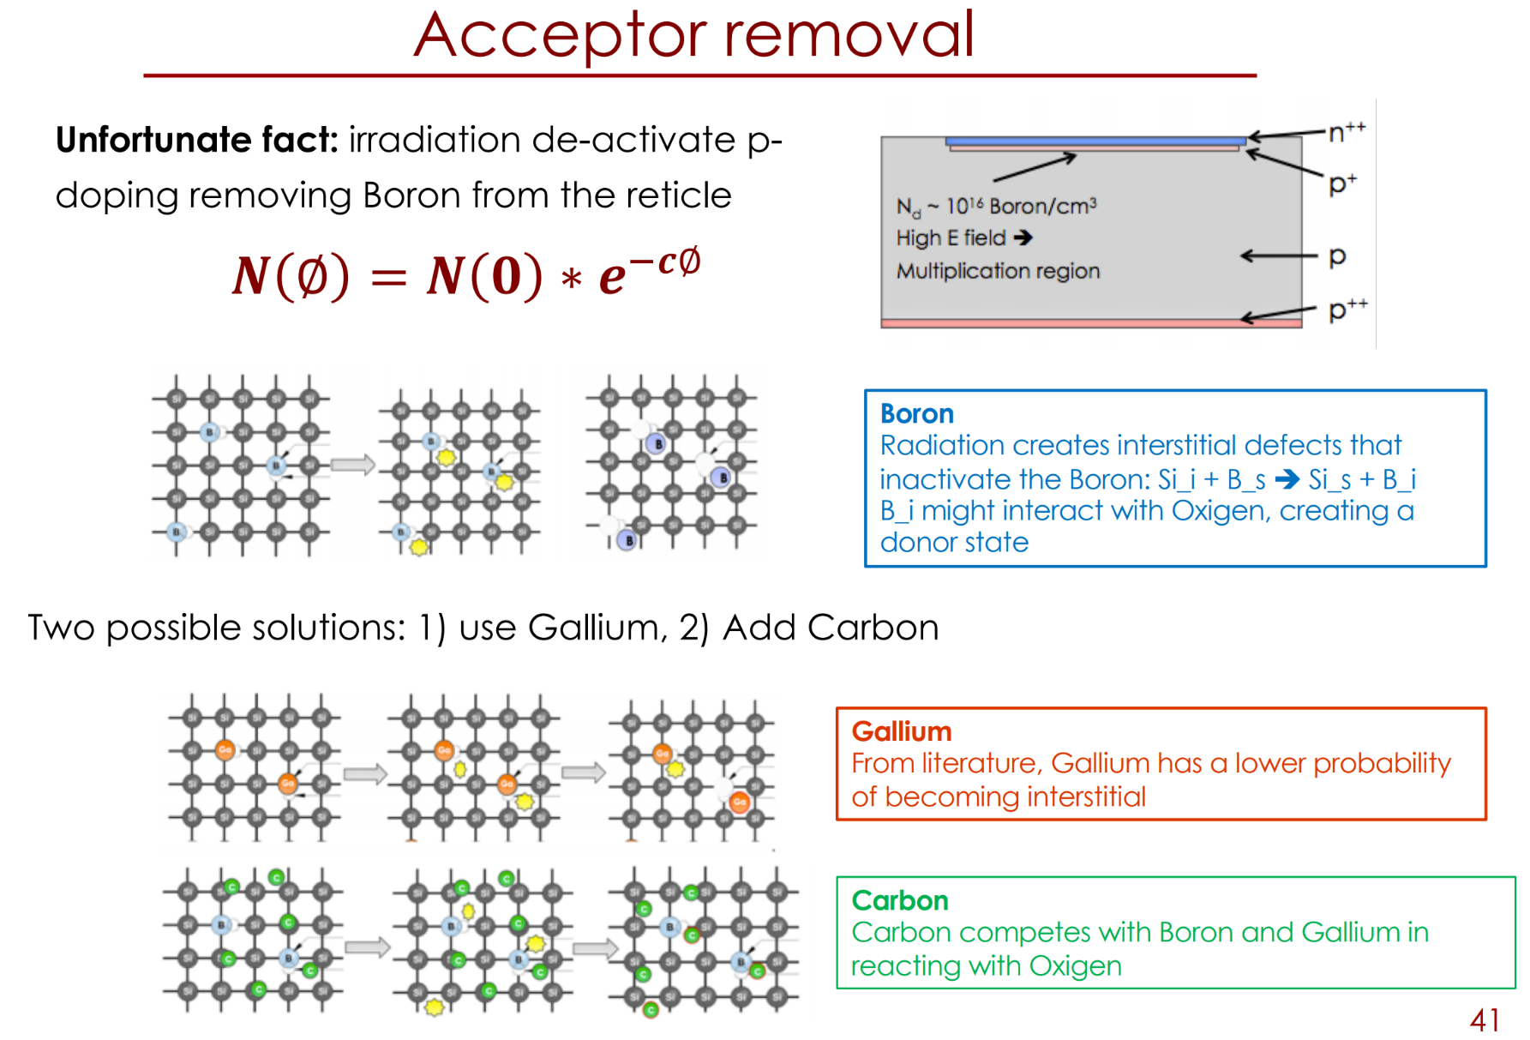

Slide 29
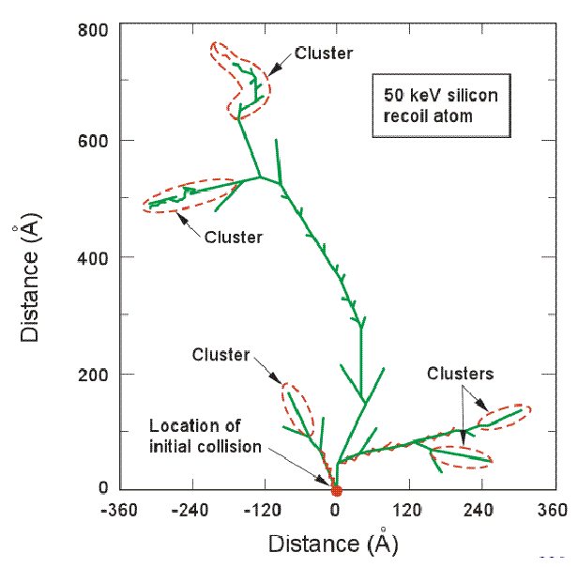
A new hope: saturation of displacement damage
Overlapping clusters
At high fluence the damage might saturate since clusters of damage start overlapping

Slide 30
2D calculations of superposition
What is the probability of a particle to hit a square of 1 Å² that has not been hit before?
Probability of hitting an empty square of area 1 Å²
At 1E16 n/cm2 only 30% of particles will hit an “empty square”
Note: Silicon lattice has a cube of 5 Å; every cell has already been hit at 1E15.
Damage on damaged Silicon probably has different consequences.

