Slide 1
Development of a 3D detector on a hydrogenated amorphous silicon substrate
M. Menichelli^{(a)}, M.Boscardin^{(b)(c)}, M. Crivellari ^{(c)}, J.Davis^{(f)}, S.Dunand^{(i)} , L. Fanò^{(a)(d)}, A.Morozzi^{(a)(g)}, F.Moscatelli^{(a)(e)}, M. Movileanu-Ionica^{(a)}, D.Passeri^{(a)(g)} , M.Petasecca^{(f)}, M.Piccini^{(a)}, A.Rossi^{(a)(d)}, A.Scorzoni^{(a)(g)}, G.Verzellesi^{(b)(h)}, N.Wyrsch^{(i)}.
(a) INFN, Sez. di Perugia, Perugia (ITALY)
(b) INFN TIPFA, Trento (ITALY)
(c)Fondazione Bruno Kessler, Trento (ITALY)
(d) Dip. Di Fisica dell’Università degli studi di Perugia, Perugia (ITALY)
(e) CNR-IOM Perugia (ITALY)
(f)Centre for Medical Radiation Physics, University of Wollongong, NSW 2522, (AUSTRALIA)
(g)Dip. Di Ingegneria dell’Università degli studi di Perugia, Perugia (ITALY)
(h) Università di Modena e Reggio Emilia, Modena (ITALY)
(i) Ecole Polytechnique Federale de Lausanne (EPFL), Institute of Microengineering (IMT), Neuchatel, (SWITZERLAND)

Slide 2
Hydrogenated Amorphous Silicon a-Si:H
The first study on a-Si:H was reported by Chittik et al. in 1969
Material was obtained by plasma-enhanced chemical vapor deposition (PECVD) of SiH₄ (Silane) + Hydrogen.
Substantial progress of the a-Si:H technology were performed when Spear and Lecomber demonstrated that this material could be substitutionally doped (both in n and p-types); this led to the development of various types of electronic devices such as transistors, solar cells, memories and eventually, in the second half of the 80’, planar radiation detector in p-i-n structures.

Slide 3
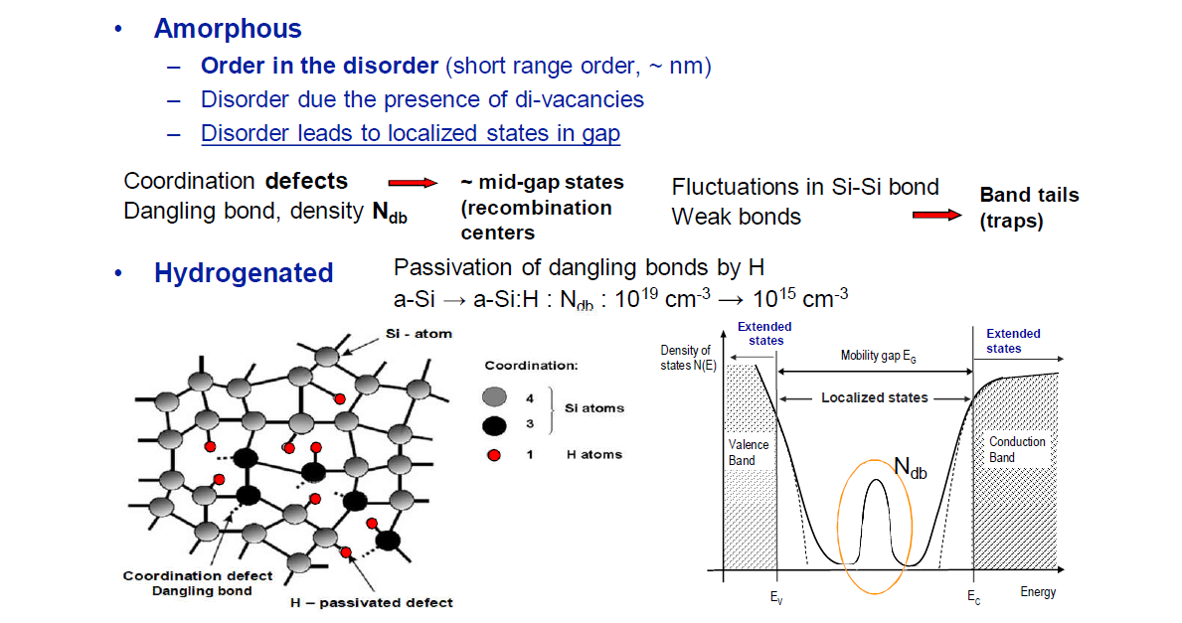
A-Si:H Structure and density of states

Slide 4
A-Si:H planar detectors pros & cons I
Pros:
  Extremely low radiation damage.
  Low cost production (this technology is currently used in solar cells production)
  Possible deposition in many different substrate materials

Slide 5
A-Si:H planar detectors pros & cons II
Cons
  High depletion voltage (about 1100 V for 50 um thickness)
  Growth on a non-removable substrate
  Pretty low charge collection efficiency: 50%(on a 30 um thick detector) energy to create a e-h pair similar to crystalline silicon (3.4-4.0 eV)
  High leakage current (in the order of few uA/cm² on a 30 um detector)
  Low mobility (from 1 to 10 cm² /Vs for electrons 2 orders of magnitude less for holes)
  Limited thickness of substrates (max 100-150 um)

Slide 6
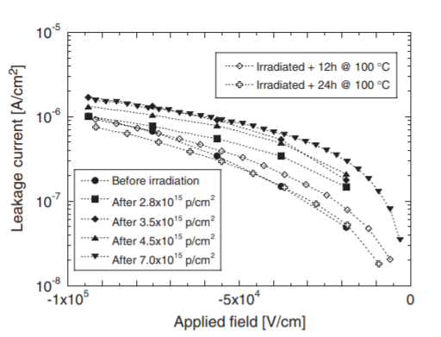
Displacement damage on a 30 um a-Si:H planar detector

Slide 7
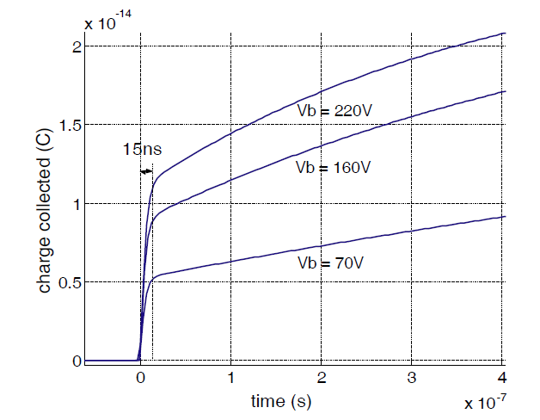
Signal formation on planar a-Si:H detectors

Slide 8
3D technology on a-Si:H
The depletion potential applies on the interelectrode distance that is not coincident with the thickness of the detector
Never attempted before
Noise reduction test at cold temperature (e.g. -30°C)

Slide 9
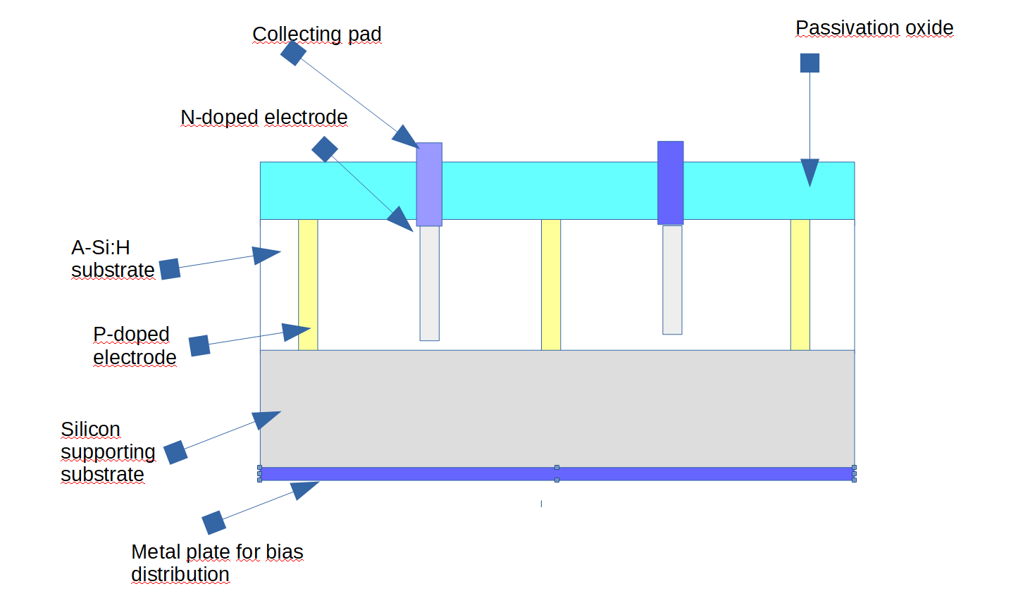
Baseline 3D detector structure

Slide 10
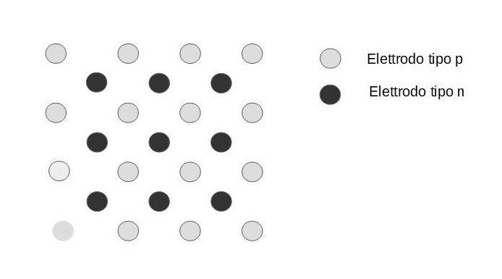
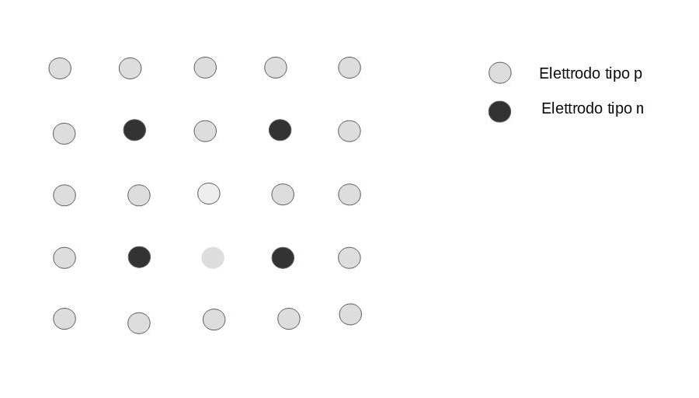
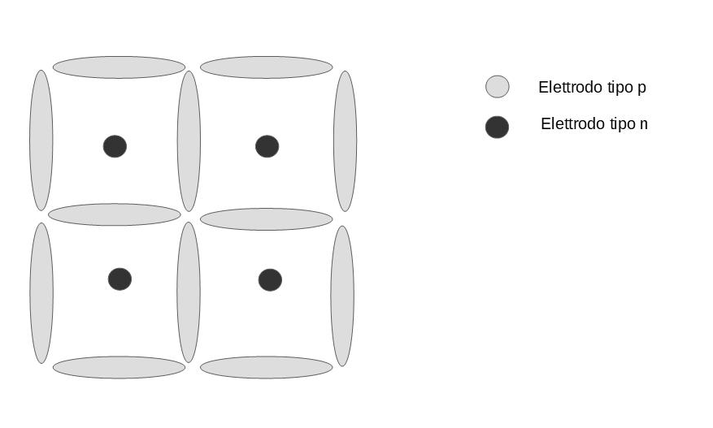
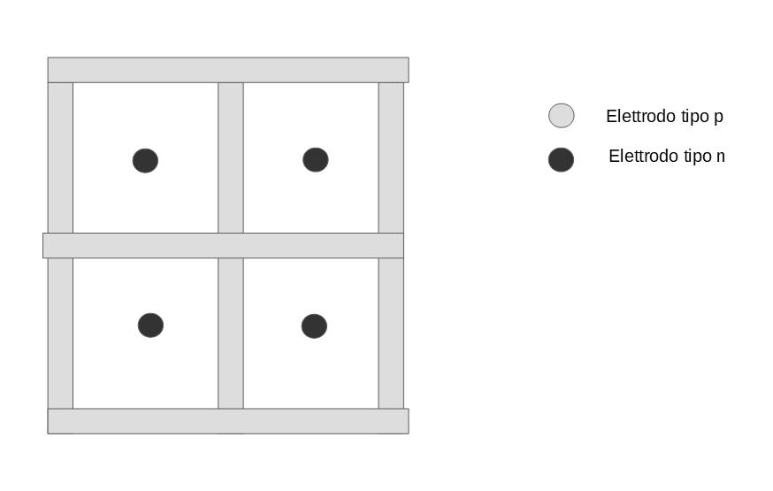
Possible 3D detector configurations

Slide 11
Technological options for doping the electrodes
Option 1: Selective layers of metal oxide deposited via ALD
Option 2: Ion implantation and low temperature activation (250 °C or below )

Slide 12
Prototype development
Phase 1: construction of planar diodes with option 1 and 2 doping techniques.
Phase 2: Construction of basic 3D structures in order to test the two proposed doping techniques.
Phase 3: Construction of 3D detectors in various configurations.

Slide 13
Diodes and test structures layout in phase 1 prototypes
Before depositing a-Si:H the p-type silicon wafer is divided in two halves and in one of the two halves is oxidated.
In the non-oxidated half vertical diodes are fabricated
In oxidated half lateral diodes are fabricated

Slide 14
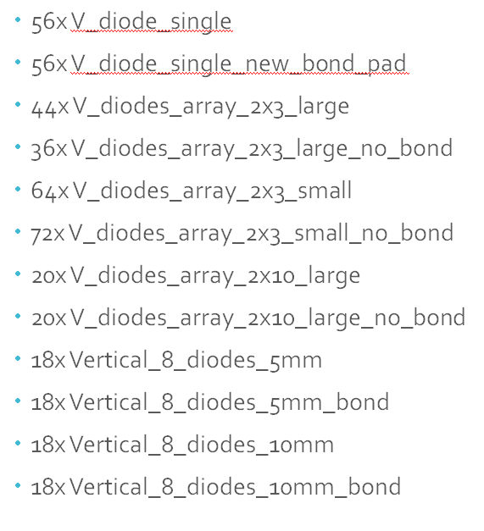
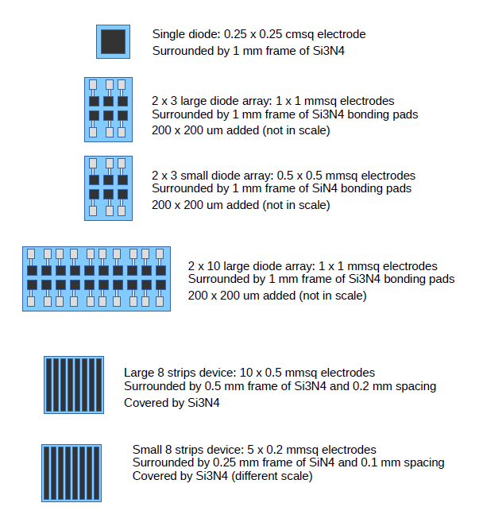
Vertical diodes

Slide 15
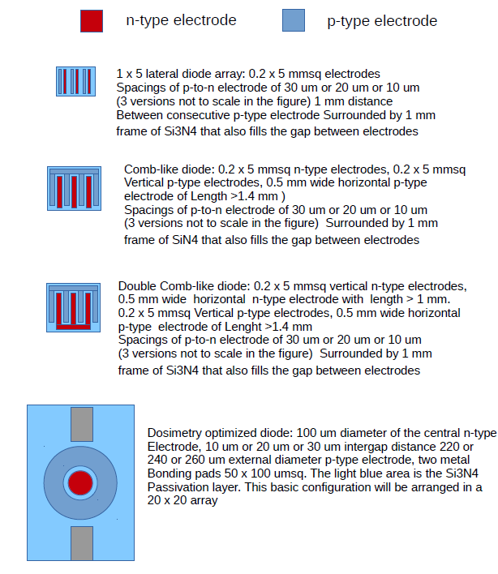
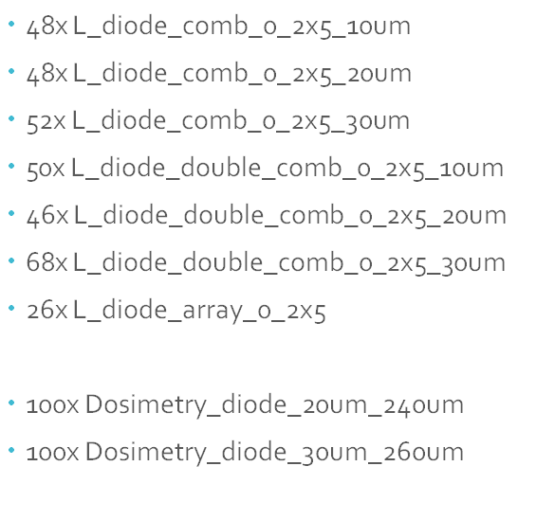
Lateral diodes

Slide 16
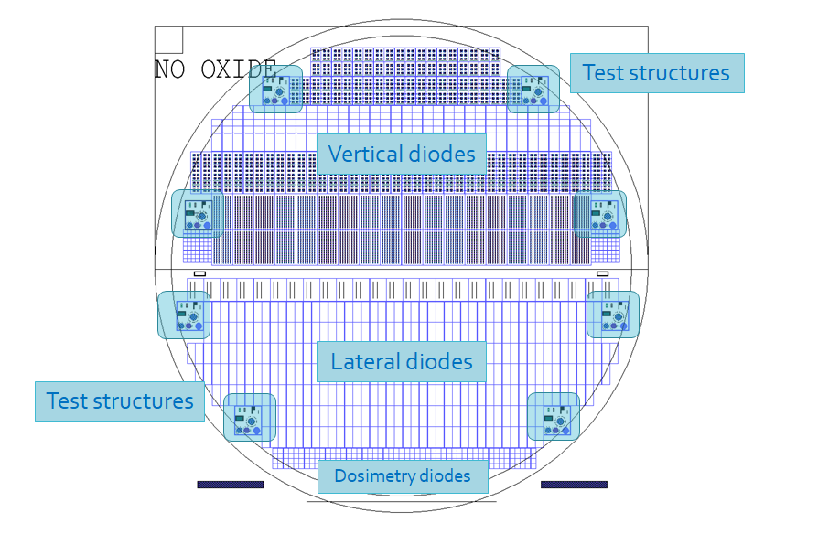
Final complete Layout

Slide 17
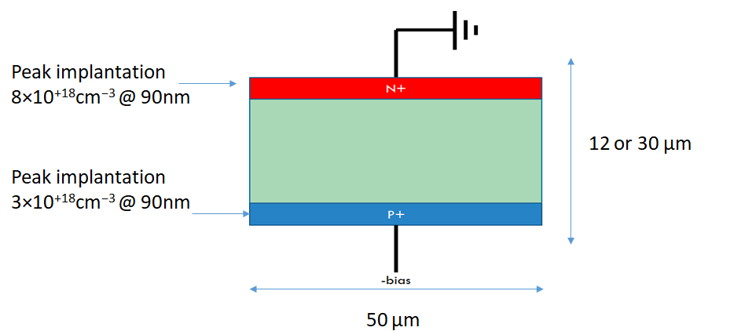
A-Si:H material simulation
Parameter (units) | Literature | Simulation
Relative permittivity | 11.8-11.9 | 11.7
Electron mobility (cm² V⁻¹ s⁻¹) | 0.5-20 | 10
Hole mobility (cm² V⁻¹ s⁻¹) | 0.003-10 | 0.01
Band Gap (eV) | 1.7-1.9 | 1.84
Dangling bond density (cm⁻³) | 5 x 10¹⁴ – 5 x 10¹⁶ | 4 x 10¹⁵
Activation energy (eV) | 0.42-0.49 | 0.52

Slide 18
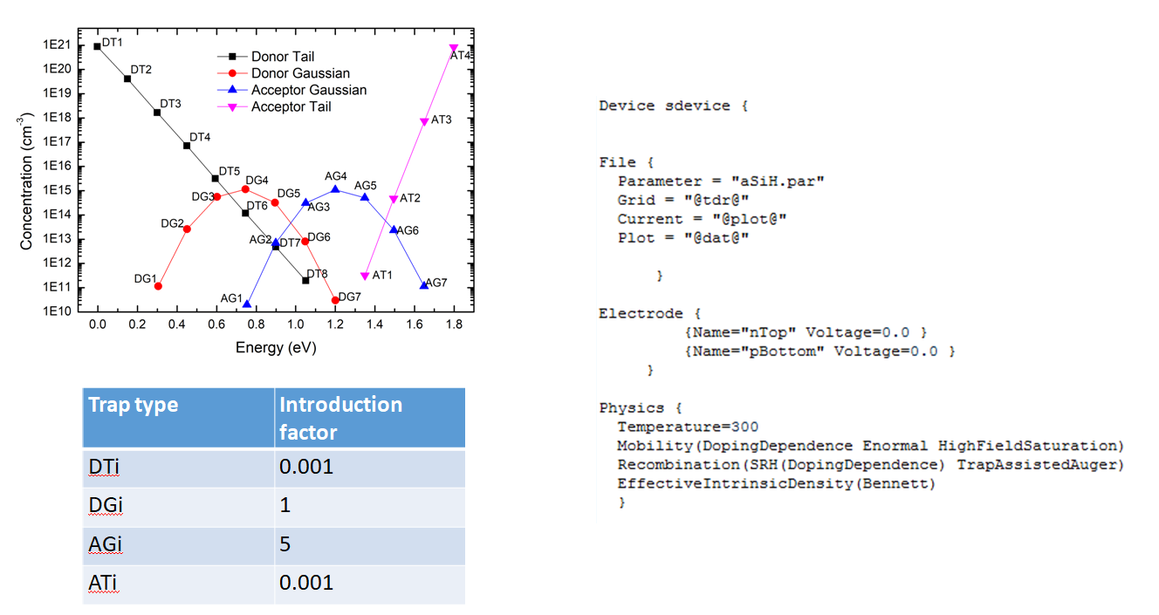
Defects model

Slide 19
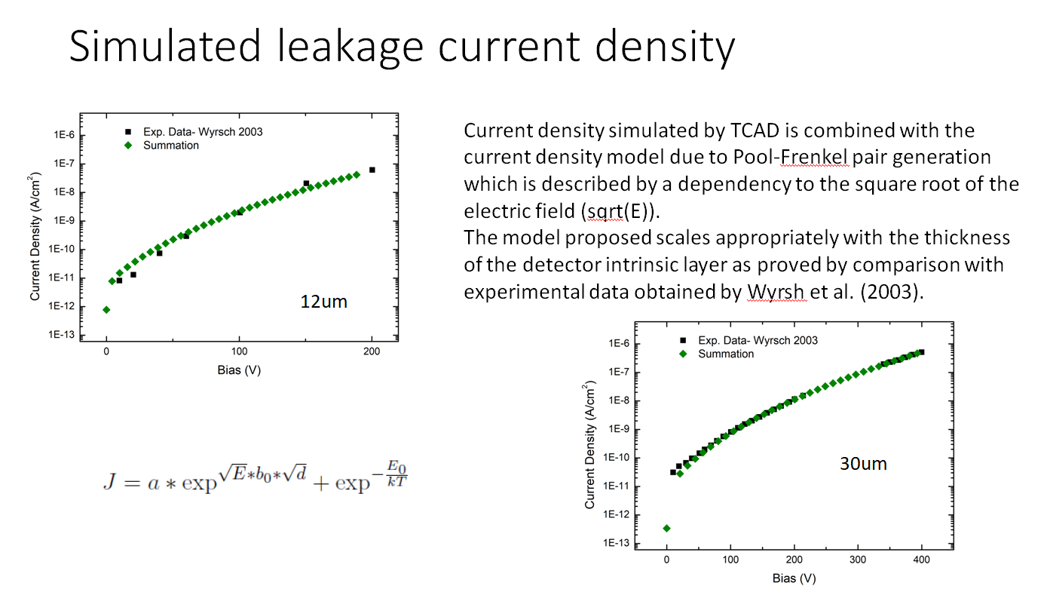

Slide 20
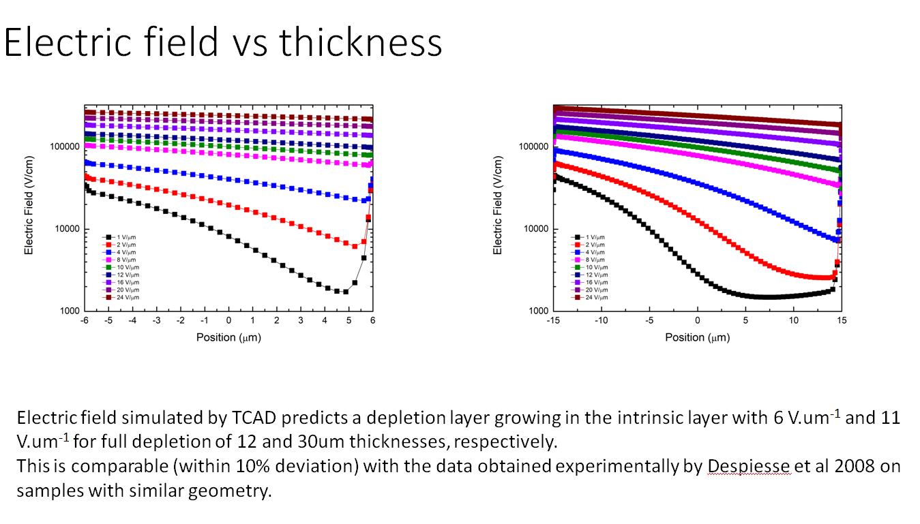

Slide 21
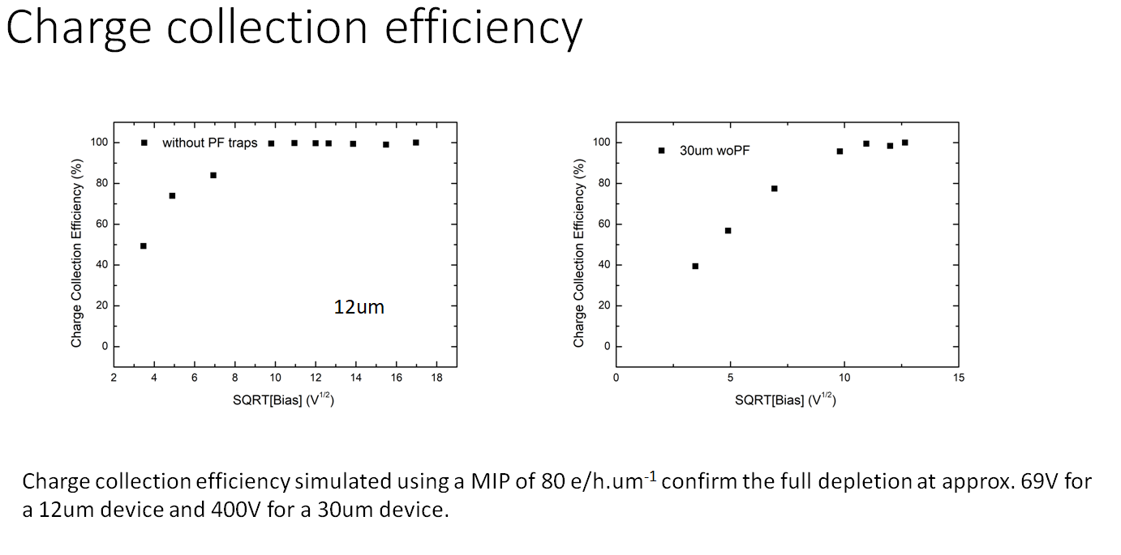

Slide 22
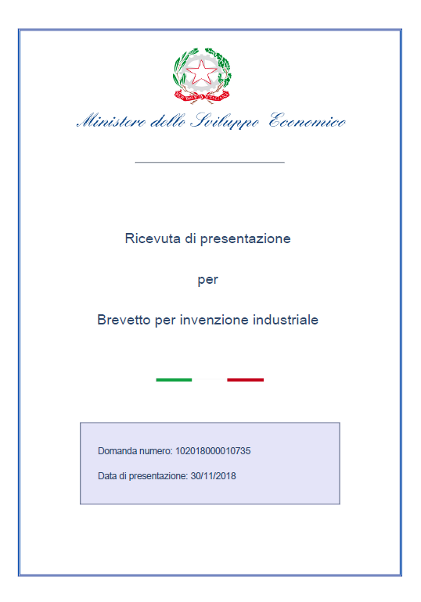
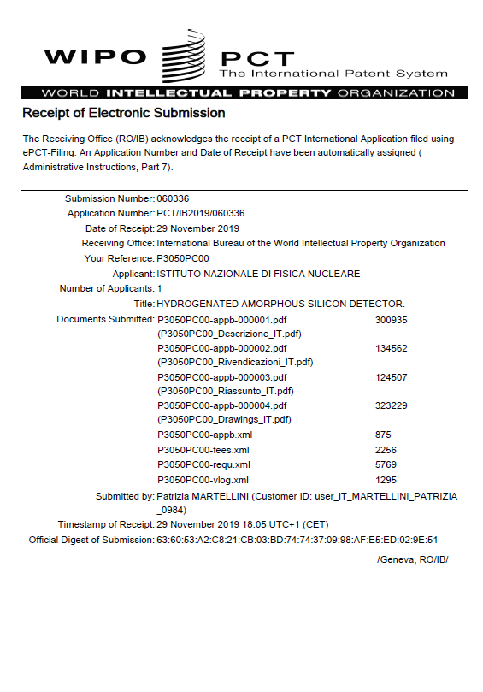

Slide 23
Timeline of the 3 years program
Tape out of the phase 1 prototype. DONE
Completion of production of the phase 1 prototype by January at most.
Testing of the phase 1 prototype and beginning of definition of the phase 2 prototype by april 2020
Construction of phase 2 prototype by mid 2020.
Testing of phase 2 prototype and design of the phase 3 prototype by the end of 2020
Production and testing of the phase 3 prototype by the end of 2021

Slide 24
The future of 3D a-Si:H detector
Fabrication of an actual pixel detector bump-bonded on a readout chip.
Deposition of a-Si:H directly on the readout chip and construction of the 3D detector on the deposited substrate.

