Slide 1
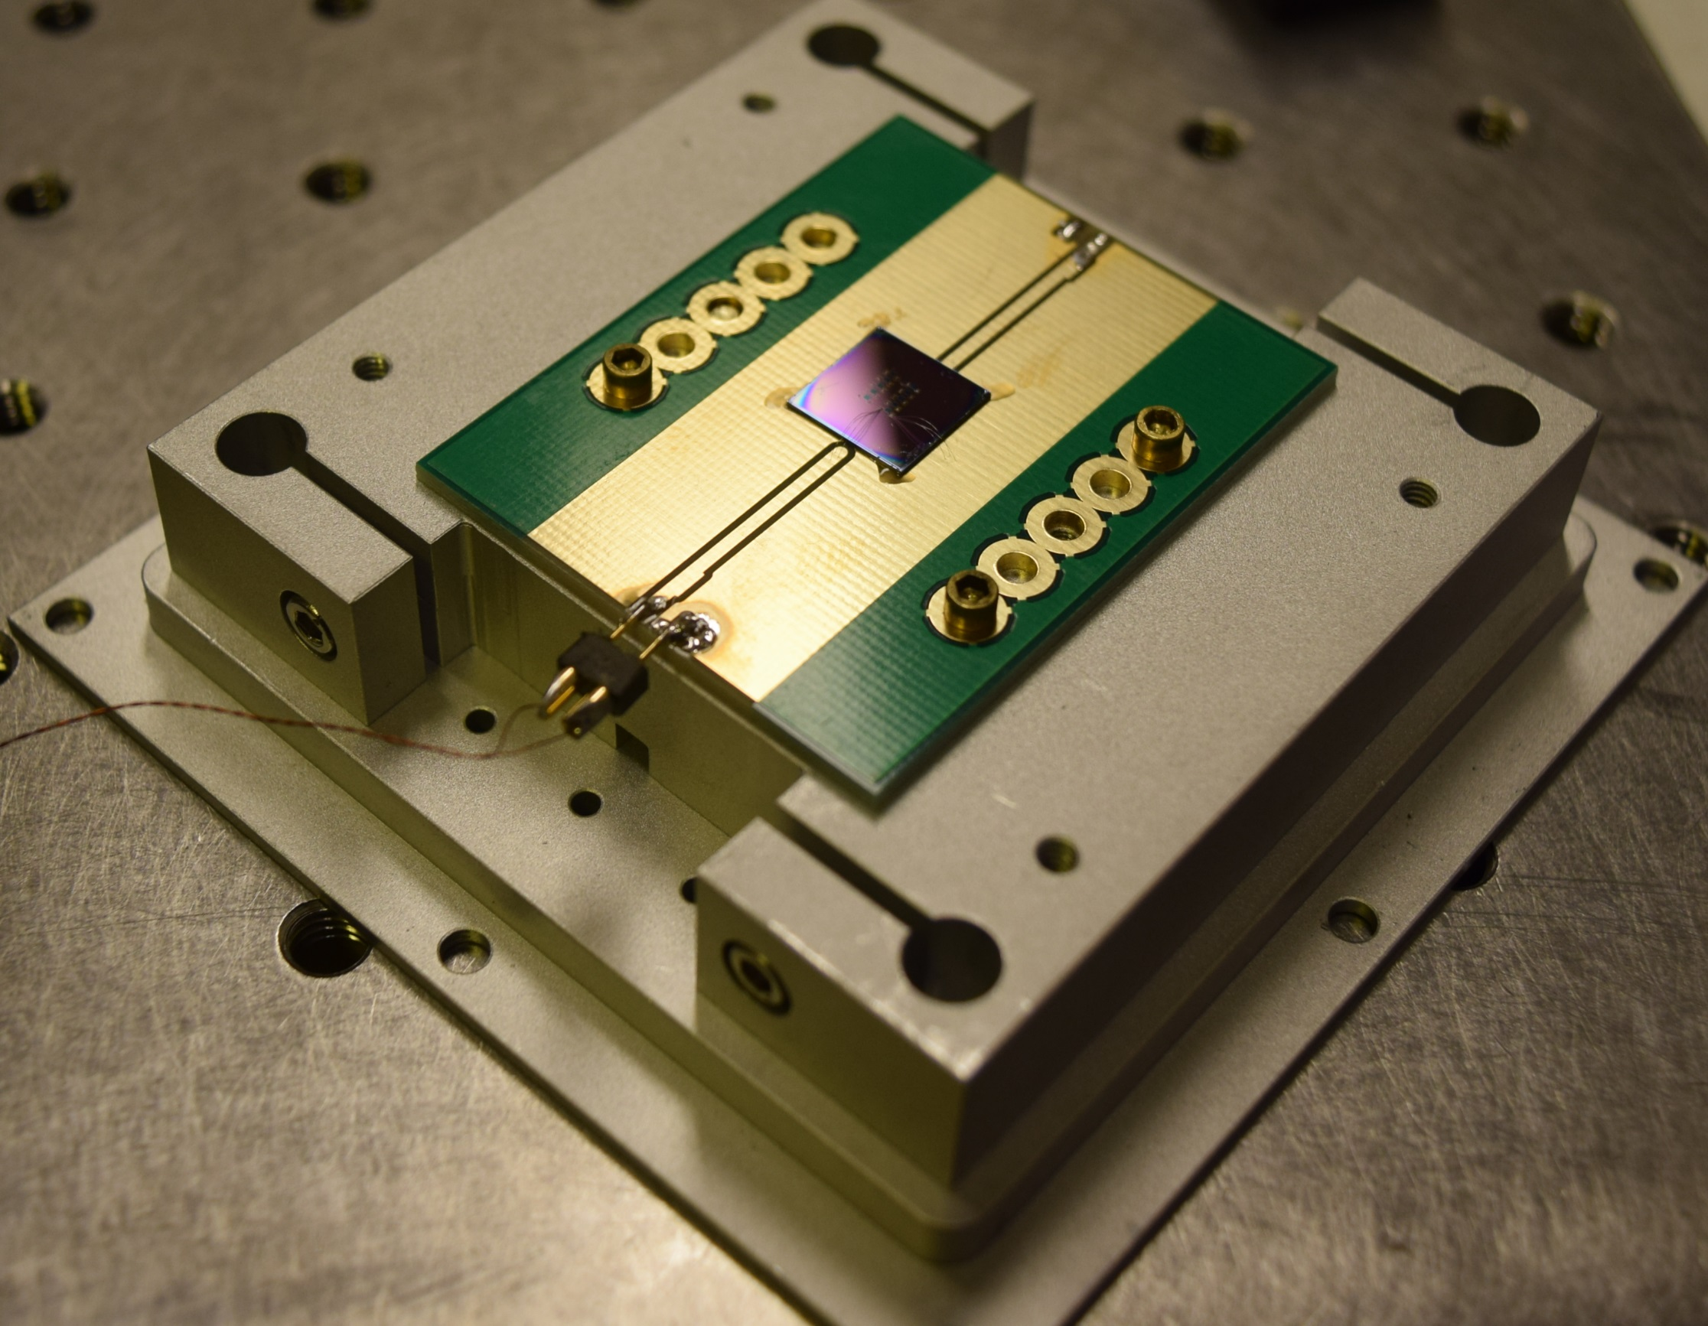
High-performance multilayer optical haloscope for a dark photon search
Presenter: Jeff Chiles, NIST
Teams/Affiliations:
NIST: Jeff Chiles, Sae Woo Nam, Varun E. Verma, Adriana Lita
MIT: Ilya Charaev, Karl K. Berggren, Marco Colangelo
Perimeter Institute for Theoretical Physics: Asimina Arvanitaki, Junwu Huang
New York University: Masha Baryakhtar
UCSB: Ken Van Tillburg
Stanford: Robert Lasenby

Slide 2
Intro: detecting dark photons and axions

Slide 3
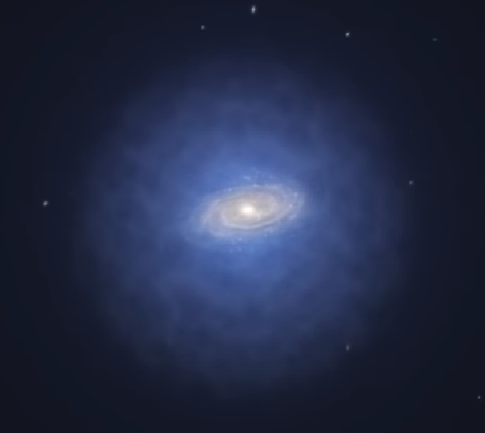
The quest for dark matter
Surrounds most if not all galaxies in a halo
Has mass, mostly interacts through gravity
Dark matter halo of milky way
(artist rend.)
DM flux ~ 14 W/m²
https://www.eso.org/public/videos/eso1217a/
95% of galaxy is dark matter
Solar flux ~ 1.4 kW/m²

Slide 4
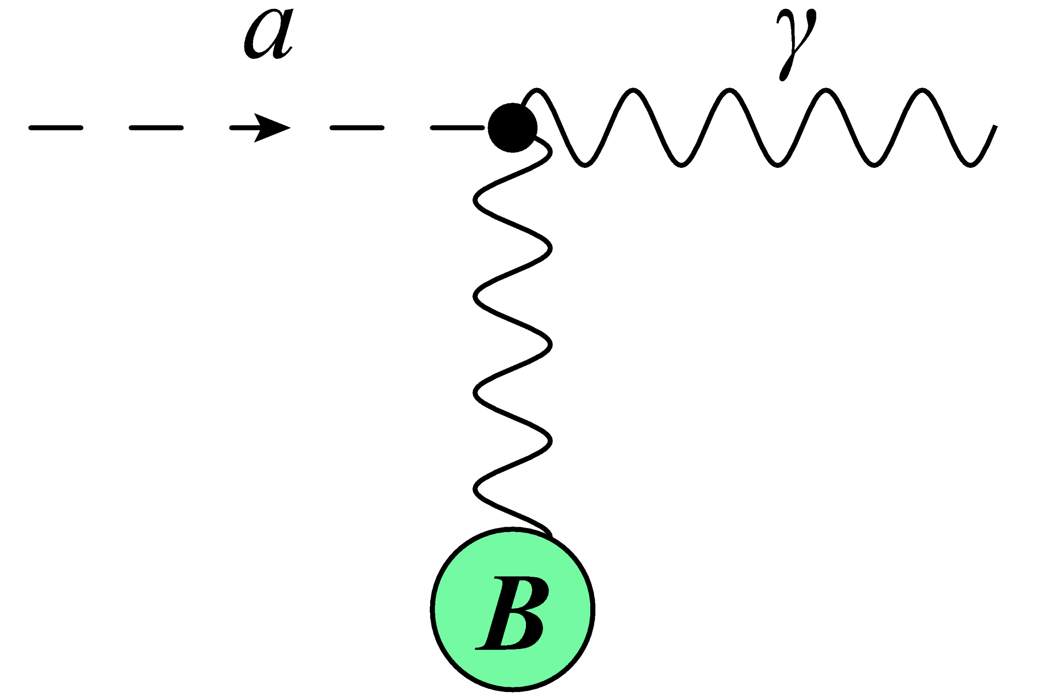
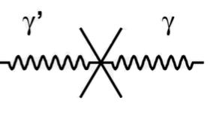
Seeing light bosonic dark matter
Photon can convert into axion (dark photon) and back through E·B (kinetic mixing) term

Slide 5
Seeing light bosonic dark matter
Photon can convert into axion (dark photon) and back through E·B (kinetic mixing) term
Could we see axion or dark photon dark matter converting to photons?
  In theory yes
  Then why don’t we see it all the time?

Slide 6


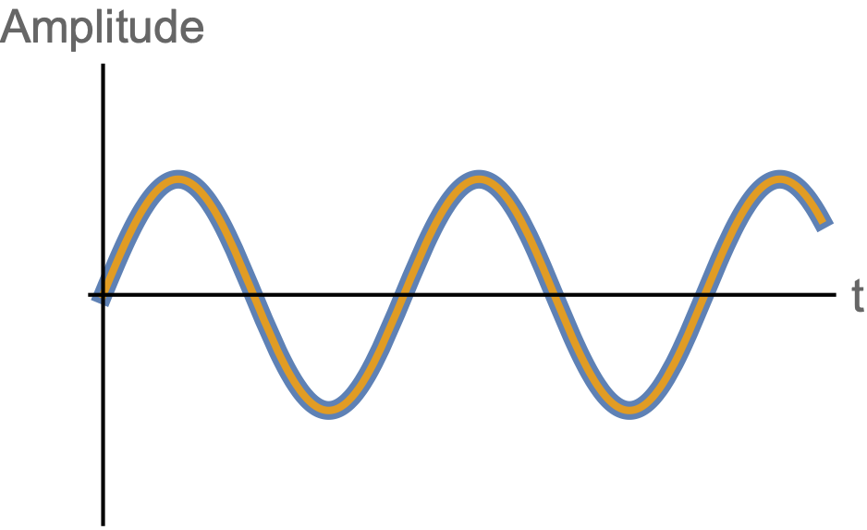
Seeing light bosonic dark matter
photon
dark matter
Dark matter
Photon
t
For a given particle energy, oscillation is matched in time

Slide 7
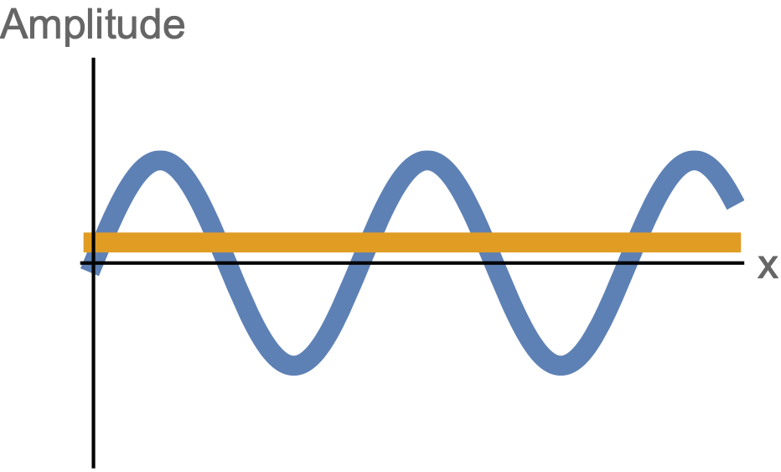
Seeing light bosonic dark matter
photon
dark matter
Photon
Dark matter
x
But highly spatially mismatched due to dark matter’s mass and slow velocity

Slide 8
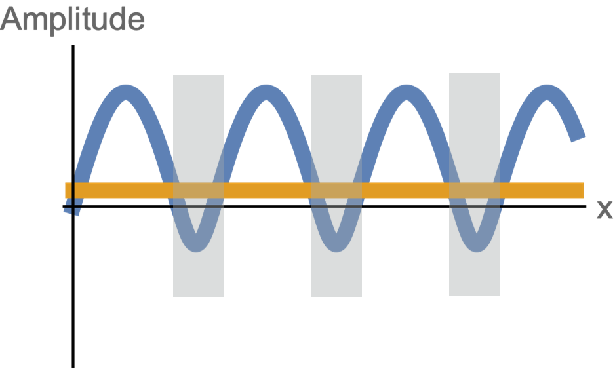
Seeing light bosonic dark matter
A periodic index of refraction can correct the momentum mismatch
Electric field no longer integrates to zero against a constant DM background
Higher refractive index
t
x
M. Baryakhtar et al., Phys. Rev. D 98, 035006 (2018)

Slide 9
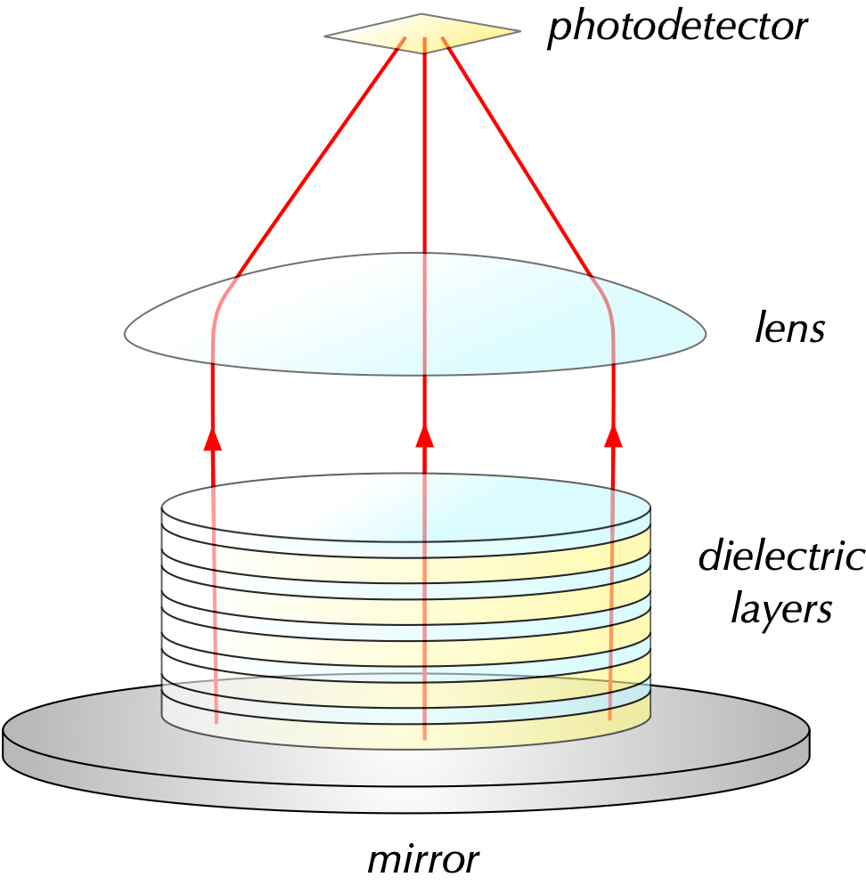
Multilayer haloscope concept
photodetector
High index of refraction contrast increases power
  e.g. silicon (n₂=3.4) and silica (n₁=1.46)
Large number of layers N increases power while decreasing mass coverage
  E&M fields add coherently
Signal photons efficiently focused onto detector
  10⁶ smaller than the stack
lens
d2, n2
thickness N (d1+d2)
d1, n1
mirror
area A ~ (10 cm)²
M. Baryakhtar et al., Phys. Rev. D 98, 035006 (2018)

Slide 10
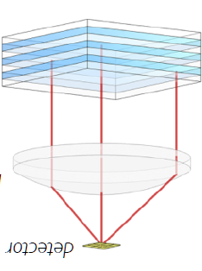
Multilayer optical haloscope design
3 major aspects

Slide 11
Multilayer optical haloscope design
3 major aspects
  Detector
    -Pick up the signal with low noise
    -Provide large area to ease alignment
(1)

Slide 12
Multilayer optical haloscope design
3 major aspects
  Detector
    -Pick up the signal with low noise
    -Provide large area to ease alignment
  Multilayer target
    -Convert DM to SM photons
    -Precisely engineered thin film coating for target wavelength
(2)
(1)

Slide 13
Multilayer optical haloscope design
(3)
3 major aspects
  Detector
    -Pick up the signal with low noise
    -Provide large area to ease alignment
  Multilayer target
    -Convert DM to SM photons
    -Precisely engineered thin film coating for target wavelength
  Optomechanical assembly
    -Align all elements (lens, target, detector)
(2)
(1)

Slide 14
Superconducting nanowire single photon detectors (SNSPDs)

Slide 15
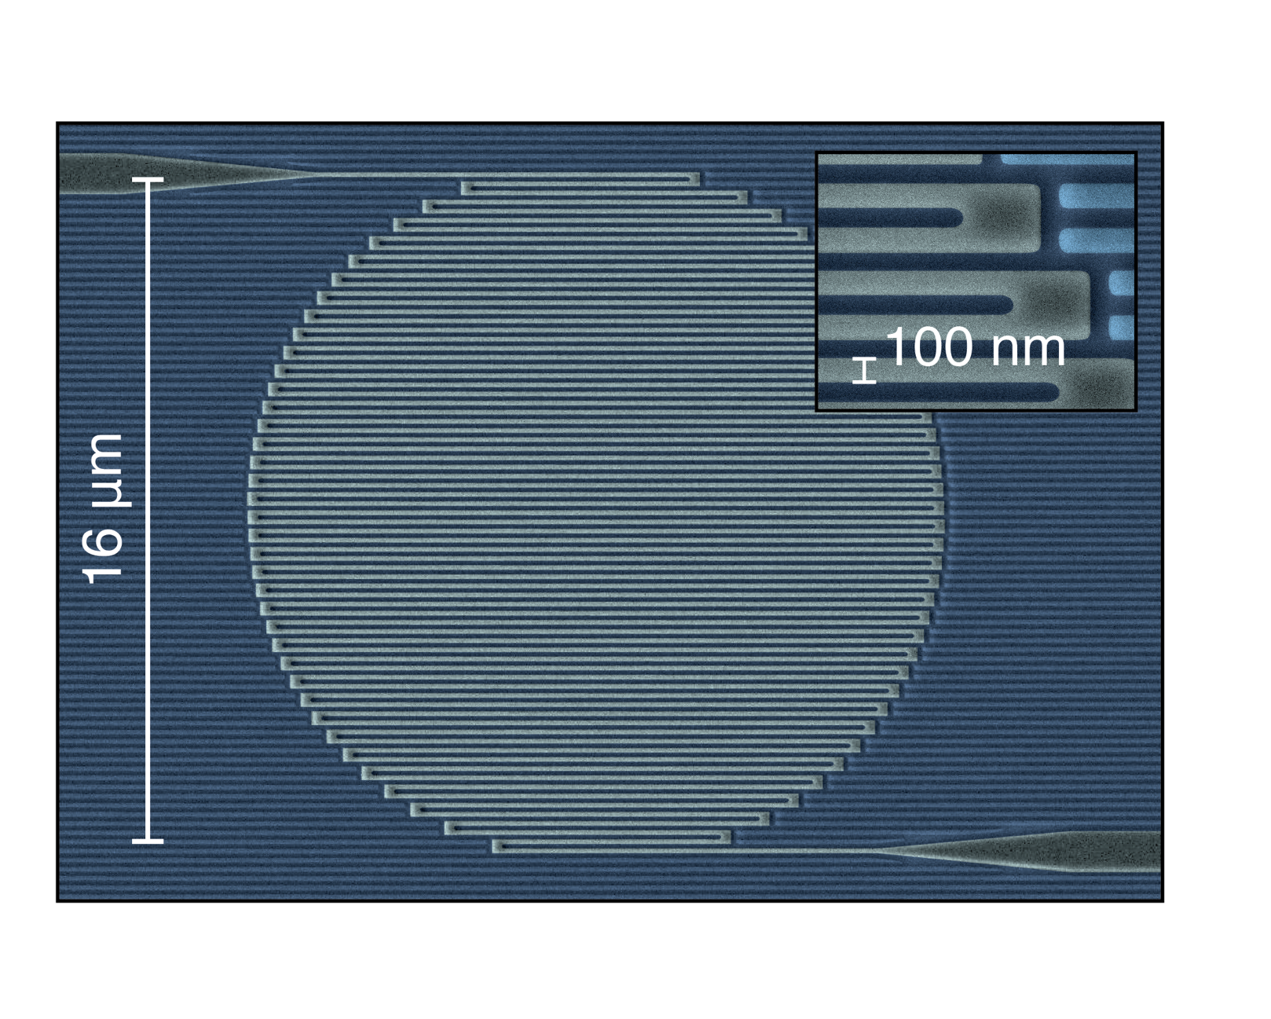
Superconducting Nanowire Single-Photon Detector
Meandered wire of superconducting thin film with a small bias current
V. Verma (NIST)
Notes:
First, some quick background and theory, for anyone in the audience who is not very familiar with these devices. A modern SNSPD may look something like the device pictured below, a meandered wire of a thin superconducting film. It is cooled well below the superconducting transition temperature and biased with a DC current.

Slide 16
Superconducting Nanowire Single-Photon Detector
Photon creates hotspot
Bias Current (I_{B})
Suppressed Superconductivity
Superconducting
I_{B}
R_{L}
L
SNSPD
Anomalously, large Inductance, L
Notes:
Zooming in on a small section of the wire – when a photon is incident on it and strikes the surface, it is absorbed by the metallic film and locally changes the critical current, or maximum current density that is permitted before superconductivity breaks down

Slide 17
Superconducting Nanowire Single-Photon Detector
Bias Current (I_{B})
Normal
I_{B}
R_{L}
L
SNSPD
Notes:
The hotspot becomes normal, or resistive, quickly crowding out an blocking any superconducting path through the wire. As a result, current is diverted into the amplifier monitoring the device, generating a voltage spike that is easily detected.

Slide 18
Superconducting Nanowire Single-Photon Detector
Superconductivity is restored
Bias Current (I_{B})
Superconducting
I_{B}
R_{L}
L
SNSPD
Anomalously, large Inductance, L
Notes:
After some time, with the bias current removed from the nanowire, it cools down below the transition temperature, at which point it will become a short circuit again.

Slide 19
Superconducting Nanowire Single-Photon Detector
Bias Current Restored
Bias Current (I_{B})
τ = L / R_{L}
Superconducting
I_{B}
R_{L}
L
SNSPD
Notes:
The bias current settles at the normal value, and the detector is ready for the next photon.

Slide 20
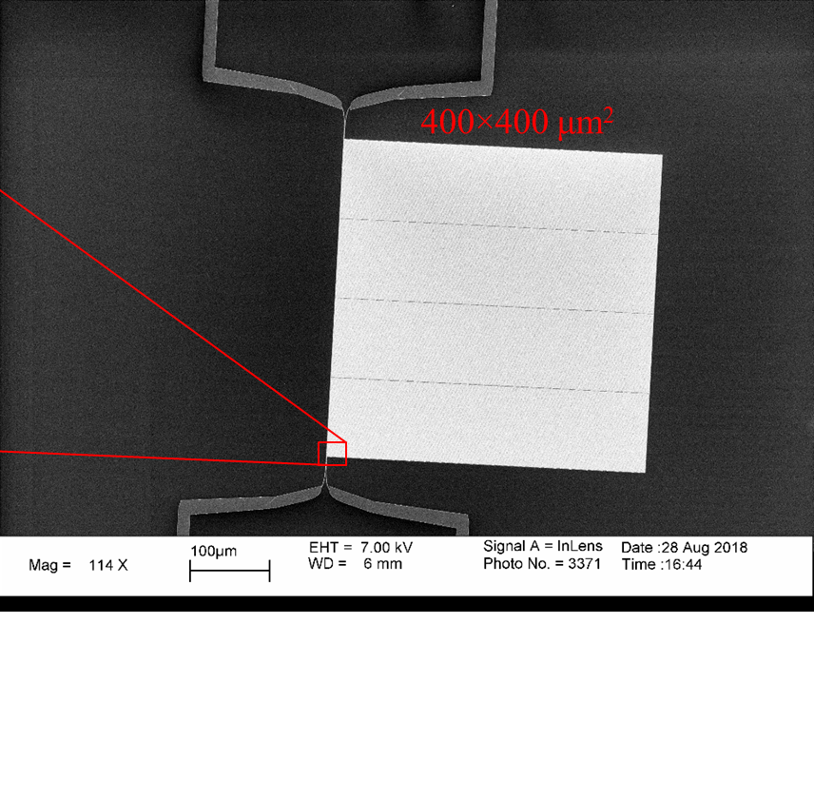

Detector for optical haloscope
See Ilya Charaev’s talk at 9:35 AM
400 x 400 um² detectors with 10⁻⁵ Hz dark count rate
Notes:
For our optical haloscope detector, we used a tungsten silicide thin film deposited at NIST, and Ilya Charaev at MIT, from Karl Berggren’s group, fabricated nanowire detectors on these films. These are some of the largest nanowire detectors to date. For our experiment, we utilized one of his large-area detectors spanning 400x400um^2.

Slide 21
Scaling up with “microwires”
Large detector areas: increase target size, ease alignment
  Narrow nanowires harder to yield over large surface areas of mm²
  Korneeva et al. recently demonstrated single-photon sensitivity in nanowires > 1 um in width (EPJ Web Conf. 190 (2018))

Slide 22
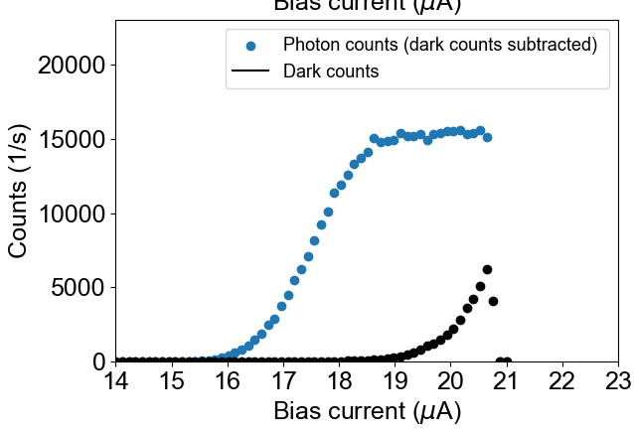
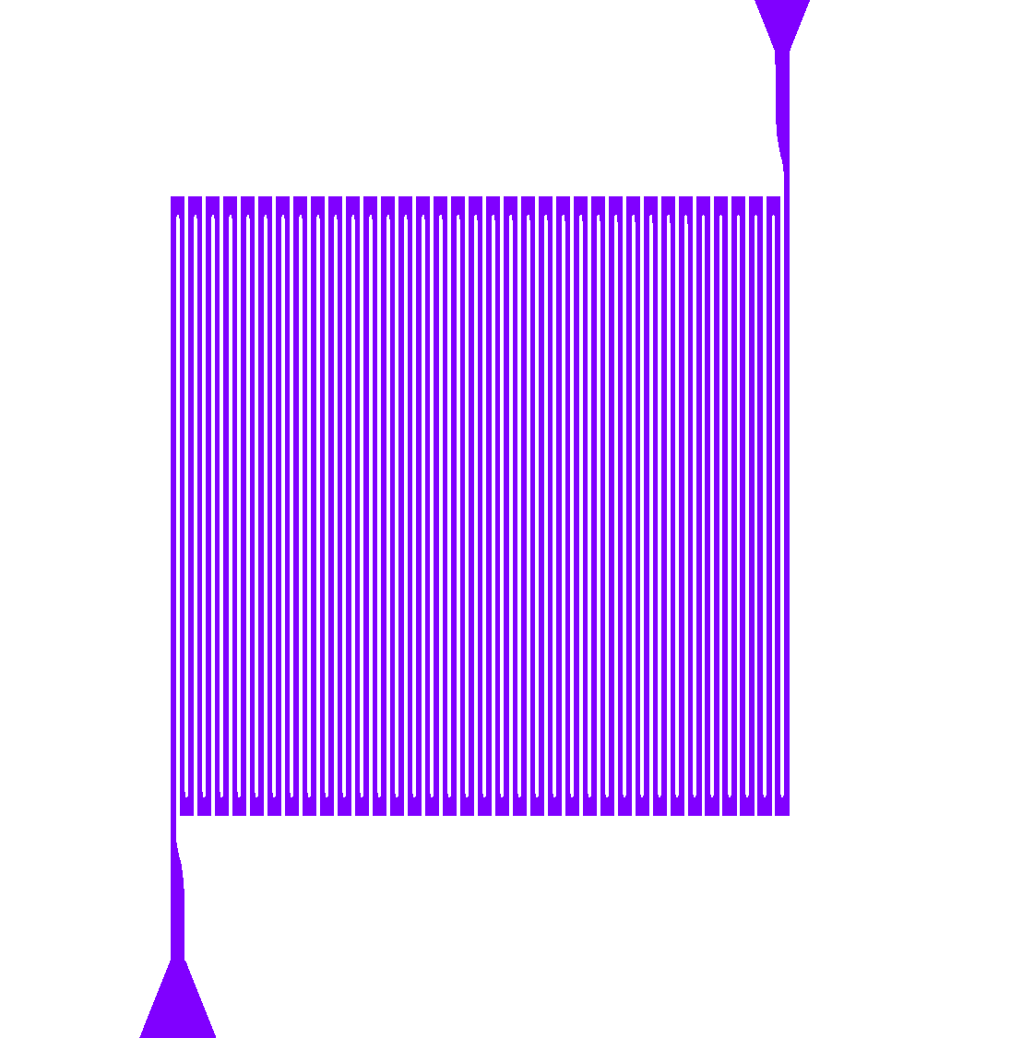
Scaling up with “microwires”
Large detector areas: increase target size, ease alignment
  Narrow nanowires harder to yield over large surface areas of mm²
  Korneeva et al. recently demonstrated single-photon sensitivity in nanowires > 1 um in width (EPJ Web Conf. 190 (2018))
We have demonstrated single-photon-sensitive detectors working at 1550 nm with 2 um wire width and area of 360 x 360 um²
J. Chiles et al., SPW 2019
In preparation for submission

Slide 23
Multilayer target (Stack)
Notes:
Next, I’ll talk about the multilayer optical target, or stack. Being a photonics guy, this (and the optomechanical assembly portion) are more where my expertise comes in.

Slide 24
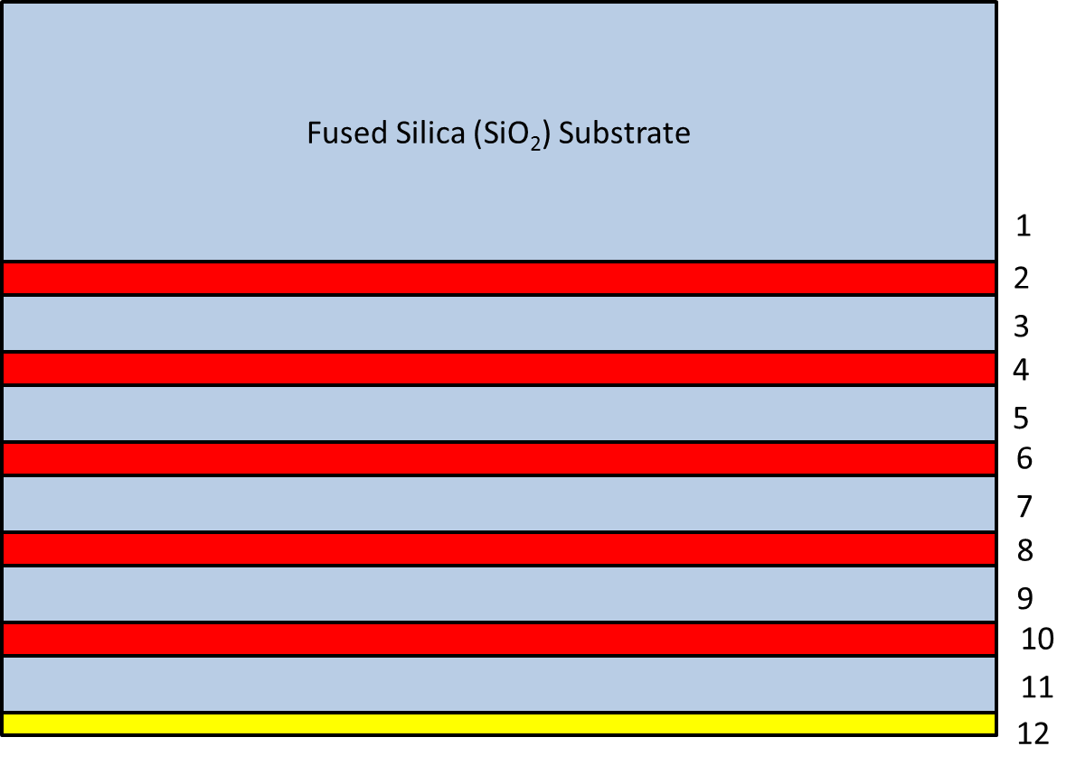
Multilayer Target
5 pairs of amorphous silicon / silicon dioxide (n = 2.74/1.45)
  λ / 2 thickness stack
    Constructive interference at design wavelength Λ_{T}
    Index contrast of ~ 1.3 at λ = 1550 nm
    Fused SiO2 substrate: minimize thermal expansion mismatch
a-Si
SiO2
…
Au mirror
Notes:
The target consists of a 2” diameter fused silicon dioxide wafer, polished on both sides. On the bottom surface, five pairs of amorphous silicon and silicon dioxide have been deposited at lambda/2 optical thicknesses. This, and the gold mirror placed at the bottom, are required for selecting the proper optical mode for maximum signal photon generation. Constructive interference is achieved at a design wavelength I’ll call LambdaT.

Slide 25
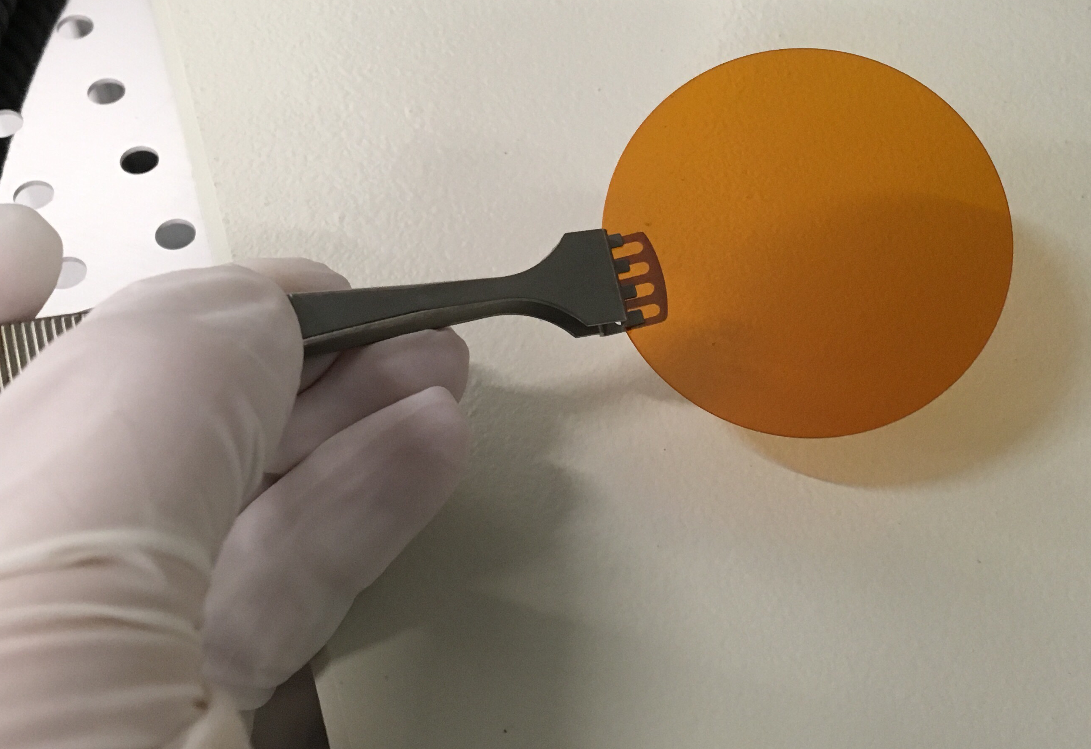
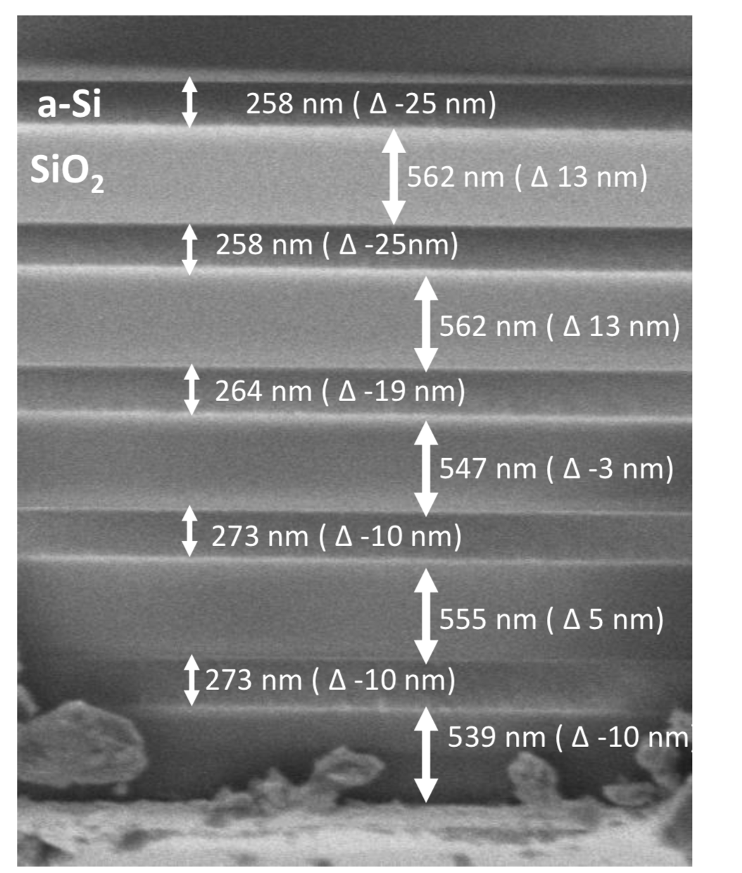
Multilayer target fabrication
Done in-house at NIST
  Highly uniform
  Low-temperature deposition to withstand cryo shock

Slide 26
Multilayer target characterization
White light interferometry
  Fifth reflectance null after photonic bandgap indicates emission wavelength Λ _{T}
Design/Simulation
Experiment/Measured
Reflectance
Λ _{T} = 1.55 μm
Λ _{T} = 1.55 μm
Reflectance
About 1 dB power loss in optical transmission through the target

Slide 27
Optomechanical assembly
Notes:
The third and final section of my talk will focus on the optomechanical assembly.

Slide 28
Function of the assembly
Align optical path
  Multilayer target -> Lens -> Detector
  Provide experimental verification
    Laser alignment source for targeting
House detector and electrical interface
Additional light blocking

Slide 29
Function of the assembly
Align optical path
  Multilayer target -> Lens -> Detector
  Provide experimental verification
    Laser alignment source for targeting
House detector and electrical interface
Additional light blocking
Next: a walkthrough of the assembly and its elements

Slide 30
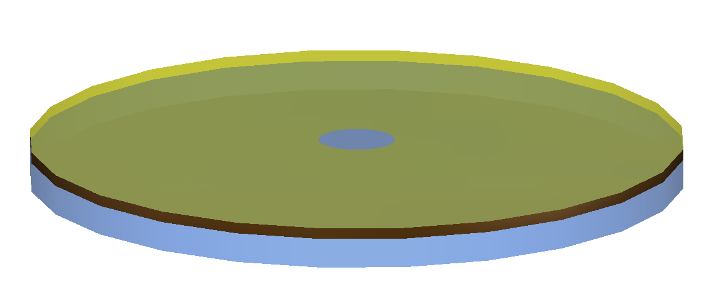
Multilayer target, top profile
Gold mirror
Alignment aperture
Multilayer stack
Target substrate
Notes:
First we have the target. As we saw before, it’s a silicon dioxide wafer with a multilayer stack, and a gold mirror placed at the end of the multilayers. However, in this profile view, you can see an aperture that we open up in the middle. This is used later for aligning the optical axis to the detector chip.

Slide 31
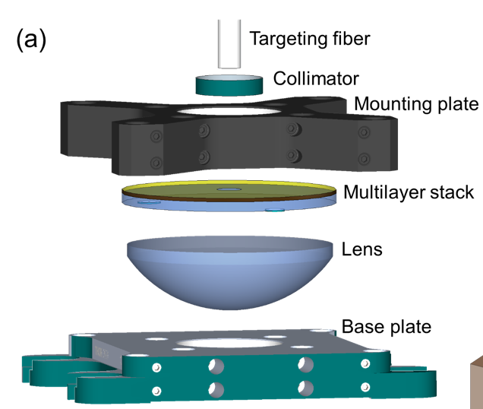
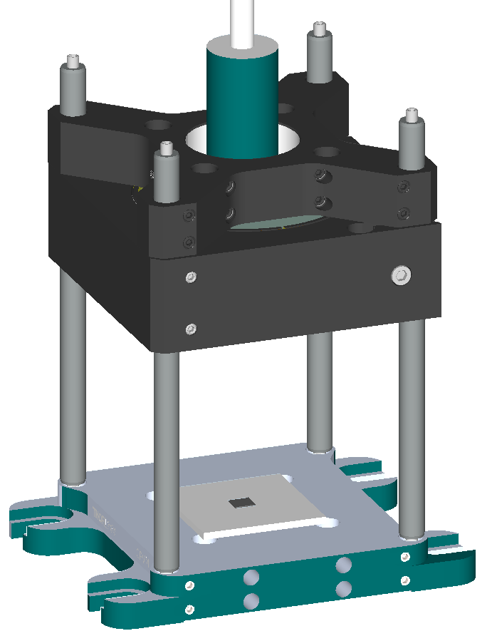
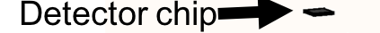
Optomechanical assembly
Exploded
Assembled

Slide 32
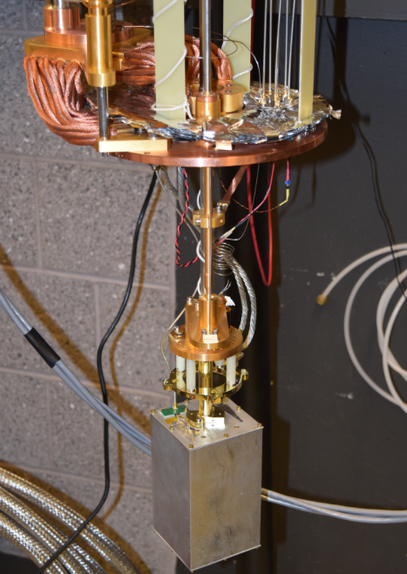
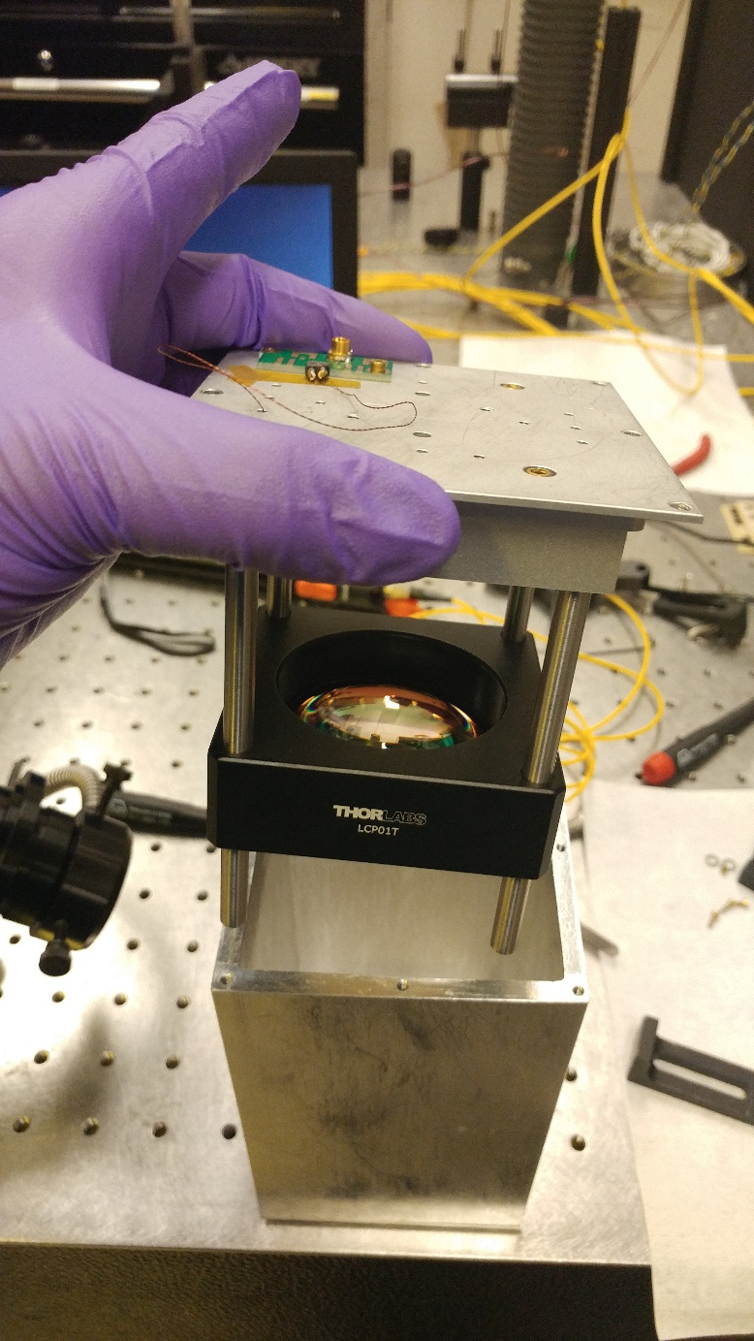
First-generation haloscope
Recorded no dark count events in ~26 hours

Slide 33
Issues identified in pilot run
Challenging to guarantee alignment of signal path to targeting path

Slide 34
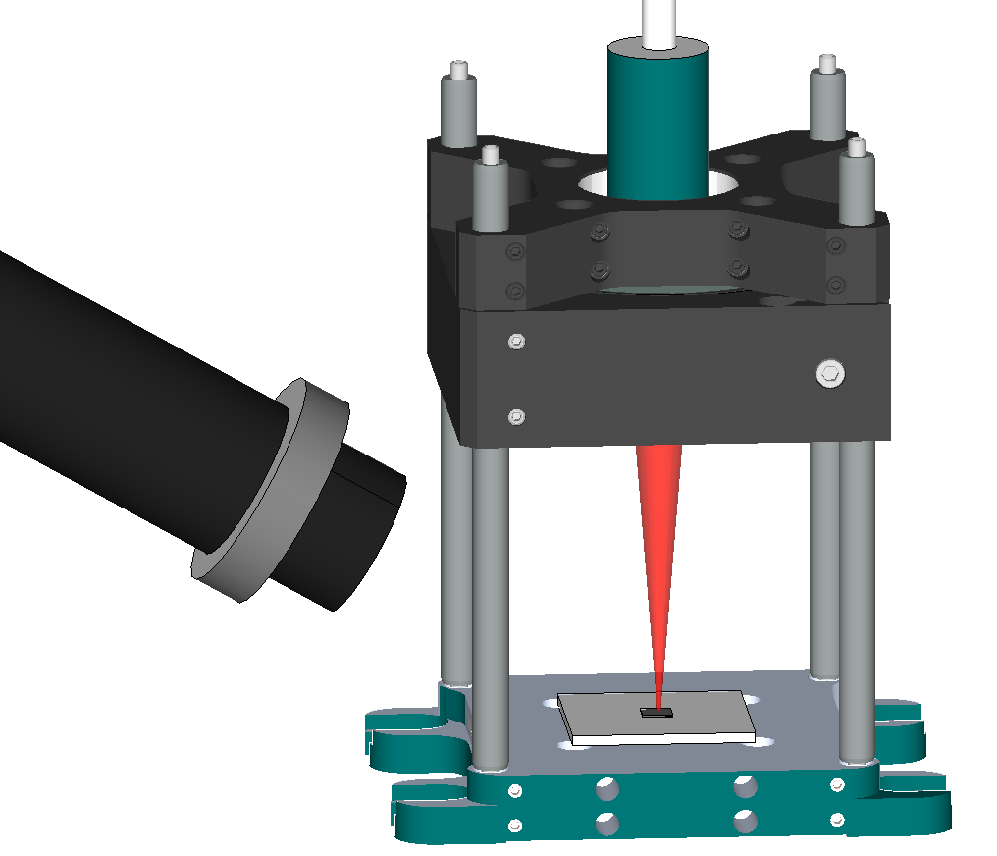
Issues identified in pilot run
Adjustment of lens focal length
  Hugely underfilling the focusing lens leads to large depth of focus (bad)
  Difficult to accurately judge when you’re at focus

Slide 35
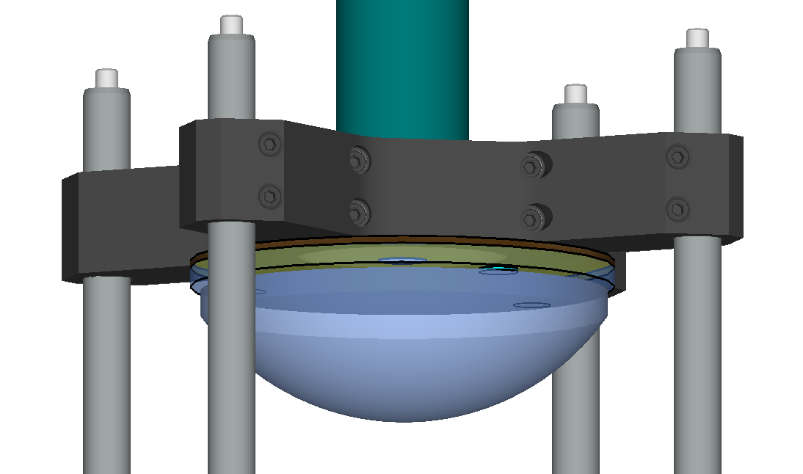
Solutions
Challenging to guarantee alignment of signal path to targeting path
  Co-mount lens, stack and collimator on same optomechanical assembly
  Use collimator with low pointing error off mechanical centerline
Adjustment of lens focal length
  Oversized (1” diameter) reflective collimator
  Invar cage rods for low CTE

Slide 36
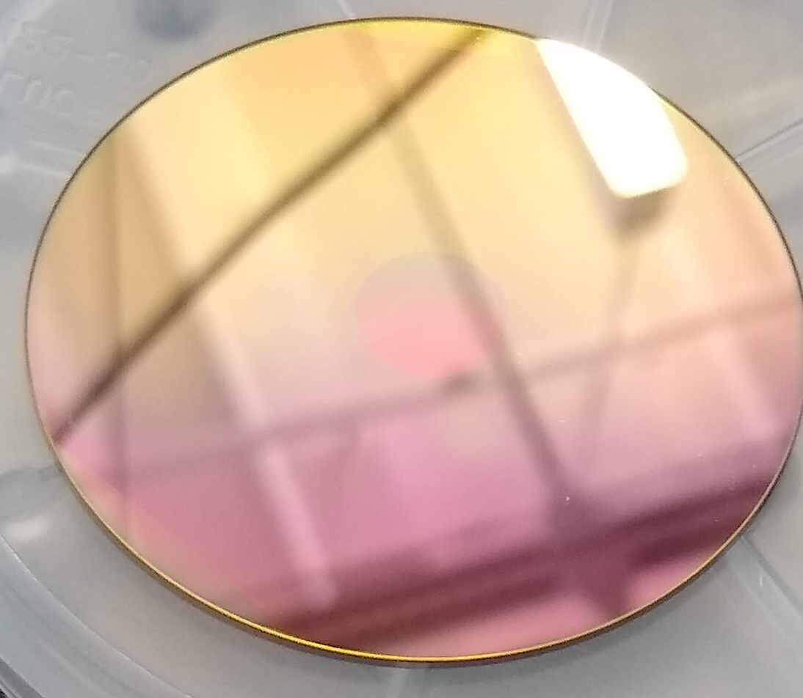
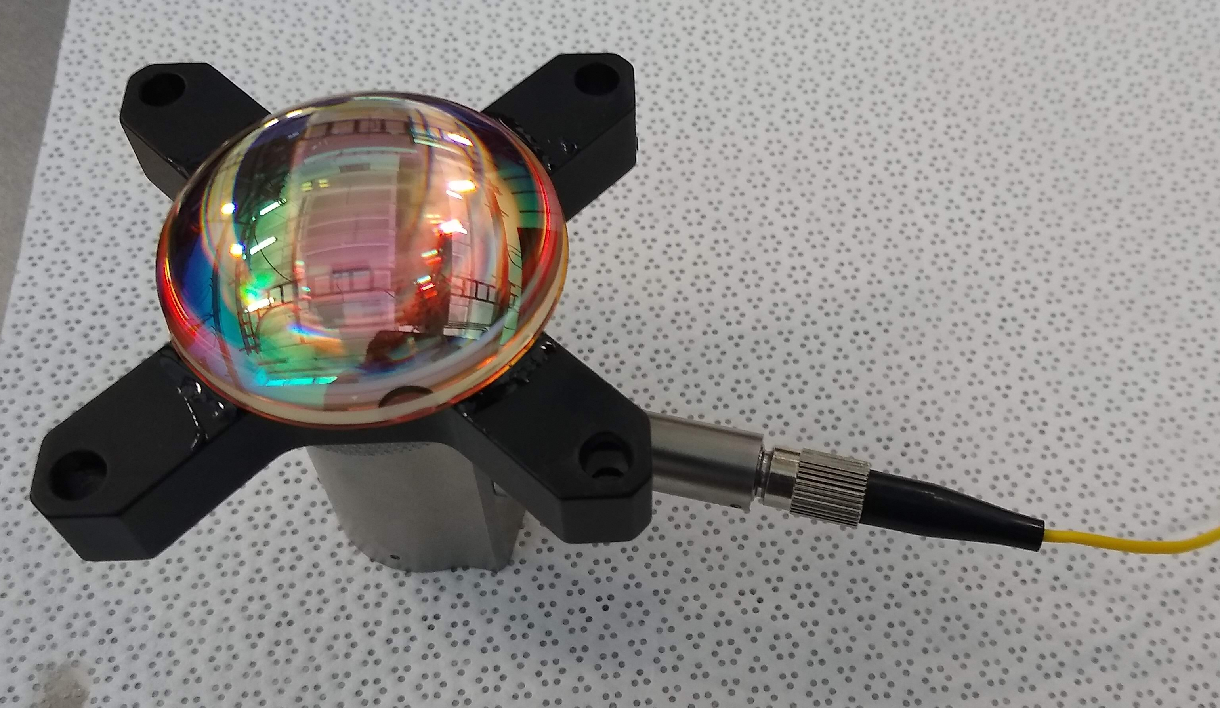
Latest version assembled and ready for detector integration
Target – pre-assembly
1 cm alignment aperture

Slide 37
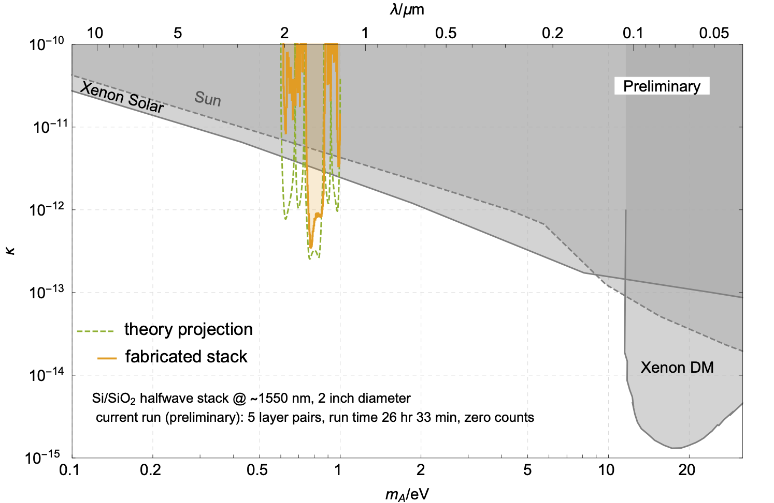
Expected reach – run 2
Can break through solar bounds in ~1 day of run time
Notes:
Next, I’ll talk about our first experiment using this technology.

Slide 38
Improving the reach
Detector efficiency improvements
  Currently estimated around 15% (no optimization)
  Can get up to 98% with AR coating and back reflector
    D. Reddy, CLEO 2019, FF1A.3
More layers
  Limited by practical tooling considerations (chamber cleanliness)
  Commercial vendors for thick film sputtering or PECVD
  Need to carefully manage stress, adhesion of films
Longer integration times
  Extended experiment planned soon
Noise mitigation
  Muon veto, optimized detectors, better electrical noise management

Slide 39
What about muons?
Detector is 400 x 400 um² with 50% fill factor
  → muon flux of 1x10⁻⁵ Hz on nanowire active area
Substrate events?
  1x10⁻² Hz muon flux across 1x1 cm substrate for chip
  Substrate (Si) does not scintillate
  Detector electrically isolated from Si substrate
WSi
WSi
SiO2
Si

Slide 40
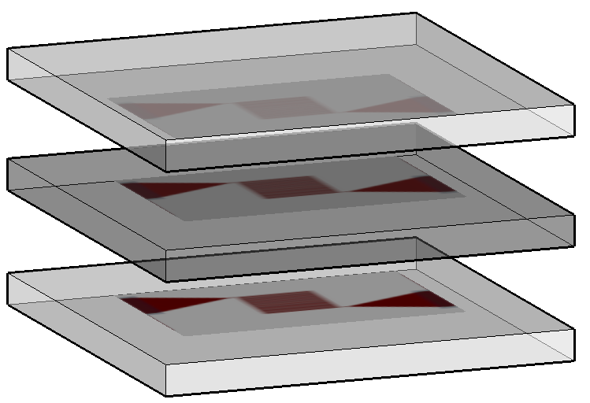
Measuring muon events
Proposed approach: scintillator “sandwich” with SNSPDs
SNSPD
Si:GaAs chip
Si chip
Si:GaAs chip

Slide 41
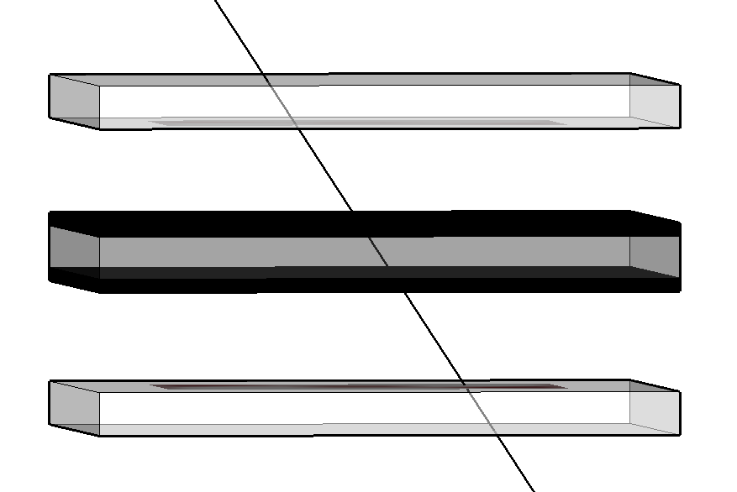
Muon incident on stack:
  Hits first GaAs chip
  Hits Si chip (hits detector)
  Hits second GaAs chip
Veto when Si-SNSPD clicks are coincident with GaAs-SNSPD clicks
~1.3 eV
SNSPDs on GaAs see event due to scattered photons
Light-blocking screens

Slide 42
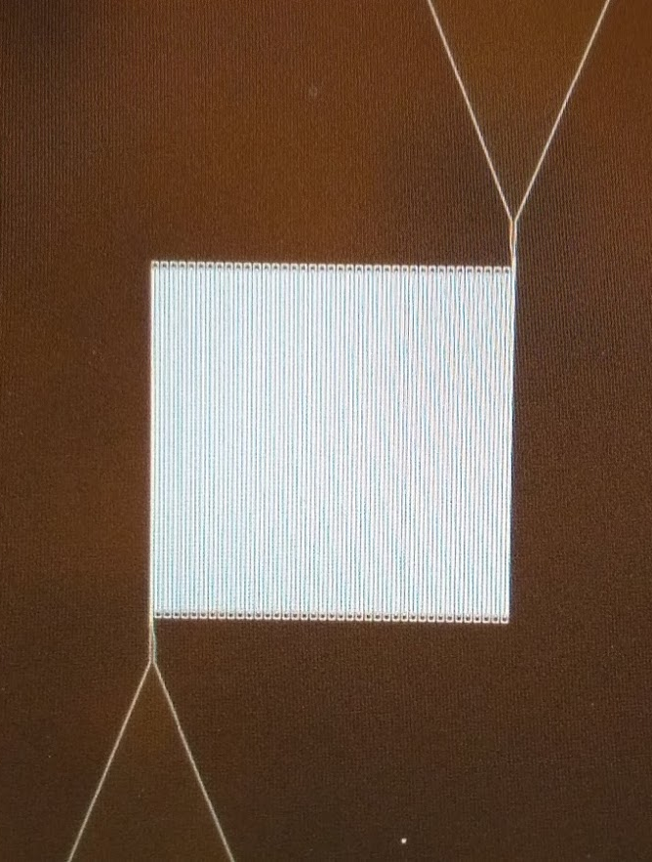
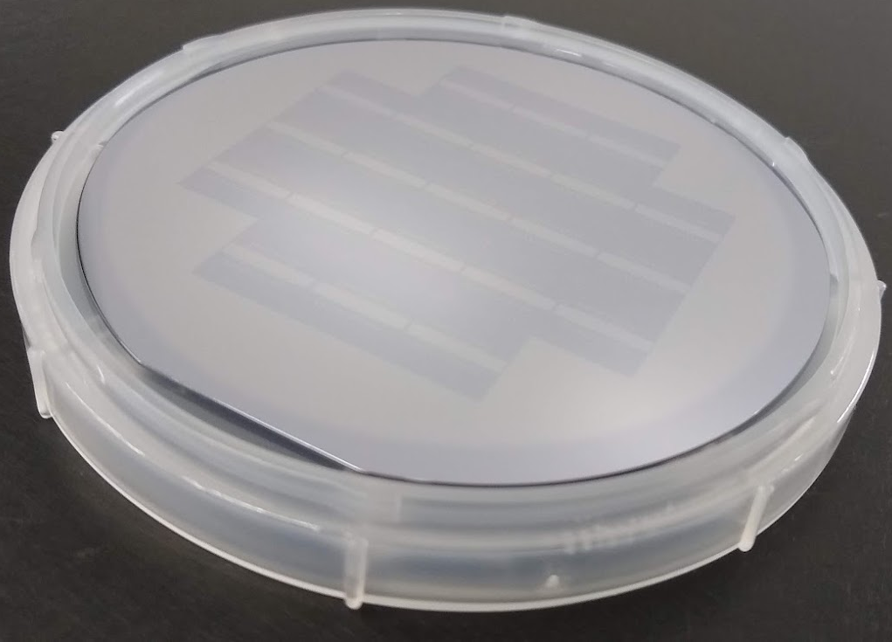
Experimental progress on muon veto
Full wafer of SNSPDs on Si:GaAs fabricated
260 x 260 um pixels (1 um wide wires) on 1 cm chips
Integration and testing at MIT soon

Slide 43
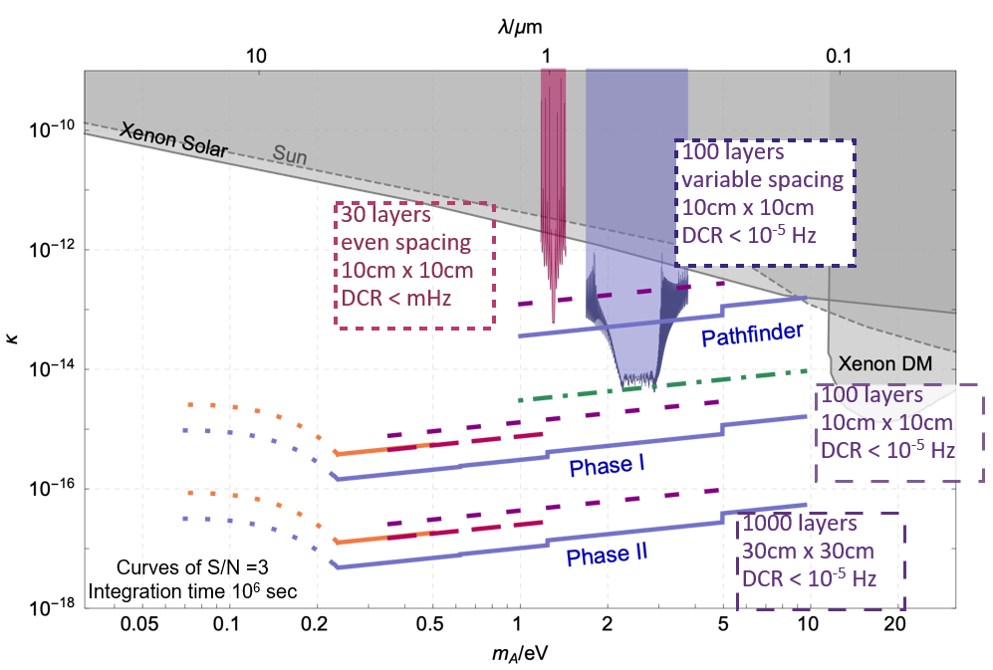
How far can we go?
M. Baryakhtar et al., Phys. Rev. D 98, 035006 (2018)

Slide 44
Future work
Notes:
Before I wrap up, I’ll just touch on a couple exciting directions we are considering taking this approach to dark matter detection.

Slide 45
Future work: scaling to larger coverage
Experiment scalable by adding multiple targets of different periodicity
  Volume still significant, cryostat volume precious

Slide 46
Future work: scaling to larger coverage
Experiment scalable by adding multiple targets of different periodicity
  Volume still significant, cryostat volume precious
Modify haloscope design: decouple optics+target from the SNSPD

Slide 47
Future work: scaling to larger coverage
Can integrate dozens of these in one moderately low-T fridge
  Just cold enough to eliminate blackbody IR coupled into fibers

Slide 48
Future work: resonant detection schemes
DM can also potentially couple to matter such as molecules
  0.2 – 20 eV sensitivity range
  Many “control knobs” for background rejection

Slide 49
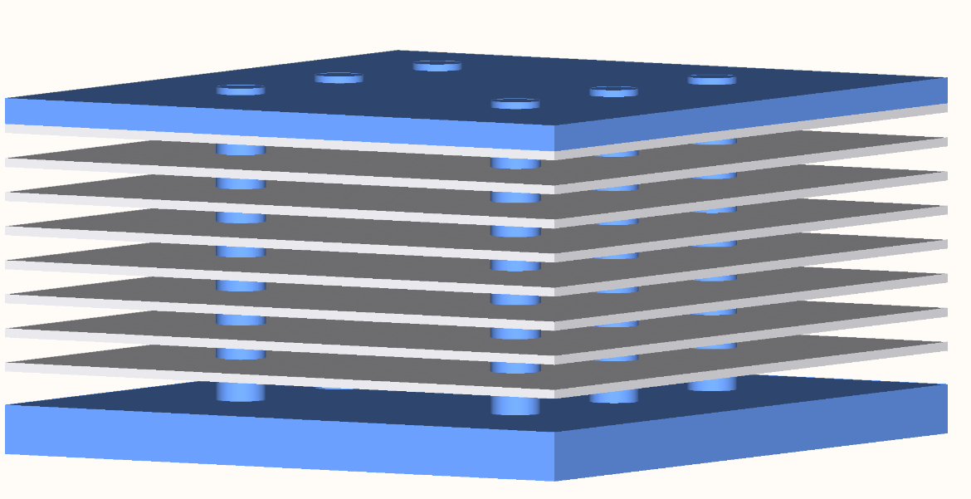
Future work: resonant detection schemes
DM can also potentially couple to matter such as molecules
  0.2 – 20 eV sensitivity range
  Many “control knobs” for background rejection
Developing suspended target structures for resonant coupling to gases
A. Arvanitaki et al., arXiv:1709.05354 (2017)

Slide 50
Funding/Support
NIST: Internal funds
MIT: DOE
NIST: Jeff Chiles, Sae Woo Nam, Varun E. Verma, Adriana Lita
MIT: Ilya Charaev, Karl K. Berggren, Marco Colangelo
Perimeter Institute for Theoretical Physics: Asimina Arvanitaki, Junwu Huang
New York University: Masha Baryakhtar
UCSB: Ken Van Tillburg
Stanford: Robert Lasenby
M. Baryakhtar et al., Phys. Rev. D 98, 035006 (2018)
Arvanitaki et al., arXiv:1709.05354 (2017)
Y. Hochberg et al., Phys. Rev. Lett. 123, 151802 (2019)

Slide 51
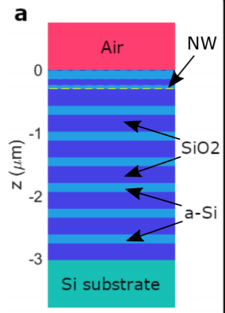
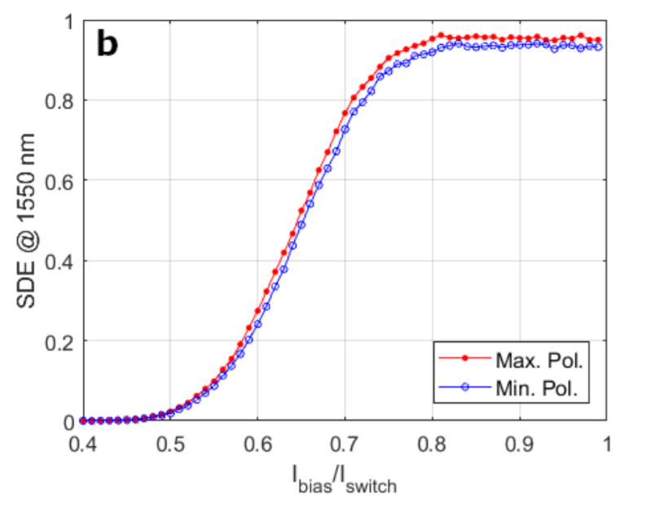
High system detection efficiency
Ultimately, SNSPD efficiency can be improved to >98% through well-established techniques
98%
D. Reddy et al, CLEO FF1A.3 (2019)

