Slide 1
Dark Matter and Fundamental Physics Searches using Atomic Magnetometers
Young Jin Kim
Ping-Han Chu, Leanne Duffy, Shaun Newman, Igor Savukov, Al Urbaitis
Los Alamos National Laboratory
Dec. 10, 2019
CPAD Workshop
Madison, WI
LA-UR-19-31996

Slide 2
Research at Los Alamos National Laboratory
Our experiments
aim to search for light new fundamental bosons, such as axions and hidden photons, that can serve as as light dark matter.
use new detection concepts based on atomic magnetometers via observable effects induced by new bosons coupled with SM particles.

Slide 3
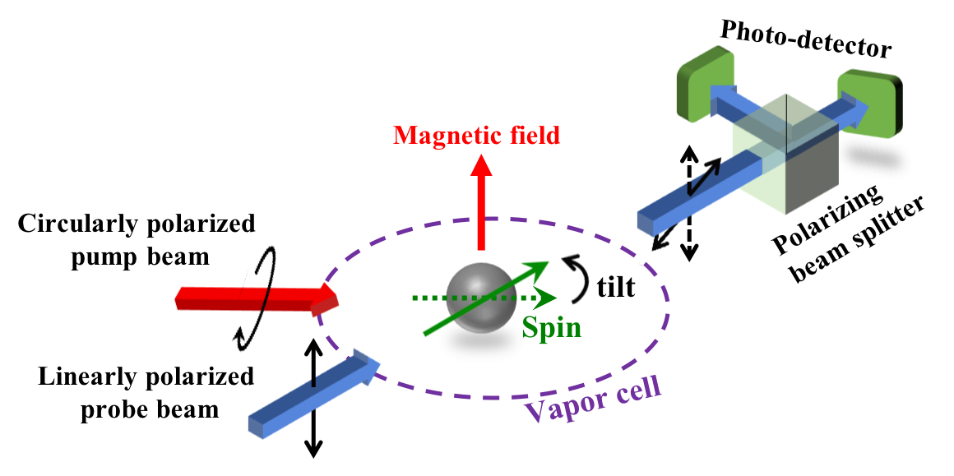
Atomic Magnetometer (AM)
Atomic Magnetometer (Quantum sensor):
  based on lasers and alkali-metal (Cs, Rb, K) vapor cells
  the most sensitive non-cryogenic magnetic-field sensor at femto-Tesla sensitivity
Principle of operation of AM:
  Pump beam initializes spins
  Weak external magnetic field tilts spins by a small angle
  The tilt is measured with a probe beam

Slide 4
Fundamental Magnetometer Sensitivity
Fundamental quantum limit (due to spin-fluctuation noise):
= gyromagnetic ratio of alkali atoms, n = density of alkali atoms
V = measurement cell volume, t = the measurement time
T₂ = transverse spin relaxation time
At low frequencies lower than kHz:
Fundamental limit: 0.005 fT/Hz^{1/2} in the cell volume of 0.3${ cm}^{3}$
Current best sensitivity: 0.16 fT/Hz^{1/2} at 40 Hz in the cell volume of 0.45${ cm}^{3}$
Dang, Maloof, Romalis, Applied Physics Letters 97, 152220 (2010)
At high frequencies larger than kHz:
Fundamental limit: 0.01 fT/Hz^{1/2} in the cell volume of 200${ cm}^{3}$
Savukov, Seltzer, Sauer, Romalis, Physical Review Letters 95, 063004 (2005)
Current best sensitivity: 0.24 fT/Hz^{1/2} at 423 kHz in the cell volume of 96${ cm}^{3}$
Lee, Sauer, Seltzer, Alem, Romalis, Applied Physics Letters 89, 214106 (2006)

Slide 5

Exotic interaction
LANL:
Exotic
interactions
LANL:
Oscillating magnetic field
Two internal
LANL LDRD projects:
Dark matter mass
eV
meV
$μ$eV
neV
peV
QCD Axion

Slide 6
Exotic interaction
New fundamental bosons mediate exotic interactions between SM particles:
Interaction range:
If m_{b} = μeV, λ = 2.5 mm (macroscopic interaction)
m_{b}
m_{b} c
15 possible exotic spin-dependent interactions:
Moddy, Wilczek, PRD 30, 130 (1984)
T-odd
T-even
P-,T-violation
P-violation
Static
Velocity-dependent
Examples:
Spin-0 boson exchange
Spin-1 boson exchange
No violation
T-violation
Two spins-dependent
Two spins & velocity-dependent
f : Coupling strength, r and $υ$: relative distance and velocity between interacting particles

Slide 7
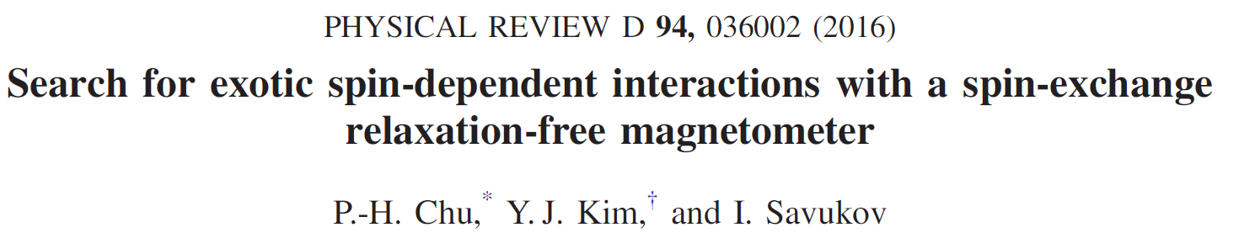
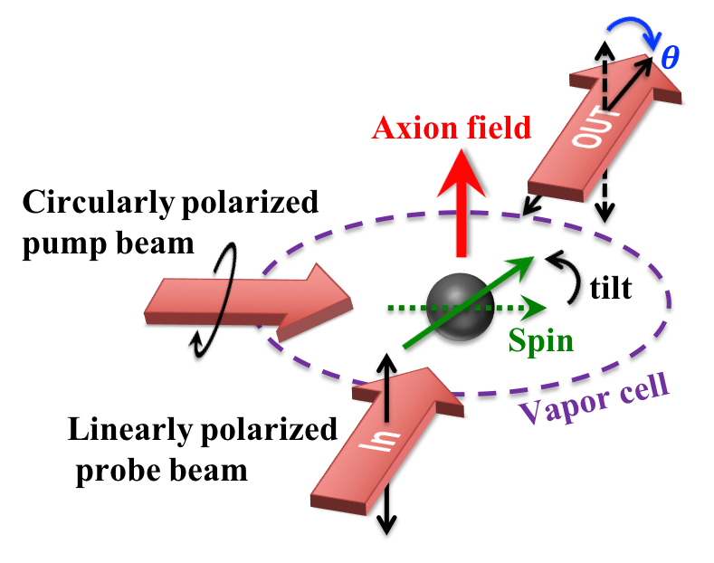

LANL approach
Effective magnetic field
Examples:
$$\vec{A}, \vec{B}$$
Unpolarized mass
Polarized mass
Advantages of our approach:
AM serves as both a source of electrons and a detector
Simple experimental design; Cryogenic-free experiments
Sensitive to all 15 spin-dependent interactions

Slide 8
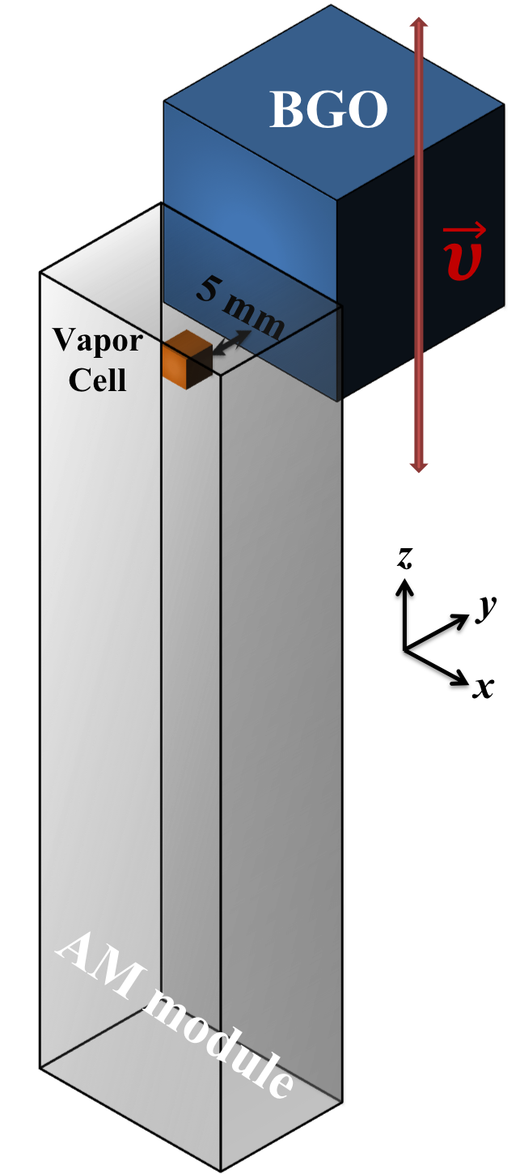
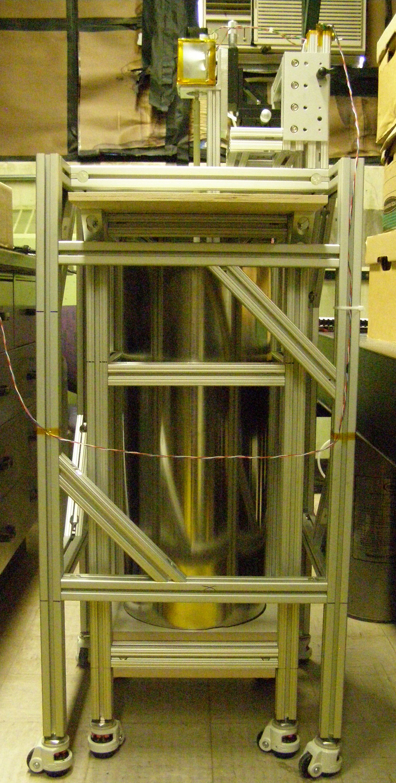
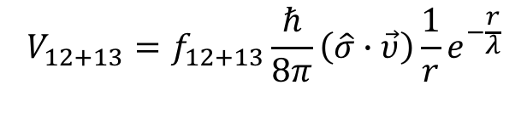


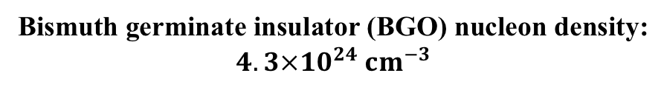


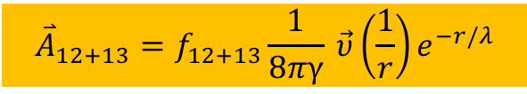
Spin- and velocity-dependent exotic interaction
$$+υ$$
$$V_{12+13}=f_{12+13}\frac{ℏ}{8π}\left(\hat{σ}∙\vec{υ}\right)\frac{1}{r}e^{−\frac{r}{λ}}$$
Parity-odd
Modulation
For unpolarized particles:
Bismuth germinate insulator (BGO) nucleon density:
$$4.3×{10}^{24} {cm}^{−3}$$
$${\overset{⃑}{A}}_{12+13 }$$
$$−υ$$
$V_{12+13}=γℏ\hat{σ}∙{\overset{⃑}{A}}_{12+13} = ∆E$
69 cm
20 fT/Hz^{1/2}
QuSpin AM
$${\overset{⃑}{A}}_{12+13}=f_{12+13}\frac{1}{8πγ} \vec{υ}\left(\frac{1}{r}\right)e^{−r/λ}$$
29 cm

Slide 9
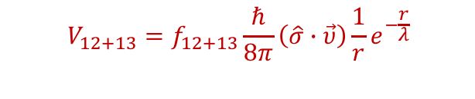

Constraining the coupling strength f₄₊₅ and f₁₂₊₁₃
$$V_{12+13}=f_{12+13}\frac{ℏ}{8π}\left(\hat{σ}∙\vec{υ}\right)\frac{1}{r}e^{−\frac{r}{λ}}$$
$$V_{4+5}={−f}_{4+5}\frac{ℏ^{2}}{8πm_{e}c}[\hat{σ}∙\left(\vec{υ}×\hat{r}\right)]\left(\frac{1}{λr}+\frac{1}{r^{2}}\right)e^{−\frac{r}{λ}}$$
m_{b} (eV)
m_{b} (eV)
LANL
Kim, Chu, Savukov, Newman, Nature Comm. 10, 2245 (2019)
Kim, Chu, Savukov, PRL 121, 091802 (2018)

Slide 10
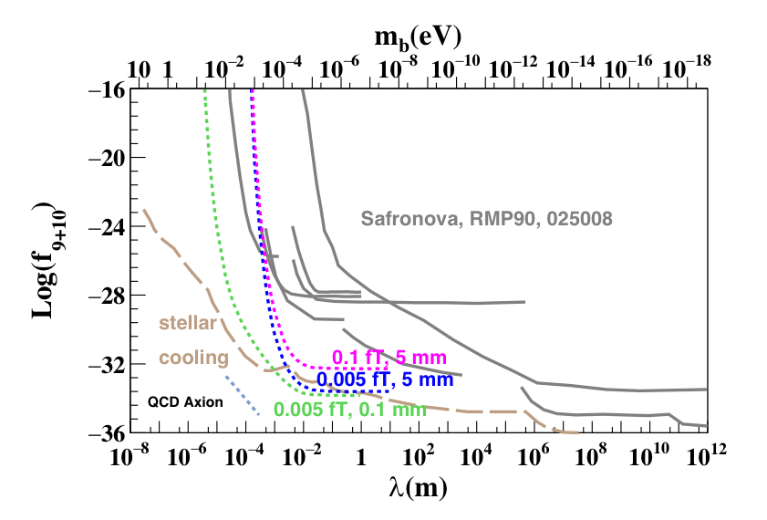

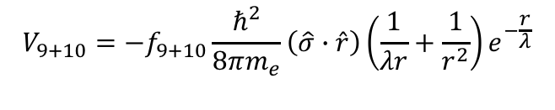
Sensitivity to QCD axion
$$V_{9+10}=−f_{9+10}\frac{ℏ^{2}}{8πm_{e}}\left(\hat{σ}∙\hat{r}\right)\left(\frac{1}{λr}+\frac{1}{r^{2}}\right)e^{−\frac{r}{λ}}$$
$${f_{9+10}=g}_{P}^{e}g_{S}^{N}$$
Axion exchange
P-,T-violation
Unpolarized nucleon
Projected LANL sensitivity
Further improvement:
AM sensitivity enhancement
Smaller stand-off distance between electrons and nucleons
Current experimental limits

Slide 11
Axion-induced oscillating magnetic field
LANL:
Oscillating magnetic field
Two internal
LANL LDRD projects:
LANL:
Exotic
interactions
Dark matter mass
eV
meV
$μ$eV
neV
peV
QCD Axion

Slide 12
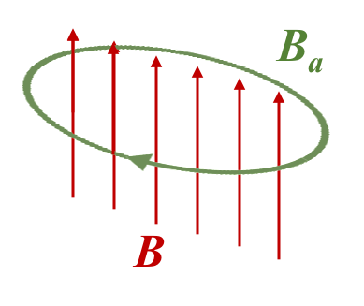
Axion-induced oscillating magnetic field
Axion dark matter oscillates at a frequency of the axion mass
Modified Maxwell equation:
Axion-induced oscillating field
Axion-photon coupling
Static field
at a frequency of m_{a}

Slide 13
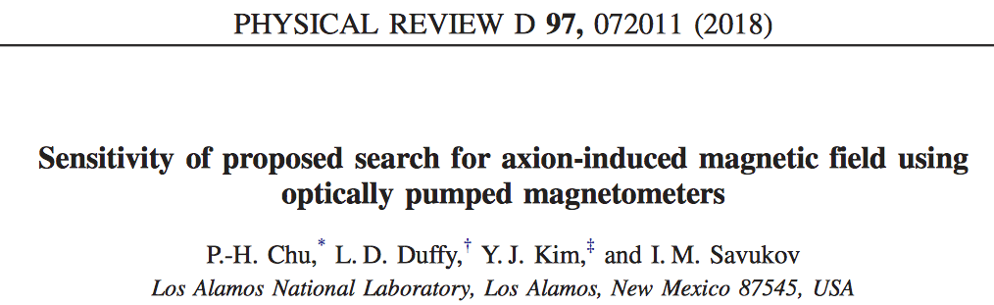
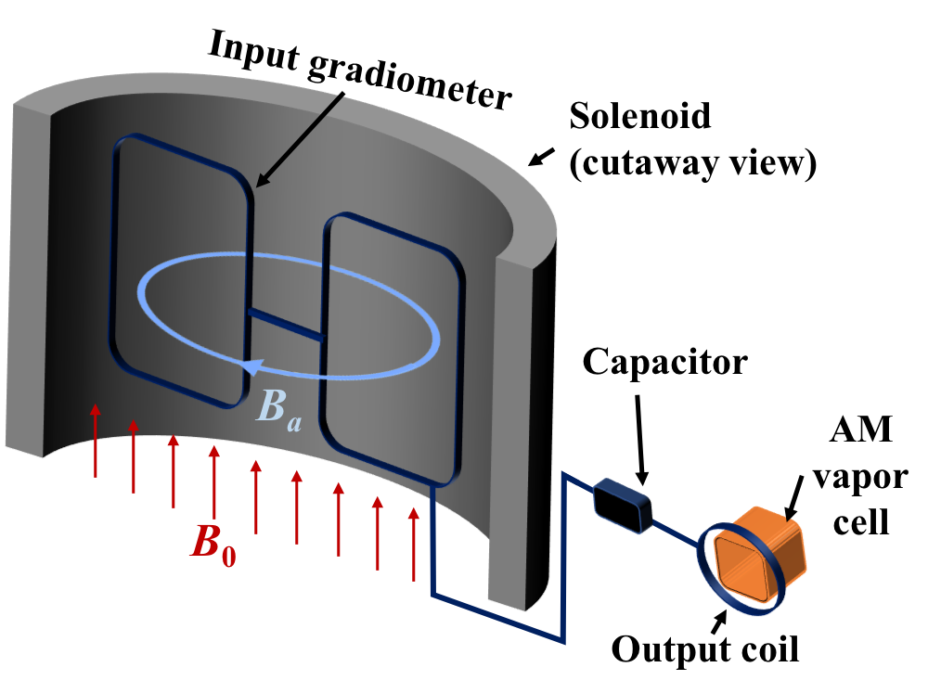
LANL approach: LC circuit + AM
Prototype development
LANL approach is based on an LC circuit and an atomic magnetometer
Axion-induced oscillating magnetic field is amplified by the LC circuit.
AM sensitively detects the amplified signal from the output coil.
LC circuit + sensitive magnetometer:
Sikivie, Sullivan and Tanner, PRL 112, 131301 (2014)
LC = inductor-capacitor

Slide 14
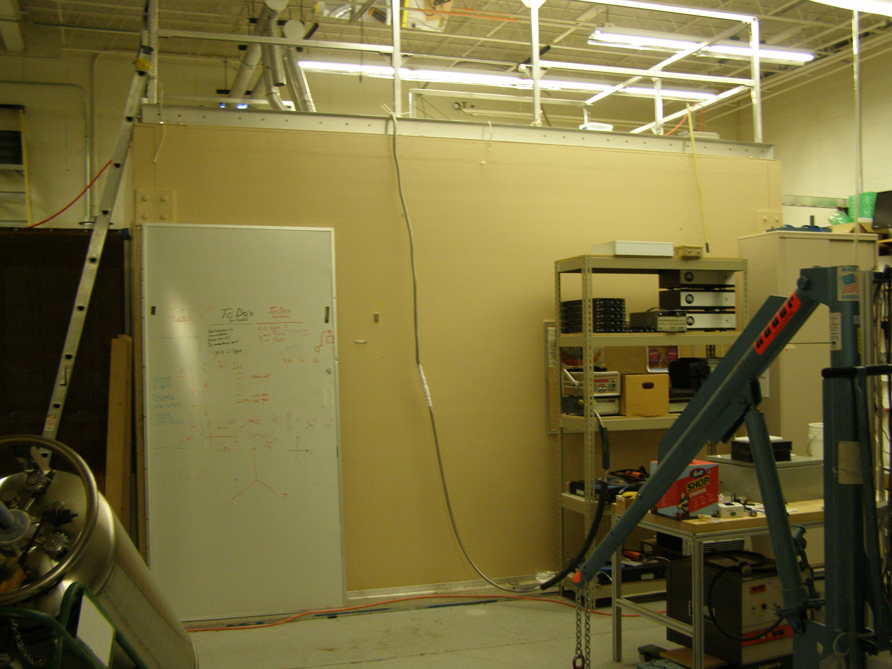
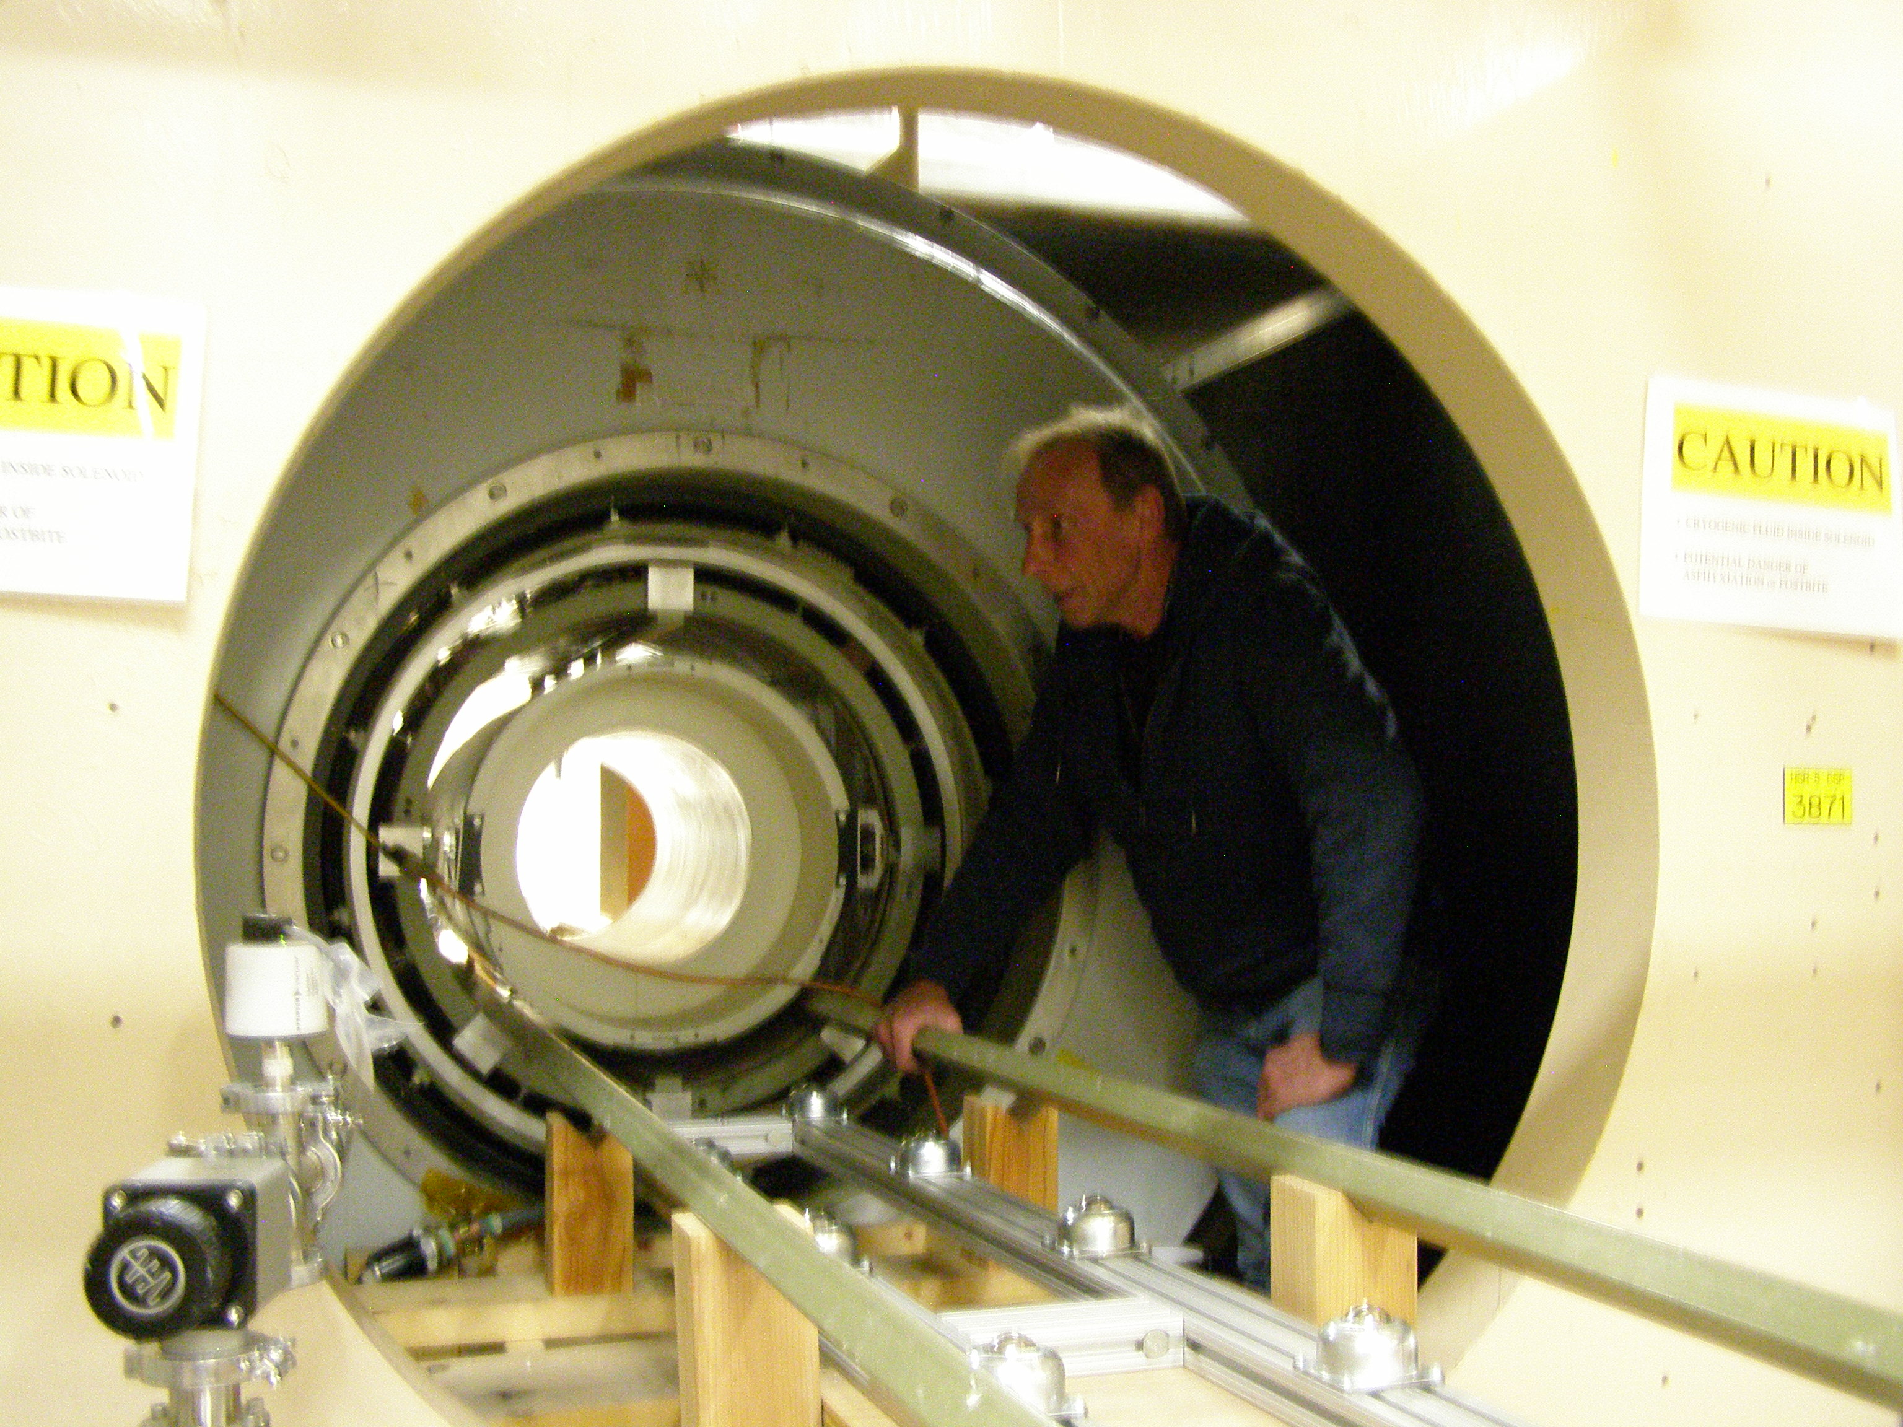
LANL large 2 T magnet
Superconducting solenoid coil
External magnetic shielding
Gradient & shimming coils
Will be removed
Technician: Al Urbaitis
Magnet
Magnet bore (1 m D & 3 m L)

Slide 15
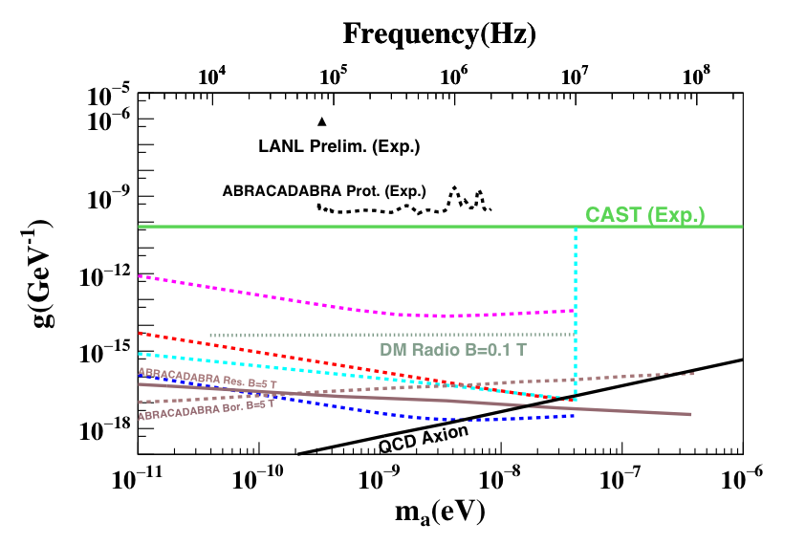
Projected LANL sensitivity
LANL sensitivity is limited by the magnetic Johnson noise of the LC circuit at room temperature.
Further improvement:
  Cooling the LC circuit to 77 K or 4 K
  Improving the AM sensitivity to the quantum limit on the order of 0.01 fT/Hz^{1/2}
LANL 300K, 1 fT
LANL 77K, 0.01 fT
Sikivie
LANL 4 K, 0.01 fT
Possible to reach QCD axion

Slide 16
Summary
High-sensitivity atomic magnetometers can be used for dark matter and fundamental physics searches.
LANL experiments are relatively small projects at lower cost, mainly due to the use of room-temperature atomic magnetometers.
LANL experiments can explore light dark matter particles between peV and meV.
AM sensitivity enhancement to the fundamental limit is required.
LANL has world leading expertise in development of atomic magnetometers and unique facilities such as a large 2 T superconducting magnet and three large magnetically shielded rooms.

Slide 17
Thank you !

