Slide 1

The Cross-Cut Group
Preliminary Assessment
Marcel Demarteau (ORNL)
Jim Fast (PNNL)
Peter Fisher (MIT)
Young-Kee Kim (Chicago)
Sunil Golwala (Caltech)
Abe Seiden (UCSC)
CPAD Meeting
Madison, WI
December 9, 2019

Slide 2
Audience for the Report
A primary audience for the BRN report is policy makers, which frames the front-end language and ambition of the report, the OHEP program managers and the community.
The goal is to make a compelling argument to increase the funding for detector development for particle physics articulated in a way that appeals to policy makers and is aligned with current policy of OSTP
The P5 report provided a 10-year program with a 20-year vision and has been very successful with policy makers; we expect the P5 update to be equally successful. The P5 science drivers provide the long-term scientific motivation and the PRDs should build on these science drivers.
The PRD should be ambitious and forward looking. The current set of projects that are at CD-1 or beyond should not be part of the PRDs. If there still is important R&D to be carried out, that simply has to be successfully completed to deliver the approved projects.

Slide 3
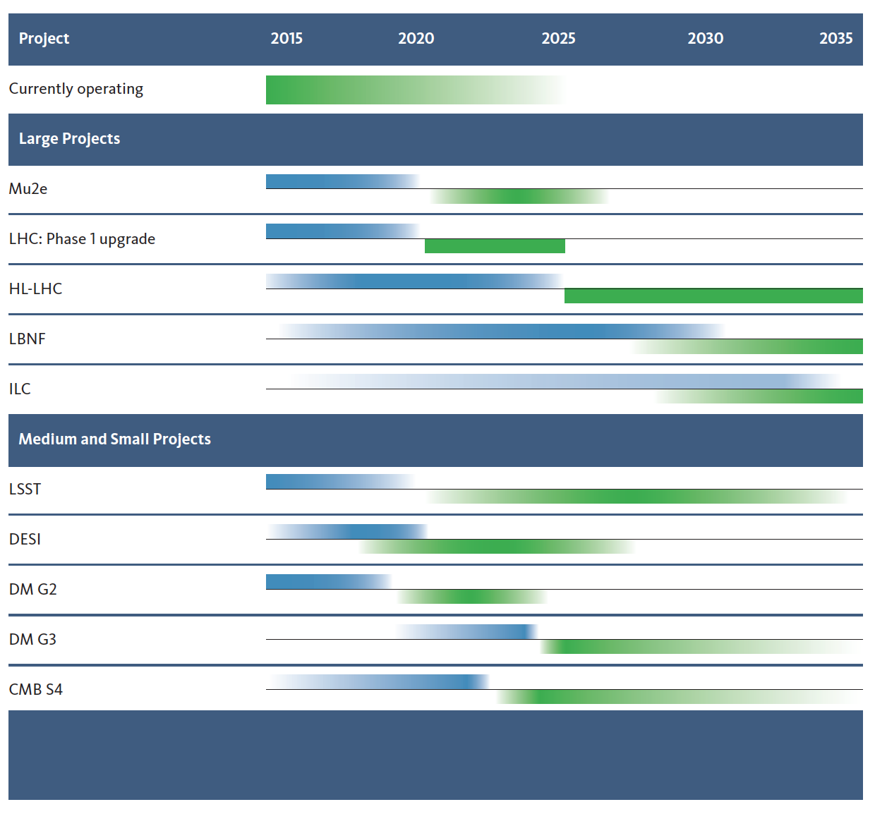
High-Priority Projects
P5 supported directed R&D for the near future.
Directed R&D has targeted current set of approved experiments:
  The Phase-II upgrades of the LHC,
  DUNE, module 1
  G2 dark matter experiments,
  CMB-S4
Continued investments in these projects are expected, but the goal of the BRN is to expand the program with more forward leaning efforts.
A long-term view should be taken for the PRDs
Today

Slide 4
The Priority Research Directions
The cross-cut group has distilled from the 3- and 6-pagers a total of about 120 PRDs

Slide 5
The Priority Research Directions

Slide 6
The Priority Research Directions

Slide 7
Key Challenges
It is suggested to have 3 to 5 key instrumentation challenges that can be captured in catchy statements.
The key challenges are the ambitions of the field that cross-cut technologies
Template key challenges:
  Breaking the picosecond time barrier
  Quantum-enhanced photoproduction and photodetection over the full frequency spectrum
  Sub-eV and below the standard quantum limit detectors
  5D Calorimetry over five orders of dynamic range
  The ultimate undetectable charged particle tracker
  Advanced semi-conductor detectors and devices
  Quantum enhanced …

Slide 8
The Flow
Key Challenge
Priority Research Direction
Requirement
Physics Objective
Science Impact
Many areas are very thin on requirements, or are absent all together. We need help!
The “flow” we are looking for is:

Slide 9
The Flow
Key Challenge
Priority Research Direction
Requirement
Physics Objective
Science Impact
Key Challenge
Priority Research Direction
Requirement
Physics Objective
Science Impact
Many areas are very thin on requirements, or are absent all together. We need help!
The “flow” we are looking for is:

Slide 10
The Flow
Key Challenge
Priority Research Direction
Requirement
Physics Objective
Science Impact
Key Challenge
Priority Research Direction
Requirement
Physics Objective
Science Impact
Many areas are very thin on requirements, or are absent all together. We need help!
The “flow” we are looking for is:
Key Challenge
Priority Research Direction
Requirement
Physics Objective
Science Impact

Slide 11
The Flow
Breaking the Picosecond Time Barrier
Calorimetry and Tracking
5ps per hit timing resolution
Event disambiguation
Higgs (self)-Couplings
(5%) 1%
Many areas are very thin on requirements, or are absent all together. We need help!
Example “flow”:

Slide 12
The Flow
Enhanced Photodetectors
Water-based Liquid Scintillators
Cherenkov and Scintillation light requirement ?
Better Particle Identification, background rejection ?
Accelerated Measurement of MO?
Many areas are very thin on requirements, or are absent all together. We need help!
Example “flow”:

Slide 13
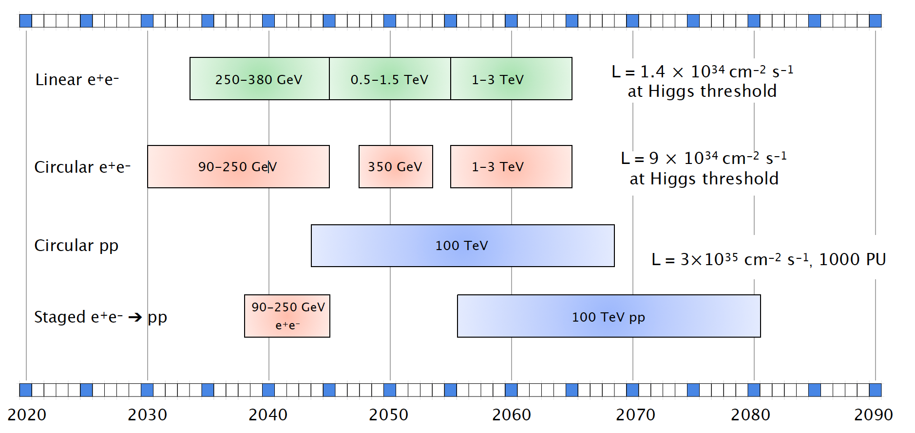
The Priority Research Directions
Each technology group is asked to identify 3 to 5 Priority Research Directions with a quantified physics motivation for each PRD.
We believe that the timelines identifying the technology challenges will be very helpful to identify the PRDs and help identify the cross-cut PRDs
Higgs timeline is a great start, but technology challenges should be added.

Slide 14
Example from Exploring the Unknown: Flavour Physics
ATLAS, CMS Phase II+ Upgrade (new inner tracking layers))
LHCb Upgrade Phase II
LHCb Upgrade Phase Ib
Belle II
LHCb accumulates 300fb-1
LHCb Upgrade Phase Ia
2020
2025
2030
2035
2040
Tracking with high granularity and good time resolution
Calorimetry with high granularity and timing
Real Time Processing of large amount of data
Readout
PhotoDetectors
Quantum Sensors
Noble Liquids
Calorimetry
SS and Tracking
TDAQ

Slide 15
Sample Priority Research Directions for Discussion and Framing
Enhanced photo-production and photo-detection.
PRDs
    Higher QE VUV sensitive detectors --- Neutrinos, Dark Matter,
    Water-based Liquid Scintillators --- Neutrinos
    Novel scintillator materials --- Neutrinos, Energy Frontier, Dark Matter
    Superconducting single-photon nanowires --- Dark Matter, QIS, ….
    ….
    PRDs could be quantitative and indicate what science regime is made accessible.

Slide 16
Sample Priority Research Directions for Discussion and Framing
Advanced semi-conductor devices and detectors
PRDs
    IR sensitive Ge CCD development -- Cosmic frontier
    Double the size of the observable universe
    12” rad hard Si technology for 5D imaging calorimetry -- Energy frontier
    Thinned MAPS technology with 5micron pixel size, 1μW/pixel -- Energy frontier
    28nm ASIC technology with integrated wireless transmission -- Intensity, Energy frontier
    Cryogenic pixelated LAr readout with aA sensitivity, …. -- neutrinos,
    …
    The development of the ASIC technology is becoming more and more expensive. Careful thought needs to be given to university-lab balance and workforce development.
    Need to develop contacts with foundries. Link to the Micro-electronics BRN needs to be established.

Slide 17
Sample Priority Research Directions for Discussion and Framing
The PRDs should be a balance between transformative and incremental R&D, but in either case be ambitious
Many other areas to be considered
  AI and ML: receives a lot of support within the Office of Science. Including this as a PRD is expected to be well received. However, there are other venues for support.
  Advanced manufacturing: additive and subtractive manufacturing techniques that work at the nanoscale level for functionalized materials.
  A critically important issue is also the workforce development, which will have to be addressed in the report.

Slide 18
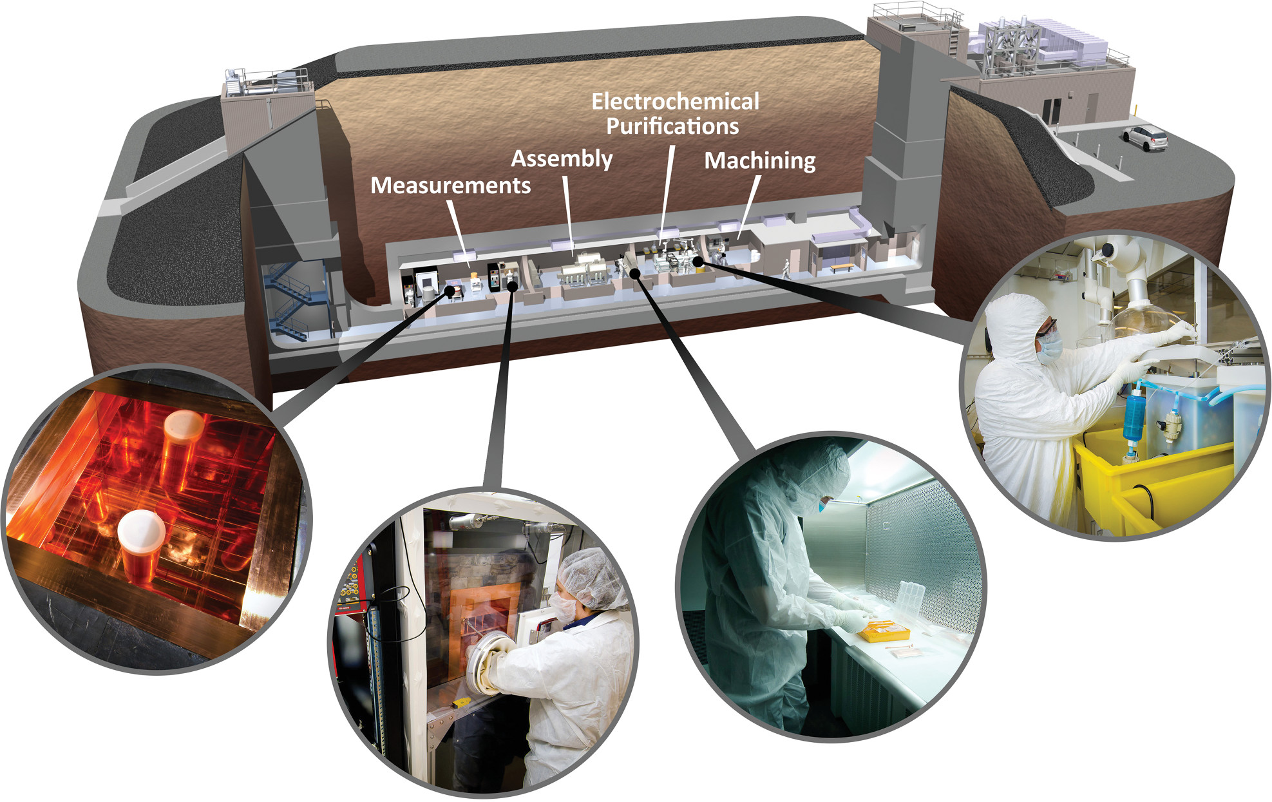
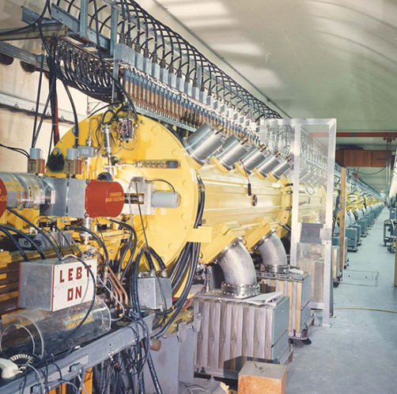
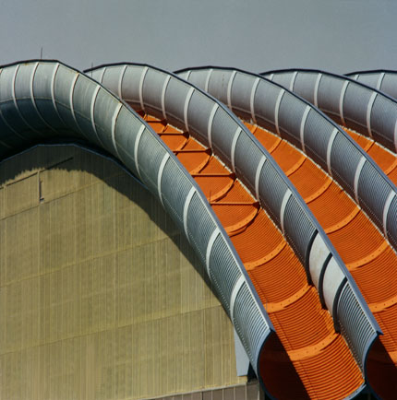
Facilities Support
To deliver on the priority research directions, a key element is the availability of test facilities to support the instrumentation development, which will not be listed as a PRD
Low Background Facility
Test Beams
Irradiation Facilities
Characterization Platforms
  Provides support for low-background experiments in the areas of materials and assay
Critical need for low-background experiments
  Provides high-quality beams and data taking infrastructure to develop and characterize new detector technologies
  Critical need to explore new technologies
Provides facilities to validate radiation resistance to extremely high fluences
Essential for Energy and Intensity Frontier experiments
Provides platforms for determining fundamental physics of materials
Vital for determining proof of principle and long-term viability of proposed materials and environments

Slide 19
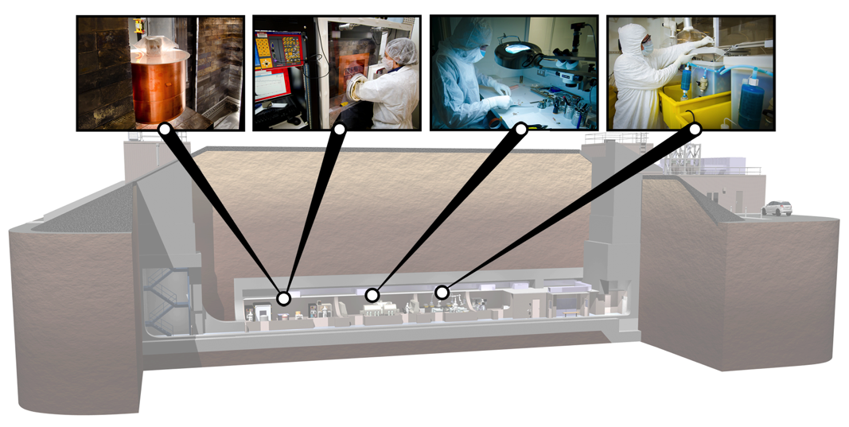
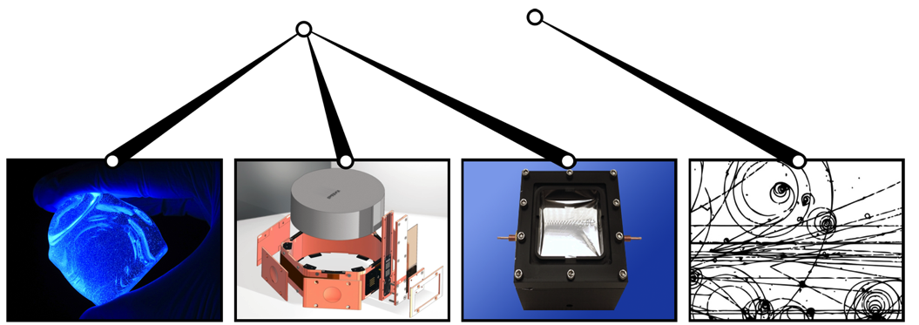
Facilities Support: Low Background Facility
PNNL’s Shallow Underground Laboratory provides support sought by dark matter experimental collaborations for experience and expertise depth in:
  Materials and assay
  Low background design and construction
  Novel radiation detector developments to reduce backgrounds
  Unique facilities and resources for low background development
High-Purity Germanium
Detector Arrays
Ultra-Low-Background
Proportional Counters
Ultra-Low-Background
Detector Assembly
Electrochemical
Purifications
Ultra-Low-Background
Liquid Scintillation Counting
Ultra-Low-Background
HPGe Well Detector for
Small Samples
Ultra-Low-Background
Beta Spectrometer for Solid Samples
Prototype Next-Gen Detector Technology for Dark Matter

Slide 20
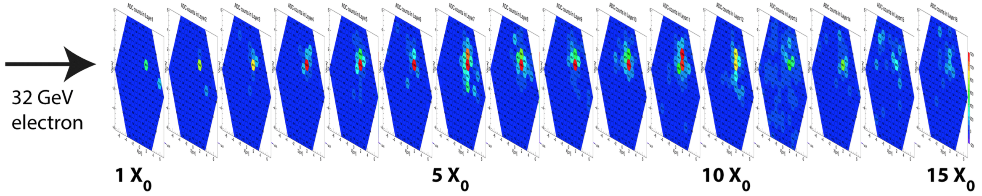
Facilities Support: Test Beams
Fermilab Test Beam has serviced large user community with critical support for high-priority projects
  R&D directed toward the HL-LHC upgrade of CMS
    High-grained calorimeter; Low Gain Avalanche Diode (LGAD) sensors; rad-hard ASIC tests; tile scintillator R&D, …
Experiment Beam | weeks
Collider (LHC) | 35
Collider (Non-LHC) | 11
General R&D | 2
Muon | 2
Outreach/Facility | 1
Neutrino | 4
Total | 55
ν
LHC
Cosmic Ray Veto Test (Mu2e)

Slide 21
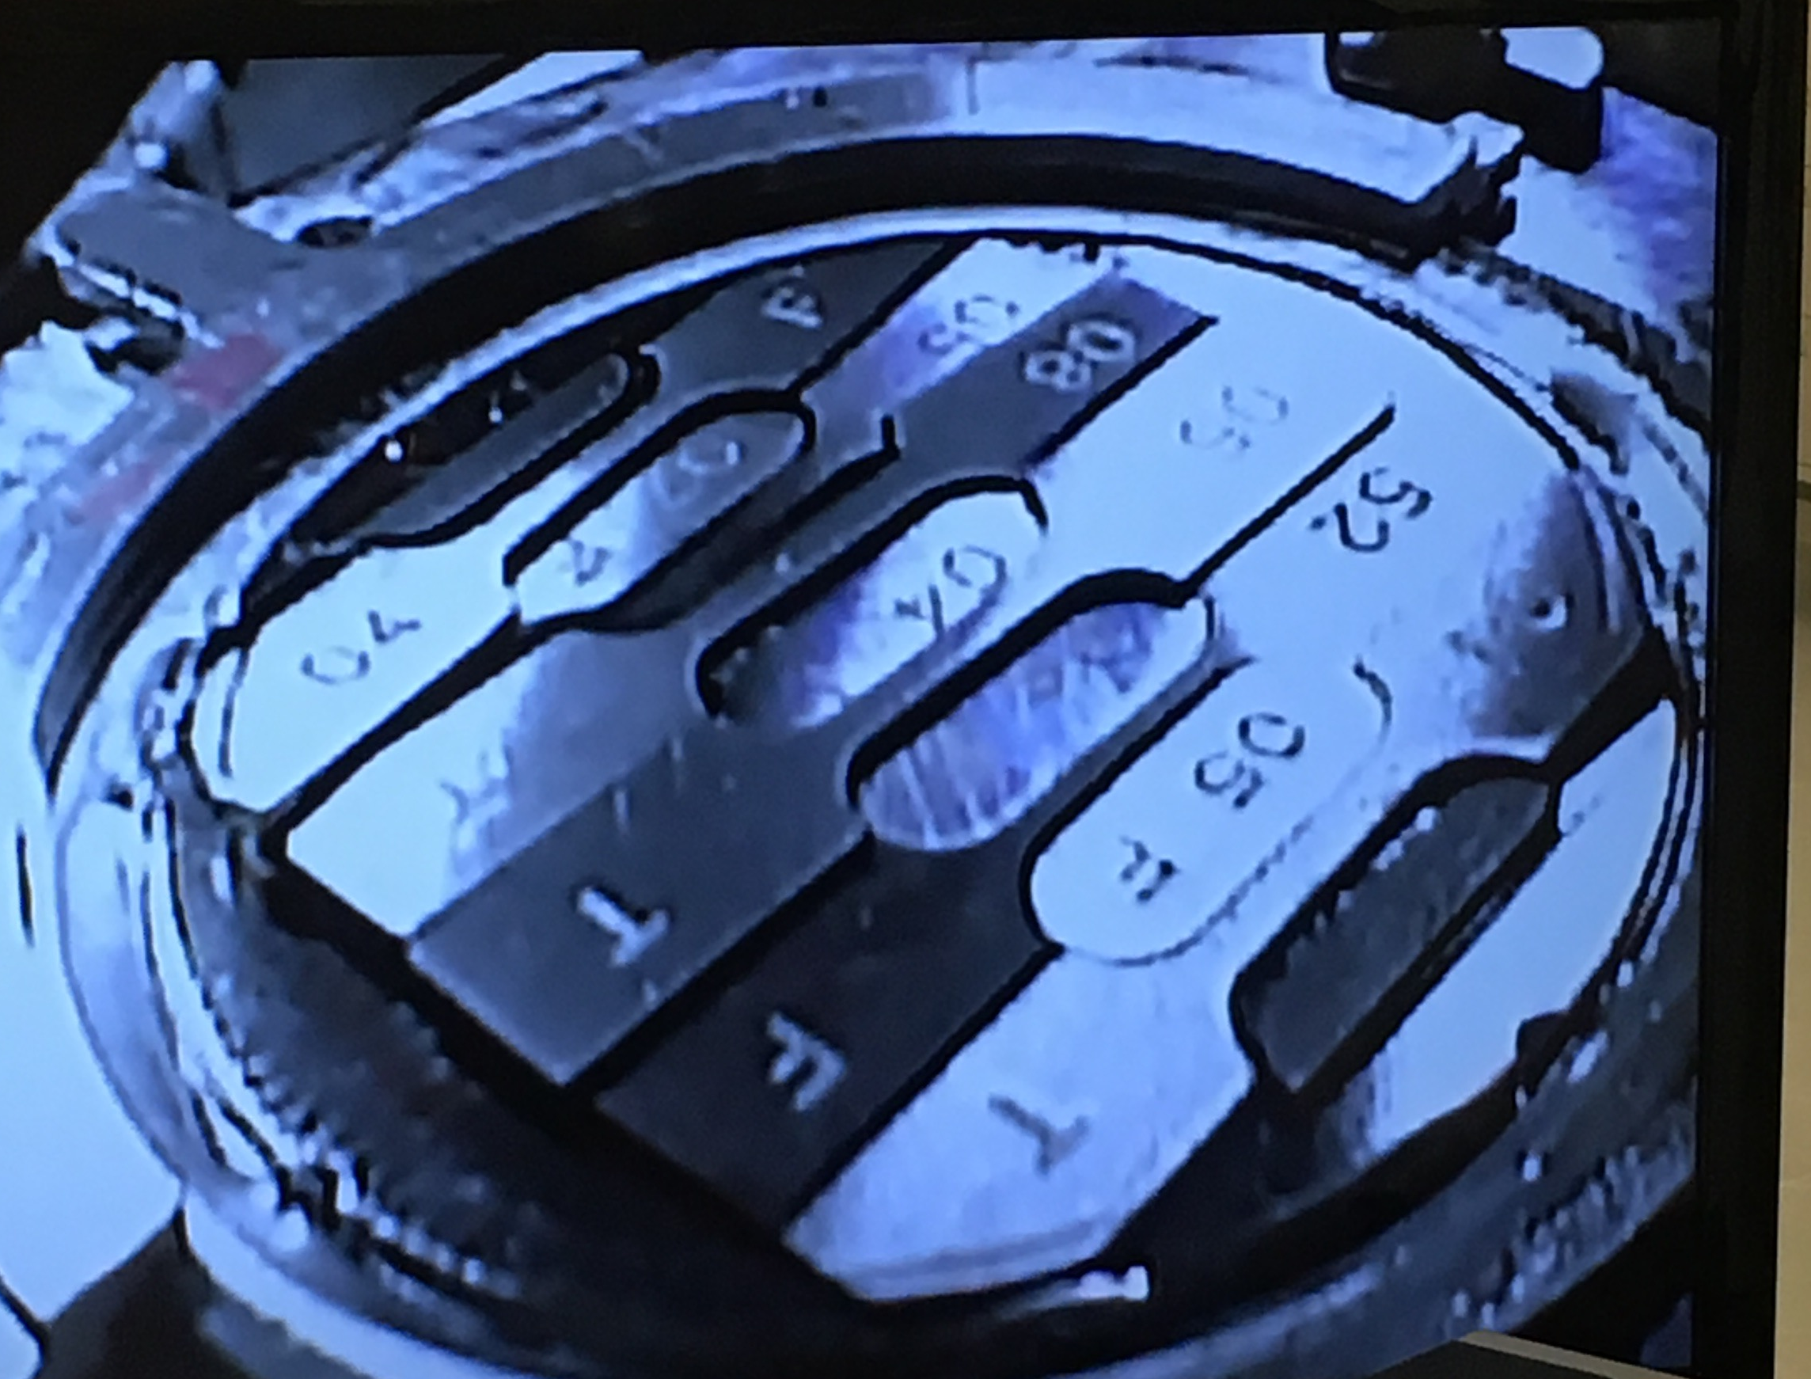
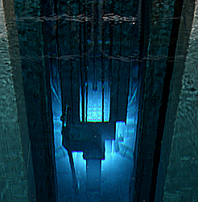
Facilities Support: Irradiation Facilities
Tensile testing of Ti alloys at PNNL for targetry
Brookhaven Linear Isotope Producer
  Material irradiation by 181 MeV p (~130 μA) at BNL BLIP facility for targetry
  In-beam thermal shock test at CERN HiRadMat facility, Tensile tests at PNNL
Los Alamos Neutron Science Center
  Proton beams of 800 MeV with ~10¹¹ p/cm²/s
Neutron irradiation at the Rhode Island Nuclear Science Center
  Maximum neutron flux of 3 10¹² n/cm²s at core end; 6” and 8” ports available
NASA Space Radiation Laboratory (BNL)
  ~1000 beam hours/year of protons to Au (up to 2.5 GeV/n)
  2.5 GeV protons at ~2.2 x 10¹¹ cm⁻²
Fermilab Irradiation Test Area only now being constructed
Rhode Island Nuclear Science Center for Si irradiation for HL-LHC
ν
LHC

Slide 22
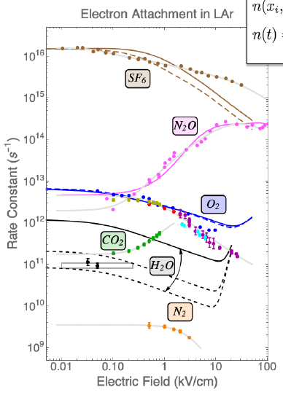
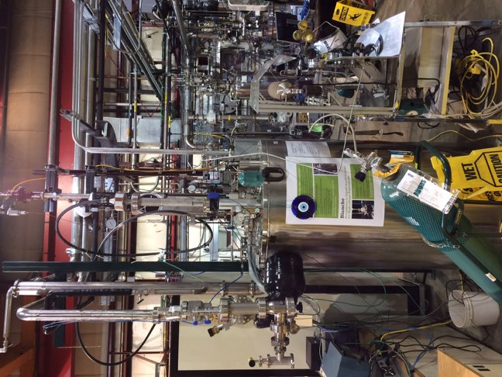
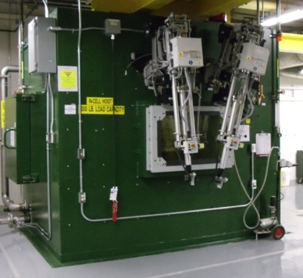
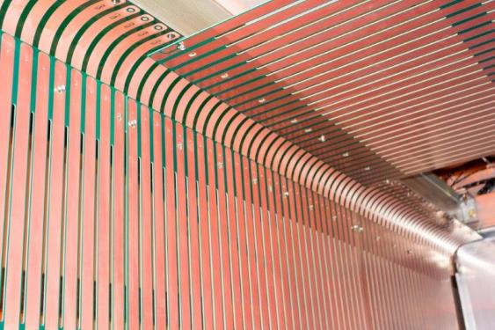
Facilities Support: Characterization Platforms
Noble Liquid
Platform
Calibration
Platform
Irradiation Evaluation Platform
Fundamental Properties
Platform
  System test of components of noble liquid detectors under operating conditions
  Calibration platform for various systems, such as liquid Argon field cage system to measure TPC field response
Evaluate radiation resistance of materials exposed to extremely high fluences for targetry
Platform for measurement of fundamental physics properties

Slide 23

Comments?

