Slide 1
Laboratory Neutrino Physics Experiments Enabled with High-Resolution and Low-Threshold TES Detection Technologies
NLDBD – a test of Majorana vs. Dirac nature of neutrinos
Major challenge is background rejection, which requires multiple signals for event reconstruction
For bolometric techniques, requires detecting thermal signal and at least one other signal (e.g. Cherenkov or scintillation light)
Secondary signal is faint, which requires low threshold detector technology
Neutrino capture with Tritium (cosmologically motivated, but challenging)
Direct measurements of cosmic neutrino background, CvB capture rate depends on whether neutrino is Majorana or Dirac
Capable of detecting keV sterile neutrinos in “Beta Decay mode”
Requires low threshold high resolution measurements at the endpoint and for the spectrum
CEvNS
Search for light sterile neutrinos
Recoil events are at low energy
Implement TES as high sensitivity thermistors coupled to target mass arrays
Measurement of a neutrino magnetic moment
Measuring 𝝻_{𝝼} < 3 ×10⁻¹²𝝻_{B} (cosmology ROI) for new physics beyond SM
Semiconductor ionization detector with a large thermal gain and TES readout
Argonne has developed a Ir/Pt bilayer TES with Tc tunable between 10 mK and 200 mK

Slide 2
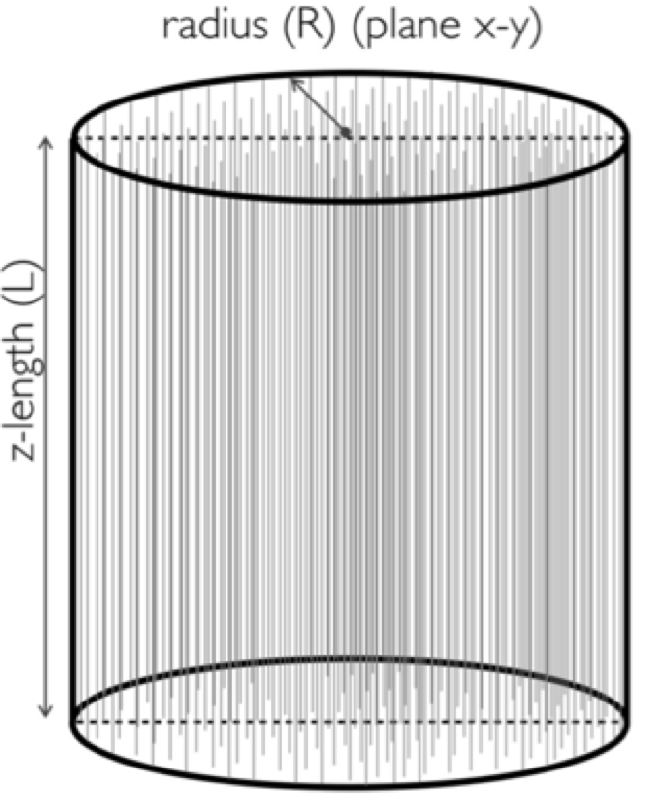
LiquidO: A new approach
Liquid Scintillator (LS) detectors have been a workhorse in neutrino physics
Conventional strategy: propagate light through the scintillator to surrounding photosensors
A new proposal called LiquidO is a departure with two main features:
1) Use an opaque scintillator
Main purpose: stochastically confine light near its creation point, to preserve the precious topological information of particle interactions
Archetypical LiquidO detector
2) Collect light with a dense fiber array
Unprecedented capabilities:
Imaging down to the MeV scale
Affinity for doping well beyond current limits
Potential application in many areas of neutrino physics
(Gamma and Electron are 2 MeV, positron is 1 MeV)

Slide 3
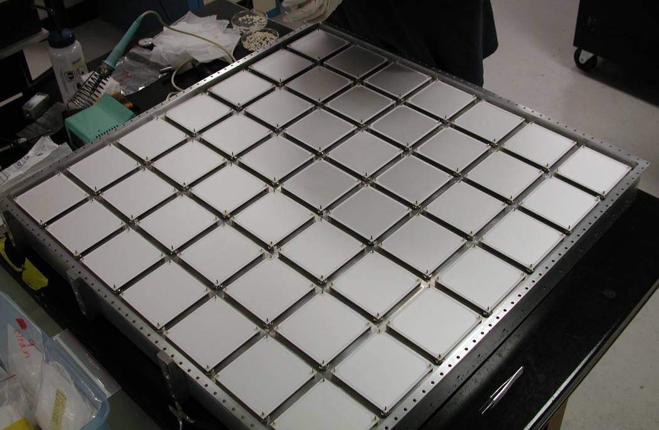
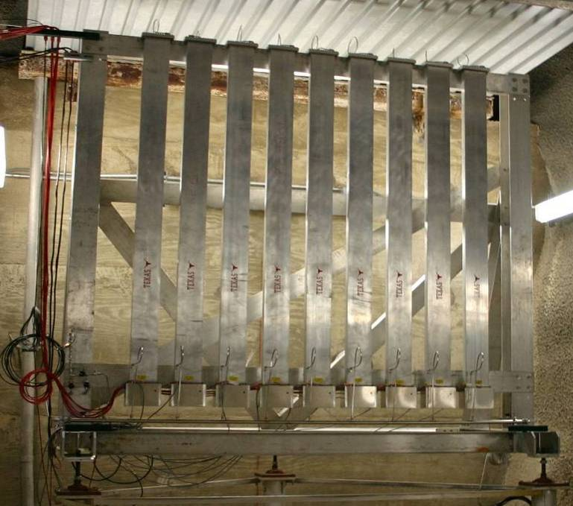
Radiation Hard Beam Monitor and Muon Spectroscopy by using Machine Learning
NuMI Target system
Hadron monitor
(0.8x0.8 m², 7x7 pixels)
Thermocouple detector
(3+3 Be wires)
Beam monitor signal is evaluated by ML to control the beam related systematic uncertainty
Muon monitor
(2x2 m², 9x9 pixels)

