Slide 1
New Flow: key challenge, PRD, requirement, physics objective, Science impact
Key challenge: detection of structure of matter in the universe: denser, fainter, across cosmic time
Science impact: discover/constrain the nature of DM, DE/Inflation
Optical IR Spectroscopy
New detectors (Ge, Skipper, etc)
Fiber positioners
21 cm IM: 1000’s of telescope, timing, data rates
mm wave IM, CMB: Millions of detectors and readout : mKIDs, highly multiplexed RD

Slide 2
P5 Science Drivers
• Use the Higgs boson as a new tool for discovery
• Pursue the physics associated with neutrino mass
• Identify the new physics of dark matter
• Understand cosmic acceleration: dark energy and inflation
• Explore the unknown: new particles, interactions, and physical principles.

Slide 3
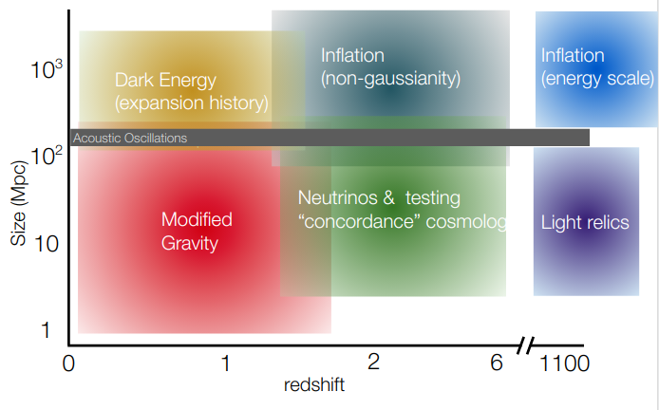
Key cosmological science drivers as a function of redshift and the scale of clustering

Slide 4
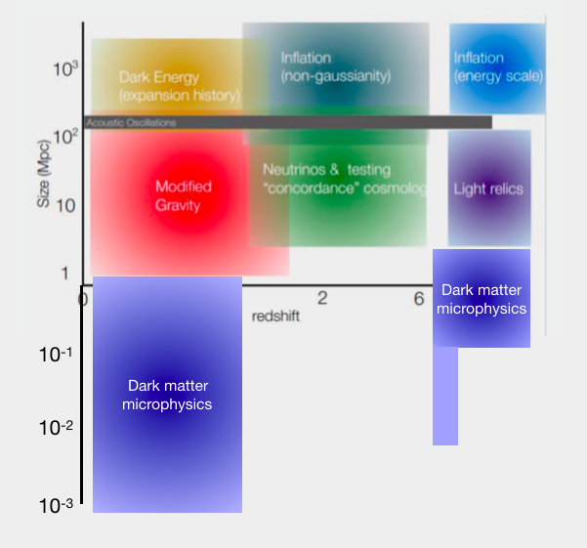
Include Astrophysical probes of DM in DE/Inflation subgroup?
dwarf galaxies ~1 kpc are ~100 pc scales for stellar streams, and strong lensing. Dwarfs and streams are at redshift zero, while strong lensing probably goes out to redshift 1.
Galaxy cluster probe dark matter microphysics too, and are at scales of ~1Mpc out to at least redshift z = 1
Technology: Massive Spec. Survey with Skipper CCDs for faint low S/N objects
CMB probes at similar scales from CMB-HD which could probe scales of k ~ 10 Mpc^-1 (https://arxiv.org/pdf/1906.10134.pdf)
21 cm recent paper probing scales of k ~ 10 Mpc^-1 to 100 Mpc^-1 at redshifts of z = 12 - 25.
(https://arxiv.org/abs/1911.11144)
Alex Drlica-Wagner

Slide 5
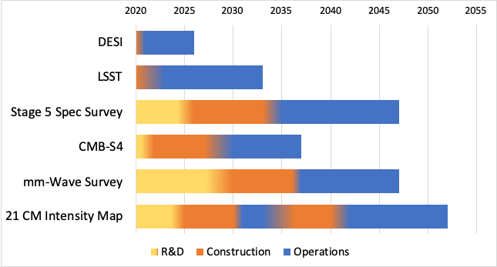
DE and Inflation Draft Timeline
Stage 5 Spec. Survey :
Technology Milestone
2025: Ge CCDs and 5mm pitch fiber positioners
Science Milestones
2026: DESI Survey complete, demonstrated power of spec survey
2033: LSST complete- target list complete
21 cm Intensity Mapping
Technology+Science Milestones
2025: Demonstration of 21cm IM at z: 1-2, build PUMA-5k
2033: Demonstration of PUMA-5k, start building PUMA-32K
mm-Wave Surveys: Intensity Mapping/CMB-HD
Technology MS
2022: Detector and readout high density and uniformity demonstration by CMB-S4
2023: Install prototype IM Focal Plane on existing telescope
Science MS
2026 Demonstrated cosmology impact of mm IM, SO, SPT-3G

