Slide 1
Physics Graduate Student Council
(PGSC)
pgsc.physics.wisc.edu
Susan Sorensen - President
sorensen3@wisc.edu

Slide 2
PGSC: Constructed & Run by Physics Grad Students
Our mission: to improve the well-being and success of graduate students in the department. Specifically:
Facilitate communication with the department and advocate on behalf of the graduate students,
Assist the department in welcoming new students and recruiting prospective students,
Promote social cohesion among graduate students, and
Provide resources to help prepare students for post-graduate careers.
PGSC formed in June/July 2018 following explicit approval (via petition signatures) of PGSC’s proposed mission, structure, and constitution by the graduate student body.

Slide 3
Physics Graduate Student Council Organizational Chart
President
Susan Sorensen
Vice President
Kayla Leonard
All officers can be found on our website: pgsc.physics.wisc.edu
Committee Chairs
Recruit & Welcome
Megan Tabbutt
Professional Development
Rob Morgan
Peer Mentoring
Brent Mode
Social Activities
Trevor Oxholm & Urvashi Gupta
Advocacy Team
1st Year Rep
[Nominations open now]
2nd/3rd Year Rep
Ben Harpt
4th/5th+ Year Rep
Leslie Taylor
International Rep:
Leah Tom

Slide 4
Physics Graduate Student Council Organizational Chart
President
Susan Sorensen
Vice President
Kayla Leonard
New position this year!
Committee Chairs
Recruit & Welcome
Megan Tabbutt
Professional Development
Rob Morgan
Peer Mentoring
Brent Mode
Social Activities
Trevor Oxholm & Urvashi Gupta
Advocacy Team
1st Year Rep
[Nominations open now]
2nd/3rd Year Rep
Ben Harpt
4th/5th+ Year Rep
Leslie Taylor
International Rep:
Leah Tom

Slide 5
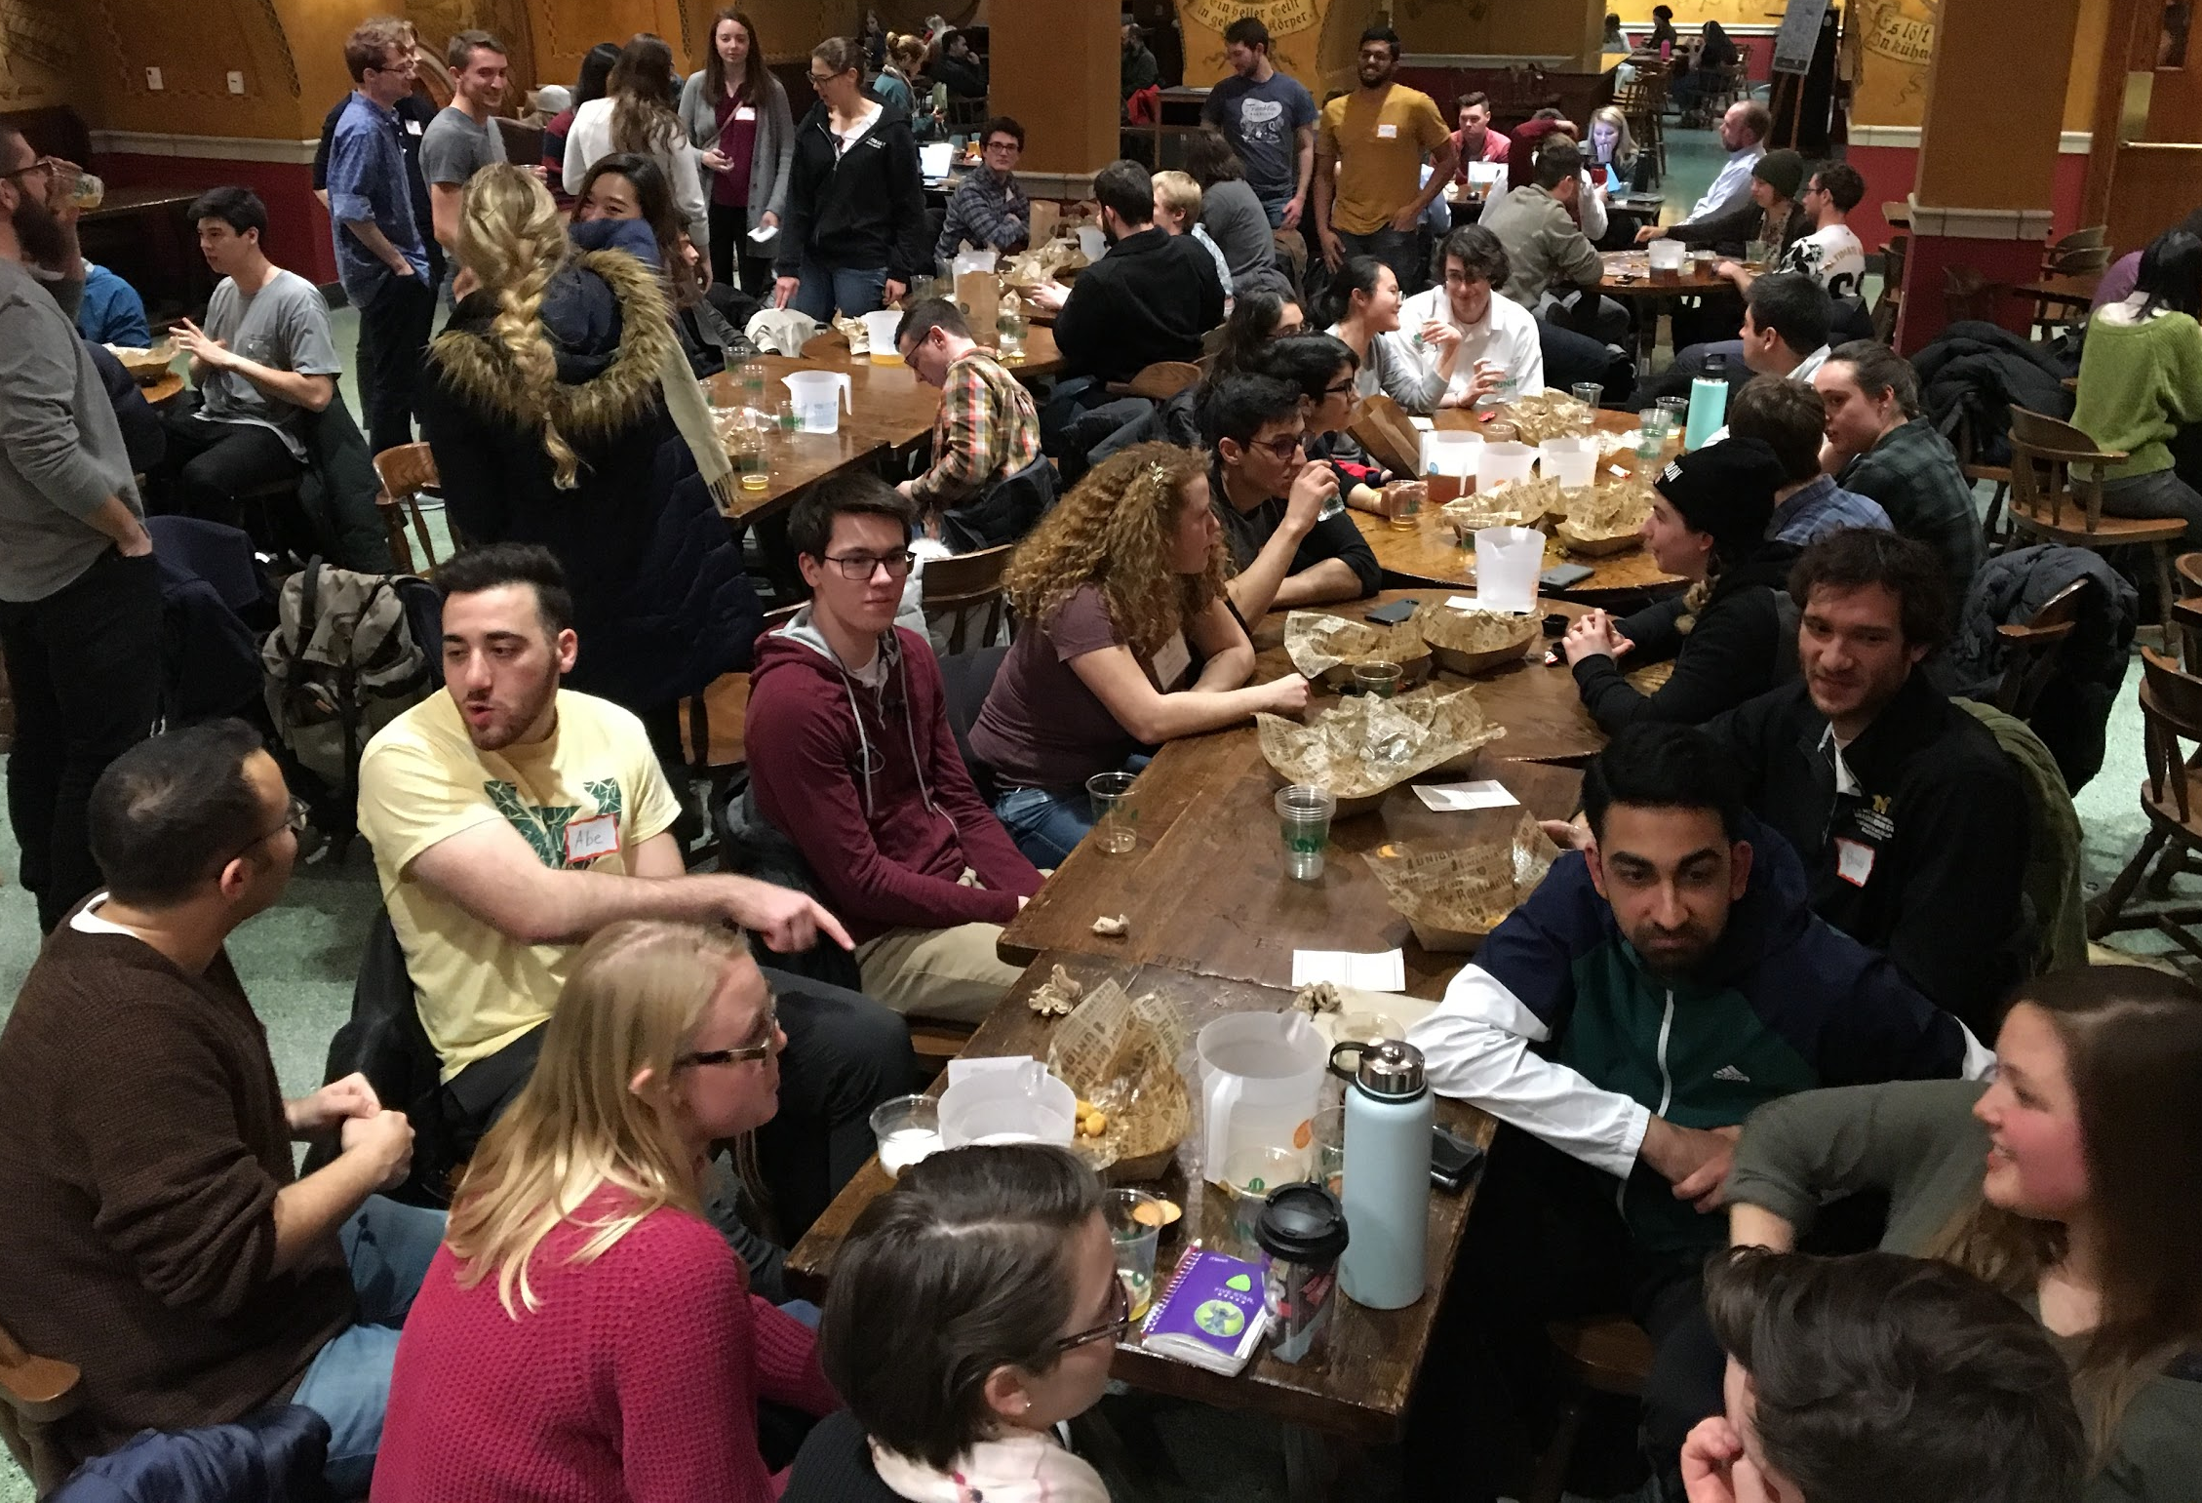
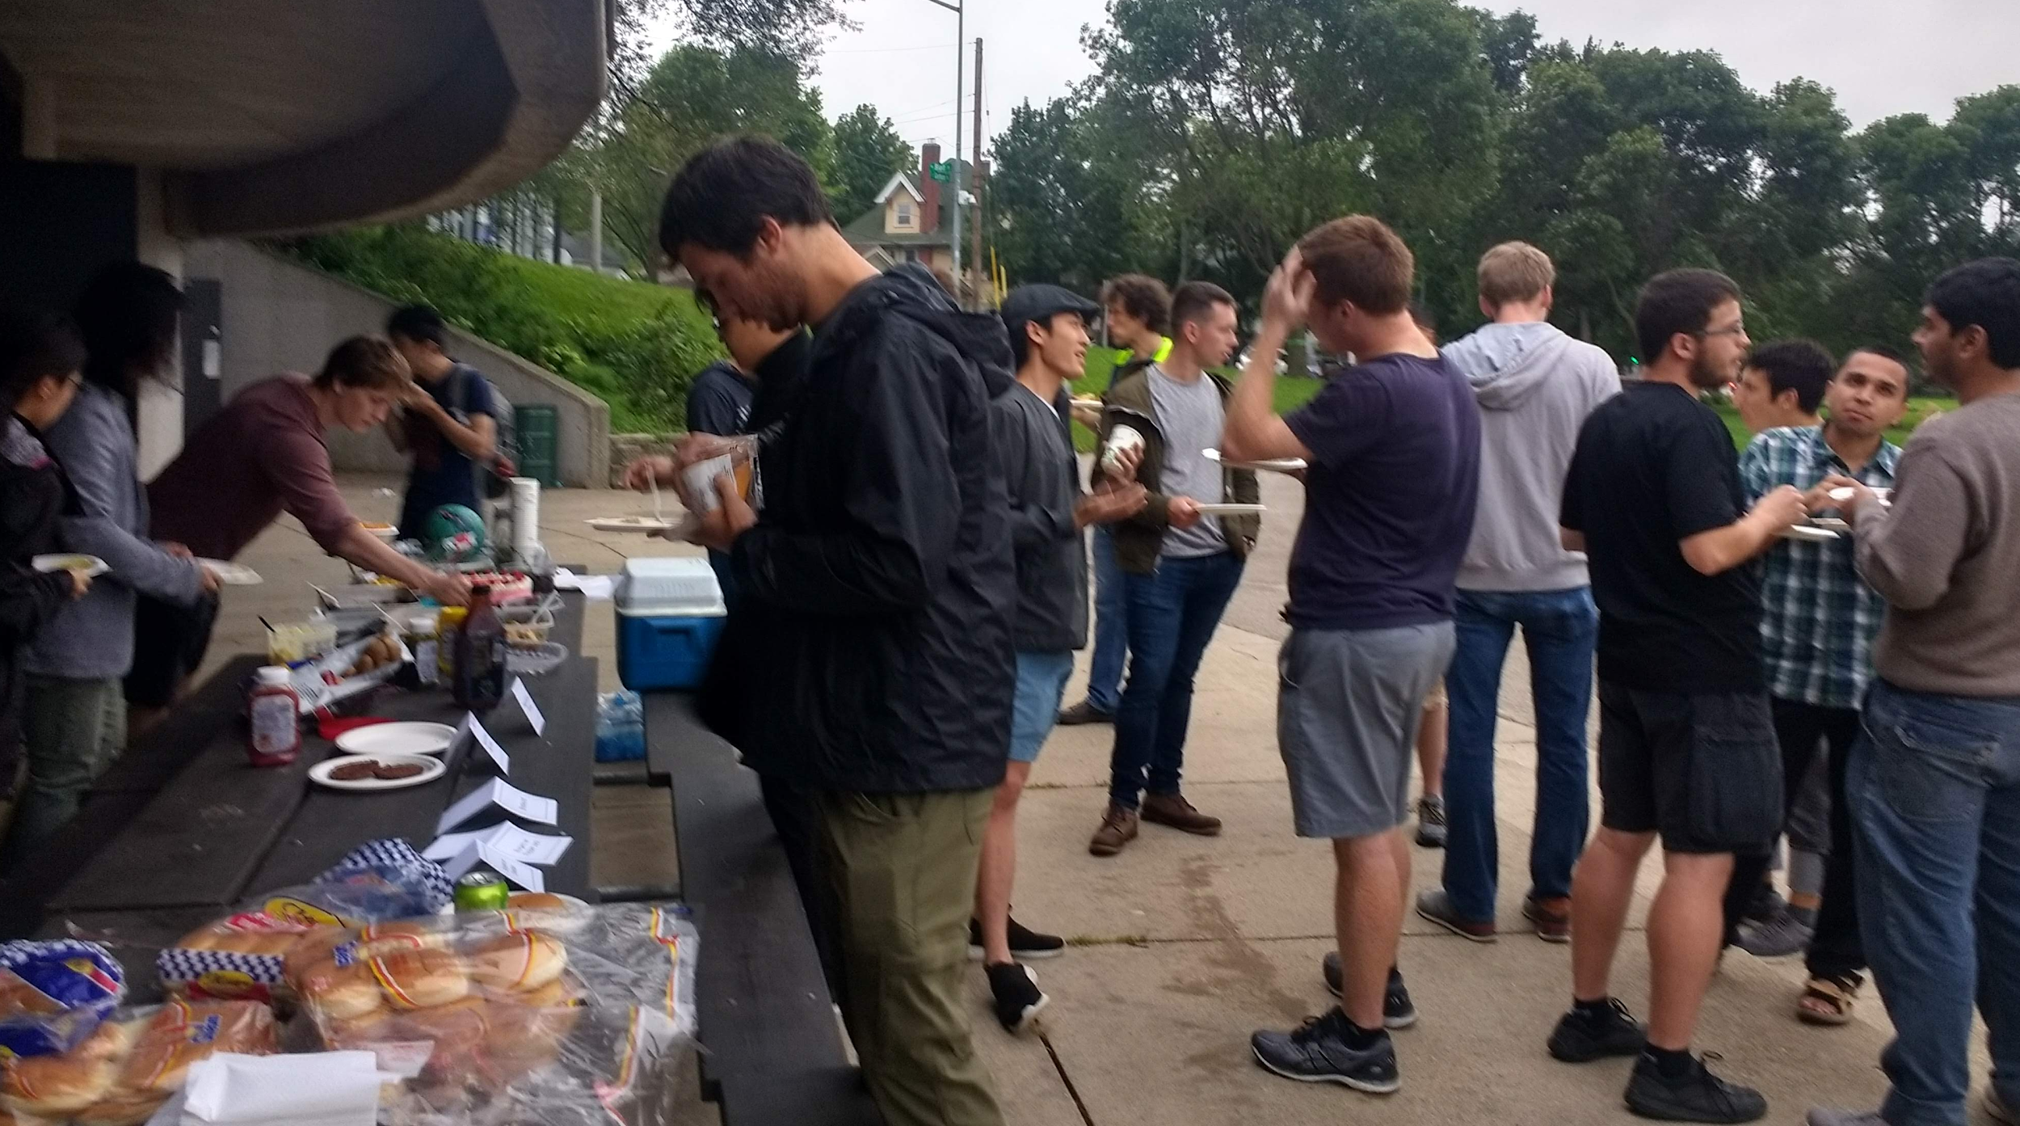
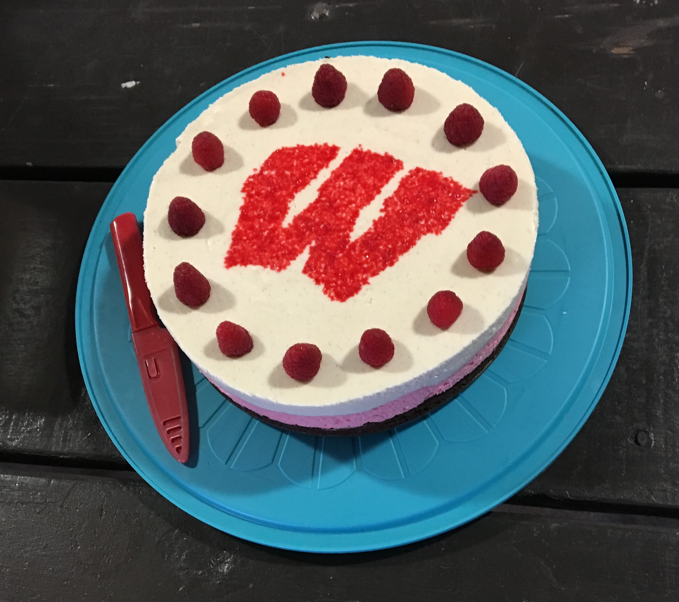
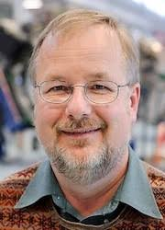
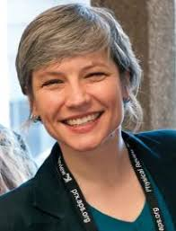
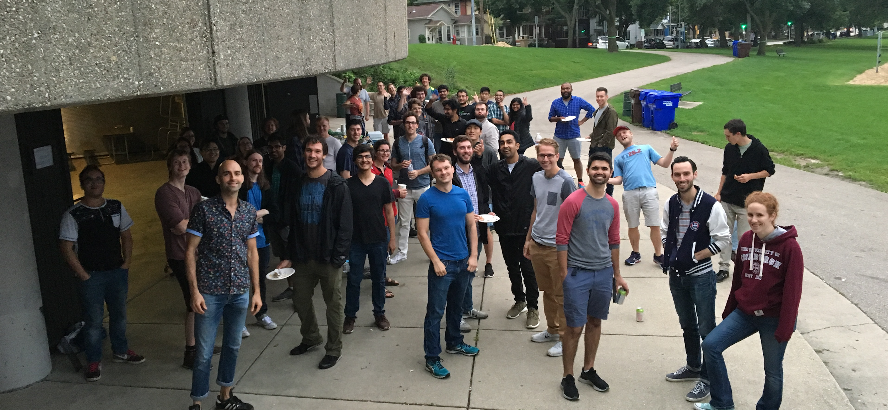
Last Year
Communication / Advocacy
Students on Department Committees
Climate & Diversity
Graduate Program (advised on minor requirements and faculty mentoring)
First year study sessions
Recruit & Welcome
Q&A Panels during First-Year Orientation
Meals with current grad students during Prospective Student Weekends
Social Cohesion
Welcome Picnic
Cookie Time
Pizza Nights
Ping pong tournament
Pi day bake-off
Professional Development
Invited speaker seminars:
Rock Mackie
Crystal Bailey

Slide 6
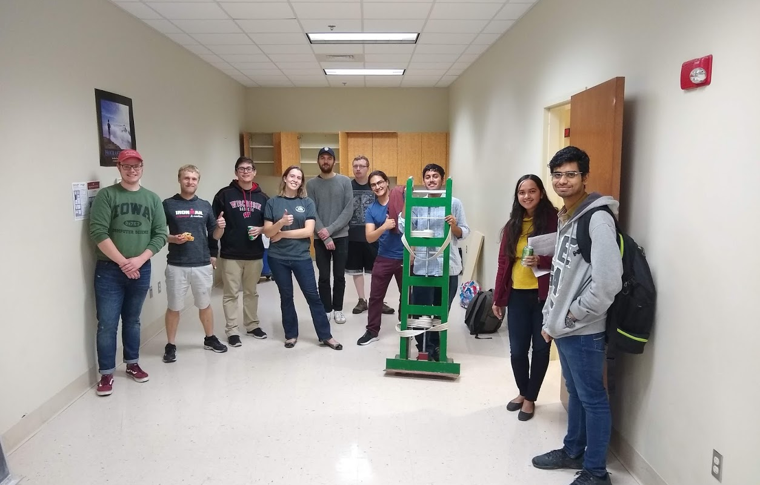
New/Upcoming This Year
Communication / Advocacy
Climate Survey
International Student Nights
Recruit & Welcome
PGSC-hosted lunch & evening activities during orientation and prospective weekend
First-year study groups
Peer Mentoring
Designed to work in tandem with faculty mentoring
Social Cohesion
Professional Development
Bi-weekly workshops
Resources and info here:
https://rmorgan10.github.io/UWMadisonPGSC-PD/

Slide 7
New/Upcoming This Year
Communication / Advocacy
Climate Survey
International Student Nights
Recruit & Welcome
PGSC-hosted lunch & evening activities during orientation and prospective weekend
First-year study groups
Peer Mentoring
Designed to work in tandem with faculty mentoring
Social Cohesion
Professional Development
Bi-weekly workshops
Resources and info here:
https://rmorgan10.github.io/UWMadisonPGSC-PD/
Notes:
Climate survey - neil campbell has been working on. First to grad students, but recently started working with dept faculty/staff Kevin Black and Michelle Holland (hope to extend climate survey to whole dept next time). Trying to work out a way to hire the Campus Survey Center to help organize, administer, and ensure privacy of participants.

Slide 8
Professional Development Seminars
How you can help:
Host a seminar during the next BoV meeting
Refer local alumni or other contacts we can invite
Suggest topics and/or resources
Notes:
Session 1 - build your own website workshop
Session 3 - your resume: from good to great
Session 4 - using prof. Development resources at UW-Madison
Session 5 - Faculty and postdoc career panel

Slide 9
PGSC and BoV
From BoV website: goals include “Provide mentoring, networking, and career assistance to Physics undergraduates, graduate students, and post-doctoral associates.”
From PGSC’s mission: Provide resources to help prepare students for post-graduate careers.
Let’s work together!
•PGSC Website: pgsc.physics.wisc.edu/
•Professional Development Website: rmorgan10.github.io/UWMadisonPGSC-PD/
•LinkedIn Group – “UW-Madison Physics Alumni and Students”: www.linkedin.com/groups/12301943/
•President – Susan Sorensen: sorensen3@wisc.edu
•Vice President – Kayla Leonard: kayla.leonard@wisc.edu
•Professional Development – Rob Morgan: robert.morgan@wisc.edu
•Climate Survey – Neil Campbell: ncampbell4@wisc.edu
•Advocacy Team Contact – Leslie Taylor: ltaylor23@wisc.edu
Notes:
Develop network of alumni mentors - Join LinkedIn group “UW-Madison Physics Alumni and Students” - Ask to become an admin!

