Slide 1
HTCondor Architecture
HTCondor Week 2020
Todd Tannenbaum
Center for High Throughput Computing

Slide 2

Start with People
Notes:
We start with people.

Slide 3
People have Problems
Notes:
And people have problems…
But not these people. These are happy undergraduates have Socratic discussions on the quad.

Slide 4

“1,000x more compute, could revolutionize
my field”
“Some of my jobs need a lot of memory, others a lot of cores”
“My laptop will take three years to complete my analysis, and I want to submit a paper in three weeks”
Notes:
This is a researcher in our Chemistry department. She has computational wants and needs. Here are three examples of problems she has with her computations.

Slide 5
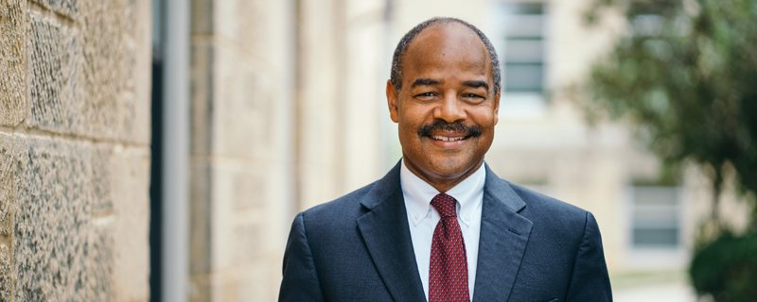
“We pay a lot of money for research computing. I want these computers always busy, helping research”
“If Physics invests twice what Chemistry does in computers, they should get 2x the computing”
“If an important group needs all the computers for three days to make a paper deadline, I’m ok with that”
Notes:
This is our dean of Letters and Sciences. He helps pay for the machines that researchers use. He also has wants and needs. Here are three of his.

Slide 6


HTCondor
Manages
These
constraints
Constraints
Constraints
Notes:
HTCondor helps to manage the computing want and needs of both the user of the machine and the provider, and do that independently of one another.

Slide 7
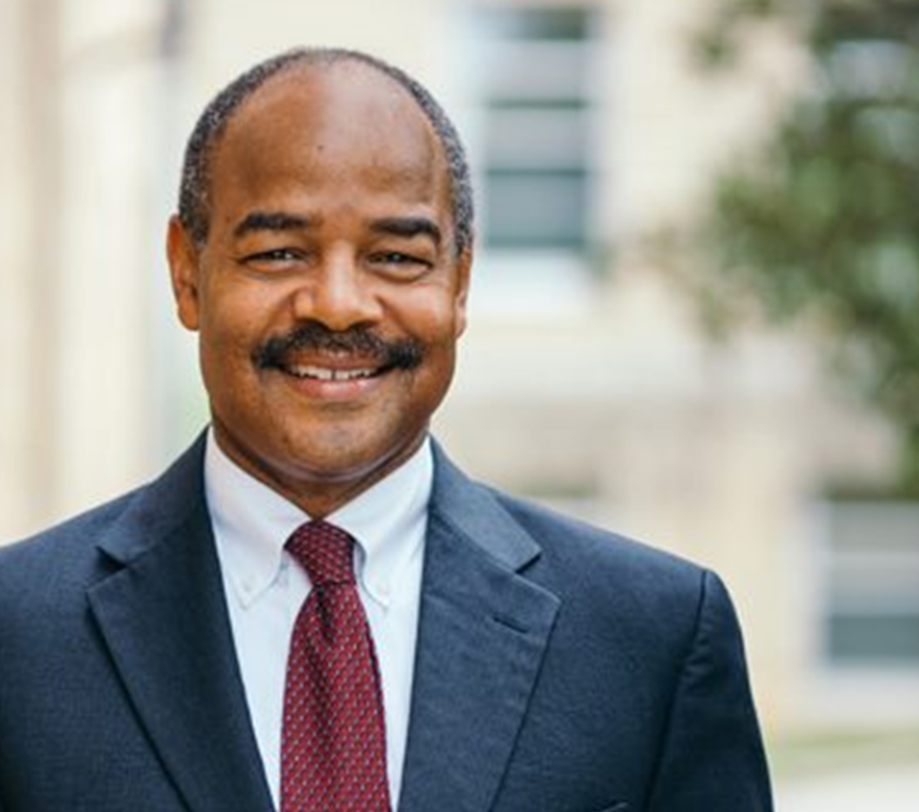
Not even that easy
In the real world, many users,
Many resource providers
Notes:
But in the real world, it isn’t even that easy. One system is used by many people, often with conflicting needs. And any one campus doesn’t have one sole provider of resource, but many.

Slide 8
This is a distributed problem.
Distributed because of *people*
Not because of machines.
Our goal is to satisfy all these constraints.
Notes:
We call this kind of problem distributed. Yes, it is distributed in the sense that it uses multiple computers with a network, but more importantly, the policies are distributed – there are distributed users with different wants and needs and many providers, again with potentially conflicting wants and needs. The goal of our system is to provide mechanisms for each of these policies to be expressed independently of each other, and to harmonize the polices into one coherent system.

Slide 9
The Philosophy on 1 slide
To reliably run as much work as possible
on as many machines as possible
Subject to all constraints
Notes:
So, here’s the philosophy one one slide. Say it a couple of times to let it sink in. Note that reliability is first.
However, this is a very user, or job – centric view of things – it only expresses the system in terms of what the job submitter sees. This is just one side of the coin. There is a dual to this, and that is the administrators side. It expresses the same thing, just from a different perspective.

Slide 10


The other side: administrator’s
To maximize machine utilization
*subject to constraints*
High Throughput is also High Utilization Computing!
Notes:
The other side is the administrator’s side. This view is of high utilization. These systems are expensive to acquire, and it is in the organization’s best interest that they always be busy – if not for their primary purpose, for some secondary or tertiary purpose that still advances the mission of the organization.

Slide 11
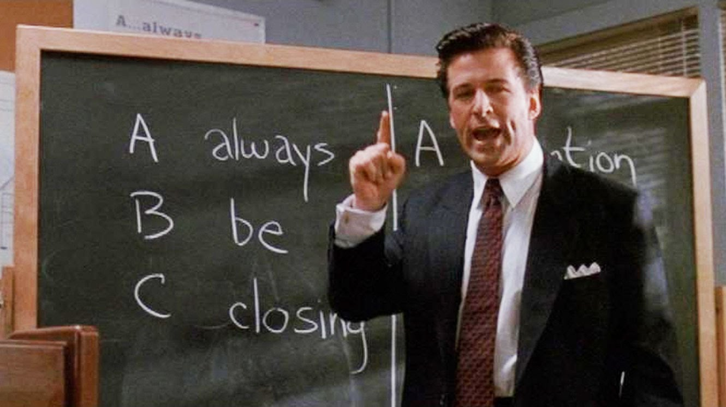
computing
Notes:
Or, as Alec Baldwin would say “Always be Computing”

Slide 12
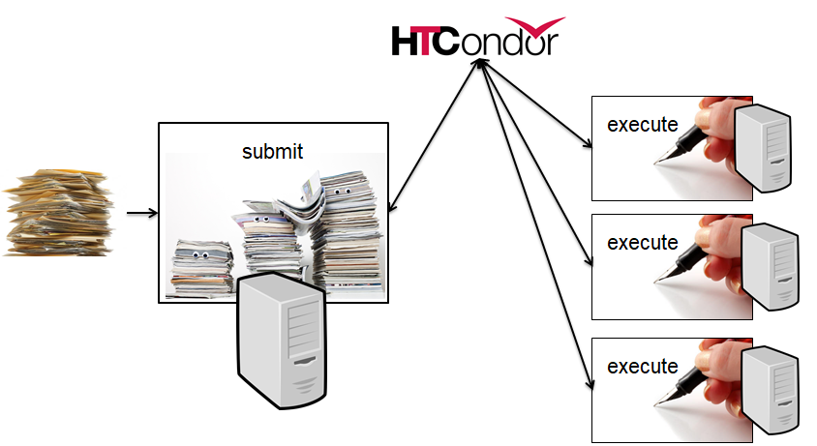
The Unstated Assumption
“Work” can be broken up into smaller jobs
Smaller the better (up to a point)
files as ipc
any interdependencies via DAGs
Optimize time-to-finish
not time-to-run
*
Notes:
Now, this whole philosophy is predicated on the assumption that large workflows can be broken down into many small independent jobs.

Slide 13


Overview of condor:
3 sides
Execute
Submit
Central Manager
Notes:
Three sides mimic the different natures of the people’s problems – the user, the owner, and the mitigation in the middle which creates the whole abstraction.

Slide 14
We are going to fill in the boxes!
Central Manager
Submit Machine
Execute Machine
14
Notes:
14

Slide 15

ClassAds: The lingua franca of HTCondor

Slide 16
What are ClassAds?
ClassAds is a language for objects (jobs and machines) to
  Express attributes about themselves
  Express what they require/desire in a “match” (similar to personal classified ads)
Structure : Set of attribute name/value pairs, where the value can be a literal or an expression. Semi-structured, no fixed schema.

Slide 17
ClassAd Values
Literals
  Strings ( “RedHat6” ), integers, floats, boolean (true/false), …
Expressions
  Similar look to C/C++ or Java : operators, references, functions
  References: to other attributes in the same ad, or attributes in an ad that is a candidate for a match
  Operators: +, -, *, /, <, <=,>, >=, ==, !=, &&, and || all work as expected
  Built-in Functions: if/then/else, string manipulation, regular expression pattern matching, list operations, dates, randomization, math (ceil, floor, quantize,…), time functions, eval, …
17
Notes:
17

Slide 18
Simple Example
Job Ad
Type = "Job"
Requirements =
HasMatlabLicense
== True &&
Memory >= 1024
Rank = kflops + 1000000 * Memory
Cmd= "/bin/sleep"
Args = "3600"
Owner = "gthain"
NumJobStarts = 8
KindOfJob = "simulation"
Department = "Math"
Machine Ad
Type = "Machine"
Cpus = 40
Memory = 2048
Requirements =
(Owner == “gthain”) ||
(KindOfJob == “simulation”)
Rank = Department == "Math"
HasMatlabLicense = true
MaxTries = 4
kflops = 41403

Slide 19
Four-valued logic
ClassAd Boolean expressions can return four values:
  True
  False
  Undefined (a reference can’t be found)
  Error (Can’t be evaluated)
Undefined enables explicit policy statements in the absence of data (common across administrative domains)
Special meta-equals ( =?= ) and meta-not-equals (=!=) will never return Undefined
  [
  HasBeer = True
  GoodPub1 = HasBeer == True
  GoodPub2 = HasBeer =?= True
  ]
  [
  GoodPub1 = HasBeer == True
  GoodPub2 = HasBeer =?= True
  ]

Slide 20
The Magic of Matchmaking
Two ClassAds can be matched via special attributes: Requirements and Rank
Two ads match if both their Requirements expressions evaluate to True
Rank evaluates to a float where higher is preferred; specifies the which match is desired if several ads meet the Requirements.
Scoping of attribute references when matching
    MY.name – Value for attribute “name” in local ClassAd
    TARGET.name – Value for attribute “name” in match candidate ClassAd
    Name – Looks for “name” in the local ClassAd, then the candidate ClassAd

Slide 21
ClassAd Types
HTCondor has many types of ClassAds
  A "Job Ad" represents a job to Condor
  A "Machine Ad" represents a computing resource
  Others types of ads represent other instances of other services (daemons), users, accounting records.

Slide 22
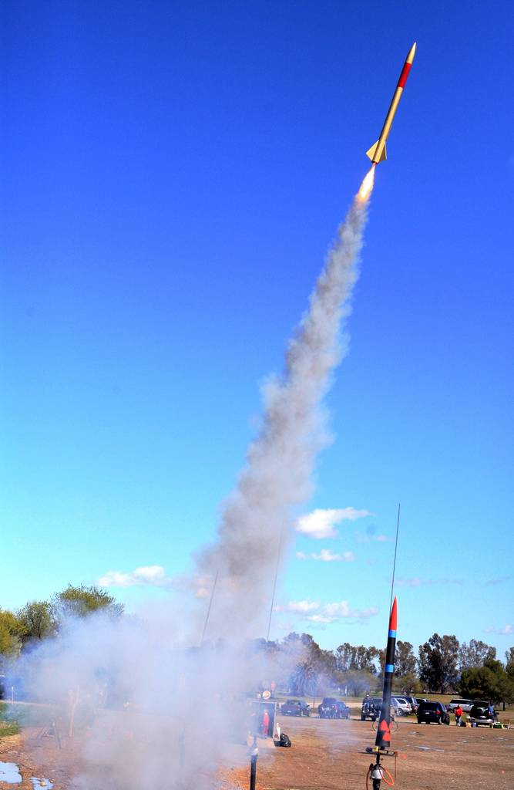
Architecture &
Job Startup

Slide 23
Quick Review of Daemons
condor_master: runs on all machine, always
plus a condor_procd, condor_shared_port
condor_schedd: runs on submit machine
condor_startd: runs on execute machine
condor_negotiator, condor_collector: runs on central manager
Notes:
Also responsibilities of each daemon

Slide 24
Submit Machine Process View
condor_master
(pid: 1740)
fork/exec
condor_procd
condor_shared_port
condor_schedd
Tools: condor_submit, condor_q,
condor_rm, condor_hold, …
fork/exec
condor_shadow
condor_shadow
condor_shadow

Slide 25
Execute Machine Process View
condor_master
(pid: 1740)
fork/exec
condor_procd
condor_shared_port
condor_startd
condor_starter
condor_starter
condor_starter
Job
Job
Job

Slide 26
Central Manager Process View
condor_master
(pid: 1740)
condor_procd
fork/exec
condor_shared_port
condor_collector
condor_negotiator

Slide 27
Claiming Protocol
Central Manager
Q
Negotiator
Collector
J
S
S
Submit Machine
Execute Machine
CLAIM
J
S
S
Q
Schedd
Startd
S
J
J
J
Submit
27
Notes:
27
Steps
1. Startd sends collector ClassAd describing itself. (The Schedd does as well, but it has nothing interesting to say yet.)
2. The user calls condor_submit to submit a job. The job is handed off to the schedd and condor_submit returns.
3. The schedd alerts the collector that it now has a job waiting.
4. The negotiator asks the collector for a list machines able to run jobs and schedd queues with waiting jobs.
5. The negotiator contacts the schedd to learn about the waiting job.
6. The negotiator matches the waiting job with the waiting machine.
7. The negotiator alerts the schedd and the startd that there is a match.
8. The schedd contacts the startd to claim the match.
9. The schedd starts a shadow to monitor the job.
10. The startd starts a starter to start the job.
11. The starter and the shadow contact each other.
11. The starter starts the job.
12. If the job is using the Condor syscall library (typically through being condor_compiled), it will contact the shadow to access necessary files.

Slide 28
Claim Activation
Central Manager
Negotiator
Collector
Submit Machine
Execute Machine
Schedd
CLAIMED
Startd
Activate
Claim
Starter
Job
Shadow
28
Notes:
28
Steps
1. Startd sends collector ClassAd describing itself. (The Schedd does as well, but it has nothing interesting to say yet.)
2. The user calls condor_submit to submit a job. The job is handed off to the schedd and condor_submit returns.
3. The schedd alerts the collector that it now has a job waiting.
4. The negotiator asks the collector for a list machines able to run jobs and schedd queues with waiting jobs.
5. The negotiator contacts the schedd to learn about the waiting job.
6. The negotiator matches the waiting job with the waiting machine.
7. The negotiator alerts the schedd and the startd that there is a match.
8. The schedd contacts the startd to claim the match.
9. The schedd starts a shadow to monitor the job.
10. The startd starts a starter to start the job.
11. The starter and the shadow contact each other.
11. The starter starts the job.
12. If the job is using the Condor syscall library (typically through being condor_compiled), it will contact the shadow to access necessary files.

Slide 29
Repeat until Claim released
Central Manager
Negotiator
Collector
Submit Machine
Execute Machine
Schedd
CLAIMED
Startd
Activate
Claim
Starter
Job
Shadow
29
Notes:
29
Steps
1. Startd sends collector ClassAd describing itself. (The Schedd does as well, but it has nothing interesting to say yet.)
2. The user calls condor_submit to submit a job. The job is handed off to the schedd and condor_submit returns.
3. The schedd alerts the collector that it now has a job waiting.
4. The negotiator asks the collector for a list machines able to run jobs and schedd queues with waiting jobs.
5. The negotiator contacts the schedd to learn about the waiting job.
6. The negotiator matches the waiting job with the waiting machine.
7. The negotiator alerts the schedd and the startd that there is a match.
8. The schedd contacts the startd to claim the match.
9. The schedd starts a shadow to monitor the job.
10. The startd starts a starter to start the job.
11. The starter and the shadow contact each other.
11. The starter starts the job.
12. If the job is using the Condor syscall library (typically through being condor_compiled), it will contact the shadow to access necessary files.

Slide 30
Repeat until Claim released
Central Manager
Negotiator
Collector
Submit Machine
Execute Machine
Schedd
CLAIMED
Startd
Activate
Claim
Starter
Job
Shadow
30
Notes:
30
Steps
1. Startd sends collector ClassAd describing itself. (The Schedd does as well, but it has nothing interesting to say yet.)
2. The user calls condor_submit to submit a job. The job is handed off to the schedd and condor_submit returns.
3. The schedd alerts the collector that it now has a job waiting.
4. The negotiator asks the collector for a list machines able to run jobs and schedd queues with waiting jobs.
5. The negotiator contacts the schedd to learn about the waiting job.
6. The negotiator matches the waiting job with the waiting machine.
7. The negotiator alerts the schedd and the startd that there is a match.
8. The schedd contacts the startd to claim the match.
9. The schedd starts a shadow to monitor the job.
10. The startd starts a starter to start the job.
11. The starter and the shadow contact each other.
11. The starter starts the job.
12. If the job is using the Condor syscall library (typically through being condor_compiled), it will contact the shadow to access necessary files.

Slide 31
When is claim released?
When relinquished by one of the following
  lease on the claim is not renewed
    Why? Machine powered off, disappeared, etc
  schedd
    Why? Out of jobs, shutting down, schedd didn’t “like” the machine, etc
  startd
    Why? Policy re CLAIM_WORKLIFE, prefers a different match (via Rank), non-dedicated desktop, etc
  negotiator
    Why? User priority inversion policy
  explicitly via a command-line tool
    E.g. condor_vacate

Slide 32
Architecture items to note
Machines (startds) or submitters (schedds) can dynamically appear and disappear
  Key for expanding a pool into clouds or grids
  Key for backfilling HPC resources
Scheduling policy can be very flexible (custom attributes) and very distributed
Central manager just makes a match, then gets out of the way
Distributed policy enables federation of resources across different organizations (administrative domains)
  Lots of network arrows on previous slides
  Reflects the P2P nature of HTCondor

Slide 33
Layout of a General Condor Pool
= Process Spawned
Execute-Only
Central Manager
= ClassAd
Communication
Pathway
master
master
startd
negotiator
Execute-Only
Submit-Only
collector
master
master
startd
schedd
Submit-Only
Both!
master
master
schedd
startd
schedd

Slide 34
Thank You!

