Slide 1
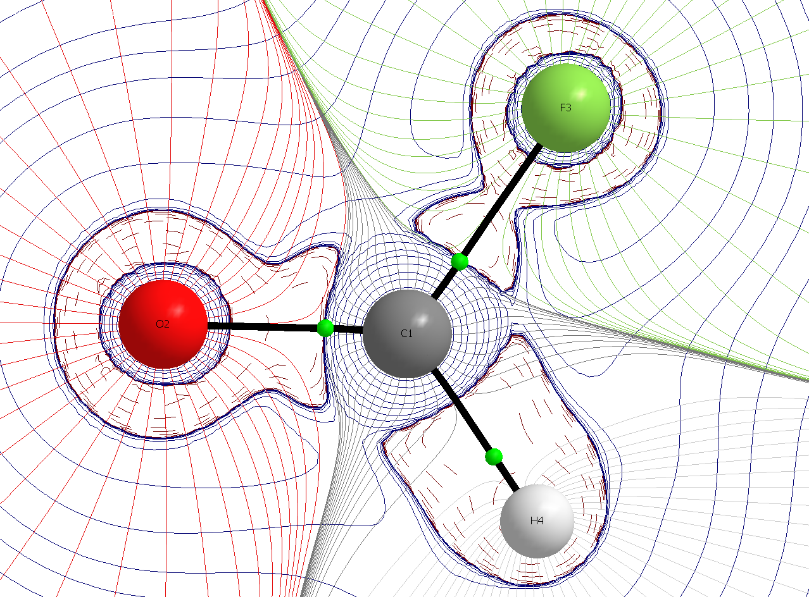
Use of master-worker and integration with OSG Connect
Roman Zubatyuk
Department of Chemistry
Carnegie Mellon University

Slide 2
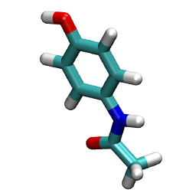
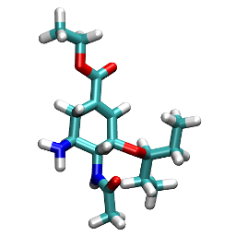
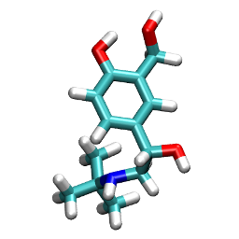
Supervised machine learning on quantum-chemical data
QM
ML
Unique Molecular
Representation
Predicted QM Energy &
Properties
Property
Database of calculated QM energies and properties for 50M molecules
Traditional quantum mechanics: Slow calculations, one molecule at a time
QSAR: Statistical modeling of historical experimental data
Now we could use accumulated historical QM data to train a statistical models that can accurately predict results of quantum mechanics
J. Smith, O. Isayev, A. Roitberg. Chem. Sci., 2017, 8, 3192-3203

Slide 3
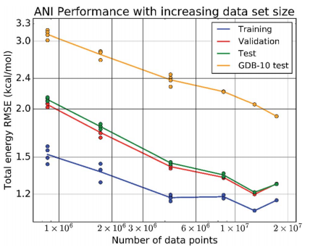
Fast, accurate, transferable and extensible neural network potentials
ANI1: 20M DFT calculations (CHNO)
ANI-1x: 5M DFT calculations (CHNO)
ANI-1ccx: 0.5M CCSD(T)/CBS (CHNO)
ANI-2x, AIMNet: 9M DFT calculations (CHNOSFCl)
Current development: more chemical elements, charged molecules.
Smith, Justin S., Olexandr Isayev, and Adrian E. Roitberg. "ANI-1: an extensible neural network potential with DFT accuracy at force field computational cost." Chemical science 8.4 (2017): 3192-3203.
Smith, Justin S., et al. "Less is more: Sampling chemical space with active learning." The Journal of chemical physics 148.24 (2018): 241733.
Smith, Justin S., et al. "Approaching coupled cluster accuracy with a general-purpose neural network potential through transfer learning." Nature communications 10.1 (2019): 2903.
Zubatyuk, Roman et al., “Accurate and Transferable Multitask Prediction of Chemical Properties with an Atoms-in-Molecules Neural Network.” Sci. Adv. 2019, 5 (8), eaav6490.

Slide 4
Our computational tasks
DFT calculations for small molecules (ORCA)
Semiempirical molecular dynamics (XTB)
Molecular docking (AutoDock Vina)
~ 10⁴ – 10⁶ tasks
Short (20s - 2h CPU time)
Small input size (1 – 100 kb)
Portable software stack
=> Ideal for OSG
“Free” opportunistic computational resource
Single core, small memory, small disk, short run time.

Slide 5
Standard workflow
Create inputs for tasks, transfer to submit host.
Transfer to submit host
Write job execution script
Submit to Condor (or SLURM)
Wait
~ 10⁶ tasks
group several tasks together: all done or all fail
Resubmit failed tasks
Master-worker workflow
Put tasks to a master database.
Write script to perform single task
Launch workers what execute tasks.
Workers communicate with the master (get task, put results)
Data are organized, tasks are independent, computer resource use is efficient
Easy to use

Slide 6
Master-worker implementation
Message queue database (message == task)
Consumers execute tasks (each message should be delivered only once)
Implemented RQ (Redis Queue) Python library
Other alternatives are Celery, Huey2, Dramatiq, Ray, Uber Cherami, and many more.
We did not re-invented the wheel. We made a wheel without bells and whistles that fits our vehicle:
RQ is simple, scalable and customizable
RQ workers need very basic environment
Tasks are simple Python functions
Single-user environment

Slide 7
Task life cycle
configure environment (application software)
get next job from Redis || die
get extra job data from Redis
execute job
parse results
return results
repeat
if jobs in Redis and few Condor jobs:
ssh osgconnect condor_submit
sleep
repeat
get MongoDB records
create RQ jobs
Condor Submit
RQ Submit
MongoDB
Redis
Worker
Worker
Worker
Worker
Worker
Collect
User interface:
Put data to MongoDB
rq_submit <query> <job function name> <parameters>
rq info for status of jobs and workers
Find results in MongoDB
get completed RQ jobs
write results to MongoDB
sleep
repeat

Slide 8
Job definition file
campaign: wb97mv
campaign_config:
func_name: htrq.htrun.scripts.orca.sequential
job_timeout: 15000
args:
- name: wb97md3bj
route: |
! wB97m-d3bj def2-tzvpp def2/j rijcosx engrad tightscf
%elprop dipole true quadrupole true end
%output PrintLevel mini Print[P_DFTD_GRAD] 1 end
%scf maxiter 256 end
parsers:
stdout:
- htrq.htrun.parser.orca.total_energy
- htrq.htrun.parser.orca.gradient
- htrq.htrun.parser.orca.dipole
keep_files:
stdout: '{id}_wb97md3bj.out'
orca.gbw: '{id}_wb97md3bj.gbw’
kwargs:
mongo_output_key: wb97mv
submit:
query:
wb97mv.wb97md3bj: null
projection: []
queue: orca:high
<- job function (run ORCA)
<- what to compute (energy & gradient)
<- how to parse data
<- some results could be stored on file system instead of MongoDB
<- how to store results in MongoDB
<- how to select and submit jobs

Slide 9
RQ job data
Database, ID
Input data (coordinates of atoms, etc.)
Job Python function (e.g. DFT energy + gradient calculation)
Redis key containing parameters of job function (e.g. DFT functional and basis set)
=> Unique job ID
Worker environment
Python 3.5+ (OCG Connect CVMFS)
python-rq and python code to execute task (OSG Connect Stash < 10 MB)
Application software binaries (OSG Connect Stash < 500 MB)

Slide 10
Performance of RQ
MongoDB, Redis, submit and collect scripts on a single mid-grade workstation (i7, 32GB RAM)
10M tasks in Redis Queue
10,000 workers at a time (probably, could be few times more)
100 jobs/sec
1 Gbps sustained incoming network traffic to Redis
About 20 M CPU core hours consumed on OSG, XSEDE and TACC Frontera with same RQ-based framework!

Slide 11
Acknowledgements
Funding:
CHE-1802789
HPC Computing:

